Slide 1

Open Science and the value of documenting, notifying, and sharing
Tyler Walters, SHARE Director
Dean, University Libraries, Virginia Tech
CERN Workshop on Innovations (OAI9), June 18, 2015

Slide 2


What is SHARE?
SHARE is creating an open data set about research activities across their life cycle. This comprehensive inventory of research will be widely accessible, discoverable, and reusable.
Notes:
SHARE is being built as part of the Open Science Framework, created by the Center for Open Science.

Slide 3




Founded by Academic Leaders, Built with Open Technology
Research universities are long-lived and are mission-driven to generate, make accessible, and preserve over time new knowledge and understanding.

Slide 4

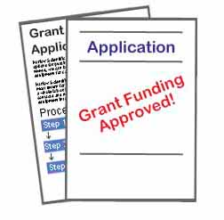
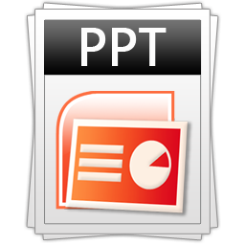



Stakeholders/beneficiaries
Researchers
Higher ed administration
Libraries
Repositories
Research funders
The Public / communities

Slide 5
Open data allows for innovation

Slide 6
Gather
Notify
Providers
Consumers

Slide 7
Gather
Notify
Providers
Consumers

Slide 8





Gather
Notify
Providers
Consumers

Slide 9



























Slide 10
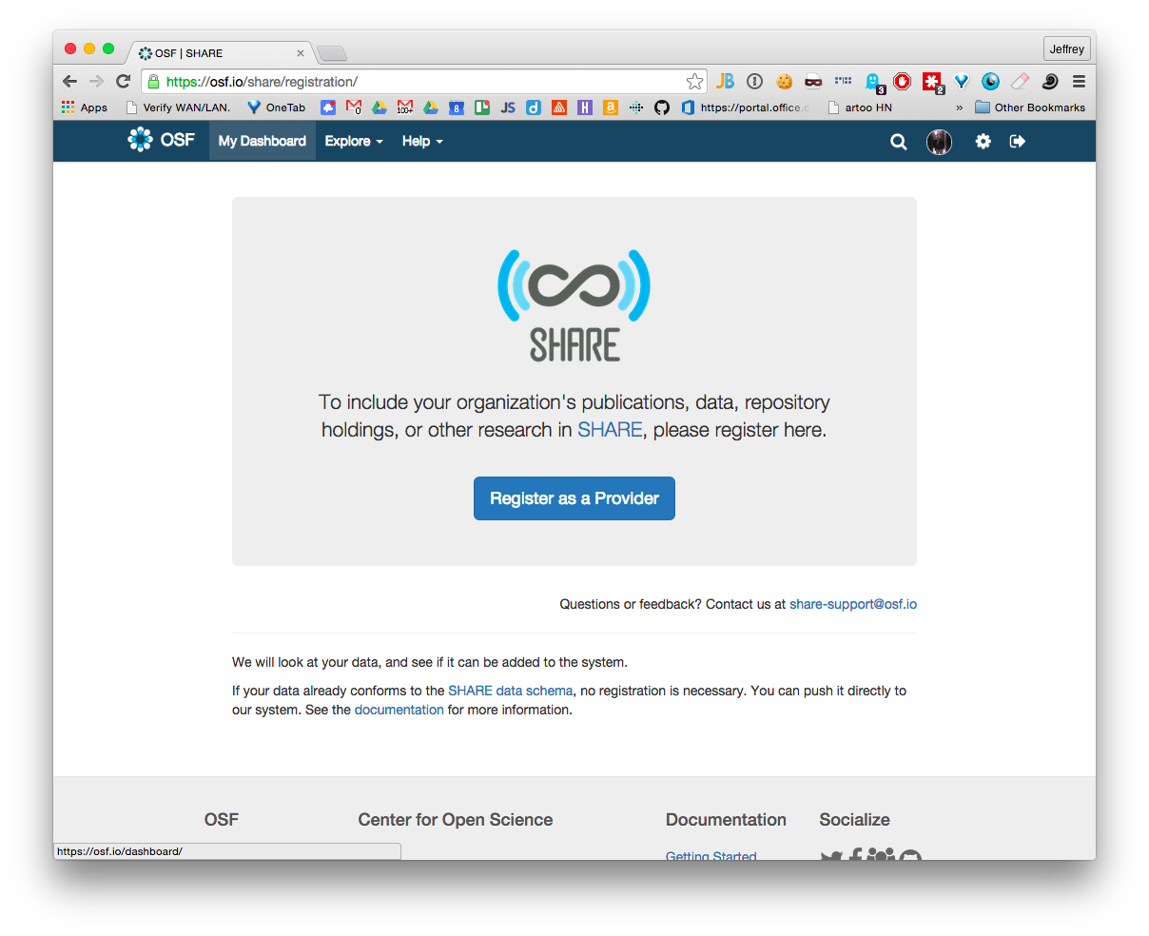
osf.io/share/registration
Notes:
Have been harvesting; now accepting data via push

Slide 11
title: string
description: string
contributors: array
anyOf: $person, $organization
...
otherProperties: array
shareProperties: object

Slide 12
otherProperties: object
name
description
properties
uri

Slide 13
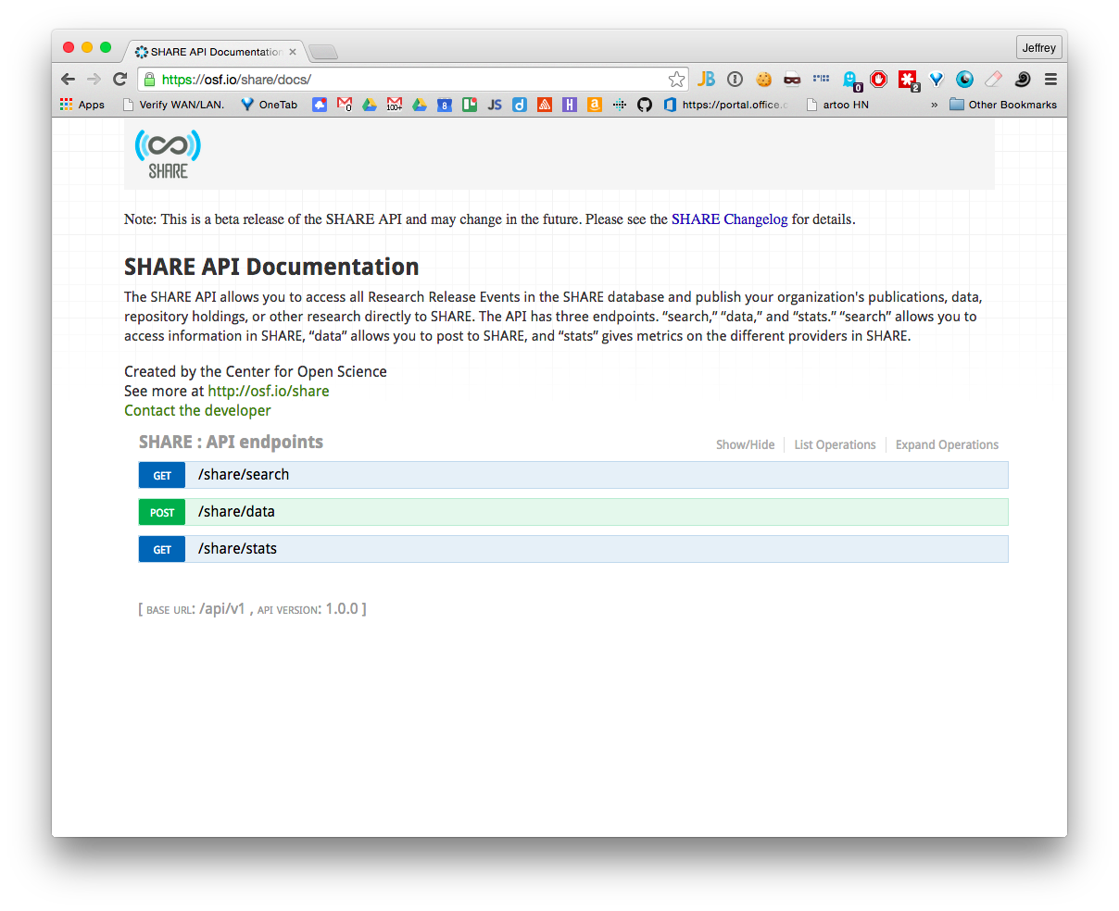
osf.io/share/docs

Slide 14
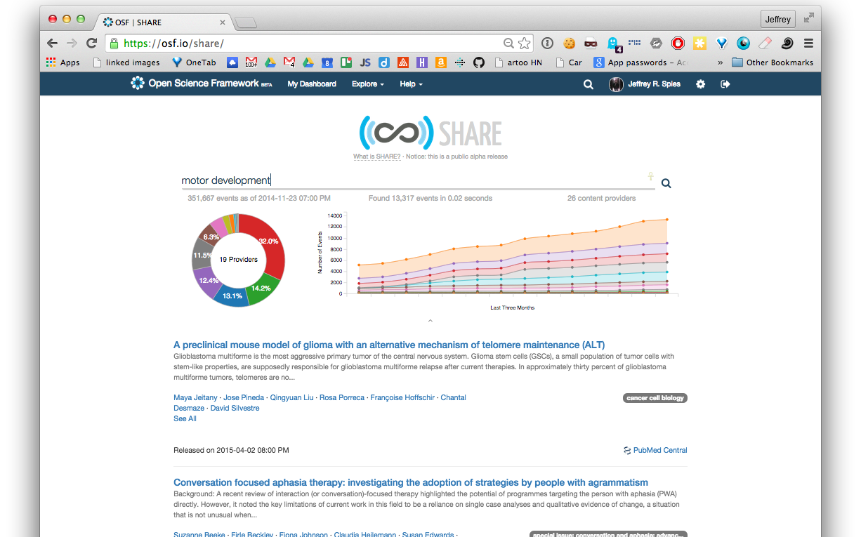
http://osf.io/share
1,023,951
research release events
since
16 June 2015
42 content providers

Slide 15
Technology Focus
Modularity
Reliability
Flexibility
Scalability

Slide 16












Notes:
We use many different tools to make this happen, including python of course!

Slide 17
What we’ve learned
Metadata is applied inconsistently across the research ecosystem (quality and consistency)
Providers are unsure of their rights to share metadata (availability)
Solutions will involve improvements to workflow, policy, and technical infrastructure
Notes:
quality, consistency, availability

Slide 18
Where we’re going
Analyze stakeholders’ current processes through which research passes from conception to completion
Promote and reward policies that encourage data sharing
Deploy multiple strategies to enhance metadata in the open data set

Slide 19
Providers
Consumers
Enhance

Slide 20
Enhancement – the challenge
Software Techniques for:
Identifying conflicts and duplication
Normalizing metadata
Inferring metadata
Improving metadata supplied to SHARE
Professional curation of metadata
Crowdsourcing abilities
Notes:
Open
Collect
Identify
Connect

Slide 21
SHARE is a Community Project
Opportunities for participation:
Infrastructure https://github.com/centerforopenscience/share
https://osf.io/wur56/wiki/
Policy/Workflow
SHARE Working Group
Standards, identifiers, behaviors

Slide 22




http://share-research.org
www.facebook.com/SHARE.research
www.twitter.com/share_research
SHARE@ARL.org
tyler.walters@vt.edu

