Slide 1
Putting the Academy at the heart of Scholarly Publishing
OAI9
June 2015
Catriona MacCallum
PLOS Senior Advocacy Manager
& Consulting Editor (PLOS ONE); OASPA BoD
@catmacOA

Slide 2
PLOS by numbers
7 journals
135,000 articles 2003-2014
33,000 articles in 2013
11.6 million monthly article views (2014)
1.9 million monthly article downloads (2014)
6,900+ editors (2014)
90,000 reviewers (2014)

Slide 3
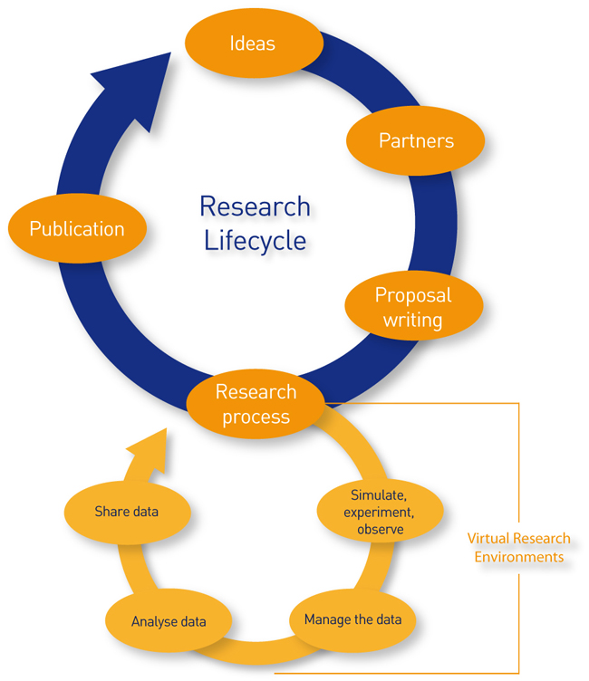
?
What is publishing
© 2014 Jisc: Creative Commons BY-NC-ND
http://www.webarchive.org.uk/wayback/archive/20140615113149/http://www.jisc.ac.uk/whatwedo/campaigns/res3/jischelp.aspx

Slide 4
In the beginning (~17th Century)
Small groups of scholars
Scholars communicated directly, in person
Experiments often done openly in public
Criticism was open and transparent
Neylon, Cameron. DataONE Webinar: Boyle’s Laws in a Networked World: How the Future of Science Lies in Understanding Our Past on Vimeo. Accessed June 10, 2015. https://vimeo.com/121809639.

Slide 5

and then…
Philosophical Transactions of the Royal Society:
Started in 1665; first journal devoted exclusively to science publishing

Slide 6
The Journal
“Journals form a core part of the process of scholarly communication and are an integral part of scientific research itself. Journals do not just disseminate information, they also provide a mechanism for the registration of the author’s precedence; maintain quality through peer review and provide a fixed archival version for future reference.”
The STM Report, Fourth Edition, 2015

Slide 7
Figure 3: The publishing cycle
The STM Report, Fourth Edition, 2015

Slide 8
Now
>28, 000 peer-reviewed English language journals (2014)
  10,900 in Journal Citation Reports
2.5 million articles a year
500-10,000 journal publishers
7-9 million researchers
Most publishers have >90% content available online
The STM Report, Fourth Edition, 2015 (and citations within)

Slide 9
The Oligopoly of Academic Publishers in the Digital Era
In the 19th C, journals became the fastest and most convenient way of disseminating results
Most were initially published by scientific societies (before the 1940s)
The digital revolution affected the economic market, while journals remained essentially the same (pdf distribution dominant):
Larivière V, Haustein S, Mongeon P (2015) The Oligopoly of Academic Publishers in the Digital Era. PLoS ONE 10(6): e0127502. doi:10.1371/journal.pone.0127502 (and citations within)

Slide 10
Analysis of publisher share of papers 1973-2013
Thomson Reuter’s Web of Science
>44 million documents published by journals
Looked at mergers and acquisitions
Larivière V, Haustein S, Mongeon P (2015) The Oligopoly of Academic Publishers in the Digital Era. PLoS ONE 10(6): e0127502. doi:10.1371/journal.pone.0127502
http://journals.plos.org/plosone/article?id=10.1371/journal.pone.0127502

Slide 11
Proportion held by the top five publishers
Disciplines | 1973 | Mid 1990s | 2013 | Relative Share 2013
Natural and Medical Sciences | 20% | 30% | 53% | 47% by Reed-Elsevier, Springer, Wiley-Blackwell ~6% T&F and Am. Chem. Society
Social Sciences & Humanities | 10% | 15% | 51% | Elsevier 16.4% T&F 12.4% Wiley-Blackwell 12.1% Springer 7.1% Sage 6.4%
Larivière V, Haustein S, Mongeon P (2015) The Oligopoly of Academic Publishers in the Digital Era. PLoS ONE 10(6): e0127502. doi:10.1371/journal.pone.0127502
http://journals.plos.org/plosone/article?id=10.1371/journal.pone.0127502

Slide 12
Biomedical papers only | 2009 | 2013
Share of top 5 | 49% | 42%
Decline mainly result of new OA journals (e.g. PLOS ONE)
Physics | 2001 | 2013
Elsevier | 28% | 21%
Springer | 3% | 11%
Societies (APS, AIP, IOP) | ~35%* | 38%
field less profitable for commercial publishers?
importance of Societies
arXiv
SCOAP3
*read from Fig 5
Larivière V, Haustein S, Mongeon P (2015) The Oligopoly of Academic Publishers in the Digital Era. PLoS ONE 10(6): e0127502. doi:10.1371/journal.pone.0127502
http://journals.plos.org/plosone/article?id=10.1371/journal.pone.0127502

Slide 13
“University presses and disciplinary associations were founded to disseminate research in the original cycle of scholarly communication […] However, over the past fifty years, as federal research funding has encouraged specialization, journal publishing has become commercialized, and some parts of the scientific and technical literature are now being monopolized by multinational publishing conglomerates.” (p. 89)”
Lyman P, Chodorow S. (1998) The Future of Scholarly Communication. In Hawkins BL, Battin P, editors. The Mirage of Continuity: Reconfiguring Academic Information Resources for the 21st Century. Washington D.C.: CLIR and AAU; 1998. pp. 87–104. Cited in Larivière V, Haustein S, Mongeon P (2015)

Slide 14
?
What is publishing
© 2014 Jisc: Creative Commons BY-NC-ND
http://www.webarchive.org.uk/wayback/archive/20140615113149/http://www.jisc.ac.uk/whatwedo/campaigns/res3/jischelp.aspx

Slide 15
It’s no longer just about journals or books

Slide 16















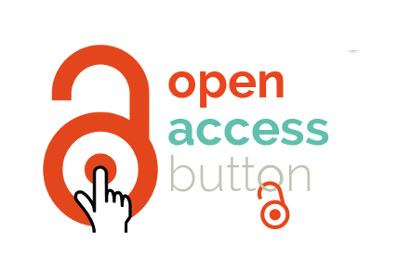


it’s also this...
Notes:
There are so many different ways of accessing information

Slide 17
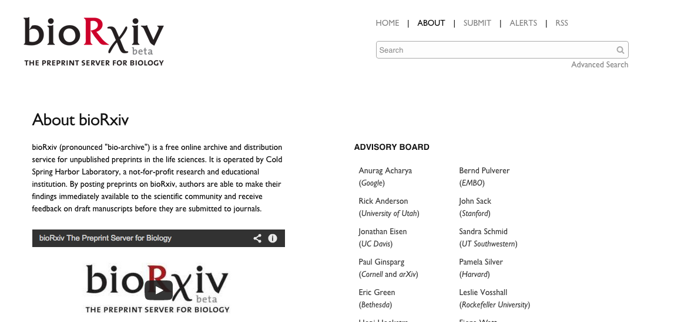
and this…

Slide 18
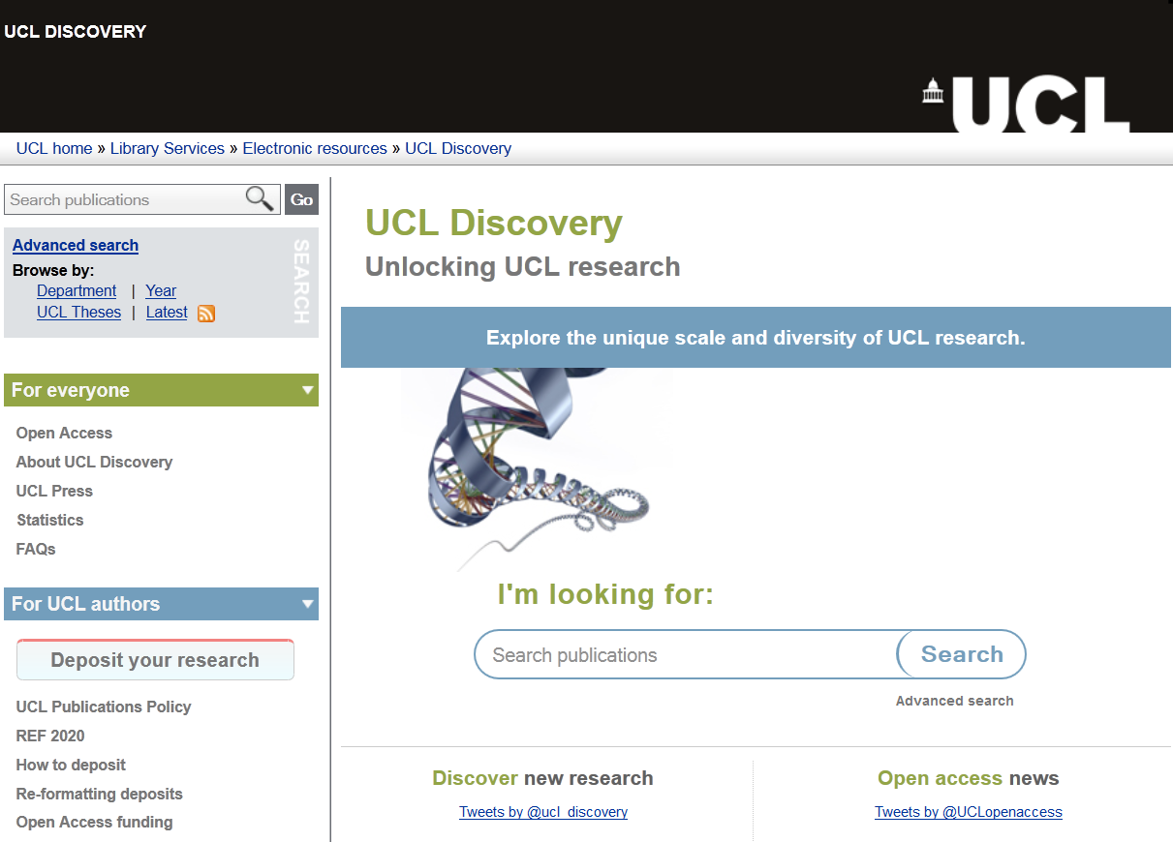
and this...

Slide 19
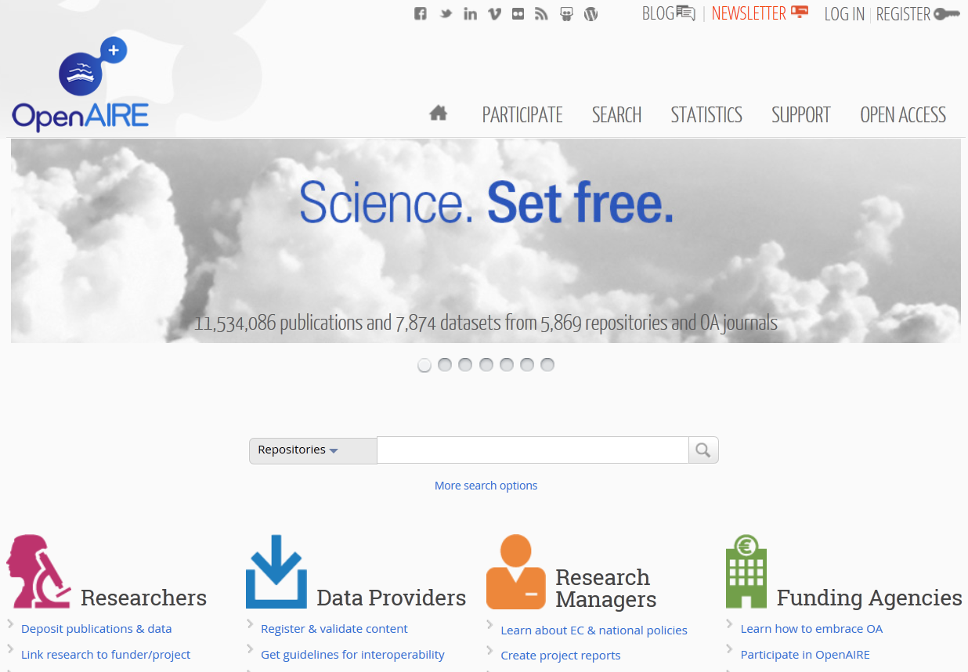
and this...

Slide 20
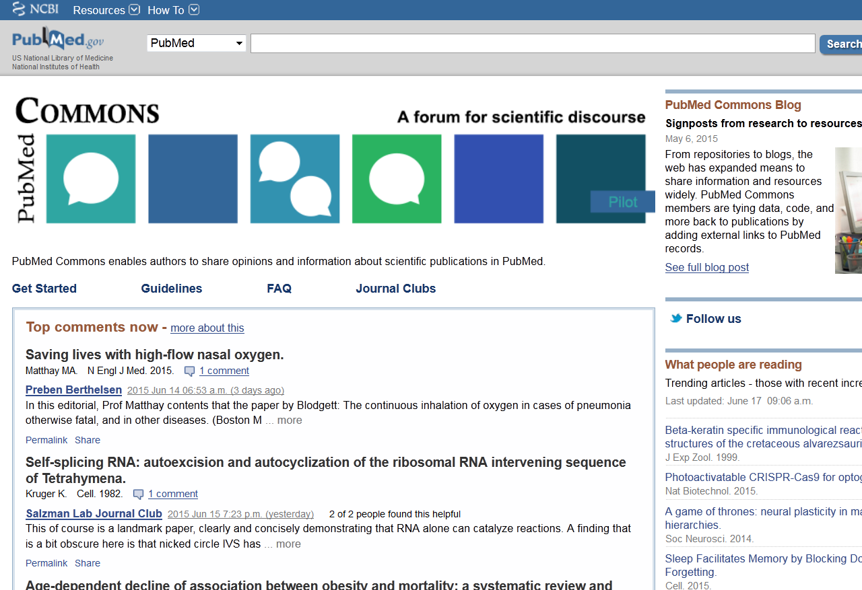
and this...

Slide 21
It’s not a cycle…

Slide 22
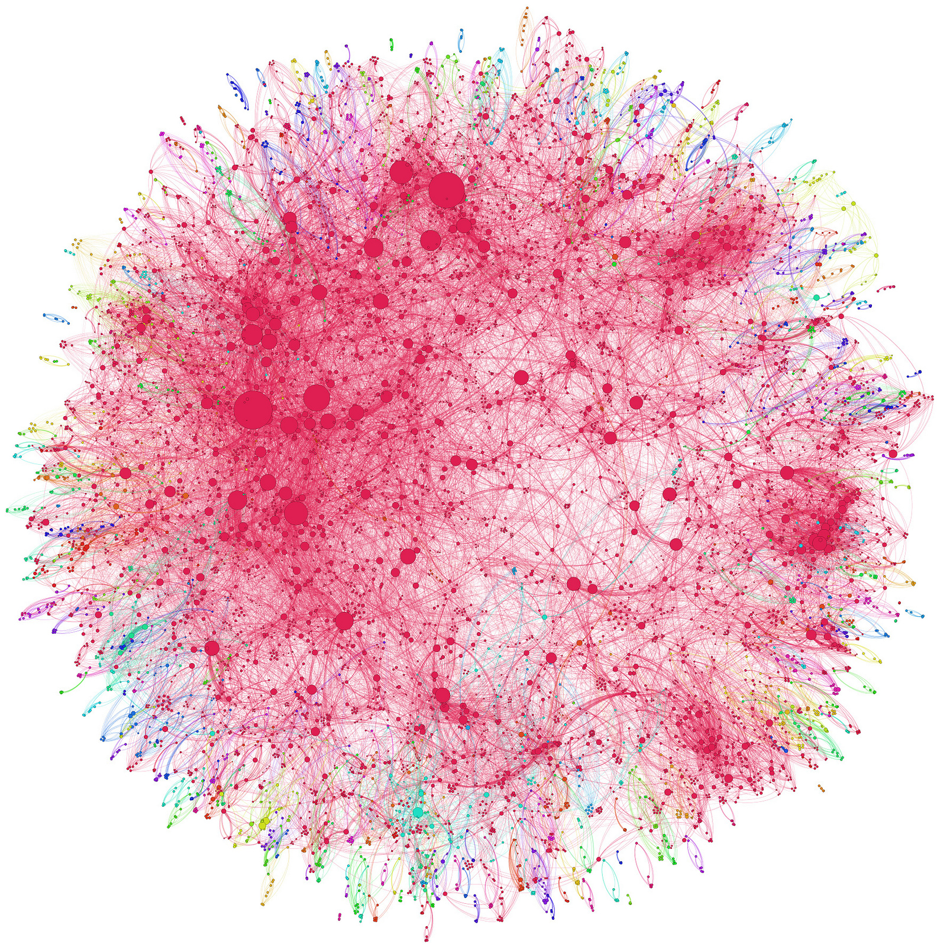

…it’s a Netw rk
Image: Andy Lamb, CC BY https://www.flickr.com/photos/speedoflife/8273922515/in/photostream/

Slide 23
the increasing interconnection of networks is an important phenomenon.
    increased connectivity itself leads to changes

Slide 24
Implications of increased connectivity
Increased global collaboration
  potential for new areas of research that would not otherwise be addressed
  research questions that could not previously be tackled
  Increased local engagement
  Opportunity for engagement and collaboration beyond the traditional research community, driven by a more highly connected network
  potential to enhance the application of research to local problems

Slide 25
Facilitating the network…
Ensure scholarship can be used
Ensure scholarship is re-used
Application
Commercialisation
Education
Engagement
RE-USE = IMPACT
Citation
Download
Tweet
etc
…ensure scholarship is re-usable

Slide 26
How?
Build scale
  interoperable platforms and infrastructure
Ease Connections
  remove access barriers (e.g. paywalls, permissions)
  remove re-use barriers
    Technical (metadata, DOIs, NISO, etc)
    Cultural (quality assurance, ‘reproducibility’, transparency, )
Maximise network effects
  incentivise players (technicians, researchers, institutions, publishers, funders, citizen scientists)
Monitor progress
  Create an ‘observatory’

Slide 27
Making something available on the web is the least interesting thing you can do

Slide 28
‘Publishing’ is not [just] about content provision….

Slide 29
it’s about connections…
People
Organisations
Objects, facts, ideas
Events

Slide 30
and relationships…
People
Organisations
Objects, facts, ideas
Events

Slide 31
and discovery…
People
Organisations
Objects, facts, ideas
Events

Slide 32
and reliability….
People
Organisations
Objects, facts, ideas
Events

Slide 33
… it’s about services
servicing the scholarly communications network

Slide 34
The Institution as a Service Provider

Slide 35
Services
Open Access (CC BY)
  Data, text
Content to build the network
  OA presses (e.g. UCL)
  Repositories
  New authoring and reviewing tools
Global interoperable, sustainable infrastructure
Transparency (intelligent Openness)
  Open Peer review
  Pricing
  Workflows (e.g. APC management)
Assessment
  Alternative metrics
Rewards and ‘Incentives
  Rewarding Open/networked behaviour

Slide 36









Services: information that is machine readable
http://dmtrk.com/2PXJ-HVU-9FNJFS36A/cr.aspx and http://www.slideshare.net/ORCIDSlides/orcid-adoption-and-use
Notes:
Orcid enables machine readable connections between identifiers for organisations, works/objects and people
Ensures adoption and use of research information standards
ORCID record includes funder name, grant number, source, date

Slide 37
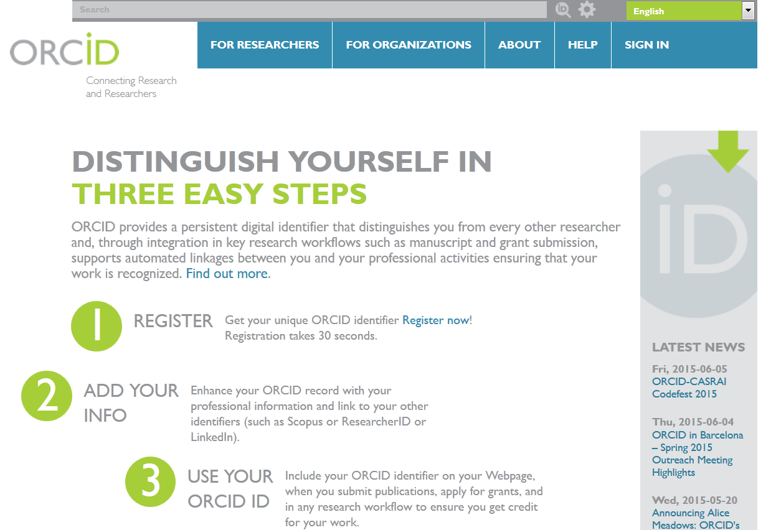
http://orcid.org/

Slide 38
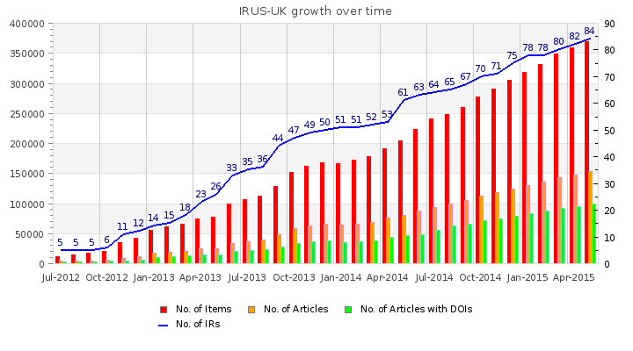
IRUS-UK growth over time
http://www.irus.mimas.ac.uk/ IRUS-UK (Institutional Repository Usage Statistics UK) is a Jisc-funded national aggregation service, which provides COUNTER-compliant usage statistics for all content downloaded from participating UK institutional repositories (IRs). - See more at: http://www.irus.mimas.ac.uk/#sthash.VGOZ4MFd.dpuf

Slide 39


CrossRef DET pilot (Data Event Tracker)
Provides a way to track activities – ‘events’ – around DOIs
Crossref acts as a hub
The data are openly available from CrossRef
Requires ‘Lagotto’ - Open Source Software from PLOS (used to retrieve data on Article Level Metrics)
Collaboration of publishers
  Co-Action, eLife, BMC, Elsevier, OUP, PLOS, Wiley
  University of Wolverhampton, Wellcome, Mendeley, CrossRef

Slide 40
Services: Access to original datasets
PLOS Policy Effective March 1, 2014:
All data underlying the findings must
be deposited in field-standard repository
upon submission.
Must be available without restriction, with
rare exception.
Data Availability Statement is published with
accepted article
Compliance?
Acceptable data-sharing methods:
Data deposition (recommended; must include DOIs or accession numbers)
Data in supporting information files
(in file format from which data can be efficiently
extracted)

Slide 41
Compliance
How to enforce?
Currently monitoring
Policy will evolve to reflect this
Independent assessment (one subject area) showed that data availability increased from 12%- 40% from March-Nov 2014*
If representative (unlikely):
  PLOS ONE publishes ~33000 paper in 2013
  So, 13,200 papers where the data in a paper can be reused compared with 3960 before policy
*Van Noorden, Richard. Nature 515, no. 7528 (November 26, 2014): 478–478. doi:10.1038/515478a.

Slide 42
Services: Reliability (Reproducibility)
It’s not just access to data that’s a problem
Bias (common)
Misreporting (common)
Spin (common)
Misconduct (on the increase?)
  Falsification
  Fabrication
  Plagiarism
  Violation of ethical standards
  Other types of misconduct
How can these be addressed?

Slide 43

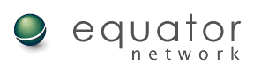
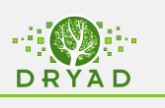

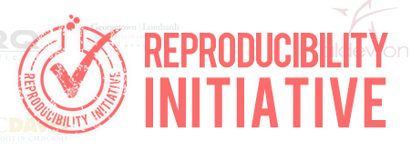
Potential solutions
Raise reporting standards
  CONSORT, ARRIVE (EQUATOR)
Improve access to original datasets
Ensure access to historical documents eg protocols – ensure what has been reported can be compared against what was planned
Incentivise reproducibility/reliability of original studies
Open continuous peer review
Transparency
Eisen JA, Ganley E, MacCallum CJ (2014) Open Science and Reporting Animal Studies: Who's Accountable? PLoS Biol 12(1): e1001757. doi:10.1371/journal.pbio.1001757
The PLOS Medicine Editors (2013) Better Reporting of Scientific Studies: Why It Matters. PLoS Med 10(8): e1001504. doi:10.1371/journal.pmed.1001504

Slide 44
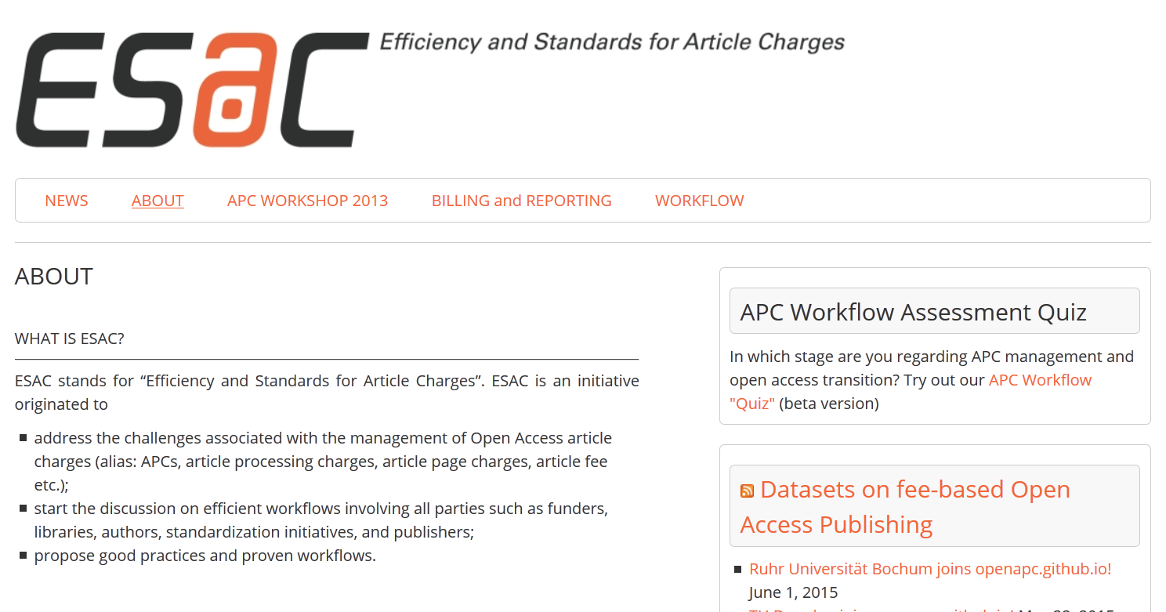
Services: transparent and competitive market
http://esac-initiative.org/about/

Slide 45
Objectives of ESAC
To keep transaction costs for Open Access article charges at a minimum level.
To support and contribute to the development of a transparent and efficient APC market.
Signing non-disclosure agreements is NOT a service

Slide 46
Transparency – Intelligent Openness
Greater transparency can improve on the reproducibility and reliability of research results.
Greater transparency can enable independent experts to assess the effectiveness of different services themselves (e.g. peer review)
  Needs to be balanced against the need for “privacy of thought” which allows researchers to work through to an understanding of their results.
  Needs to take account of confidentiality (patient, endangered species etc)

Slide 47

Services: Incentives
Research Assessment
  Prestige dominates
  Decisions generally not transparent
  Researchers are risk-averse
  Institutions are risk-averse
Impact Factor – perverse incentive
  Researchers & institutions unable to ‘wean themselves’ off impact factor
  Impact factor ‘propping up’ subscription model (Claudio Aspesi, Business analyst)
Research assessment isn’t linear

Slide 48
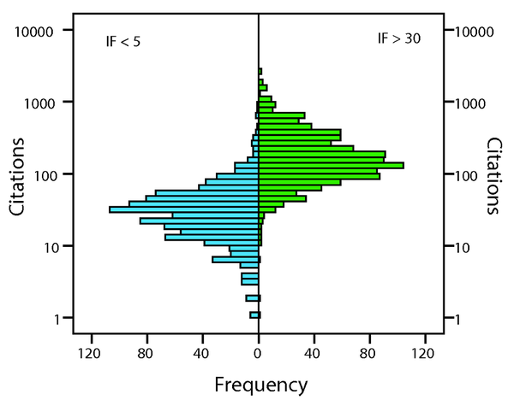
Figure 5. The distribution of the number of citations in journals with IF&lt;5 and IF&gt;30 in the F1000 dataset.
Eyre-Walker A, Stoletzki N (2013) The Assessment of Science: The Relative Merits of Post-Publication Review, the Impact Factor, and the Number of Citations. PLoS Biol 11(10): e1001675. doi:10.1371/journal.pbio.1001675
See also: Eisen JA, MacCallum CJ, Neylon C (2013) Expert Failure: Re-evaluating Research Assessment. PLoS Biol 11(10): e1001677. doi:10.1371/journal.pbio.1001677

Slide 49

‘qualities…’
Nicolas Raymond https://www.flickr.com/photos/82955120@N05/8691488200/in/photostream/ CC BY

Slide 50

not ‘quality’

Slide 51
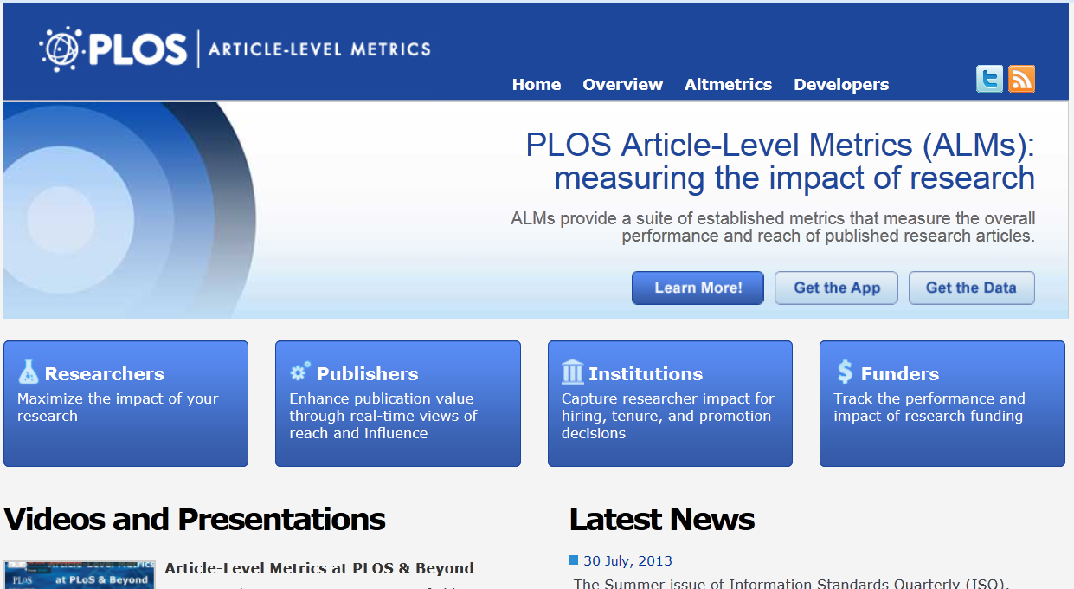
Open Metrics
http://article-level-metrics.PLOS.org

Slide 52
Networked scholarship requires network incentives
Mechanisms and frameworks that drive directional change at the system level rather than highly targeted interventions with specific goals.
Policy interventions focussed on the creation of frameworks and mechanisms that drive directional change and through the monitoring of implementation
  e.g. rewards for ‘networked’ behaviour
  A system of hiring and firing that moves the culture away from journals and impact factors

Slide 53
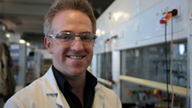
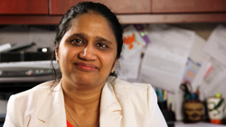


Rewarding open behaviour
Accelerating Science Awards Program (ASAP)
Global Collaboration
to Fight Malaria
Matthew Todd, PhD
HIV Self-Test
Empowers Patients
Nitika Pant Pai, MD, MPH, PhD,
Caroline Vadnais, Roni Deli-Houssein
and Sushmita Shivkumar
Visualizing Complex Science
Daniel Mietchen, PhD, Raphael Wimmer
and Nils Dagsson Moskopp
Networkable
http://asap.plos.org

Slide 54
Putting the Academy at the heart of Scholarly
Publishing
Communication
we need a new word

Slide 55
The Institution as a Service Provider

Slide 56

https://www.flickr.com/photos/34005137@N05/18396066832/in/photostream/ srose15 CC BY

Slide 57
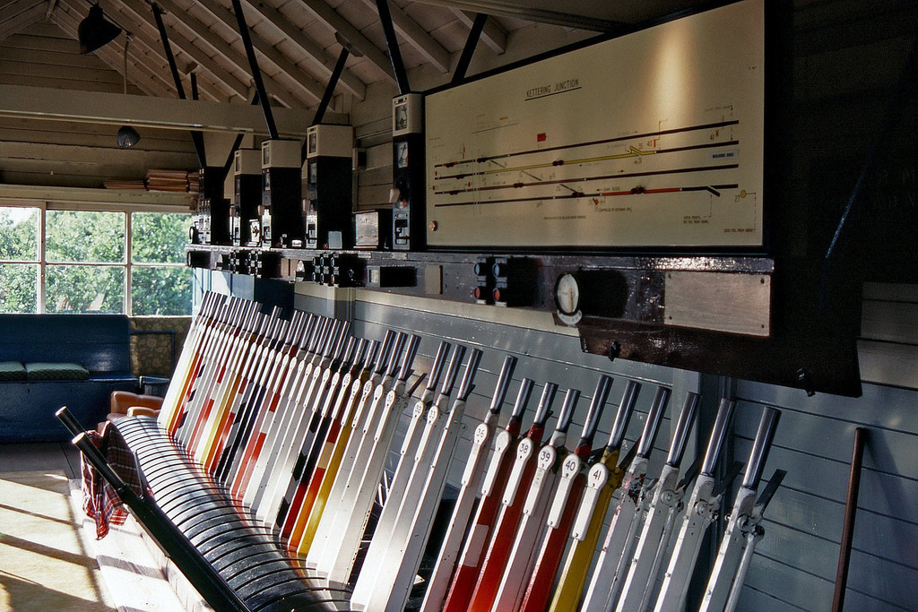
https://www.flickr.com/photos/ingythewingy/4793928695/in/photostream/ Ingy the Wingy CC BY

Slide 58

https://www.flickr.com/photos/terrycady/5402775342/ stantoncady CC BY

Slide 59

https://www.flickr.com/photos/121776594@N07/14043599788/
Kevin Dinkel CC BY-SA

Slide 60
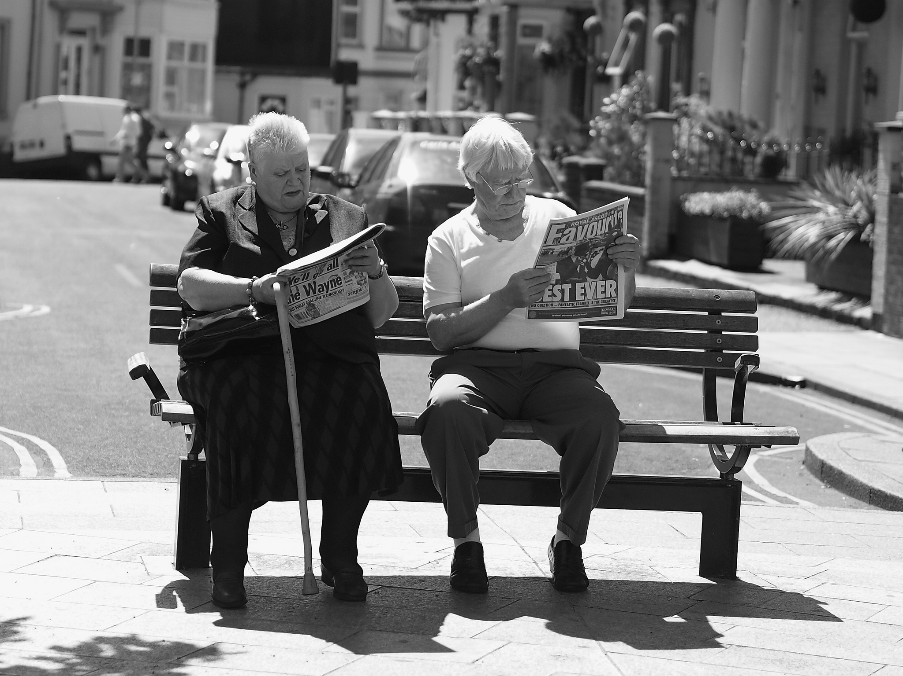
https://www.flickr.com/photos/publicplaces/7418726440/ David Hodgeson CC BY

Slide 61

https://www.flickr.com/photos/sektordua/6152508407/ Tanti Ruwani CC BY

Slide 62


Slide 63
Thank you

