Slide 1

Vision for Institutional Publishing I-II
Dr Paul Ayris
Director of UCL Library Services and UCL Copyright Officer
Chief Executive, UCL Press
Chair of the LERU community of Chief Information Officers
Adviser to the LIBER Board on Horizon 2020 and EU issues
e-mail: p.ayris@ucl.ac.uk

Slide 2
Format of the Breakout Group
Session I
Open Science (30 mins)
Discussion (10 mins)
Session II
UCL Press as a model for institutional publishing (30 mins)
Discussion: How can Universities develop publishing arms? (20 mins)
Reporting back for the OAI9 website (15 mins)

Slide 3
Format of the Breakout Group
Session I
Open Science (30 mins)
Discussion (10 mins)
Session II
UCL Press as a model for institutional publishing (30 mins)
Discussion: How can Universities develop publishing arms? (20 mins)
Reporting back for the OAI9 website (15 mins)

Slide 4
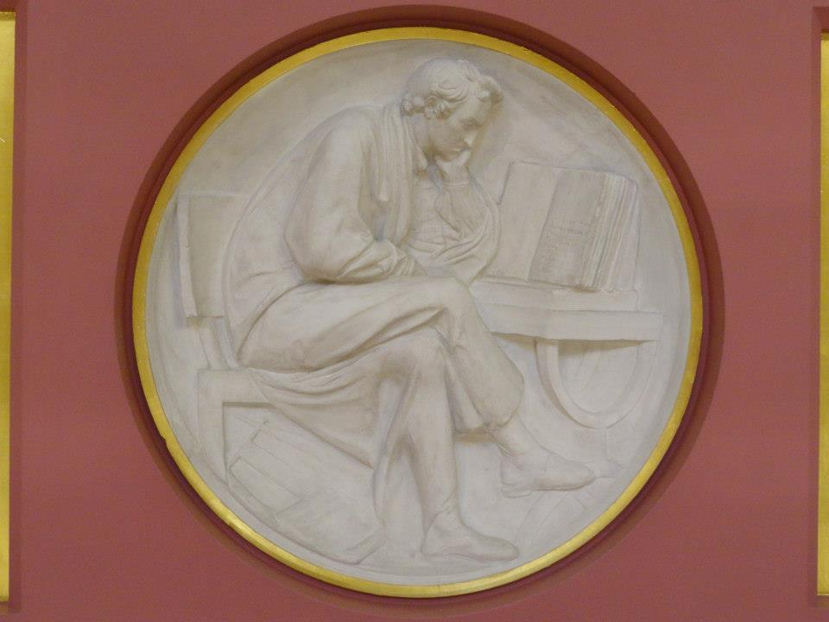
Contents
The Institution as publisher
  UCL Press
Business Modelling
Look at UCL publications
Collaborations?
Discussion: How can Universities develop publishing arms?
Plaster Relief by John Flaxman,
Flaxman Gallery, UCL

Slide 5
Contents
The Institution as publisher
  UCL Press
Business Modelling
Look at UCL publications
Collaborations?
Discussion: How can Universities develop publishing arms?
Plaster Relief by John Flaxman,
Flaxman Gallery, UCL

Slide 6
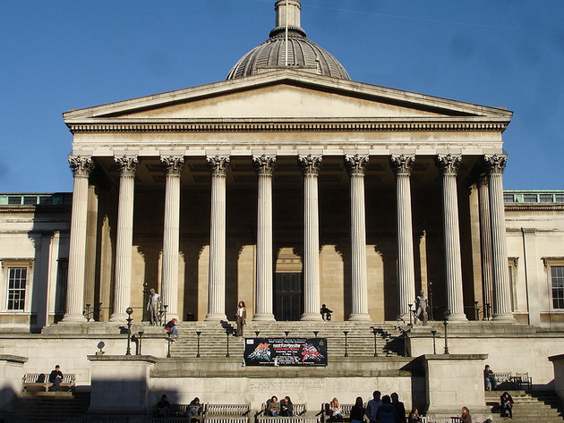
Open Access as an opportunity for libraries
Traditional model for a research library
  Collector of knowledge
  Cataloguer of knowledge
  Curator of knowledge
Open Science
  ‘A paradigm shift in the modus operandi of research and science impacting the entire scientific process’
University Library can be:
  Creator of knowledge
  As a University Press…
UCL, Wilkins Building, 1826

Slide 7
UCL Press
UCL Press imprint
Imprint licensed to commercial publishers
Reasons to change
Inactivity using the current model for provision
UCL Press as OA Press
Strategic fit with UCL’s Connected Curriculum and research-based learning
Open Access seen as an opportunity, not a threat
Imprint passed through a number of hands
No publishing using imprint since around 2007
No regular contact between publisher and UCL academics
More freedom if publishing activity managed in-house
Greater visibility for UCL as an institution

Slide 8
Contents
The Institution as publisher
  UCL Press
Business Modelling
Look at UCL publications
Collaborations?
Discussion: How can Universities develop publishing arms?
Plaster Relief by John Flaxman,
Flaxman Gallery, UCL

Slide 9
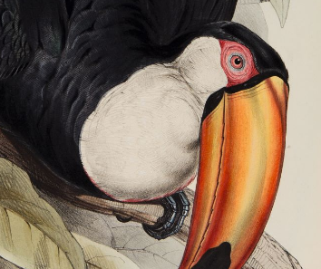

Business Modelling
Publishing List
Formats to be published
Staffing structures
Running Costs

Slide 10

Publishing List from the
Business Plan
2014-15
10 books
2 journals
2015-16
20 books
5 journals
2016-17
30 books
8 journals

Slide 11
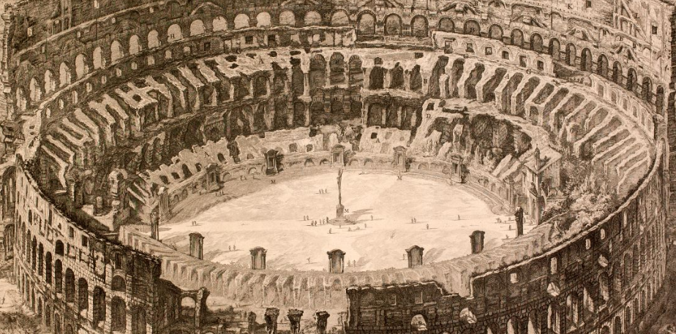

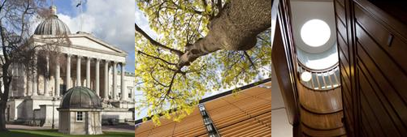
Formats
Journal publishing platform
  OJS (Open Journal Systems) overlaying UCL Discovery as storage layer
  Peer-reviewed journals
  Run by academic Editorial Committees
Research Monograph list
  Using Open Monograph Press
Textbook infrastructure
  Being constructed with JISC project monies
See http://www.ucl.ac.uk/ucl-press

Slide 12
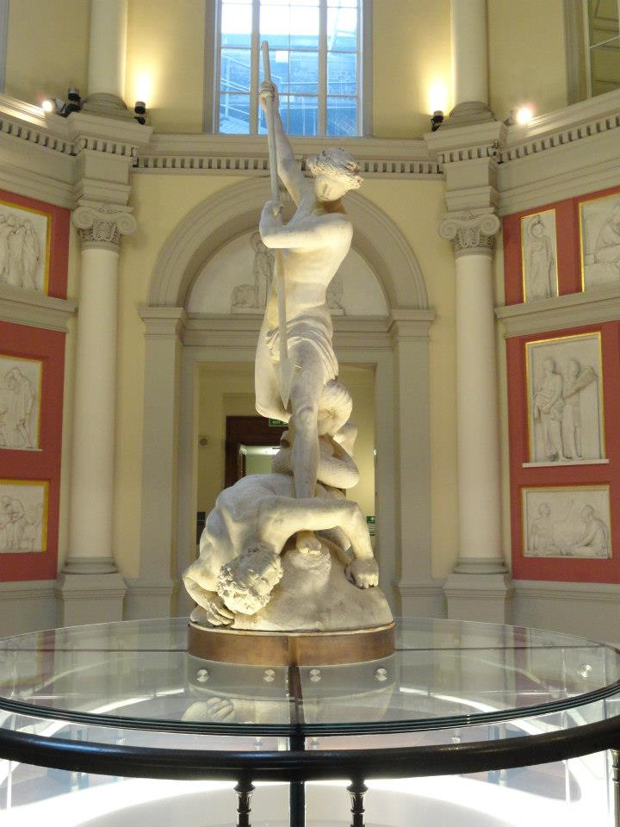
Challenges for Text Books
Students want remote access to core readings 24x7
In the US, just five textbook publishers control more than 80% of the $8.8 billion textbook market
E-book publishers are nervous about making course texts available as e-books (free at the point of use) as they do not want to cannibalize their print sales to students and lose revenue
St Michael, by John Flaxman, UCL

Slide 13
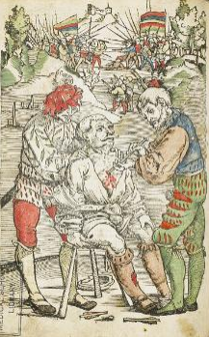
Textbooks
Successful in a JISC funding for OA e-textbooks
2 exemplars will help build e-textbook infrastructure
  Public Archaeology, based on curriculum at UCL
  Burns, Plastic and Reconstructive Surgery, based on UCL M.Sc course
E-Textbooks suitable for UK curricula difficult to source
Universities can publish their own
UCL Special Collections, Hans von Gersdorff, Feldtbuch der Wundartzney (Strassbourg, 1530)

Slide 14
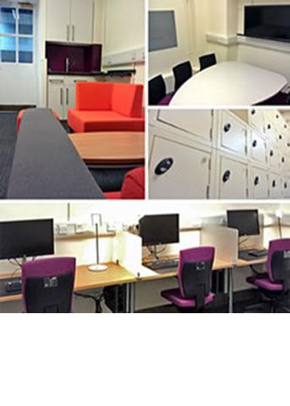
Public Archaeology
Course Book in Public Archaeology
Will give overview based on current undergraduate and postgraduate teaching
Will take account of global scholarship and practice
Target audience is undergraduates and postgraduates
Lecturers in countries where Public Archaeology is a growing field of practice

Slide 15
Plastic and Reconstructive surgery
Written by leading practitioner at Royal Free Hospital
Intended for MSc in Burns, Plastic and Reconstructive Surgery
Will provide overview for students coming from a variety of specialisms across the world
Course is only one of a handful to train medics not only in practice, but also in research and innovation in materials and techniques

Slide 16

UCL Publishing model
Open Access business model
  PDF in UCL Discovery
  Enhanced digital versions in UCL Digital Press
Sales via Print on Demand
Books will be peer reviewed before publication
Innovative technical solutions for Monographs and Textbooks
Open up publishing to new communities

Slide 17
Staffing Structure
CEO
Director of UCL Library Services
Assistant Director
Support Services
Publishing Manager
Managing
Editor
Marketing & Distribution
Manager
Commissioning
Editor
3 more to be appointed

Slide 18
Running Costs
2014-15
£500K
2015-16
£550K
2016-17
£650K

Slide 19
Contents
The Institution as publisher
  UCL Press
Business Modelling
Look at UCL publications
Collaborations?
Discussion: How can Universities develop publishing arms?
Plaster Relief by John Flaxman,
Flaxman Gallery, UCL

Slide 20
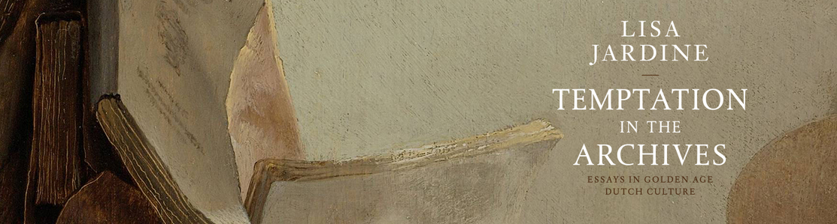

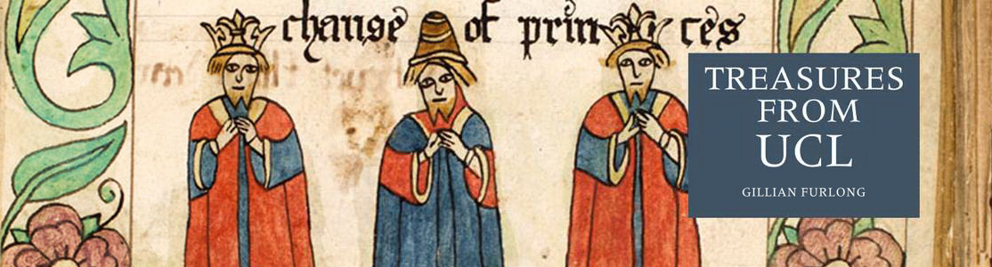
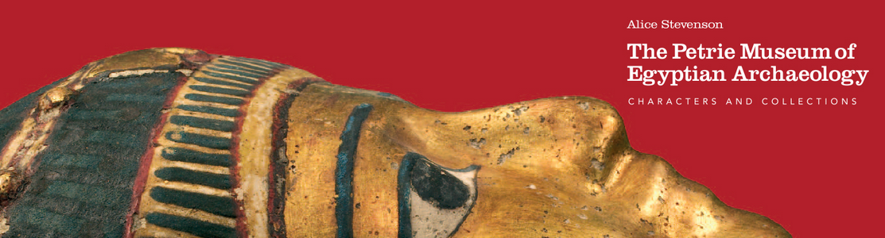

Slide 21
Contents
The Institution as publisher
  UCL Press
Business Modelling
Look at UCL publications
Collaborations?
Discussion: How can Universities develop publishing arms?
Plaster Relief by John Flaxman,
Flaxman Gallery, UCL

Slide 22
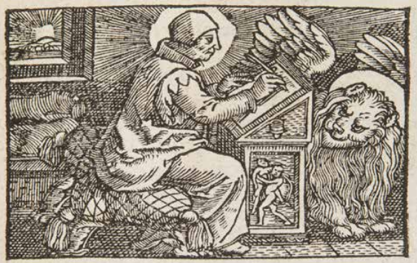
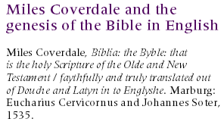
Case Study – Shared European infrastructure for monographs?
19 European partners, led by UCL
European universities can become publishers
Shared publishing infrastructure with OA business models
OAPEN to provide much of the technical infrastructure
Collaboration launched at UCL in December 2013

Slide 23
What could be achieved?
OUTPUTS
Shared publishing infrastructure Shared by 19 partners Scaleable to all European Universities
Advocacy for new solutions to solve monograph crisis
Marketing frameworks
Business Modelling activities
At least 180 OA monographs in 35 series

Slide 24
Indicative series in European collaboration
35 series titles proposed in total | Subject area
Media History and Film Theory | Media studies, Film theory
Spirituality Studies in Theology | Theology
World Oral Literature Series | Literary Studies
Iranian Studies | Middle Eastern Studies
Law, Governance and Development Research | Law, International Studies
Interdisciplinary Issues - Art, City, Society | Urban Studies
New Ideas in Human Interaction | Linguistics

Slide 25
Contents
The Institution as publisher
  UCL Press
Business Modelling
Look at UCL publications
Collaborations?
Discussion: How can Universities develop publishing arms?
Plaster Relief by John Flaxman,
Flaxman Gallery, UCL

Slide 26

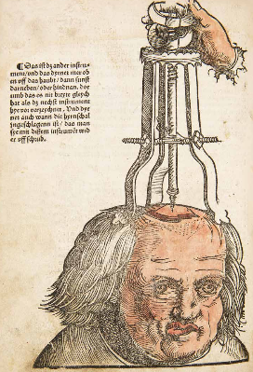
Discussion
How can Universities develop publishing arms?
UCL Special Collections, Hans von Gersdorff, Feldtbuch der Wundartzney (Strassbourg, 1530)
UCL Special Collections, the Centenary edition of the College Magazine, June 1927

