Slide 1

Photo by Darkroom Daze - Creative Commons Attribution-NonCommercial-ShareAlike License https://www.flickr.com/photos/25453448@N02
Created with Haiku Deck

Slide 2

Photo by bengrey - Creative Commons Attribution-ShareAlike License https://www.flickr.com/photos/28196992@N07
Created with Haiku Deck

Slide 3

Photo by dalbera - Creative Commons Attribution License https://www.flickr.com/photos/72746018@N00
Created with Haiku Deck

Slide 4
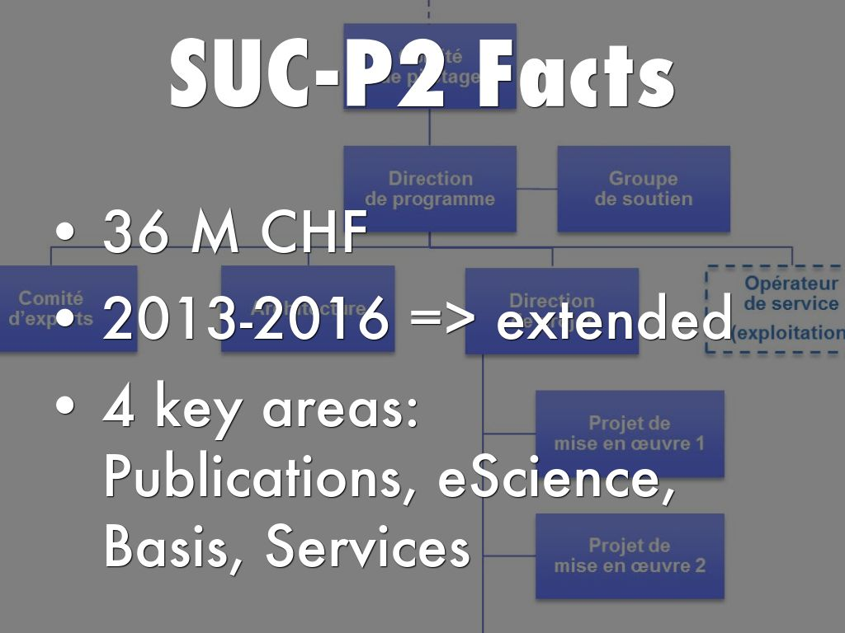

Slide 5
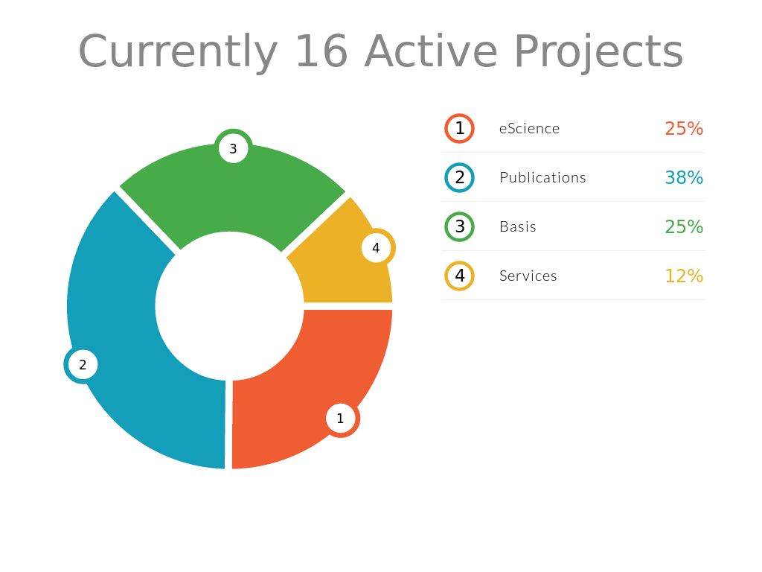
Photo by ohefin - Creative Commons Attribution-ShareAlike License https://www.flickr.com/photos/47515486@N05
Created with Haiku Deck

Slide 6

Photo by Dru! - Creative Commons Attribution-NonCommercial License https://www.flickr.com/photos/36543076@N00
Created with Haiku Deck

Slide 7

Photo by dalbera - Creative Commons Attribution License https://www.flickr.com/photos/72746018@N00
Created with Haiku Deck

Slide 8


Slide 9
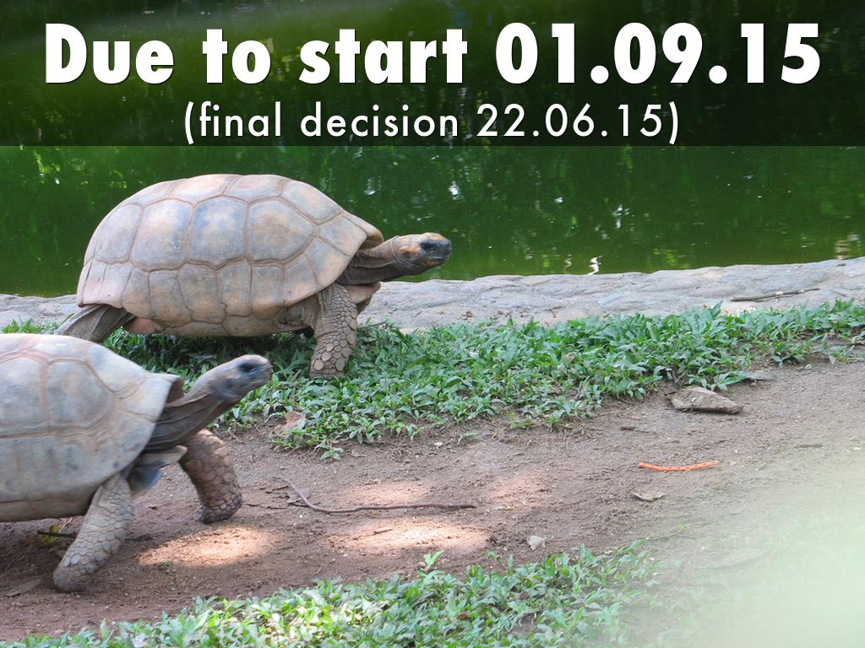
Photo by dipurinku | MERGED - Creative Commons Attribution-NonCommercial-ShareAlike License https://www.flickr.com/photos/62219432@N00
Created with Haiku Deck

Slide 10

Photo by smiling_da_vinci - Creative Commons Attribution-NonCommercial License https://www.flickr.com/photos/62186767@N00
Created with Haiku Deck

Slide 11


Slide 12
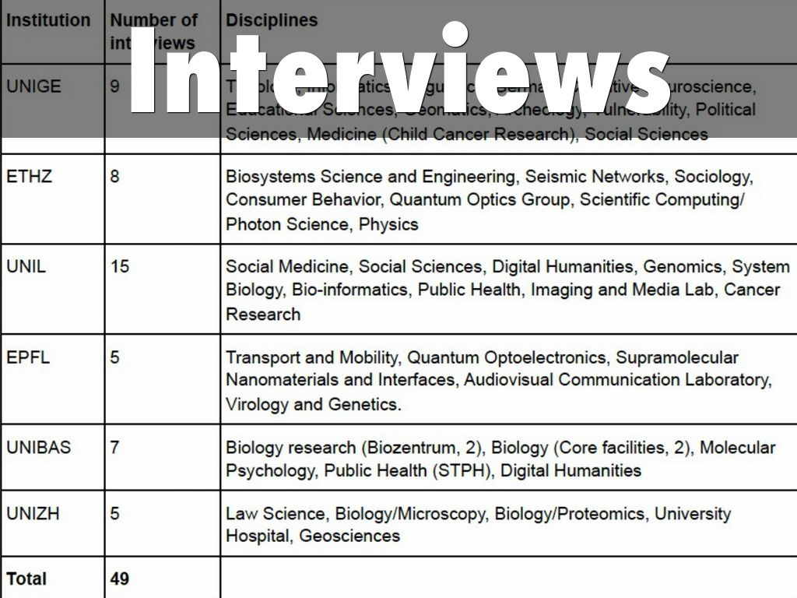

Slide 13
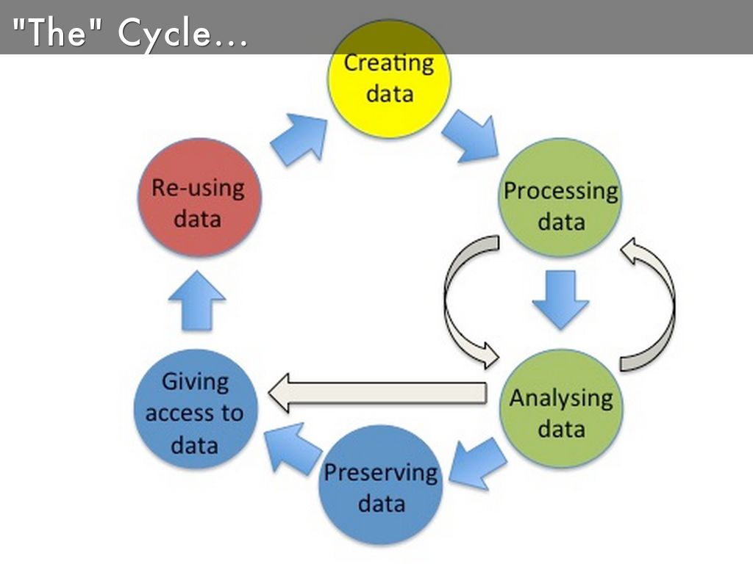

Slide 14
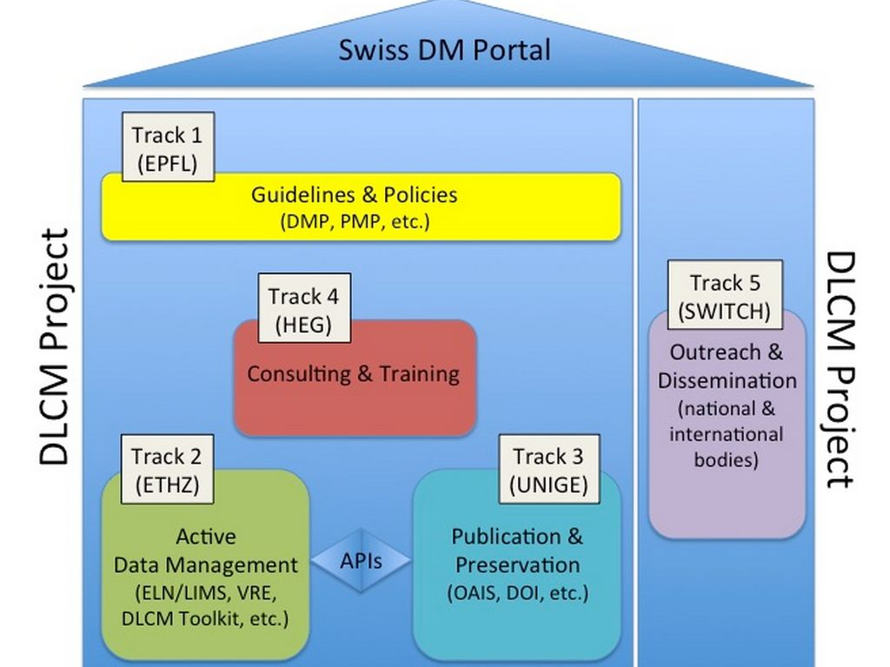

Slide 15
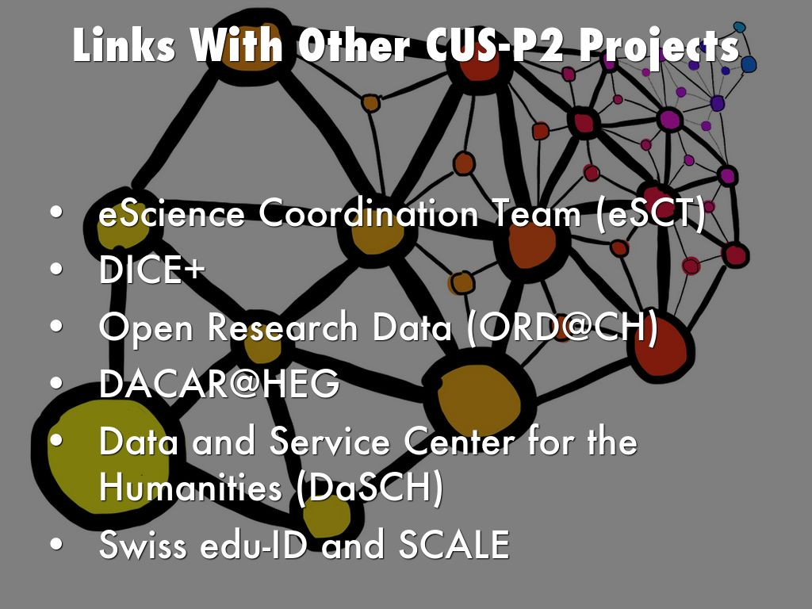
Photo by elcovs - Creative Commons Attribution-ShareAlike License https://www.flickr.com/photos/103454225@N06
Created with Haiku Deck

Slide 16
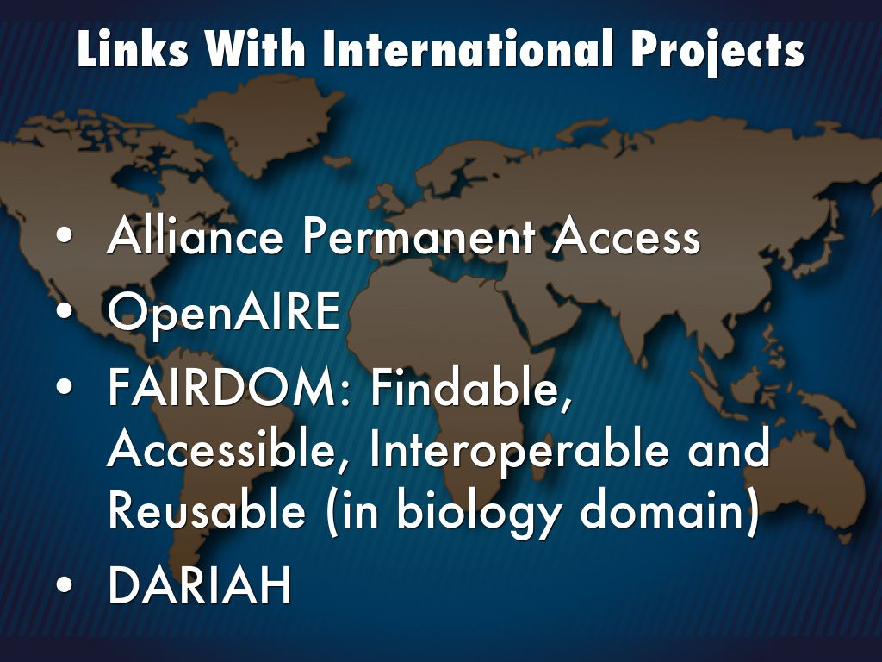
Photo by shaire productions - Creative Commons Attribution License https://www.flickr.com/photos/9822107@N08
Created with Haiku Deck

Slide 17
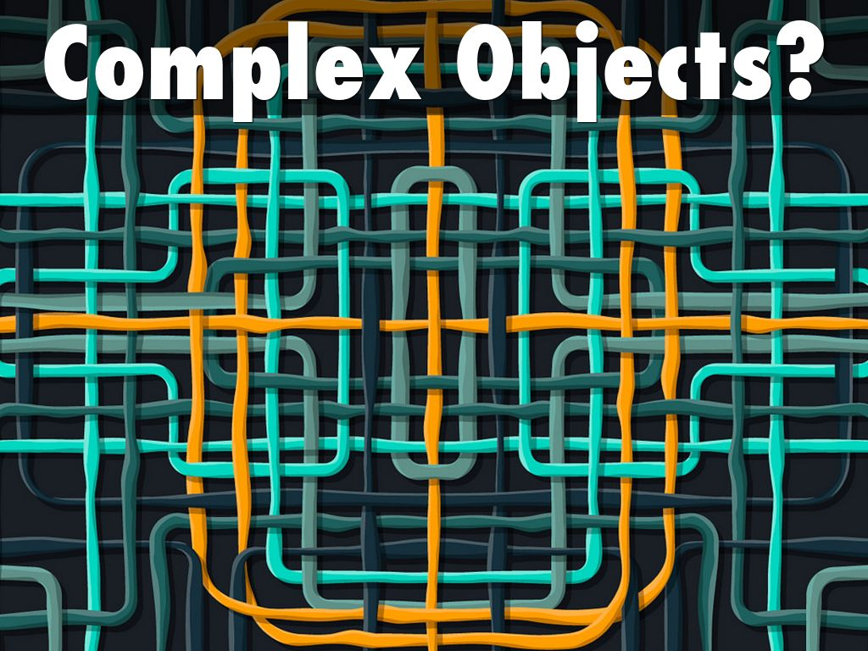
Photo by Gwendal_ - Creative Commons Attribution-NonCommercial-ShareAlike License https://www.flickr.com/photos/10661825@N07
Created with Haiku Deck

Slide 18
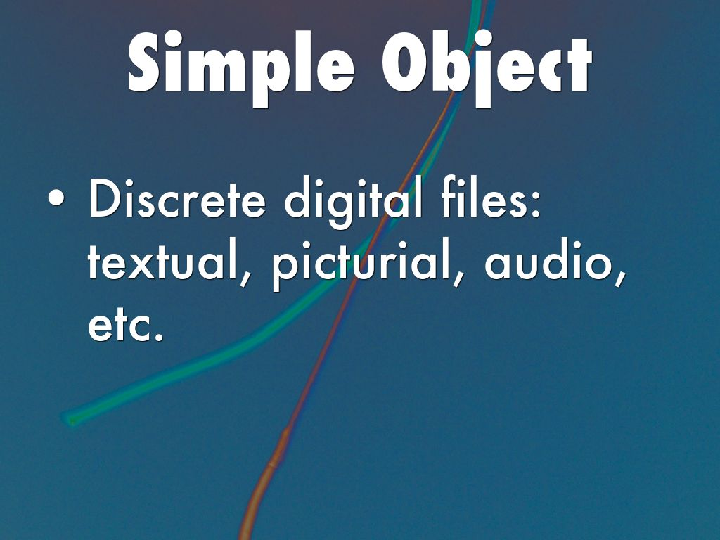
Photo by milena mihaylova - Creative Commons Attribution License https://www.flickr.com/photos/25758374@N00
Created with Haiku Deck

Slide 19
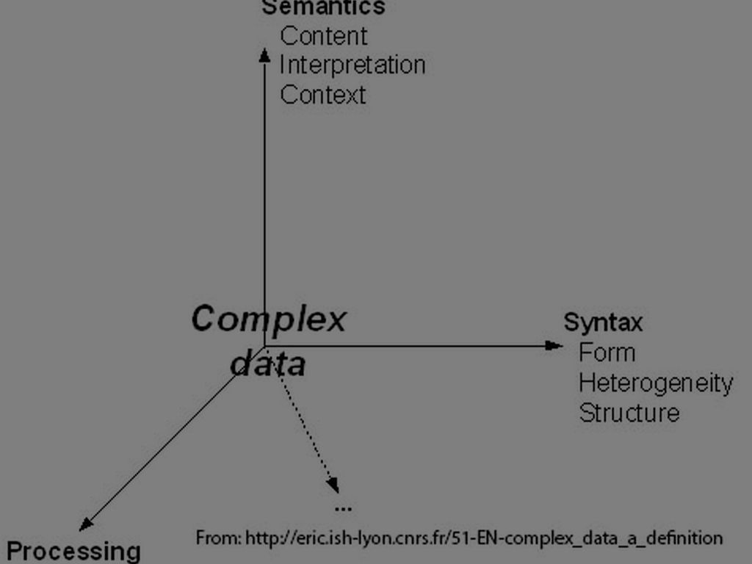

Slide 20
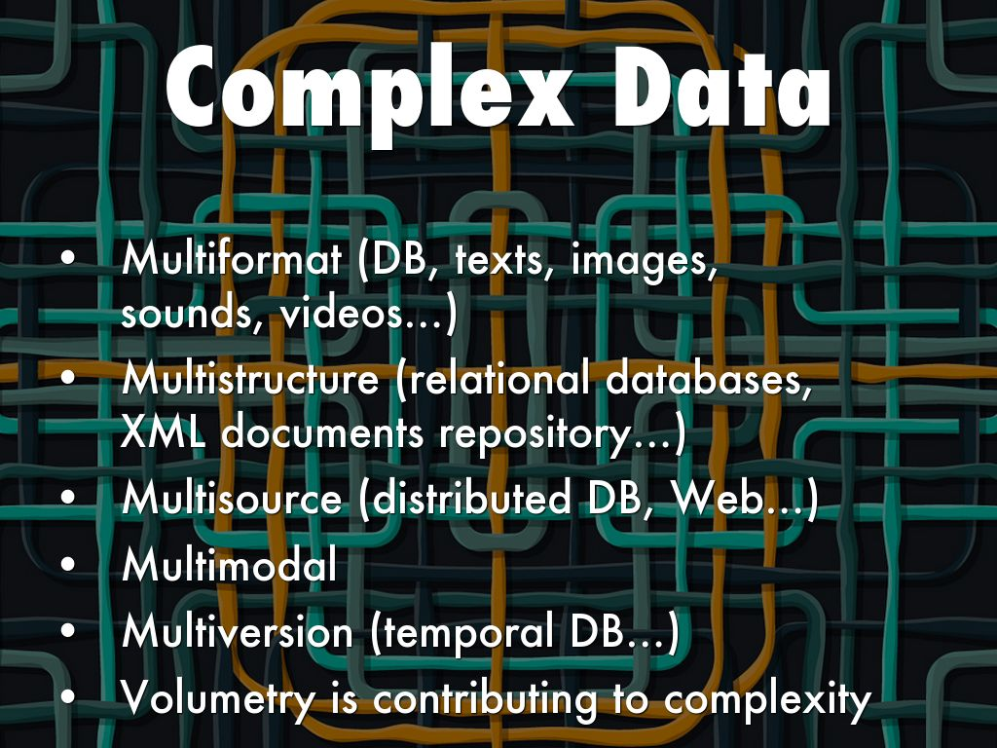
Photo by Gwendal_ - Creative Commons Attribution-NonCommercial-ShareAlike License https://www.flickr.com/photos/10661825@N07
Created with Haiku Deck

Slide 21
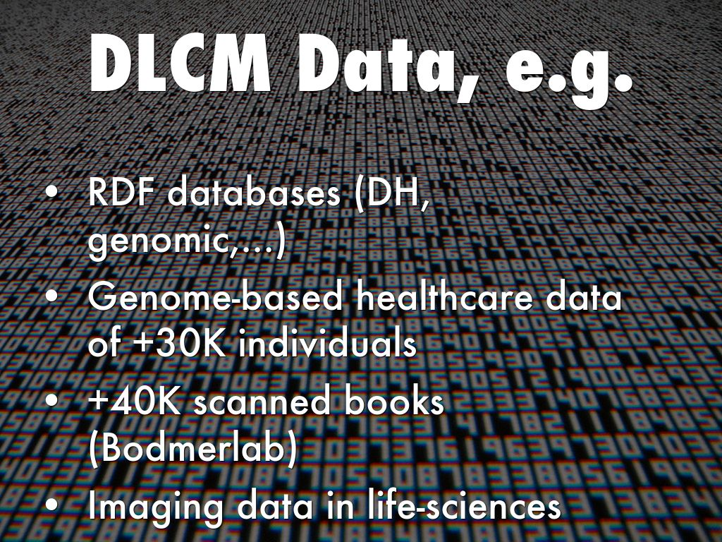
Photo by dalbera - Creative Commons Attribution License https://www.flickr.com/photos/72746018@N00
Created with Haiku Deck

Slide 22
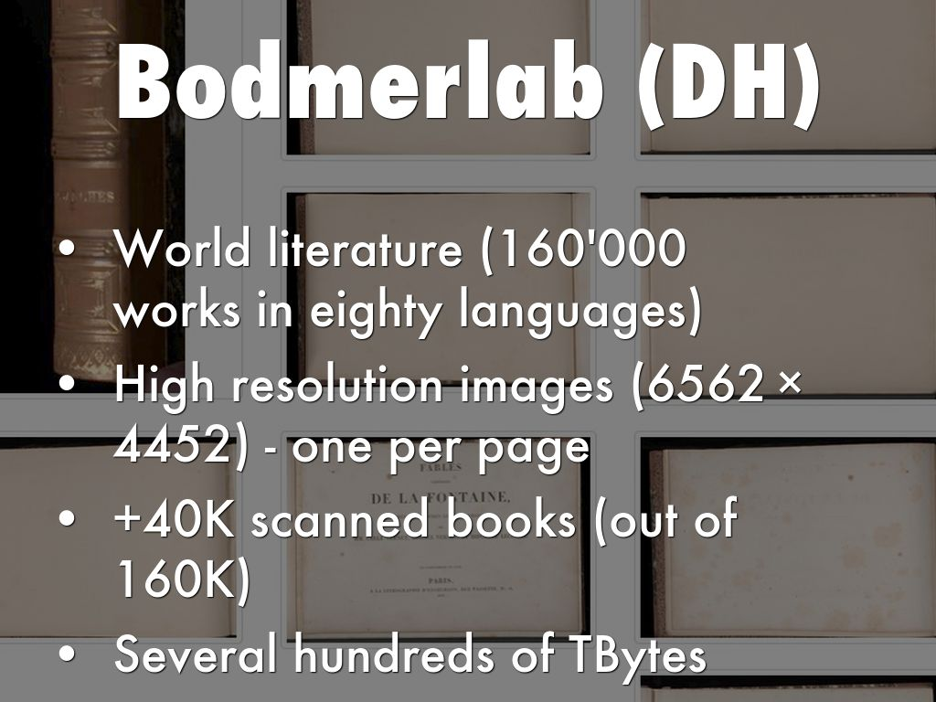

Slide 23
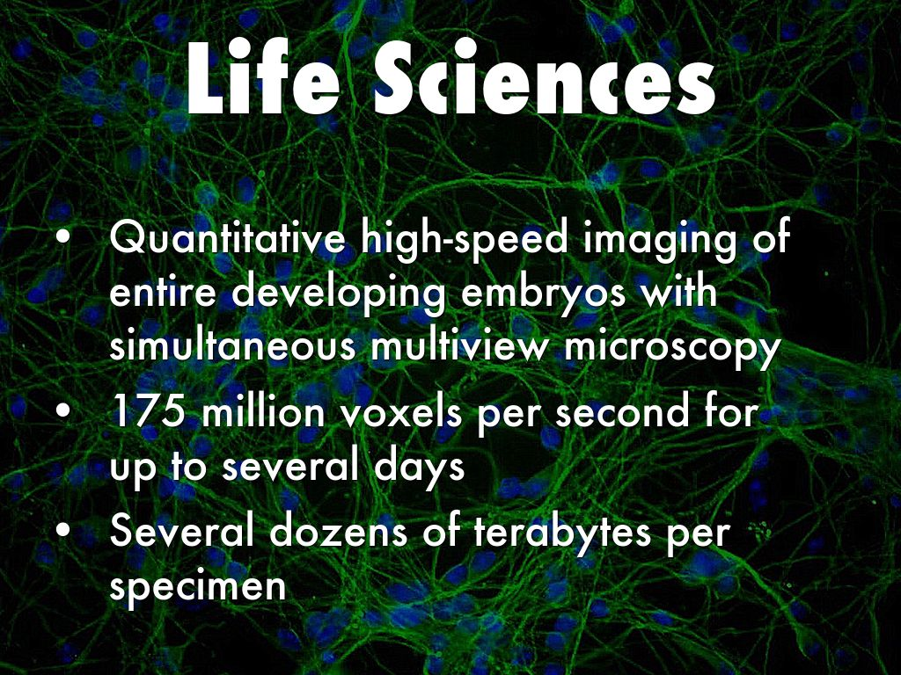
Photo by Grey cells - Creative Commons Attribution-NonCommercial License https://www.flickr.com/photos/60242105@N00
Created with Haiku Deck

Slide 24

Photo by magnuscanis - Creative Commons Attribution-NonCommercial-ShareAlike License https://www.flickr.com/photos/41304989@N00
Created with Haiku Deck

Slide 25
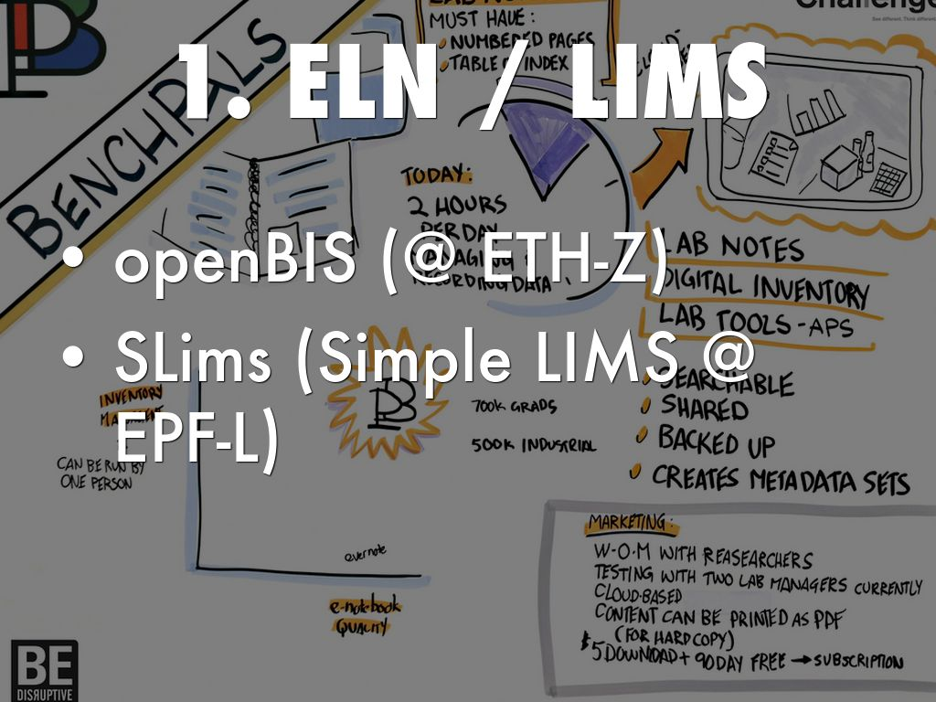
Photo by deanmeyersnet - Creative Commons Attribution-NonCommercial-ShareAlike License https://www.flickr.com/photos/36363318@N04
Created with Haiku Deck

Slide 26
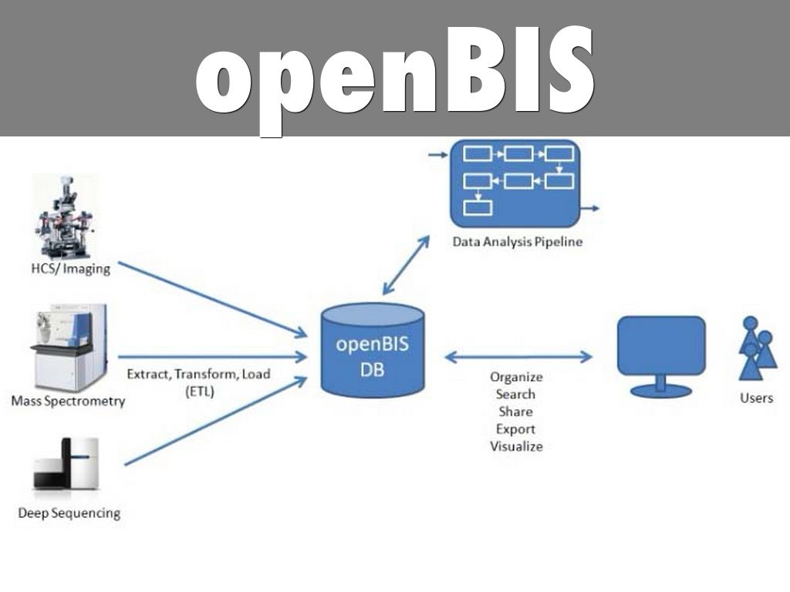

Slide 27
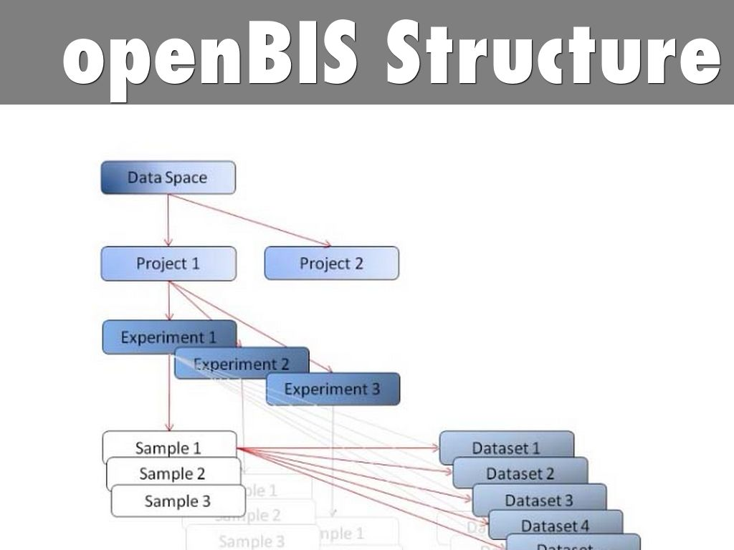

Slide 28
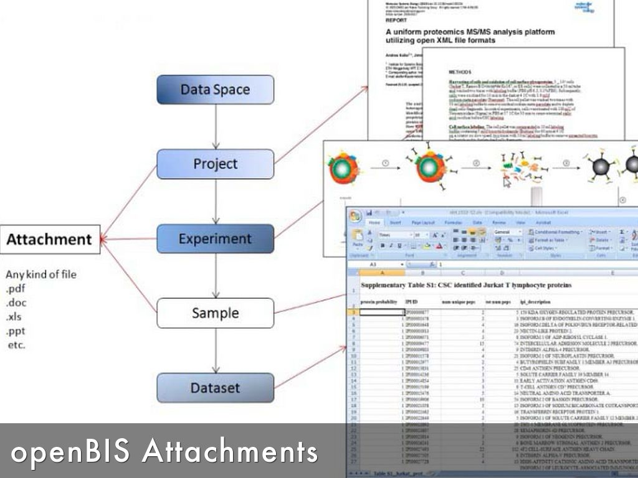

Slide 29

Photo by saguayo - Creative Commons Attribution License https://www.flickr.com/photos/94187100@N00
Created with Haiku Deck

Slide 30
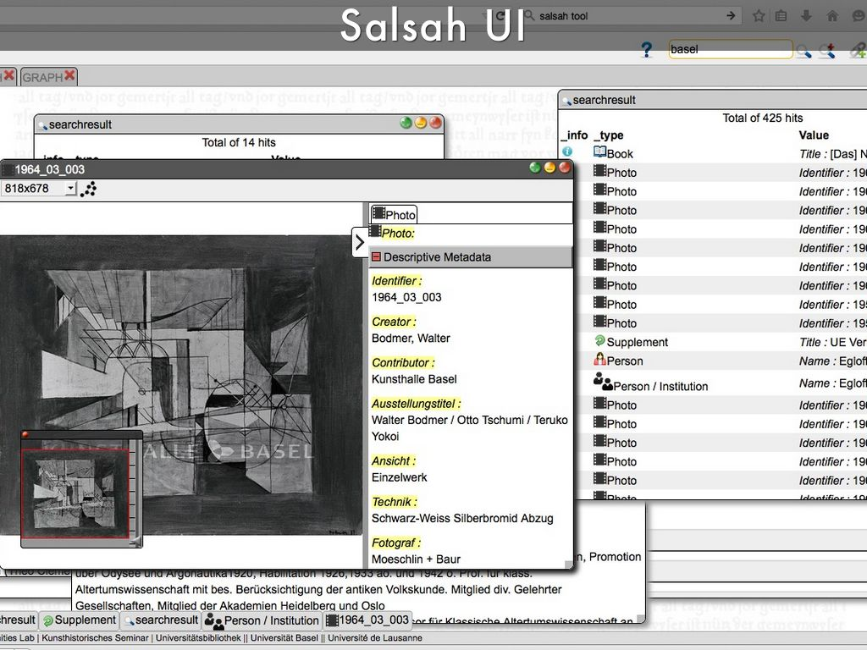

Slide 31
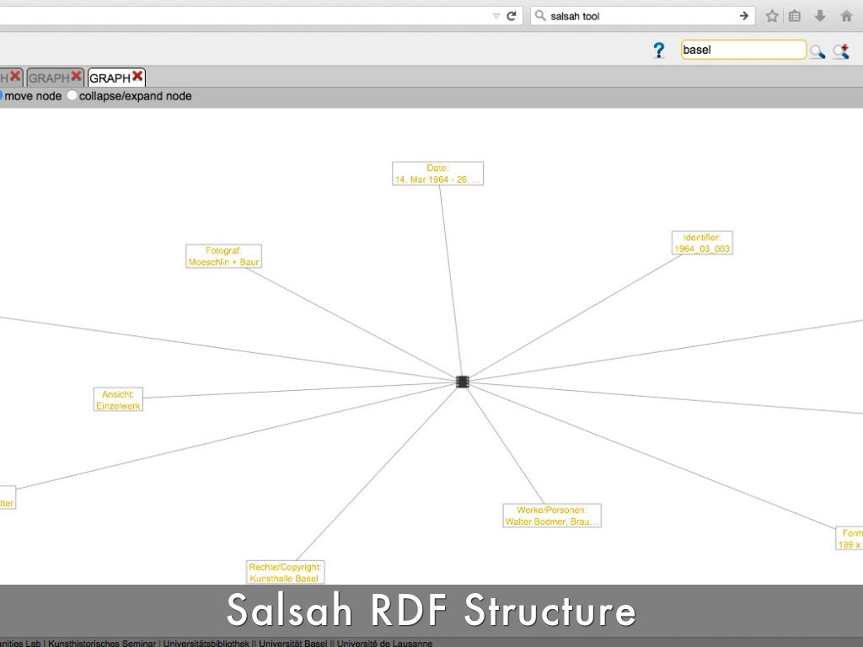

Slide 32
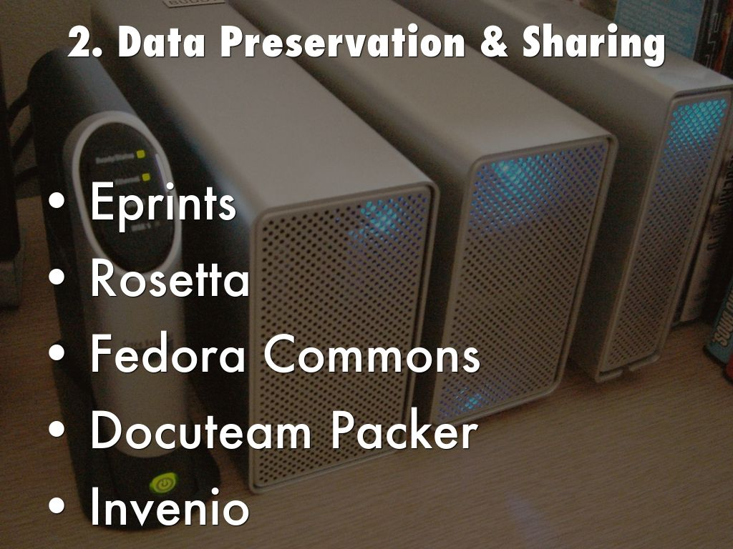
Photo by inju - Creative Commons Attribution-NonCommercial-ShareAlike License https://www.flickr.com/photos/35468141938@N01
Created with Haiku Deck

Slide 33
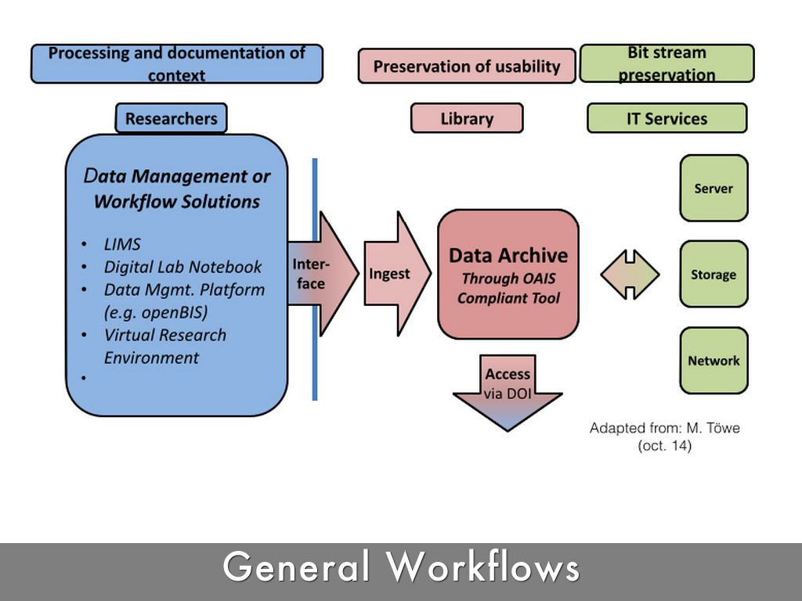

Slide 34
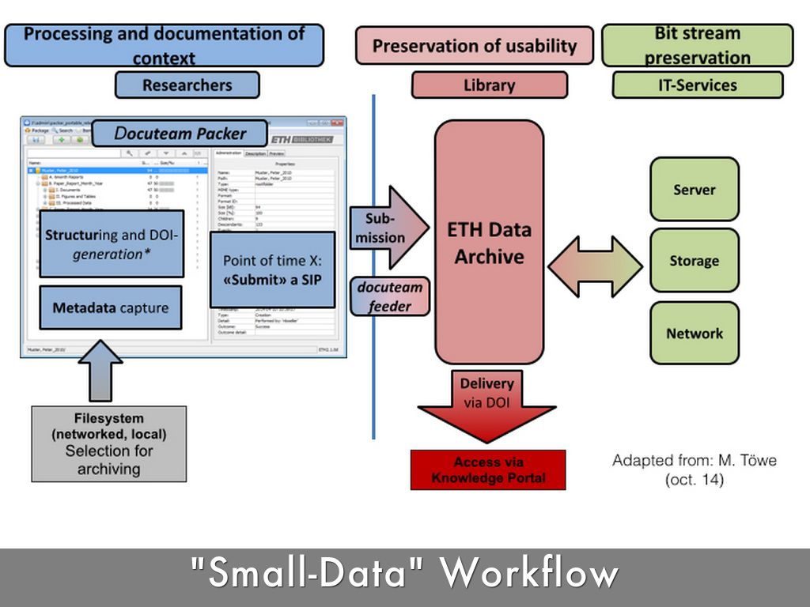

Slide 35
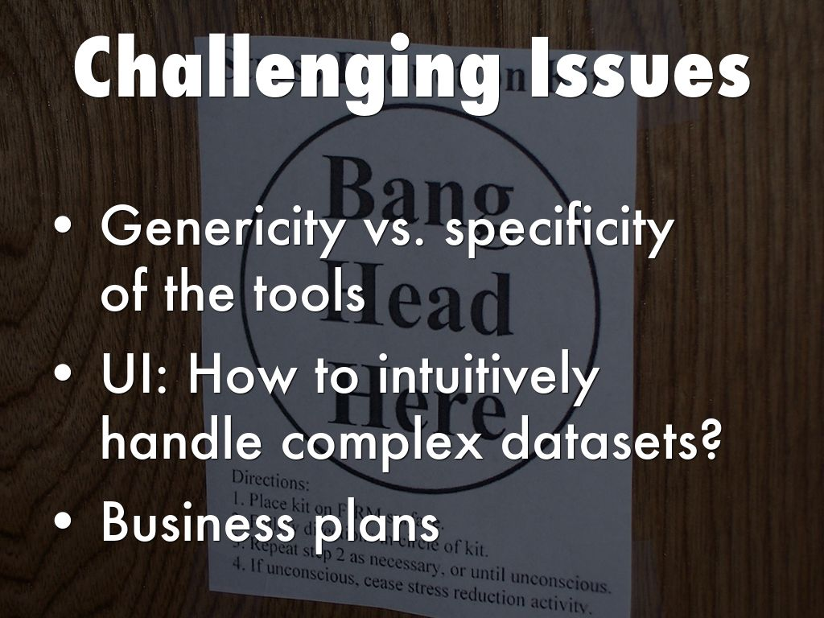
Photo by programwitch - Creative Commons Attribution-NonCommercial-ShareAlike License https://www.flickr.com/photos/56661936@N00
Created with Haiku Deck

Slide 36

Photo by JASElabs - Creative Commons Attribution-NonCommercial-ShareAlike License https://www.flickr.com/photos/8776396@N02
Created with Haiku Deck

