Slide 1
Beyond Open Access
Michael Nielsen
OAI9, June 2015
http://michaelnielsen.org/ @michael_nielsen
Notes:
Thankyou all very much for coming along this morning.
My talk today is about open science and how it can be used to accelerate scientific discovery.
To explain what I mean by open science, let me start with an example.

Slide 2
Open Access to what,
exactly?

Slide 3
digital versions of traditional
journal articles

Slide 4
(maybe updated with
hyperlinks and DOIs and
a few other elements)

Slide 5
Open Access to traditional
journal articles would be a
tremendous achievement

Slide 6
fall far short of what is possible

Slide 7
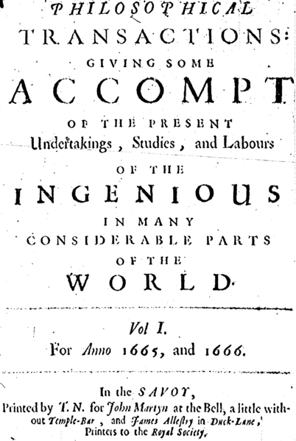

opportunity isn’t just to
digitize paper

Slide 8
new media forms

Slide 9
radically different to

Slide 10
going far beyond

Slide 11
traditional journal articles

Slide 12
amplify our individual and
collective intelligence

Slide 13
What would such
media forms look like?

Slide 14
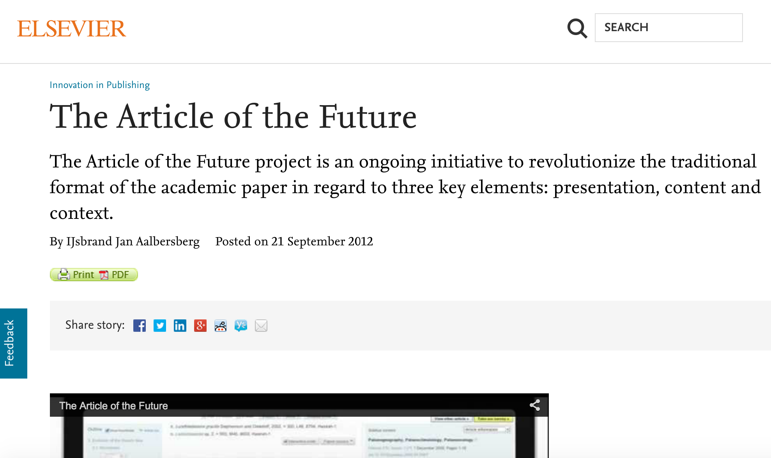
look further afield

Slide 15
experiments that scientists are doing

Slide 16
most creative designers in other fields

Slide 17
Some of the examples I
show will likely be familiar

Slide 18
the point is to look at even familiar
examples through an unusual lens,
that of media theorist and designer

Slide 19
to identify powerful design patterns
that lets us do things traditional
media can’t do

Slide 20
What I won’t do:
look at a lot of the usual suspects:
open data, online collaboration,
reproducibility, open peer review,
etc

Slide 21
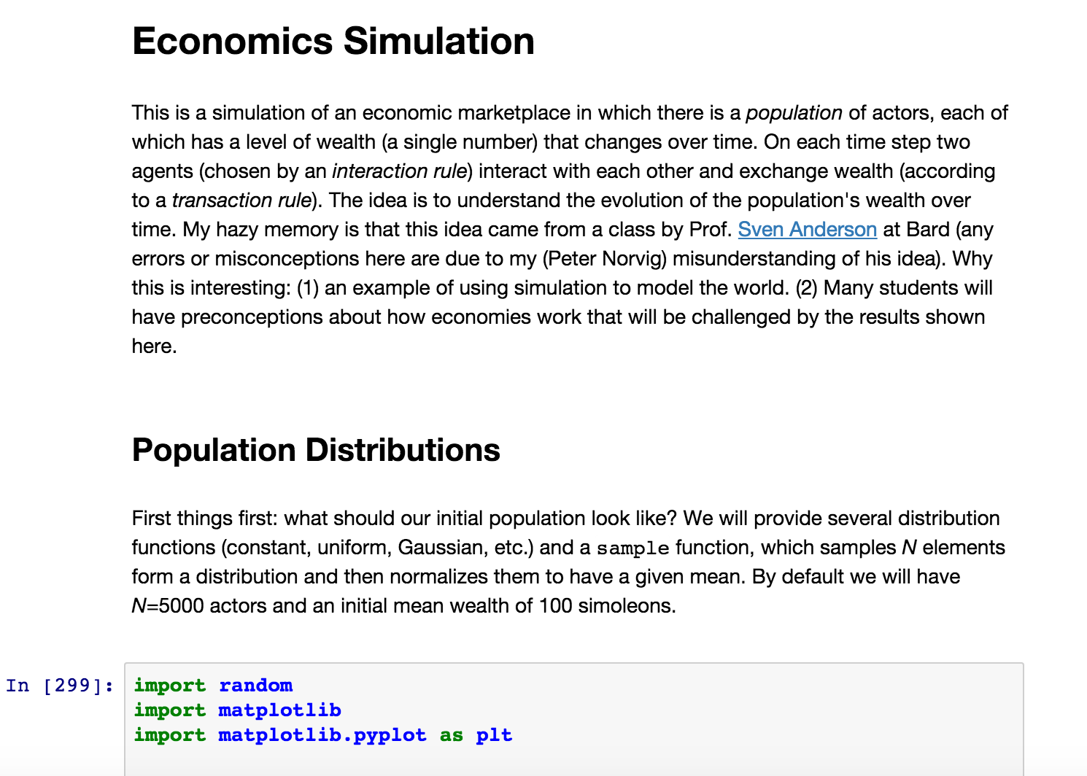
example from Peter Norvig (Google)

Slide 22
interactive essay about economics

Slide 23
explore how the distribution of wealth
changes over time

Slide 24
challenge preconceptions
about economics

Slide 25
iPython notebook

Slide 26
essay format which mixes exposition
with (live, editable) Python code

Slide 27
you don’t need to understand
details of Python or economics!

Slide 28
point is the media form

Slide 29
probably many of you have seen
iPython notebooks before

Slide 30
often touted for reproducibility
or open code

Slide 31
focus on something different:

Slide 32
iPython notebooks as a powerful
new media form

Slide 33
enables the reader to easily perform
formerly difficult cognitive tasks

Slide 34
taking a close up look at the essay

Slide 35
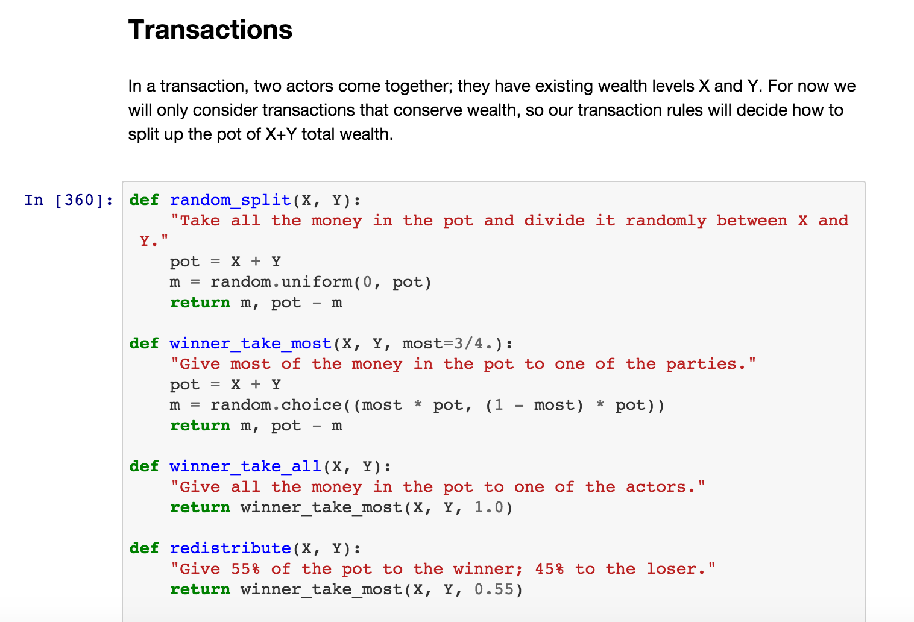
code to execute transactions between
two members of the population

Slide 36
Norvig considers several possibilities

Slide 37
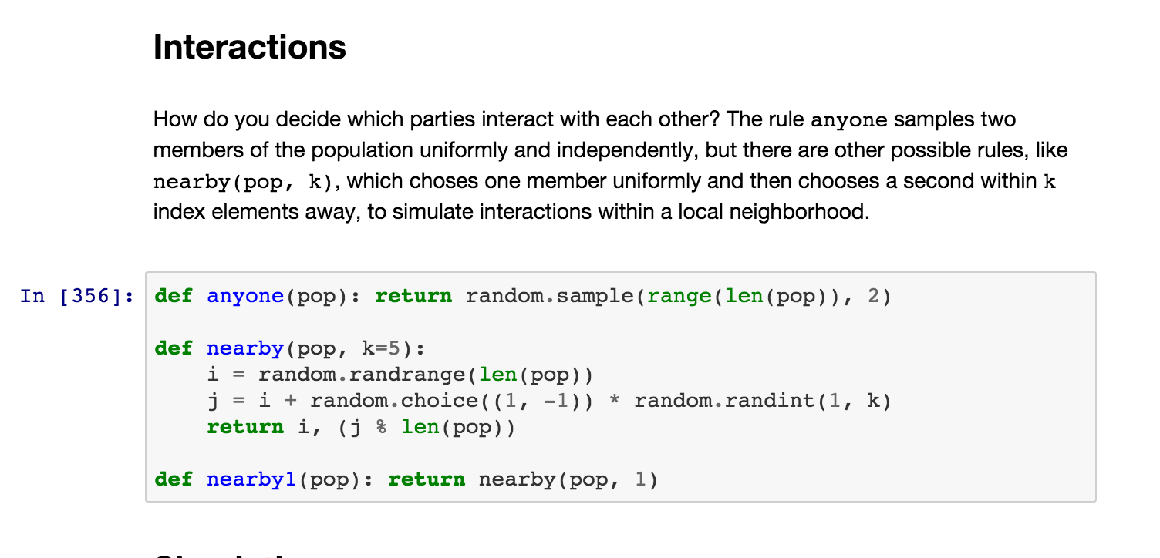
deciding which members of the
population have transactions

Slide 38
exposition
code
exposition
code
exposition
code
exposition

Slide 39
once Norvig gets the code running,
he performs simulations, running
transactions over and over again,
looking at the long-term
distribution of wealth

Slide 40
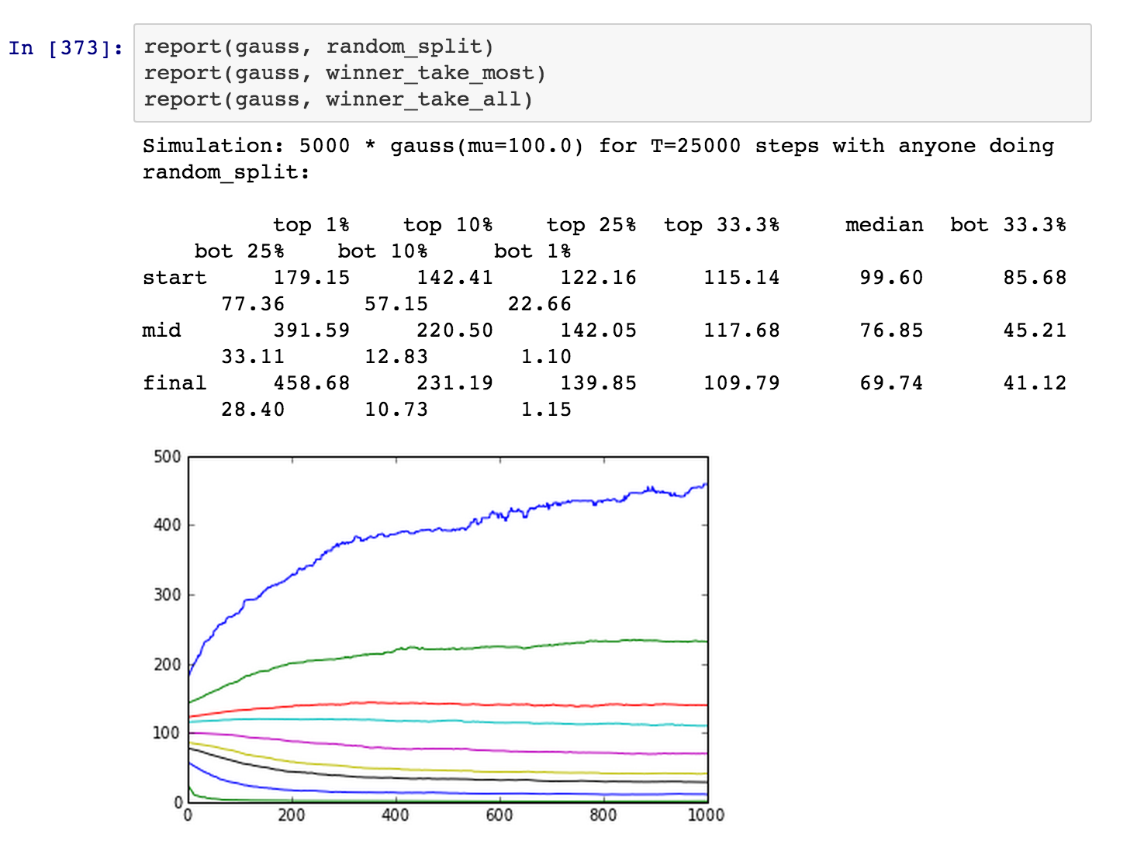
Richest 1%
Poorest 1%
(-> 1 unit)

Slide 41
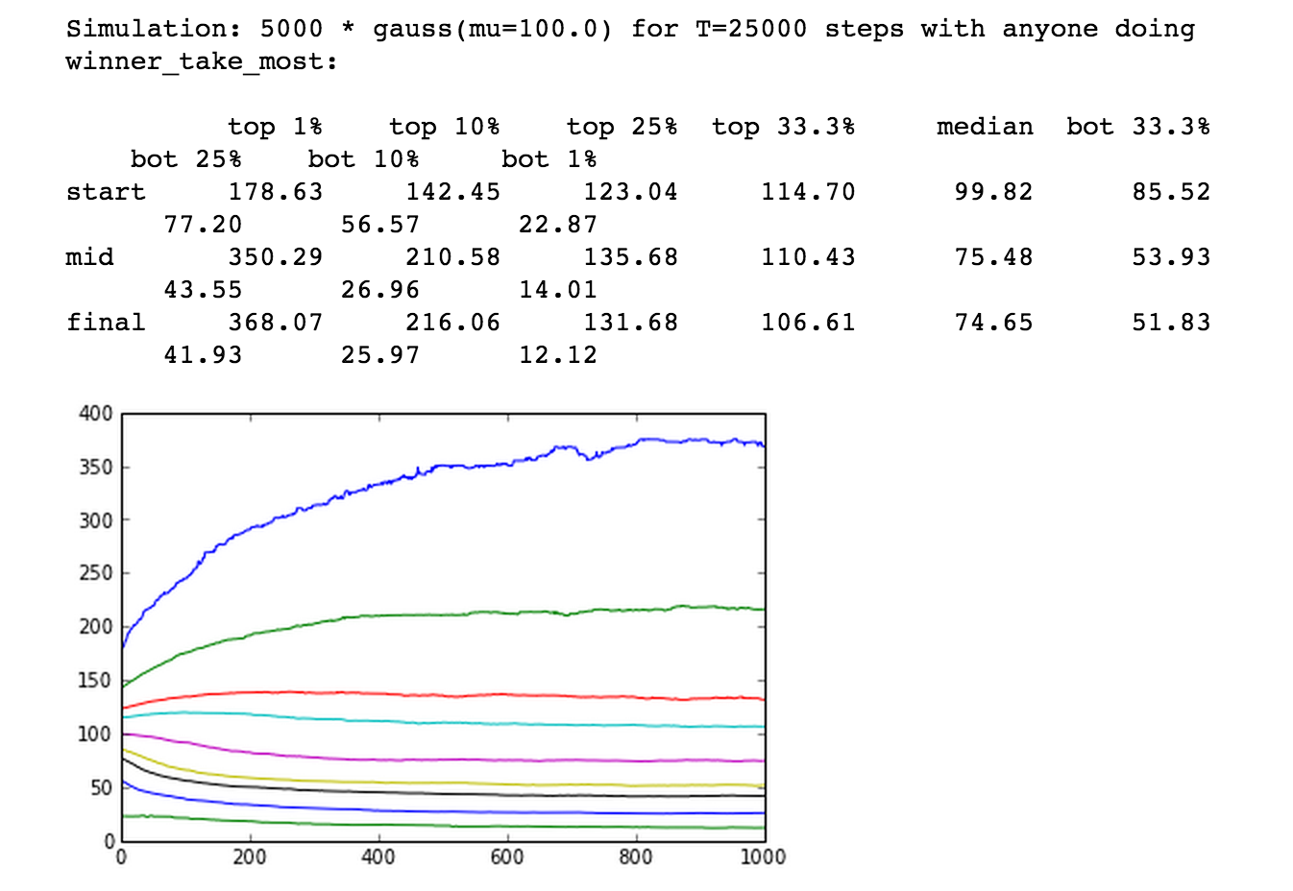
370 units
(down from 460)
12 units
(up from 1)

Slide 42
not going to get into
why this happens

Slide 43
instead: what makes iPython
notebooks interesting as
a media form?

Slide 44
imagine we used a traditional
journal format for this set of results

Slide 45
it’d contain an abstract mathematical
model, and describe the results

Slide 46
a reader would need a sophisticated
knowledge of mathematics to figure
out the consequences of even
tiny changes to the model

Slide 47
Norvig’s essay doesn’t just contain
an abstract version of the model

Slide 48
It contains an executable, live
version of the model

Slide 49
Anyone who knows a tiny bit of
programming can edit the code,
and actually change the model

Slide 50
You could, for example, change the
split and see how this affects the
final distribution of wealth

Slide 51
This can be done live, simply
by editing the notebook

Slide 52
And you can also change the
assumptions in other ways

Slide 53
notebook format dramatically
expands the range of people
who can understand and compare
these different models

Slide 54
makes this knowledge both more
explorable and more extensible

Slide 55
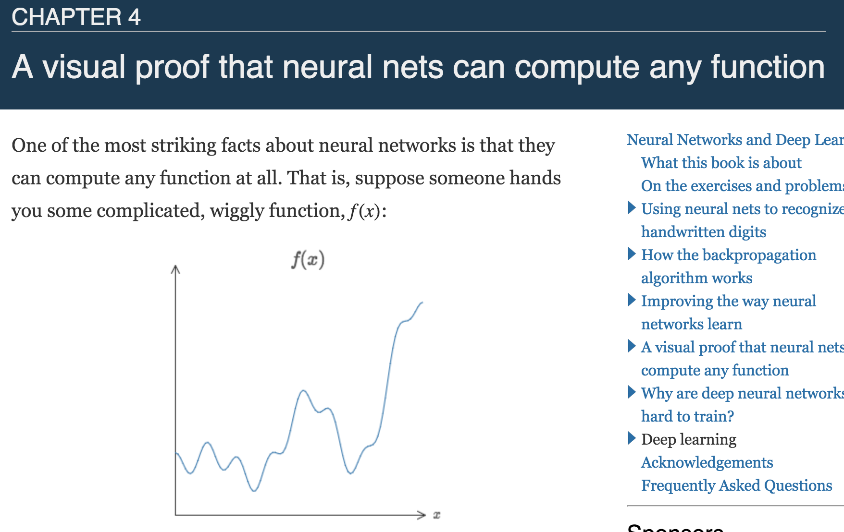
interactive visual essay
Notes:
“love to solve”, completely in the open, using his blog to post ideas and partial progress.
Whatsmore, he issued an open invitation, inviting anyone in the world who thought they had an idea to contribute to post it in the comments section of the blog.
His hope was that by combining the ideas of many minds he could make easy work of this difficult mathematical problem.

Slide 56
part of a book on neural networks & deep learning
Notes:
“love to solve”, completely in the open, using his blog to post ideas and partial progress.
Whatsmore, he issued an open invitation, inviting anyone in the world who thought they had an idea to contribute to post it in the comments section of the blog.
His hope was that by combining the ideas of many minds he could make easy work of this difficult mathematical problem.

Slide 57
don’t worry if you don’t know
anything about neural networks
Notes:
“love to solve”, completely in the open, using his blog to post ideas and partial progress.
Whatsmore, he issued an open invitation, inviting anyone in the world who thought they had an idea to contribute to post it in the comments section of the blog.
His hope was that by combining the ideas of many minds he could make easy work of this difficult mathematical problem.

Slide 58
examine this as a medium
Notes:
“love to solve”, completely in the open, using his blog to post ideas and partial progress.
Whatsmore, he issued an open invitation, inviting anyone in the world who thought they had an idea to contribute to post it in the comments section of the blog.
His hope was that by combining the ideas of many minds he could make easy work of this difficult mathematical problem.

Slide 59
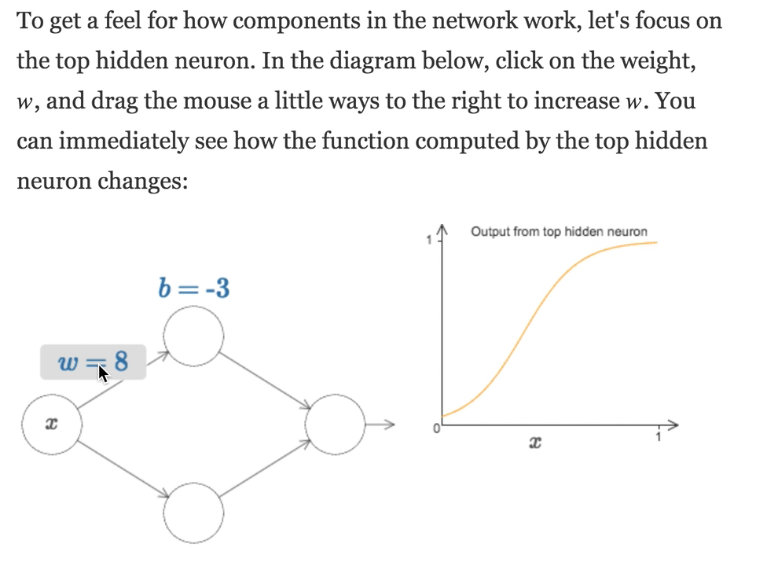
bias
weight
simple artificial neural network (on left)
Notes:
“love to solve”, completely in the open, using his blog to post ideas and partial progress.
Whatsmore, he issued an open invitation, inviting anyone in the world who thought they had an idea to contribute to post it in the comments section of the blog.
His hope was that by combining the ideas of many minds he could make easy work of this difficult mathematical problem.

Slide 60
ask reader to experiment with
changing weights and biases
Notes:
“love to solve”, completely in the open, using his blog to post ideas and partial progress.
Whatsmore, he issued an open invitation, inviting anyone in the world who thought they had an idea to contribute to post it in the comments section of the blog.
His hope was that by combining the ideas of many minds he could make easy work of this difficult mathematical problem.

Slide 61
take the reader through several exercises
Notes:
“love to solve”, completely in the open, using his blog to post ideas and partial progress.
Whatsmore, he issued an open invitation, inviting anyone in the world who thought they had an idea to contribute to post it in the comments section of the blog.
His hope was that by combining the ideas of many minds he could make easy work of this difficult mathematical problem.

Slide 62
asking them to vary weights and biases
to get desired output signal
Notes:
“love to solve”, completely in the open, using his blog to post ideas and partial progress.
Whatsmore, he issued an open invitation, inviting anyone in the world who thought they had an idea to contribute to post it in the comments section of the blog.
His hope was that by combining the ideas of many minds he could make easy work of this difficult mathematical problem.

Slide 63
won’t go through details
Notes:
“love to solve”, completely in the open, using his blog to post ideas and partial progress.
Whatsmore, he issued an open invitation, inviting anyone in the world who thought they had an idea to contribute to post it in the comments section of the blog.
His hope was that by combining the ideas of many minds he could make easy work of this difficult mathematical problem.

Slide 64
by going through this, readers can build up
intuition for what’s going on in the network
Notes:
“love to solve”, completely in the open, using his blog to post ideas and partial progress.
Whatsmore, he issued an open invitation, inviting anyone in the world who thought they had an idea to contribute to post it in the comments section of the blog.
His hope was that by combining the ideas of many minds he could make easy work of this difficult mathematical problem.

Slide 65
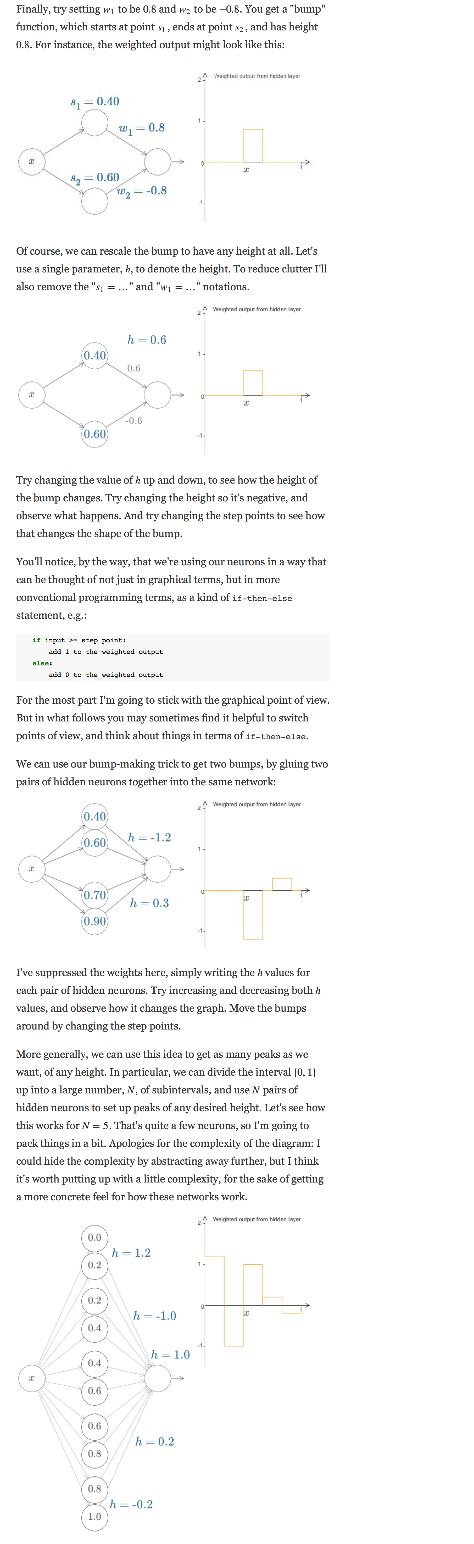
exposition
neural network
exposition
slightly more complex neural network
and so on
gradually learn more and more
complex things we can do with
a neural network
essay proceeds back and forth
Notes:
“love to solve”, completely in the open, using his blog to post ideas and partial progress.
Whatsmore, he issued an open invitation, inviting anyone in the world who thought they had an idea to contribute to post it in the comments section of the blog.
His hope was that by combining the ideas of many minds he could make easy work of this difficult mathematical problem.

Slide 66
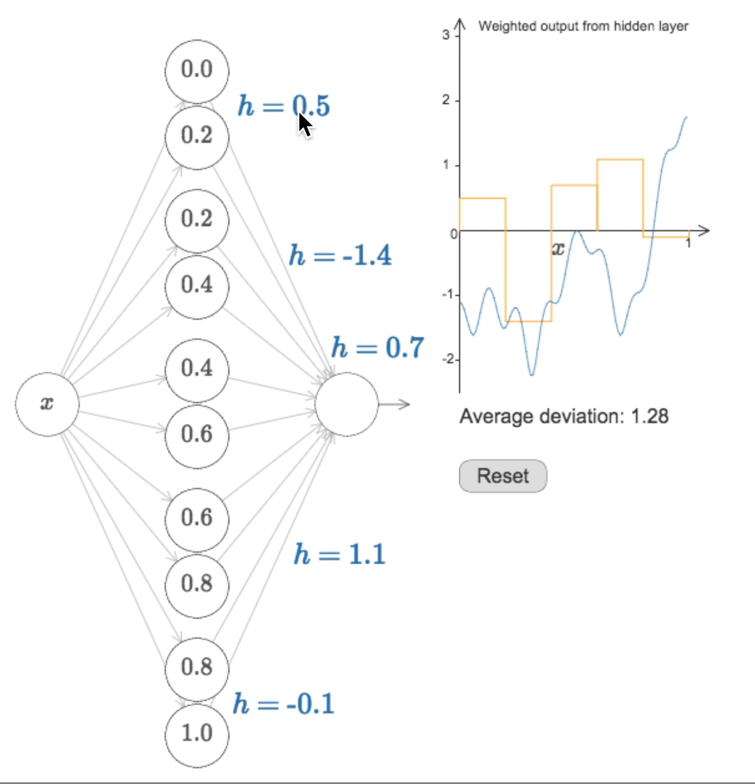
eventually, I ask readers to change parameters
of network to compute some desired function
Notes:
“love to solve”, completely in the open, using his blog to post ideas and partial progress.
Whatsmore, he issued an open invitation, inviting anyone in the world who thought they had an idea to contribute to post it in the comments section of the blog.
His hope was that by combining the ideas of many minds he could make easy work of this difficult mathematical problem.

Slide 67
abstracting away, there’s a dialogue
back and forth between
discussions of an abstract
mathematical model, and concrete,
explorable versions of the model,
which the reader can play with
to achieve some goal

Slide 68
early models are very simple
Notes:
“love to solve”, completely in the open, using his blog to post ideas and partial progress.
Whatsmore, he issued an open invitation, inviting anyone in the world who thought they had an idea to contribute to post it in the comments section of the blog.
His hope was that by combining the ideas of many minds he could make easy work of this difficult mathematical problem.

Slide 69
little the reader can do
Notes:
“love to solve”, completely in the open, using his blog to post ideas and partial progress.
Whatsmore, he issued an open invitation, inviting anyone in the world who thought they had an idea to contribute to post it in the comments section of the blog.
His hope was that by combining the ideas of many minds he could make easy work of this difficult mathematical problem.

Slide 70
as the reader builds up knowledge,
the models get more complex,
and the readers get more options
to explore

Slide 71
those options add complexity and
make the reader’s life more difficult

Slide 72
Notes:
“love to solve”, completely in the open, using his blog to post ideas and partial progress.
Whatsmore, he issued an open invitation, inviting anyone in the world who thought they had an idea to contribute to post it in the comments section of the blog.
His hope was that by combining the ideas of many minds he could make easy work of this difficult mathematical problem.

Slide 73
but the reader’s understanding
has grown, and so they are able to
deal with the added complexity

Slide 74
media form:
building this dialogue between
abstract discussion and concrete,
explorable models

Slide 75
this media form looks
superficially similar to a
journal article,
but is actually essentially
different

Slide 76
also looks similar to the media form
of Norvig’s article: a dialogue
between abstract discussion and code

Slide 77
actually quite different

Slide 78
each model is
complete in itself
each code snippet is
merely part of an
overall model
build up to complexity
through a series of models,
each complete in itself
build up to complexity
by looking closely at all
the constituent parts
Notes:
“love to solve”, completely in the open, using his blog to post ideas and partial progress.
Whatsmore, he issued an open invitation, inviting anyone in the world who thought they had an idea to contribute to post it in the comments section of the blog.
His hope was that by combining the ideas of many minds he could make easy work of this difficult mathematical problem.

Slide 79
the media forms do different things

Slide 80
both are valuable

Slide 81
neither can be done in a
conventional journal format

Slide 82
Maybe the lesson is that we should
be adding interactivity?
Notes:
“love to solve”, completely in the open, using his blog to post ideas and partial progress.
Whatsmore, he issued an open invitation, inviting anyone in the world who thought they had an idea to contribute to post it in the comments section of the blog.
His hope was that by combining the ideas of many minds he could make easy work of this difficult mathematical problem.

Slide 83
That analysis is too shallow
Notes:
“love to solve”, completely in the open, using his blog to post ideas and partial progress.
Whatsmore, he issued an open invitation, inviting anyone in the world who thought they had an idea to contribute to post it in the comments section of the blog.
His hope was that by combining the ideas of many minds he could make easy work of this difficult mathematical problem.

Slide 84
Interactivity by itself is irrelevant
Notes:
“love to solve”, completely in the open, using his blog to post ideas and partial progress.
Whatsmore, he issued an open invitation, inviting anyone in the world who thought they had an idea to contribute to post it in the comments section of the blog.
His hope was that by combining the ideas of many minds he could make easy work of this difficult mathematical problem.

Slide 85
easy to create terrible
interactive explanations
Notes:
“love to solve”, completely in the open, using his blog to post ideas and partial progress.
Whatsmore, he issued an open invitation, inviting anyone in the world who thought they had an idea to contribute to post it in the comments section of the blog.
His hope was that by combining the ideas of many minds he could make easy work of this difficult mathematical problem.

Slide 86
what matters is the details of
the media form
Notes:
“love to solve”, completely in the open, using his blog to post ideas and partial progress.
Whatsmore, he issued an open invitation, inviting anyone in the world who thought they had an idea to contribute to post it in the comments section of the blog.
His hope was that by combining the ideas of many minds he could make easy work of this difficult mathematical problem.

Slide 87
exposition
live model
exposition
more complex live model
…
dialogue back and forth
Notes:
“love to solve”, completely in the open, using his blog to post ideas and partial progress.
Whatsmore, he issued an open invitation, inviting anyone in the world who thought they had an idea to contribute to post it in the comments section of the blog.
His hope was that by combining the ideas of many minds he could make easy work of this difficult mathematical problem.

Slide 88
doesn’t require that
the reader be a
programmer
need to know just a little
mathematics
because it uses
visual, concrete
representations,
rather than Python
programs
OTOH the representations
are fixed
Notes:
“love to solve”, completely in the open, using his blog to post ideas and partial progress.
Whatsmore, he issued an open invitation, inviting anyone in the world who thought they had an idea to contribute to post it in the comments section of the blog.
His hope was that by combining the ideas of many minds he could make easy work of this difficult mathematical problem.

Slide 89
you are not limited by
what Norvig has done
you can arbitrarily modify
and extend the code
a platform for open-
ended exploration
you could, for instance,
introduce your own model
of a transaction, & play
with that, to develop insight
Notes:
“love to solve”, completely in the open, using his blog to post ideas and partial progress.
Whatsmore, he issued an open invitation, inviting anyone in the world who thought they had an idea to contribute to post it in the comments section of the blog.
His hope was that by combining the ideas of many minds he could make easy work of this difficult mathematical problem.

Slide 90
Norvig’s notebook is something
of a toy
imagine you developed it further
in the same vein
introduce more complex models,
explore the assumptions behind
them, …
eventually, your models would
reach the edge of human thought
on economics
Notes:
“love to solve”, completely in the open, using his blog to post ideas and partial progress.
Whatsmore, he issued an open invitation, inviting anyone in the world who thought they had an idea to contribute to post it in the comments section of the blog.
His hope was that by combining the ideas of many minds he could make easy work of this difficult mathematical problem.

Slide 91
someone playing with the notebook
could make modifications that would
let them explore questions no-one
had ever asked previously
and they might make new
discoveries
Notes:
“love to solve”, completely in the open, using his blog to post ideas and partial progress.
Whatsmore, he issued an open invitation, inviting anyone in the world who thought they had an idea to contribute to post it in the comments section of the blog.
His hope was that by combining the ideas of many minds he could make easy work of this difficult mathematical problem.

Slide 92
such a notebook would be a
powerful cognitive medium
a medium for people to think
and explore and make new
discoveries in
for millenia, paper and pencil has
been the most common cognitive
medium
a sufficiently good digital notebook
could reify in an active form much
of the knowledge we have about
the world
Notes:
“love to solve”, completely in the open, using his blog to post ideas and partial progress.
Whatsmore, he issued an open invitation, inviting anyone in the world who thought they had an idea to contribute to post it in the comments section of the blog.
His hope was that by combining the ideas of many minds he could make easy work of this difficult mathematical problem.

Slide 93
that knowledge would then be
composable in a way that paper
and pencil is not
that would make it far, far easier
for people to explore than in
a conventional, static form
Notes:
“love to solve”, completely in the open, using his blog to post ideas and partial progress.
Whatsmore, he issued an open invitation, inviting anyone in the world who thought they had an idea to contribute to post it in the comments section of the blog.
His hope was that by combining the ideas of many minds he could make easy work of this difficult mathematical problem.

Slide 94
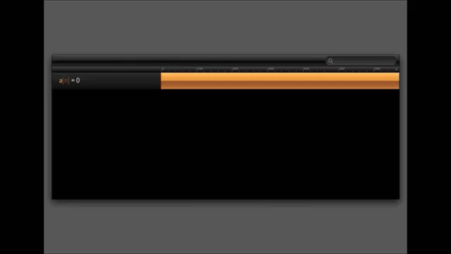
another cognitive medium,
from designer Bret Victor
Notes:
“love to solve”, completely in the open, using his blog to post ideas and partial progress.
Whatsmore, he issued an open invitation, inviting anyone in the world who thought they had an idea to contribute to post it in the comments section of the blog.
His hope was that by combining the ideas of many minds he could make easy work of this difficult mathematical problem.

Slide 95
this isn’t a journal article
Notes:
“love to solve”, completely in the open, using his blog to post ideas and partial progress.
Whatsmore, he issued an open invitation, inviting anyone in the world who thought they had an idea to contribute to post it in the comments section of the blog.
His hope was that by combining the ideas of many minds he could make easy work of this difficult mathematical problem.

Slide 96
no reason such a medium shouldn’t
be integrated with iPython notebook
Notes:
“love to solve”, completely in the open, using his blog to post ideas and partial progress.
Whatsmore, he issued an open invitation, inviting anyone in the world who thought they had an idea to contribute to post it in the comments section of the blog.
His hope was that by combining the ideas of many minds he could make easy work of this difficult mathematical problem.

Slide 97
both are media for
exploration and creation
Notes:
“love to solve”, completely in the open, using his blog to post ideas and partial progress.
Whatsmore, he issued an open invitation, inviting anyone in the world who thought they had an idea to contribute to post it in the comments section of the blog.
His hope was that by combining the ideas of many minds he could make easy work of this difficult mathematical problem.

Slide 98
both are media for
exploration and creation
Notes:
“love to solve”, completely in the open, using his blog to post ideas and partial progress.
Whatsmore, he issued an open invitation, inviting anyone in the world who thought they had an idea to contribute to post it in the comments section of the blog.
His hope was that by combining the ideas of many minds he could make easy work of this difficult mathematical problem.

Slide 99
suggest a publishing platform
which evolves toward being a
cognitive medium, integrating
all our best tools in an
environment for exploration
and discovery
Notes:
“love to solve”, completely in the open, using his blog to post ideas and partial progress.
Whatsmore, he issued an open invitation, inviting anyone in the world who thought they had an idea to contribute to post it in the comments section of the blog.
His hope was that by combining the ideas of many minds he could make easy work of this difficult mathematical problem.

Slide 100
consider more closely some
of the user interface ideas
Notes:
“love to solve”, completely in the open, using his blog to post ideas and partial progress.
Whatsmore, he issued an open invitation, inviting anyone in the world who thought they had an idea to contribute to post it in the comments section of the blog.
His hope was that by combining the ideas of many minds he could make easy work of this difficult mathematical problem.

Slide 101
the “joining trick”
Notes:
“love to solve”, completely in the open, using his blog to post ideas and partial progress.
Whatsmore, he issued an open invitation, inviting anyone in the world who thought they had an idea to contribute to post it in the comments section of the blog.
His hope was that by combining the ideas of many minds he could make easy work of this difficult mathematical problem.

Slide 102
“searching over an expression”
Notes:
“love to solve”, completely in the open, using his blog to post ideas and partial progress.
Whatsmore, he issued an open invitation, inviting anyone in the world who thought they had an idea to contribute to post it in the comments section of the blog.
His hope was that by combining the ideas of many minds he could make easy work of this difficult mathematical problem.

Slide 103
these are fundamental new operations
to do with difference equations
Notes:
“love to solve”, completely in the open, using his blog to post ideas and partial progress.
Whatsmore, he issued an open invitation, inviting anyone in the world who thought they had an idea to contribute to post it in the comments section of the blog.
His hope was that by combining the ideas of many minds he could make easy work of this difficult mathematical problem.

Slide 104
they actually expand the range
of our thinking
Notes:
“love to solve”, completely in the open, using his blog to post ideas and partial progress.
Whatsmore, he issued an open invitation, inviting anyone in the world who thought they had an idea to contribute to post it in the comments section of the blog.
His hope was that by combining the ideas of many minds he could make easy work of this difficult mathematical problem.

Slide 105
they’re new atoms of cognition
Notes:
“love to solve”, completely in the open, using his blog to post ideas and partial progress.
Whatsmore, he issued an open invitation, inviting anyone in the world who thought they had an idea to contribute to post it in the comments section of the blog.
His hope was that by combining the ideas of many minds he could make easy work of this difficult mathematical problem.

Slide 106
maybe cognitive media will stimulate
the invention of many new
atoms of cognition
Notes:
“love to solve”, completely in the open, using his blog to post ideas and partial progress.
Whatsmore, he issued an open invitation, inviting anyone in the world who thought they had an idea to contribute to post it in the comments section of the blog.
His hope was that by combining the ideas of many minds he could make easy work of this difficult mathematical problem.

Slide 107
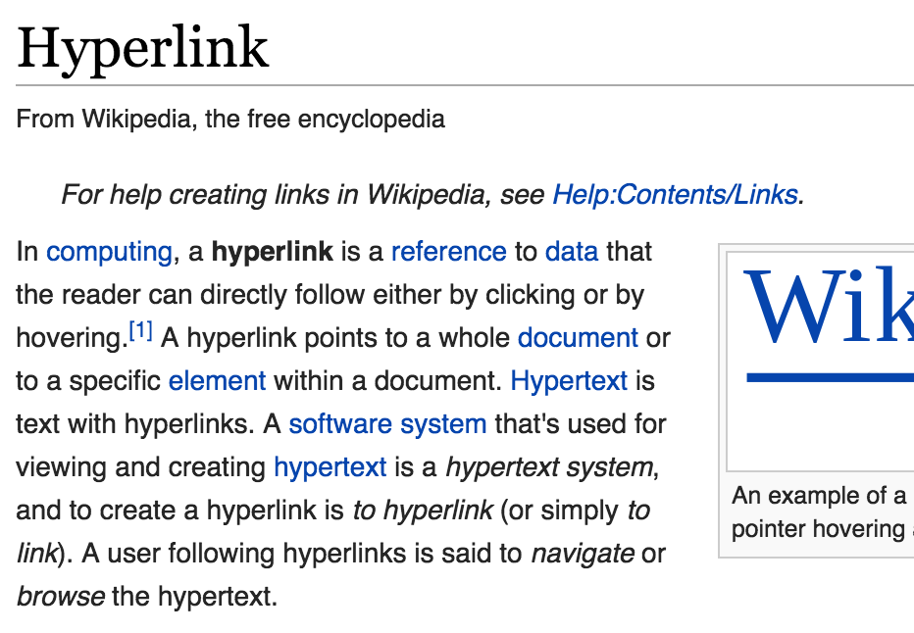
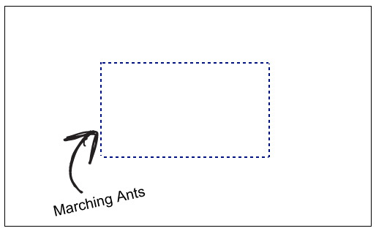

Notes:
“love to solve”, completely in the open, using his blog to post ideas and partial progress.
Whatsmore, he issued an open invitation, inviting anyone in the world who thought they had an idea to contribute to post it in the comments section of the blog.
His hope was that by combining the ideas of many minds he could make easy work of this difficult mathematical problem.

Slide 108
all these ideas had to be
invented
Notes:
“love to solve”, completely in the open, using his blog to post ideas and partial progress.
Whatsmore, he issued an open invitation, inviting anyone in the world who thought they had an idea to contribute to post it in the comments section of the blog.
His hope was that by combining the ideas of many minds he could make easy work of this difficult mathematical problem.

Slide 109
What new primitives
for thought can we invent?
Notes:
“love to solve”, completely in the open, using his blog to post ideas and partial progress.
Whatsmore, he issued an open invitation, inviting anyone in the world who thought they had an idea to contribute to post it in the comments section of the blog.
His hope was that by combining the ideas of many minds he could make easy work of this difficult mathematical problem.

Slide 110
What’s all this got to do with
open access?
Open access to what?
Do repositories like the arXiv and PubMed
provide a platform for experimentation with
more powerful media forms?
How should open access policies be crafted
to ensure we don't inhibit innovation by
constraining experimentation?
How can we ensure wild experimentation with
new media forms?
Notes:
“love to solve”, completely in the open, using his blog to post ideas and partial progress.
Whatsmore, he issued an open invitation, inviting anyone in the world who thought they had an idea to contribute to post it in the comments section of the blog.
His hope was that by combining the ideas of many minds he could make easy work of this difficult mathematical problem.

Slide 111
Thankyou
http://michaelnielsen.org/
@michael_nielsen

Slide 112
Notes:
“love to solve”, completely in the open, using his blog to post ideas and partial progress.
Whatsmore, he issued an open invitation, inviting anyone in the world who thought they had an idea to contribute to post it in the comments section of the blog.
His hope was that by combining the ideas of many minds he could make easy work of this difficult mathematical problem.

