Slide 1


Institution as Publisher: Getting started
OAI9 tutorial, 19 June 2015, Geneva
Eelco Fewerda, Director, OAPEN;
Jaimee Biggins, Managing Editor, UCL Press;
Ronald Snijder, Technical Coordinator, OAPEN

Slide 2
Institution as Publisher: Getting started
Agenda
Overview of Library publishing landscape - Eelco
Financial models – Eelco
Business plans – Jaimee
Workflow, including peer review – Jaimee
Technical infrastructure – Ronald
Engaging with researchers, editorial boards – Jaimee
Case studies:
  UCL + Liverpool – Jaimee
  Stockholm UP – Eelco

Slide 3
Institution as publisher 1
Overview of Library publishing landscape
Eelco Ferwerda, OAPEN

Slide 4

Overview of Library Publishing landscape
124 Library publishers listed in the Library Publishing Directory (only 13 outside North America)
Partnerships with stakeholders
within campus (91%)
Emphasis on skill set of librarians
OA business models:
  predominantly supported by library budget
  strong focus on Open Access
  only 10% charge APC’s

Slide 5
Types of publications
Journals
  faculty driven 75%; student research 71% - mostly OA
  off campus, under contract 50% - 57% OA
Monographs - 57%
Textbooks – 47%
Other: reports, conference proceedings, theses

Slide 6
Services: most common
Metadata support
Author copyright advisory
Digitisation
Training
Hosting supplemental content
Analytics
DOI assignment
ISSN registry
Audio/video streaming
Marketing
Graphic design
+ Support and maintenance of publishing platform (OJS, bepress, Dspace etc.)

Slide 7
Services: less common
Dataset management
Peer review management
Contract/license preparation
ISBN registry
Copyediting
Notification of A&I sources
PoD
Typesetting
Compiling indexes/TOC’s
Etc.

Slide 8
Services: core publishing services (1)
Metadata support
Author copyright advisory
Digitisation
Training
Hosting supplemental content
Analytics
DOI assignment
ISSN registry
Audio/video streaming
Marketing
Graphic design
+ Support and maintenance of publishing platform (OJS, bepress, Dspace etc.)

Slide 9
Services: core publishing services (2)
Dataset management
Peer review management
Contract/license preparation
ISBN registry
Copyediting
Notification of A&I sources
PoD
Typesetting
Compiling indexes/TOC’s
Etc.

Slide 10
Motives
General:
a. Supporting faculty in their teaching and research
  Supporting and improving scholarly communication for the university is a logical role:
    Universities are very much involved in scholarly publishing, they are the primary producers and consumers of scholarly publications,
    University staff are involved as researcher and author, as reviewer, they have a role securing funding and rights, they source images, clear permissions etc.
Advances in technology enable libraries to become publishers
  the internet, e-readers, open source publishing platforms, self publishing channels, etc
  new, OA business models

Slide 11
Motives
For textbooks:
  Lower costs for students, improve access
  Support remote learning
For monographs:
  Improve access and usage of monographs
  Provide publishing outlet for academics (early career researchers)

Slide 12
Challenges
Developing in-house knowledge and expertise
Achieving a sustainable and scalable approach
Competing against brand and prestige of established publishers

Slide 13
Overview of Library Publishing landscape
References
Library Publishing directory: http://www.librarypublishing.org/resources/directory
Jisc e-textbook project: https://www.jisc-collections.ac.uk/Institution-as-E-textbook-Publisher/

Slide 14
Institution as publisher 2
Financial Models
Eelco Ferwerda, OAPEN

Slide 15
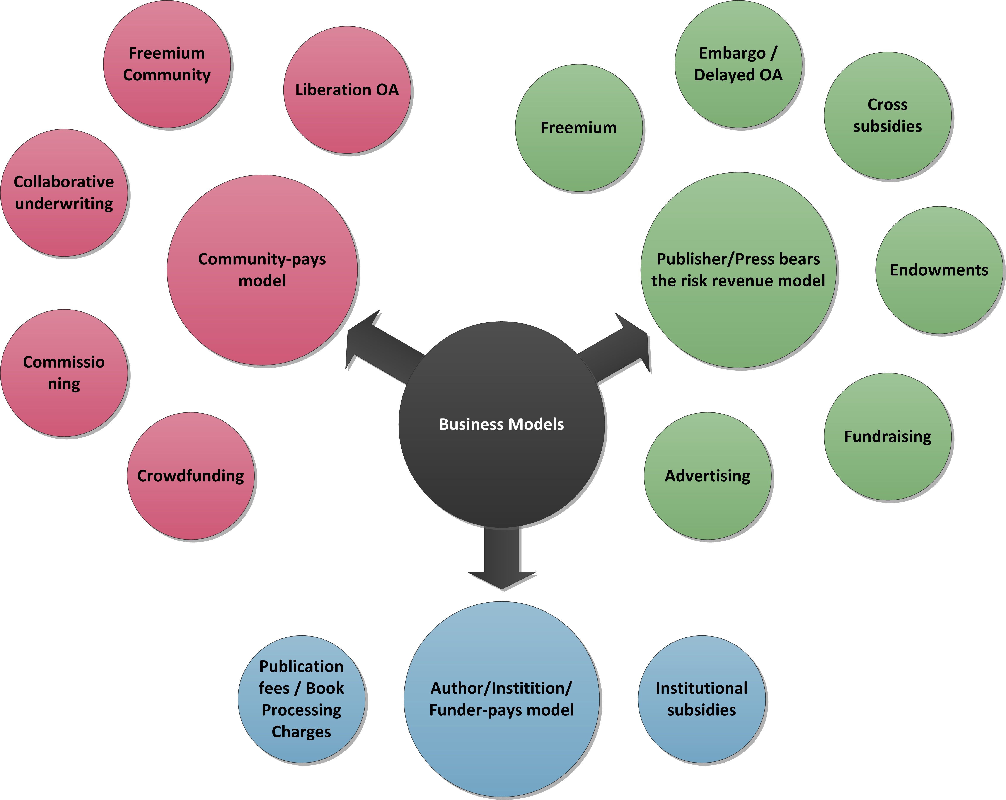
Business models for OA books

Slide 16
Business models for OA books

Slide 17
Business models for OA books
Hybrid or dual edition publishing
Author side publication fee
Institutional support
Library side models

Slide 18
Business models for OA books
Hybrid or dual edition publishing
  OA edition + sold edition (print, PoD, e-book)
  Almost all OA publishers
  Primary model for some: OECD Freemium

Slide 19
Business models for OA books
Hybrid or dual edition publishing
Author side publication fee
  BPC - ‘APC for books’
  Commercial publishers: Palgrave Macmillan, Brill, De Gruyter, Springer
  Funders: FWF, NWO, WT, SNSF
  Universities: UCL, Lund, California

Slide 20
Business models for OA books
Hybrid or dual edition publishing
Author side publication fee
Institutional support
  Grants, subsidies, press embedded in library, press sharing university infrastructure
  University Presses (outside UK) and Library Publishers
  Mpublishing, Athabasca UP, ANU press, Göttingen UP, Leiden UP

Slide 21
Business models for OA books
Hybrid or dual edition publishing
Author side publication fee
Institutional support
Library side models
  Based on Library acquisition budget
  Knowledge Unlatched, OpenEdition, Open Library of Humanities

Slide 22
Institutional support
Library Publishing Coalition:
  95% focus on Open Access
  90% are funded by their library
  on average almost 90% of budget

Slide 23
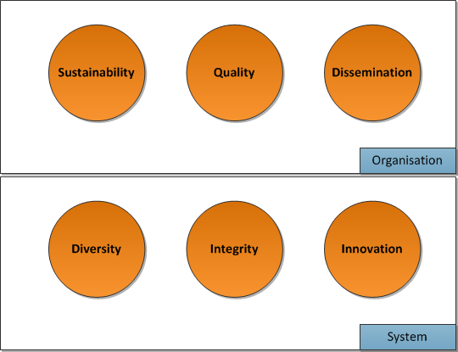
Aspects of models

Slide 24
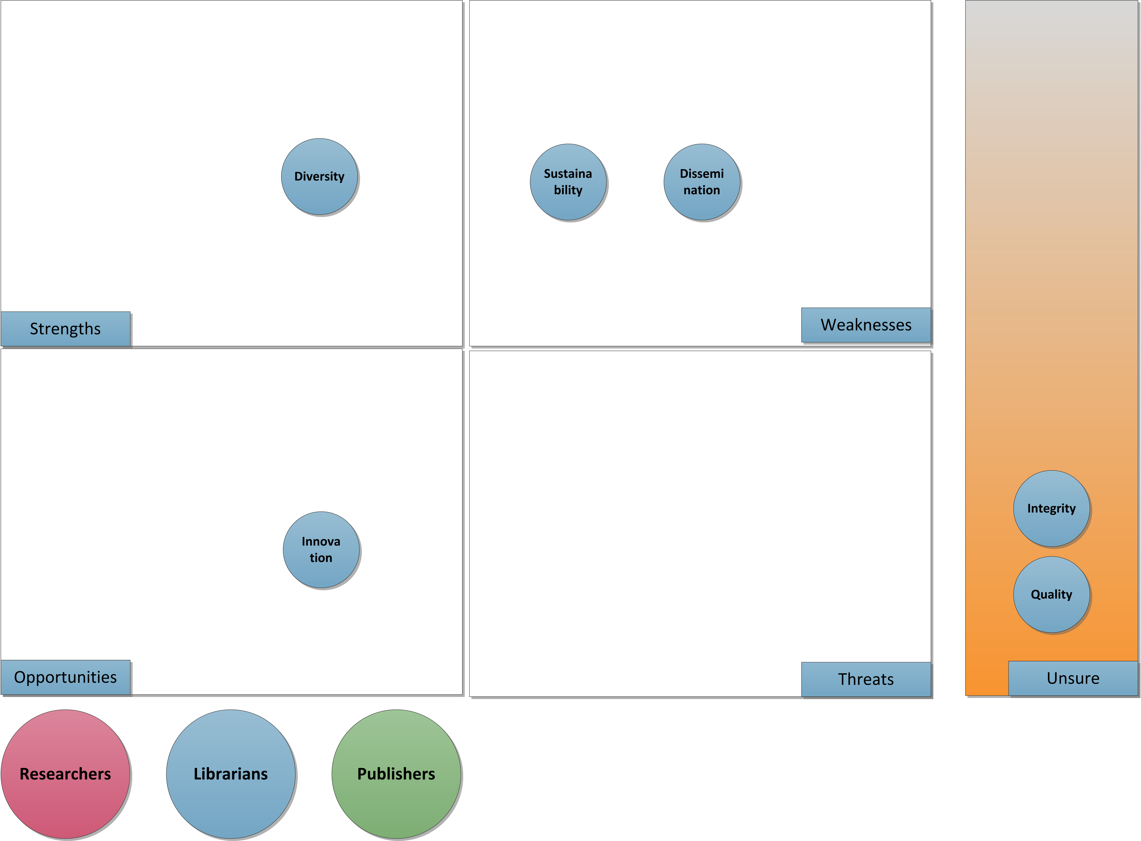
SWOT analysis for Institutional support (1)

Slide 25
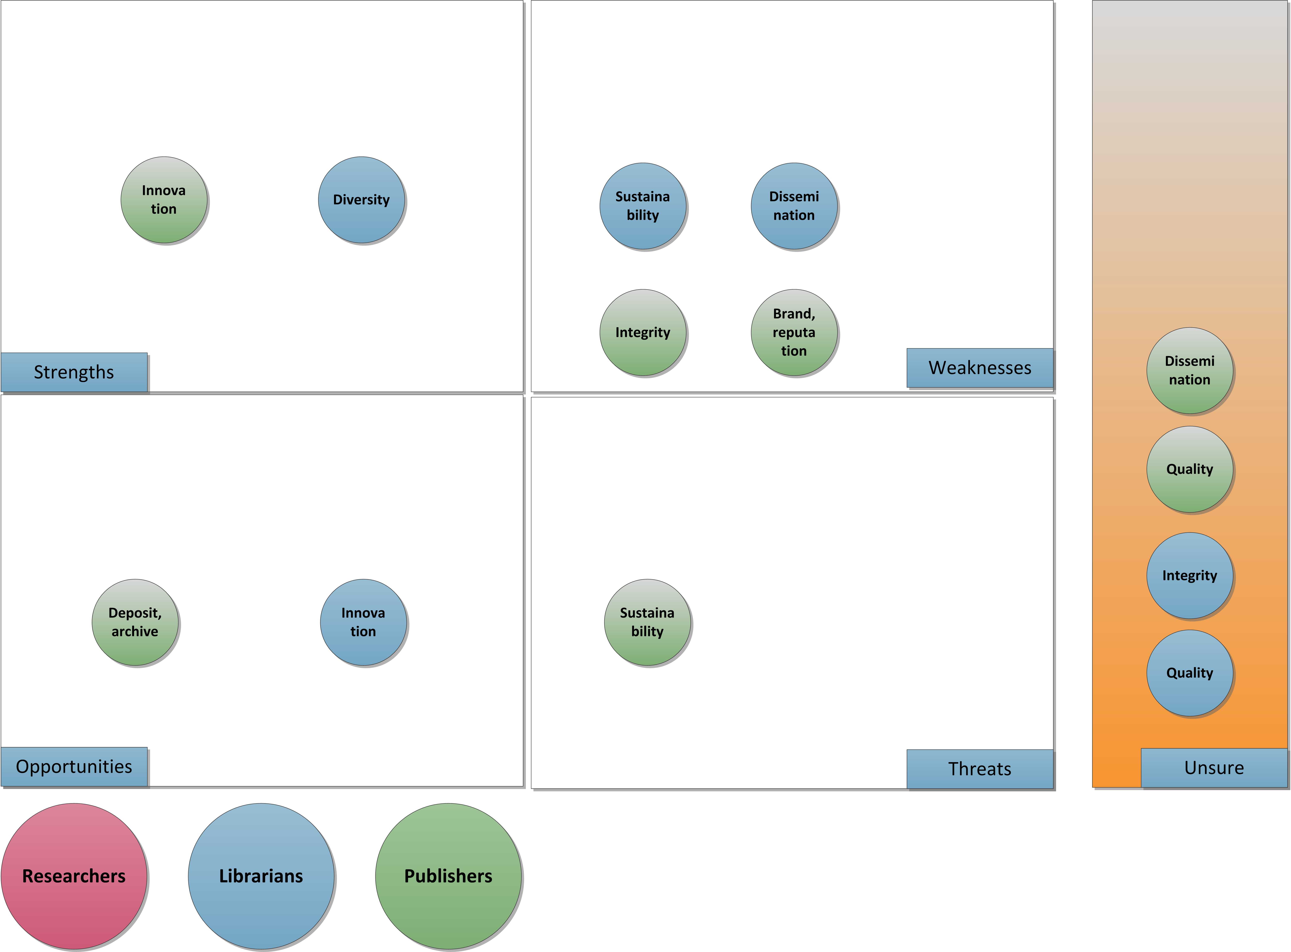
SWOT analysis for Institutional support (2)

Slide 26
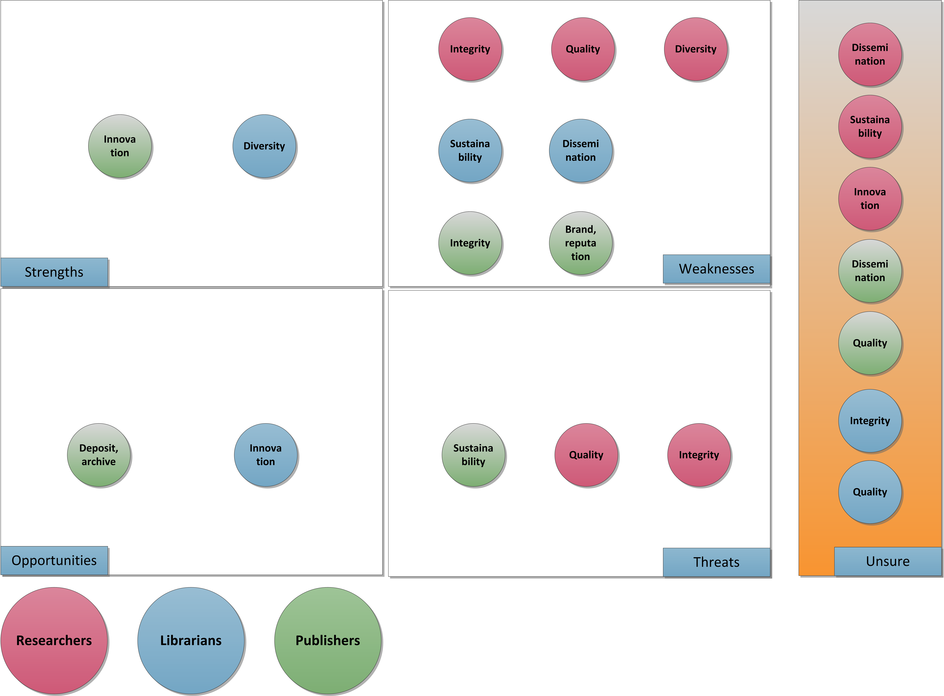
SWOT analysis for Institutional support (3)

Slide 27
Library side models
Libraries can make a difference for OA, especially in HSS:
Libraries have been the driving force of the OA movement
Opportunity to support the transition to OA
Start shifting acquisitions budget from closed to open models
Working together would have huge impact!

Slide 28
OA business models in HSS
HSS has less access to research funding
Less central funding for ‘Gold OA’, through OA publication funds
  HSS needs new models to achieve Gold OA
Importance of Library side models
  Based on libraries’ existing acquisitions budget
  Three examples

Slide 29
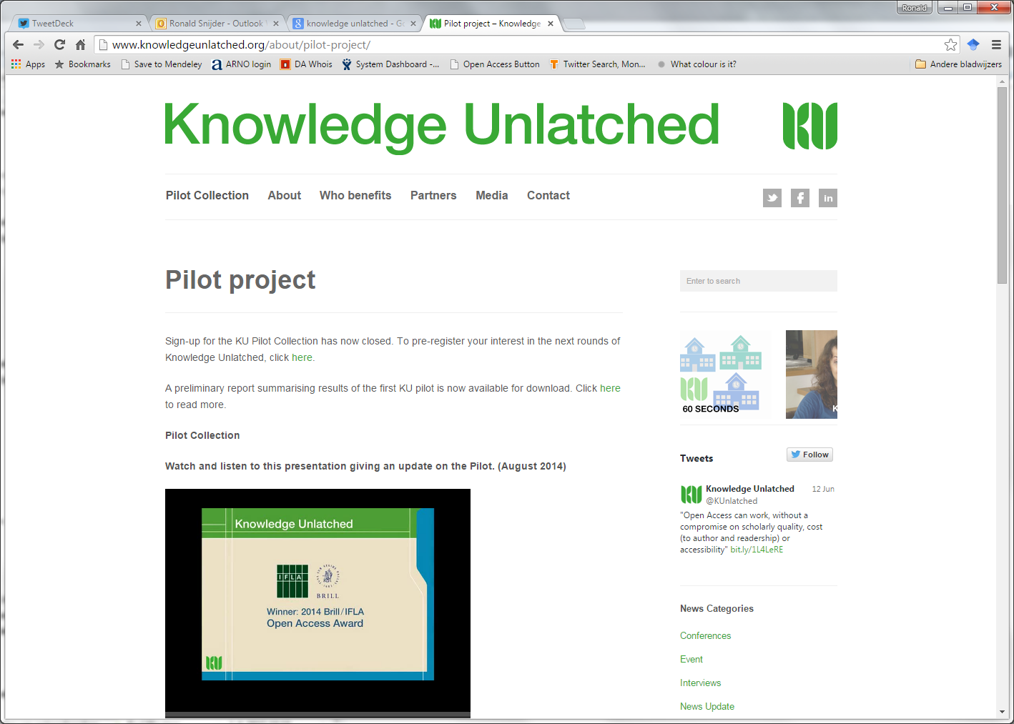

Slide 30

Knowledge Unlatched
Libraries ‘purchase’ OA books:
Libraries form a global consortium
Use their existing acquisitions budget
Select individually, purchase collectively
Price based on fixed or ‘first digital copy’ costs
Libraries receive value-added edition
Monographs are then published Open Access
  First pilot in 2014
  13 publishers, 28 books
  Second round announced
http://www.knowledgeunlatched.org/

Slide 31
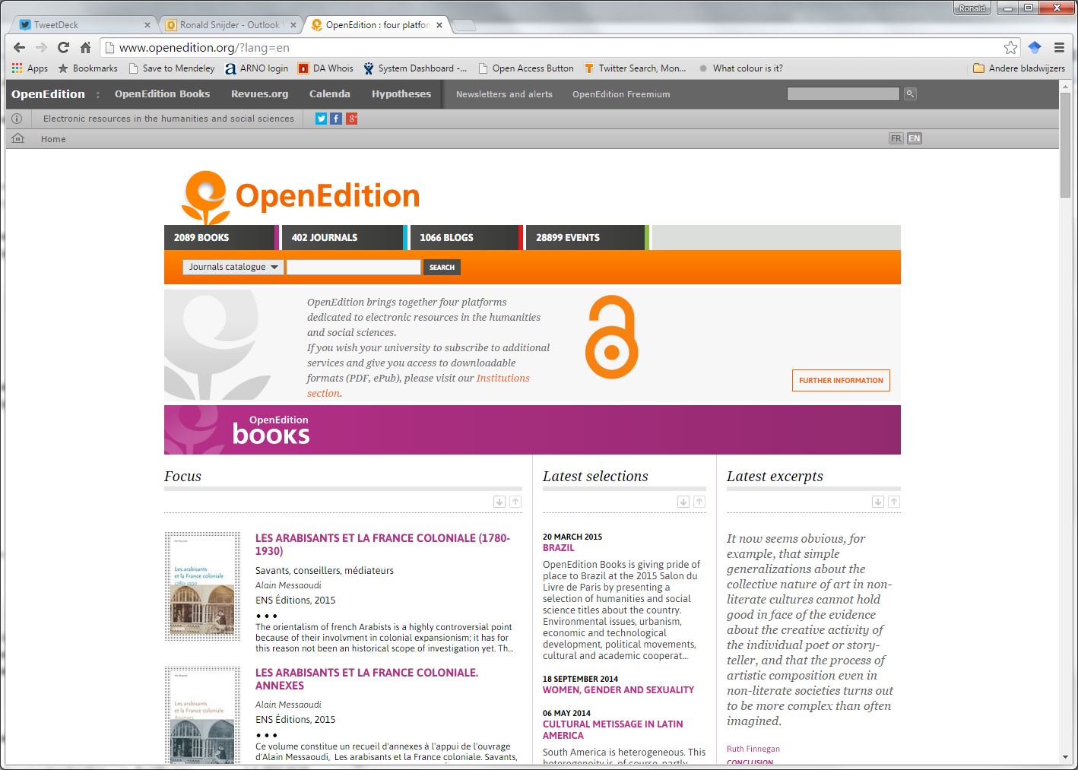

Slide 32

OpenEdition
Libraries license OA content:
OpenEdition Freemium
Free content online (HTML)
Premium content (PDF, e-reader formats) and services for libraries
Revenues split ⅓-⅔ between OpenEdition and publishers
Intended to:
  make OA content discoverable
  provide a business model for OA content
  help sustain platform
http://www.openedition.org

Slide 33
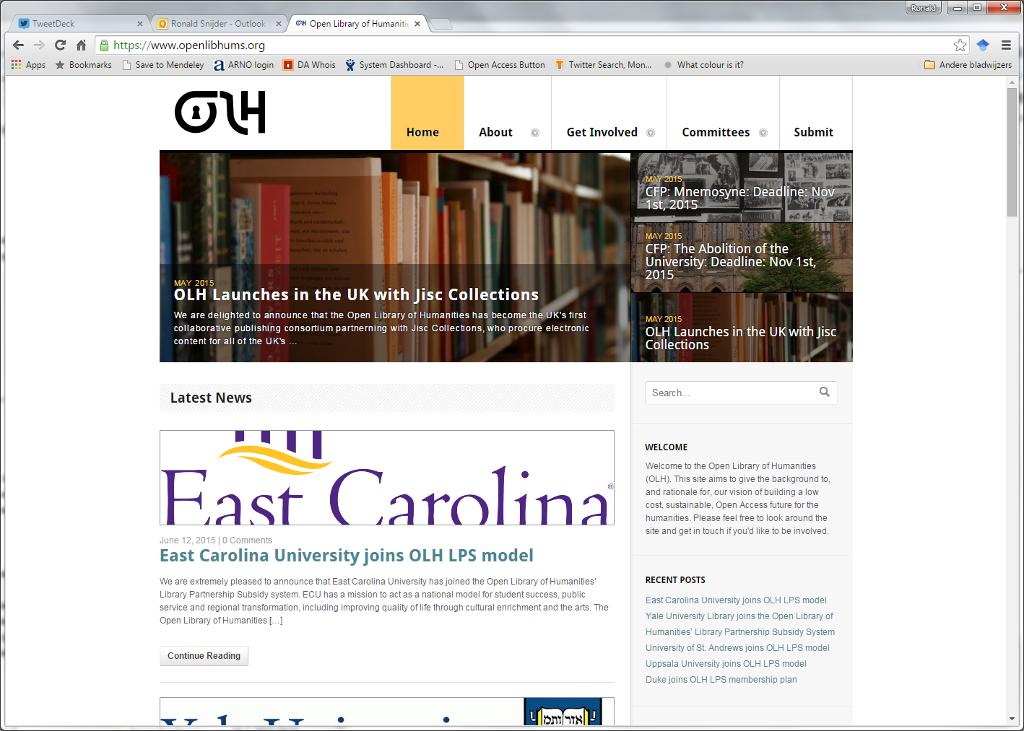

Slide 34

Open Library of Humanities
Libraries ‘subscribe’ to OA journal:
OLH: ‘mega journal’ for HSS
  Inspired by PLOS ONE
  Initiative of Martin Eve & Caroline Edwards
  Expected to launch August/September
  Different business model:
    Library Partnership Subsidy
  ‘Subscription’ model:
    Many libraries → low subsidies!
https://www.openlibhums.org/

Slide 35
Financial Models
References
OAPEN-UK - An overview of business models: http://oapen-uk.jiscebooks.org/research-findings/swot/bmoverview/
HEFCE report – Economic analysis of business models for Open Access monographs: http://www.hefce.ac.uk/media/hefce/content/pubs/indirreports/2015/Monographs,and,open,access/2014_monographs4.pdf
Open Access in Humanities and Social Sciences: http://www.slideshare.net/EelcoFerwerda/oa-in-hss-munin-conference-nov-2013-updated?related=1

Slide 36
Institution as publisher 3
Business Plans
Jaimee Biggins, UCL Press

Slide 37
Business Plans Part 1: Key questions
Purpose of publishing?
Is there academic need?
Institution vision and support?
What will you publish?
How will you attract authors?
Genres?
Subject areas?
Quantity?
Publishing model?
Funding?
Skills in house?
What is your unique offer?

Slide 38
Business Plans: Part 2 – Practicalities
General | Publishing
Staff and Skills | Commissioning strategies
Costs Staff, sales and marketing, infrastructure, capital | Costs Editorial and production
Sales and Marketing strategies | Income: print and ebook sales
Risk Evaluation | Book Publication charges
Service to authors | Governance – boards needed
Infrastructure | Peer review policy
Operations | Platform to deliver OA
Three-year plan | Traditional sales channels for print

Slide 39
Institution as publisher 4
Workflow
Jaimee Biggins, UCL Press

Slide 40
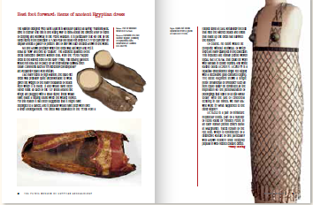
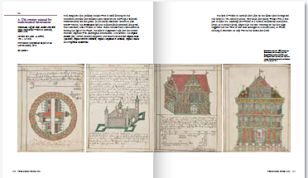
The Production Process
Peer review
Copy-editing
Typesetting
First proofs
Indexing
Revised proofs
Print or digital
Publication

Slide 41
Peer review
Submission of book proposal
Reviewed at Editorial Board
Peer review proposal and sample chapters
Editorial Board reviews peer reviews
Author revises in line with comments
Offer contract
Peer review complete manuscript

Slide 42



Print and digital output
Printing – traditional print and PoD
Open Access PDF on UCL Discovery
Conversion into ebook, epub, mobi

Slide 43
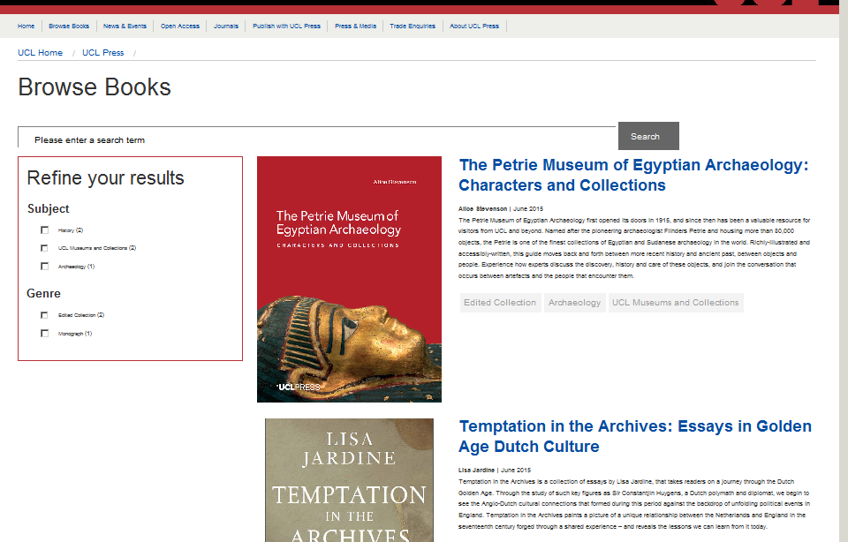



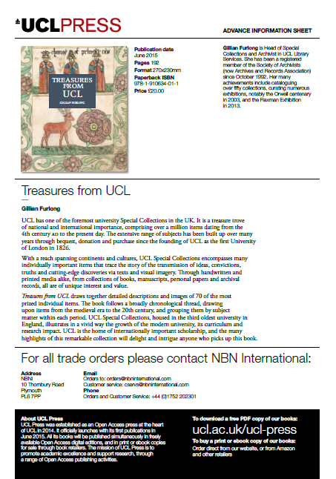

Marketing and Sales
New Pub Catalogue
Website
Twitter

Slide 44
Internal Publishing Functions
Editorial board
Commissioning editors
Desk editors & Production editors
Marketing
Sales
Journals manager
Digital manager – platforms and digital production

Slide 45
External Publishing Functions
Copy
Editors
Proofreaders
Indexers
Designers
Picture Researchers
Illustrators
Typesetters
Printers
Distributors
Sales
Force
Publishing Platforms
Digital Developers

Slide 46
Workflow
References
Societies
Publishers Association (PA) http://www.publishers.org.uk/#
Society for Editors and Proofreaders (SFEP) http://www.sfep.org.uk/
Association of European University Presses (AEUP) http://www.aeup.eu/
Open Access Scholarly Publishers Association (OASPA) http://oaspa.org/
Style guides
Butcher’s Copy-editing, Judith Butcher
Chicago Manual of Style, 16th edition
New Hart’s Rules
Other
Publishing Training Centre (PTC) http://www.train4publishing.co.uk/
The Bookseller http://www.thebookseller.com/
BookBrunch http://www.bookbrunch.co.uk/
The Academic Book of the Future http://academicbookfuture.org/

Slide 47
Institution as publisher 5
Getting started with the technical details
Ronald Snijder, OAPEN

Slide 48
From monograph to platform to dissemination to…
You need to make choices on several levels:
Monograph
  Format
  License
Metadata
  Contents
  ‘Wrapper’
Platform
  Requirements
  Types
Dissemination

Slide 49
Monograph: which format?
Format | Advantage | Disadvantage
PDF | Easy to create; Based on paper monograph layout | Hard to read on small screens
HTML | Extended possibilities: links, multimedia; Hard to ‘pirate’: making copies is not easy | Proper layout is hard to create: different for screen and print
EPUB | Optimized for any screen | More difficult to create; Limited multimedia options
XML | Enables text mining; Extended possibilities: links, multimedia; Hard to ‘pirate’: making copies is not easy | Very difficult to create

Slide 50

Each book may have a different license
CC-BY-ND
CC-BY-NC-SA
CC-BY-NC
CC-BY-NC-ND
CC-BY-SA
Free to read
CC-BY
Source: https://openclipart.org/detail/213224/gauge-icon

Slide 51
Metadata: contents
Hugely important: enable readers to find your monographs
Identify the book
  Title, Author, Publisher, ISBN, DOI, etc.
What is the book about?
  Abstract in English
  Keywords
  Classification
    Libraries: LCC, Dewey
    Publishers: BIC
What can I do with the book?
  License

Slide 52
Metadata: ‘wrapper’
‘Wrapper’: make your metadata available
Different formats for different users
Format | Intended user | Complexity
CSV (Comma Separated Values) | Everybody, including you | Low
Excel | Everybody, including you | Low/Middle
ONIX (XML) | Publishers, aggregators | High
MARCXML, MARC21 | Libraries | Very high

Slide 53
Platform: requirements
Front
  Reader friendly:
    Easy to use, easy to search
    New titles: RSS
    Enable social media, citation managers (Mendeley, Endnote etc.)
  Search engine friendly: schema.org
  Aggregator/Library friendly: metadata
Back
  OAI-PMH Harvesting?
  Long term storage – digital preservation
  COUNTER compliant usage data

Slide 54
Platform: types
Different strengths/weaknesses
Combinations are possible
Platform | Advantage | Disadvantage | Example
Repository | Low costs; Already available | Dissemination is not optimized; No production support | Institutional Repository
Dissemination platform | Optimized dissemination; Quality control | No production support | OAPEN Library
Publication platform | Production support | Less freedom in procedures; Costs | Open Edition; Ubiquity Press
Build your own | Optimized to your needs | Specialized staff and infrastructure; Costs | Open Monograph Press

Slide 55
Dissemination
Where do people find your books? = Where do you need to be present?
Directory of Open Access Books (DOAB)
Aggregators:
  Commercial: Serials Solutions, Primo Central, EBSCO Discovery Service
  Non-commercial: WorldCat, BASE, Europeana
Libraries
Search engines
Facebook, Twitter
And… your website

Slide 56
Conclusion
You need to make choices on several levels
  Trade-offs
Your metadata is your best PR tool
  Optimize it for the different users
Connecting to other networks is crucial

Slide 57
Questions?
More on OAPEN:
www.oapen.org
Twitter: @OAPENbooks
Directory of Open Access Books:
www.doabooks.org
Twitter: @DOABooks
Contact me:
r.snijder@oapen.org
Twitter: @Ronaldsnijder

Slide 58
Institution as publisher 6
Engaging with researchers, editorial boards
Jaimee Biggins, UCL Press

Slide 59
Attracting Authors
Produced a website
Book proposal form
Call for proposals in all desks newsletter
Senior support, VP & CEO, press talks and conferences
Board of academics established – for oversight, strategy, advocacy
Publishing Manager, presented at research groups, staff meetings
Clear publishing proposition, OA, no BPCs within UCL

Slide 60
Institution as publisher 7
Case Studies
Jaimee Biggins, UCL Press
Eelco Ferwerda, OAPEN

Slide 61
University Library Publishing Models
UCL
Liverpool
Stockholm
1
2
3
Notes:
Here, we present three very different ways that university libraries are publishing
UCL Press
Liverpool University Library and Liverpool University Press
Stockholm University Press

Slide 62
Case study 1: UCL Press
First fully Open Access University Press in UK
Publishing department run by publishing professionals
Sells print copies and ebooks as well as OA
No BPCs for UCL staff (BPC charged to non-UCL authors)
Funded by UCL

Slide 63
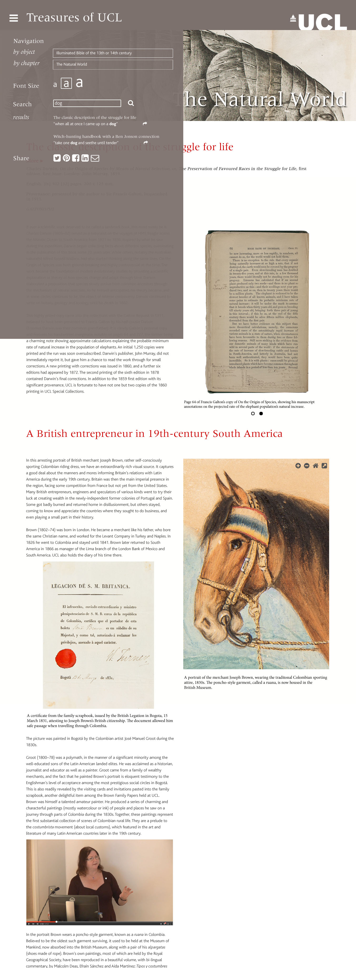
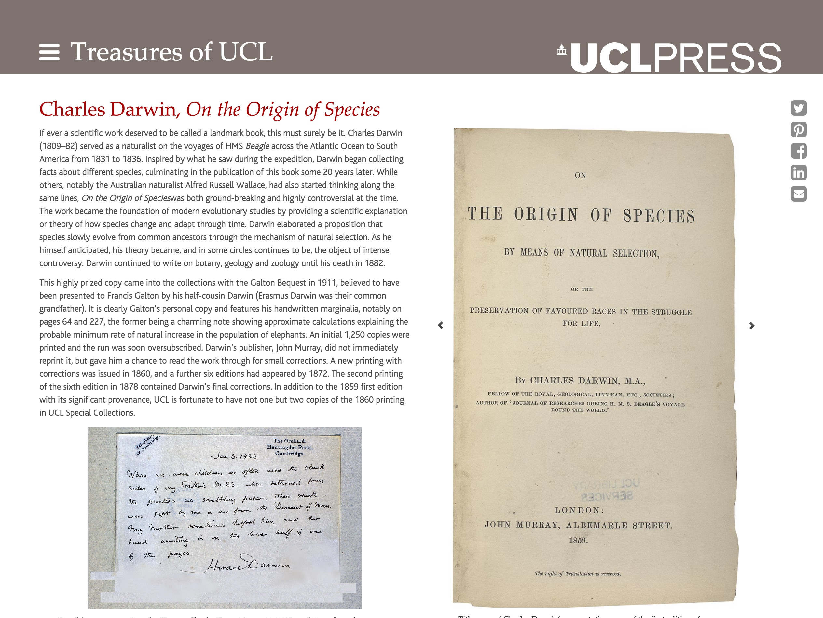
Case study 1: UCL Press
- Developing browser-based enhanced versions of books
- Brower-based publishing for scholarly monographs and textbooks delivery for autumn 2015
Video
Audio
Slideshows
Deep zoom
Music/podcasts

Slide 64
Case study 1: UCL Press
Scholarly Monographs
We will mainly
publish
Textbooks
Edited Volumes
Scholarly Editions
Journals
Year 1
Year 2
Year 3
Growth
10
Books
20
books
30
books

Slide 65
Case study 2: Liverpool: Library and Press
Liverpool University Library partnering with Liverpool University Press
Publishing two
e-textbooks
Combining LUP
publishing expertise,
with Library staff
academic and student connections
Funded by Jisc:
Institution as e-textbook publisher project
Collaboration
Shared skills, resources
& expertise
Publishing on Xertes and Biblioboard
Notes:
LUP long established as an academic press and has recently won two awards
LUL and LUP are partnering to publish two e-textbooks, using LUP publishing expertise, with Library staff leading the content creation, author liaison and digital platforms
Publishing on Xertes and Biblioboard
Funded by Jisc: Institution as e-textbook publisher
Collaboration: draw on each others’ skills and expertise

Slide 66
Case study 3: Stockholm University Press
University library staff from the comms and public engagement depts
Commission and set up editorial boards as well as existing daily role
Ubiquity Model
Publishing Partner
Platform
Website
Editorial and Production
Charge BPCs to staff authors
Notes:
Ubiquity model. University library staff from the communications and public engagement depts commission and set up editorial boards, alongside their existing daily role. Around five library staff involved. Charge BPCs to staff. Ubiquity provides the platform, the website, and the editorial and production processes.

Slide 67
Institution as publisher
Further references
Jisc Infographic: publishing an OA monograph: http://oapen-uk.jiscebooks.org/files/2015/02/Publishing-an-academic-monograph.pdf
Open Access Monographs and Book Chapters at the Wellcome Trust: a Guide for Publishers (to be released shortly)

Slide 68
Thank you!
Any questions?

