Slide 1

University-based open access publishing in Europe: challenges and opportunities in the Humanities
Victoria Tsoukala, PhD
National Documentation Centre | National Hellenic Research Foundation
OAI9, Geneva, June 19th, 2015

Slide 2
What distinguishes the Humanities scholarly communication process
Slower pace in producing publications
Heavy reliance on books
Transition from print to electronic much slower
Heavy use of local publications, reliance on local languages
Impact more difficult to measure in the Humanities, different value system
Less or minimal connection of results to monetary economy and much less funding available
Slower uptake of open access
  But sweeping recent massive developments
Most open access institutional initiatives focus on the SSH

Slide 3
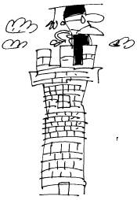
A rich OA publishing landscape around the ivory tower
Corporate Publishers
National Initiatives
Large and medium scale institutional initiatives
Small institutional initiatives
Independent publishers

Slide 4
Traits of University-based initiatives
Initiatives tightly interwoven with open access
Library initiatives
Focus on journals, increasingly on monographs
Open source technology (OJS)
Institutional funding and/or own resources
No business models, especially with journal publishing
  Journals usually outside of the APC system

Slide 5
Some typical examples
Library-led initiatives at institutional level
  Numerous large ones in Italy (Trieste), Spain (Madrid), medium ones all over Europe
  Mostly journals
Open access university presses within the library (library upress merge or new presses in library)
  UCL press
  Goettingen Press
  Stockholm Press, among others

Slide 6
Opportunities
To regain control of the valuation and dissemination of the scientific information it produces (university and researchers)
For innovative experimentation in open access publishing and open science (researchers, university)
Actively to participate in shaping an economically more transparent and fair SC system and reap benefits (university)
To expand standard and set rules for professional evaluation and advancement (Universities/administration)
Assume new and enhanced roles in the university system (libraries)

Slide 7
Challenges
Lack of systematization in a good part of efforts
Fragmentation: lack of concerted action and systematization across Europe
  Lack of shared standards, guidelines and practices; business and financing models; possible general lack of collective vision
Inability to acquire critical mass, become visible, usable and attain sustainability
Perceived less quality and trust and thus, less chances to become established (=acquire prestige status) and enter ‘systemic’ publishing

Slide 8
Need to step up!
Coordination at the European level (critical mass, shared infrastructure and services, good practices, develop shared knowledge-base and standards, measurable quality, acquire more funding, experiment more)
More research for evidence on practices, on numbers, on economics necessary
Involve the researchers and university administration more

Slide 9
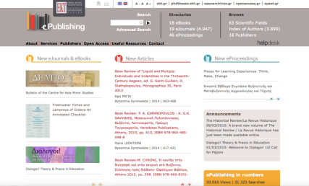
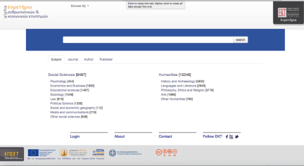
Our work at EKT!
http://epublishing.ekt.gr
  Oa publishing service for Greek publishers
  19 journals, books and proceedings (peer-reviewed)
http://www.grissh.gr
  Greek Reference Index in the Humanities (GRISSH)
  Ca 87 journals/85 publishers, documentation at article level, access to licensed content
Open Book Press Pilot
  ePress for select publishers, launch October 2015 with five monographs

Slide 10
Thank you!
tsoukala@ekt.gr

