Slide 1





Measuring the magnetic axis of quadrupoles by a stretched wire
Domenico Caiazza
4.2.2015

Slide 2
Outline
My role in PACMAN
Magnetic measurements and measurement problem
Classical stretched-wire method
Vibrating-wire method
Preliminary results and comparison
Criticalities about the vibrating wire system
Conclusions

Slide 3







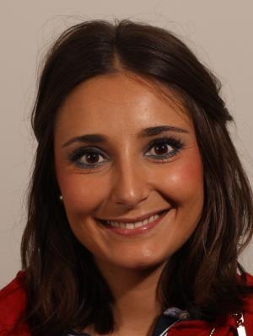




WP1 Metrology & Alignment
H. Mainaud Durand
WP2 Magnetic Measurements
S. Russenschuck
WP3 Precision mech. & stabilization
M. Modena
WP4 Beam Instrumentation
M. Wendt
Claude
Iordan
Solomon
Domenico
Giordana
Peter
Silvia
Natalia
Vasileios
David
“Stretched-wire systems for the magnetic measurement of small-aperture magnets”

Slide 4

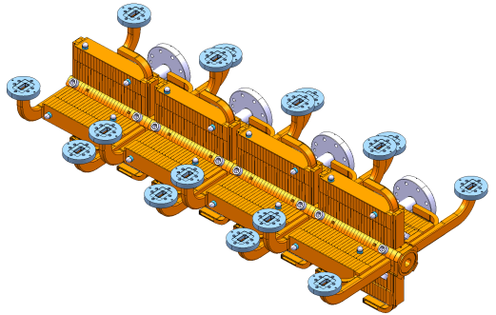
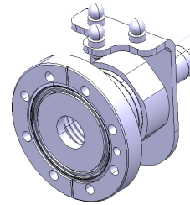
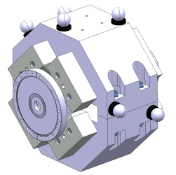
CLIC - Compact Linear Collider
A two beams, 50 km, e+/e- collider
ACCEL. Struct.
Metrological challenges imposed by CLIC
  Small beam size and impact section
    submicron range
  High-precision in focusing the beam
    500 nm horizontal and 5 nm vertical normalized beam emittance
  Tight specifications on components’ alignment
    14-17 μm error budget over 200 m
BPM
QUAD

Slide 5
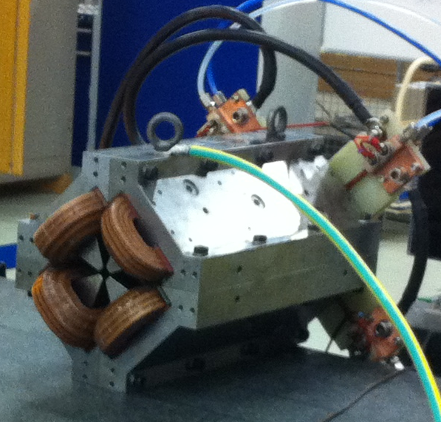
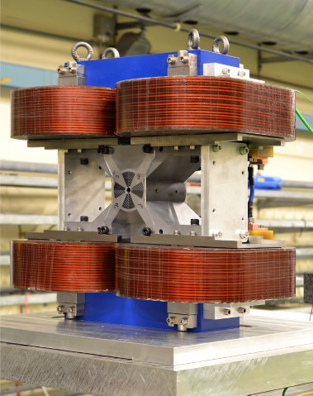
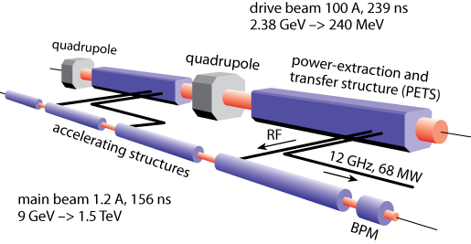
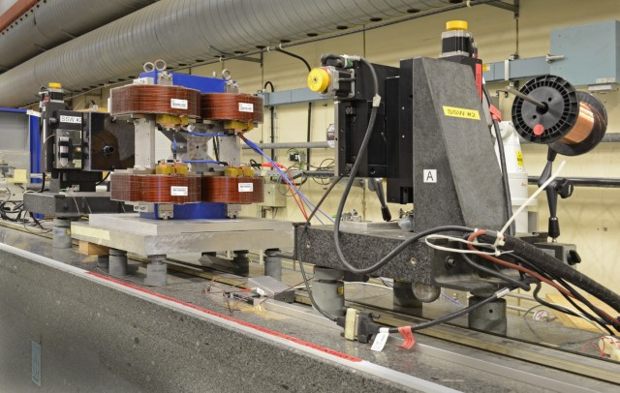
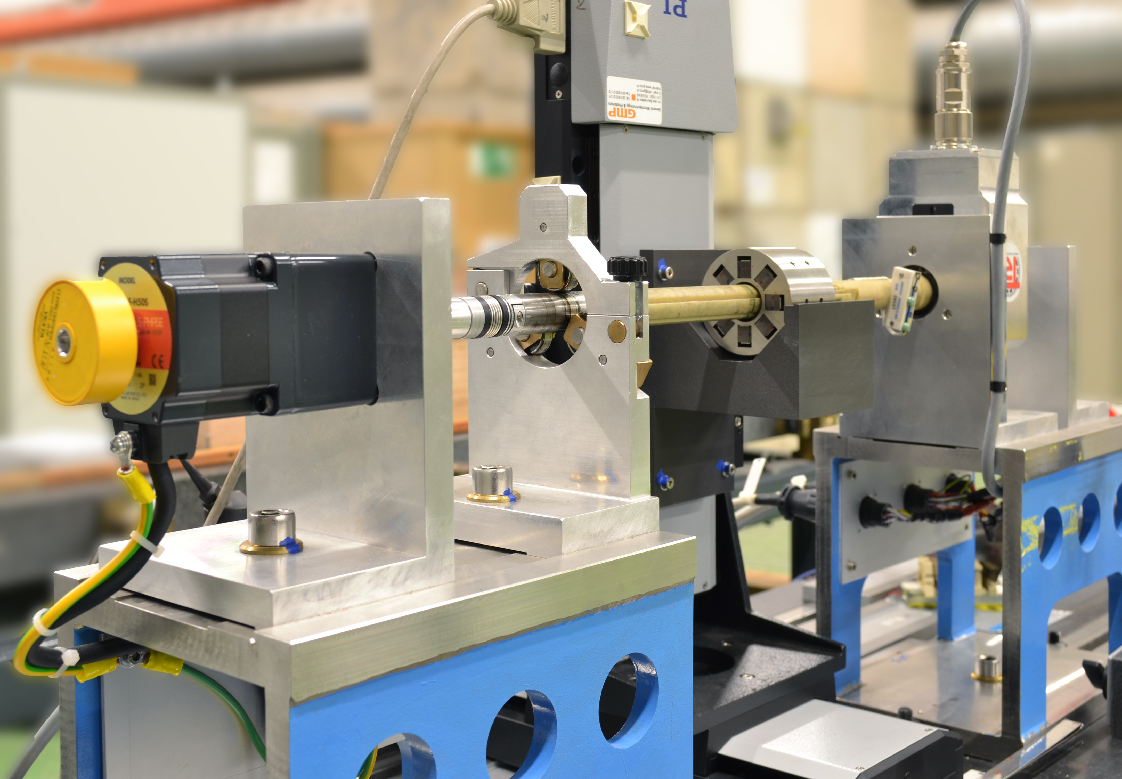
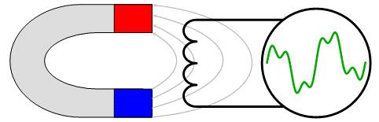
Magnetic measurements
4000 quadrupoles in the main linac
Main beam quad
Final focus quad
Magnetic measurements for PACMAN
Magnetic Measurements Section
Stretched wires
Rotating coils

Slide 6
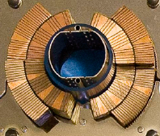
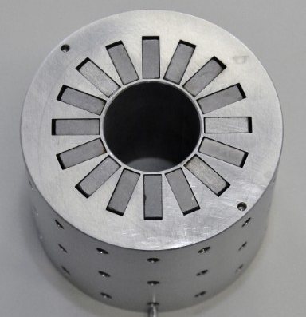
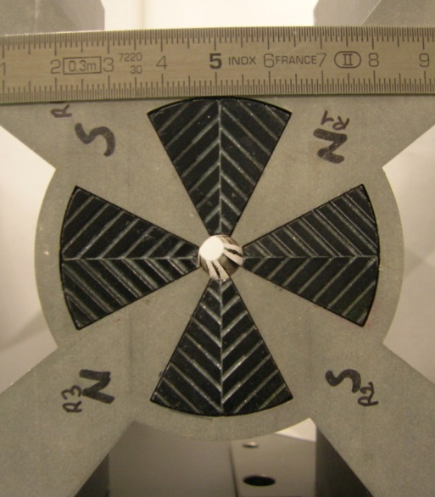
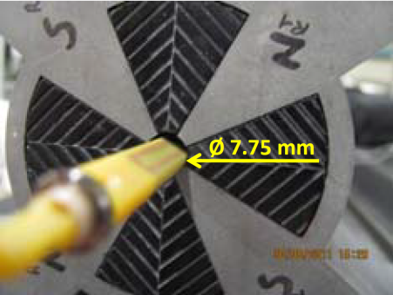
Measurement problem
Existing large accelerators
(Large Hadron Collider)
Upgrade of LHC
(Linear Accelerator 4)
Future accelerators
(Compact Linear Collider)
Ø 50 mm
Ø 20 mm
Ø 8 mm
2008
2015
2.5 x
2020
2.5 x
Limited access for Hall probe
The smaller the radius coils,
the higher the uncertainty

Slide 7
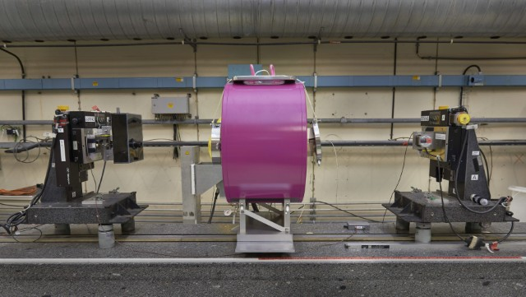
Wire-based transducers
A single stretched wire
Magnetic measurements
field strength and direction
field harmonics
magnetic axis
longitudinal field profile

Slide 8
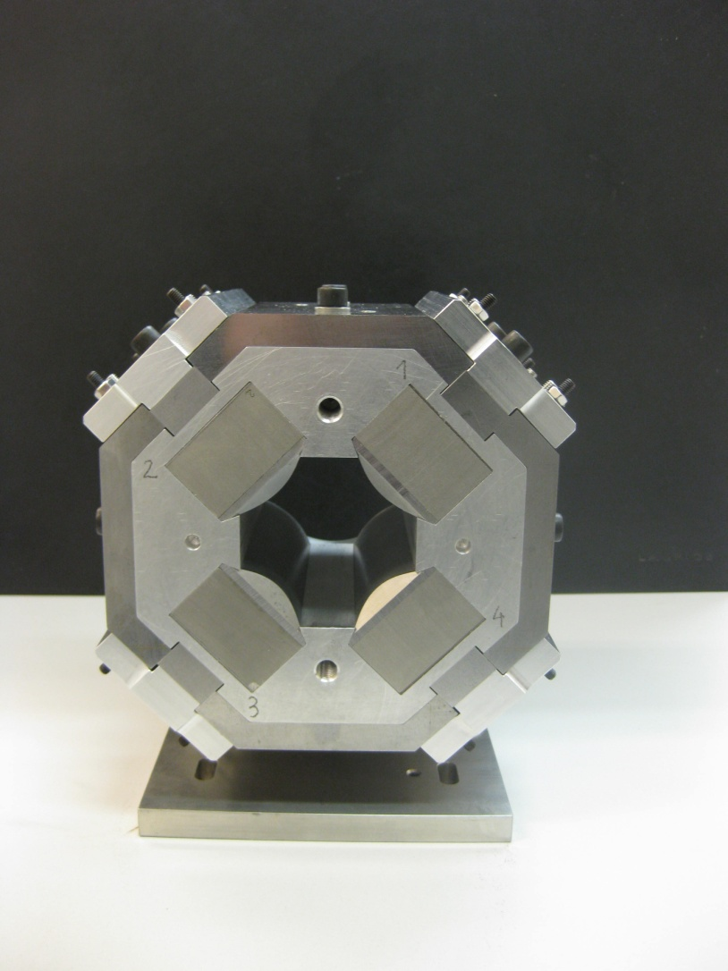
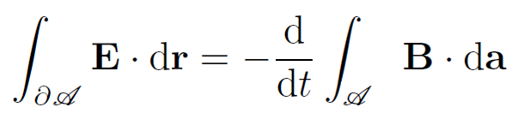

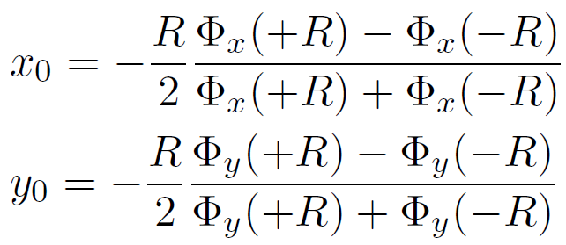
Solution 1: Stretched-wire method
Metrological reference for integrated field strength, direction and magnetic axis of LHC magnets
Magnetic flux measurement
J. Di Marco et al., “Field alignment of quadrupole magnets for the LHC interaction Regions”. IEEE Transactions on Applied Superconductivity, 2000.

Slide 9

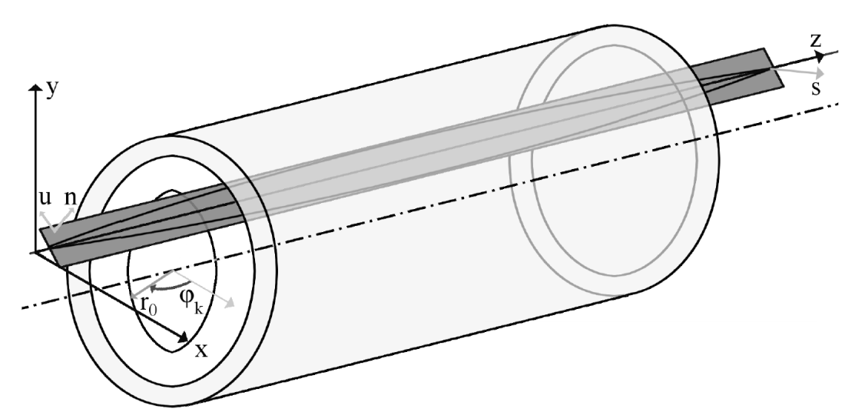

Solution 2: Vibrating-wire method
Plucked string
Wire in magnetic field
Feeding the wire by alternating current
(Lorentz Force)
Measure wire motion
amplitude X and Y components
Relate motion to
magnetic field properties
A. Temnykh. “Vibrating wire field-measuring technique”. Nuclear Instruments and Methods in Physics Research, 1997.

Slide 10
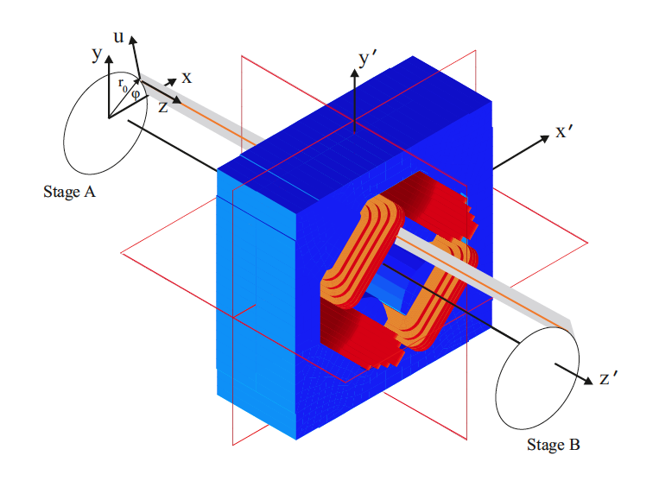


Mathematical model
Linearity
Plane motion
Uniform and constant tension
Small deflections
Constant length
Uniform mass distribution

Slide 11
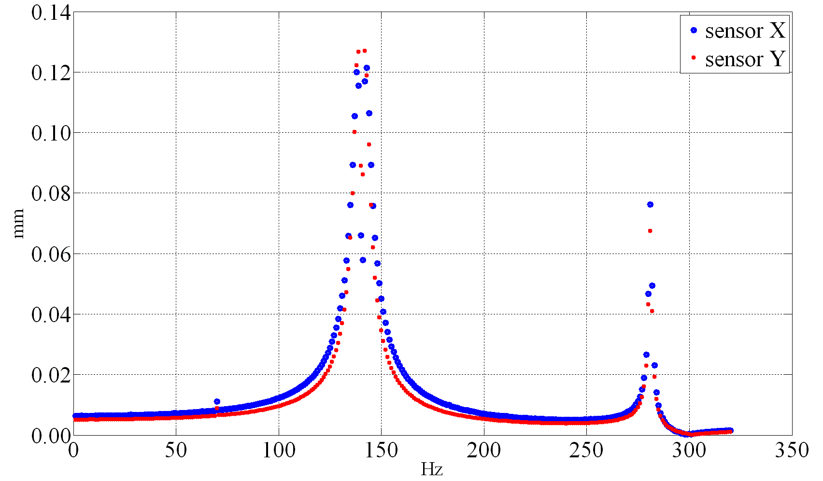
Measurement system design
Driving current frequency tuning
Resonances
Working frequencies for max sensitivity

Slide 12
Vibrating-wire axis measurement
Center finding (horizontal and vertical)
  First resonance
  Co-directional scanning
Tilt finding (pitch and yaw)
  Second resonance
  Counter-directional scanning
A
QUAD
B
QUAD
B
A
A zero-finding problem
Vibration amplitude
P. Arpaia, C. Petrone, S. Russenschuck, L. Walckiers, “Vibrating-wire measurement method for centering and alignment of solenoids”, IOP Journal of Instrumentation, Vol. 8, Nov., 2013.
Z. Wolf. “A Vibrating Wire System For Quadrupole Fiducialization ”, Tech. rep. LCLS-TN-05-1. SLAC National Accelerator Laboratory, Menlo Park, California, USA, 2005.

Slide 13
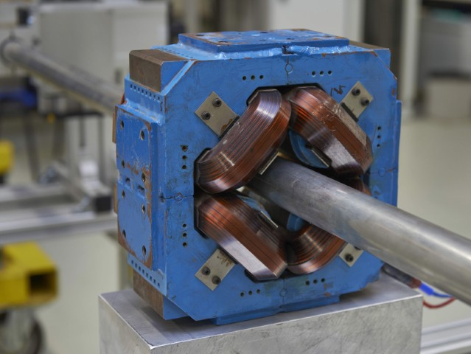
Experimental setup
System architecture
Sensors: phototransistor SharpTM GP1S094HCZ0F
Current generator: Keithley® 6351
Common marble support for magnets and stages
P. Arpaia, M. Buzio, J. G. Perez, C. Petrone, S. Russenschuck, L. Walckiers.
“Measuring field multipoles in accelerator magnets with small-apertures by an oscillating wire moved on a circular trajectory”, IOP JINST - Journal of Instrumentation, 2012.
Reference magnet
Configuration
Wire alloy | - | Cu-Be
Wire mass density | ρ | 1.1·10⁻⁴ Kg·m⁻¹
Wire length | L | 1870 mm
LHC-LI-QS

Slide 14
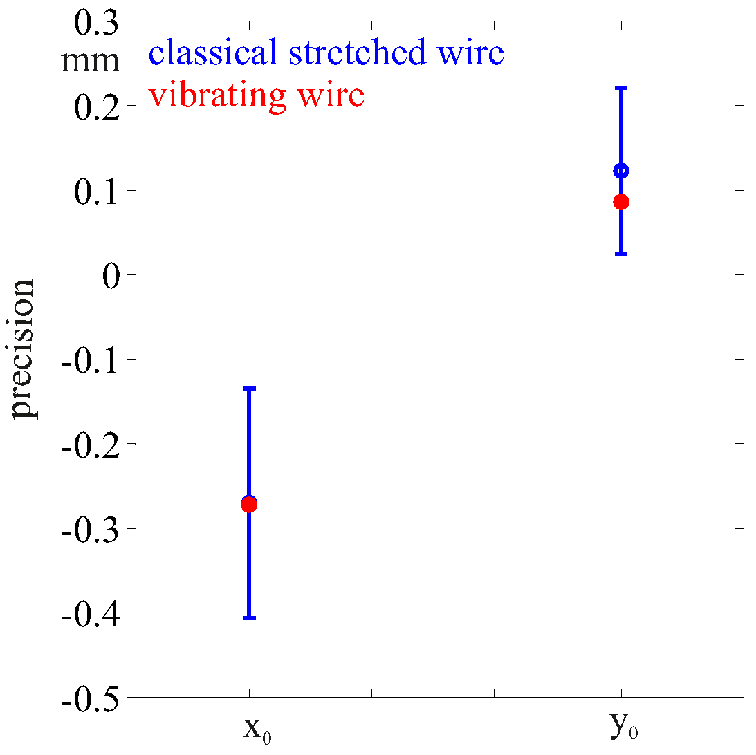
Comparison stretched-vibrating:
Preliminary results
Method 1: classical stretched wire center
Method 2: vibrating wire center
x₀ [mm] | σ_{x} [mm] | y₀ [mm] | σ_{y} [mm]
-0.270 | 0.136 | 0.123 | 0.098
x₀ [mm] | σ_{x} [mm] | y₀ [mm] | σ_{y} [mm]
-0.272 | 0.003 | 0.086 | 0.004
Precision
  Compatibility
  30 times better for the vibrating wire (3-4 μm)
Sensitivity
  Vibrating wire is suitable at low integral gradient (< 0.2 T)
Background fields
  Stretched wire not sensitive
  Compensation needed for vibrating wire

Slide 15
Background field compensation (1/2)
Solution 1: displace the quadrupole at L/4
A
B
Z. Wolf. “A Vibrating Wire System For Quadrupole Fiducialization ”, Tech. rep. LCLS-TN-05-1. SLAC National Accelerator Laboratory, Menlo Park, California, USA, 2005
Solution 2: measure at different gradients
A
B
Works if there is not a constant dipole in the magnet (not depending on I_{m})

Slide 16
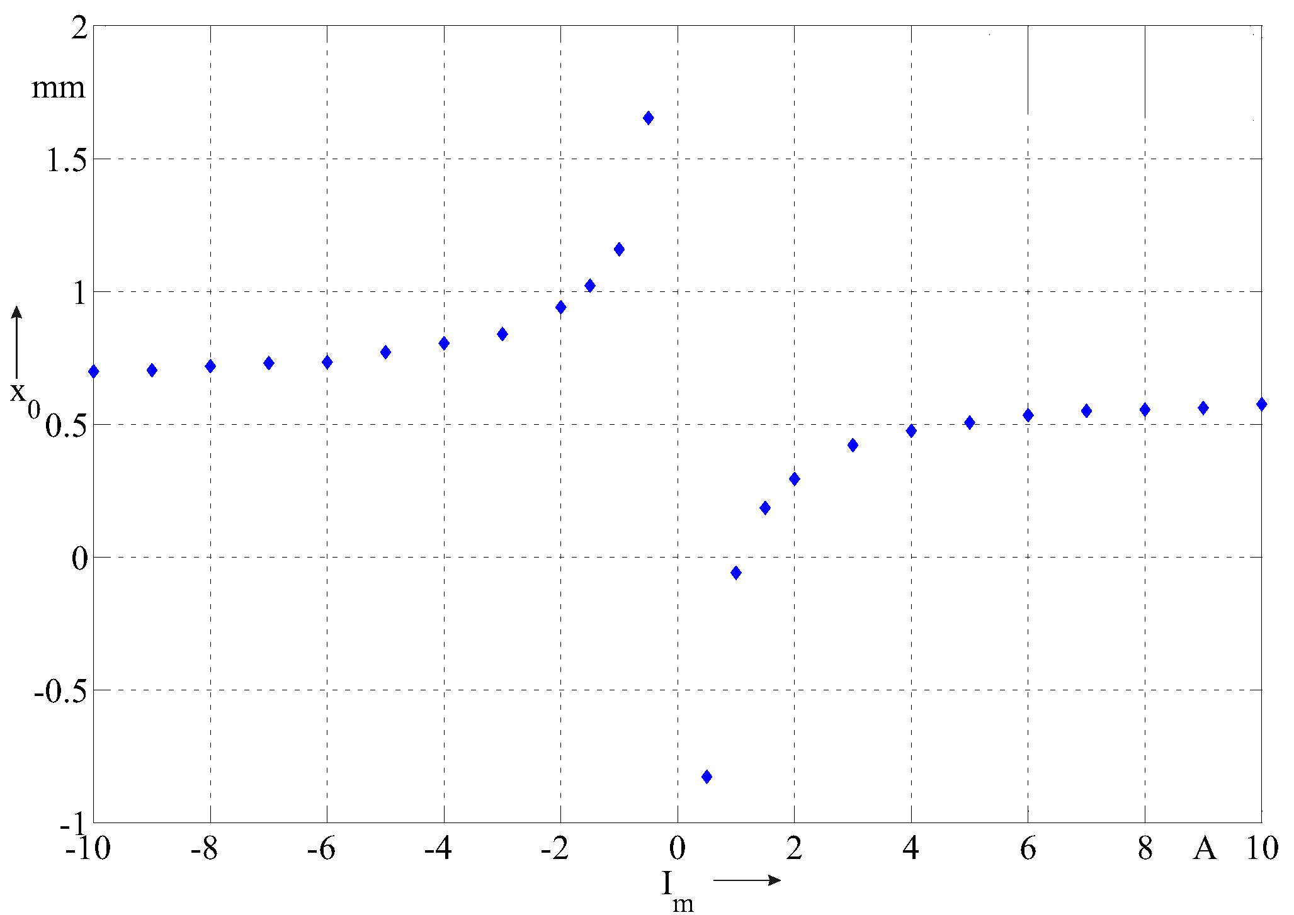
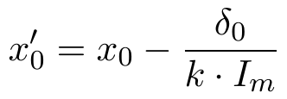
Background field compensation (2/2)
Magnetic center as a function of the magnet gradient
Hyperbolic model
Actual center
Background field effect
Fit to the hyperbolic model

Slide 17
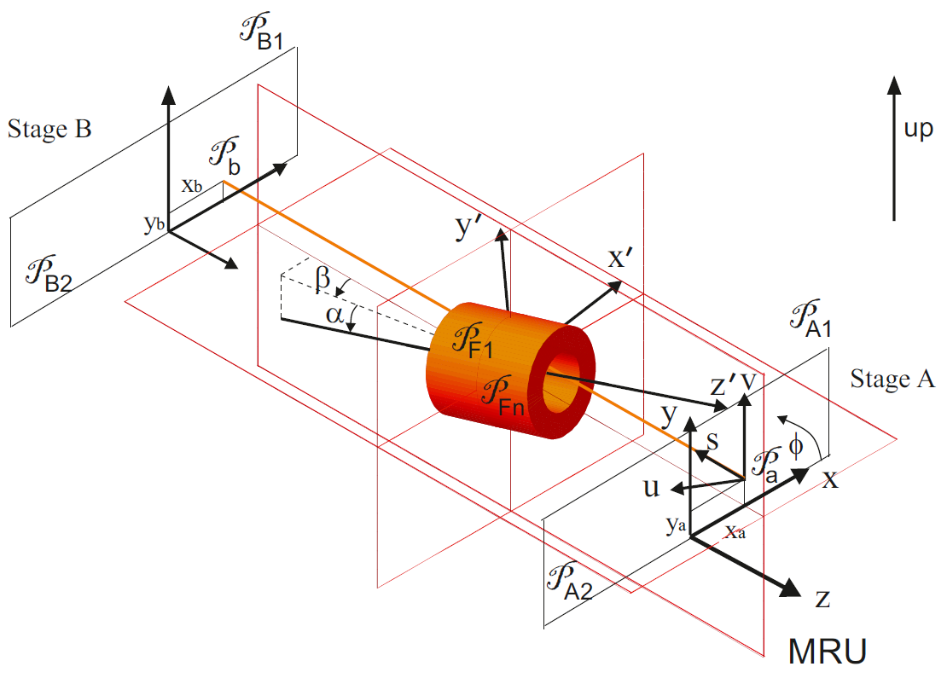
Reference frame
Fiducial marker localization

Slide 18
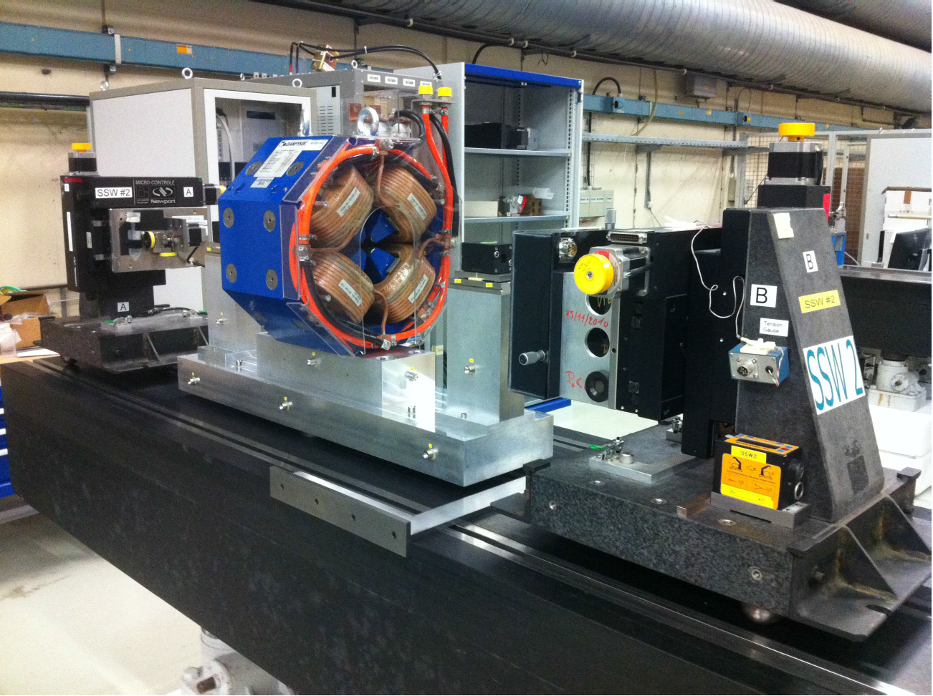
DBQ axis measurement
Magnetic axis measurement + fiducial markers localization
  In collaboration with EN-MEF-SU (Large Scale Metrology Section)
Both center and tilt were measured by the vibrating wire
Axis determination with +3 μm horizontal and +4 μm vertical precision
CLIC DBQ (12 T integrated gradient) on the fiducialization bench with vibrating wire system
Magnetic center as a function of the magnet current
M. Duquenne et al., “Determination of the magnetic axis of a CLIC drive beam quadrupole with respect to external alignment targets using a combination of wps, cmm and laser tracker measurements”. Proceedings of IPAC2014, Dresden, 2014.

Slide 19
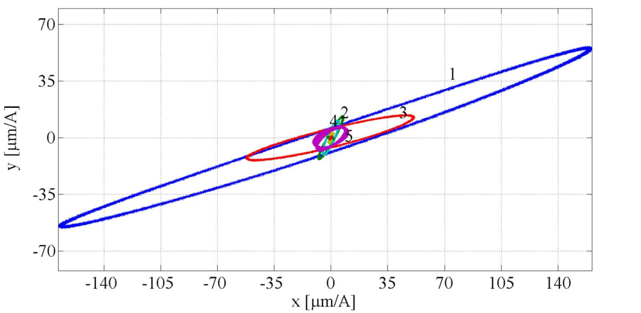
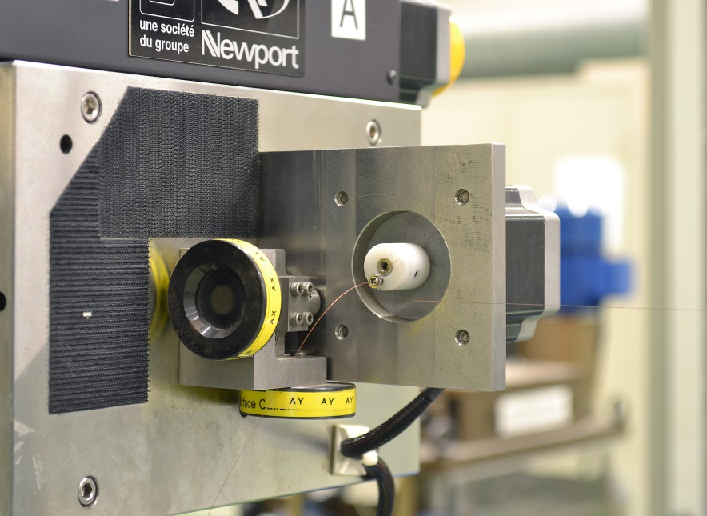
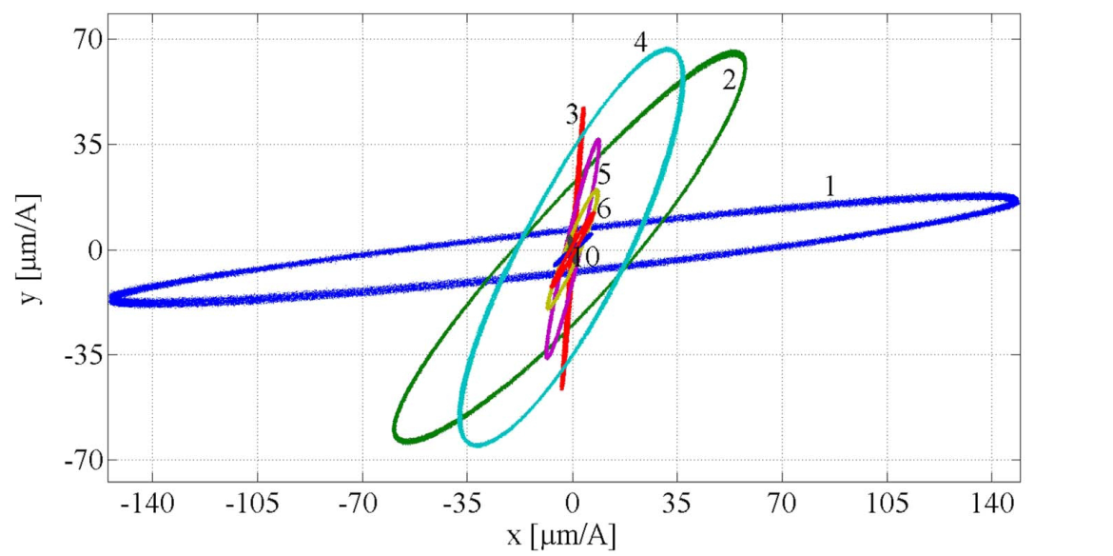
Background fields & Plane motion
No magnet on the measurement station
Background fields
  2% alteration of first harmonic
Fringe field from equipment (tensioning system)
  High-order modes amplified
Elliptically polarized trajectory
  in resonance condition
Predicted in:
J. A. Elliott. “Intrinsic nonlinear effects in vibrating strings”, American Journal of Physics, 1989

Slide 20
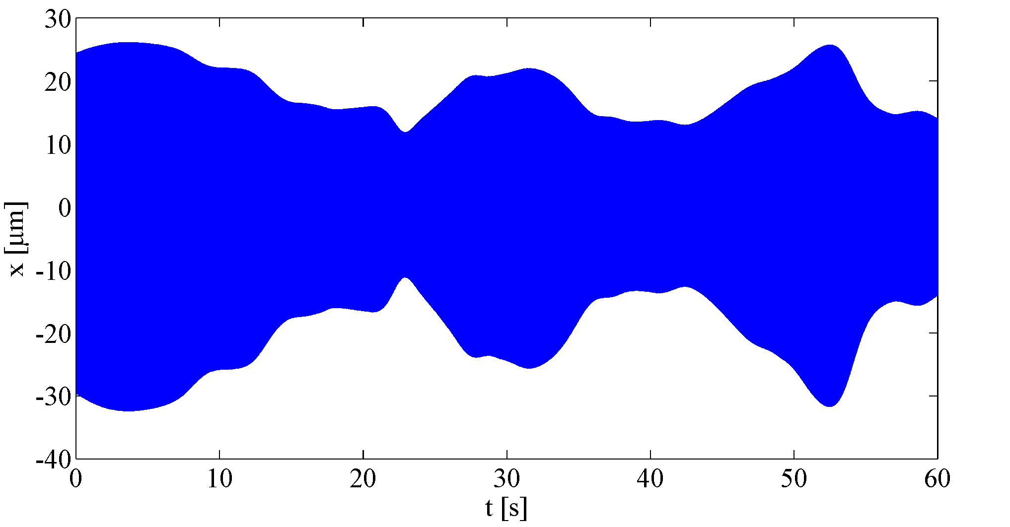
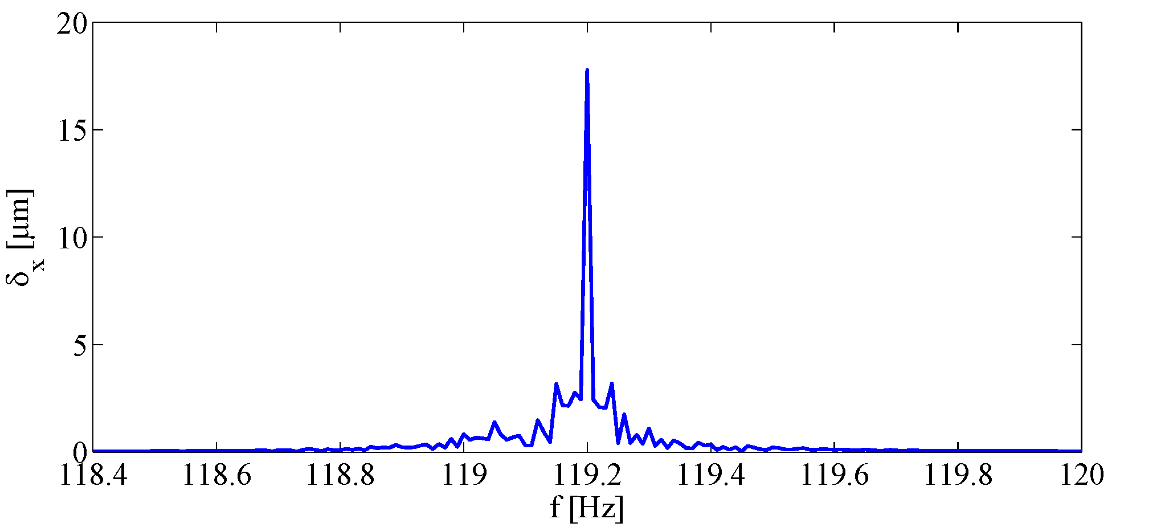
Steady-state modulation
Around resonance
  Non-constant oscillation amplitude!!!
  Effect depending on the excitation frequency: minimal in resonance condition (5%)
Side band components in the frequency spectrum
Possible reasons
  Non constant length and/or tension
  Non ideal clamping (friction on the supports)
  Excluded: coupling with ground vibrations

Slide 21
Conclusions
Two methods for magnetic axis measurement
Preliminary test on a reference quadrupole
  Comparison of precision and sensitivity
  Influence of background field
Outlook
  Uncertainty analysis of the vibrating-wire system
  Design and commissioning of the PACMAN system
  Measurement on the CLIC MBQ magnet
  Comparison with PCB rotating coil

Slide 22
Thank you for your attention
PACMAN Workshop 2015
Measuring the magnetic axis of quadrupoles by a stretched wire

Slide 23
SPARES

Slide 24
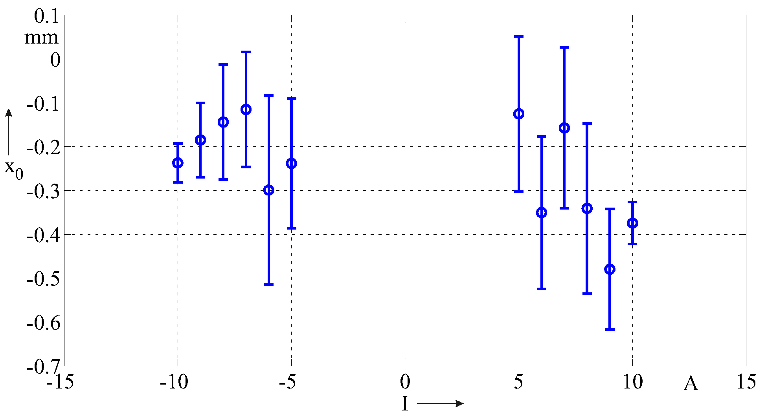
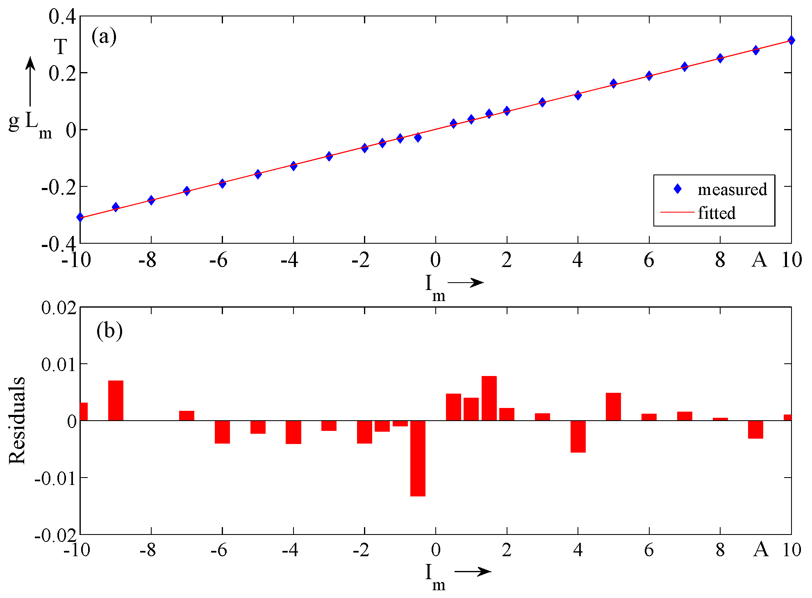
Method 1: preliminary results
Horizontal offset with respect to the magnetic center
+300 μm uncertainty for low-gradient (< 0.2 T/m·m)
Measured gradient as a function of magnet current
m
Average horizontal and vertical center offset
x₀ [mm] | St. Dev. [mm] | y₀ [mm] | St. Dev. [mm]
-0.270 | 0.136 | 0.123 | 0.098

Slide 25
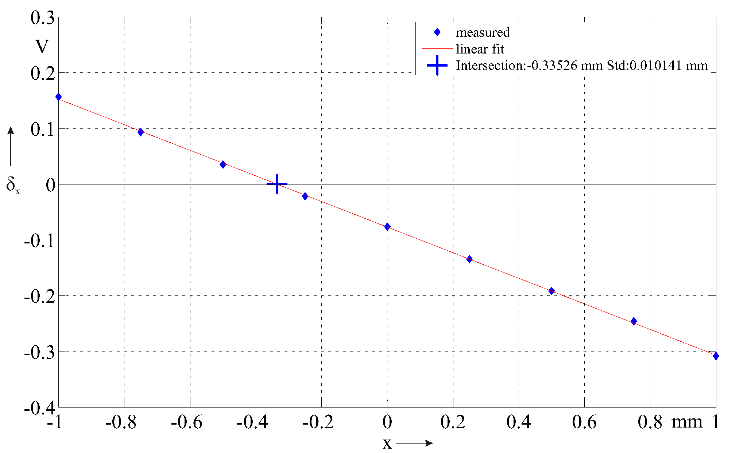
Method 2: preliminary results
Average horizontal and vertical center offset
x₀ [mm] | St. Dev. [mm] | y₀ [mm] | St. Dev. [μm]
-0.272 | 0.003 | 0.086 | 0.004
Linear regression of wire oscillation amplitude

Slide 26
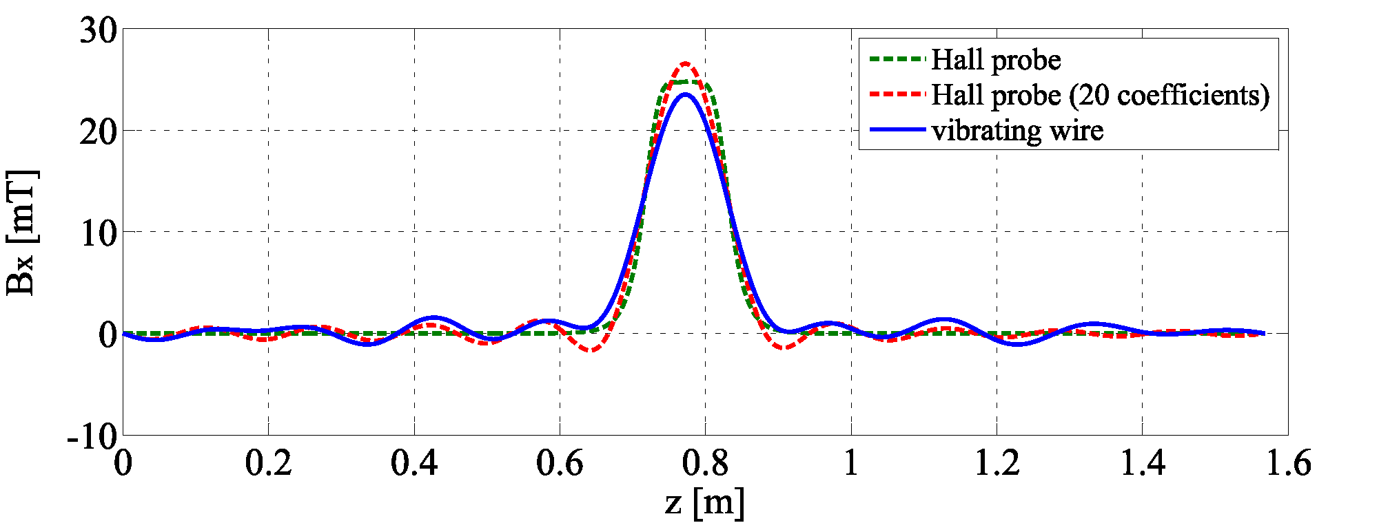
Results
Reconstruction error 3% of the field peak
Repeatability 2%
  RMS difference
Bandwidth limitation
Uncertainty sources

Slide 27
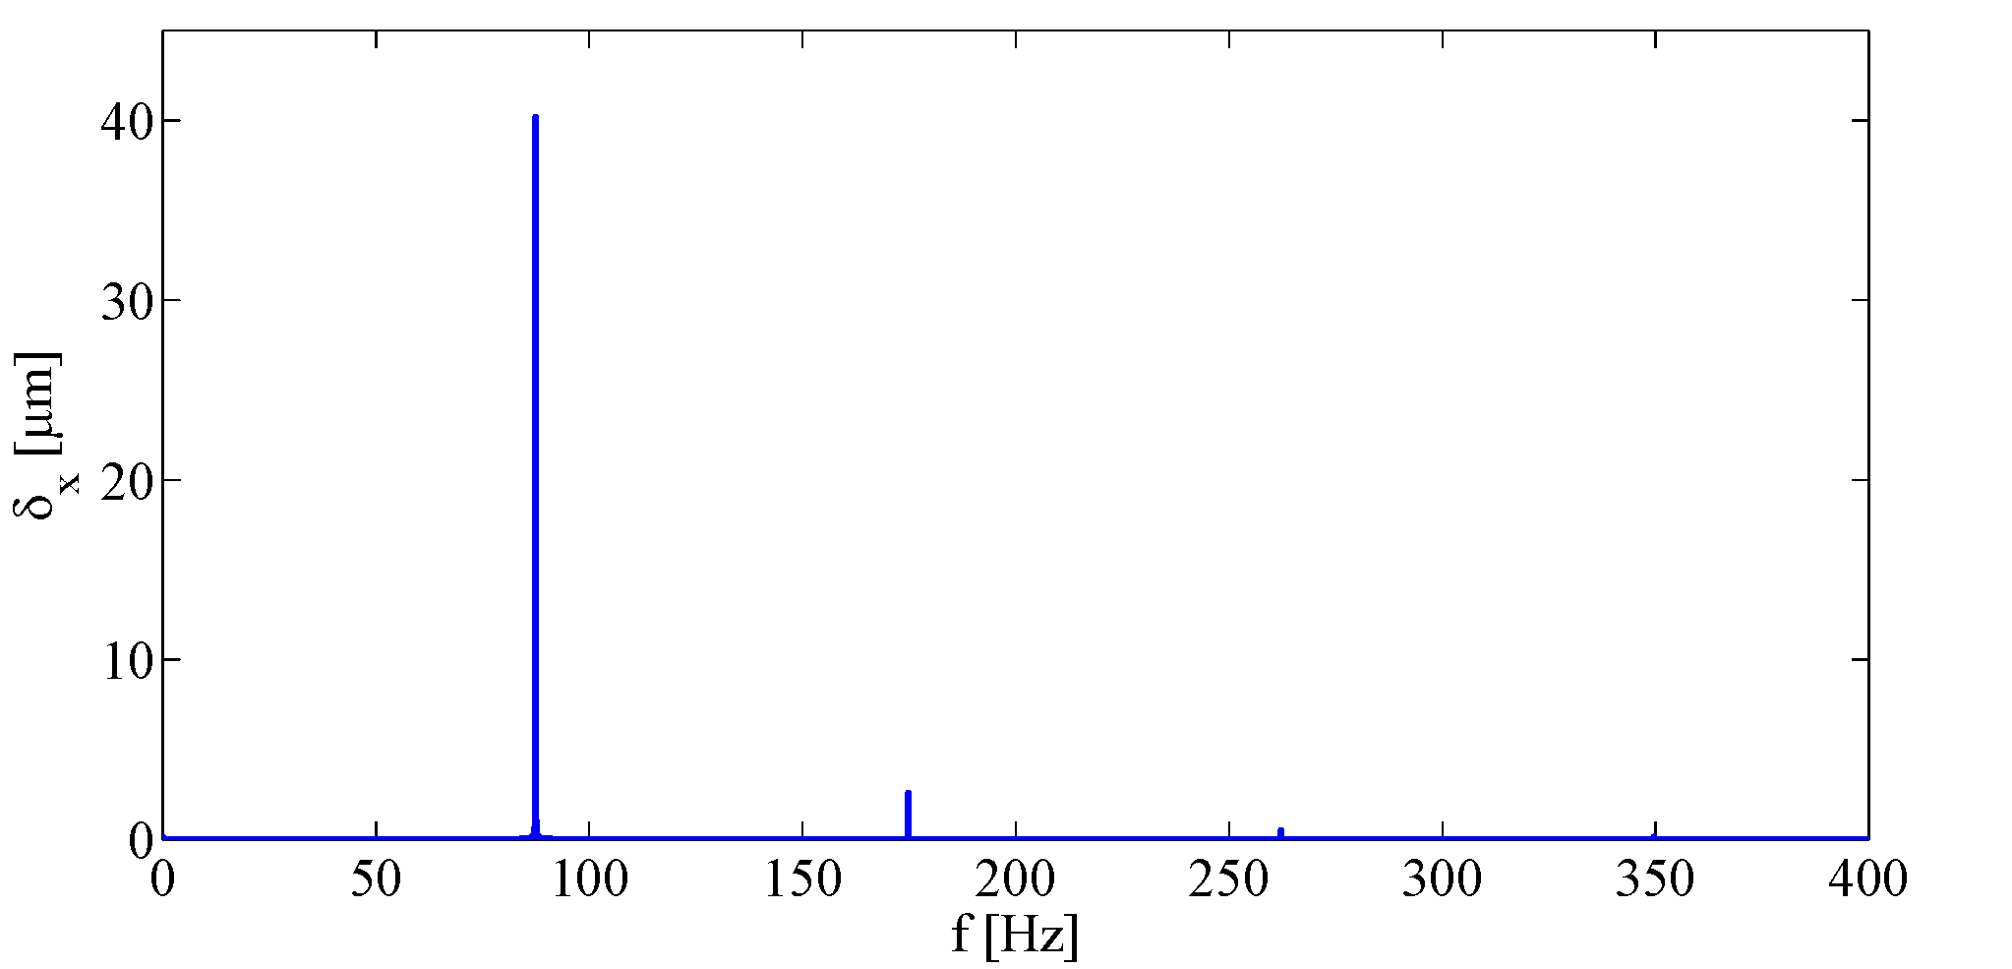
Overtones
main tone
overtones
Overtone amplitude from 2% to 7% of the main tone
  Depending on system configuration
Overtones not contained in the current excitation signal
Nonlinearity!

Slide 28
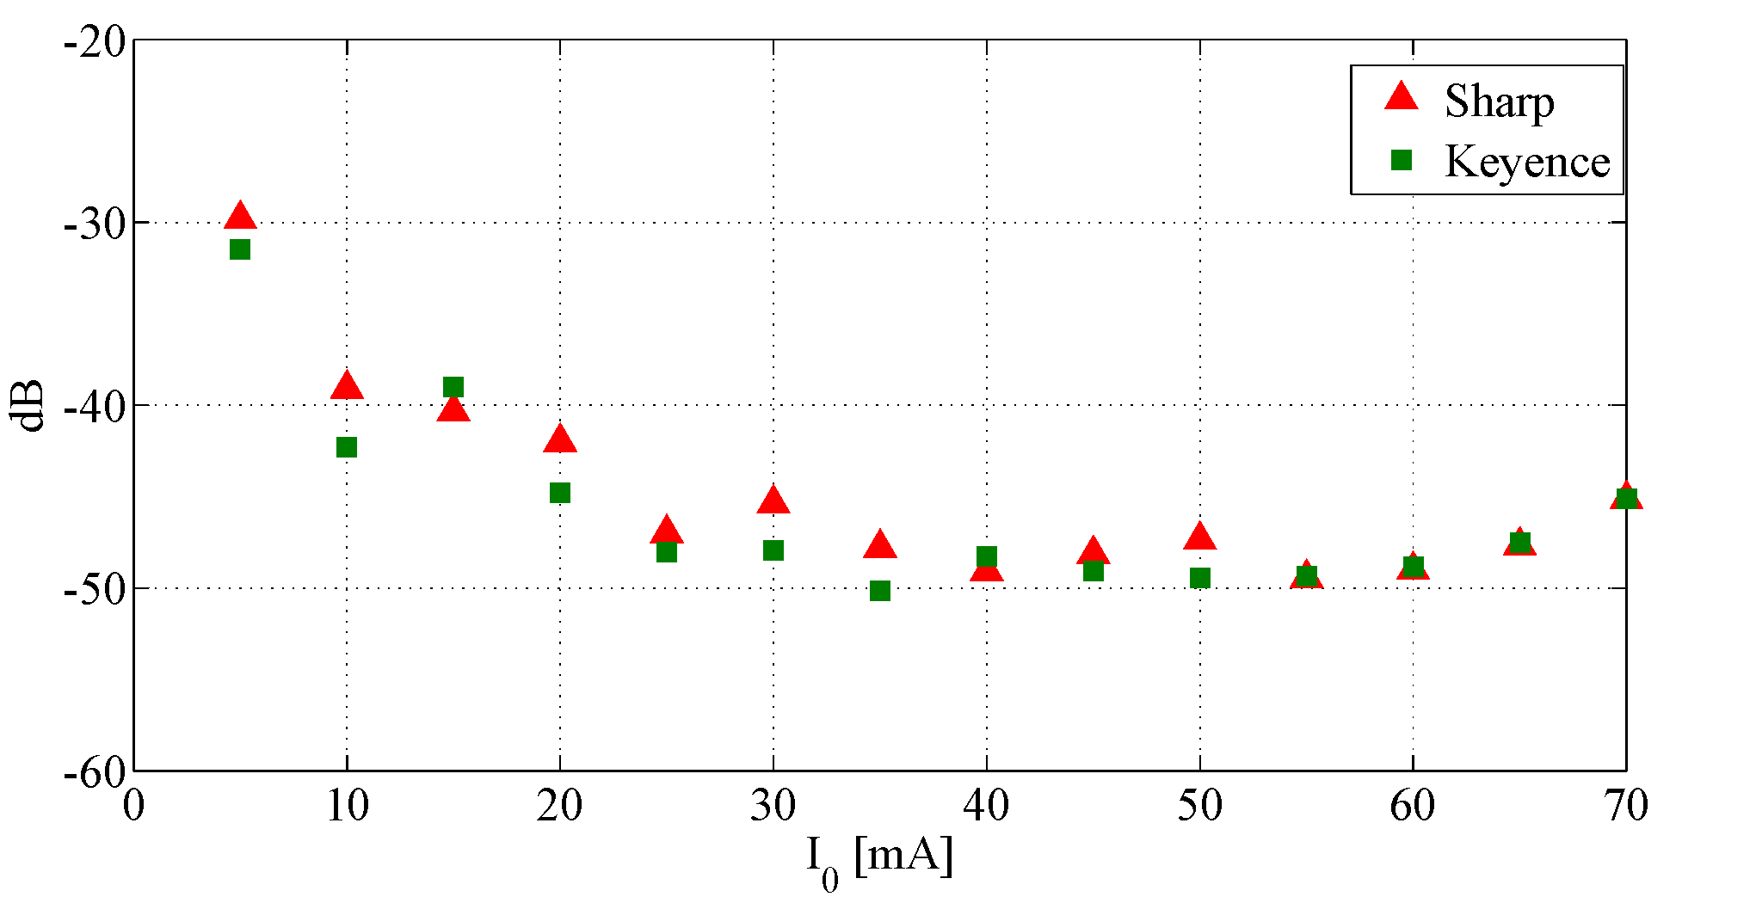
Optical sensor characterization
Sharp® phototransistors (currently employed)
  Linear domain 40 μm
  Low price
  High sensitivity
Keyence ® CCD sensors
  Wide linear domain (6 mm)
  Worse SNR
Total Harmonic Distortion
  No harmonic distortion by Sharp®
Overtones are not artifacts from nonlinear sensor response

