Slide 1

PHYSICAL AND CHEMICAL CHARACTERIZATION OF A DEPOSIT OF CHROMIUM OXIDE
Manon DURAND
Chemistry Laboratory (TE-VSC-SCC)
Student in Chemistry Engineer School (ESCOM)

Slide 2
Table of contents
Introduction
Establishment of the analytical methods and parameters
Heat treatments
Conclusion

Slide 3
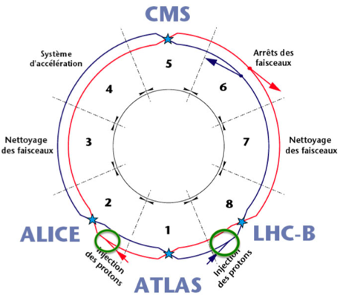
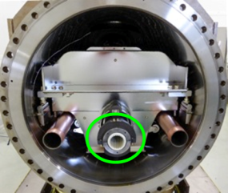
Introduction
Injection Kicker Magnets
electromagnetic devices composed of 4 magnets and 4 pulse generators
guide, maintain and focus the particle beam on its near-circular orbit
installed on the injection points of LHC
0,12Tesla in less than 900ns, for about 8ms.
Vacuum chamber

Slide 4
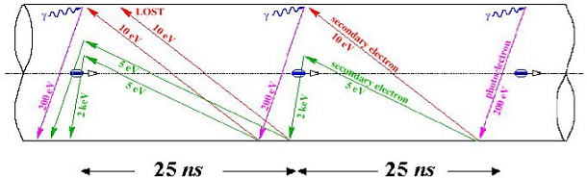
Introduction
Problem with electron clouds
vacuum chambers in alumina
high SEY ~ 9-10
adverse effects: →increase in pressure
          →rise of temperature of the cold magnets
          →instabilities, loss of beam.
(by F. Ruggiero)

Slide 5
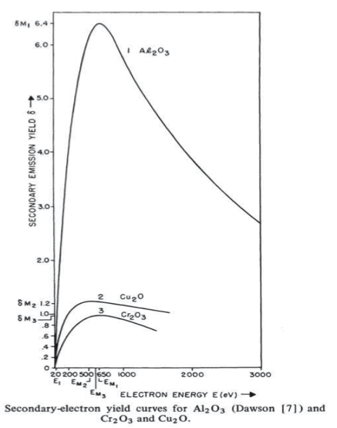
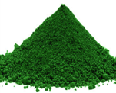
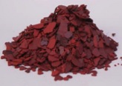
Introduction
Topic of the internship FINAL AIM: SEY reduction 1,4
Mike Barnes (TE-ABT-FPS)
Dr. Sudarshan, The Effect of Chromium Oxide Coatings on Surface
Flashover of Alumina Spacers in Vacuum (1976).
Objectives:
  Establishment of analysis methods - FT-IR spectroscopy
  - Thermal analysis
  - X-Ray diffraction (EN-MME-MM)
  - SEY measurements
  2. Heat treatments at different temperatures.
Cr2O3
Cr(III)
>500°C
Intermediary reductions
CrO3
Cr(VI)
Oxygen release

Slide 6
Establishment of the analytical
methods and parameters

Slide 7
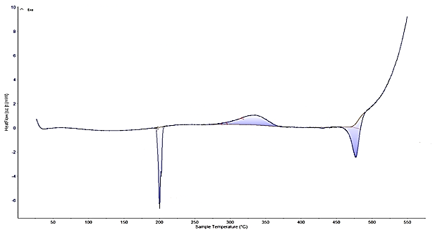
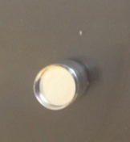
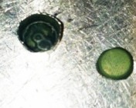
Thermal Analysis
Differential Scanning Calorimetry
Total mass loss: 30% > 23% (theory: 4CrO3 → 2Cr2O3 + 3O2)
Evaporation?
Closed crucible with pure CrO₃
Sample mass before analysis: 3,5mg
Sample mass after analysis: 2,5mg
Temperature range: 20°C → 550°C
Heating speed: 5°C/min
Gaz : nitrogen, 50mL/min
270°C

Slide 8
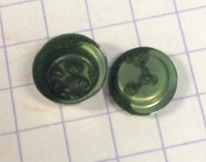
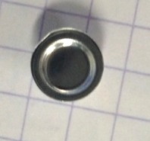
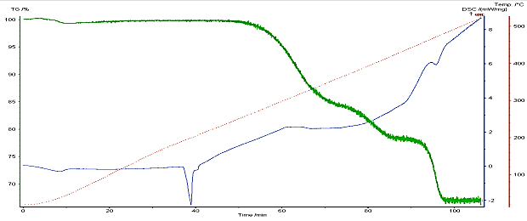
Thermal Analysis
Thermogravimetry
Total mass loss: 35% > 23% Evaporation?
Mass loss (1st reaction): ≈17%
Crucible with pure CrO₃
Sample mass before analysis: 9,4mg
Sample mass after analysis: 6,1mg
Temperature range: 20°C → 550°C
Heating speed: 5°C/min
Gaz : nitrogen, 50mL/min
17%
270°C
1h45

Slide 9
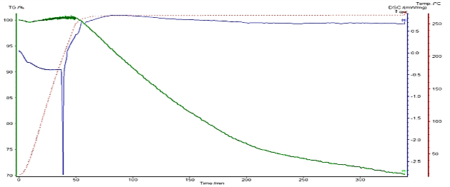
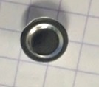
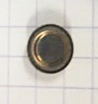
Thermal Analysis
Total mass loss: 30% > 17% Reaction + Evaporation?
→ Characterisation of the Cr(VI) thermal reduction.
→ Restart of the thermobalance.
Crucible with pure CrO₃
Sample mass before analysis: 3,5mg
Sample mass after analysis: 2,5mg
Temperature range: 20°C → 270°C
Heating speed: 5°C/min
Isothermal duration : 5h
Gaz : nitrogen, 50mL/min
5h50

Slide 10
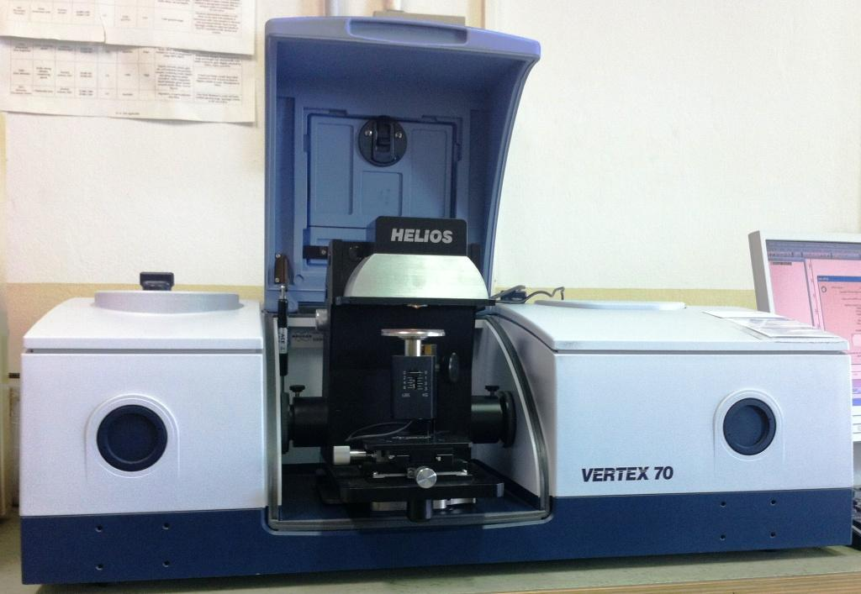
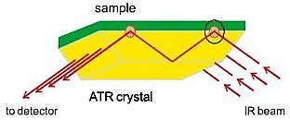
FT-IR Spectroscopy
Attenuated Total Reflectance (ATR)
+ Fast, non-destructive.
- Unsuitable for in-situ analysis in vacuum chambers.
H₂O
CrO3
Cr2O3

Slide 11
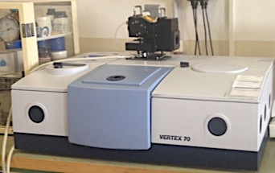
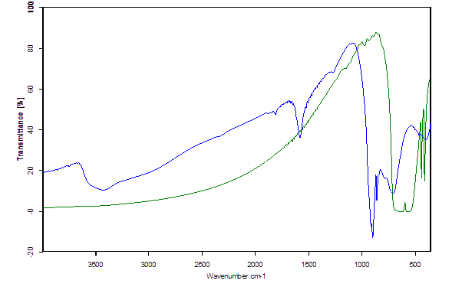


FT-IR Spectroscopy
Transmission
+ Suitable for in-situ analysis.
Characterisation of the oxides.
- Samples storage (CrVI and KBr hygroscopic).
I _{source(x)}
I _{(x)}
Sample
CrO3
Cr2O3
H₂O

Slide 12
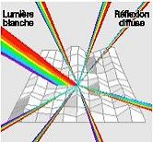
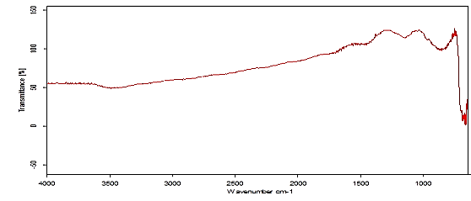


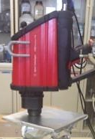
FT-IR Spectroscopy
Diffuse Reflectance
+ Suitable for analysis of residues in crucibles.
Characterisation of the oxides.
- Apparatus limitation (minimum wavelength: 600cm-1).
→ Characterisation of the chromium oxides.
CrO3
Cr2O3
H₂O
Transmittance (%)
H₂O

Slide 13
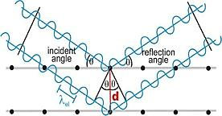
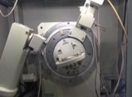
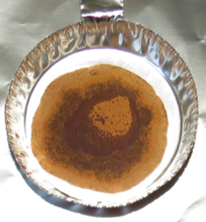
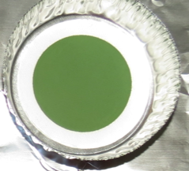
X-Ray Diffraction
(Floriane Leaux, Gonzalo Arnau Izquierdo (EN-MME-MM))
→ Characterisation of the chromium oxides.
Pure CrO₃
Standard Library CrO₃ (Cr^{VI})
Pure Cr₂O₃
Standard library Cr₂O₃ (Cr^{III})

Slide 14
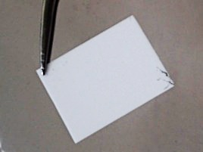
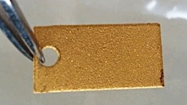
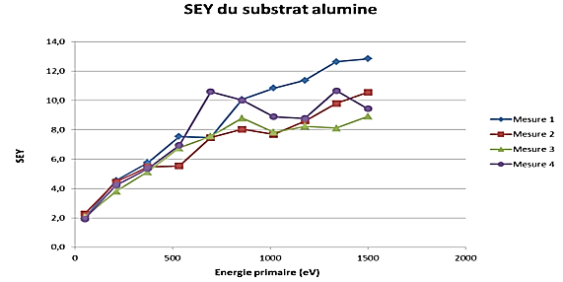
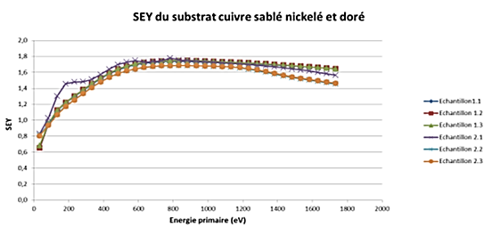
SEY Measurements
- Alumina - Sand-blasted, nickel-coated
and glided copper
(Holger Neupert, Valentin Nistor (TE-VSC-SCC))
SEY ≈9-10
SEY ≈1,8

Slide 15
Heat treatments

Slide 16
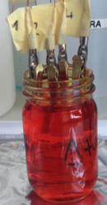
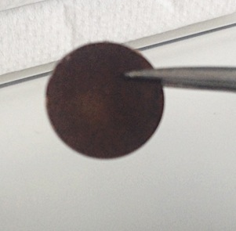
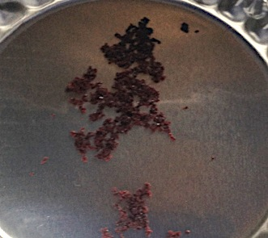
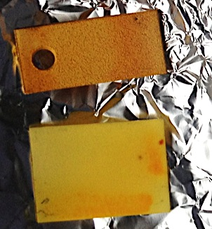
Samples before treatment
CrO3(aq) 10% (w/w) coating (Cr(VI))
(1h dipping + 1h drying (120°C))
FT-IR spectroscopy
X-Ray diffraction
SEY measurements

Slide 17

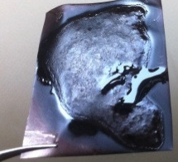
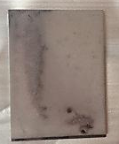
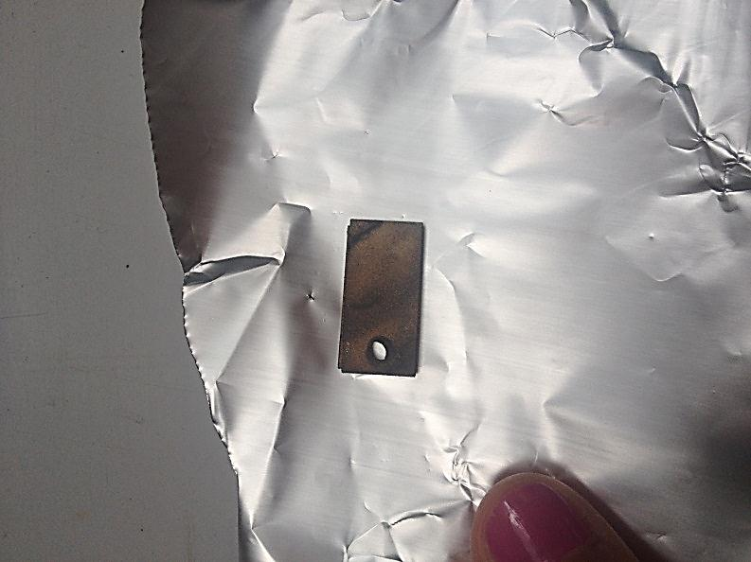
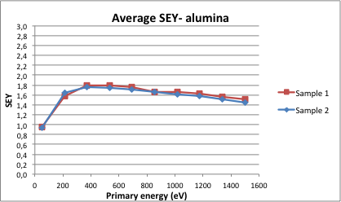
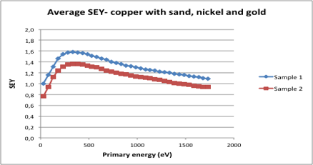
260°C for 4hours
FT-IR spectroscopy
X-Ray diffraction (EN-MME-MM)
SEY measurements
KBr+ CrO3 tablet
CrO₃ (240°C - 14H00)
Insoluble phase + liquid phase
Standard Library Cr₃O₈ (Cr^{5.33})
→ Decrease in SEY.
Inapplicable solution
(hydroscopic).
SEY ≈2
SEY ≈1,8

Slide 18

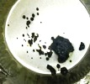
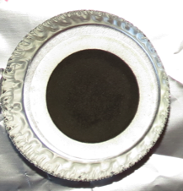
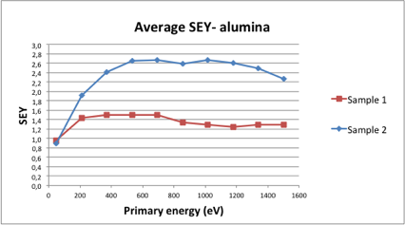
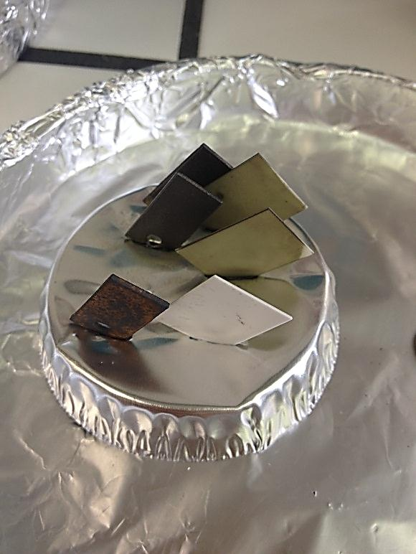
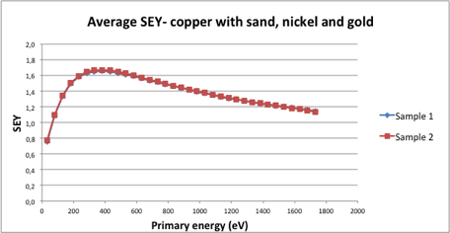
350°C for 72hours (backout simulation)
FT-IR spectroscopy
X-Ray diffraction (EN-MME-MM)
SEY measurements
KBr+ CrO3 tablet
CrO₃ (350°C - 72H00)
Standard Library Cr₂O₃ (Cr^{III})
Standard Library Cr₂O₅ (Cr^{V})
Creation of Cr(III).
→ Unstable solution.
SEY ≈2
SEY ≈1,7

Slide 19
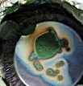
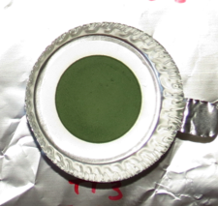
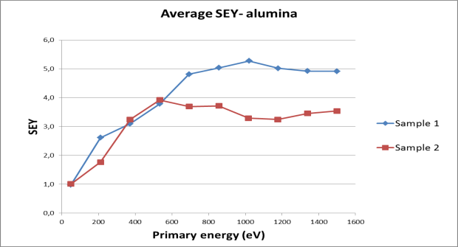
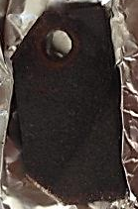
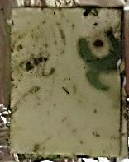
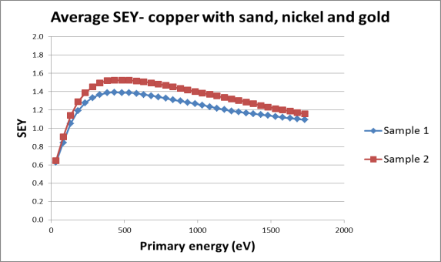
550°C for 72hours
FT-IR spectroscopy
  X-Ray diffraction (EN-MME-MM)
SEY measurements
Pure CrO3
Transmittance (%)
CrO₃ (550°C - 72H00)
Standard Library Cr₂O₃ (Cr^{III})
→ Inhomogeneous coating.
→ Presence of Cr(III).
SEY ≈1,5
SEY ≈4

Slide 20
Conclusions
Analytical methods and parameters established.
Several solutions to control coatings in the vacuum chambers.
Cr(III) seems to be a stable solution.
Improvements:
Study homogeneity of the coatings.
Identify intermediary oxides, create a FT-IR data base.
Study the influence of number of backouts for the Cr2O3 concentration.

Slide 21
Acknowledgements
- Paolo Chiggiato (TE-VSC)
- Mauro Taborelli (TE-VSC)
- Benoit Teissandier (TE-VSC)
- EN-MME: F. Leaux, G. Arnau.
- Polymers Laboratory
- TE-ABT: L. Ducimetiere, M. Barnes.
- TE-VSC: C.Charvet, D. Letant-Delrieux, F. Fesquet, H. Neupert, L. Bardo, P. Maurin, R. Setnescu, R. Leber, V. Nistor.

Slide 22
THANK YOU FOR YOUR ATTENTION

