Slide 1
First look at impedance of
RHIC stochastic cooling kickers
Benoit
With the help of Fritz, Michaela, Mike Brennan, Mike Blaskiewicz, Vito de Monte and Kevin Mernick

Slide 2
disclaimer
Of course for LHC, the geometry should be adapted in order to have a real estimate of whether these kickers can be installed in the machine.
→ These studies are just there as a starting point.

Slide 3
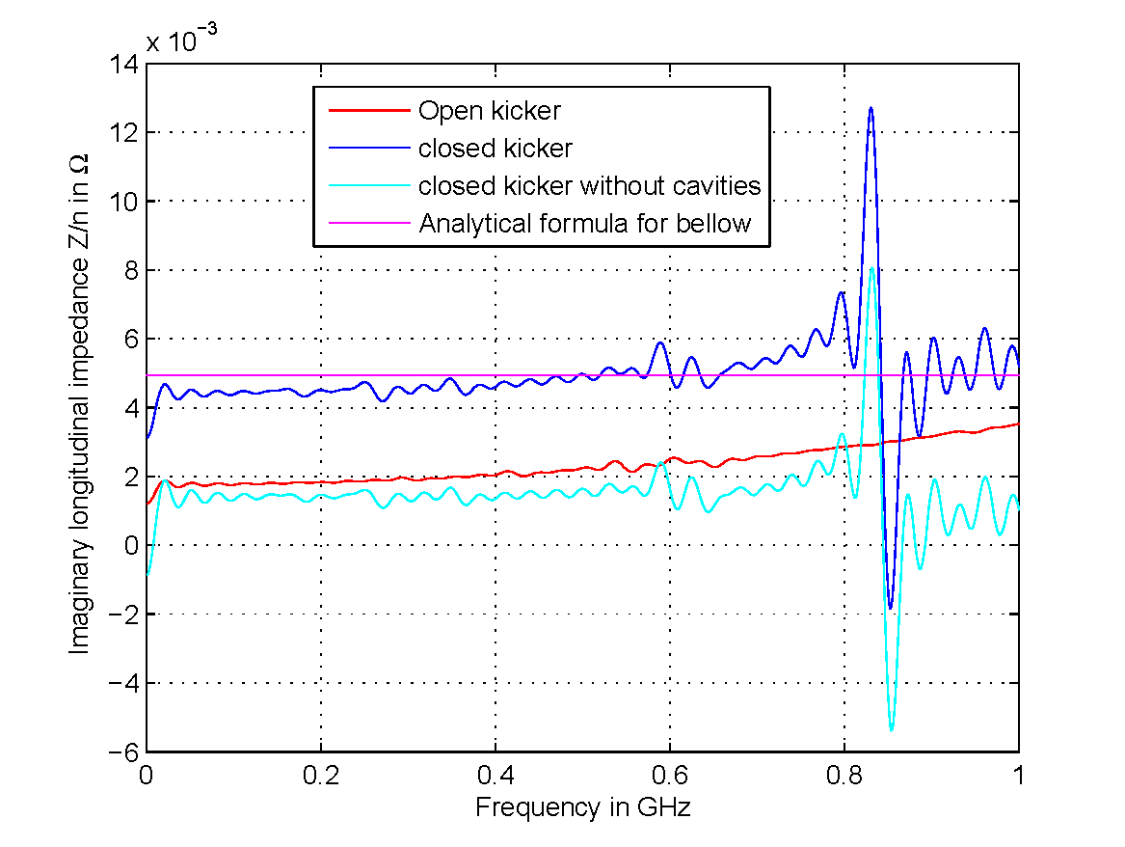
Longitudinal effective impedance
When closed, the cavities dominate the longitudinal effective impedance
When opened, the impedance of one kicker cavity is (Z/n)^{eff} ~2 mOhm
(i.e. ~2% of the full LHC impedance)
With 4 tanks, the impact on proton operation would be ~8% of full LHC impedance
and is significant.

Slide 4
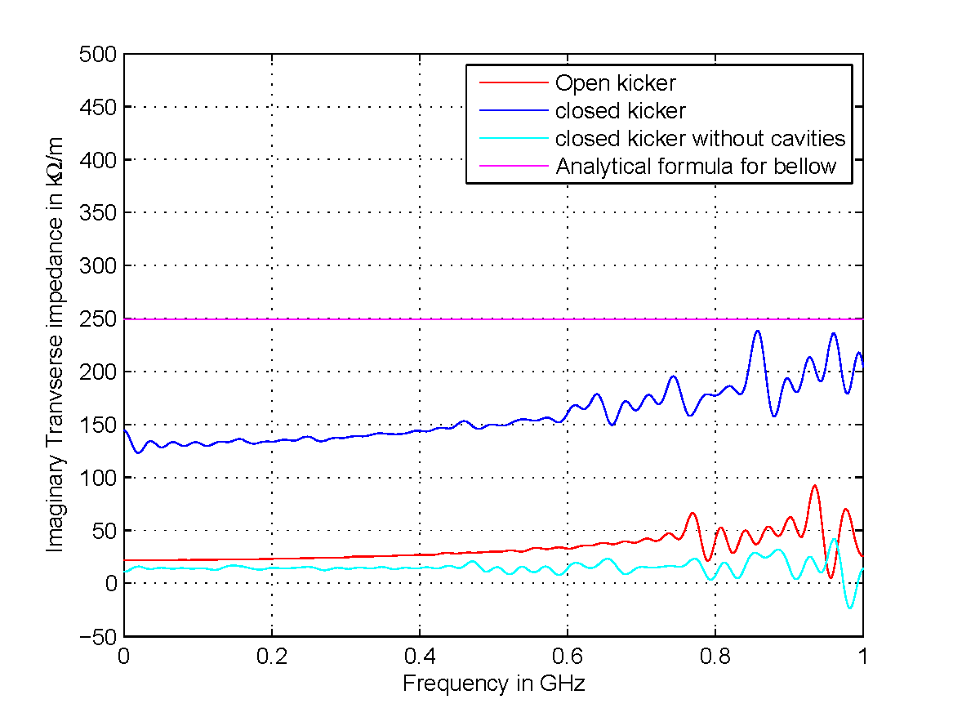
Transverse effective impedance
When closed, the cavities dominate the transverse effective impedance
When opened, the impedance of one kicker cavity is Z^{eff} ~25 kOhm/m
(i.e. ~1.2% of the full LHC impedance at injection)
With 4 tanks, the impact on proton operation would be ~5% of full LHC impedance
and is significant.

Slide 5
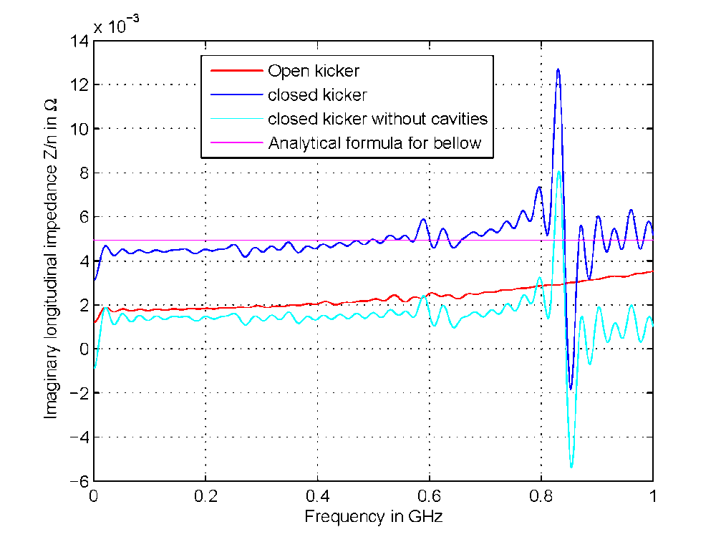
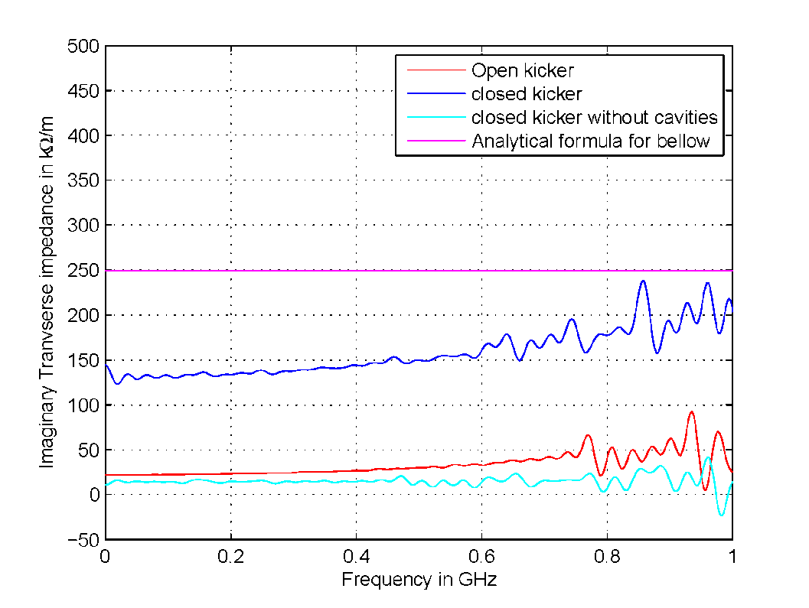

Slide 6
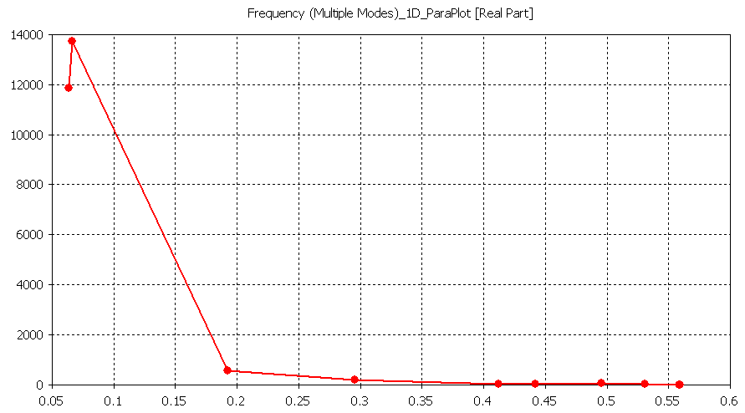
Shunt impedance of the modes
Shunt impedance in kOhm
Frequency in GHz

Slide 7
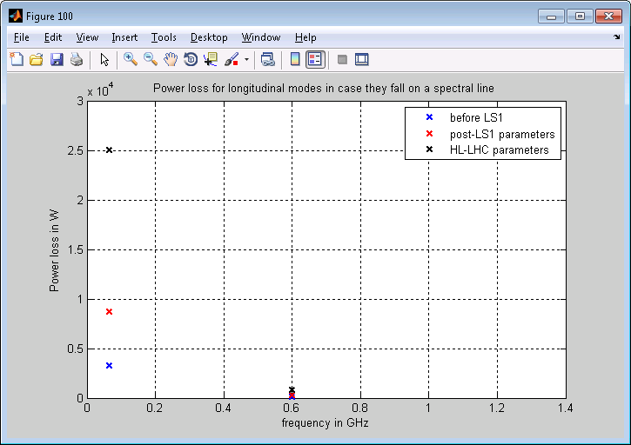
Power loss
→ Of the order of 10 kW for the first 2 modes around 50 to 60 MHz

Slide 8
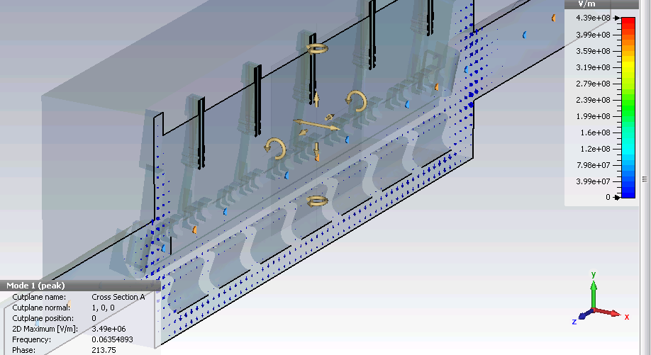
Mode pattern

Slide 9
Conclusion (very preliminary)
If our simulations are correct, the RHIC kickers could not be installed in LHC as is due to large low frequency modes.
However, these modes seem to be linked to the tank around the cavities, which of course could be optimized.
The effective impedance of the RHIC kickers would represent 5 to 10% of the total LHC impedance, which should be reduced.

