Slide 1
New ALICE Beam Pipe: Injection Protection
C. Bracco on Behalf of ABT/BTP
Acknowledgment: M. Giovannozzi

Slide 2
Outlines
Reminder
Assumptions
Aperture and beam envelope:
  Nominal injection
  Grazing event (MKI failure)
Conclusions

Slide 3
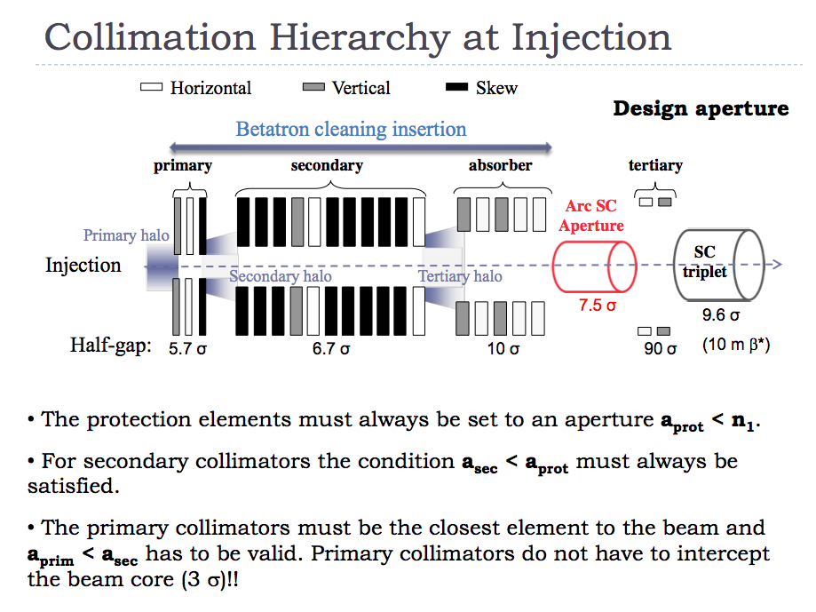
Reminder

Slide 4
Reminder
To protect the LHC aperture at injection (bottleneck in the arc) and respect the collimation hierarchy:
LHC injection protection collimators (TDI, TCLIA and TCLIB) ar at 6.8 σ
TCDI (in the TL) are at 4.5 – 5 σ

Slide 5
Alice aperture: results - I
M. Giovannozzi
β*=10 m
θ_{ext}=170 μrad
Sep=2 mm
Ok!...check MKI grazing failure..
Minimum aperture = 13 σ (bottleneck in the arc)
4 σ bottleneck in the experiment

Slide 6
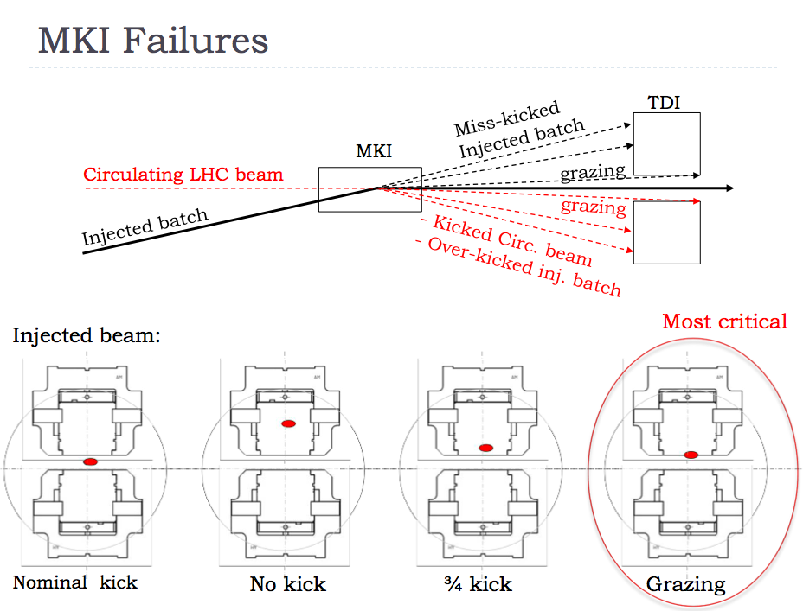
Reminder
90% MKI strength
10% MKI strength

Slide 7
Assumptions
Only MKI failures are considered :Only vertical plane
Normalised emittance of 3.5 mm mrad also for postLS2 case
Optics for protons (minimum n1):β* = 10 m, crossing angle = 170 μrad , separation =2 mm
Beam envelope: 6.8 σ_{β} (what can go through TCDIs and TDI)
Aperture: Mech.aperture* – Mech.tol.* – Orbit** – Disp.offset
* Data from ALICE and Massimo
** 3 mm *sqrt(β/max(β))
** Dy*3e-4

Slide 8
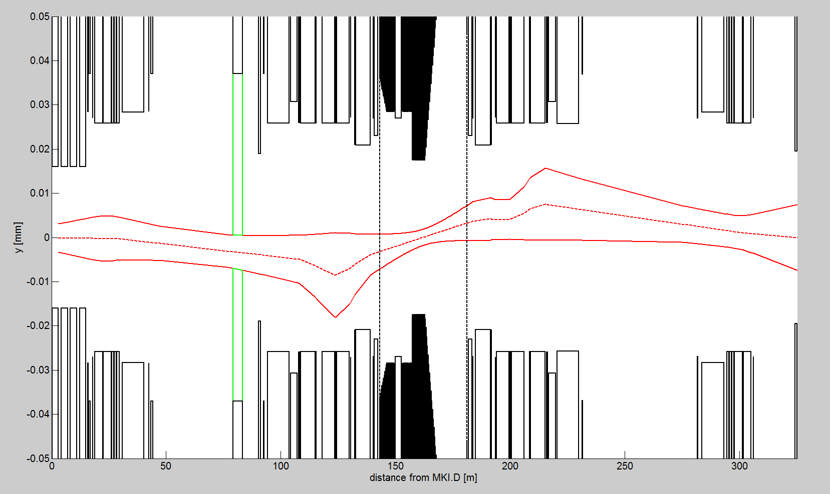
Aperture and Beam Envelope PreLS2
Nominal kick
TDI
TDI

Slide 9
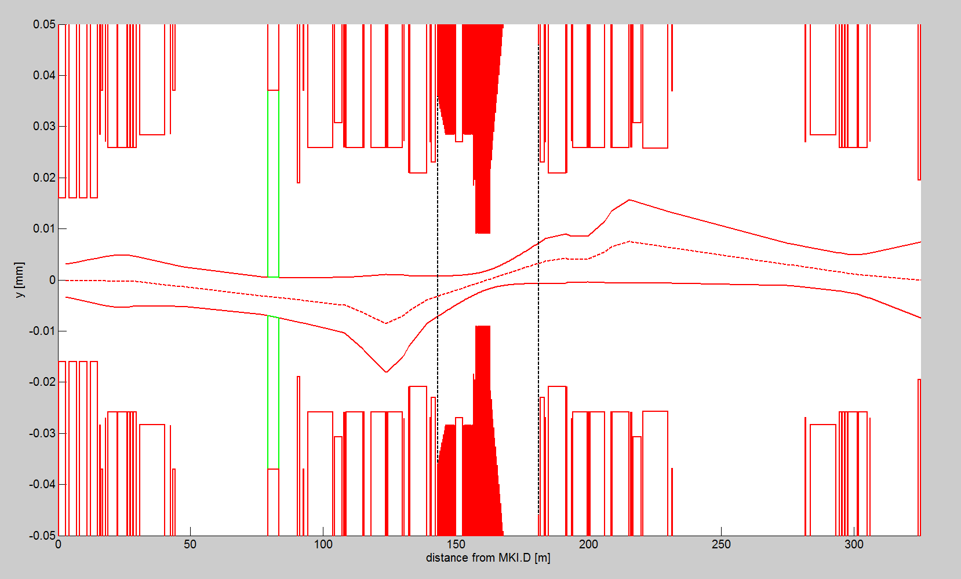
Aperture and Beam Envelope PostLS2
Nominal kick
TDI
TDI

Slide 10
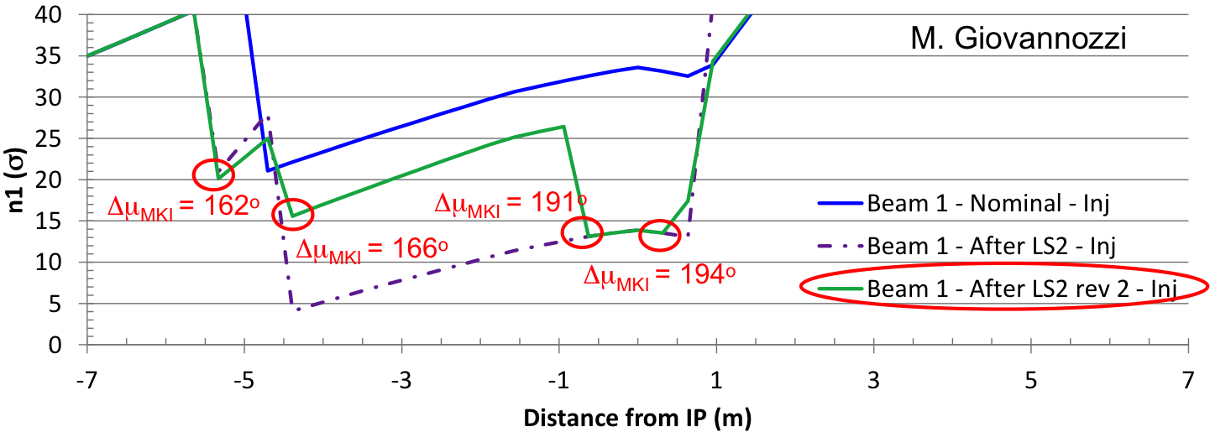
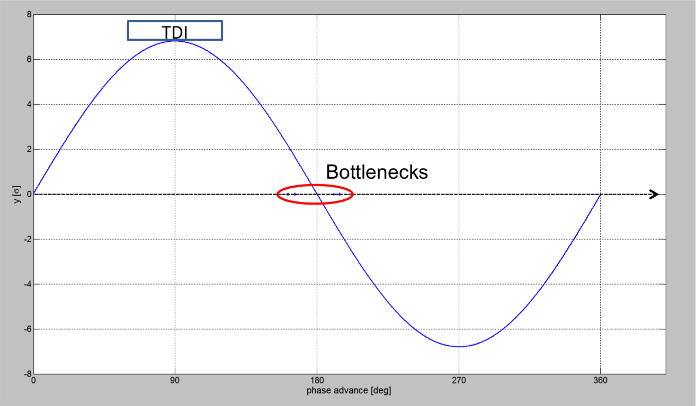
Phase Advance Min. Aperture- MKI

Slide 11
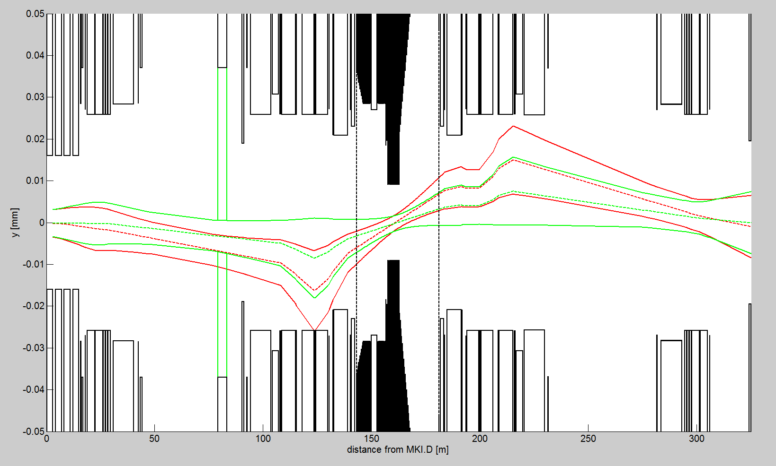
Grazing Event
grazing
(10% MKI kick)
TDI
Nominal MKI kick
TDI

Slide 12
Conclusions
The new proposed aperture fulfills the n1 requirements of collimation hierarchy: bottleneck kept in the arc and > 7.5 σ
No direct beam impact on the new aperture is expected also in case of the most critical MKI failure (grazing event)
Recommendation: calculate energy deposition induced by secondary showers in case of grazing event.

