Slide 1

STFC Contributions to the FCC Study
Peter McIntosh
STFC Daresbury Laboratory
Preparation Meeting for the FCC International Collaboration Board
CERN, 9 – 10 September 2014

Slide 2


Proposed STFC Activity Areas
WP3: Experimental Insertion Region Design:
  Task 3.3 Design machine detector interface (STFC (UMAN), INFN, CERN)
  UMAN coordinate task and study the MDI to ensure collider design is consistent with the detector performance:
    Determine detector apertures and integrate detector components into IR optics (UMAN).
    Evaluate impact of debris from the collimation system on the IR and optimise (UMAN/CERN).
    Study impact of synchrotron radiation emitted by protons on detector and machine components in the IR and develop mitigation techniques (UMAN/INFN).
WP4: Cryogenic Beam Vacuum Conception:
  Task 4.3 Mitigate beam-induced vacuum effects (STFC, CERN)
  STFC coordinate task to study different coatings to mitigate beam-induced electron cloud and ion instabilities on flat samples and beam-screen prototypes provided by CERN.
  Demonstrated coating compatibility at cryogenics temperatures:
    Adherence of coatings after several cool down and warm up cycles.
FCC MOU Tech. R&D: 100MW RF Programme: RF Cavity Design:
  The development of surface processing and coating techniques on seamless 6 GHz cavities, for possible application to 800 MHz multi-cell cavities.
  Research Agreement between CERN, CFR-INFN and STFC under preparation.

Slide 3
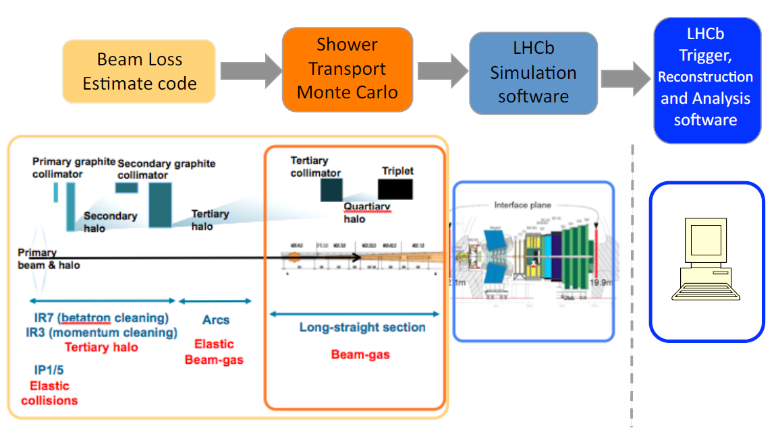
WP3: MDI Design (STFC (UMAN))
Coordinated by Rob Appleby (UMAN), with a PDRA funded from the Cockcroft Institute and EuroCirCol.
UMAN provide the required expertise and know-how on beam dynamics and collider physics, ranging from optics design to Monte Carlo simulations to beam operations.

Slide 4
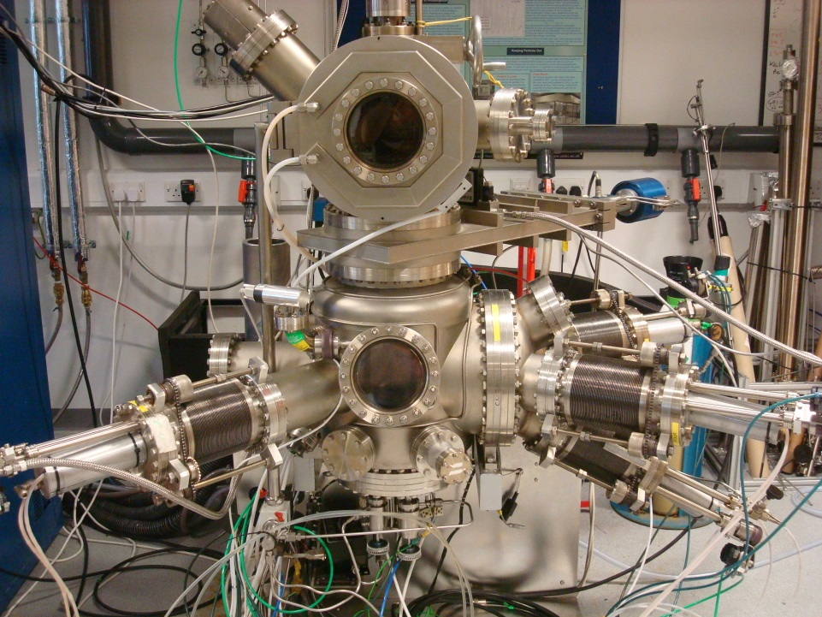
WP4: Mitigate Beam-induced Vacuum Effects (STFC)
Coordinated by Oleg Malyshev (STFC) with two Phd students funded from STFC and EuroCirCol.
NEG coating R&D:
  Ti-Zr-Hf-V coating can be activated at 150ºC:
    Comparing to at 180ºC for Ti-Zr-V.
  Dense film provides lower PSD and ESD than columnar film.
  Dual layer NEG could provide further reduction of PSD and ESD.
Magnetron and Ion Assist PVD Facility
at Daresbury

Slide 5
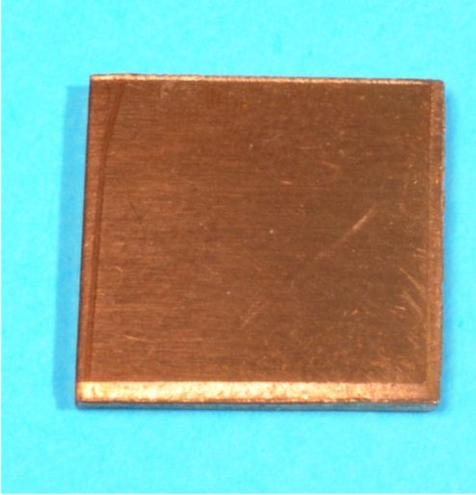
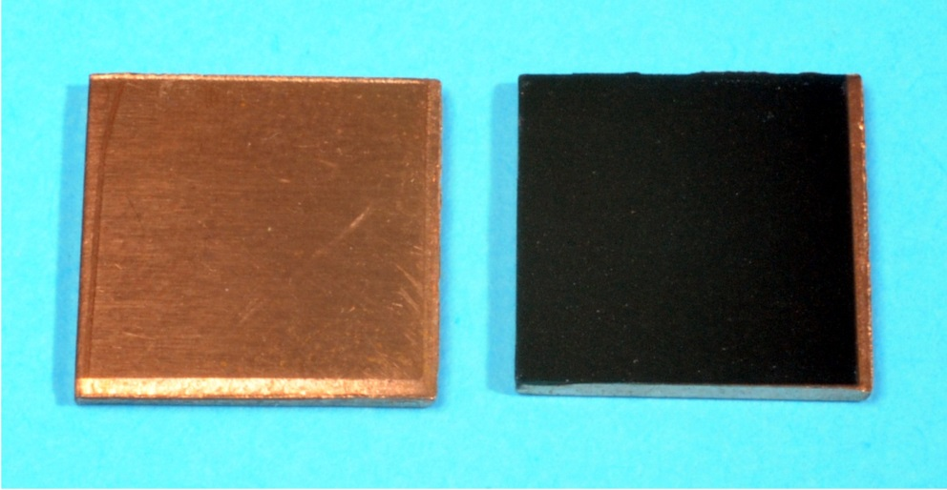
New STFC Discovery: SEY <1!
Non-treated copper surface
Laser-treated copper surface in air
STFC patent application filed.

Slide 6
WP4: Mitigate Beam-induced Vacuum Effects (STFC)
Engineered surface with SEY < 1 benefits:
  Potentially ideal solution for electron cloud mitigation.
Low cost treatment:
  The treatment is carried out in-air.
  High treatment speed (e.g. much quicker than PVD coating)
Possibility to apply to new and/or in-situ beam pipes.
Possibility to treat long vacuum chambers.
Can be done on copper, aluminium, stainless steel (tested) and, most likely, on other metals.
Does not change PSD, ESD and outgassing characteristics.
Results only preliminary at this stage – needs more R&D to validate its applicability.
Process being presented this week at the European Vacuum Conference EVC-13, Aviero, Portugal.

Slide 7
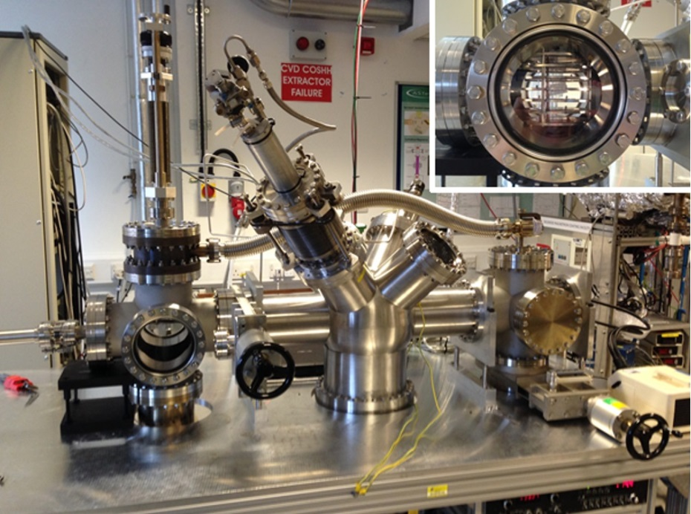
FCC MOU Technology R&D: RF Cavity Design
Reza Valizadeh (STFC) with Phd student will support CERN and CFR-INFN to analyse optimum SRF coated samples.
Two deposition facilities at Daresbury:
  PVD for flat sample deposition:
    Biased
    Pulsed
    HiPIMS
  ALD CVD for planar and 3D deposition.

Slide 8
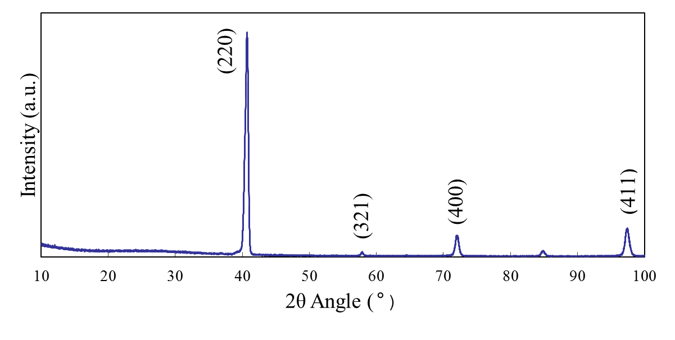
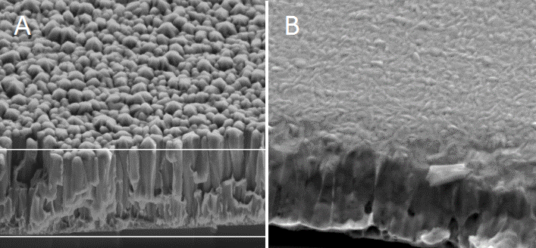
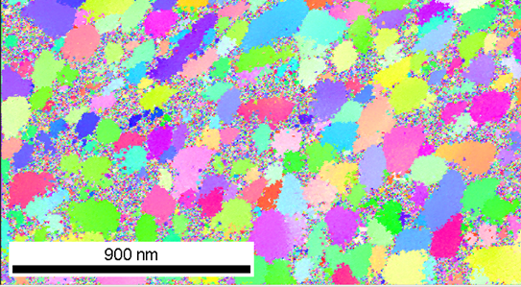
SRF Thin Film Surface Analysis
XRD spectrum for thin Nb film
Samples are analysed on its structure, morphology and chemical composition.
SEM images of samples deposited
(A) without a bias and (B) with a 50 V bias
EBSD image showing grain size up to 250 nm across. Colours relate to different lattice orientation

