Slide 1



Global Future Circular Collider (FCC) Study
Goals and Governance

Slide 2
Why
Push the energy frontier beyond LHC
High priority item within the
European Strategy for Particle Physics
Timely
  lead times for R&D very long
  LHC physics program for ~20 years
Need for a project plan when results from LHC (and other facilities) indicate direction to go

Slide 3
What
Technical / Conceptual Design Reports for linear e⁺e⁻ colliders exist: ILC and CLIC
  Japan interested in housing ILC
  Europe and CERN: participation in both endeavours will be continued
Need to go beyond present energy frontier → circular high energy collider

Slide 4
How
Exploitation of all options for such a project (hh – ee – ep) within one study
Global Collaboration for the study of Future Circular Collider options
(similar to the CLIC collaboration)
Hosted by CERN

Slide 5
Scope (i)
A conceptual design study of options for a future high-energy frontier circular collider at CERN for the post-LHC era shall be carried out, implementing the request in the 2013 update of the European Strategy for Particle Physics.
Many results of the study will be site independent.
The design study shall be organised on a world-wide international collaboration basis under the auspices of the European Committee for Future Accelerators (ECFA) and shall be available in time for the next update of the European Strategy for Particle Physics, foreseen by 2018.

Slide 6
Scope (ii)
The main emphasis of the conceptual design study shall be the long-term goal of a hadron collider with a centre-of-mass energy of the order of 100 TeV in a new tunnel of 80 - 100 km circumference for the purposes of studying physics at the highest energies.
The conceptual design study shall also include a lepton collider and its detectors, as a potential intermediate step towards realization of the hadron facility. Potential synergies with linear collider detector designs should be considered.
Options for e-p scenarios and their impact on the infrastructure shall be examined at conceptual level.
The study shall include cost and energy optimisation, industrialisation aspects and provide implementation scenarios, including schedule and cost profiles.

Slide 7
The FCC Collaboration
Organisations working together to carry out the conceptual design study, leading to a set of Conceptual Design Report volumes
Circular energy frontier collider designs
Physics cases for collider options & experiments
Key parameters of collider options & experiments
Infrastructure concepts
Detector concepts
Identify, launch and coordinate R&D programmes
Identify synergies with other high-energy frontier studies
Cost estimates, implementation scenarios

Slide 8
Host Organisation
CERN is legal entity organising the study. Participates in the study as collaboration member and appoints study leader
Establish organisational framework to carry out study
Set up international collaboration
Identify required R&D actions
Monitor compliance of collaboration members
Collect, review, verify reports and deliverables
Transmit relevant information to any party concerned
Administer member contributions and external funding

Slide 9
FCC Structure
CERN DG
Collaboration Board
Steering Committee
Advisory Committee
Study
Coordination Group
Hadron Collider Physics Experiments
Lepton Collider
Physics Experiments
e-p
Physics Experiments Machines
Hadron
Injectors
Hadron
Collider
Lepton
Injectors
Lepton
Collider
Accelerator
R&D
Technologies
Infra-structures
Operation
Costing Planning

Slide 10
FCC Governance Structure
CERN DG
Collaboration Board
Steering Committee
Advisory Committee
Study
Coordination Group
Hadron Collider Physics Experiments
Lepton Collider
Physics Experiments
e-p
Physics Experiments Machines
Hadron
Injectors
Hadron
Collider
Lepton
Injectors
Lepton
Collider
Accelerator
R&D
Technologies
Infra-structures
Operation
Costing Planning

Slide 11
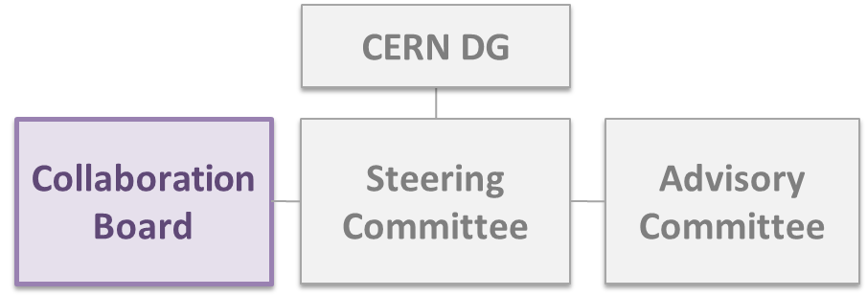
Collaboration Board
Aim at geographically well-balanced and topically complementary network of contributions
Tasks:
  Identify and review resource needs
  Find matches within collaboration
  Nominate Steering Committee in agreement with CERN DG
Meet: once per year
Composition:
  One representative per collaboration participant
  Chair elected from participant organisations
  Voting with simple majority

Slide 12
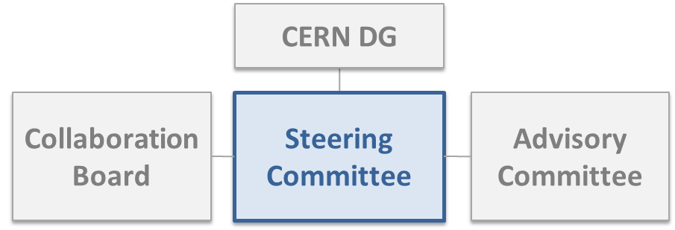
Steering Committee
Supervisory and main
governance body acting on
behalf of the collaboration
Tasks:
  Ensure implementation of collaboration board decisions
  Formulate strategy scope, individual goals and work program
  Monitor efficient carrying out of the study, report to CB and DG
Meet: four times per year
Composition (up to 9 members):
  ECFA representative and Collaboration Board chair
  Two representatives of host organisation
  Up to five further members of Collaboration Board,
  leading to well-balanced, world-wide geographical distribution

Slide 13
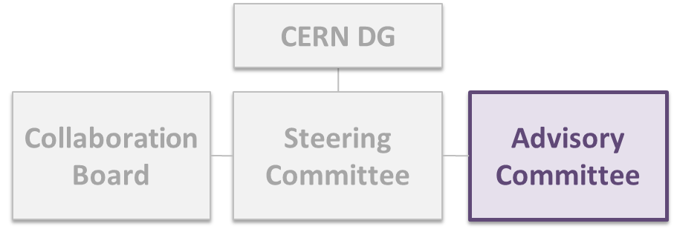
Advisory Committee
Facilitate major technical decisions of the Steering Committee
Tasks:
  Review scientific and technical progress
  Submit scientific and technical recommendations to
  Steering Committee
Meet: once per year
Composition:
  Up to two external experts for relevant domains
  (accelerators, particle physics, experiments & detectors, engineering, key technologies)
  Members proposed by Steering Committee
  Members appointed by Collaboration Board

Slide 14
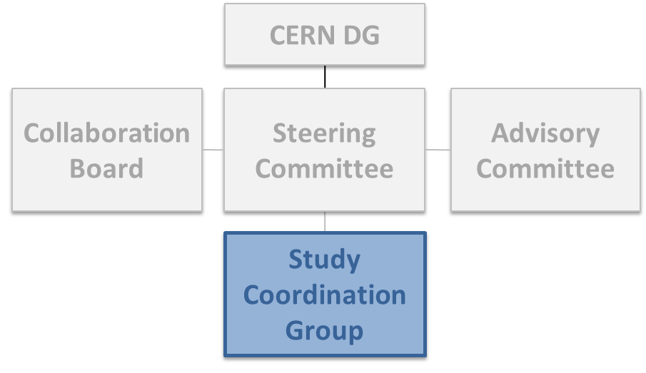
Coordination Group
Executive body of the project
Tasks:
  Coordinate work packages
  Day-to-day management
  Assist and facilitate work of Steering Committee
Meet: once per month
Composition:
  Members proposed by host organisation
  Members appointed by Steering Committee
  Chaired by Study Leader

Slide 15
Conclusions
The FCC conceptual design study, includes two large machine studies (hh, ee), as well as three detector and physics options (hh, ee, he).
The Coordination Group and Study Team will face a large parameter area and a challenging overall optimisation process.
Intensive and frequent exchange between Coordination Group and the Governance Structure will be essential in this process.
The proposed FCC organisation structure is well adapted to these challenging tasks.

Slide 16
Interim Collaboration Board Chair
Interim Chairperson for Collaboration Board, to bridge formation phase until March 2015 FCC annual workshop
By 3rd September 2014, 16 institutes had joined the collaboration by signing the MoU, while discussions are ongoing with several other potential collaboration partners.
In order to advance as fast as possible with the further organisation of the collaboration, an interim Collaboration Board chair person was selected out of the 16 institutes.
This structure should remain in place until the first annual FCC meeting scheduled for March 2015, when a definite FCC governing structure should be established.
Prof. Leonid Rivkin of EPFL has been confirmed for this role by all 16 institutes.

