Slide 1

Study Organisation
Michael Benedikt
FCC Preparatory Collaboration Board Meeting
September 9th, 2014

Slide 2
Outline
Collaboration
Memorandum of Understanding
Study Organisation
Work Breakdown
Current Status and Resources

Slide 3
Frame for FCC Study
Initiated by CERN as response to update of European Strategy for Particle Physics
Produce conceptual designs for next large-scale particle physics research infrastructure by 2018
As a collaborative effort across national boundaries & continental regions
CERN acts as enabler for an international collaboration, hosting the study

Slide 4
CERN as Host Laboratory
Establish organisational framework
Set up a functioning international Collaboration
Identify required research and development actions
Monitor compliance by the Members of the Collaborations with their obligations and planning
Collect, review and verify consistency of parameters, reports and deliverables
Transmit information relevant to the study to any other Parties concerned
Administer the contributions of the Members of the Collaboration and of external Funding Authorities

Slide 5
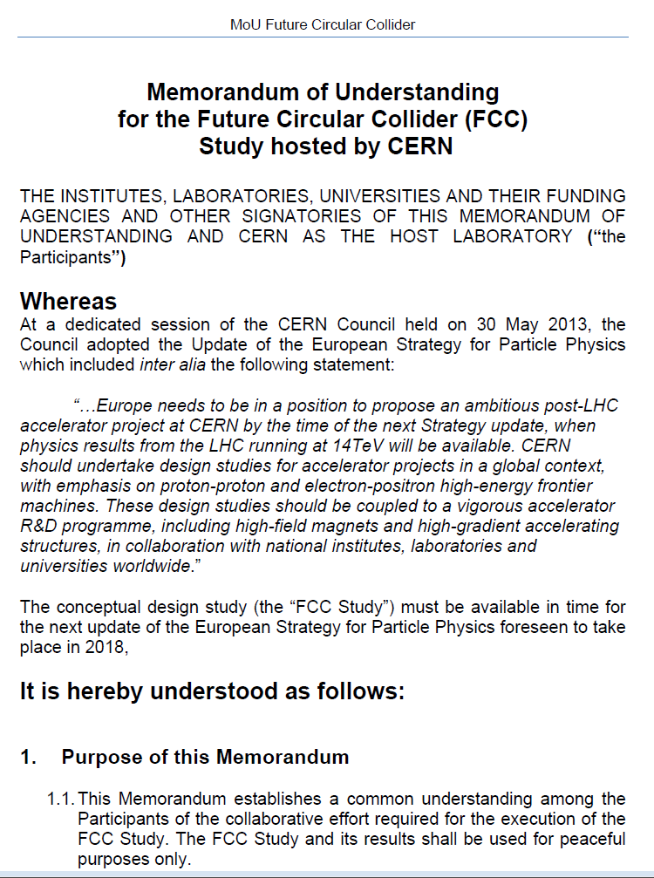

Collaboration
A number of parties who agree to carry out the conceptual design work
Memorandum of
Understanding (MoU)
defines Collaboration
A public organisation
joins the Collaboration
by signing the MoU
Collaboration is open
to continuous extension

Slide 6
MoU
Establishes a common understanding about the goals of the study
Creates a situation of trust among equal participants to permit achieving the goals
Work contribution of a participant is carried out on a “best-effort” basis
CERN also is a participant

Slide 7
Scope of Work – WBS
Work Breakdown Structure lists all work to be carried out to achieve the study goals
Serves the participants of the Collaboration to commit to well-defined and manageable portions of work
Permits the Coordinator to come to a topically complementary and geographically well-balanced network of contributions

Slide 8
MoU Addendum
Each participant agrees with the Collaboration to take over some particular work unit
Work unit contents and deliverables are defined in a specific Addendum for each participant indicating:
  Resources contributed by the participant
  ant Resources required from the host (CERN)

Slide 9
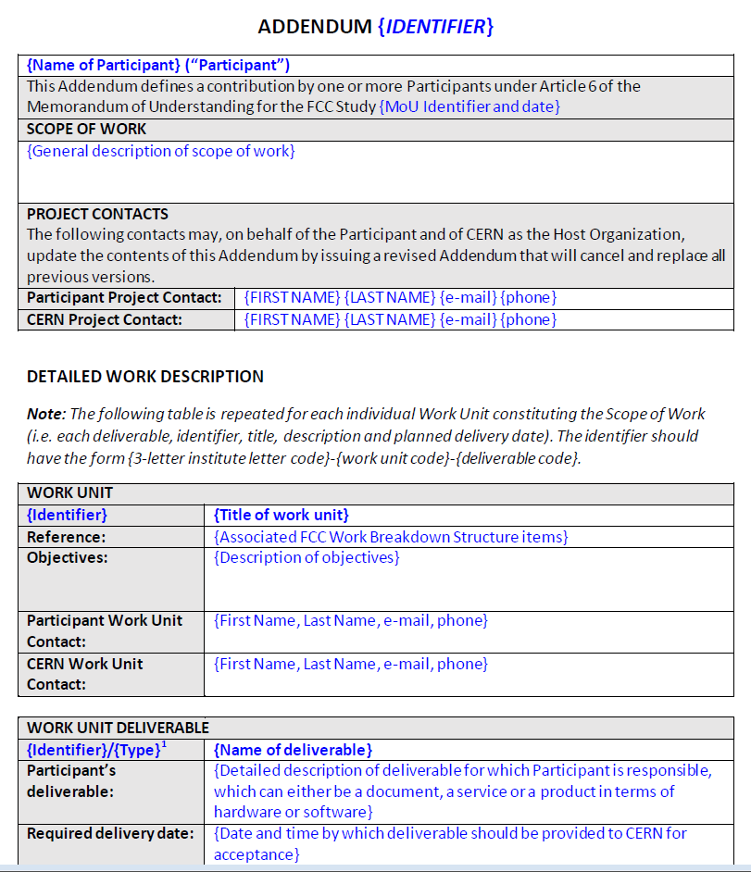
Addendum (Work Definition)
Work areas covered by the participant
competences brought into the collaboration
Contact persons participant, coordinator
Match to WBS
Definition of work
Definition of what is delivered as result

Slide 10
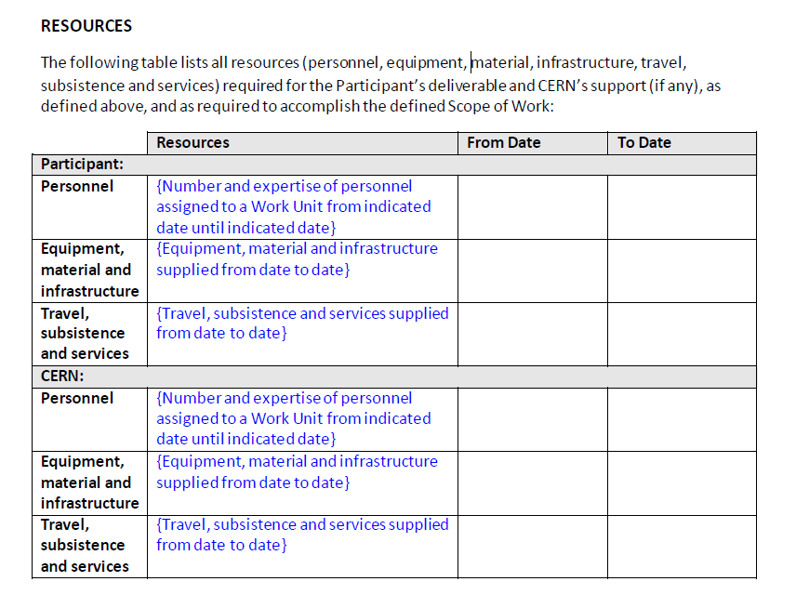
Addendum (Resources)
Contributed
Personnel
Material
Services
Contributions
required from CERN
to complete work

Slide 11
Update of Addendum
One addendum per participant
One primary contact per participant
  Separate contacts defined on participant and coordinator side for all work units
Addendum can be updated
  Participation scope and topics evolve
  Participant consists of multiple logical units
  Study scope evolves
  Resources evolve
Procedure applied for accelerators, infrastr. technology, experiments and detectors

Slide 12
Progress Monitoring
Primarily via study organisational structure and coordination group(s)
In addition participants provide a status update twice per year (by simple e-mail)
For each defined deliverable:
  Very brief status overview (5 lines)
  Remaining work to be done (5 lines)
  Showstoppers encountered (if any, 3 lines)
  Foreseen, updated completion date (1 lines)

Slide 13
FCC Study – Main Areas
FCC Study
Hadron Collider Physics and Experiments
Lepton Collider Physics and Experiments
e-p Physics and Experiments, Accelerators
Hadron Injectors
Hadron Collider
Lepton Injectors
Lepton Collider
Accelerator R & D and Technologies
Infrastructures and Operation
Costing Planning

Slide 14
Study Coordination Group
Study Coordination
M. Benedikt, F. Zimmermann
Hadron Collider Physics and Experiments
F. Gianotti, A. Ball, M. Mangano
Lepton Collider Physics and Experiments
A. Blondel, J. Ellis, P. Janot
e-p Physics, Experiments, IP Integration
M. Klein, O. Bruning
Hadron Injectors
B. Goddard
Hadron Collider
D. Schulte, M. Syphers, J.M. Jimenez
Lepton Injectors
Y. Papaphilippou (tbc)
Lepton Collider
J. Wenninger, U. Wienands, J.M. Jimenez
Accelerator R & D and Technologies
M. Benedikt, F. Zimmermann
Infrastructures and Operation
P. Lebrun, P. Collier
Costing Planning
F. Sonnemann, P. Lebrun

Slide 15
Study Organisation
Study Coordination Group
Hadron Collider Physics and Experiments
Physics
Coordination
Lepton Collider Physics and Experiments
e-p Physics, Experiments, Accelerators
Hadron Injectors
Accelerator Coordination
Hadron Collider
Lepton Injectors
Lepton Collider
Accelerator R & D and Technologies
Infrastructures and Operation
Infrastructure
Coordination
Costing Planning

Slide 16
Meeting structure (i)
Work/meeting structures established based on INDICO:
FCC Study: https://indico.cern.ch/category/5153/
FCC-hh Hadron Collider Physics and Experiments VIDYO meetings
  https://indico.cern.ch/category/5258/
  Contacts: michelangelo.mangano@cern.ch, fabiola.gianotti@cern.ch, austin.ball@cern.ch
FCC-ee Lepton Collider Physics and Experiments VIDYO meetings
  https://indico.cern.ch/category/5259/
  Contacts: alain.blondel@cern.ch, patrick.janot@cern.ch, john.ellis@cern.ch

Slide 17
Meeting structure (ii)
- FCC-hh Hadron Collider VIDYO meetings
- https://indico.cern.ch/category/5263/
- Contacts: daniel.schulte@cern.ch
- FCC-hadron injector meetings
- https://indico.cern.ch/category/5262/
- Contacts: brennan.goddard@cern.ch
- FCC-ee Lepton Collider VIDYO meetings
- https://indico.cern.ch/category/5264/
- Contacts: jorg.wenninger@cern.ch,
- FCC infrastructure meetings
- https://indico.cern.ch/category/5253/
- Contacts: philippe.lebrun@cern.ch, peter.sollander@cern.ch

Slide 18
Work Breakdown Structure
Physics and Experiments
Accelerators
Infrastructures
and Operation
Implementation
and Planning
Study and Quality
Management
Hadron Collider Physics
Hadron Injectors
Civil Engineering
Project Risk Assessment
Study Administration
Hadron Collider Experiments
Hadron Collider
Technical Infrastructures
Implementation Scenarios
Communications
Lepton Collider Physics
Lepton Injectors
Operation and Energy Efficiency
Cost Models
Conceptual
Design Report
Lepton Collider Experiments
Lepton Collider
Integration
Lepton-Hadron Collider Physics
Lepton-Hadron Collider
Computing and
Data Services
Lepton-Hadron Collider Experiment
Technology R&D
Safety, RP and Environment

Slide 19

WBS – H2020 EU DS proposal
Physics and Experiments
Accelerators
Infrastructures
and Operation
Implementation
and Planning
Study and Quality
Management
Hadron Collider Physics
Hadron Injectors
Civil Engineering
Project Risk Assessment
Study Administration
Hadron Collider Experiments
Hadron Collider
Technical Infrastructures
Implementation Scenarios
Communications
Lepton Collider Physics
Lepton Injectors
Operation and Energy Efficiency
Cost Models
Conceptual
Design Report
Lepton Collider Experiments
Lepton Collider
Integration
Lepton-Hadron Collider Physics
Lepton-Hadron Collider
Computing and
Data Services
Lepton-Hadron Collider Experiment
Technology R&D
Safety, RP and Environment

Slide 20
FCC-hh Hadron Collider
1.2.2 | Functional machine design | preliminary - institutes to be confirmed
1.2.2.1 | Single beam collective effects | KEK, CEA, TUD
1.2.2.11 | Beam-beam collective effects and dynamic aperture | KEK, EPFL, FZJ
1.2.2.2 | Collimation and absorber concepts | IN2P3-LAL, IN2P3-IPNO, DESY
1.2.2.3 | Injection and extraction concepts and designs
1.2.2.4 | Ion beam operation design considerations
1.2.2.5 | Interaction region and final focus design | JAI
1.2.2.6 | Lattice design and integration and single particle dynamics | IN2P3-IPNO, DESY, CEA
1.2.2.7 | Machine detector interface | CI, IN2P3-LAL, DESY, INFN-LNF
1.2.2.8 | Machine protection, magnet protection, QPS, BLM concepts
1.2.2.9 | Radiation maps and effects
1.2.2.10 | HE-LHC performance needs and conceptual design
1.2.2.12 | RF and feedback conceptual design
1.2.3 | Technical systems
1.2.3.1 | Technologies that require R&D
1.2.3.2 | Beam diagnostics requirements and conceptual design
1.2.3.3 | Beam transfer elements requirements and conceptual design
1.2.3.4 | Collimation systems and absorber requirements and conceptual design
1.2.3.5 | Control system requirements
1.2.3.6 | Dump and stopper requirements and conceptual design
1.2.3.7 | Element support, survey and alignment requirements and concepts
1.2.3.8 | Machine detector interface system needs and conceptual design | CI, INFN
1.2.3.9 | Machine protection system requirements and conceptual design
1.2.3.10 | Normal magnet requirements and element conceptual design
1.2.3.11 | Power converter requirements and conceptual design
1.2.3.12 | Quench protection and stored energy management requirements and concepts | INFN, TUT
1.2.3.13 | RF requirements and conceptual design | CI
1.2.3.14 | Superconducting magnet and cryostat requirements and conceptual design
1.2.3.15 | Proximity cryogenics for superconducting magnets and RF
1.2.3.16 | Vacuum system requirements and conceptual design | CI, INFN-LNF, STFC
1.2.3.17 | Shielding
1.2.3.18 | Cryogenic beam vacuum system | ALBA, CIEMAT, STFC, INFN, KIT

Slide 21
Hadron Collider Physics
2.1.1 | Exploration of EW Symmetry Breaking | preliminary - institutes to be confirmed
2.1.1.1 | High-mass WW scattering, high mass HH production
2.1.1.2 | Rare Higgs production/decays and precision studies of Higgs properties
2.1.1.3 | Additional BSM Higgs bosons: discovery reach and precision physics programme
2.1.1.4 | New handles on the study of non-SM EWSB dynamics
2.1.2 | Exploration of BSM phenomena
2.1.2.1 | Discovery reach for various scenarios
2.1.2.2 | Theoretical implications of discovery/non-discovery of BSM scenarios
2.1.3 | Continued exploration of SM particles
2.1.3.1 | Physics of the top quark
2.1.3.2 | Physics of the bottom quark
2.1.3.3 | Physics of the tau lepton
2.1.3.4 | W/Z physics
2.1.3.5 | QCD dynamics
2.1.4 | Opportunities other than pp physics
2.1.4.1 | Heavy Ion Collisions
2.1.4.2 | Fixed target experiments
2.1.4.3 | Smaller-size experiments for dedicated purposes
2.1.5 | Theoretical tools for the study of 100 TeV collisions
2.1.5.1 | Parton Distribution Function
2.1.5.2 | MC generators
2.1.5.3 | N^nLO calculations

Slide 22
Hadron Collider Experiments
2.2.1 | Detector performance | preliminary - institutes to be confirmed
2.2.1.1 | Rapidity coverage for tracking, leptons, jets
2.2.1.2 | Forward tracking and b-tag vs pile-up density
2.2.1.3 | Electromagnetic calorimeter: dynamic range, forward granularity
2.2.1.4 | Forward jet tagging
2.2.1.5 | Muon resolution in the O(10 TeV) region
2.2.1.6 | Optimisation of the bunch spacing (trigger and readout vs pile-up)
2.2.2 | Technical systems
2.2.2.1 | Technologies that require R&D
2.2.2.2 | Detector technologies
2.2.2.3 | Radiation effects
2.2.2.4 | Shielding
2.2.2.5 | ECAL
2.2.2.6 | HCAL
2.2.2.7 | Magnet system
2.2.2.8 | Muon detection
2.2.2.9 | Inner detector
2.2.2.10 | Tracking
2.2.2.11 | Trigger system
2.2.2.12 | Data acquisition, detector controls and detector safety

Slide 23
FCC-ee Lepton Collider
1.4.2 | Functional machine design | preliminary - institutes to be confirmed
1.4.2.1 | Beam-beam effects | BINP, KEK, CI
1.4.2.11 | Impedance and single-beam collective effects | KEK
1.4.2.2 | Collimation and absorber concepts
1.4.2.3 | Injection and extraction concepts and designs
1.4.2.4 | Interaction region and final focus design | BINP, CI, INFN-LNF
1.4.2.5 | Booster ring conceptual design and integration
1.4.2.6 | Lattice design and single particle dynamics
1.4.2.7 | Polarization and energy calibration | BINP, Uni Geneva
1.4.2.8 | Machine detector interface | INFN-LNF
1.4.2.9 | Machine protection concepts
1.4.2.10 | Radiation effects
1.4.3 | Technical systems
1.4.3.1 | Technologies that require R&D
1.4.3.2 | Beam diagnostics requirements and conceptual design
1.4.3.3 | Beam transfer elements requirements and conceptual design
1.4.3.4 | Collimation systems and absorber requirements and conceptual design
1.4.3.5 | Control system requirements
1.4.3.6 | Dump and stopper requirements and conceptual design
1.4.3.7 | Element support, survey and alignment requirements and concepts
1.4.3.8 | Machine detector integration
1.4.3.9 | Machine protection system requirements and conceptual design
1.4.3.10 | Normal magnet requirements and element conceptual design
1.4.3.11 | Power converter requirements and conceptual design
1.4.3.12 | Quench protection and stored energy management requirements and concepts
1.4.3.13 | RF system requirements and conceptual design
1.4.3.14 | Superconducting magnet and cryostat requirements and conceptual design
1.4.3.15 | Proximity cryogenics for RF and magnets
1.4.3.16 | Vacuum system requirements and conceptual design | KEK
1.4.3.17 | Shielding

Slide 24
FCC-ee Physics, Experiments
2.3.1 | Model building and new physics | preliminary - institutes to be confirmed
 | To be completed
2.3.2 | Precision EW calculations
 | To be completed
2.3.3 | Flavour (b,c, τ , ν) physics and rare decays
 | To be completed
2.3.4 | QCD and γγ physics
 | To be completed
2.3.5 | Combination and complementarity
 | To be completed
2.4.1 | EW physics at Z pole
2.4.2 | WW, ZZ, Zγ physics
2.4.3 | H(126) properties
2.4.4 | Top quark physics
2.4.5 | Flavour (b,c, τ , ν) physics and rare decays
2.4.6 | QCD and γγ physics
2.4.7 | Experimental signatures of new physics
2.4.8 | Experimental environment
2.4.9 | Detector designs
2.4.10 | On-line software
2.4.11 | Off-line software

Slide 25
Technology R&D
1.6.1 | 16 T Superconducting Magnet Program | preliminary - institutes to be confirmed
1.6.1.1 | Accelerator magnet design study for hadron collider | CIEMAT, UT, KEK, TUT, CEA, INFN
1.6.1.2 | Nb3Sn material R&D | UT, KEK, UNIGE
1.6.1.3 | 16 T short model construction
1.6.1.4 | 16 T support technologies
1.6.1.5 | Magnet/collider integration studies
1.6.2 | 20 T Superconducting Magnet Program
1.6.2.1 | 5 T HTS insert
1.6.2.2 | HTS Material R&D
1.6.2.3 | 20 T magnet design
1.6.5 | Injector/Booster Magnet Program | KEK
1.6.5.1 | Superferric HTS magnet
1.6.5.2 | Superferric HTS short model
1.6.5.3 | Performance of ramped SC magnets
1.6.3 | 100 MW RF Program | KEK
1.6.3.1 | Cavity design | CI
1.6.3.2 | Optimisation of cryogenic power consumption
1.6.3.3 | Multi-beam klystron demonstrator
1.6.3.4 | Klystron working point for optimum efficiency
1.6.3.5 | Cryo-module and ancillary systems design
1.6.4 | Specific Technologies Program
1.6.4.1 | More efficient, compact and higher capacity helium cryo-plants
1.6.4.2 | Non conventional cryogen mixtures for efficient refrigeration below 100 K
… | …

Slide 26
Organisation Physics/Phenomenology
Status of physics/phenomenology studies
  First exploration of physics opportunities for ee and eh already documented
  For hh (incl. heavy ions and injectors) studies ongoing, first report by end 2015
  Common (ee/eh/hh) software platform under development
Coordination of physics/phenomenology studies:
  Physics subgroups run by conveners. They outline priorities, define tasks, but also collect input from the broad pheno/theory community.
  Most work arising from independent efforts of single theory groups. New original ideas are developing. This should not be coordinated from the top: conveners to engage authors and give coherence to all material emerging from the literature
  Exploration of synergies and complementarities of ee/eh/hh jointly steered .
Participation in physics/phenomenology studies
  Fully open: inform the group leaders of intent to contribute.
  No requirement of formal MoU to join physics studies
  MoU possible, if it helps the proponent group to obtain support from funding agency. Subject to agreement by Study group coordinators.

Slide 27
MoU Status 8. September 2014
ALBA/CELLS, Spain
BINP, Russia
CBPF, Brazil
CIEMAT, Spain
Cockcroft Institute, UK
CSIC/IFIC, Spain
DESY, Germany
EPFL, Switzerland
Hellenic Open U, Greece
JAI/Oxford, UK
20 signed, 15 further basically agreed, pending signatures
KEK, Japan
King’s College London, UK
MEPhI, Russia
Sapienza/Roma, Italy
TU Darmstadt, Germany
TU Tampere, Finland
U. Geneva, Switzerland
U. Iowa, USA
U. C. Santa Barbara, USA
U Silesia, Poland

Slide 28
Resource Status
CERN
  Medium-Term Plan 2015-2019 (June ‘14)
  ~ 30 FTEs: ~ 1800 person months
  ~ 30 fellows and doct. Students ~ 1800 person months
  Material budget for fellows, PhD and technology R&D (focus on 16 T dipole program and SRF): 50 MCHF
Collaboration
  Commitment of 1085 person months for EuroCirCol H2020 DS proposal
  Other commitments (Addenda) presently: ~ 200 PM
  Further commitments TBD

Slide 29


Study Time Line
2014 |  |  |  | 2015 |  |  |  | 2016 |  |  |  | 2017 |  |  |  | 2018
Q1 | Q2 | Q3 | Q4 | Q1 | Q2 | Q3 | Q4 | Q1 | Q2 | Q3 | Q4 | Q1 | Q2 | Q3 | Q4 | Q1 | Q2 | Q3 | Q4
Study plan, scope definition
Explore options
“weak interaction”
Workshop & Review: identification of baseline
Explore options, now – spring 2015:
Investigate different options in all technical areas, taking a broad view
Deliverables: description/comparison of options with relative merits/cost, understand relative impact of options on overall study/project
FCC workshop to converge to common baseline with small number of options
1st Yearly FCC Workshop 23 – 27 March 2015, Washington DC
Followed by review ~2 months later, begin June 2015
conceptual study of baseline “strong interact.”
Workshop & Review, cost model, LHC results → study re-scoping?
Elaboration,
consolidation
Workshop & Review
→ contents of CDR
Report
Release CDR

Slide 30
Summary
Work has started
International collaboration is forming
H2020 EuroCirCol proposal submitted
Work Breakdown Structure:
http://cern.ch/fcc/Documents/Organisation/WBS.pdf
Looking forward to our FCC Collaboration!

