Slide 1
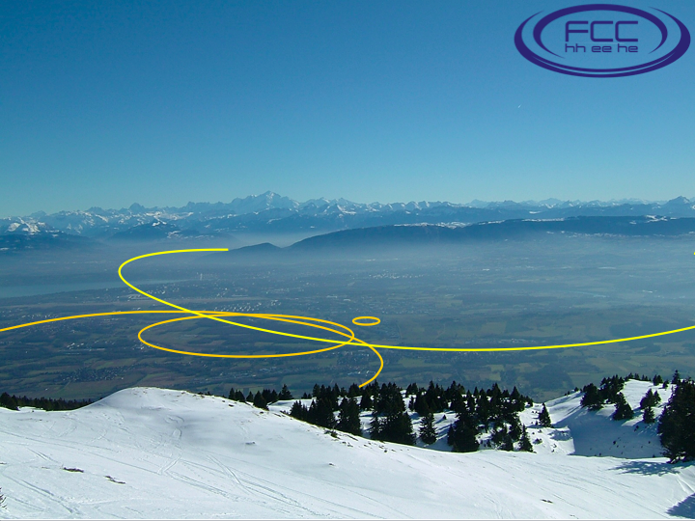

FCC Physics Studies
John Ellis - King’s College London

Slide 2
Kings College London
- Theoretical group with interests in collider physics, BSM and astroparticle physics
- Participation in ATLAS
(one faculty member: top, Higgs)
- Participation in MoEDAL
(three faculty members, incl. physics coordinator)
- Close collaboration with Imperial College CMS group

Slide 3
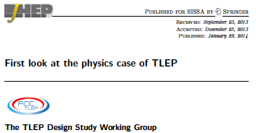
Kings College London
Interested in physics of FCC-ee, FCC-hh, interplay between them
Two faculty members engaged (Bobby Acharya, John Ellis), postdocs, students
Plan to collaborate with Imperial College London, ICTP Trieste, U. of Michigan
Funding currently through ERC grant to JE ‘Terauniverse’
Will seek other continuing sources

