Slide 1
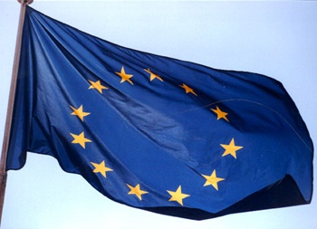
ESGARD, H2020 and FCC
http://www.esgard.org/
R. Aleksan
FCC-ICB
September 9th, 2014
Accelerator R&D in EC-FP
DS Projects submitted
Conclusion

Slide 2
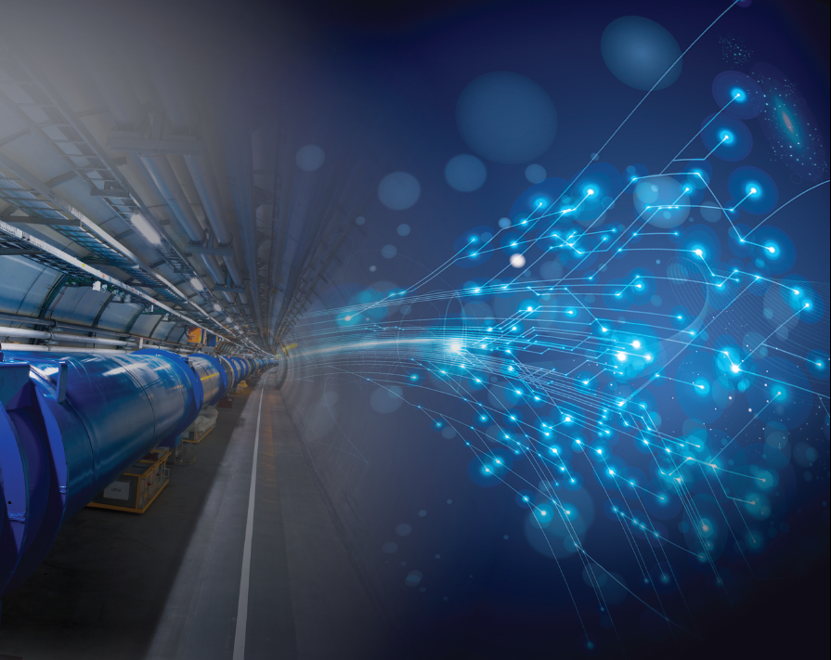

Accelerator R&D in Europe (History and today’s Organization)
Established in 2002 from the initiative of several labs.
R. Aleksan (CEA,Chair), M. Cerrada (CIEMAT),
R. Edgecock (STFC), E. Elsen (DESY) ,
S. Guiducci (INFN), M. Jezabek (IFJ)*, O. Kester (GSI), B. Launé (CNRS/IN2P3), K. Osterberg (HU)**, L. Rivkin (PSI), M. Vretenar (CERN,secretary)
http://esgard.lal.in2p3.fr
* Representing consortium of Polish institutes
** Representing consortium of Nordic institutes
ESGARD mandate: develop and implement a Strategy to optimize and enhance the outcome of the Research and Technical Development in the field of accelerator physics in Europe by
q promoting mutual coordination and facilitating the pooling of European resources
q promoting a coherent and coordinated utilization and development of infrastructures
q promoting inter-disciplinary collaboration including industry
This developed strategy led to the preparation and implementation of a coherent set of collaborative projects using the incentive funding EC Framework Programme.
Notes:
For each of these steps, there are EC calls

Slide 3

ESGARD developed and implemented a strategy to promote Accelerator R&D
with the incentive of the EC Framework Programme within ERA
 | 2003 |  | 2004 | 2005 | 2006 | 2007 | 2008 |  | 2009 |  | 2010 | 2011 |  | 2012 |  | 2013 | 2014 | 2015
Accelerator R&D
CARE (IA) |  | 3 Networks (e, ν, p) |  |  |  |  |  |  | EuCARD (IA) |  |  |  |  |  |  | EuCARD2 (IA)
CARE (IA) |  | SRF |  |  |  |  |  |  | EuCARD (SRF)
CARE (IA) |  | PHIN |  |  |  |  |  |  | EuCARD (SRF, ANAC) |  |  |  |  |  |  | EuCARD2 (RF)
CARE (IA) |  |  |  | HIPPI |  |  |  |  | EuCARD (SRF, ColMat) |  |  |  |  |  |  | EuCARD2 (COMA)
CARE (IA) |  |  |  | NED |  |  |  |  | EuCARD (HFM) |  |  |  |  |  |  | EuCARD2 (MAG)
SLHC (PP) |  |  |  |  |  |  | SLHC-PP |  |  |  |  |  | HiLumi (DS)
EUROTEV |  |  |  | DS: ILC+CLIC |  |  | ILC-HiGrade (PP)
EURISOL |  |  |  | DS: Neutrino β-beam
DS νFact |  |  |  | Scoping study |  |  |  | DS-EuroNu
EUROLEAP |  |  |  |  | e in plasma |  |  |  |  |  |  |  |  |  |  | EuCARD2 (ANAC2)
SuperB
TIARA (PP) |  |  |  |  |  |  |  |  |  |  |  | R&D-RI & program
FP6
FP7
EuCARD (ANAC)
EuCARD (ANAC)
Altogether EC has partially financed projects in FP6 and FP7
with a total budget of ~228 M€ (68 M€ from EC)

Slide 4
To build future accelerators, a strong and sustainable effort is indispensable during which it is important to get the EC involved through the EC calls issued within European the Framework Programmes (the present FP is called Horizon 2020)
Step 1: Design Studies
First step to be visible at the EC level and to enter the strategic infrastructure Roadmap of the European Union
Be included in the ESFRI roadmap
Step 2 : Preparatory Phase
Technical, managerial and Political Preparation Phase for the construction of the infrastructure
Step 3: Implementation
Launch of the construction including technology transfer and industry involvment
Step 0: Integration activities
Basic R&D
For each of these steps, there are EC calls
Although the amounts are small, it is politically extremely useful to be integrated in the EC “landscape”
Notes:
For each of these steps, there are EC calls

Slide 5
News from the EC
Proposed funding (in M€ for 2014-2020, 2011 constant prices)
European Research Council Frontier research by the best individual teams | 13 268
Future and Emerging Technologies Collaborative research to open new fields of innovation | 3 100
Marie Curie actions Opportunities for training and career development | 5 572
Research infrastructures (including e-infrastructures) (IA,DS, CNI-PP, ERA-NET…) Ensuring access to world-class facilities | 2 478
Estimated Work programme 2014-2015 Budget:
INFRA = ~580 M€, FET = ~450M€

Slide 6
3 DS (INFRADEV-1) projects being prepared
Calls | 2014 (M€) | «Max.» EC co. (M€) | Deadline
INFRADEV-1 (DS) | 15 | « 3 » | 2 Sept. 2014
ESGARD has overseen the preparation these projects
EuroCIRCOL: FCC-hh 100km Circular collider (Core part of FCC)
Coordination: lab a CERN, coordinator a M. Benedikt
Duration: 4 years; Requested EC contribution: 3 M€
EuPRAXIA: European Plasma Accelerator with High Beam Quality and Pilot Applications
Coordination: lab aDESY, coordinator a R. Assmann
Duration: 4 years; Requested EC contribution: 3 M€
ESSnuSB : neutrino Super-Beam based on ESS linac
Coordination: lab a CNRS, coordinator a M. Dracos
Duration: 3 years; Requested EC contribution: 1.8 M€

Slide 7
ESGARD recommendation on EuroCIRCOL
The Future Circular Collider (FCC) study is directly derived from the conclusions and recommendations of the European Strategy for Particle Physics, and represents the highest priority European accelerator Design Study effort enabling the Particle Physics community to address the high energy and precision frontiers in Europe.
The FCC study could lead to the next post-LHC endeavor in particle physics in Europe to address the frontiers of knowledge concerning the fundamental constituents and law of the Universe.
The H2020-DS proposal covers a self-consistent set of the most important key issues enabling one to assess the technical and organizational feasibility of a very large (100km) energy frontier (100 TeV) global collider. This H2020-DS includes the core part of the design of the hadron-hadron collider and is well integrated within the larger FCC study.
The proposal is technically very strong and federates the major European competences and institutes required to accomplish the needed tasks. It also associates major expertise from other regions of the world.
ESGARD fully and enthusiastically supports the EuroCirCol DS proposal.

Slide 8
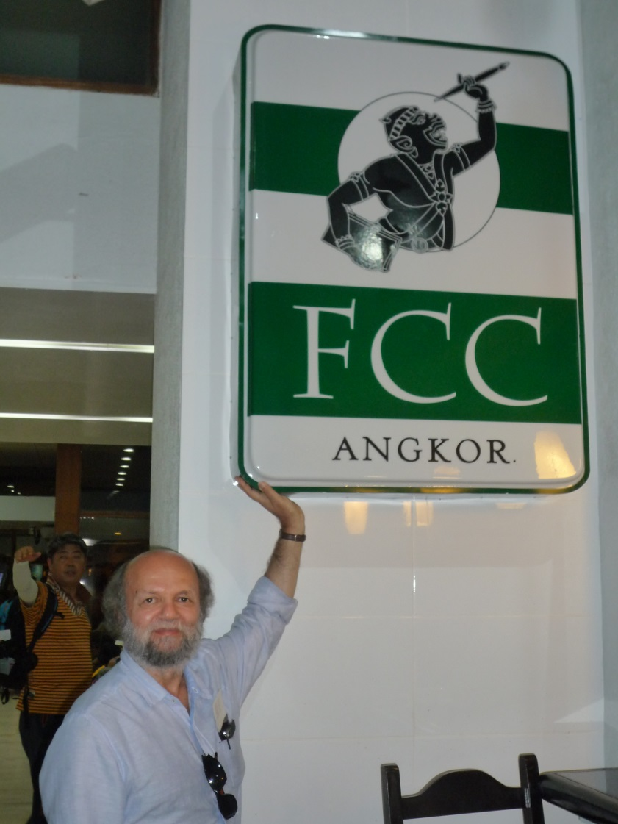
First Feedback and expected Schedule
39 DS proposals submitted
  Highly competitive (5-8? Projects will fly)
February 2015: response from the EC
May 2015: Signature of GA
June 2015: first prepayment
Very important to show to the EC that the FCC endeavor has a very wide global support

Slide 9
Horizon 2020: FET calls
Future and Emerging Technologies
Calls id. | M€ | Type | Deadline
FETOPEN | 160 | Novel Ideas for Radically New Tech. | 30/09/2014, 31/03/2015, 29/09/2015
Calls | 2014 (M€) | 2015 (M€) | « Max. » EC contr. (M€)
FETOPEN-1 (Open research projects ) | 77 | 37+40 | 4
Key words:
Long-term vision, Breakthrough S&T target, Foundational, Novelty , High-risk, Interdisciplinary

Slide 10
Horizon 2020 : Projects for FET
Plasma Acceleration
Project: HiFLUX: High repetition rate Fiber Laser-Plasma accelerators for Ultrabright X-rays
Objective: Use a train of laser pulse separated by plasma period to resonantly excite wakefield
Proposer labs a UK (JAI, ICL, UCL) +DE (JENA) + FR (ESRF)
Duration: 4 years; Requested EC contribution: 4.2 M€
Project: Electron-Beam driven Plasma Acceleration
Objective: Plasma accelerator driven by single or multi-pulse electron beams for advanced light source applications (FLASH, SPARC, VELA/CLARA)
Proposer labs a IT (INFN, Roma uni), DE (Max Planck Inst., DESY), PT(IST), UK (STFC, Manchester, Strathclyde)
Duration: 4 years; Requested EC contribution: 3.9 M€

Slide 11
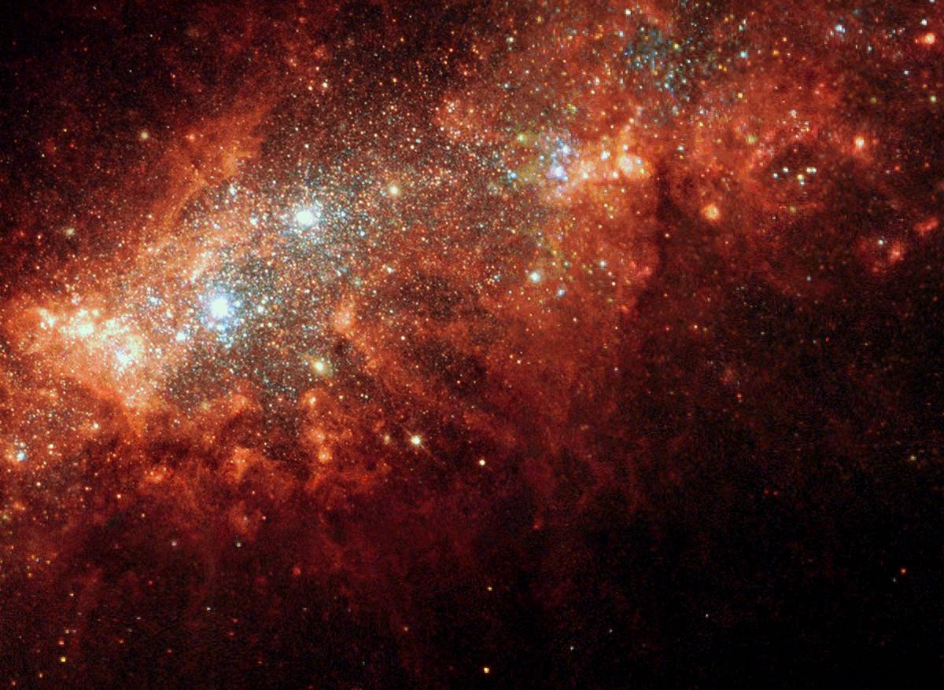
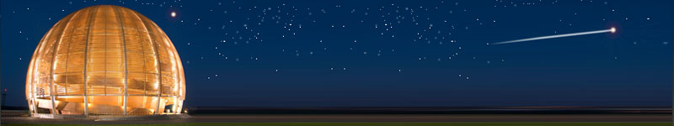
Conclusions
After having established an accelerator R&D strategy,
implemented through several very successful projects in FP6 & FP7, Horizon2020 offers the possibility to make EuroCIRCOL and FCC very visible in Europe at the conceptual, technical and political levels
ESGARD will continue to work toward a successful inclusion of FCC in the European Roadmap for future large scale infrastructures.
Accelerator science is a powerful mean
toward scientific, technical and
industrial breakthroughs and innovations…

Slide 12
BACKUP

Slide 13
FCC : 100km Circular (pp, ee, ep) collider
FCC DS is huge a WP with EC funding and WP without EC funding
a number of partners for H2020 part are limited
Physics and Experiments
Accelerators
Infrastructures
and Operation
Implementation
and Planning
Study and Quality
Management
Hadron Collider Physics
Hadron Injectors
Civil Engineering
Project Risk Assessment
Study Administration
Hadron Collider Experiments
Hadron
Collider
Technical Infrastructures
Implementation Scenarios
Communications
Lepton Collider Physics
Lepton Injectors
Operation and Energy Efficiency
Cost
Models
Conceptual
Design Report
Lepton Collider Experiments
Lepton Collider
Integration
Lepton-Hadron Collider Physics
Lepton-Hadron Collider
Computing and
Data Services
Lepton-Hadron Collider Experiment
Technology R&D
Safety, RP and Environment

Slide 14
FCC : 100km Circular (pp, ee, ep) collider
H2020-DS core subpart: Key activities
Management
Projet Management , Global collaboration issues, Projet Costing, CD&O…
Arc Lattice Design (lattice, dynamic aperture, magnet field quality, design collinmation sections, functional specs beam pipe & magnets… )
EIR (IR Design, functions andperformance of key beam-line elements, MDI … )
Hadron
Collider design
Cryogenic Beam Vaccuum System (beam screen, proximity cryogenics, magnet cold bore and vaccuum system, radiation heat load absorption…)
Dipole magnet design
FCC is likely to be the next large scale project in particle physics in Europe after the LHC
H2020-DS is important for FCC
  To get a European visibility
  For being in the list of ESFRI infrastructures
  To get funding for some key partners

Slide 15
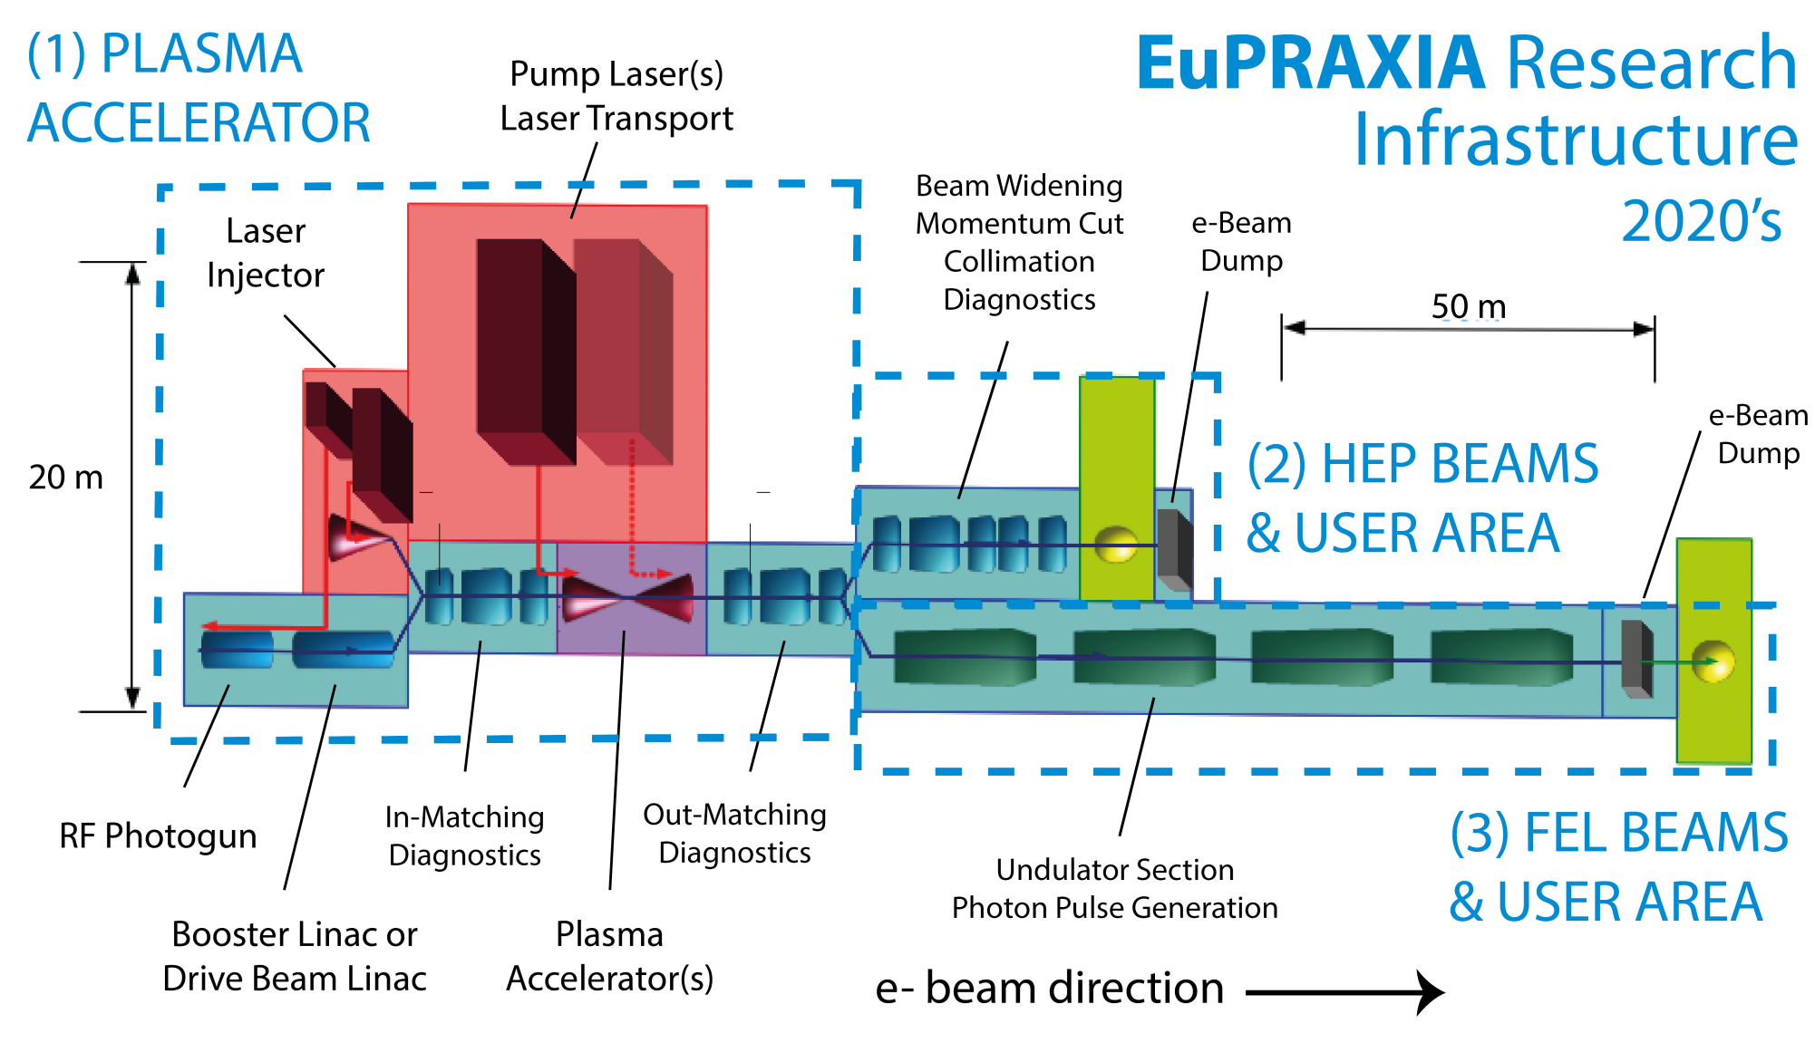
European Plasma Accelerator with High Beam Quality and Pilot Applications
a Go from Plasma Acceleration to Plasma Accelerator with useable beam quality
  Cood. DESY, 16 beneficiaries from France (3), Germany (2), Italy (4), Portugal (1), UK (6)

Slide 16
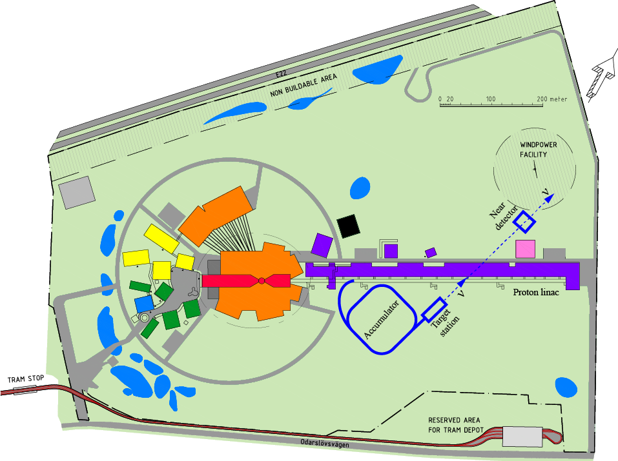
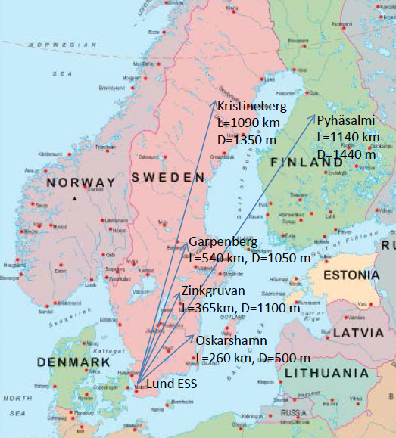
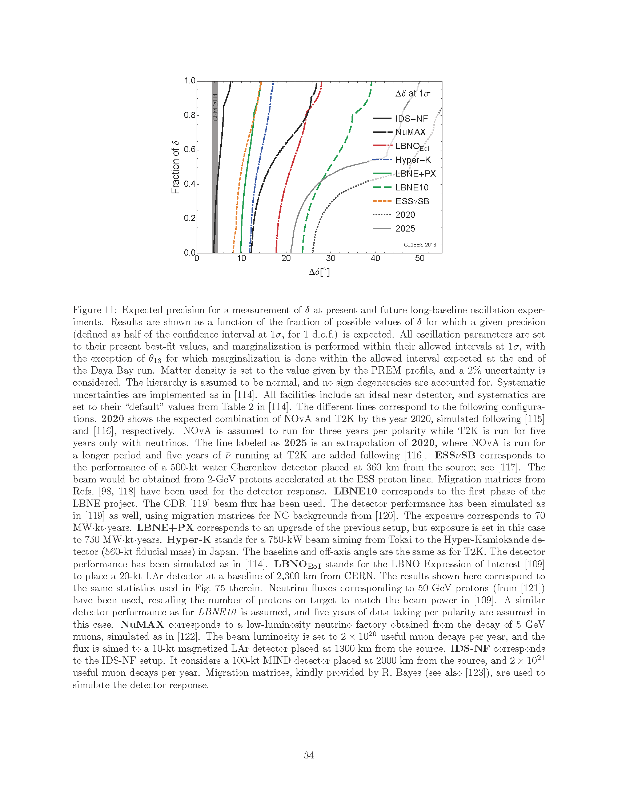
ESSnuSB : neutrino Super-Beam based on ESS linac
a Doubling the power of the linac (10MW) by doubling the duty cycle (4% to 8%)
a Buiding accumulator ring(s), target, horn, detectors
Envisaged Work Packages and participants
Management
Linac
accumulator
Target station Horn
Detectors
Physics performance
Strasbourg, Uppsala
ESS, CERN, CNRS, Uppsala
Uppsala, CERN, CNRS
AGH Krakow, CNRS, Uppsala
Lund, , CERN, INFN, Sofia, Uppsala
UAM Madrid, KTH, INFN, UDUR

