Slide 1
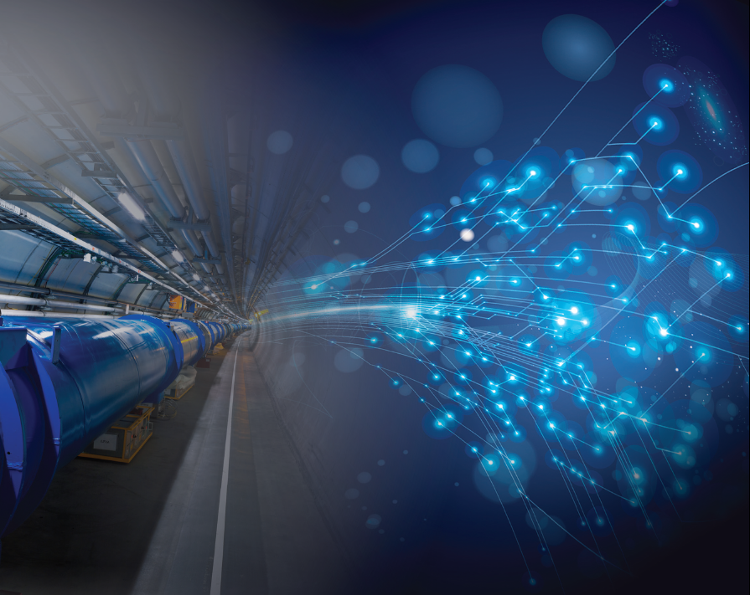

CEA/IRFU (Saclay) and FCC
Main areas of interest within FCC
IRFU: Institute of Research into the Fundamental laws of Universe at CEA
R. Aleksan
ICB
Sept. 10, 2014
See also F. Millet presentation on proposed contributions for cryogenic system from CEA-Grenoble
LHC
PS
SPS
FCC
Organization
IRFU’s area of interest

Slide 2
IRFU
PhD, Post Docs, … :
134
Physicists :
152
IRFU personnel in 2013 : ~790
Adm. Staff
74
Instrument. Scientists +Engineers : 287
Technicians
142
IRFU
Astrophysics
Space technologies
Accelerators,
Supra. Magnets
SAP
SACM
Nuclear Physics
Detectors, electronic,
computing
SPHN
SEDI
Particle Physics
Systems engineering
SPP
SIS

Slide 3
IRFU and FCC
Both for FCC-hh and FCC-ee , the areas of interest cover
Physics Studies
Detector Studies
Accelerator Studies
In the following, the proposed contributions with quantitative commitment efforts are indicated in green,
Interest without quantitative commitment efforts is indicated in magenta
Note: other topics (not mentioned here) are under discussion in the group

Slide 4
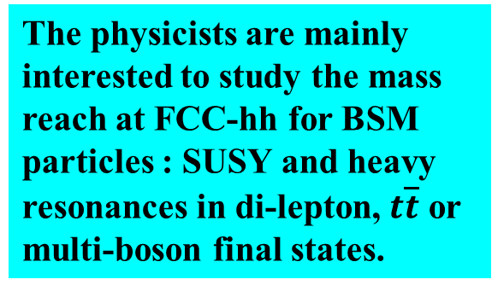
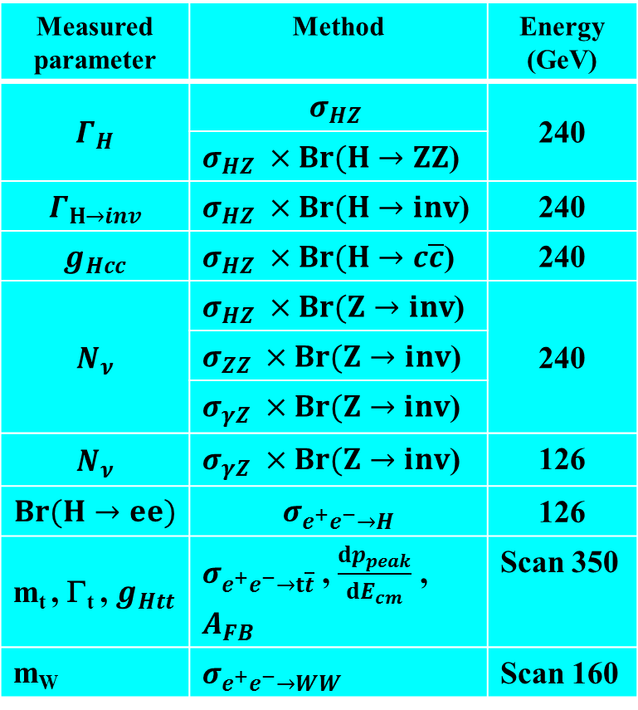
Involvement of IRFU in FCC
Physics Studies
FCC-hh
FCC-ee
Search of new physics
Precision measurements
Measured parameter | Method | Energy (GeV)
$$Γ_{H}$$ | $$σ_{HZ}$$ | 240
 | $σ_{HZ} ×Br(H→ZZ$)
$$Γ_{H→inv}$$ | $σ_{HZ} ×Br(H→inv$) | 240
$$g_{Hcc}$$ | $σ_{HZ} ×Br(H→c\overline{c}$) | 240
$$N_{ν}$$ | $σ_{HZ} ×Br(Z→inv$) | 240
 | $σ_{ZZ} ×Br(Z→inv$)
 | $σ_{γZ} ×Br(Z→inv$)
$$N_{ν}$$ | $σ_{γZ} ×Br(Z→inv$) | 126
$$Br(H→ee)$$ | $$σ_{e^{+}e^{−}→H}$$ | 126
m_{t} , Γ_{t} , $g_{Htt}$ | $σ_{e^{+}e^{−}→t\overline{t}}$ , $\frac{dp_{peak}}{dE_{cm}}$ , $A_{FB}$ | Scan 350
m_{W} | $σ_{e^{+}e^{−}→WW}$ | Scan 160
The physicists are mainly interested to study the mass reach at FCC-hh for BSM particles : SUSY and heavy resonances in di-lepton, $t\overline{t}$ or multi-boson final states.

Slide 5
Involvement of IRFU in FCC
Detector study
FCC-hh
FCC-ee
Study and optimization of the magnetic configuration and magnet layout of the FCC-hh detectors.
Study of the operability of a TPC for a FCC-ee detector
Capitalizing on IRFU’s experience in LEP and LHC, we propose to study the magnetic configuration and magnet layout of the FCC-hh detectors.
Comparative studies of the solenoid options with passive and active shielding.
Study of the a large toroid option.
This may be extended for the FCC-ee detectors
Two important issues have to be studied
1) Ions
Primary ions
Back flow of ions
2) Low power electronic
Minimization of material in the end plates
Synergy with IRFU contribution to ILD detector for ILC

Slide 6
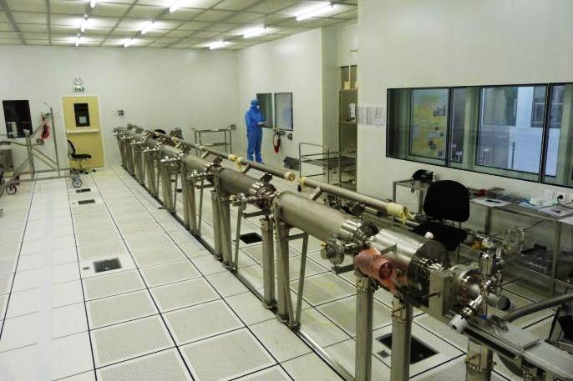
Involvement of IRFU in FCC
Accelerator study
FCC-hh
FCC-ee
Fully involved in EuroCirCol
SRF system
Design of the arc lattice , e.g.
  Dynamic aperture evaluation
  Aperture and field quality specifications
          108 p-m
High-field Accelerator Magnet Design e.g.
  Dipole Magnet design
  Field quality evaluation, comparison and optimization
          36 p-m
RF generation
Cavities
Cryomodule
  Arc Quad Magnet design
  Field quality evaluation, comparison and optimization
IRFU is a major participant to XFEL (photo) and ESS SC-RF systems

Slide 7
Conclusions
Strong interest from IRFU in FCC Study
  Physics Studies
  Detector Studies
  Accelerator Studies
Potentially large group
  18 physicists
  9 engineers
  have declared interest… but most people involved in operating experiments/projects
144 p-m committed in EuroCIRCOL (pending its approval)
Yet difficult to quantify the available p-m on other topics

Slide 8
Backup

Slide 9
With the discovery of the Higgs Boson
Self-consistent model (SM) accounting for all Particle Physics phenomena at presently accessible energy
but does not explain major issues
Mass of neutrino (in the most general way)
Baryon Asymmetry of Universe
Dark Matter, Dark Energy
Unification of all interactions
New Physics must exist … but at which energy scale?
Direct Exploration of Higher Energy Scales
Precision measurements rare process studies

Slide 10
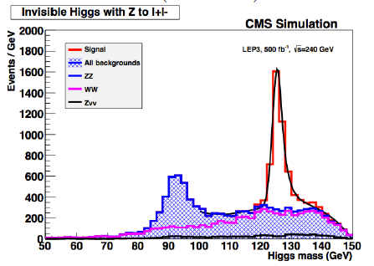
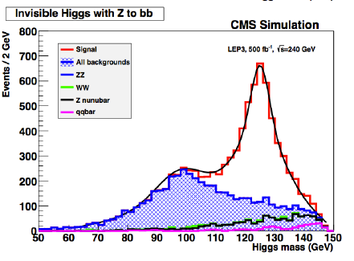
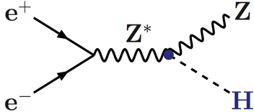
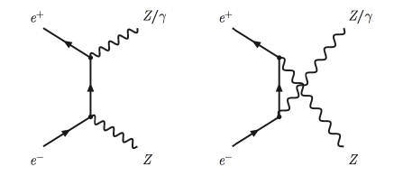


Involvement of IRFU in FCC
N_{ν} at FCC-ee (240 GeV)
LEP measurement : $Nν= 2.984 ±0.008$
$$→inv.$$
ν
ν
ν
ν
ν
ν
Combined (ZZ, ZH) precision potentially lead to δN_{ν}= 0.006
γZ events potentially lead to δN_{ν}= 0.001

Slide 11
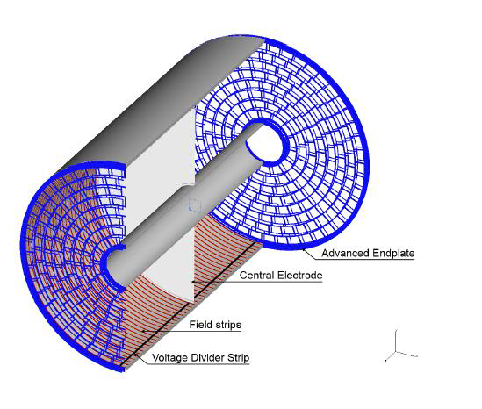
Involvement of IRFU in FCC
TPC for FCC-ee
There is a believe that TPC is the ideal detector for e⁺e⁻. Certainly TPC have been used with success at LEP and LHC (ALICE)
Minimum of material
For excellent tracking capability (large number of measured points)
Some PID with de/dx (5% resolution)
Capitalization of studies done at IRFU (T2K/ILC) using micromegas
Possible synergies with linear collider studies (ILD)
But cannot be used in all environments!
R_{in} : 229 mm
R_{out} : 1808 mm
L_{z} : 2×2350 mm
B=4 T
σ_{R-φ} ~100 μm
σ_{R-Ζ} ~500 μm
dp/p² = 8 x 10⁻⁵ (full tracking : 2 x 10⁻⁵)
Most demanding conditions @ Z-pole
~33 kHz Bhabhas
~17 kHz of hadronic events with <mult.> ~20 (~1 evt / 60 μs avg)
Total drift time ~50μs
On average < 1 evt drifting in TPC
2-hit r-z resolution is 8 mm (160 ns drift time) a evt mixing is negligible

Slide 12
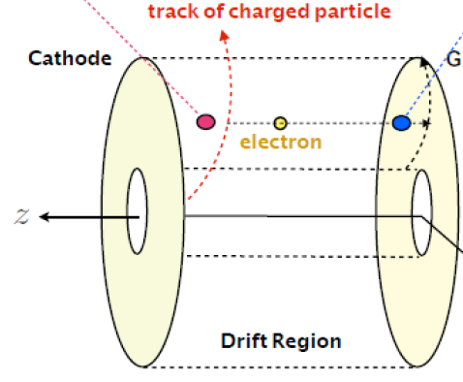
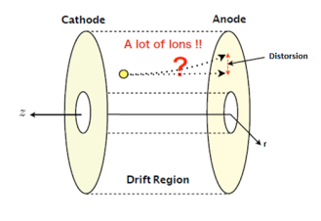
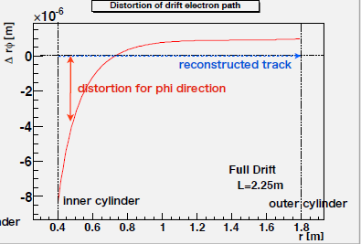
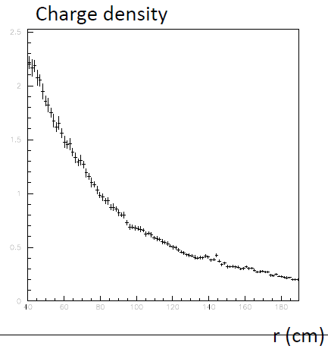
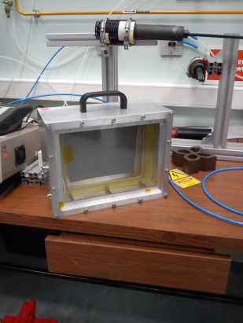
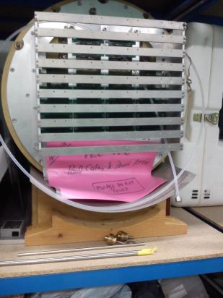
Involvement of IRFU in FCC
TPC for FCC-ee : ions are the main issue
Primary ions
Secondary ions
With high evt rate TPC is filled with primary ions
Preliminary calculations for Z-pole operation
0.70*10⁹ Ions (B=3.5 T)
(0.66*10⁹ @ ILC dominated by beamstrahlung γ−γ events; non-issue @ FCC-ee)
Secondary ions are a serious issue. May in principle be reduced but one needs
Study optimized end-plate chamber configuration for ion suppression
Calculate the impact on resol.
Verify with test
FCC-ee
Maximum distorsion
8.5 mm (negligible)!
0.4 1.8
r(m)
We need
To improve simulations for FCC-ee environment
To carry out an R&D programme for measuring these effects

Slide 13
Involvement of IRFU in FCC
TPC: Electronic power consumption
Typically, the present power per channel for high rate operation is 30-40mW. With 1 x 4mm² pads one gets 7-10kW/m²
This is manageable but requires but significant (excessive?) material will be needed to evacuate such a heat load. ILC solves the issue with power pulsing, not possible @ FCC-ee.
Conceptual architecture study to reduce consumption by factor 10
Other possible studies
Comparative study of options for calorimetry and optimization for FCC-ee requirements of resolution/operability/cost
Investigation of wireless powering and data transmission

