Slide 1


Programme Objectives
Konrad Jende, UK Teacher Programme 2014

Slide 2
Programme Objectives
Konrad Jende, UK Teacher Programme 2014

Slide 3


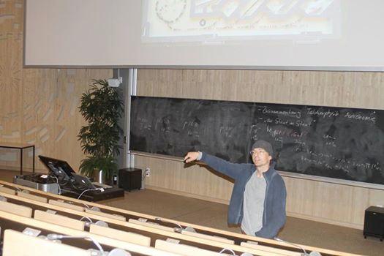
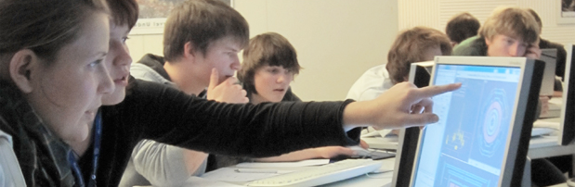
How to bring modern science into classroom?

Slide 4
How to bring modern science into classroom?

Slide 5
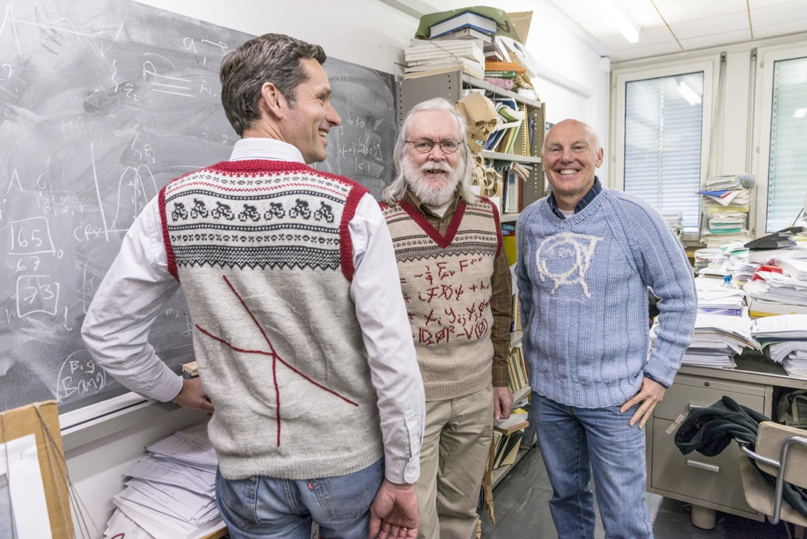
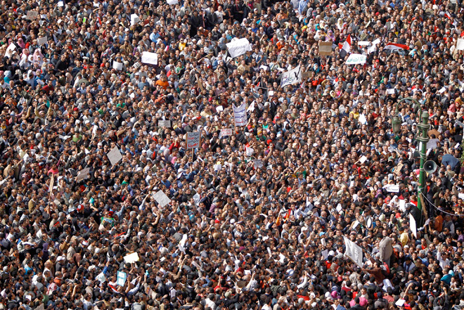
We need you!

Slide 6
Our objectives
Raise and Maintain the interest of students in moderns science
  Motivate them to continue scientific education at school
  help them to better understand the physical world
Instil a feeling of mystery and discovery potential
  Motivate students to study science/engineering at universities
Improve scientific literacy
  Prepare the future generation of scientists/engineers

Slide 7

How researchers view science

Slide 8
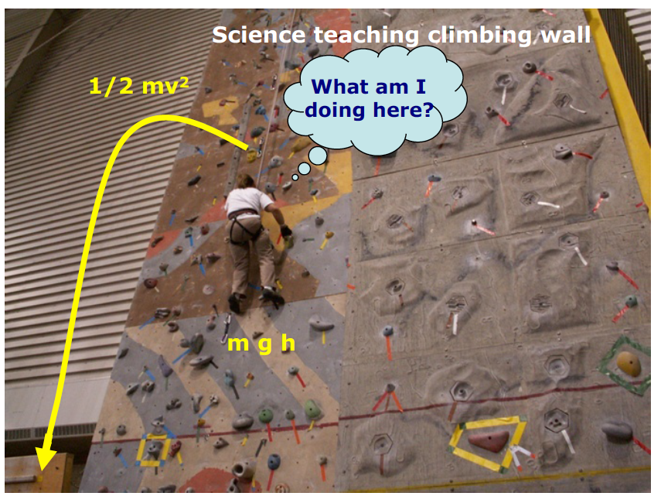
How students view science

Slide 9
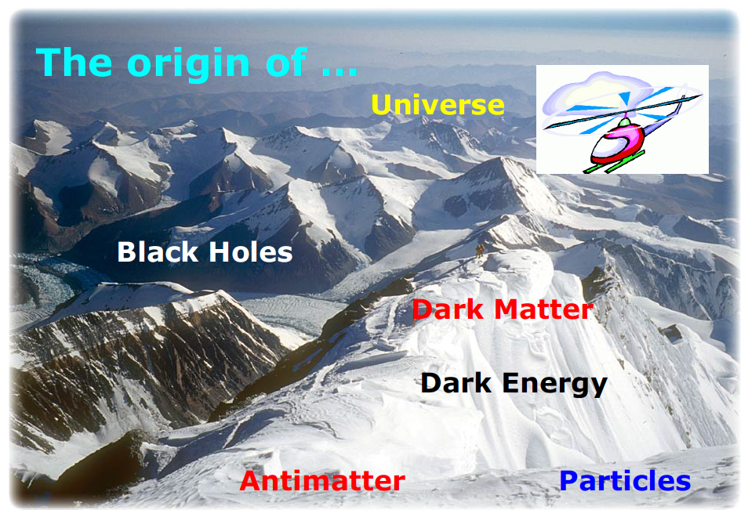
Take students on a sight-seeing tour
Link modern physics to school curriculum

Slide 10
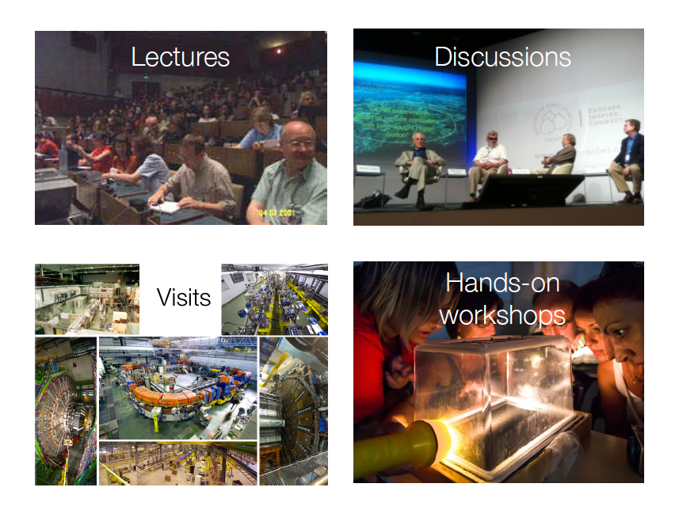
CERN’s Teacher Programmes

Slide 11
CERN’s Teachers’ Programmes
2 days to one week long national teachers’ programmes (NTP) in native language
three week long High School Teachers Programme (HST) in English

Slide 12
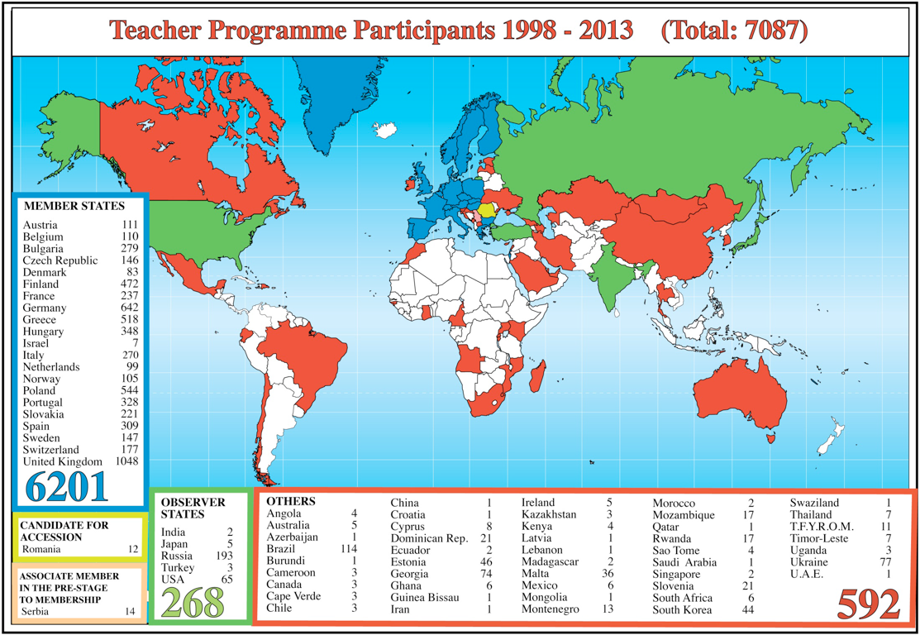
CERN’s Teachers’ Programmes
Stats 1

Slide 13
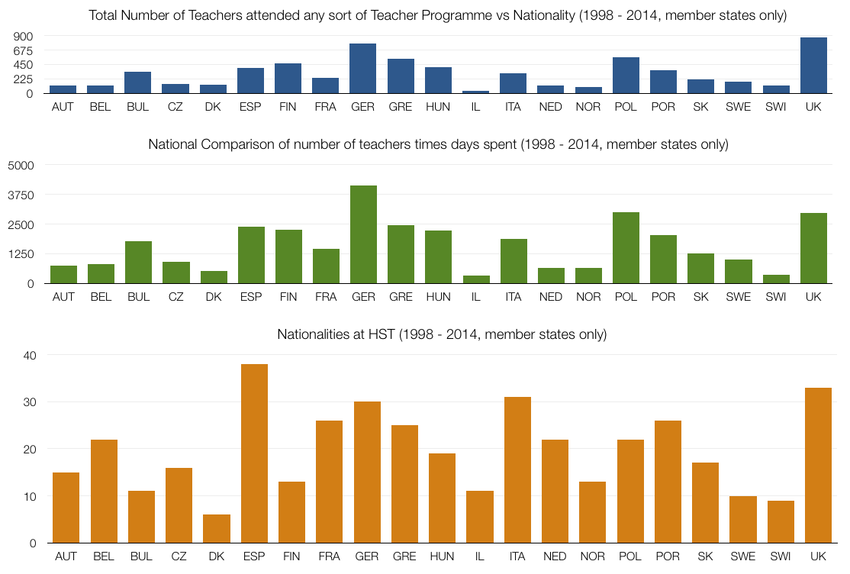
CERN’s Teachers’ Programmes
Stats 2

Slide 14
Outcome and To-Do-List
newly inspired, motivated and confident teachers
inspiring and motivating teachers
Share your experience with your students!
Share your experience with colleagues!
Share your experience with the general public!
Act as ambassador for science/engineering in general and particle physics in particular
Organize follow-up activities
Promote our programmes

Slide 15

Any questions?
Konrad Jende - konrad.jende@cern.ch
33-R-010 +41 76 487 0246

