Slide 1


Ressources in Education
Konrad Jende, UK Teacher Programme 2014

Slide 2
Ressources in Education
Konrad Jende, UK Teacher Programme 2014

Slide 3
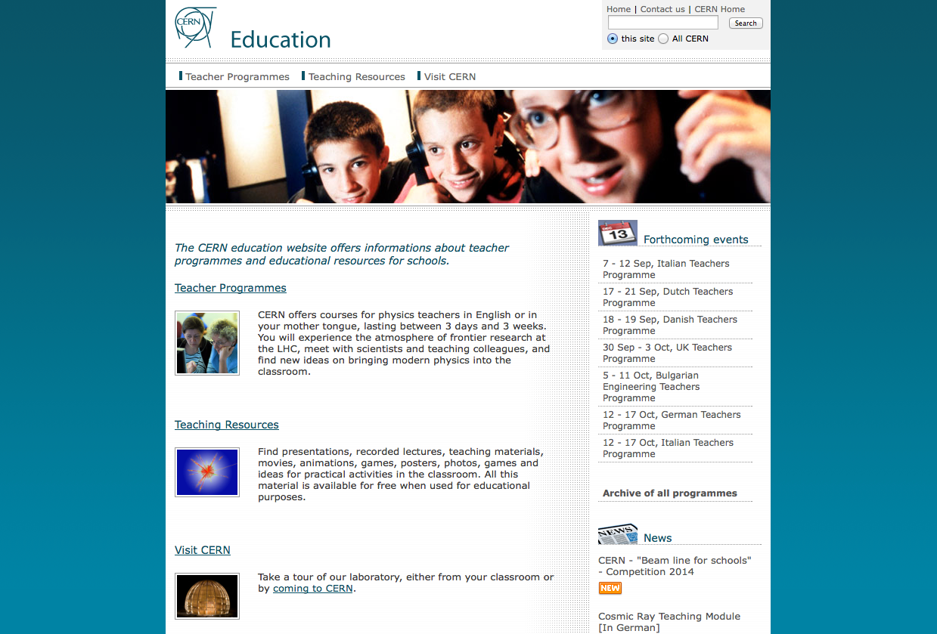
CERN Education

Slide 4
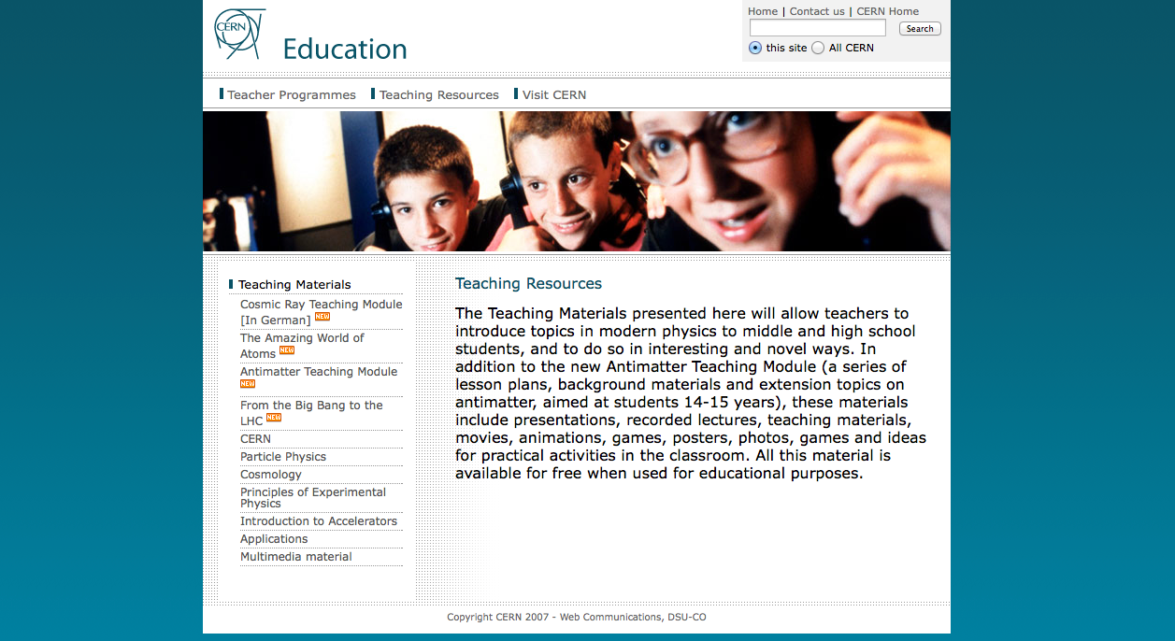
Ressource 1

Slide 5
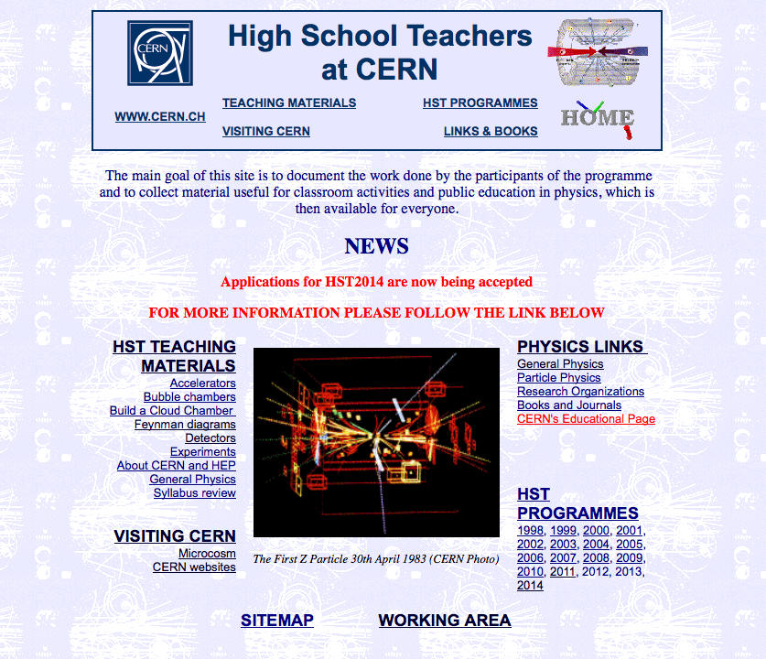
Ressource 2

Slide 6
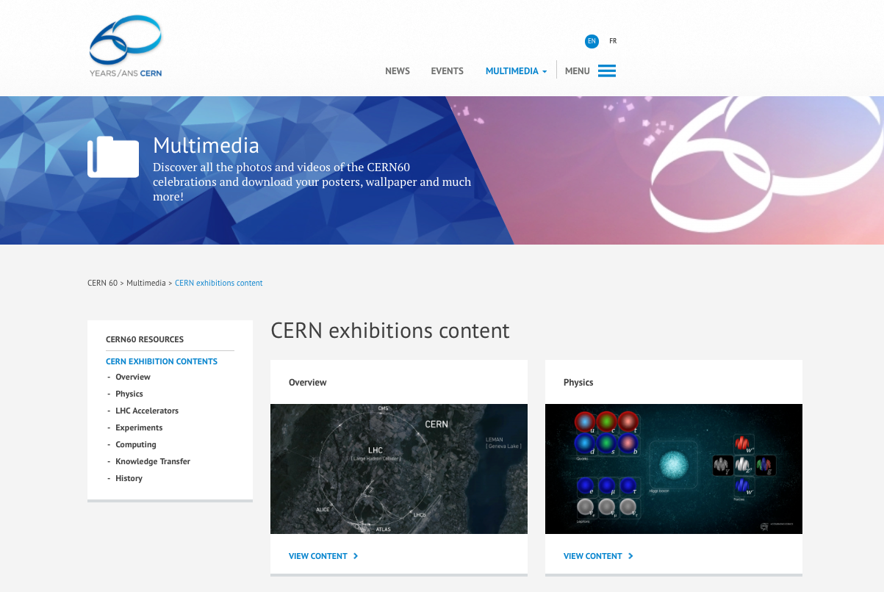
Ressource 3

Slide 7
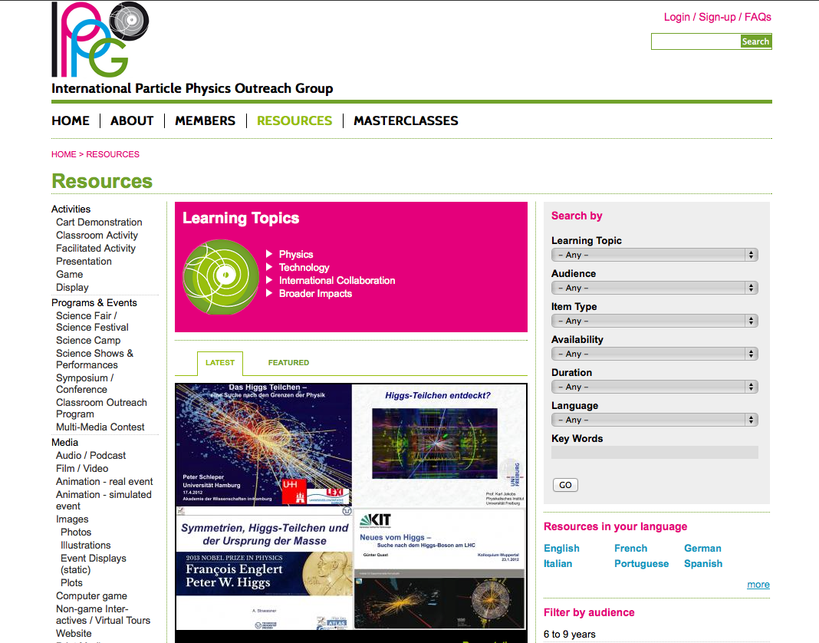
Ressource 4

Slide 8

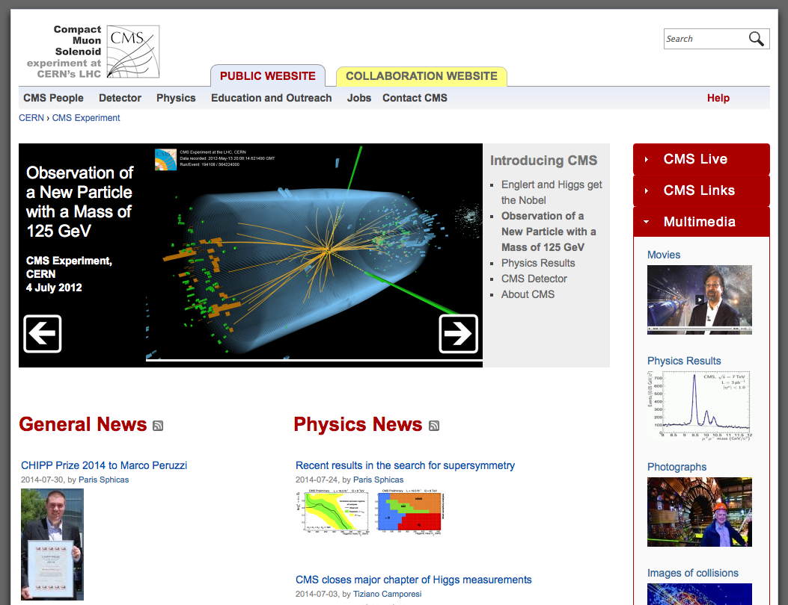
Ressource 5

Slide 9

Any questions?
Konrad Jende - konrad.jende@cern.ch
33-R-010 +41 76 487 0246

