Slide 1
A. Herlert, CERN PH-IS
ISOLDE scientific coordinator’s report
INTC meeting, May 19, 2008
Schedule 2008
ISOLDE Startup 2008

Slide 2
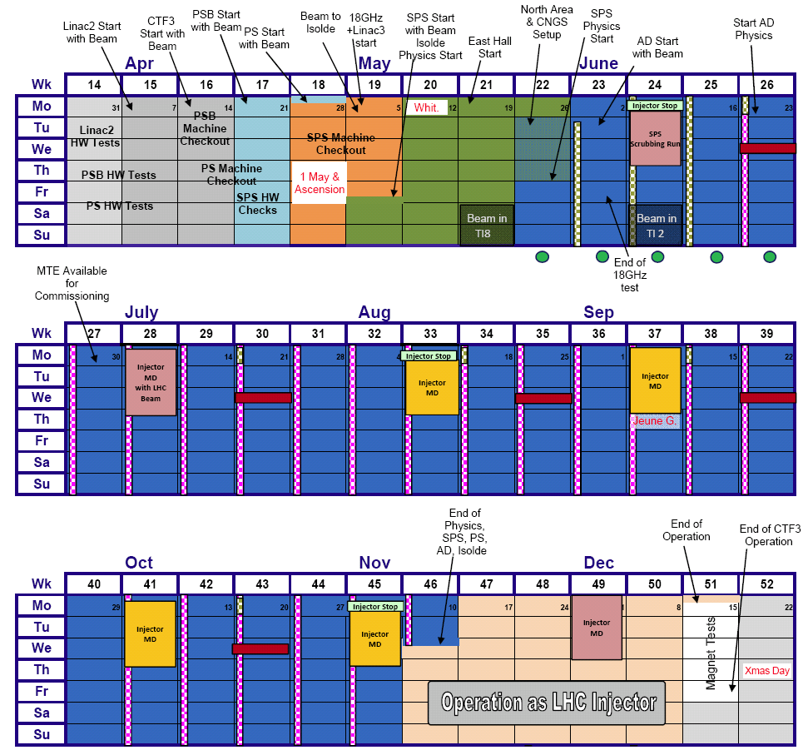
Accelerator schedule 2008
Approved by CERN Research
Board November 28, 2007
ISOLDE dates:
protons from PSB May 5
physics start ISOLDE May 9
protons stop November 12
(i.e. 27 weeks for physics)
Expected frequent changes
of supercycles (as 2007)
Several long periods of MD
without protons to ISOLDE
(delivery of p not guaranteed)

Slide 3
ISOLDE experiments
Active experiments 2007
  63 with 470 shifts in total
INTC meeting February 2008 + Beam requests
  5 experiments closed
  9 new experiments and additional shifts for existing experiments
  67 active experiments with about 700 shifts
Notes:
3

Slide 4
ISOLDE beam requests 2008
Limits in key resources
  RILIS (installation of new solid state lasers, max 2000 h operation)
  UC_{x} targets (about 10 new units maximum)
REX operation
  MINIBALL ready for Physics June 1
Schedule:
  470 RIB shifts left after 2007 for approved experiments
  231 RIB shifts from new proposals and addenda at February INTC meeting 2008
    in total 701 RIB shifts for 2008 (and following years ...)
  551 RIB shifts requested
    compare to 480 RIB shifts requested in 2007 with 407 scheduled shifts
    requested RILIS shifts: 337 --> more than 2700 h operation
    requested RIB shifts with UC target: 410 (together with RILIS: 308)
Notes:
4

Slide 5
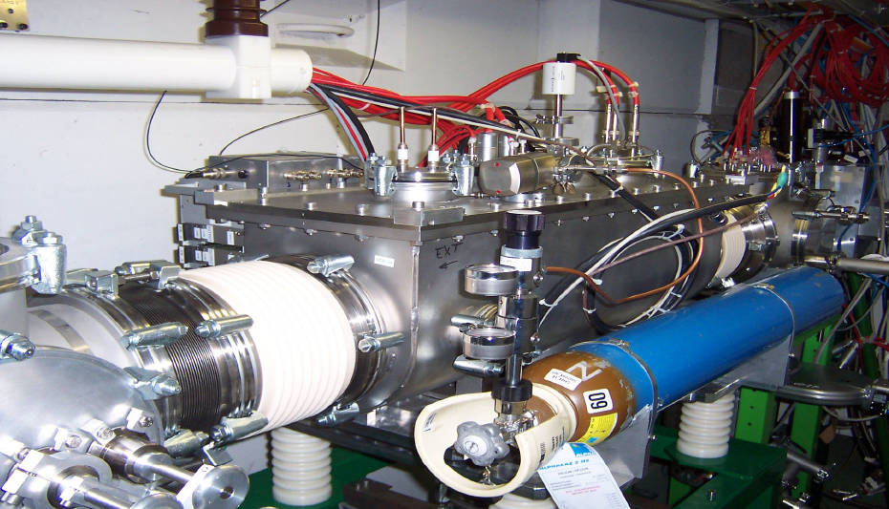
ISCOOL and new tapestation
ISCOOL
  maintenance during shutdown
  2007/2008
  test in off-line period April 2008
  permanently installed in 2008
  running in transmission and
  bunch mode
  special setup time before each
  HRS run
New tape station (IHPC Strasbourg):
  displacement time 100ms for 415mm
  to be installed in June 2008 at LA2 beam line

Slide 6
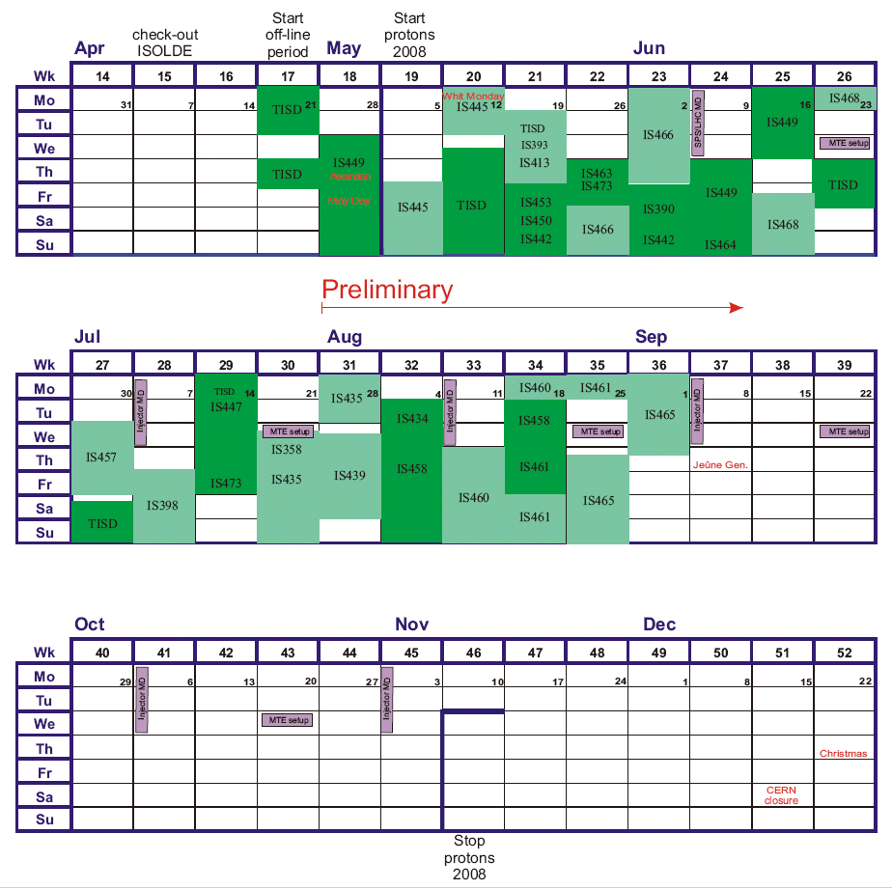
ISOLDE schedule 2008 (first part)
ISOLDE dates 2008:
2 weeks off-line period
protons started May 5
physics started May 9
protons stop Nov. 12
27 weeks
for physics
So far scheduled:
23 IS experiments
17 target units
(3 old units)
9 UC_{x} targets
(2 old units)

Slide 7
ISOLDE off-line period 2008 (I)
2 weeks off-line period: GPS
  check new RILIS laser system (efficiency, operation, new scheme)
  IS449 off-line experiment at COLLAPS beam line (stable Be)
New solid state pump laser working
  efficiency of Ga ionization compared with data obtained with copper-vapor-laser system
  check of Nd ionization scheme not possible, Nd mass marker not working (wrong position in ion source oven?) - another try later in the year
IS449 test run successful
  preliminary data confirms offset of GPS and HRS high tension read-back value --> important for laser spectroscopy experiments
  setup installed and tested for on-line run (n-rich Be isotopes)
  vacuum intervention by H. Vestergard during long weekend

Slide 8
ISOLDE off-line period 2008 (II)
2 weeks off-line period: HRS
  check ISCOOL after shutdown maintenance
  setup of REX (also for first on-line run)
  injection of molecular CO beam into REX-TRAP
ISCOOL working
  checked transmission and bunching
  further optimization needed (dedicated period in schedule to test bunching and additional day to setup ISCOOL before each HRS on-line run)
REX setup and injection of beam from ISCOOL
  various technical problems (REX-TRAP local ion source not working, discharges in REX-TRAP,...) - REX-LINAC and EBIS fine
  setup delayed due to longer cold check-out work and problems with the ISOLDE controls (CERN-wide problem)
  power cut on April 30 (just before long weekend)

Slide 9
First on-line runs in 2008 (I)
IS445: ⁹C beam to 2nd beam line of REX-ISOLDE
  CaO/CP target as used in off-line period (idea to start setup of ISCOOL and REX-ISOLDE already in the off-line period)
  Very difficult beam (molecular beam, first time injection of beam from ISCOOL into REX-TRAP, ...)
  lots of problems with REX-TRAP already in the off-line period
  Tremendous effort by technical group to get system running --> beam to the users almost on time - BIG THANKS FROM USERS!
  Again problems with controls (machine supervisors spent more time on debugging than tuning the system ...)
  ¹⁰C beam to the users, however with more than 5 times lower yield than in yield database (no time for retuning target) - ⁹C beam not possible
  finally, target line broken (planned target test cancelled)
Results
  no physics, but succesful test (CO beam through REX-ISOLDE)
  total efficiency of REX 4% (not fully opimized)

Slide 10
First on-line runs in 2008 (II)
TISD: YO target with MiniMono ion source (GPS)
  testing ⁷²Kr and CO beams
  successful run
For the upcoming runs:
  need stable controls
  limitation of proton beam intensity on GPS:
  need results from thick target

Slide 11
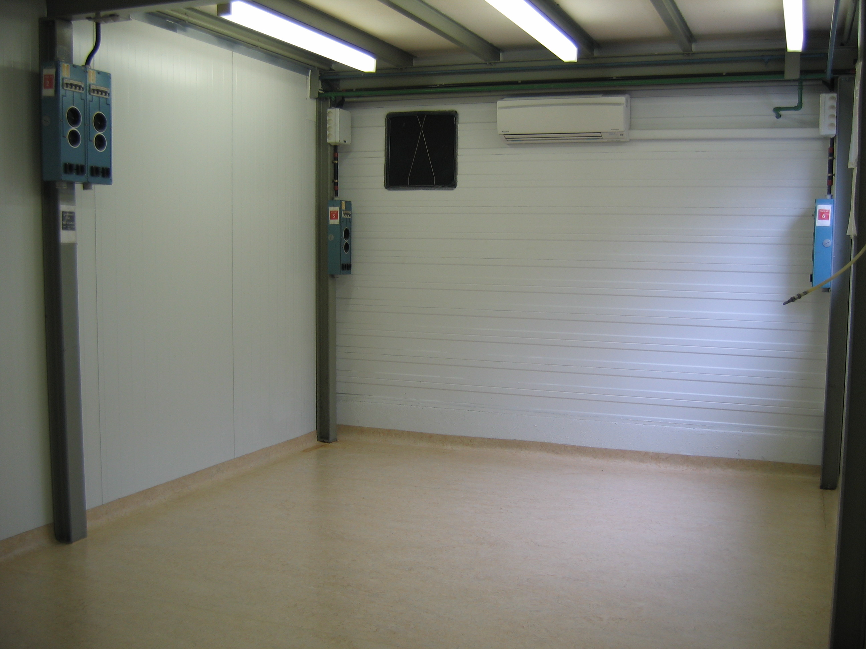
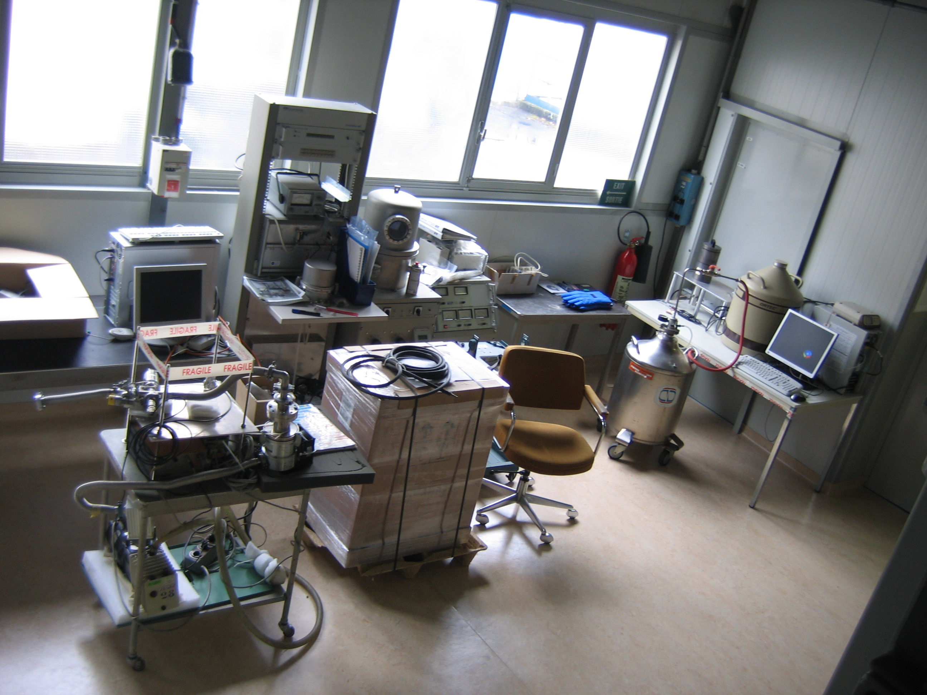
New solid state physics lab
Building 115
Ready for operation in 2008
All equipment has been
moved from building 275
to the new location
(except lab G. Correia)

Slide 12
Safety at ISOLDE
New safety structure
    GLIMOS (Group Leader in Matters Of Safety)
    ISOLDE GLIMOS (ISOLDE Physics Coordinator)
    Deputy GLIMOS (ISOLDE Physics group leader)
    Nominating Installation Supervisors for larger experimental
    installations (ISOLTRAP, COLLAPS, NICOLE, ...)
Safety courses
    Basic safety course (mandatory)
    Laser safety course (will become mandatory ???)
    New Radioprotection course (Part I+II) to obtain dosimeter
    Special Radioprotection course (web-based course for ISOLDE)
    Cryogenics safety course (recommended)
    Bridge crane used restricted (new rules for access)

