Slide 1
Present status of HIE-ISOLDE RF cavities coating
TE-VSC seminar
Guillermo Merino Fernández

Slide 2
Outlook
Introduction: about RF cavities and coatings
Preparation for the coating
Sputtering process
Next goals
Current status

Slide 3
Introduction
Use of Ultra High Vacuum (UHV) systems to coat HIE-ISOLDE (High Intensity and Energy) (Isotope Separator On Line DEtector) copper (Cu) RF cavities with niobium (Nb) thin films
Coatings are done using sputtering technique
These cavities will be installed in HIE-ISOLDE SC linac
Our facilities are located in B252

Slide 4
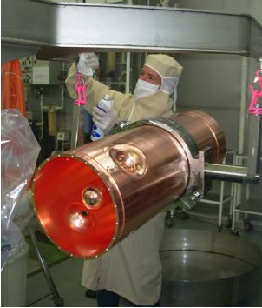
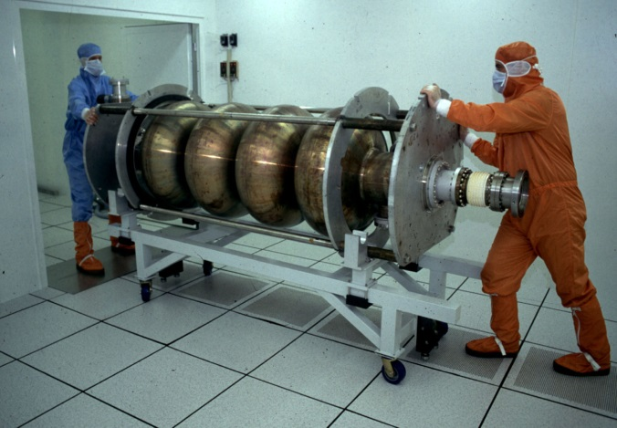
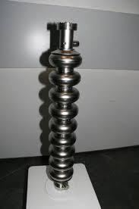
Introduction: What is an RF cavity
Device in charge of accelerate the beam inside a particle accelerator using an RF electric field
There are a big variety of shapes and geometry depending on the specification of the accelerator, frequency, kind of particles…
CERN, LEP cavity 352MHz
CERN, HIE-ISOLDE 101MHz
DESY, tesla cavity 1.3GHz

Slide 5
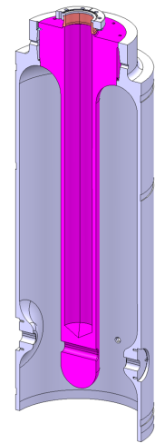
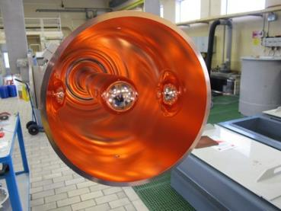
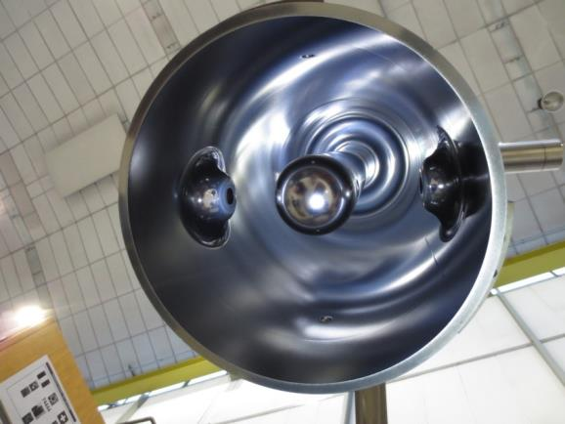
Introduction: coating a surface
Deposit a layer of a certain material on a substrate
Even a very thin film (in the order of nanometers to micrometers) can change the properties of the surface in a significant way
This allows to have advantages of both materials in one piece
Liquid helium
reservoir
Radioactive ion beam
Bulk copper RF cavity without coating
RF cavity coated with Niobium

Slide 6
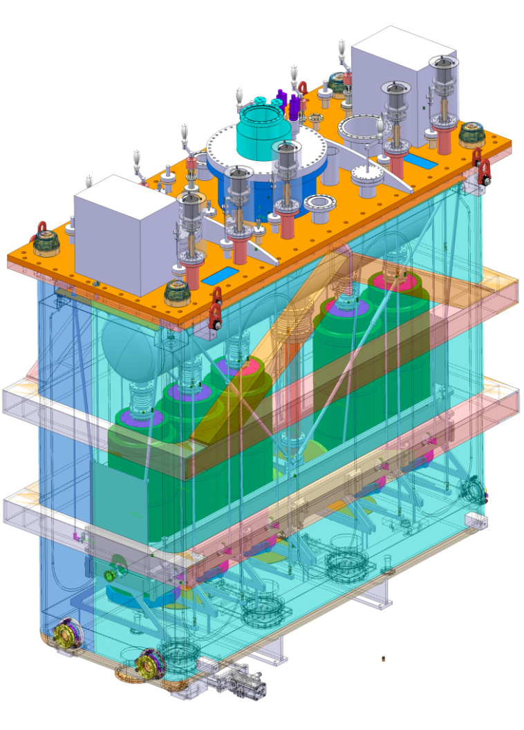
Introduction: cavities in HIE-ISOLDE
Installing these cavities is one of the upgrades to transform ISOLDE into HIE-ISOLDE to achieve higher energy
It will become a super conducting linac instead of a warm linac as it was before
A superconducting accelerator needs liquid Helium to cool down the cavities to reach working temperature (4.2K)
Copper thermal conductivity allows to cool the cavity down from the antenna reservoir to achieve working temperature
These cavities will reduce energy losses due to low surface resistance
Goal 2014 is 5 cavities
Cryomodule with 5 cavities

Slide 7
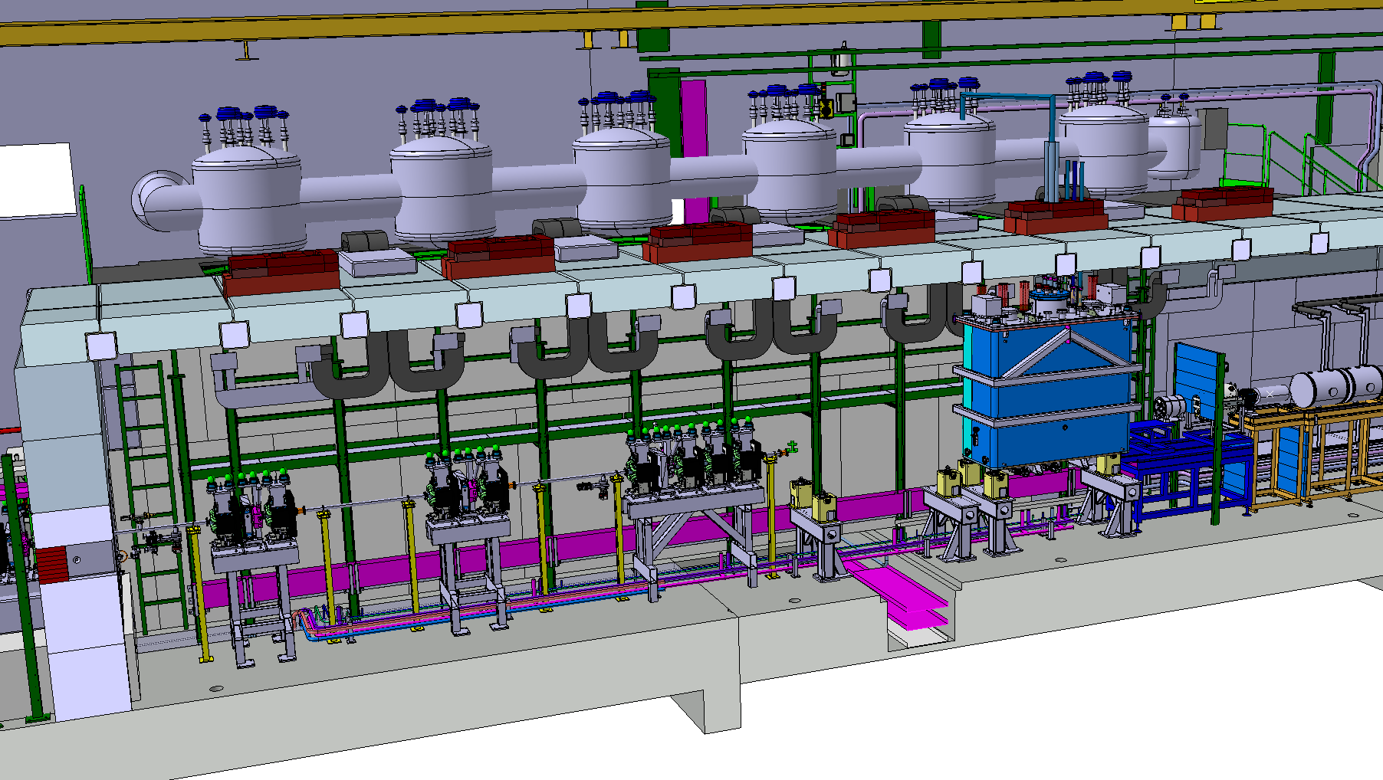
Cryomodules in the accelerator

Slide 8
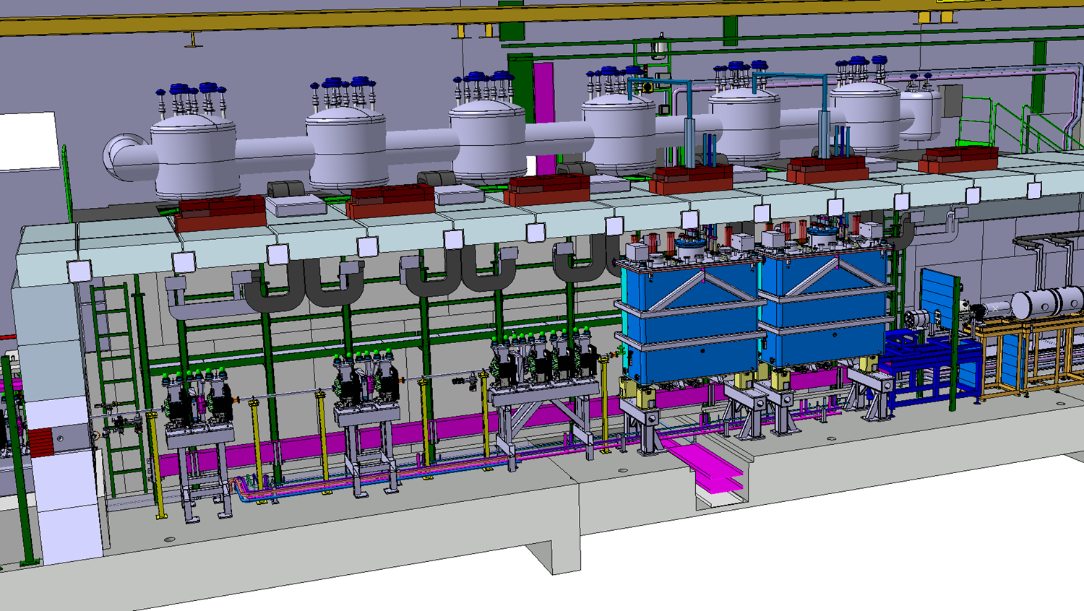
Cryomodules in the accelerator

Slide 9
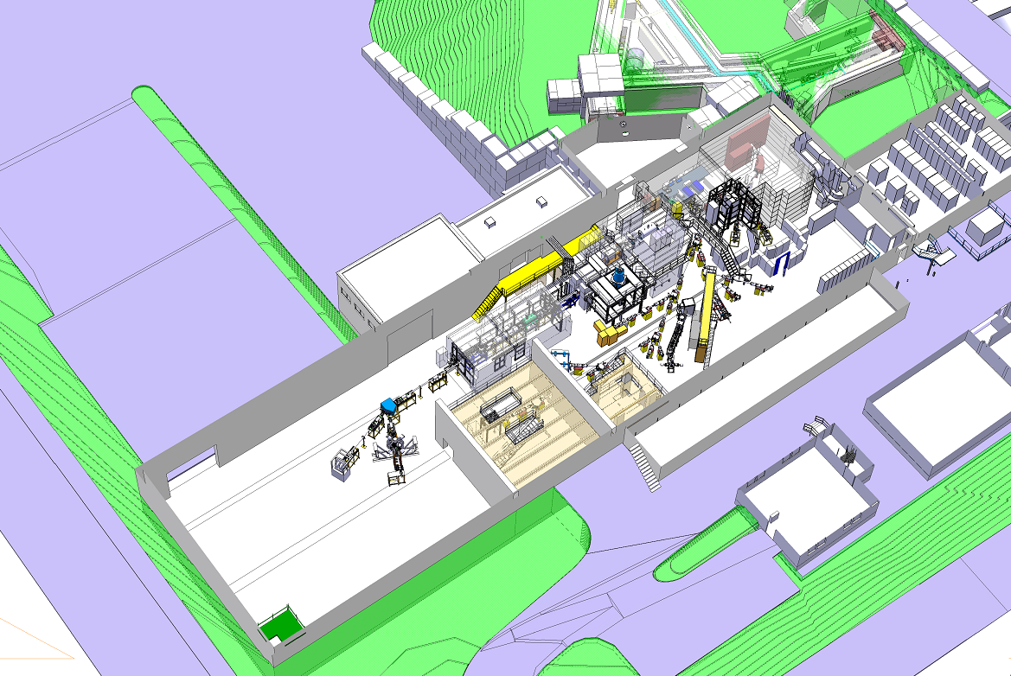
ISOLDE layout

Slide 10
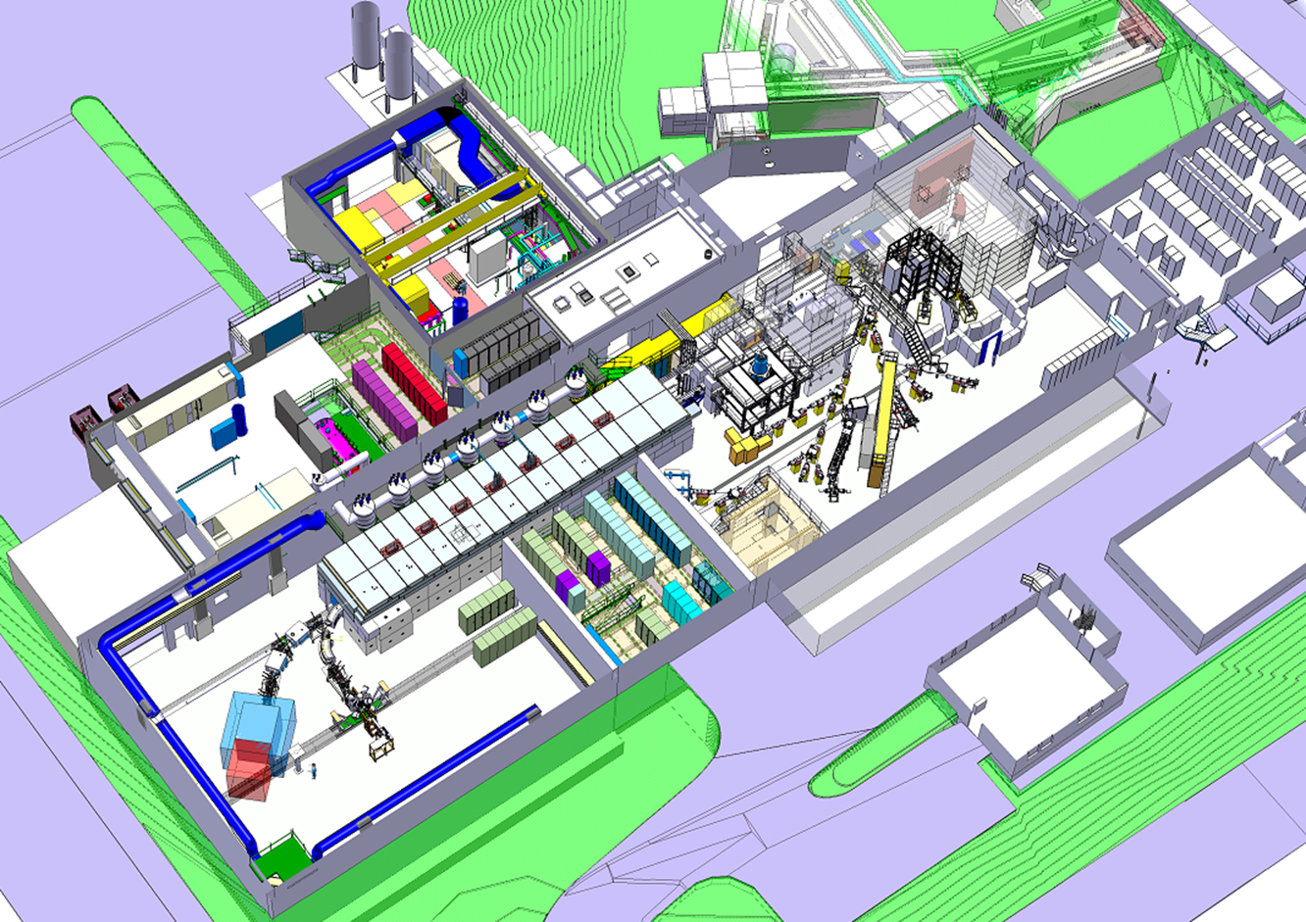
HIE-ISOLDE

Slide 11
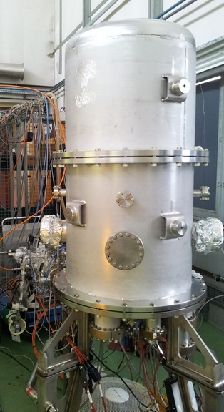
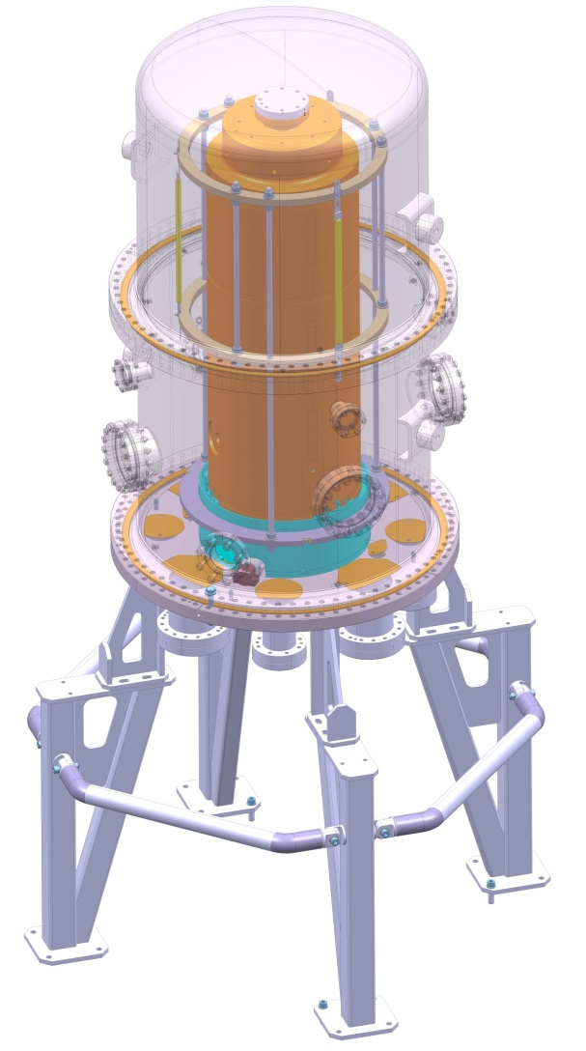
Introduction to coating system
350mm
624mm
950mm
DN612
624mm
729mm

Slide 12
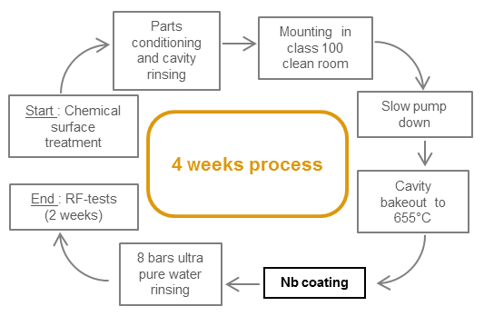
Timeline
Development stage is done. Production phase

Slide 13
Preparation for the coating
Cavity’s surface treatment (cleaning and chemical polishing) in the surface treatment workshop
Conditioning of the parts and mounting of the vacuum system in cleanroom
Pumpdown and high temperature bakeout
NEG pump activation

Slide 14
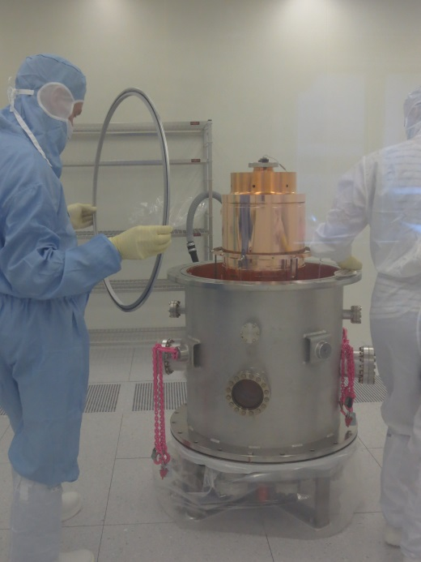
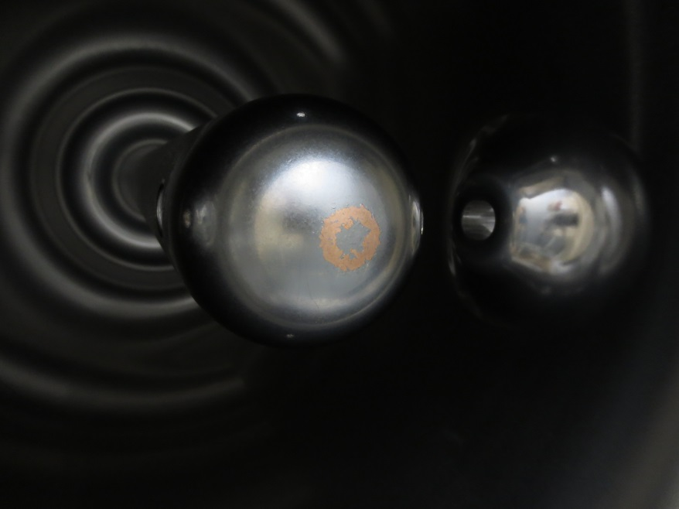
Preparation for the coating: cleanroom
Mounted inside to prevent airborne particles contamination in our surface
This would create peel-off and hot spots during the operation in the cryomodule, due to higher electrical resistivity
Exceeding the cooling capacity of the cryomodule would result in a drop of cavity’s performance
Cleanroom assembly
Peel-off

Slide 15
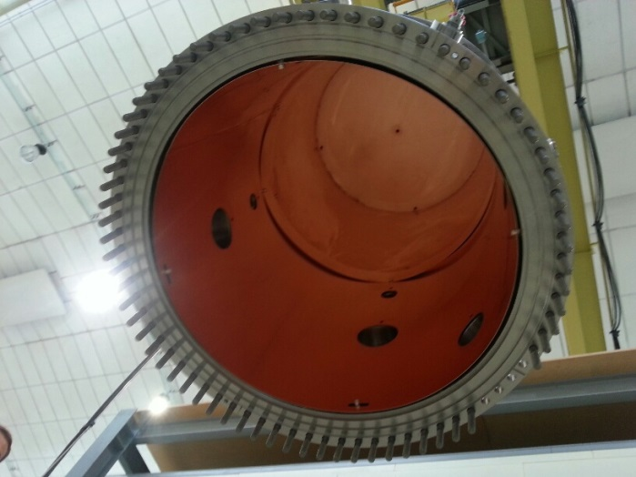
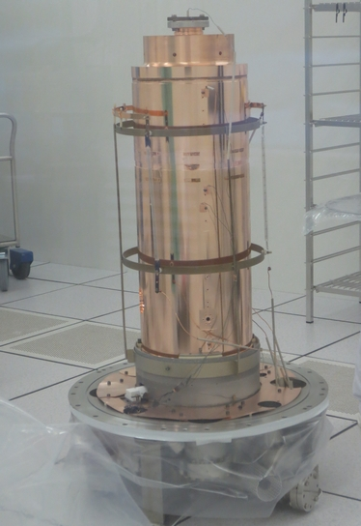
Preparation for the coating:
Special Bakeout of the cavity and NEG
Classical bake out: heating between 120 and 200°C all the surfaces of our vacuum system, depending on the sensitivity of our devices
One limitation of our system are Viton seals (can’t stand more than 140°C) in the big flanges (612mm) of the vacuum chamber
Special bake out: the cavity is heated up to 650°C using IR to release the gas trapped in the substrate (H₂ and O₂)
To reduce thermal losses during bakeout, we shield our chambers with copper screens
Activation of NEG pump after bakeout to pump H₂ with higher efficiency + compensate Viton permeation.
Copper shields
IR lamps

Slide 16
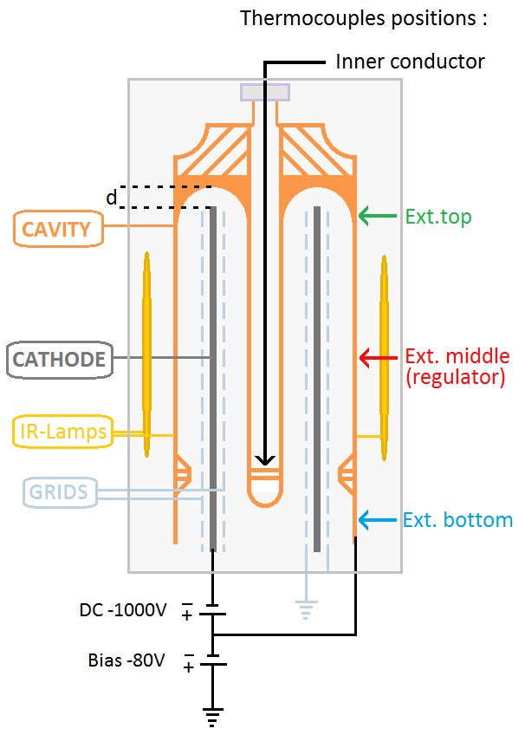
Diode Sputtering process Schematic
After bakeout and NEG activation, ultimate vacuum is reached (P<1x10E-7 mbar) at 300°C
We inject a noble gas (Ar) in the chamber up to a process pressure (0,2 mbar) and create a plasma. →Coating
High temperature : better film properties (from 300°C to 620°C)
High power (8kW): better RF performance
Recording all pressures and temperatures.

Slide 17
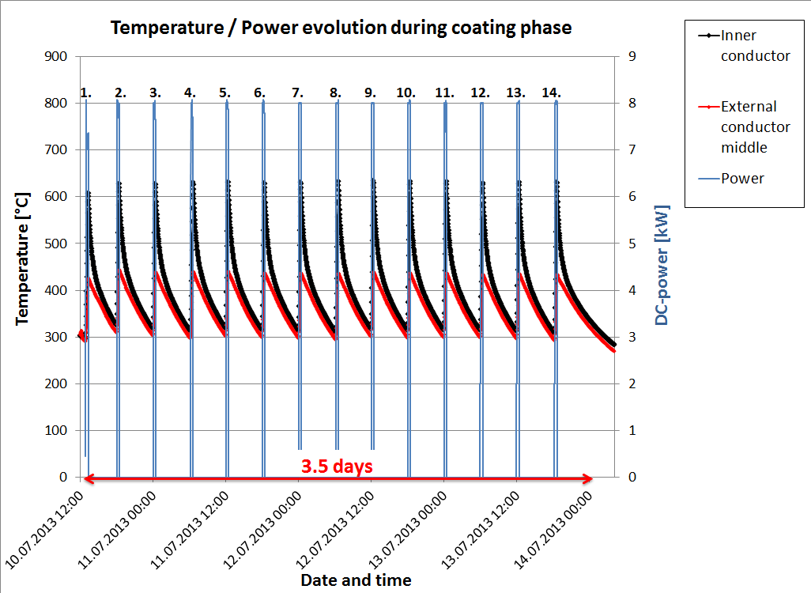
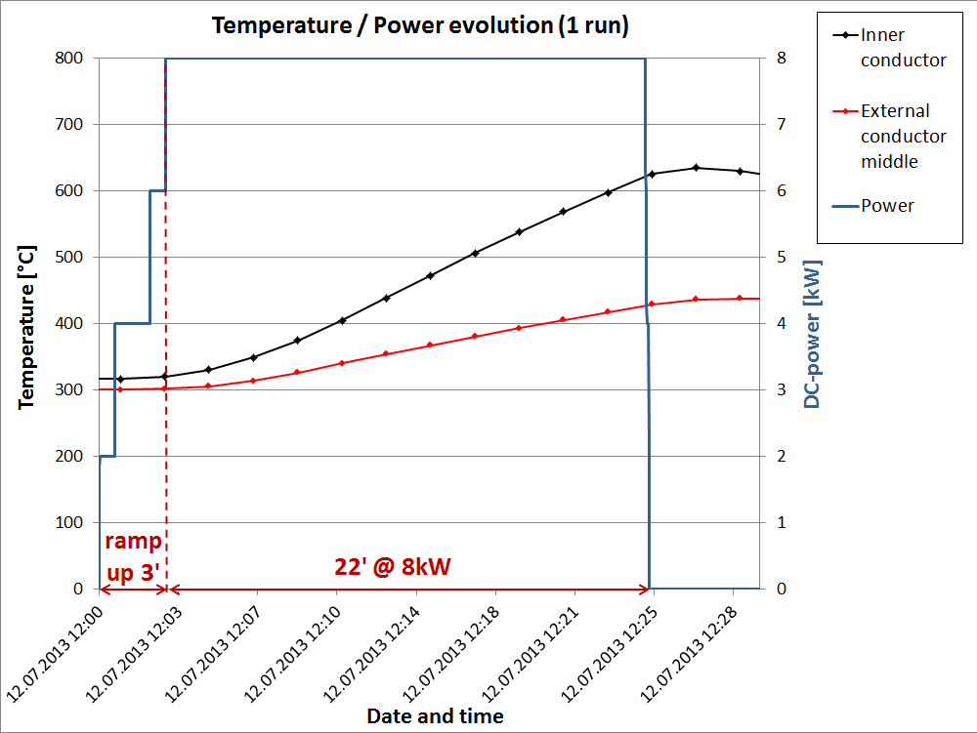
Cycles of the Sputtering process: temperature evolution
Total energy: 43kWh
Around 25min per run + 5h30 cooling
We need 14 runs to complete a coating
Total effective coating time: 6 hours

Slide 18
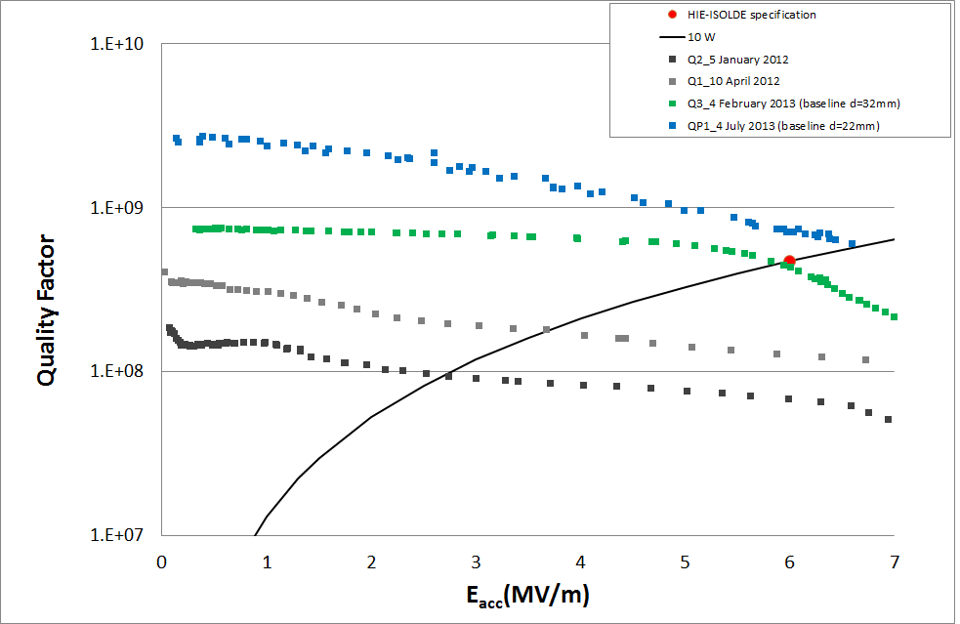
RF results
8kW, special bakeout, baseline recipe
Final geometrical configuration
8kW, special bakeout, baseline recipe
4kW, standard bakeout
Different geometrical configuration
2kW, standard bakeout
Notes:
2kW → Text =486°C / Tin unknown
4kW → Text=590°C / Tin unknown
8kW → (both) Text=430°C / Tin=620°C.

Slide 19
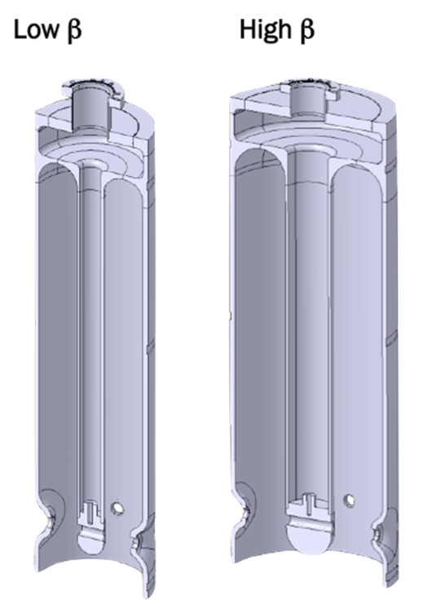
Next goals
Backup in case of failure of 1st coating system
Focus on development with different techniques (magnetron, double cathode, other cavities…)
Start development of Low beta cavities
→ Second coating system

Slide 20
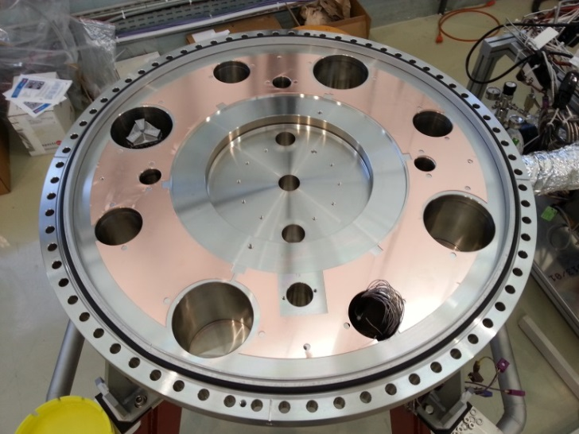
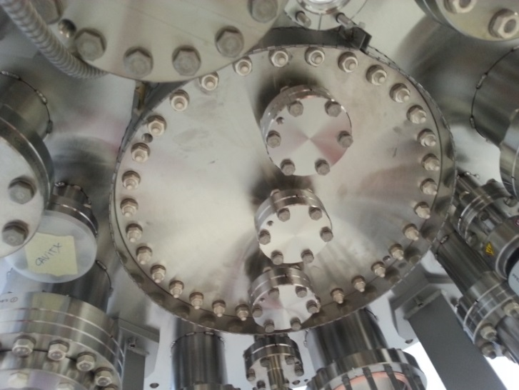
Flexibility in configuration
Built entirely in stainless steel 316L
  Stands better chemical treatments for cleaning
  Less interaction with magnetic field for magnetron
Geometry of bottom flange
  Allows to adapt different cavities (High and low Beta)
  Develop a double cathode coating system for layer thickness uniformity in complex geometries
More viewports located in specific zones to implement:
  Visual control
  Optical plasma diagnosis and monitoring system
DN273
Top view
Bottom view

Slide 21
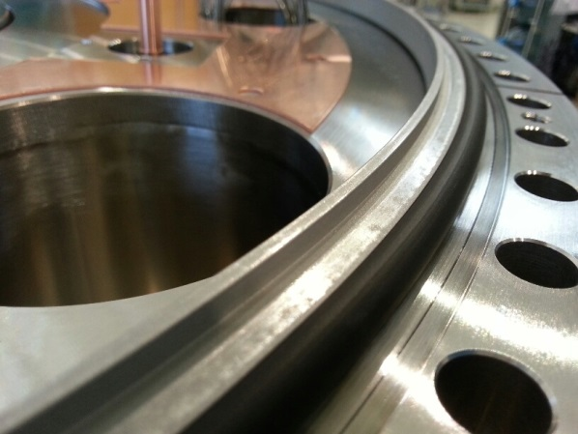
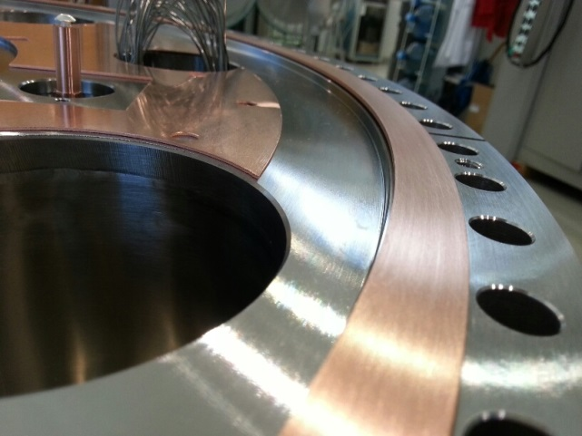
Flexibility in performance
Special 612mm Flanges: chamber sealed either by copper gaskets or Viton O-rings
  Copper gaskets (612mm) allow to have a wider temperature range during bakeout and coating
  Better leak tightness with copper gaskets
  Viton can still be installed instead of copper (cheaper and faster)
Viton O-Ring
Copper gasket

Slide 22
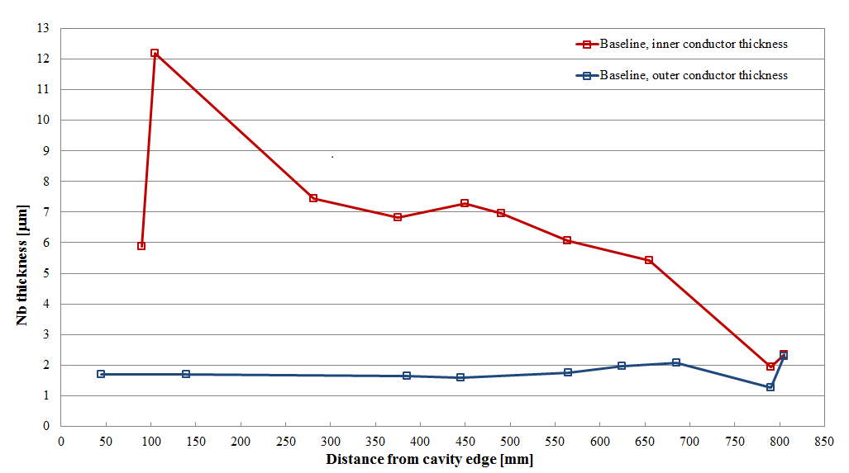
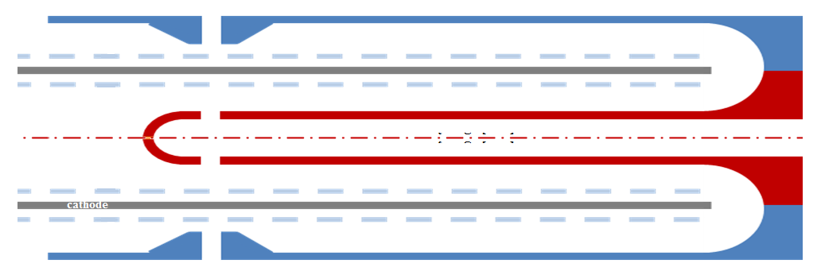
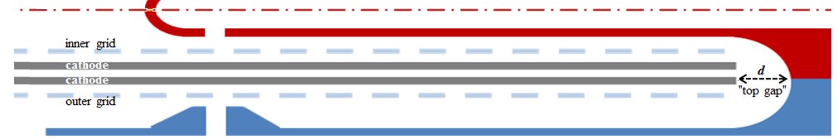
Thickness profile

Slide 23
Current status
Second system status :
  Pieces cleaned in the chemistry
  Checking assembly of all the pieces
  Installation of external devices (gauges, valves, NEG pump) and integration in the vacuum system
  Leaktight
  Will be fully qualified when one cavity is coated with the standard recipe and tested afterwards in RF facilities reaching specs.
  Cavities status :
  3 series cavities already coated and measured
  1 series cavity coated → waiting for measurement
  1 more series cavity is needed → arrival at CERN next week

Slide 24
Acknowledgements
Thin films group, specially Noemie, Alban and Mauro
Giovanna Vandoni

Slide 25
Thank you very much for your attention
Questions?

Slide 26
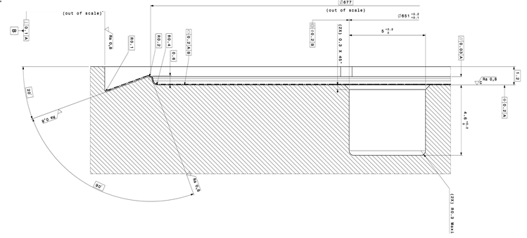
Bottom flange

Slide 27
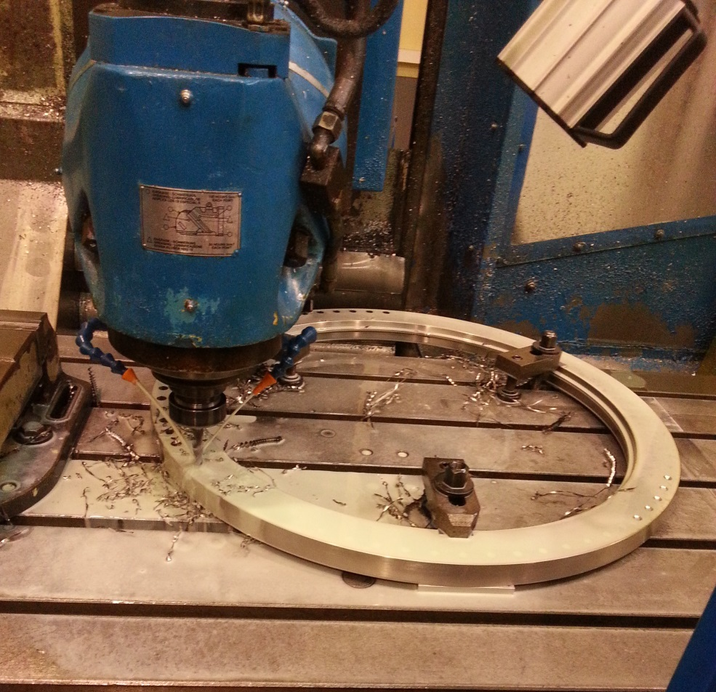
Manufacturing
Manufactured by Trinos Vacuum Projects Spain, raw material provided by CERN
  Vacuum chambers
  Copper shields
  Support for the structure
  Cavity support
  Grids
  Ceramic isolation pieces

