Slide 1
Testing Theories
(What to do and what definitely not to do)
R. F. Casten
Yale
August 2014

Slide 2
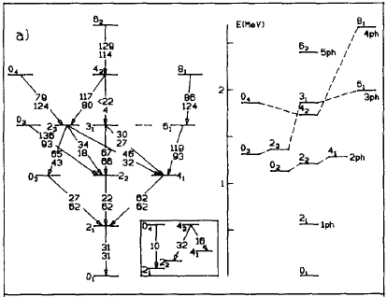
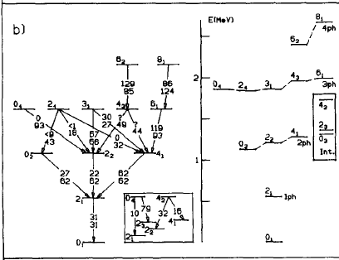
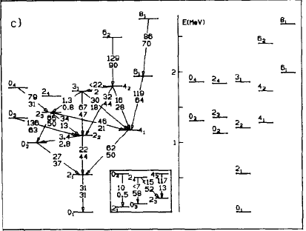

Which theory and how to test it?
¹¹⁴ Cd
?

Slide 3
A very simple first example:
Which theory is better
Now look at χ²
Ironically,
super-precise data can lead you astray

Slide 4
χ² analyses
The good, the bad, and the ugly

Slide 5
Avoid over-weighting super-precise data
BUT
The real problem in the above example is not the accurate data per se for some states but the lack of inclusion of
Theoretical Uncertainties

Slide 6
Theoretical uncertainties
This seldom refers to numerical uncertainties in the calculations but to how good we can expect a model to be.
A model that says nuclei are all shaped like coca cola bottles is less likely to be accurate than one that says some nuclei are shaped like soft ellipsoids.

Slide 7
~ 800 ~ 0.01

Slide 8
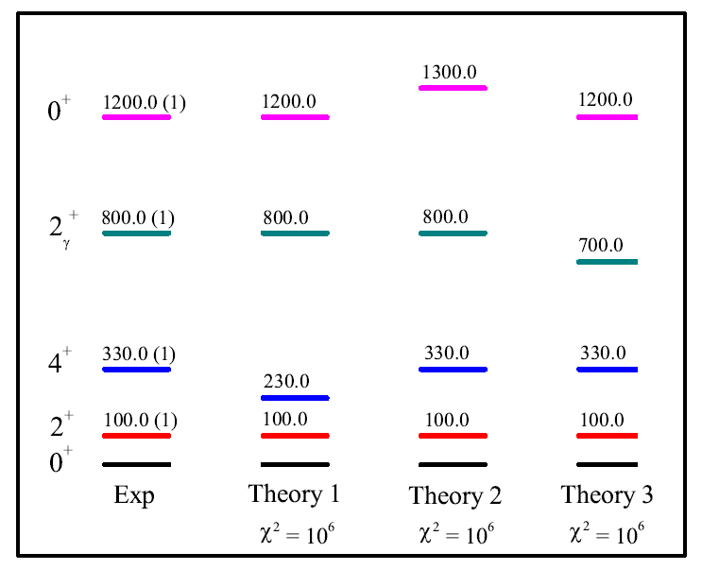
Evaluating theories with equal discrepancies
Theoretical uncertainties: Yrast: Few keV ; Vibrations ~ 100 keV
χ² ~1000 1

Slide 9
How did we estimate the theoretical uncertainties?
More or less by “feeling”, experience, “communal wisdom”. I would guess that most nuclear structure physicists over about 40 years old would come to similar estimates.
BUT
Its hardly rigorous and somewhat uncomfortable. Can we do better?
Answer is yes, but with a lot of work and probably not in a simple case like this. You can do a correlation analysis of theoretical/experimental deviations and get quantitative measures of the sensitivity to each observable. Gets pretty formal. See article:
Also interesting for model reliability in policy making:

Slide 10
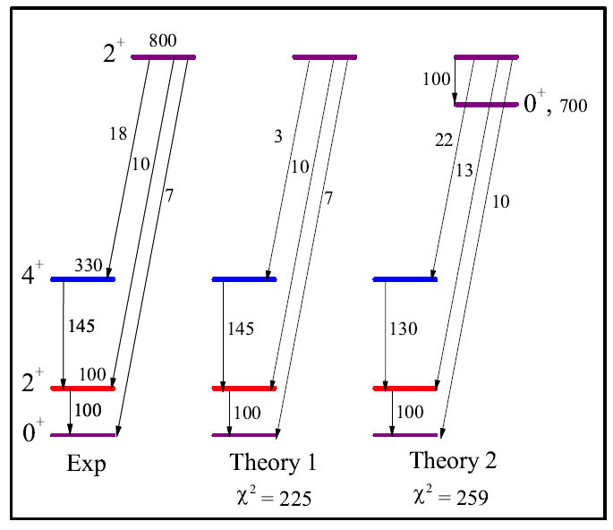
Example with B(E2) values
All exp. uncertainties 1 Wu
Here we directly use physics understanding to evaluate theories

Slide 11
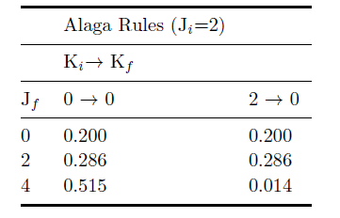
Alaga rules
Transition to J = 4: Largest Smallest

Slide 12
K = 0
with unknown 0⁺

Slide 13
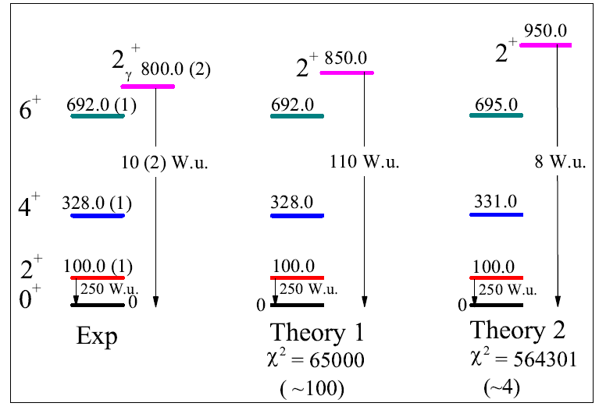
Both energies and B(E2) values
χ²
Theor. Uncertainties: Yrast, 3 keV; Vib Es, 100 keV; B(E2)s, 10 Wu

Slide 14
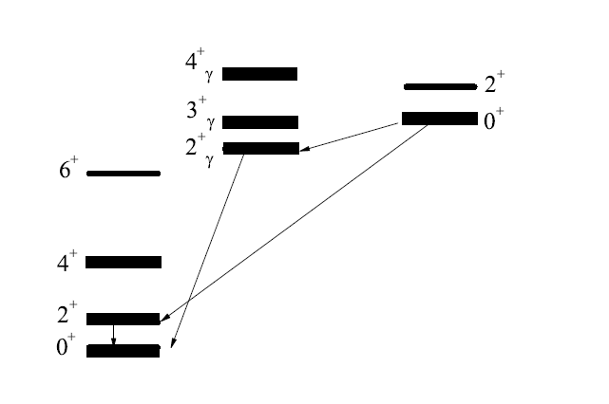
Not all observables equally important; many multiply-test same physics
Including many yrast levels in a χ² test overweights that physics. The more, the worse it gets.
10⁺
6⁺
7⁺
6⁺
4⁺
8⁺
5⁺
Staggering:
γ softness
Vibrationalbandhead energies
Rel.
Band mixing
Rel.
Abs.
Rel.
Rotational spacings
Collectivity
What are the key observables for testing collective models?

Slide 15
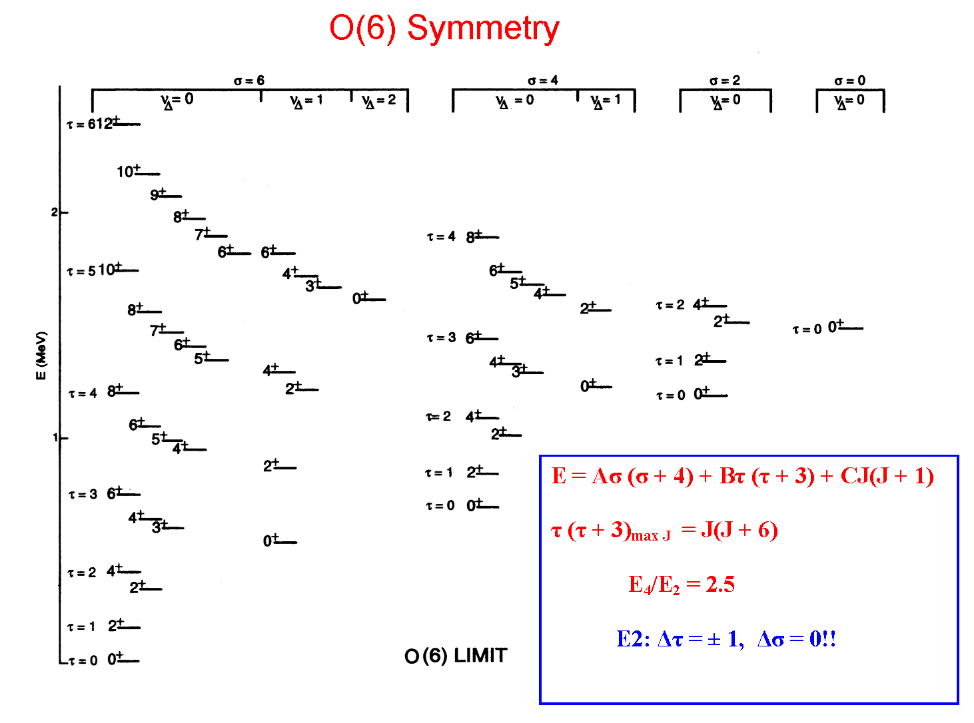
Choosing observables sensitive to specific physics
(σ,τ)

Slide 16
Parameters

Slide 17




Parameters
5
3
2
Notes:
17

Slide 18
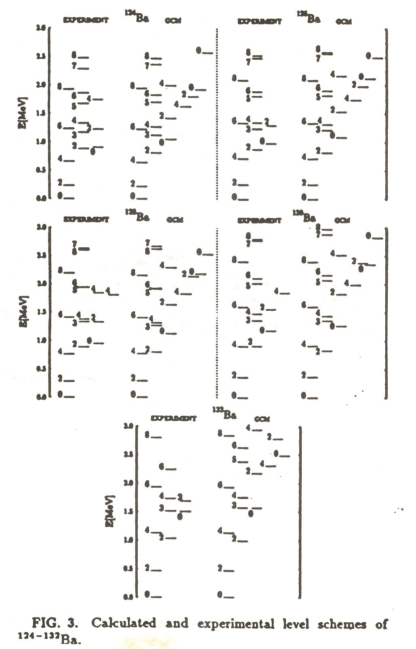
Dealing with multi-parameter models

Slide 19
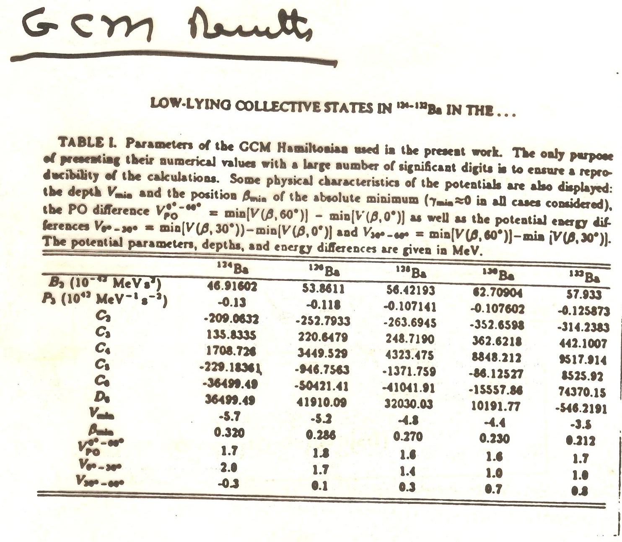

Slide 20
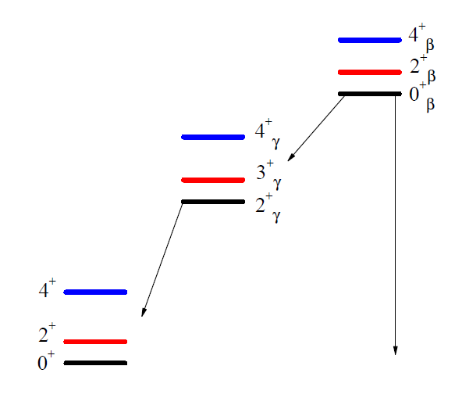
Parameters
Interpreting this level scheme with bandmixing
How many parameters?

Slide 21
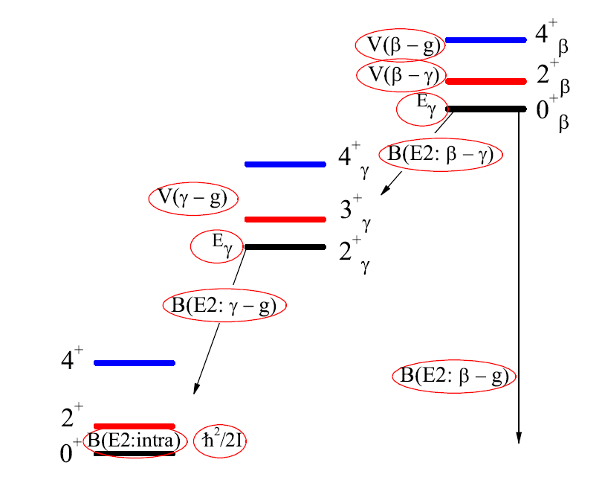
Beware of parameters
β

Slide 22
Why do some models have so many and others so few parameters?
Compare above 10-15 parameter calculation with the IBA which obtains comparable or better fits with 2-3 parameters.
Why? It’s the same physical system both are describing.
An answer sheds some light on the nature of models.
The IBA makes an ansatz: truncate shell model. That saves many parameters. But that ansatz is itself a kind of parameter choice – to set to zero the amplitudes of many shell model configurations.
One can thus often think of models as searches to select the appropriate degrees of freedom. Those choices are effectively physics-based parameterizations that don’t appear as explicit parameters.
The success or failure of those models teaches us about these ansatzes and the physics behind them

Slide 23
Summary
Beware of blind statistical optimizations
Always include theoretical uncertainties
Do not multiply fit the same physics
Choose observables that select specific physics
Be conscious of the number and nature of (often hidden) parameters.

