Slide 1


Hadronization Study of the Meson
Michael Wood
Canisius College
Buffalo, NY USA

Slide 2

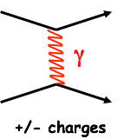
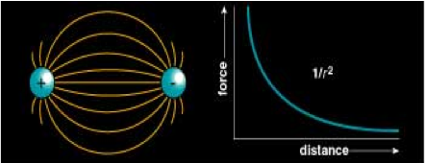

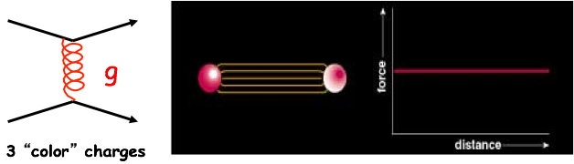
Strong Nuclear Interaction
Electromagnetic
Strong Nuclear

Slide 3
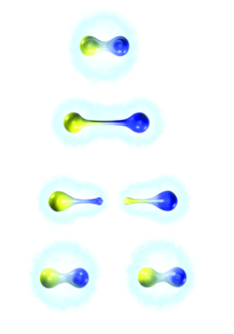
Confinement
As the two quarks are pulled apart, the energy in the gluon field increases. There is enough energy to convert to mass and produce new particles.
Goal: understand quantitatively the confinement mechanism.
Quarks have mass so they cannot travel faster than the speed of light. They will be deconfined for a short period of time.

Slide 4
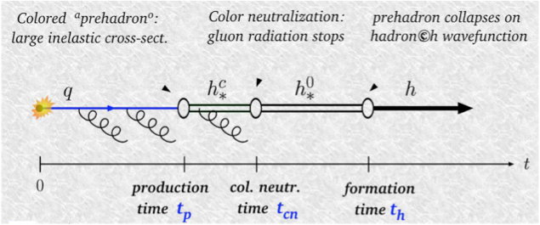
Questions
Does the quark interact with the nucleus?
What is the quark propagation time?
What is the hadron formation time?
Does the hadronic mass matter?
Does the quark flavor matter?
Image shamelessly borrowed from W. Brooks

Slide 5


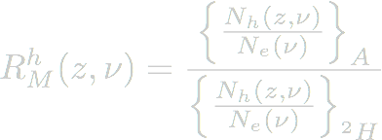

Observables
Knock a quark out of a proton (neutron) with an electron.
Detect the particle that is created from the free quark.
Use a nucleus as a ruler (compare to deuterium).
pT Broadening
Long propagation time means more quark interactions with the nucleus and more transverse momentum.
Particle Multiplicity
More particles implies long formation times. If carbon produced the same number of particles as Pb, formation time is small.
Fractional hadron energy:

Slide 6
Previous Studies
Study | Beam | Targets | Ref.
SLAC | e- (20.5 GeV) | ²H, Be, C, Cu, Sn | L.S. Osborne, et al., PRL 40 (1978) 1624.
EMC | µ () | ²H, C, Cu, Sn | J. Ashman, et al., Z. Phys. C 52 (1991) 1.
E665 | µ (490 GeV) | ²H, Xe | M.R. Adams, et al., PRD 50 (1994) 1836.
HERMES | e+ (27.6 GeV) | ²H, He, N, Kr, Xe | A. Airapetian, et al., EPJC 20 (2001) 479, A. Airapetian, et al., PLB 577 (2003) 37. A. Airapetian, et al., NPB 780 (2007) 1.
CLAS | e- (4-5 GeV) | ²H, C, Fe, Sn, Pb | H. Hakobyan, PhD thesis (2008), A. Daniel et al., PLB 706 (2011) 26, T. Mineeva, PhD thesis (2014)
In general: multiplicity decreases (hadron production is suppressed) as target A increases.

Slide 7
Hadronization at Hall B
Hadron |  | Mass (GeV) | Institution
 | 25 nm | 0.13 | URich, UConn
 | 7.8 m | 0.14 | ANL,UConn, ODU
 | 0.17 nm | 0.55 | URich, UConn
 | 23 fm | 0.78 | Canisius College
 | 0.98 pm | 0.96 | URich, UConn
 | 44 fm | 1.0 | UNH, OhioU
f1 | 8 fm | 1.3 | Canisius College
K^{+,-} | 3.7 m | 0.49 | UNH, OhioU
K⁰ | 27 mm | 0.50 | UNH, OhioU
Hadron |  | Mass (GeV) | Institution
p | stable | 0.94 | ANL,UConn, ODU
 | 79 mm | 1.1 | JMU
 | 13 fm | 1.5 | JMU
 | 24 mm | 1.2 | JMU
 | 22 pm | 1.2 | JMU
 | 87 mm | 1.3 | JMU
 | 49 mm | 1.3 | JMU

Slide 8
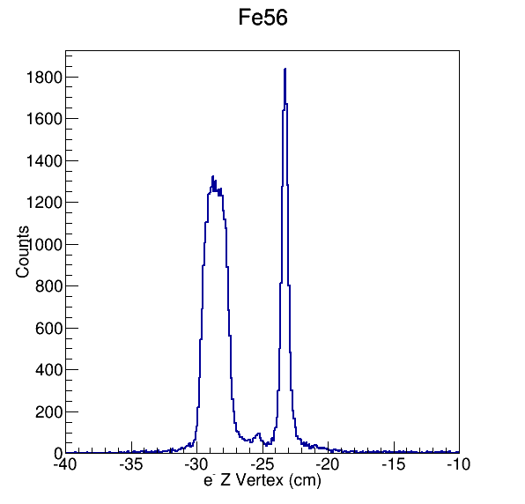
The eg2 Experiment
Key facts about eg2
Electron scattering experiment at JLab in Hall B with CLAS
Designed for two measurements
  E04-104 - Studies of Hadronization
  E02-110 - Search for Color Transparency
Collected data in 2003-2004 over three run periods
  eg2a - Ee = 4.0 GeV
  eg2b - Ee = 4.5 GeV
  eg2c - Ee = 5.014 GeV
Targets: ²H, C, Al, Sn, Fe, and Pb
Two targets in beam simultaneously (²H and heavy target)
Fe
²H

Slide 9
Data Mining
Filtered files from eg2 data set with EG2EventSelection.
Final state:
Filtering of each target data took ~ 1day (ran overnight)
Converted the output EVIO files to ROOT trees (evio2root).
Analyzed output with ROOT macros.
Target | C | Sn | Fe | Pb
Events | 302,926 | 10,767 | 43,617 | 59,166
Canisius College is a primarily undergraduate institution. This work would not be possible without data mining project.
Example:
Summer 2009 - student spent 8 weeks building CLAS software and writing a filtering program. Filtered Fe files, but analysis stalled.
Summer 2013 - different student (Andy Beiter) installed DMS and filtered C files in 1 week. Spent the remaining 7 weeks making histograms.

Slide 10
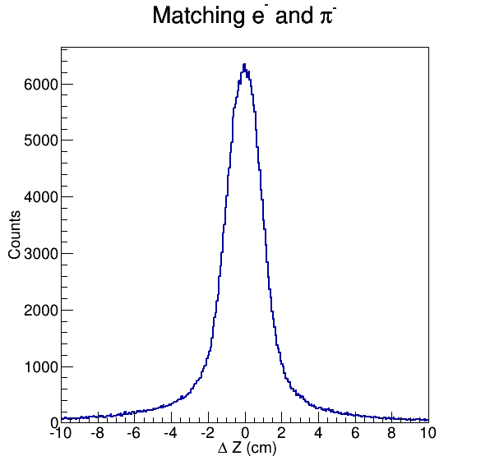
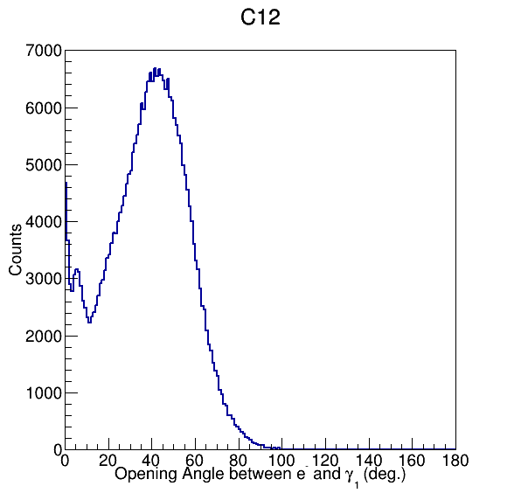




Cuts
Vertex matching:
Opening angle between scattered electron and photons:
mass

Slide 11
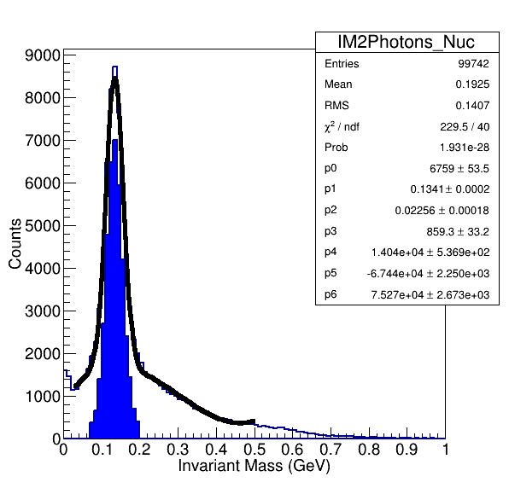
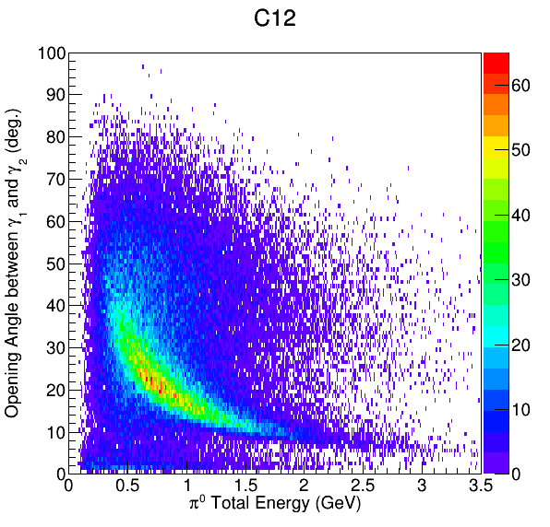
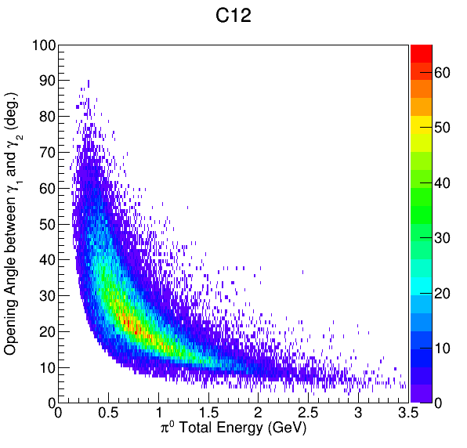
Analysis
Before cut
After cut

Slide 12
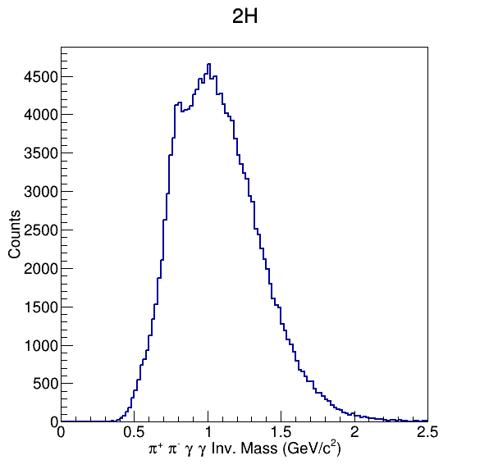
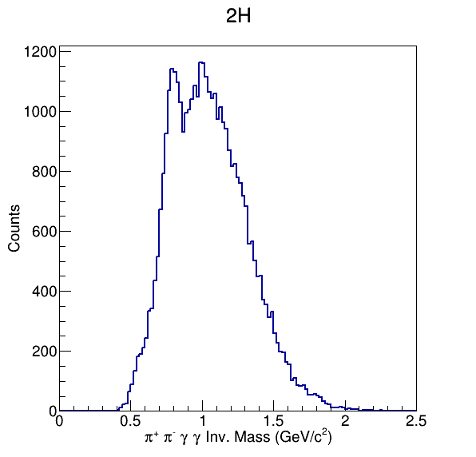
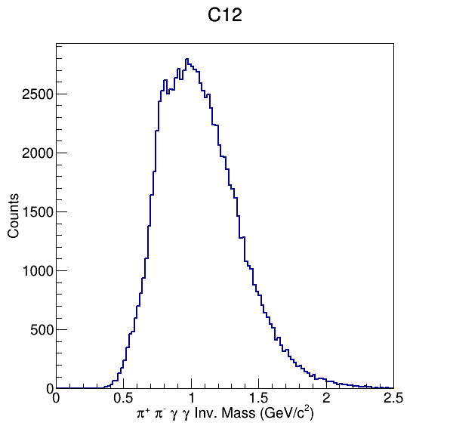
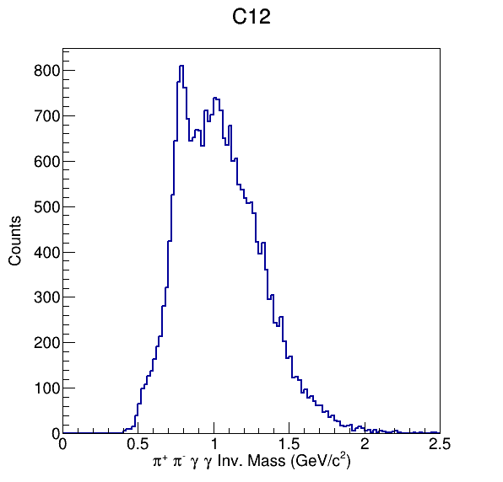
Invariant Mass
After Cuts

Slide 13
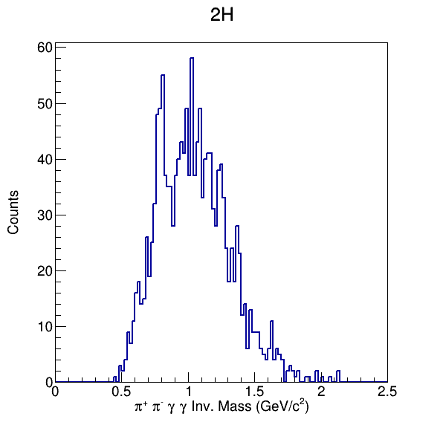
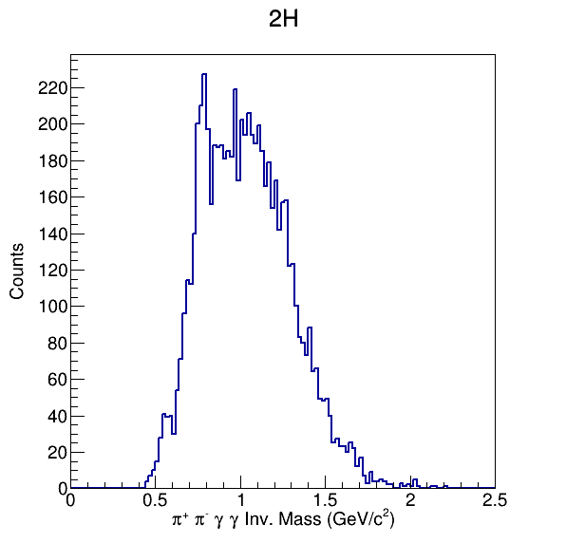
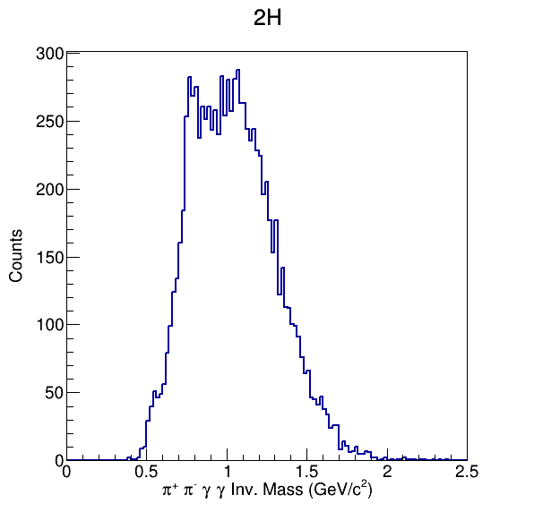
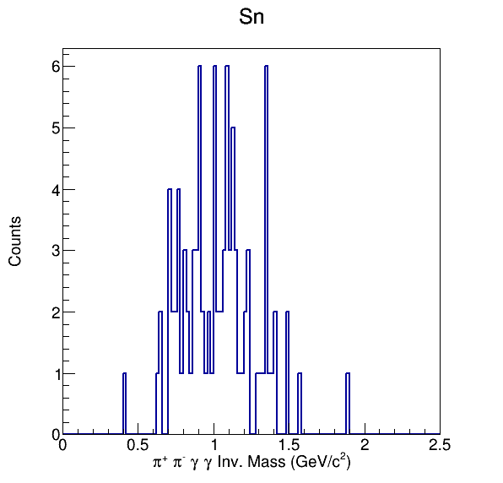
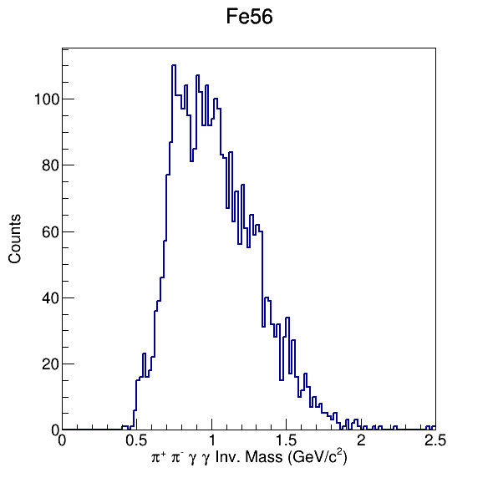
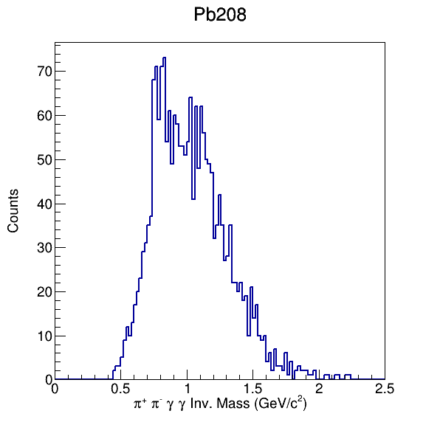
Invariant Mass
Sn Data
Fe Data
Pb Data

Slide 14
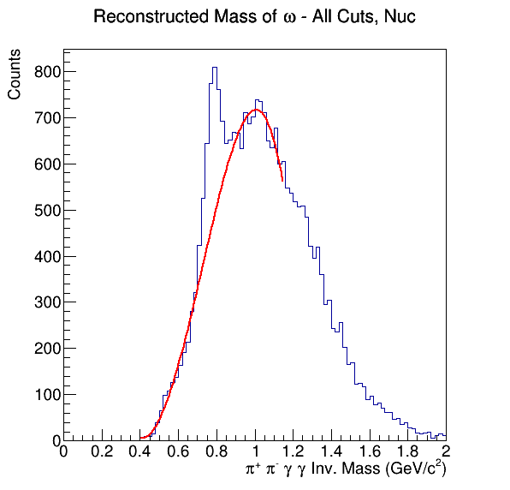
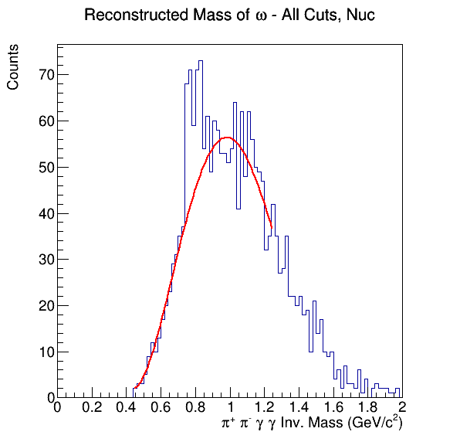
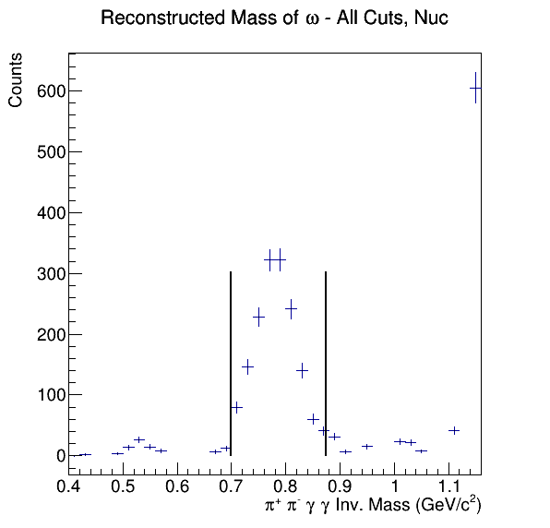
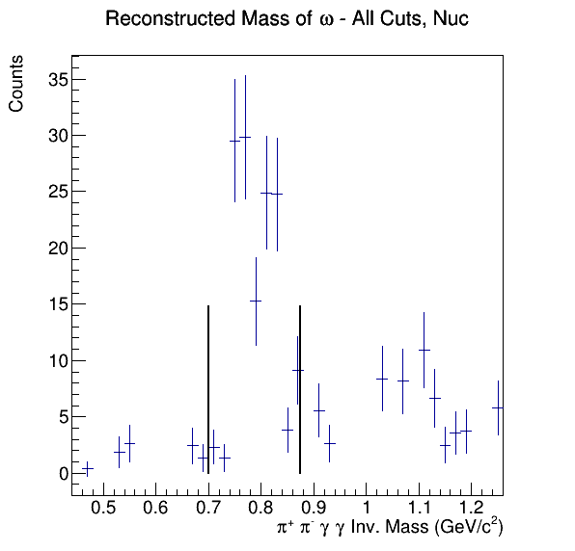
Yields
Simple background subtraction: remove bins with peak and fit polynomial to background
Pb208
C12
Preliminary
 | C | F | Pb
2H Yield | 2209 +/- 47 | 410 +/- 20 | 493 +/- 22
Nuc. Yield | 1592 +/- 40 | 202 +/- 14 | 142 +/- 12
Ratio (Nuc./2H) | 0.72 | 0.49 | 0.29

Slide 15
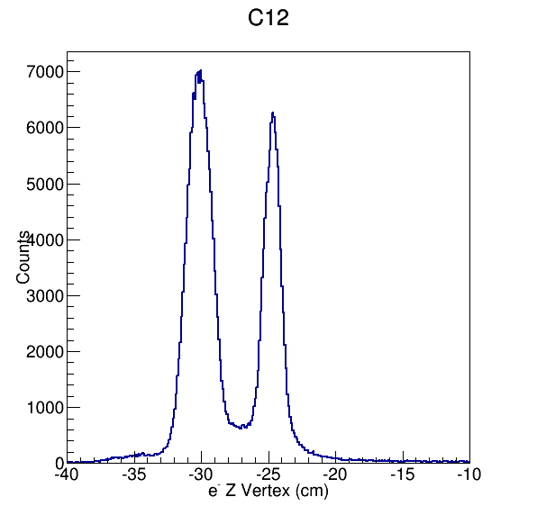
Target Vertex Corrections
²H
C
Fe
²H

Slide 16
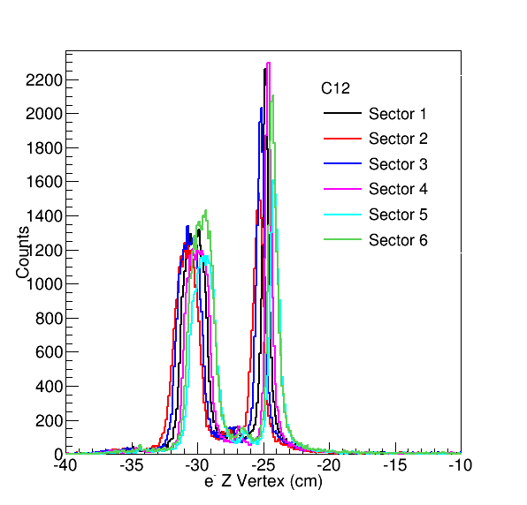
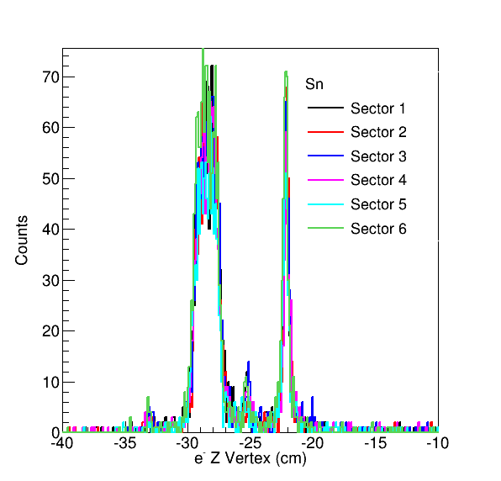
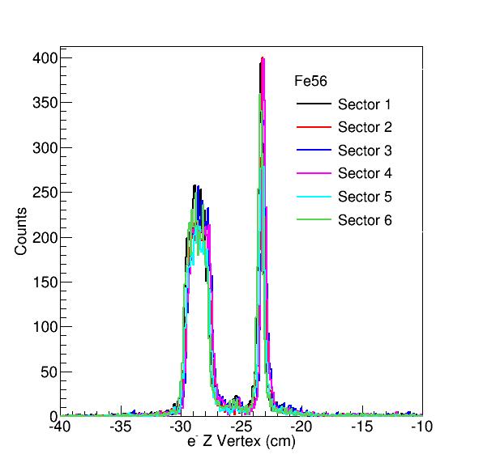
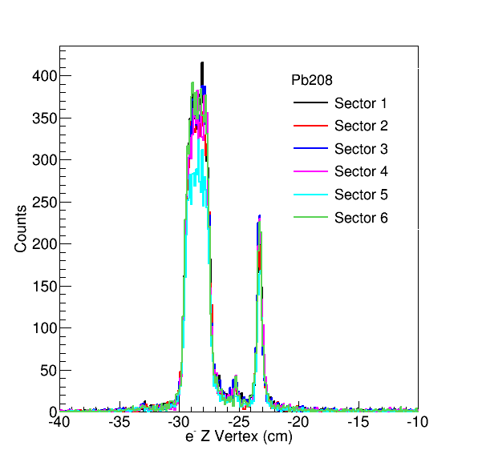
Target Vertex Corrections

Slide 17
Standard Cuts & Corrections
From T. Mineeva’s dissertation on hadronization, there are a number of cuts and corrections applied:
Electron ID cuts (EC, CC, momentum, timing)
Photon ID cuts (EC, momentum, timing)
EC fiducial cuts
DC fiducial cuts
Target vertex corrections
Photon energy correction
What are the parameters in EG2EventSelection?
Do I have to show these for the CLAS Analysis Review?

Slide 18
Simulations
The full analysis is going to require detector simulations to understanding efficiencies, acceptance, and model background.
Standard analysis chain:
Generate events.
Simulate detector with GSIM.
Correct the output with GPP.
Reconstruct the output with A1C or RECSIS.
Analyze with same code as the actual data.
How will this change with data mining software?

Slide 19
Summary
Preliminary analysis of eg2 data shows promise for a hadronization study of the meson.
Clear signal in the mass spectrum. The real work is underway to reduce the background and extract the yields. Suggestions are always appreciated.
The data mining software has been a tremendous help in both time and resources.
Big questions on how to make the mining even more robust and sophisticated.

