Slide 1

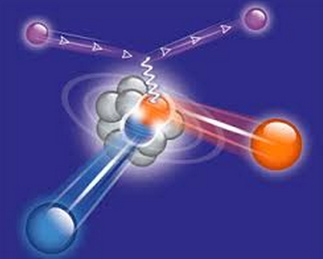
Neutron Detection
in
JLab’s Hall B
Michael Braverman
Tel-Aviv University
In Collaboration With :
E. Piasetzky and O. Hen (TAU)
L. B. Weinstein (ODU)
H. Hakobyan (UTSM)
Data Mining Meeting , MIT , August 9th 2014

Slide 2
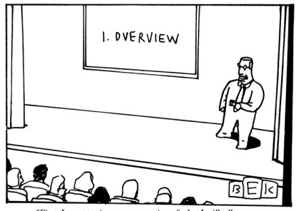
Outline
Motivation.
Hall B
  Electromagnetic Calorimeter.
  EG2 run period.
Neutron Calibration
  Event Selection
  Momentum Error
  Path Length Correction
  Corrected Momentum
  Efficiency : Angular dependence
  Efficiency : Momentum dependence
Future Plans

Slide 3
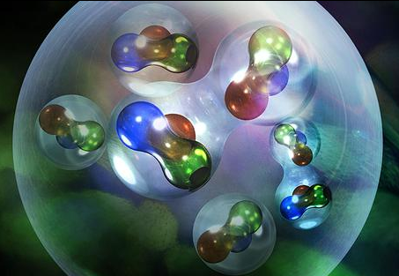
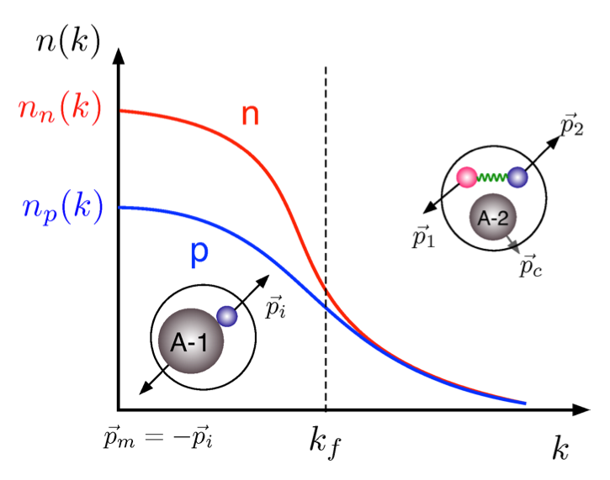
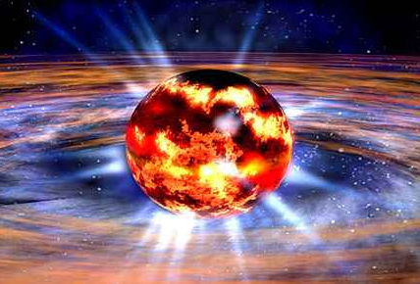
Motivation…
Experiments show :high momentum n-p
correlation.
Interesting implication : protons are faster
than neutrons ?
Possible Consequences
Neutron Starts.
Nutev effect.
Notes:
Experiments show that high momentum protons are coupled to high momentum neutrons in nuclei, where the high momentum is relative to the Fermi level of the nuclei – those experimental results were explained due to the dominance of the tensor part of the nucleon-nucleon interaction in this momentum regime.
In heavy asymmetric (N>Z) nucleons – there are more neutrons than protons. Never the less, the amount of high momentum neutrons should be equal to the amount of high momentum protons (because they are coupled) this means that the fraction of high momentum protons is higher than the fraction of high momentum neutrons and thus – the average momentum and kinetic energy of the protons should be higher than those of the neutrons !

Slide 4
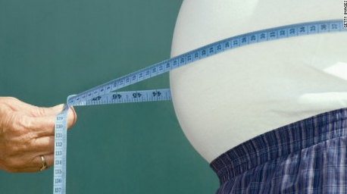
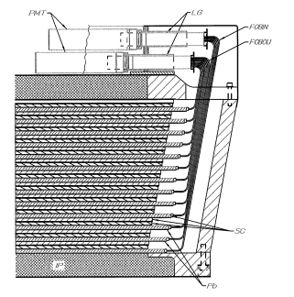
Hall B : Electromagnetic Calorimeter
  Experimental Setup : Hall B’s CLAS detector.
  The neutral Particles are detected in Hall B using the EC.
    Less accurate than the charged particles.
  CLAS : 6 EC Sectors.
  EC: Alternating planes of scintillator strips and
  lead sheets.
  Two layers :
    5 planes = inner layer
    8 planes = outer layer
  Neutrons = Hits in the EC with no track recorded which are not photons meaning with betta<1.
Notes:
ASSOCIATE
The neutral Particles are detected in Hall B using the EC.
Each EC sector is :
39 scintillator layers divided into 3 possible direction (120 degree)
called U,V,W (13 scintillators in each layer) each direction layer
has further 36 strips parallel to each other.
Each direction is further divided into an “inner” and “outer”
Layer ( inner = first 5 scintillators , outer = last 8 scintillators in
each direction). All the layers of each direction are coupled
to the same one photo-multiplayer.
Neutral Particle Identification And Measurement : Neutrals, photon and neutrons = EC clusters that has no charge track reconstruction in the DC. Photons and neutrons are separated using their TOF.
Neutral particle momentum measured using it’s path length and TOF from creation vertex. The path length has obvious error due to it’s thickness and unknown interaction point within it. Interaction point approximated to be in the middle. Good approximation to charged particles and bad approximation for neutral particles.

Slide 5
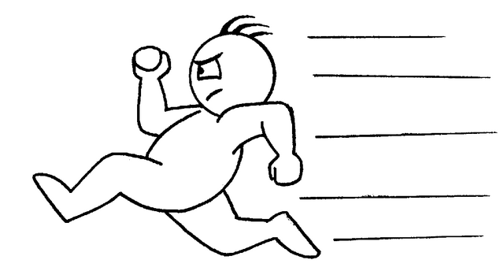
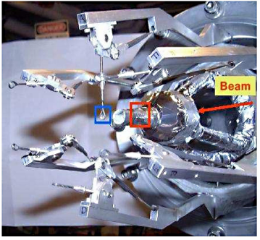
Hall B : EG2 run period
Data collected during 2004 .
Two Targets Simultaneously :
  Cryogenic liquid target (hydrogen and
  deuterium)
  Changing Solid Target : Fe , C , Al , Pb , Sn.
5.015 GeV electron beam.
Notes:
The eg2 experiments used two targets simultaneously to reduce the systematic error in the measurements such as the nuclear transparency.

Slide 6
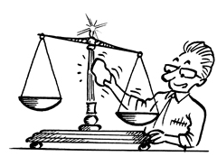
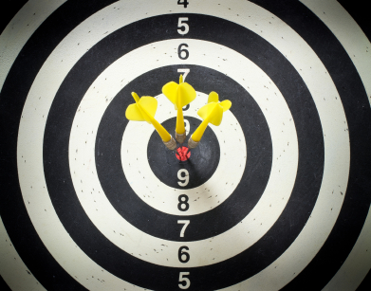


Neutron Extraction : Hall B Calibration
Q : how to extract the EC precision and efficiency for neutron detection ?
: Exclusive process
$$e+d→e′pπ^{+}π^{−}n$$
Over determination
EC
Reconstructed:
Compare To . . .
$$e+d→e′pπ^{+}π^{−}X$$
Notes:
Purpose : Identify events In which X is an actual neutron as oppose to other background effect ( Ask Or : What other background effect could that be ? )
Method : Kimetic cuts on the missing momentum.

Slide 7
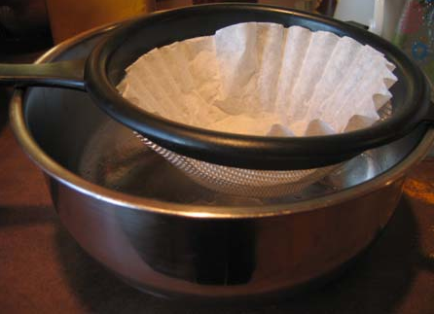
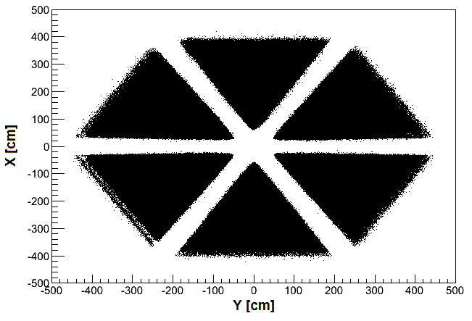

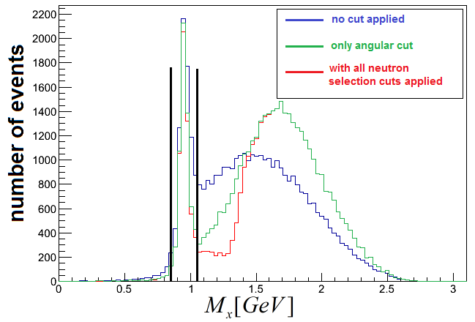
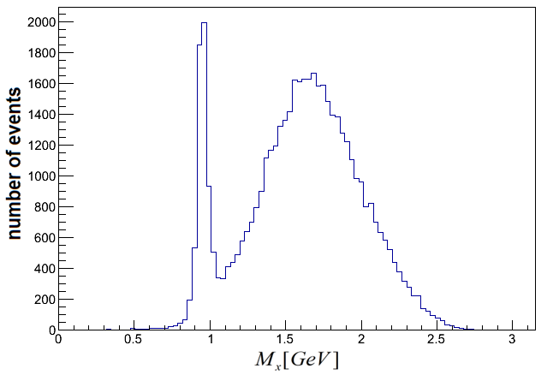
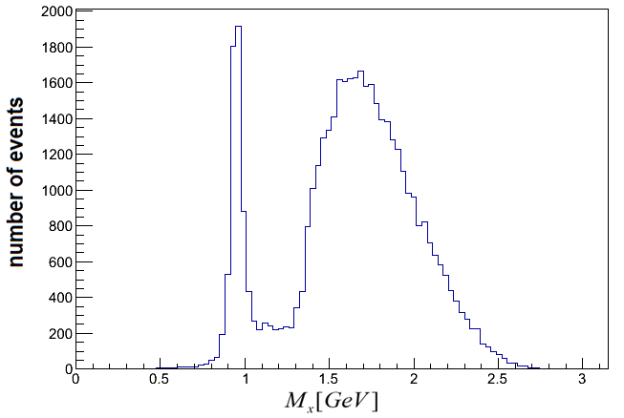
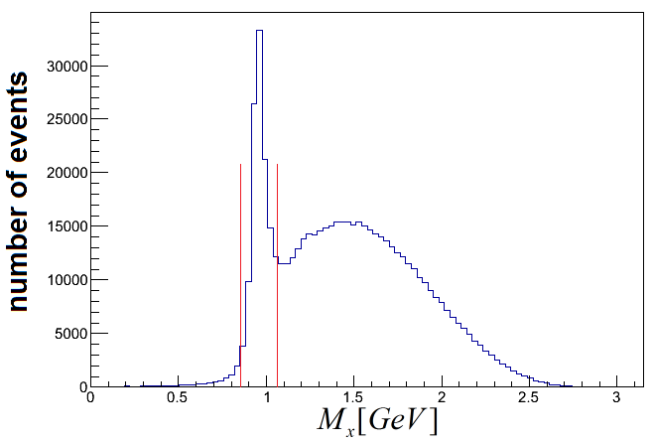
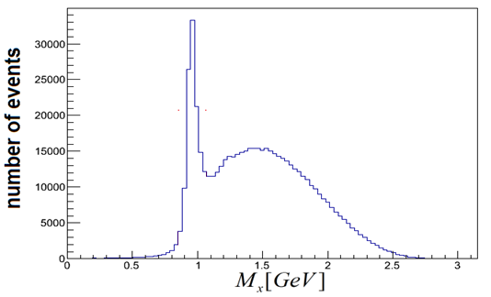
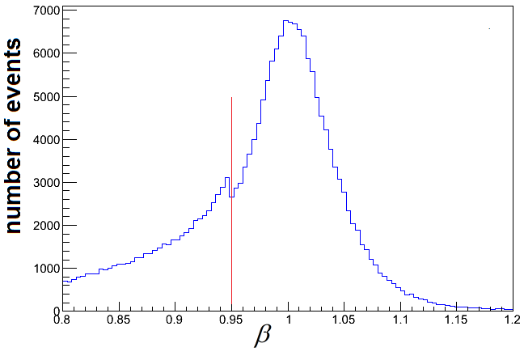
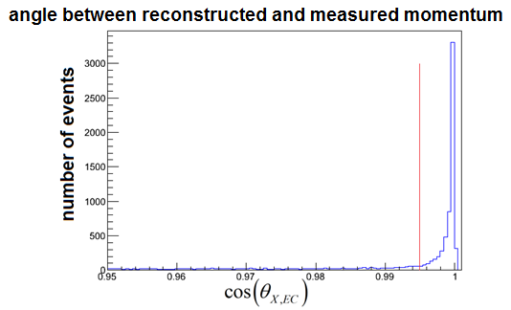
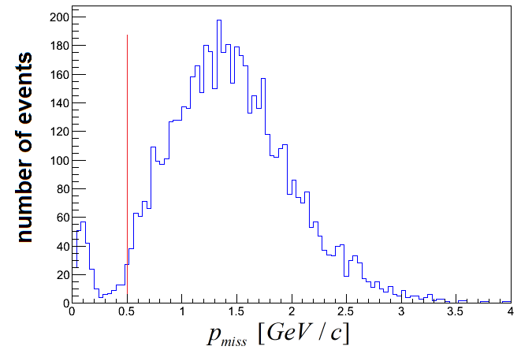
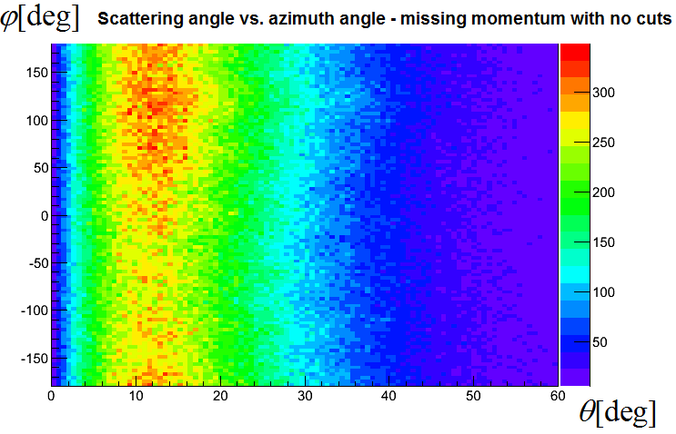
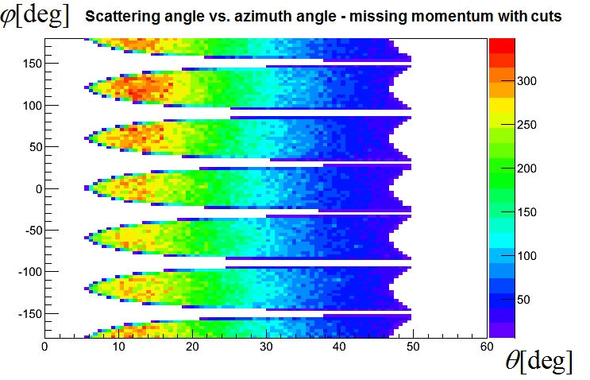




Neutron Extraction : Event Selection
Objective : identify events in which X is an neutron as oppose to other background event.
$$e→e′pπ^{+}π^{−}X$$
Third Cut : missing mass
Forth Cut : Scattering angle
Fifth Cut : missing momentum
First Cut : Betta Cut
Second Cut : Fidutial
: Identify

Slide 8
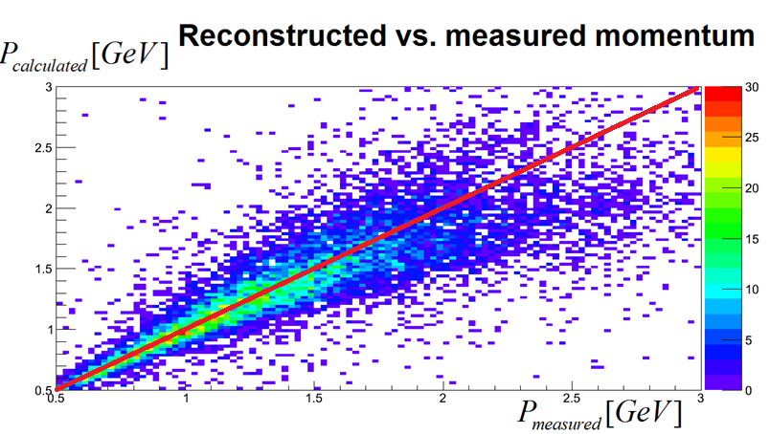
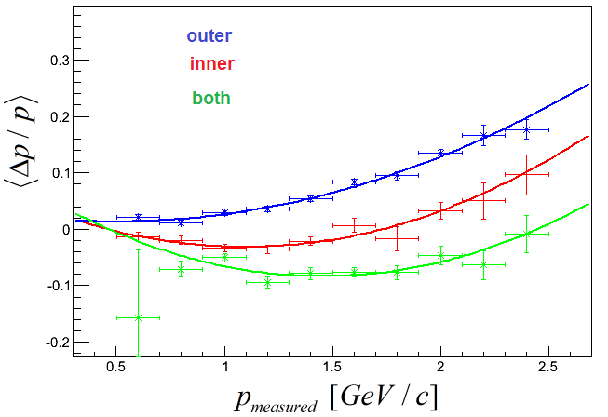
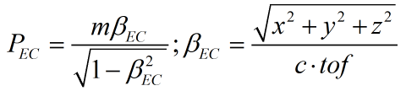
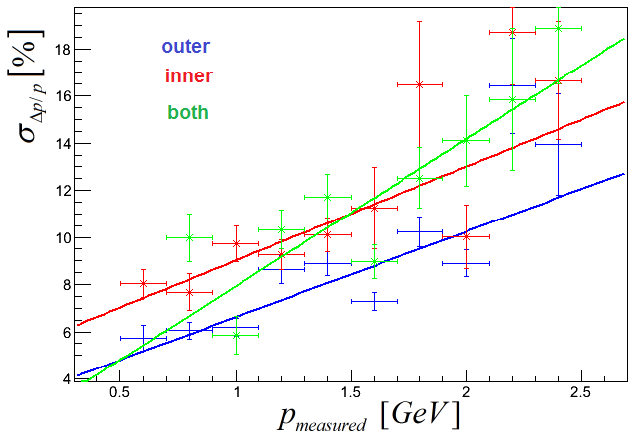
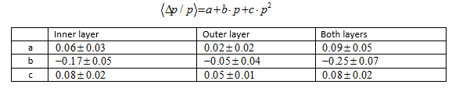

EC momentum measurement
The Momentum measured using the EC and the Missing momentum has some discrepancies between them.
: Identify
Momentum resolution
Momentum offset parameters
Momentum resolution parameters

Slide 9
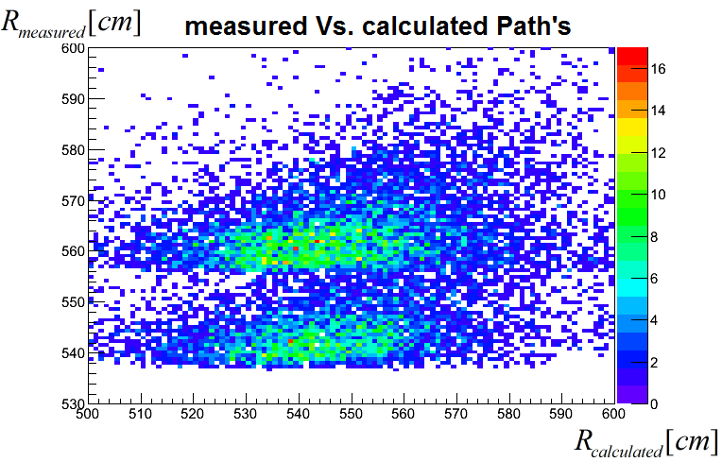


Calibration : Path Length Correction
The EC has non-neglectable uncertainty in the radial hit coordinate due to it’s width.
Measuring and fixing this might take care of the discrepancy.
: Identify
Outer layer
Inner layer
Notes:
So we saw that there are significant discrepancies between the measured and reconstructed momentums and we want to understand where do they come from and how can we fix them ?
One of the first things that we wanted to look at are the path length measurement of the EC. Why so ? Well , as you remember the EC is made out of two layers with very reasonable widths and the hit location is determined in a not so accurate fashion within it – so there could be reasonable offsets in the path length measurement which then can create significant discrepancies between the measured and calculated momentums
להגדיל את הצירים
להוסיף למשוואה את Z-Z0

Slide 10
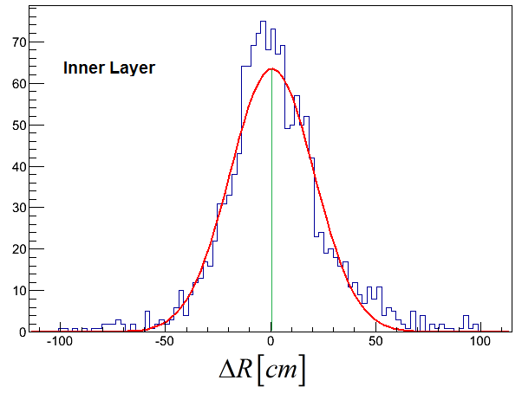
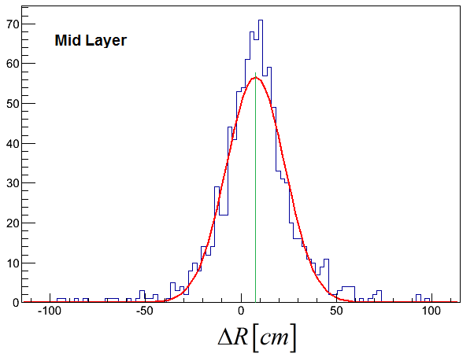
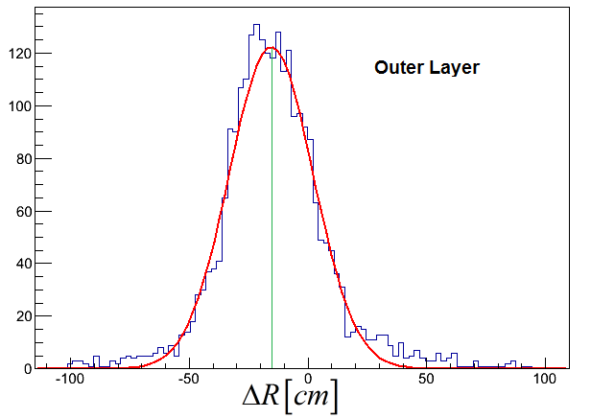




Calibration : Path Length Correction
Each of the EC Layer’s has a different Path Length offset.
: Identify

Slide 11
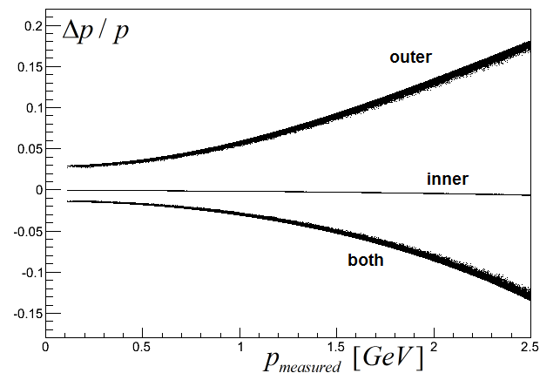
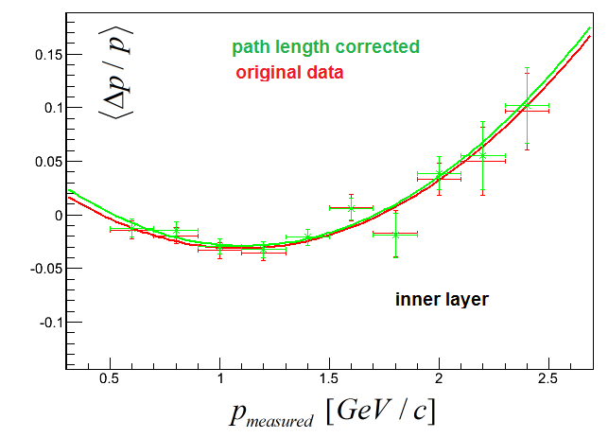
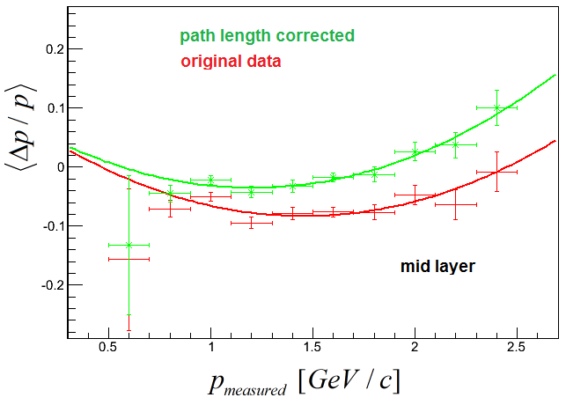
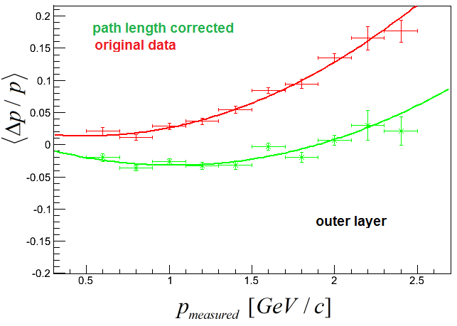
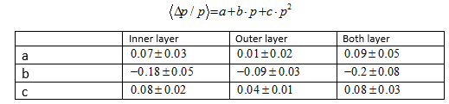
Calibration : Path Length Correction
Applying the Path length offset correction to each layer we got the following improvement in the momentum readings :
the effect of the path length correction
: Identify
After path length correction Fit parameters

Slide 12
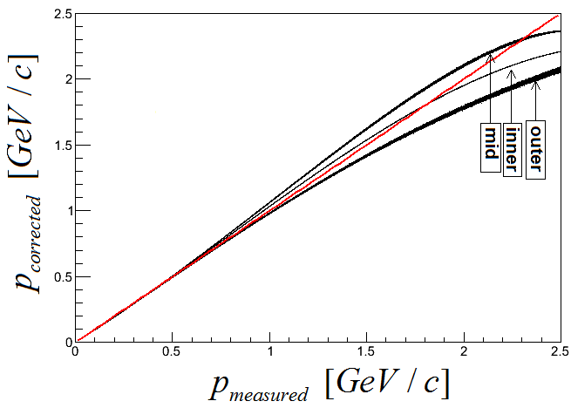
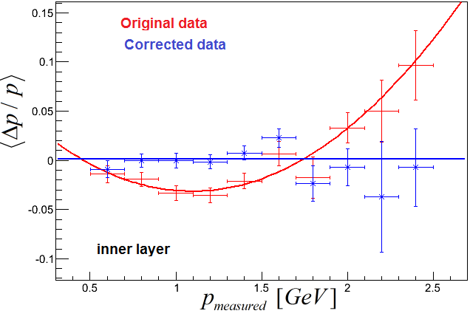
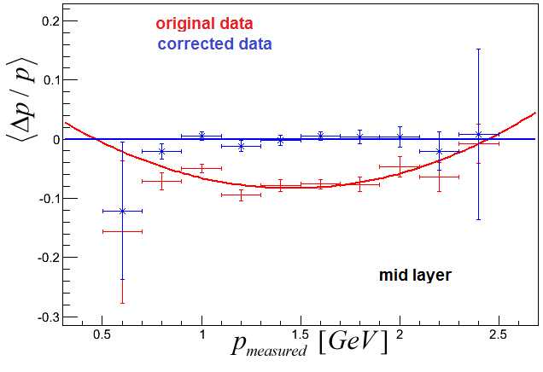
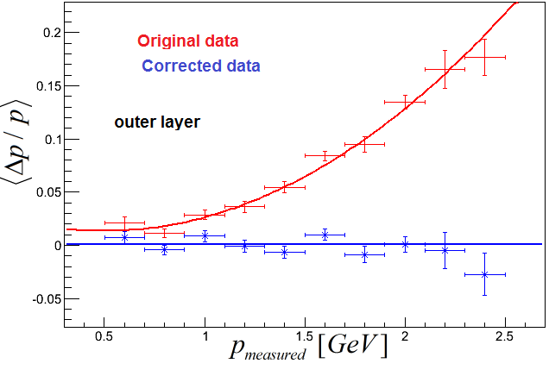
Calibration : Momentum Correction
Only Path Length Correction is not enough , additional empirical correction is applied :
The Final Correction Function
: Identify

Slide 13
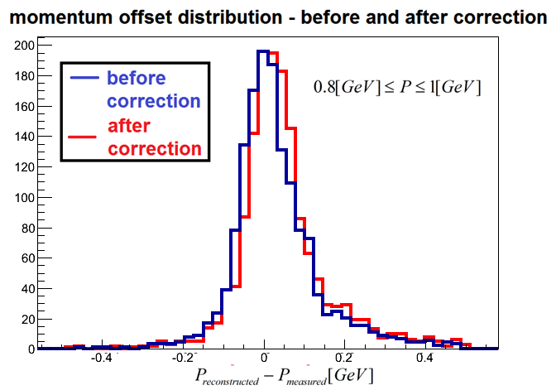
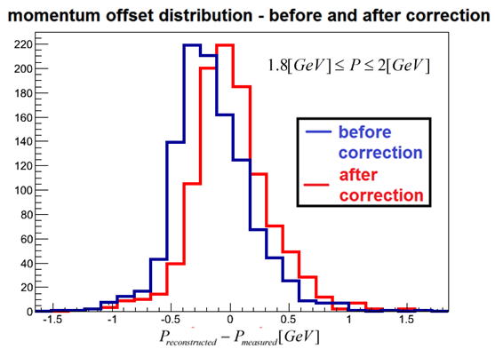
Calibration : Momentum Correction
: Identify

Slide 14
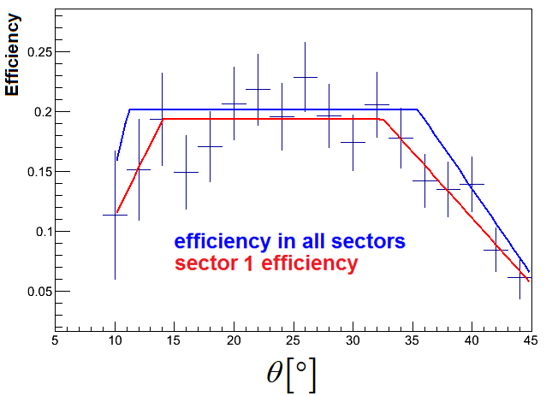
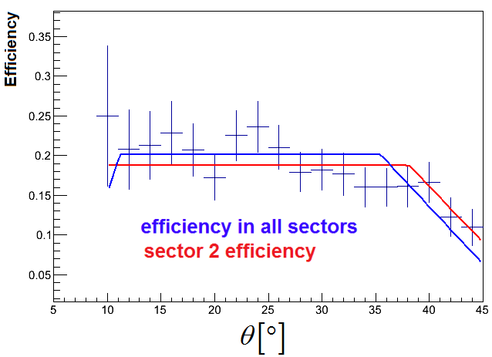
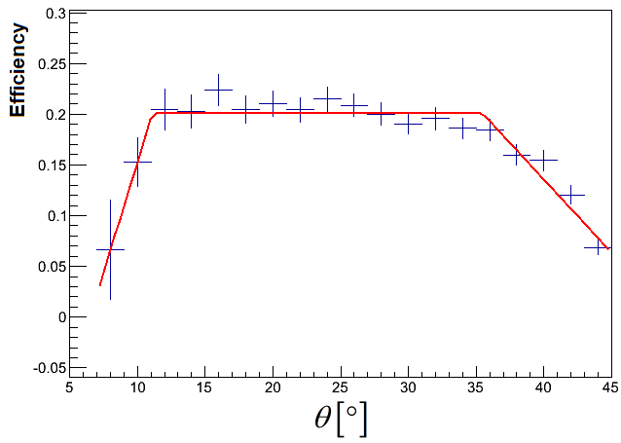
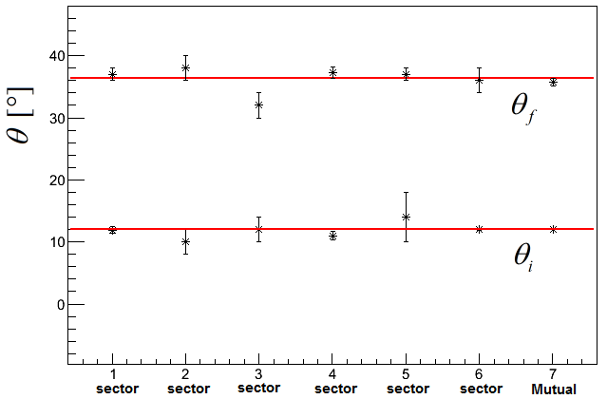
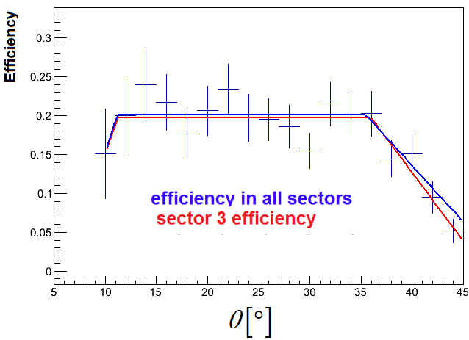
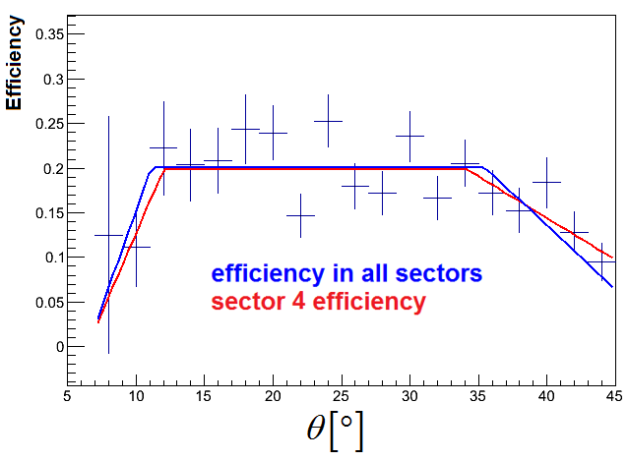
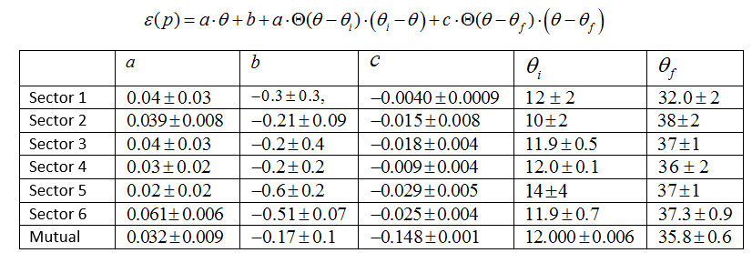



Calibration : Neutron Detection Efficiency – Angular dependence
20 %
30 %
20 %
Angular Efficiency is ~ constant between:
10 %
Angular Efficiency – fit parameters
10 %
$$12°<θ<36.3°$$
30 %
30 %
20 %
20 %
10 %
10 %
30 %
30 %
20 %
20 %
10 %
10 %
Notes:
Generally the efficiency is a fucntion of the momentum and all the angles, but , we don’t have enough data to find the most general function. Luckly , we shall see that the angular efficiency is almost constant in a wide region of angles . So we can start by looking at this angular region and for this region find the exact efficiency function.

Slide 15









Calibration : Neutron Detection Efficiency – Momentum dependence
50 %
50 %
30 %
30 %
Previous Results
10 %
10 %
Angular Efficiency – fit parameters
50 %
50 %
30 %
30 %
10 %
10 %
50 %
50 %
30 %
30 %
10 %
10 %

Slide 16



Validation : C(e,e’n) Rate Ratios. Step 1 : QE event selection
Previously , for protons , missing momentum and energy were used for QE event selection. Due to the smearing : not so simple for neutrons.
Missing energy Vs. Missing momentum scatter plot for protons
Missing energy Vs. Missing momentum scatter plot for smeared protons according to EC resolution.
Method : use known proton cuts to identify the QE region in term of resolution invariant variables such as : y,w,Q2,and angles.

Slide 17






Validation : C(e,e’n) Rate Ratios. Step 1 : QE event selection
Spatial Distribution of electron and neutrons QE events in each sector
Sector 1
Sector 2
Sector 3
Sector 4
Sector 5
Sector 6

Slide 18





Validation : Rate Ratios. Step 2 : validate ratios
Ratios with no correction
Ratios with uniform correction
Fit Parameters
Ratios with per sector correction

Slide 19


Future Plans
  Write a CLAS technical note (stepan stephanian request).
  Validate the calibrations by simulating d(e,e’n) data using existing d(e,e’p) data and compare it to the measured data.
  Use Calibrated data to
  calculate the SRC to MF neutron
  ratio for asymmetric nuclei.
: Identify

Slide 20

Questions ?

Slide 21


Slide 22



Dynamic Variable Scatter plot for QE events
: Identify

Slide 23


Dynamic Variable Scatter plot for QE events
: Identify

Slide 24



Dynamic Variable Scatter plot for QE events
: Identify

