Slide 1
Developments for the ISOLDE resonance ionization laser ion source RILIS
Thomas Day Goodacre
CERN, The University of Manchester

Slide 2

Outline
1. Introduction
2. RILIS scheme development
3. Ion sources, blurring the boundaries
4. Summary
Tom Day Goodacre ISOLDE Workshop 2014 2

Slide 3
1. Introduction
Tom Day Goodacre ISOLDE Workshop 2014 3

Slide 4
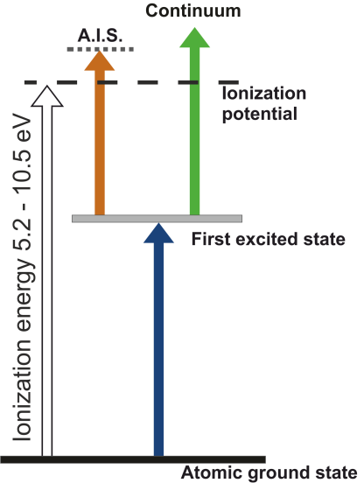
RILIS
Stepwise resonance ionization
Ionizing step:
AIS
Ionization to the continuum at 532 nm
22/34 RILIS schemes 532nm final step
Tom Day Goodacre ISOLDE Workshop 2014 4

Slide 5
RILIS history
1984 ISOLDE Workshop
RILIS concept proposed
Information from slides of V. Fedosseev
Tom Day Goodacre ISOLDE Workshop 2014 5

Slide 6
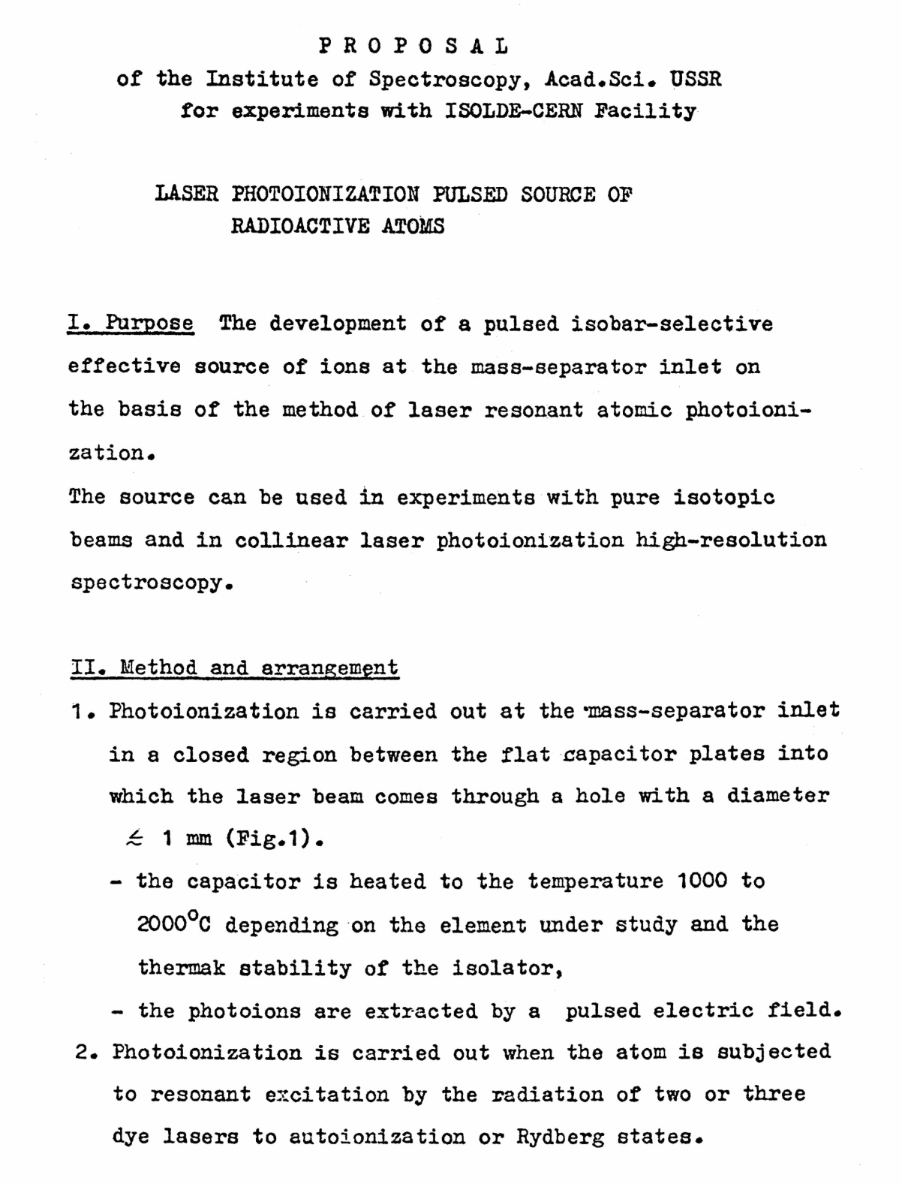
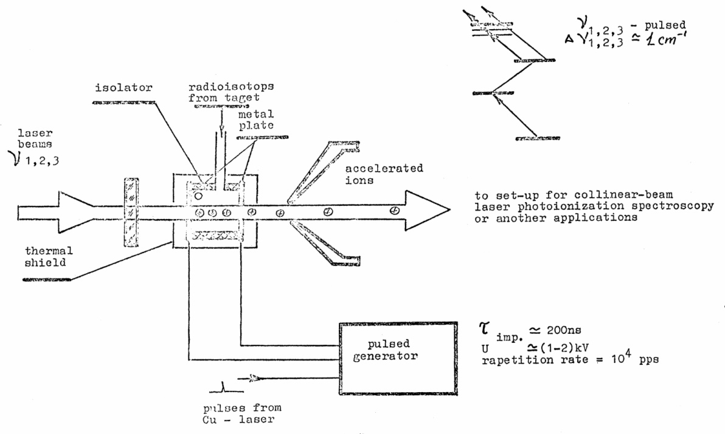
RILIS history
(V. S. Letokhov and V. I. Mishin)
1984 ISOLDE Workshop
RILIS concept proposed
Information from slides of V. Fedosseev
Tom Day Goodacre ISOLDE Workshop 2014 5

Slide 7
RILIS history
1984 ISOLDE Workshop
RILIS concept proposed
Information from slides of V. Fedosseev
Tom Day Goodacre ISOLDE Workshop 2014 5

Slide 8
RILIS history
1984 ISOLDE Workshop
RILIS concept proposed
1988 PNPI
RILIS demonstrated at IRIS
Information from slides of V. Fedosseev
Tom Day Goodacre ISOLDE Workshop 2014 5

Slide 9
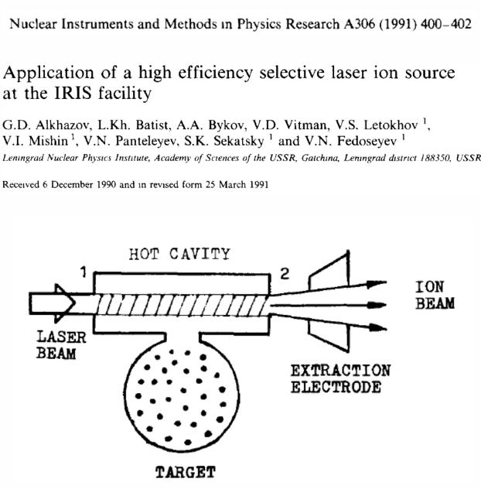
RILIS history
1984 ISOLDE Workshop
RILIS concept proposed
1988 PNPI
RILIS demonstrated at IRIS
Information from slides of V. Fedosseev
Tom Day Goodacre ISOLDE Workshop 2014 5

Slide 10

RILIS history
1984 ISOLDE Workshop
RILIS concept proposed
1988 PNPI
RILIS demonstrated at IRIS
Information from slides of V. Fedosseev
Tom Day Goodacre ISOLDE Workshop 2014 5

Slide 11
RILIS history
1984 ISOLDE Workshop
RILIS concept proposed
1988 ISOLDE
RILIS proposal accepted
1988 PNPI
RILIS demonstrated at IRIS
Information from slides of V. Fedosseev
Tom Day Goodacre ISOLDE Workshop 2014 5

Slide 12
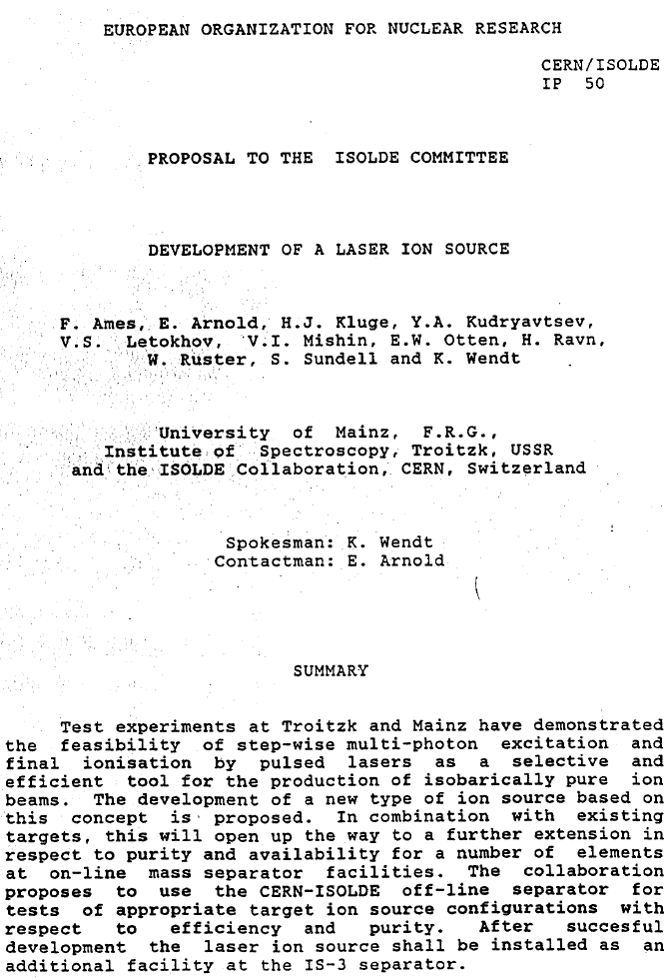
RILIS history
1984 ISOLDE Workshop
RILIS concept proposed
1988 ISOLDE
RILIS proposal accepted
1988 PNPI
RILIS demonstrated at IRIS
Information from slides of V. Fedosseev
Tom Day Goodacre ISOLDE Workshop 2014 5

Slide 13
RILIS history
1984 ISOLDE Workshop
RILIS concept proposed
1988 ISOLDE
RILIS proposal accepted
1988 PNPI
RILIS demonstrated at IRIS
Information from slides of V. Fedosseev
Tom Day Goodacre ISOLDE Workshop 2014 19

Slide 14
RILIS history
1984 ISOLDE Workshop
RILIS concept proposed
1988 ISOLDE
RILIS proposal accepted
1988 PNPI
RILIS demonstrated at IRIS
1990 ISOLDE
RILIS demonstrated at ISOLDE-3
Information from slides of V. Fedosseev
Tom Day Goodacre ISOLDE Workshop 2014 19

Slide 15
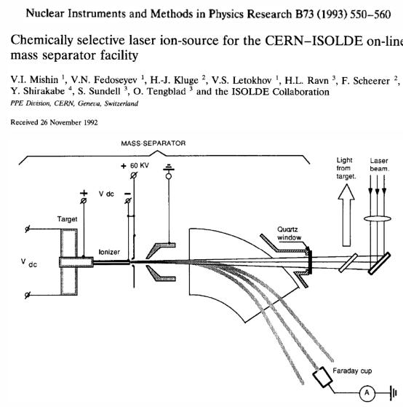
RILIS history
1984 ISOLDE Workshop
RILIS concept proposed
1988 ISOLDE
RILIS proposal accepted
1988 PNPI
RILIS demonstrated at IRIS
1990 ISOLDE
RILIS demonstrated at ISOLDE-3
Information from slides of V. Fedosseev
Tom Day Goodacre ISOLDE Workshop 2014 5

Slide 16

RILIS history
1984 ISOLDE Workshop
RILIS concept proposed
1988 ISOLDE
RILIS proposal accepted
1988 PNPI
RILIS demonstrated at IRIS
1990 ISOLDE
RILIS demonstrated at ISOLDE-3
Information from slides of V. Fedosseev
Tom Day Goodacre ISOLDE Workshop 2014 5

Slide 17
RILIS history
1984 ISOLDE Workshop
RILIS concept proposed
1988 ISOLDE
RILIS proposal accepted
1994 ISOLDE
RILIS@PSB ISOLDE
1988 PNPI
RILIS demonstrated at IRIS
1990 ISOLDE
RILIS demonstrated at ISOLDE-3
Information from slides of V. Fedosseev
Tom Day Goodacre ISOLDE Workshop 2014 5

Slide 18
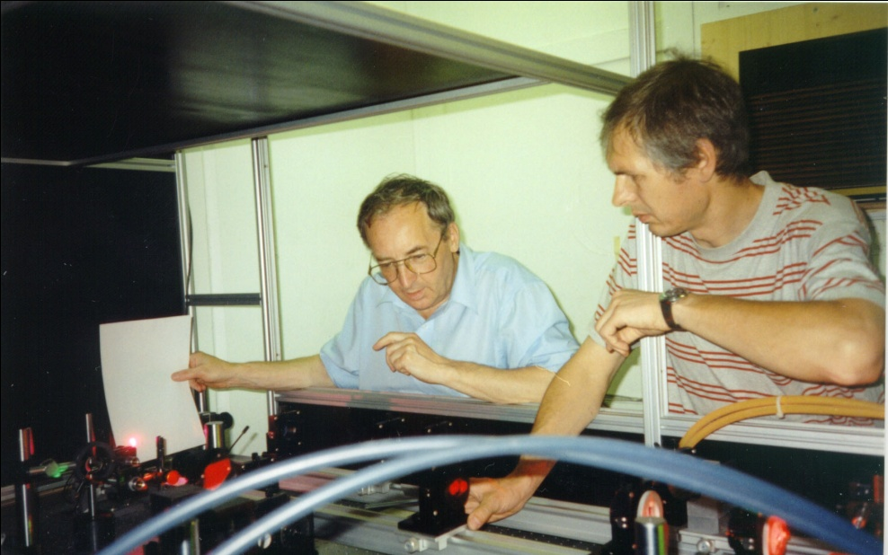
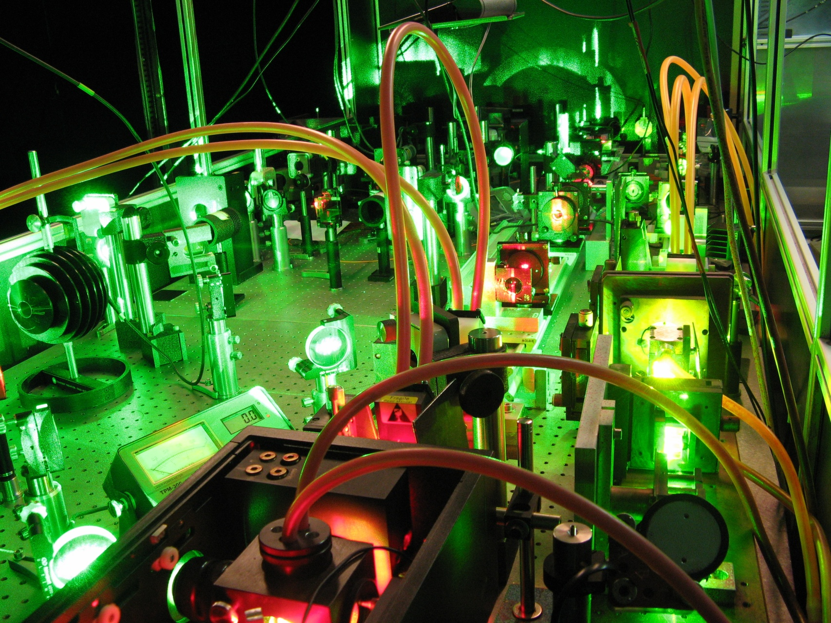
RILIS history
1984 ISOLDE Workshop
RILIS concept proposed
1988 ISOLDE
RILIS proposal accepted
1994 ISOLDE
RILIS@PSB ISOLDE
1988 PNPI
RILIS demonstrated at IRIS
1990 ISOLDE
RILIS demonstrated at ISOLDE-3
Information from slides of V. Fedosseev
Tom Day Goodacre ISOLDE Workshop 2014 5

Slide 19
RILIS history
1984 ISOLDE Workshop
RILIS concept proposed
1988 ISOLDE
RILIS proposal accepted
1994 ISOLDE
RILIS@PSB ISOLDE
1988 PNPI
RILIS demonstrated at IRIS
1990 ISOLDE
RILIS demonstrated at ISOLDE-3
Information from slides of V. Fedosseev
Tom Day Goodacre ISOLDE Workshop 2014 5
CVL lasers: ν_{rep}=11.000 Hz
Oscillator + 2 amplifiers
2-3 dye lasers with amplifiers,
nonlinear crystals BBO

Slide 20
RILIS history
1984 ISOLDE Workshop
RILIS concept proposed
1988 ISOLDE
RILIS proposal accepted
1994 ISOLDE
RILIS@PSB ISOLDE
1988 PNPI
RILIS demonstrated at IRIS
1990 ISOLDE
RILIS demonstrated at ISOLDE-3
2008 ISOLDE
Solid state pump laser and dye laser upgrade
Information from slides of V. Fedosseev
Tom Day Goodacre ISOLDE Workshop 2014 5
CVL lasers: ν_{rep}=11.000 Hz
Oscillator + 2 amplifiers
2-3 dye lasers with amplifiers,
nonlinear crystals BBO

Slide 21
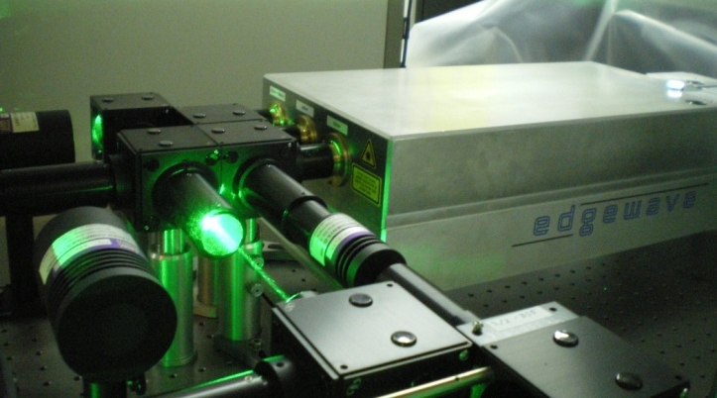
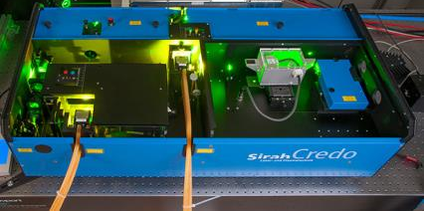
RILIS history
1984 ISOLDE Workshop
RILIS concept proposed
CVL lasers: ν_{rep}=11.000 Hz
Oscillator + 2 amplifiers
2-3 dye lasers with amplifiers,
nonlinear crystals BBO
1988 ISOLDE
RILIS proposal accepted
1994 ISOLDE
RILIS@PSB ISOLDE
1988 PNPI
RILIS demonstrated at IRIS
1990 ISOLDE
RILIS demonstrated at ISOLDE-3
2008 ISOLDE
Solid state pump laser and dye laser upgrade
Information from slides of V. Fedosseev
Tom Day Goodacre ISOLDE Workshop 2014 5
CVL lasers: ν_{rep}=11.000 Hz
Oscillator + 2 amplifiers
2-3 dye lasers with amplifiers,
nonlinear crystals BBO

Slide 22

RILIS history
1984 ISOLDE Workshop
RILIS concept proposed
1988 ISOLDE
RILIS proposal accepted
1994 ISOLDE
RILIS@PSB ISOLDE
1988 PNPI
RILIS demonstrated at IRIS
1990 ISOLDE
RILIS demonstrated at ISOLDE-3
2008 ISOLDE
Solid state pump laser and dye laser upgrade
Information from slides of V. Fedosseev
Tom Day Goodacre ISOLDE Workshop 2014 5
CVL lasers: ν_{rep}=11.000 Hz
Oscillator + 2 amplifiers
2-3 dye lasers with amplifiers,
nonlinear crystals BBO

Slide 23
RILIS history
1984 ISOLDE Workshop
RILIS concept proposed
2011 ISOLDE
Installation of a complimentary Ti:Sa System
1988 ISOLDE
RILIS proposal accepted
1994 ISOLDE
RILIS@PSB ISOLDE
1988 PNPI
RILIS demonstrated at IRIS
1990 ISOLDE
RILIS demonstrated at ISOLDE-3
2008 ISOLDE
Solid state pump laser and dye laser upgrade
Information from slides of V. Fedosseev
Tom Day Goodacre ISOLDE Workshop 2014 5
CVL lasers: ν_{rep}=11.000 Hz
Oscillator + 2 amplifiers
2-3 dye lasers with amplifiers,
nonlinear crystals BBO

Slide 24
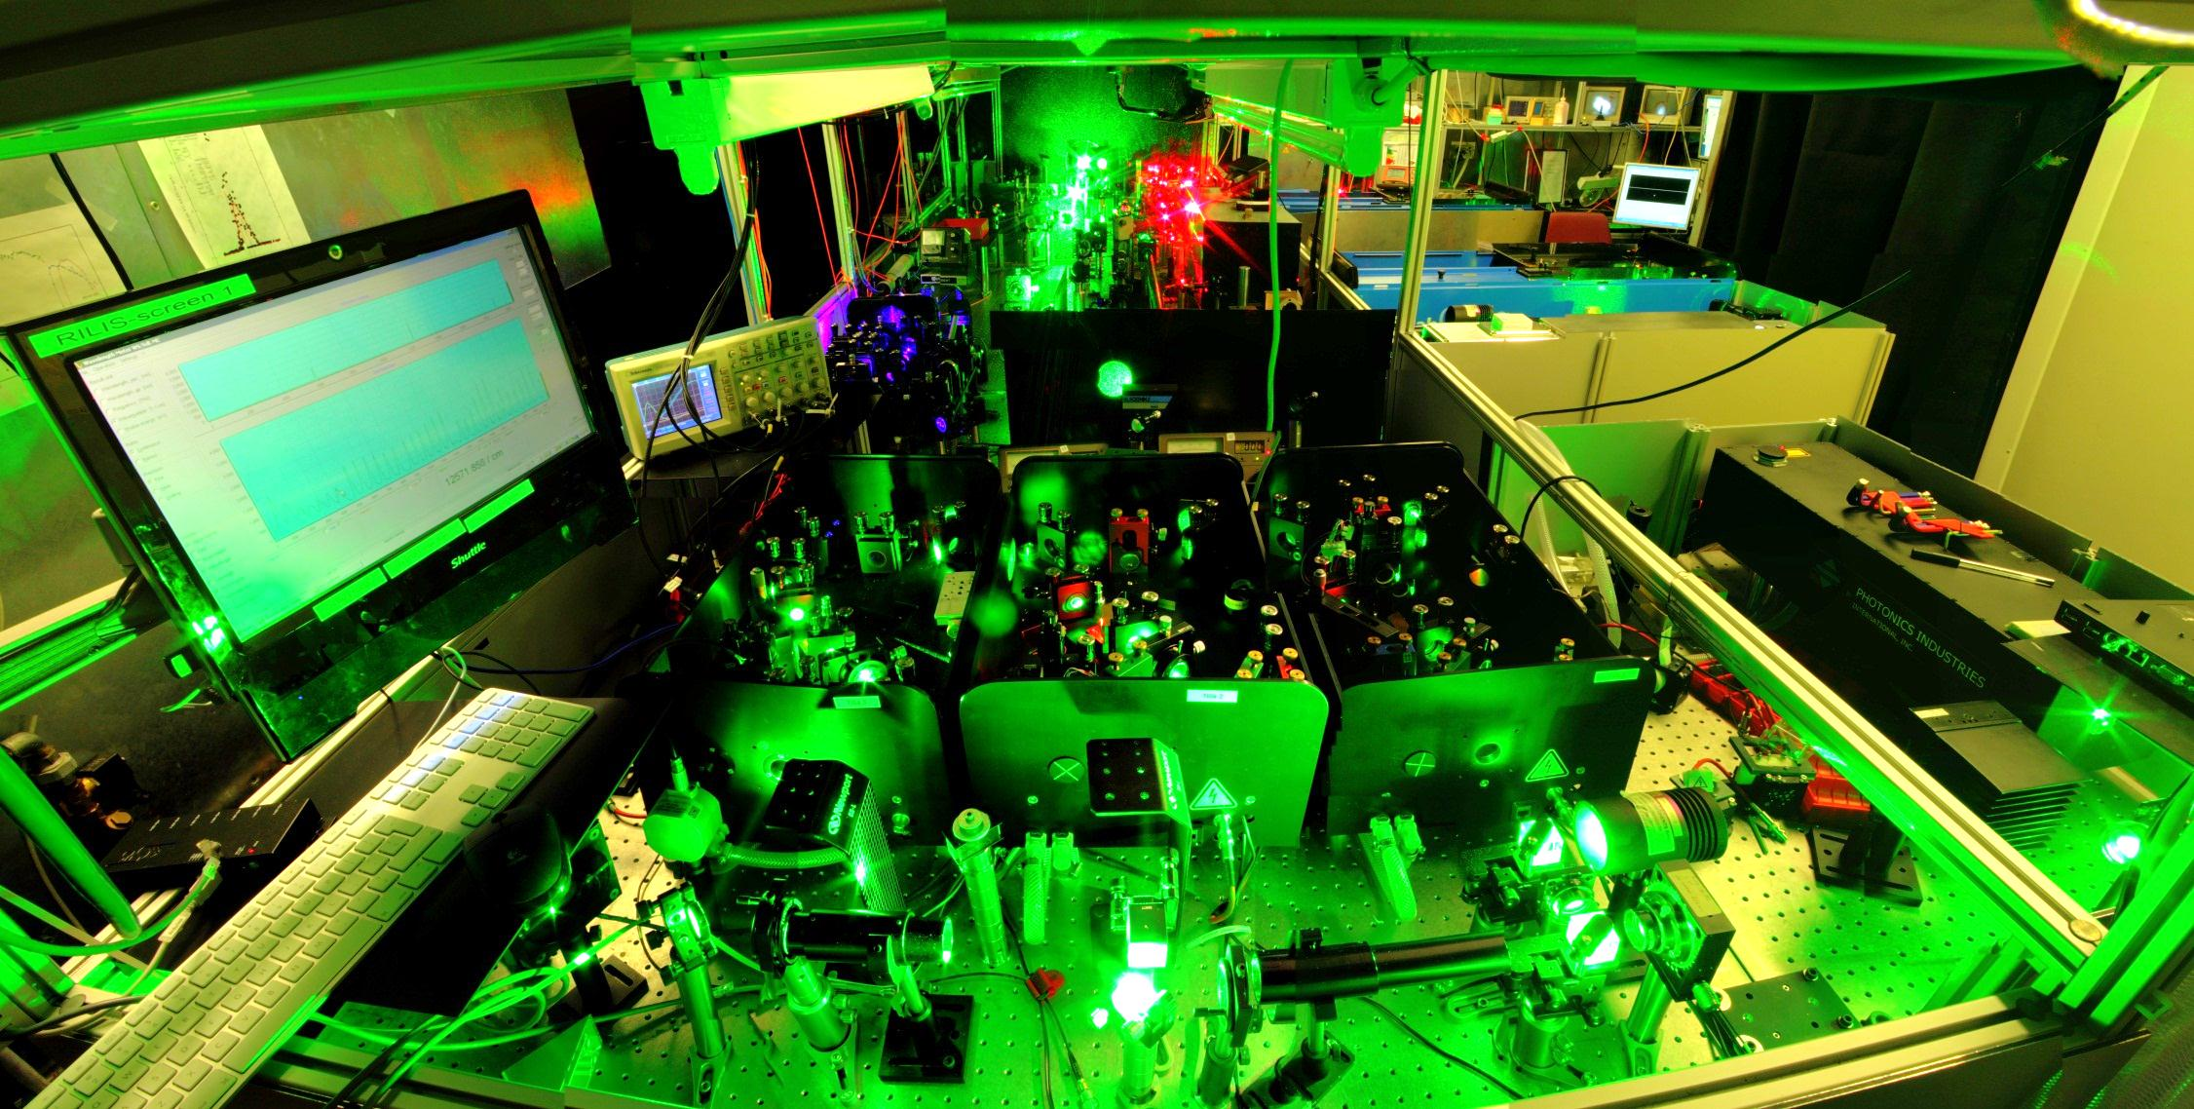
RILIS history
1984 ISOLDE Workshop
RILIS concept proposed
2011 ISOLDE
Installation of a complimentary Ti:Sa System
1988 ISOLDE
RILIS proposal accepted
1994 ISOLDE
RILIS@PSB ISOLDE
1988 PNPI
RILIS demonstrated at IRIS
1990 ISOLDE
RILIS demonstrated at ISOLDE-3
2008 ISOLDE
Solid state pump laser and dye laser upgrade
PhD of S. Rothe
Information from slides of V. Fedosseev
Tom Day Goodacre ISOLDE Workshop 2014 5
CVL lasers: ν_{rep}=11.000 Hz
Oscillator + 2 amplifiers
2-3 dye lasers with amplifiers,
nonlinear crystals BBO

Slide 25
RILIS history
1984 ISOLDE Workshop
RILIS concept proposed
2011 ISOLDE
Installation of a complementary Ti:Sa System
1988 ISOLDE
RILIS proposal accepted
1994 ISOLDE
RILIS@PSB ISOLDE
1988 PNPI
RILIS demonstrated at IRIS
1990 ISOLDE
RILIS demonstrated at ISOLDE-3
2008 ISOLDE
Solid state pump laser and dye laser upgrade
Information from slides of V. Fedosseev
Tom Day Goodacre ISOLDE Workshop 2014 5
CVL lasers: ν_{rep}=11.000 Hz
Oscillator + 2 amplifiers
2-3 dye lasers with amplifiers,
nonlinear crystals BBO

Slide 26
2. Scheme Development
Tom Day Goodacre ISOLDE Workshop 2014 6

Slide 27
Expanding the ISOLDE RILIS capabilities
RILIS schemes tested for 29 elements
New laser ionization schemes
Tom Day Goodacre ISOLDE Workshop 2014 8

Slide 28
2. Scheme development
2.1 Schemes for standard operation
Tom Day Goodacre ISOLDE Workshop 2014 9

Slide 29
Lumera Blaze laser
Higher transmission to the source = increased efficiency
65% of RILIS schemes!
B. Marsh et al., CERN-ATS-Note-2013-007 TECH
Tom Day Goodacre ISOLDE Workshop 2014 7

Slide 30

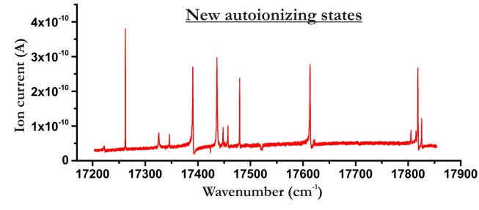
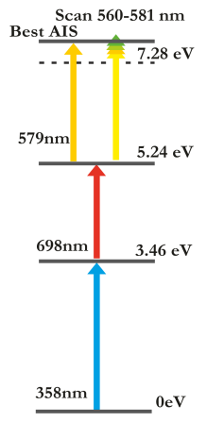
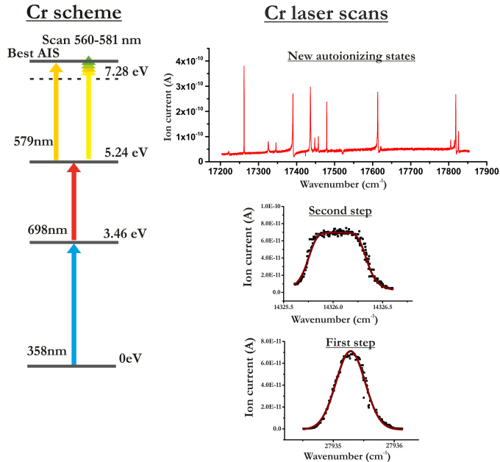
Cr scheme development
14 new AIS identified
2200:1 laser to surface ratio
Used online for ISOLTRAP
Efficiency measurement during the winter shutdown
Tom Day Goodacre ISOLDE Workshop 2014 10

Slide 31

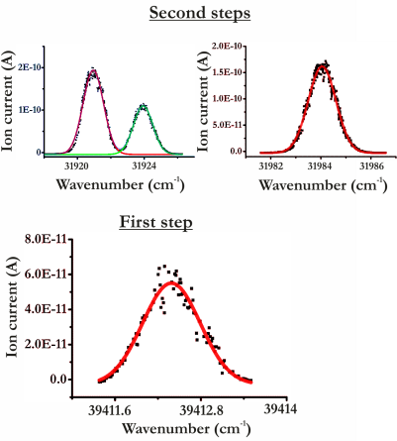
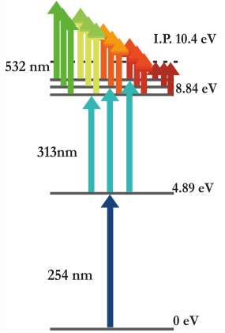
Hg scheme development
No autoionizing resonances seen
Previous efficiency 0.1%
Highest signal from ionization to continuum
6% Efficiency
Tom Day Goodacre ISOLDE Workshop 2014 11

Slide 32
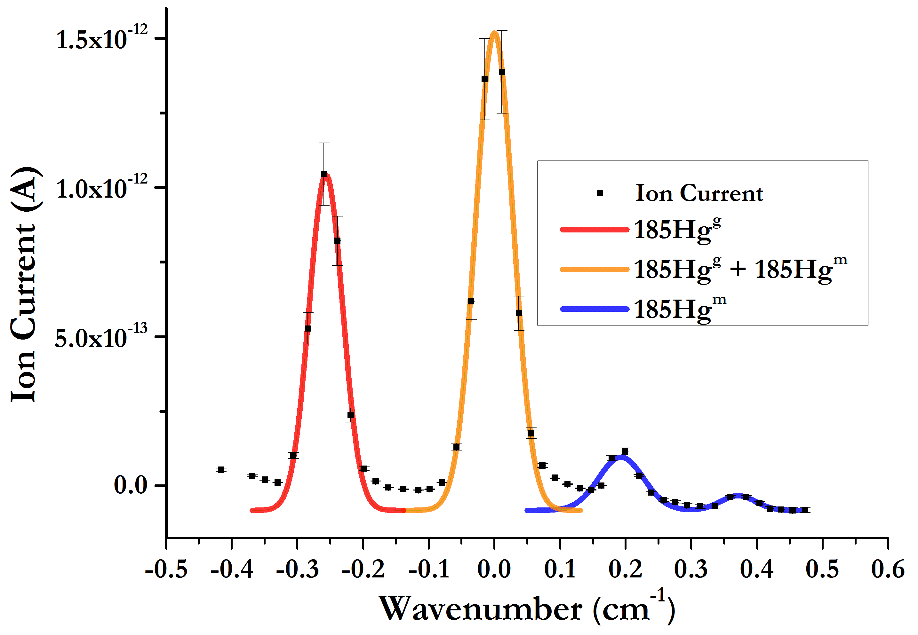
Isomer separation ¹⁸⁵Hg^{g,m}
Demonstration of isomer selectivity ¹⁸⁵Hg^{g,m}
Tom Day Goodacre ISOLDE Workshop 2014 19

Slide 33

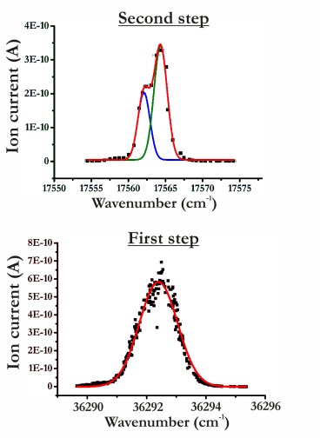

Ge scheme development
Limited time
Scheme dictated by available lasers
3.3% measured at ORNL using a different scheme
2% Efficiency
4% Expected with additional first step
AIS still to be
investigated
Tom Day Goodacre ISOLDE Workshop 2014 12

Slide 34
2. Scheme development
2.1 Schemes for standard operation
2.2 Application for IPs below 5.4eV
Tom Day Goodacre ISOLDE Workshop 2014 13

Slide 35
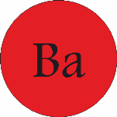
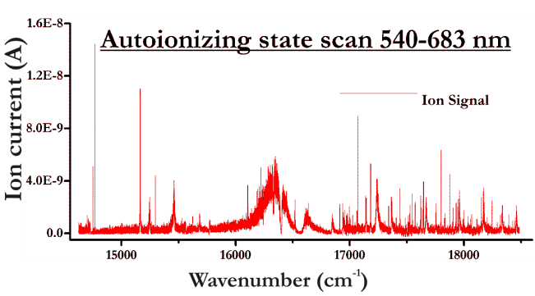
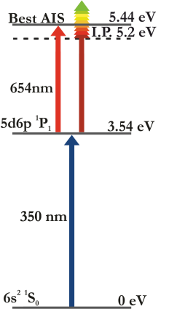
Ba scheme development
New scheme tested with a tungsten surface ion source: 60% laser enhancement
Estimated 15-30% laser ionization efficiency
Tom Day Goodacre ISOLDE Workshop 2014 14

Slide 36
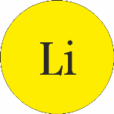
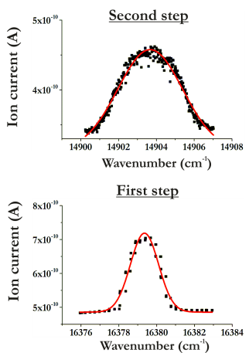
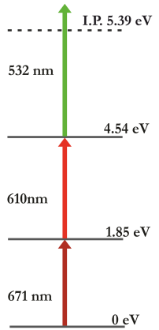
Li scheme development
Off-line 61% enhancement of ⁷Li
Success!
On-line:
58% enhancement of ¹¹Li
Tom Day Goodacre ISOLDE Workshop 2014 19

Slide 37
3. Ion sources, blurring the boundaries
Tom Day Goodacre ISOLDE Workshop 2014 15

Slide 38
Expanding the ISOLDE RILIS capabilities
RILIS schemes tested for 29 elements
New laser ionization schemes
Laser ionization of atoms inside a hot cavity surface ion source
Ion source development
Tom Day Goodacre ISOLDE Workshop 2014 16

Slide 39
3. Ion sources, blurring the boundaries
3.1 Surface + RILIS
Tom Day Goodacre ISOLDE Workshop 2014 17

Slide 40
Potential contaminants in Ba beams
Surface ionization in a tungsten hot cavity efficient for IPs <6 eV
Ba: IP 5.21 eV
Major risks of surface ionised contamination:
Cs: IP 3.89 eV
In: IP 5.78 eV
Tom Day Goodacre ISOLDE Workshop 2014 18

Slide 41
Potential contaminants in Ba beams
Surface ionization in a tungsten hot cavity efficient for IPs <6 eV
Ba: IP 5.21 eV
Major risks of surface ionised contamination:
Cs: IP 3.89 eV
In: IP 5.78 eV
Take advantage of the surface ionization?
Tom Day Goodacre ISOLDE Workshop 2014 18

Slide 42
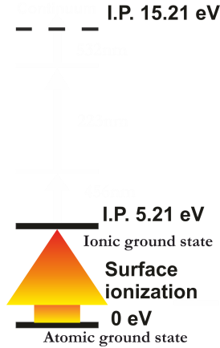
2+ resonance ionization of Ba?
Potential contaminants mass 56-59
(beams of ¹¹²⁻¹¹⁸Ba2+)
Titanium | 6.82eV
Vanadium | 6.75 eV
Chromium | 6.77 eV
Manganese | 7.43eV
Iron | 7.9eV
Cobalt | 7.88eV
Nickel | 7.64eV
Copper | 7.73eV
Zinc | 9.39 eV
Tom Day Goodacre ISOLDE Workshop 2014 19

Slide 43
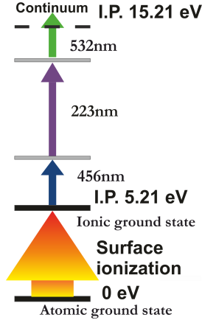
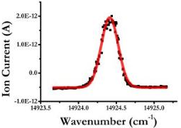
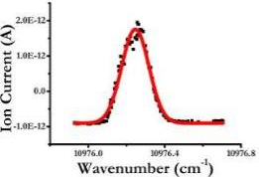
First hot cavity resonance ion-ionization
Success!
1.2% of Surface ions ionized
Second step
First step
Tom Day Goodacre ISOLDE Workshop 2014 20

Slide 44
First hot cavity resonance ion-ionization
Success!
1.2% of Surface ions ionized
Second step
Room for improvement:
Ensure saturation of 2nd step
New laser for non resonant ionisation
First step
Tom Day Goodacre ISOLDE Workshop 2014 20

Slide 45
3. Ion sources, blurring the boundaries
3.1 Surface + RILIS
3.2 RILIS@VADIS & VADLIS
Tom Day Goodacre ISOLDE Workshop 2014 21

Slide 46
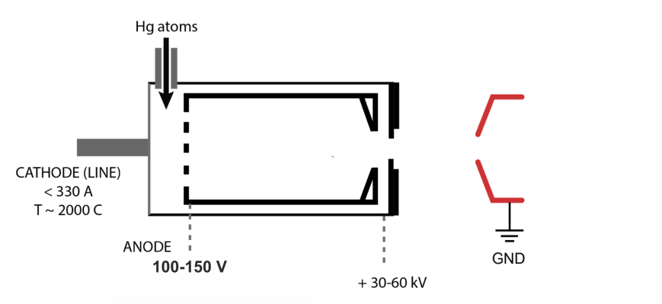
VADIS: Versatile Arc Discharge Ion Source
FEBIAD type ion source: arc discharge ionization
Image from slides of B. Marsh
Ionizes all elements that leave the target
http://neutrons.ornl.gov/conf/icis09/presentations/R-1_%20Penescu.pdf
Tom Day Goodacre ISOLDE Workshop 2014 22

Slide 47
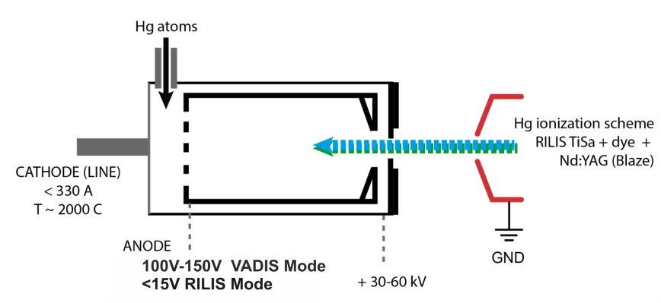
VADIS: Versatile Arc Discharge Ion Source
FEBIAD type ion source: arc discharge ionization
Image from slides of B. Marsh
Element selective laser resonance ionization
Tom Day Goodacre ISOLDE Workshop 2014 23

Slide 48
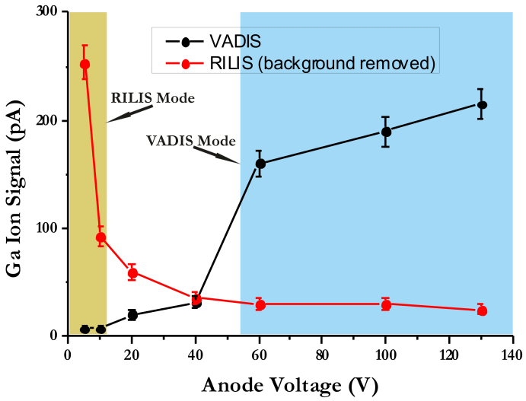
Off-line identification of different VADIS Modes (modified VADIS)
Tom Day Goodacre ISOLDE Workshop 2014 24

Slide 49
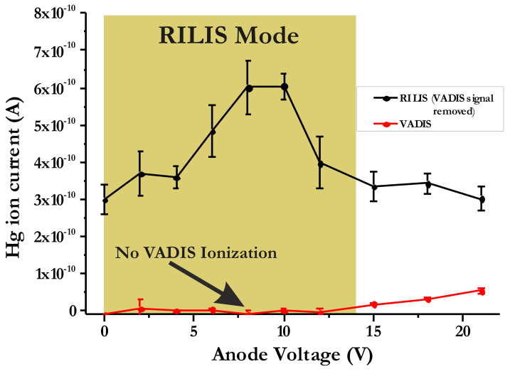
On-line verification of RILIS Mode
Tom Day Goodacre ISOLDE Workshop 2014 25

Slide 50
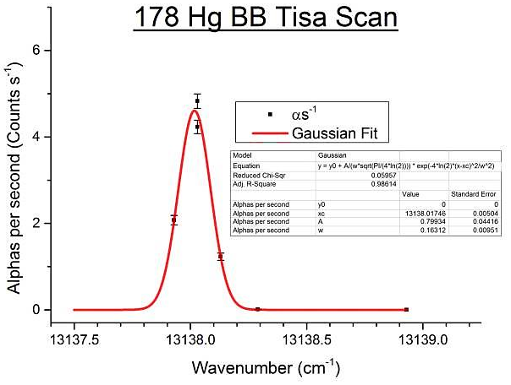
First in-source RILIS@VADIS spectroscopy
¹⁷⁸Hg Broadband Ti:Sa
Online physics 5 months after the first off-line test!
Tom Day Goodacre ISOLDE Workshop 2014 26

Slide 51
Further information
Appendix 1: Potential of RILIS@VADIS
Appendix 2: RILIS functions and ongoing development
Tom Day Goodacre ISOLDE Workshop 2014 27

Slide 52
4. Summary
Ba, Li, Ge, Cr, Hg (+isomer selectivity) ionization schemes.
Tom Day Goodacre ISOLDE Workshop 2014 28

Slide 53
4. Summary
Ba, Li, Ge, Cr, Hg (+isomer selectivity) ionization schemes.
First 2+ hot cavity resonance ion ionization
Tom Day Goodacre ISOLDE Workshop 2014 28

Slide 54
4. Summary
Ba, Li, Ge, Cr, Hg (+isomer selectivity) ionization schemes.
First 2+ hot cavity resonance ion ionization
Laser ionisation in the VADIS cavity:
RILIS now coupled with molten targets
Switching between RILIS and VADIS ion sources possible mid run
Tom Day Goodacre ISOLDE Workshop 2014 28

Slide 55







Acknowledgements
V. Fedosseev, B. Marsh, S. Rothe, R. E. Rossel, M. Veinhard, R. Catherall, J. P. Fernandes Pinto Ramos, A. Gottberg, T. M. De Melo Mendonca, T. Stora, B. Crepieaux, M. Butcher, J. Billowes, T. Cocolios, K. M. Lynch, C. Sotty, D. Fedorov, A. Barzakh, M. Seliverstov, P. Molkanov, L. P. Gaffney, C. Van Beveren, S.Sels.
EC funding contract: PITN-GA-2011-289191
Tom Day Goodacre ISOLDE Workshop 2014 29

Slide 57
Appendix 1: Potential of RILIS@VADIS
Achieved
  RILIS now coupled with a molten target
  In-source spectroscopy
  Signal identification with laser on/off
  Beam purity
Future possibilities
2+ ionization
Make use of the “inbuilt” repeller
Probing the VADIS via laser ionization
Refractory metal beams at ISOLDE
2 Photon spectroscopy
http://ecos-eurisol14.sciencesconf.org/conference/ecos-eurisol14/pages/Marsh_RILIS_FEBIAD_BM_1.pdf
Tom Day Goodacre ISOLDE Workshop 2014 19

Slide 58
Appendix 2: RILIS functions and development
Functions offered by RILIS
- Ionization of 34 elements in a hot cavity
- Ionization in a cavity of arc discharge ion source (VADIS)
- Highly selective LIST
- In-source spectroscopy
- Optical manipulation of ion states in the IS Cooler
- RILIS laser light to CRIS via optical fiber
Ongoing Development
- Further scheme development
- Compression of ions bunches in a high resistance hot cavity
- Ionization of refractory elements via molecular break-up
- Two-photon in-source spectroscopy
Tom Day Goodacre ISOLDE Workshop 2014 19

Slide 59
RMPS for on-call operation
Collaboration between EN-STI-LP and EN-STI-ECE
4 successful runs!
Tom Day Goodacre ISOLDE Workshop 2014 19

