Slide 1




High-precision mass measurements of 129-131Cd and their impact on nuclear astrophysics
ISOLDE Workshop and Users meeting 2014
Frank Wienholtz
- University of Greifswald -
for the ISOLTRAP Collaboration
Motivation and Introduction
ISOLTRAP setup
Neutron rich cadmium
Other activities
Summary
http://isoltrap.web.cern.ch
wienholtz@uni-greifswald.de

Slide 2
Motivation - rapid neutron capture process

Slide 3
Motivation - rapid neutron capture process
Half lives, spins and electromagnetic moments of cadmium studied at ISOLDE^{1,2,3}
Mass of the “waiting point” nuclide ¹³⁰Cd only indirectly determined through β- decay²
1: M. Hannawald et al., PRC 62, 054301 (2000); 2: I. Dillmann et al., PRL 16, 162503-1 (2003); 3. D.T. Yordanov et al., PRL 110, 192501 (2013); M. Wang et al., CPC 36 1603 (2012);

Slide 4
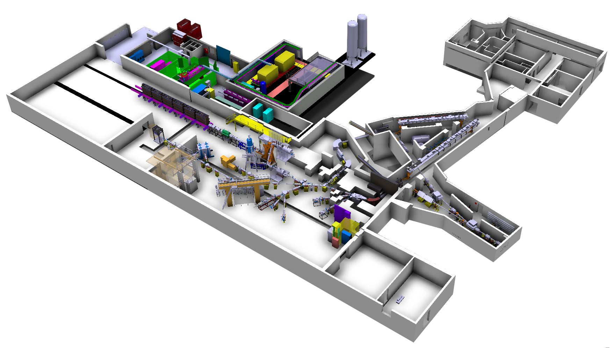
ISOLDE – Isotope Separator On-Line (DEvice) / CERN
RILIS CERN ionization
of Cadmium
ISOLTRAP
HRS
proton
beam

Slide 5
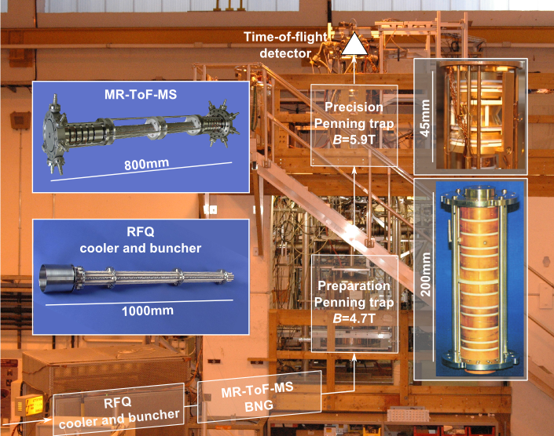
ISOLTRAP overview
1987
2010
1999
1994

Slide 6
ISOLTRAP overview
1987
2010
1999
1994
ISOLDE 1985-1987: In the shadow of LEP construction
H.J. Kluge 16.12.2014 9:45 – 10:05AM

Slide 7
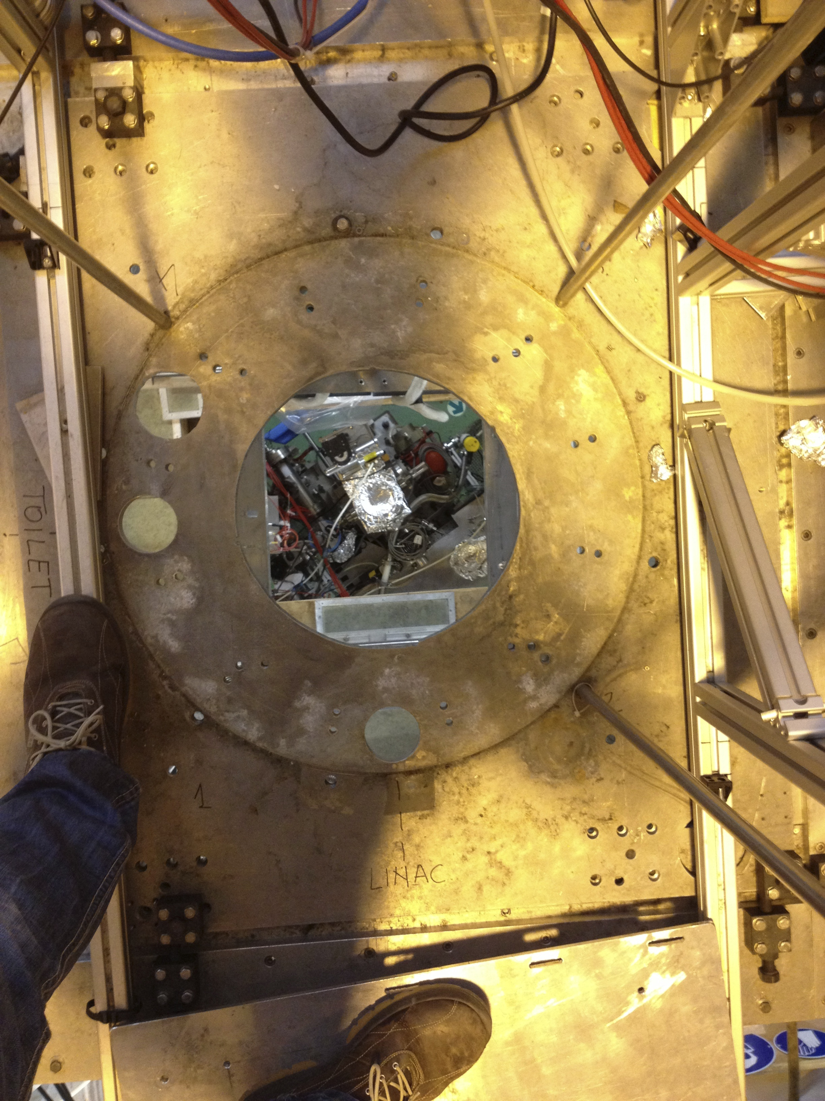
In the middle of last year…
Where are the magnets?

Slide 8
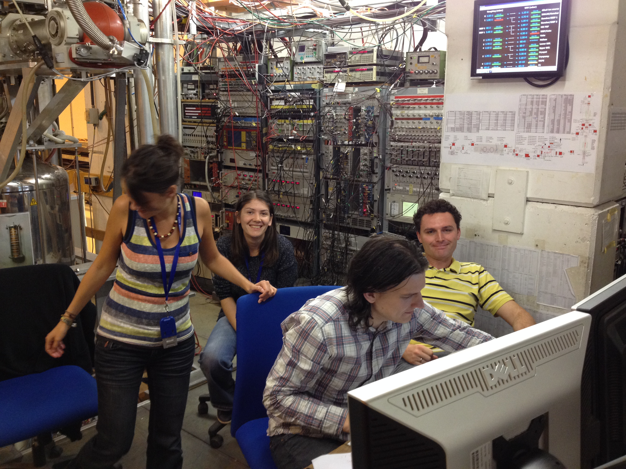
Successful cadmium beam time IS574 in August 2014

Slide 9
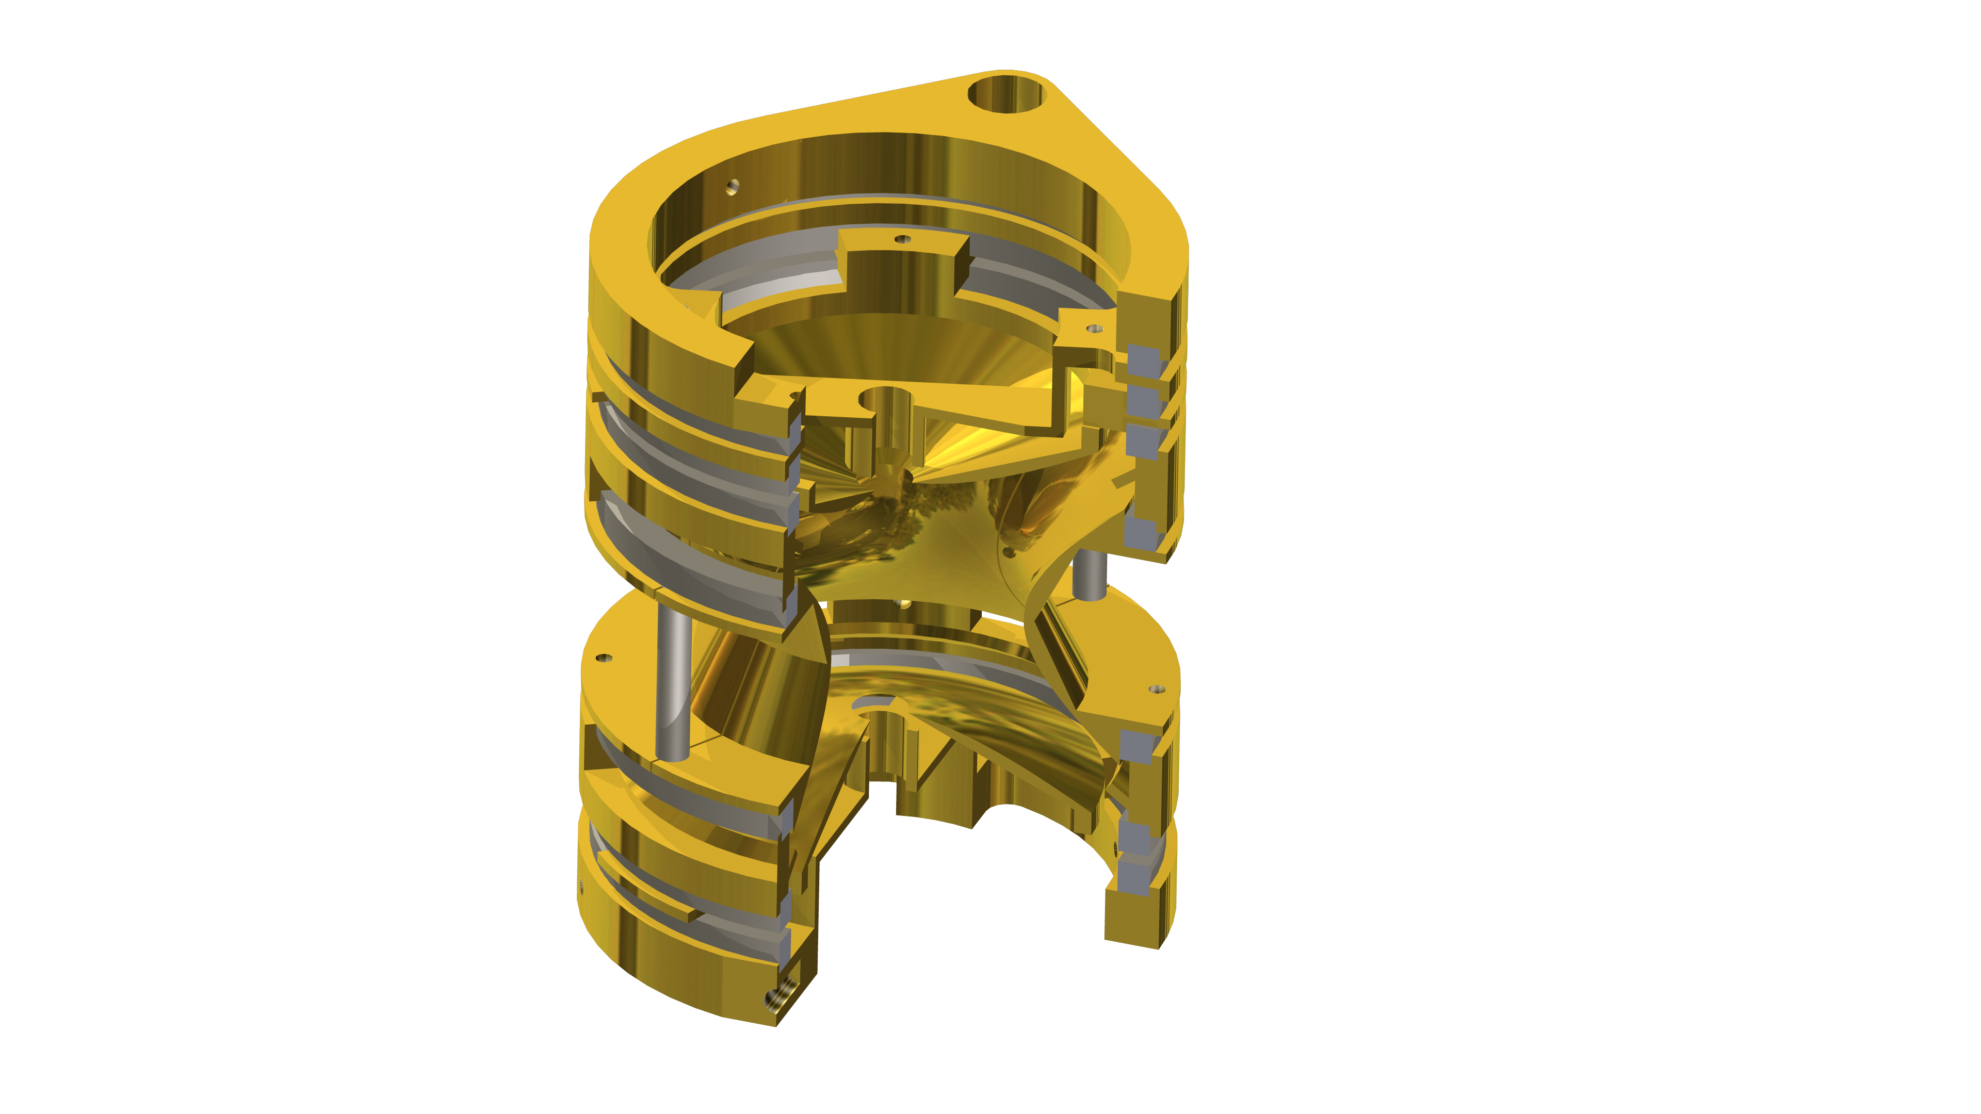
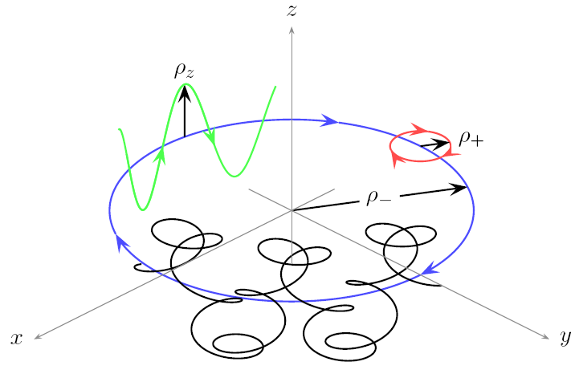
ISOLTRAP overview: the Penning-trap / ToF ICR
Axial motion ν_{z}
Modified
cyclotron
motion ν₊
Magnetron
motion ν₋
Radial frequencies:
Brown & Gabrielse, Rev. Mod. Phys. 58, 233 (1986); Gräff et al., Z. Physik A -- Atoms and Nuclei 297, 35 (1980); S. George et al., Phys. Rev. Lett. 98, 162501 (2007)

Slide 10
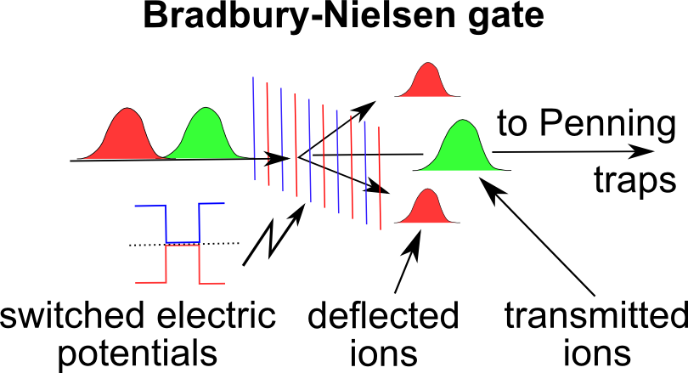
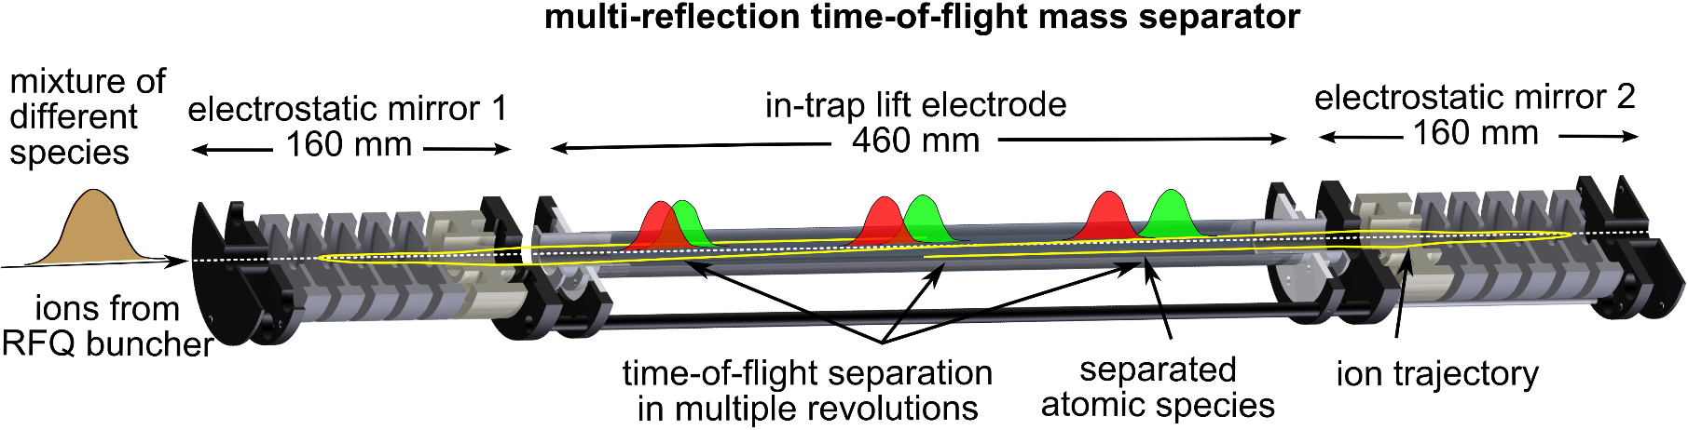
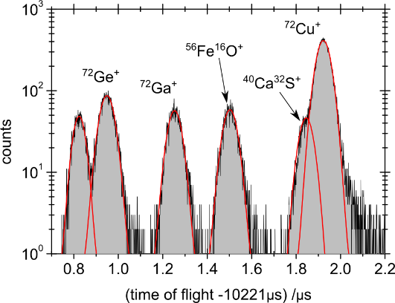
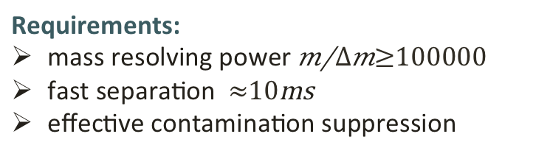
ISOLTRAP overview: MR-ToF-MS¹
Requirements:
mass resolving power $m/{∆m≥100000}$
fast separation $≈10\text{ms}$
effective contamination suppression
mass
separator
MR-ToF-MS:
2 electrostatic ion mirrors + drift tube
ToF separation due to different m/q
non-scanning device for isobars
single-ion sensitivity
mass
spectrometer
1: Wollnik & Przewloka, Int. J. Mass Spectrom. Ion Proc. 96, 267 (1990); Wolf et al., IJMS 313, 8 (2012); Wolf et al., IJMS 349-350, 123 (2013);

Slide 11
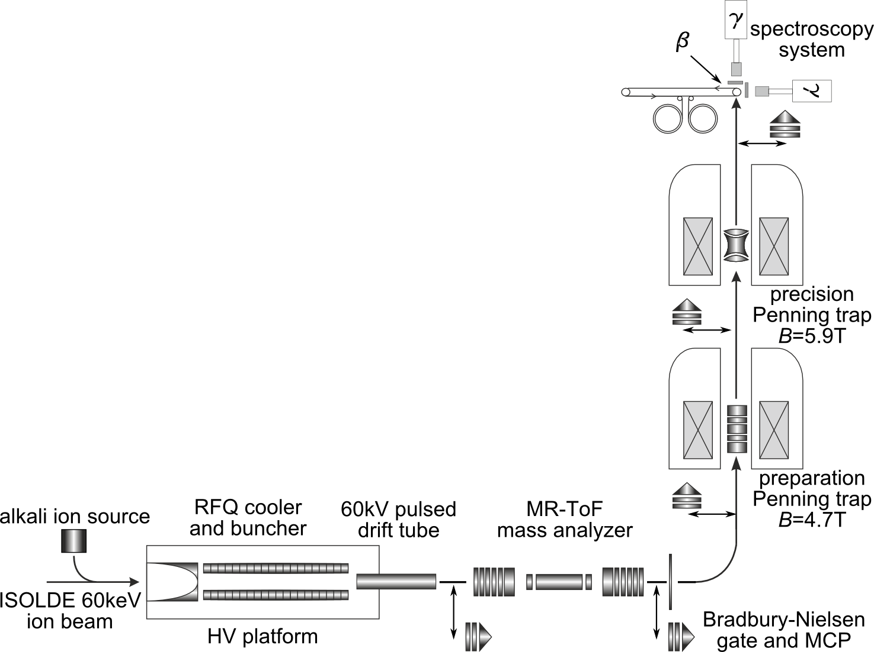
ISOLTRAP setup and cadmium measurements
100ms
70ms
160ms
10ms
15ms
ISOLDE delivers a
mixture of isobaric species

Slide 12
ISOLTRAP setup and cadmium measurements
100ms
70ms
160ms
10ms
15ms
ISOLDE delivers a
mixture of isobaric species

Slide 13
ISOLTRAP setup and cadmium measurements
100ms
70ms
160ms
10ms
15ms
ISOLDE delivers a
mixture of isobaric species

Slide 14
129Cd – Half life

Slide 15
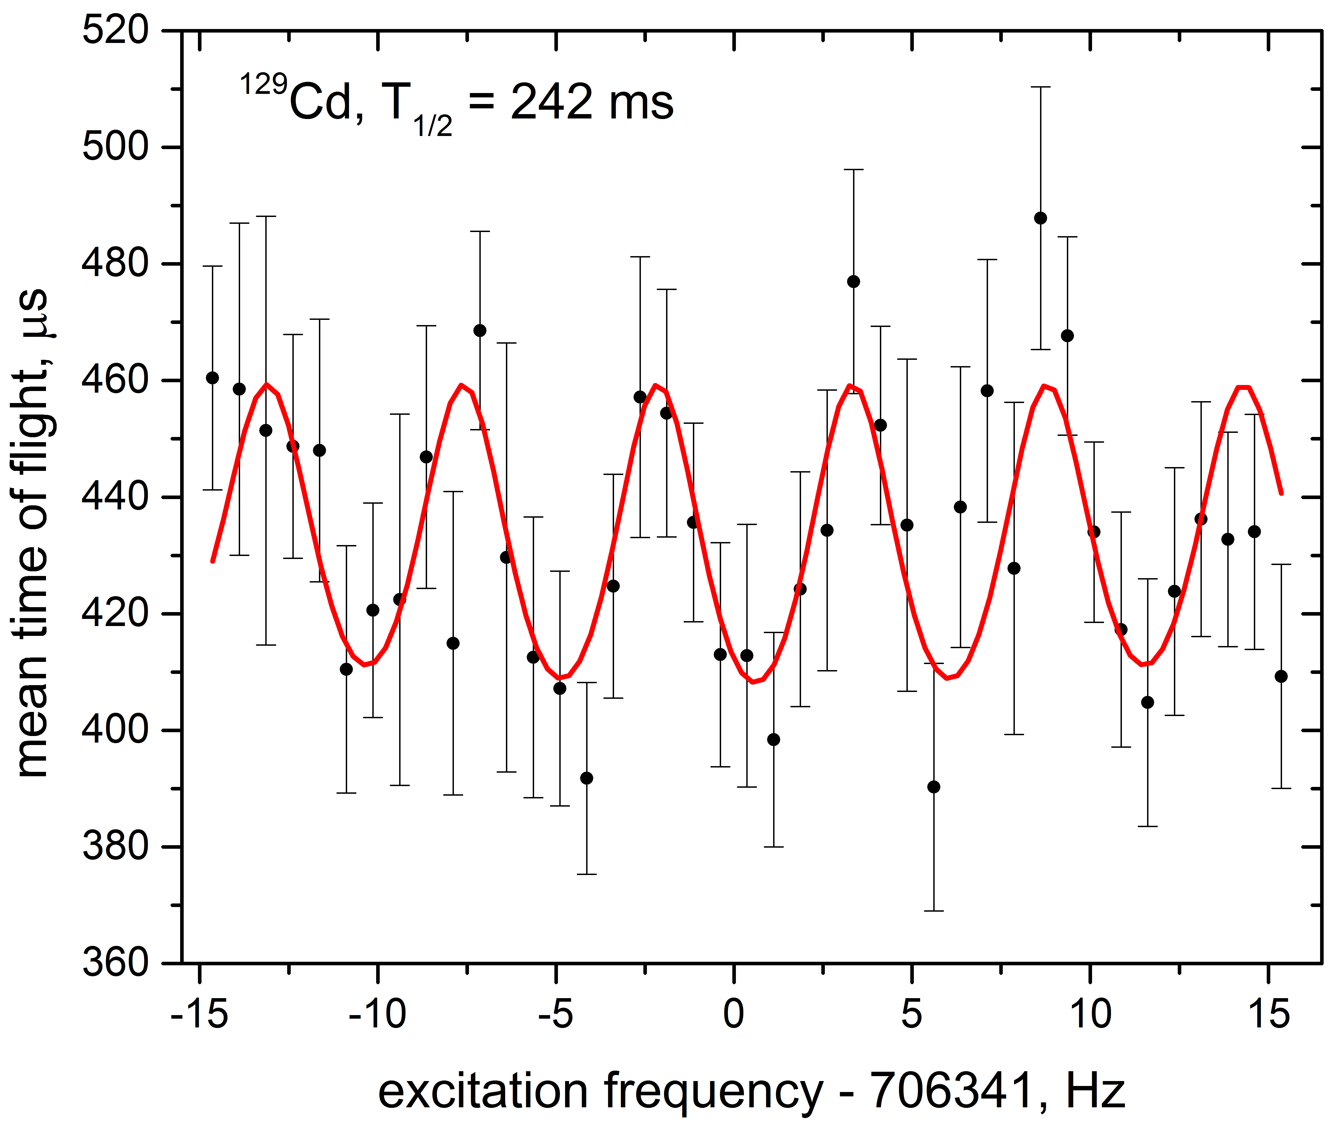
129Cd – Mass measurement
¹²⁹Cd after 100 revolutions in MR-ToF MS
¹²⁹Cd Ramsey-type resonance
20ms – 160ms – 20ms
¹²⁹Cd
Laser blocked
PRELIMINARY
≈6300 ions/s from ISOLDE
Clean beam of ¹²⁹Cd
Total 1539 ions
4 ToF-ICR resonances
  1 normal, 3 Ramsey
→ Δm/m≈1.2E-7

Slide 16
130Cd – Mass measurement
¹³⁰Cd after 1000 revolutions in MR-ToF MS
¹³⁰Cd Ramsey-type resonance
10ms – 80ms – 10ms
¹³⁰Cs/¹³⁰Ba
¹³⁰In
¹³⁰Cd
PRELIMINARY
Laser blocked
≈625 ions/s from ISOLDE
¹³⁰Cd/contamination≈0.2 but
only low mass resolving power of 15k needed
Total 588ions
3 ToF-ICR resonances
  1 normal, 2 Ramsey
→ Δm/m≈1.6E-7

Slide 17
131Cd – Mass measurement
¹³¹Cd after 500 revolutions in MR-ToF MS
≈ 88 ions/s from ISOLDE
Total of 1366 ions collected after MR-ToF MS in ≈6.6h

Slide 18
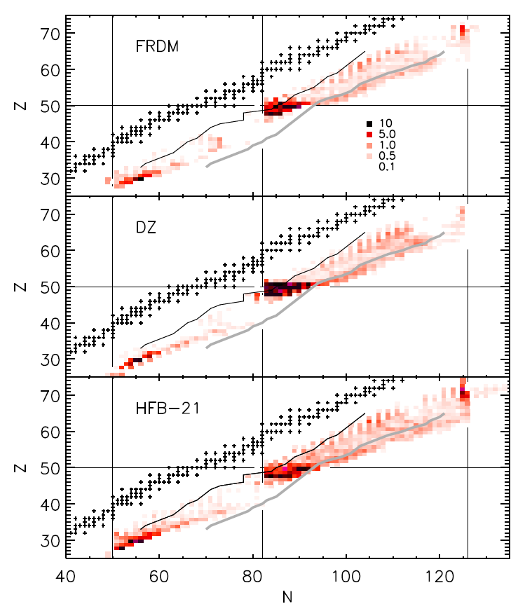
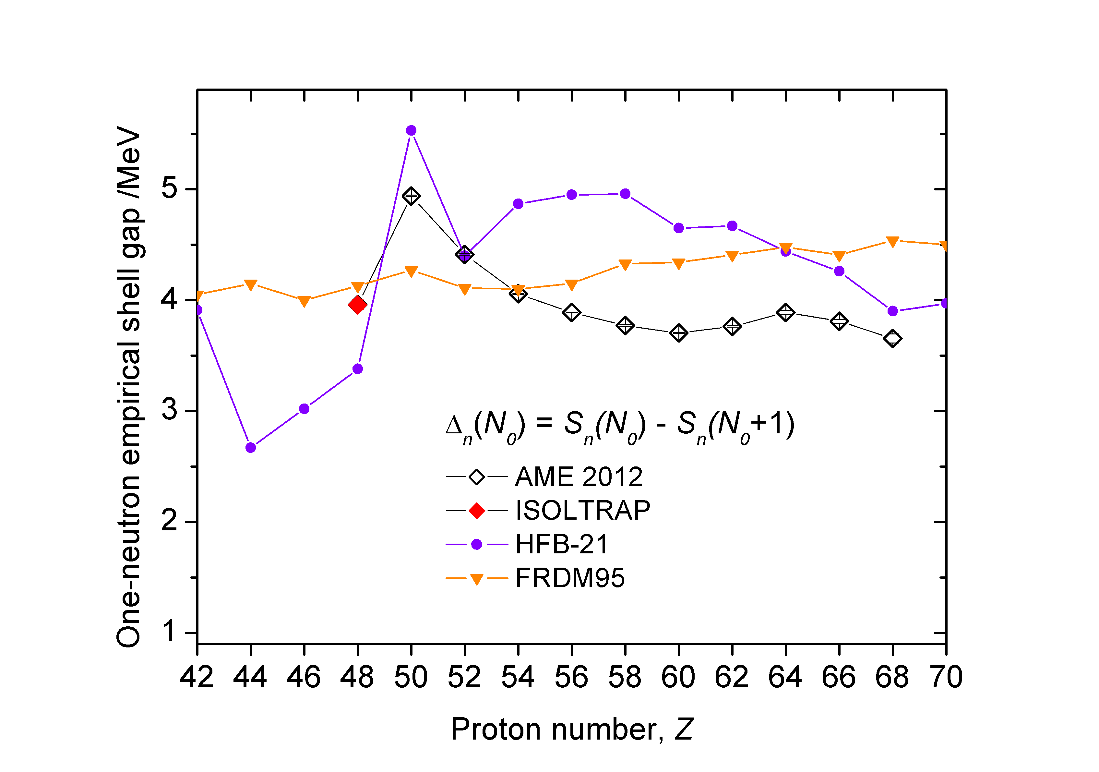
Results
Direct impact:
- Important impact of the neutron separation energy S_{n} on the predicted r-process abundances.
- Irrespective of model, ^{A>130}Cd isotopes have among the largest impact.
- ≈0.5 MeV deviations found from AME values and extrapolations (analysis ongoing).
Indirect impact:
The one-neutron shell gap agrees with the picture of a fast reduction (quenching) for Z < 50.
PRELIMINARY
S. Brett et al., Eur. Phys. J. A 48, 184, 2012.
S. Goriely, N. Chamel, J.M. Pearson, Phys. Rev. C 82, 035804, 2010.
P. Möller, J. R. Nix, W. D. Myers, W. J. Swiatecki, ADNDT 59, 185, 1995.

Slide 19
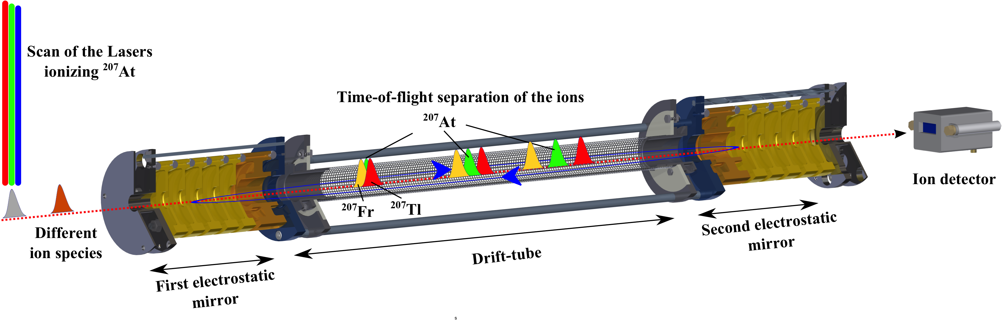
IS534 – ISOLTRAP, Windmill and RILIS experiments studied astatine
Using the RILIS lasers to measure the hyperfine structure of astatine isotopes
Two different techniques
  Alpha spectroscopy using the Windmill setup
  Selective single ion counting using MR-ToF MS of the ISOLTRAP setup
Gating on
²⁰⁷At peak
Studied 21 isotopes in total
11 Isotopes with MR-ToF MS

Slide 20
IS534 – ISOLTRAP, Windmill and RILIS experiments studied astatine
Using the RILIS lasers to measure the hyperfine structure of astatine isotopes
Two different techniques
  Alpha spectroscopy using the Windmill setup
  Selective single ion counting using MR-ToF MS of the ISOLTRAP setup
Gating on
²⁰⁷At peak
Studied 21 isotopes in total
11 Isotopes with MR-ToF MS
Hyperfine structure studies of At isotopes using in-source laser spectroscopy J.G. Cubiss 16.12.2014 1:40 – 1:55PM

Slide 21
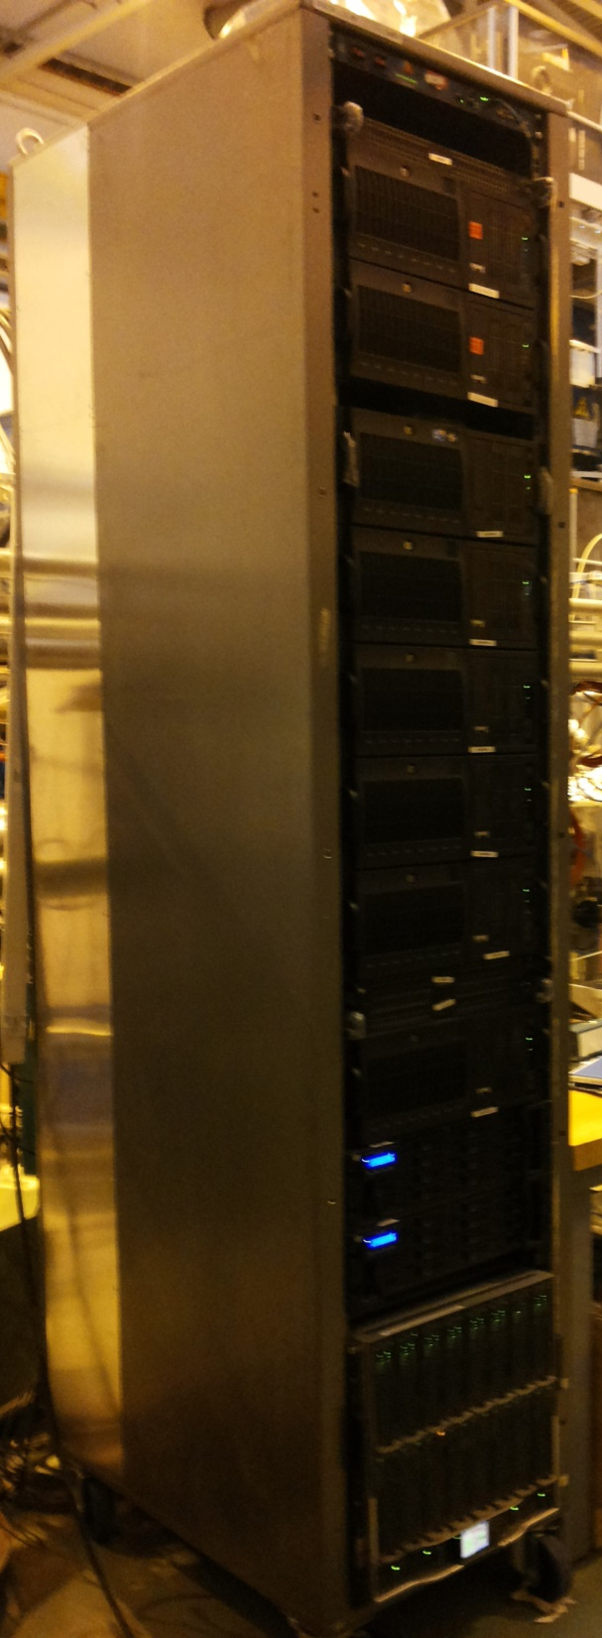
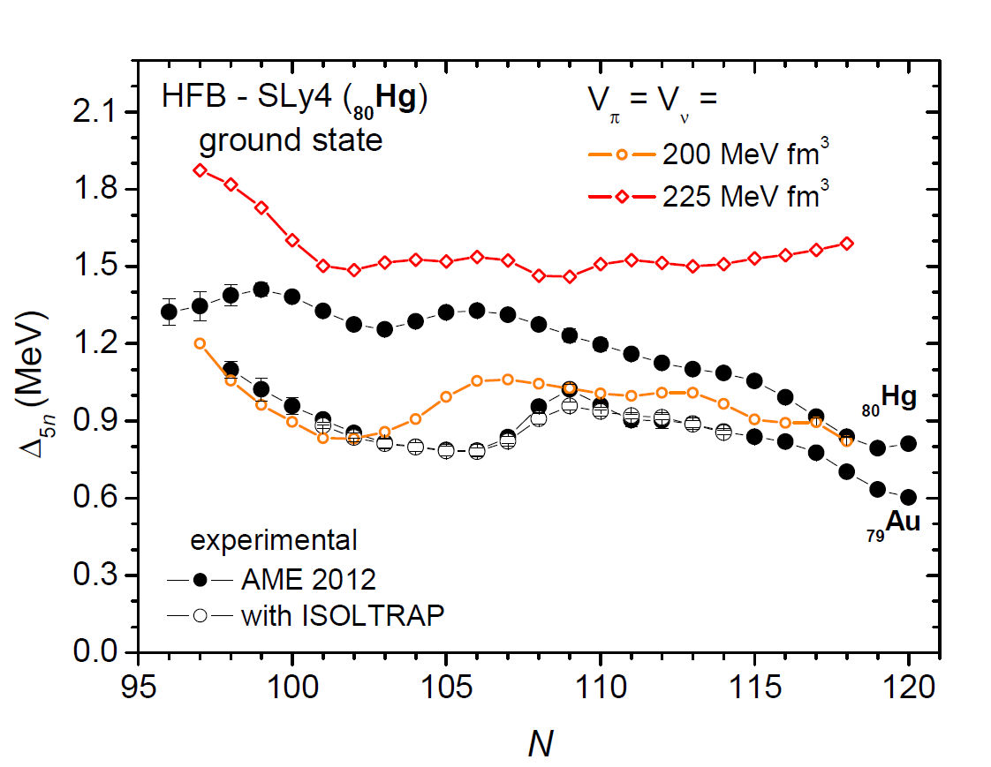
New computational capabilities
- Computer cluster: 32 nodes x 16 cores each.
- Mean-field calculations of odd mercury isotopes with neutron quasi-particle blocking using the HFODD code (≈ 1500 h of serial computation time reduced to less than 24 h using 10% of CPUs):
J. Dobaczewski and J. Dudek, Comp. Phys. Commun. 102, 183 (1997).
N. Schunck et al., Comp. Phys. Commun. 183, 166 (2012).

Slide 22
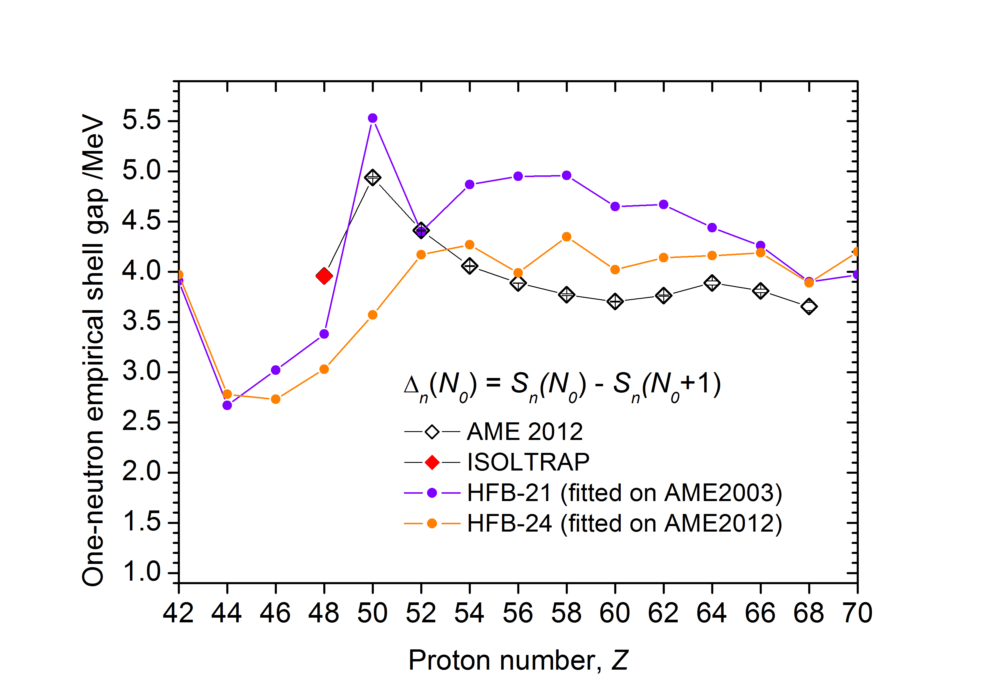

Summary
Maintained the whole vertical ISOLTRAP beam line in 2013
  Ready on time for the beam time period 2014
Successful cadmium run in August
  Found deviation from literature and AME values which will have an impact on the r-process
Additional successful measurement campaigns on astatine, chromium, strontium and rubidium
Installation of second hand PC cluster for nuclear physics calculations

Slide 23










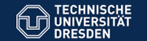

Thanks to…
M. Rosenbusch, R.N. Wolf, L. Schweikhard, Stefan Kemnitz
P. Ascher, D. Atanasov, Ch. Böhm, Ch. Borgmann, R. B. Cakirli,
S. Eliseev, T. Eronen, S. George, D. Kissler, S. Naimi, K. Blaum
D. Beck, F. Herfurth, A. Herlert, E. Minaya-Ramirez, D. Neidherr, Y. Litvinov
G. Audi, V. Manea, M. Wang, D. Lunney
M. Kowalska, S. Kreim,
J. Stanja, A. Welker, K. Zuber
N. Althubiti, T. Cocolios
M. Breitenfeldt
Thank you
for your attention!
Grants No.:
05P12HGCI1
05P12HGFNE
Our summer students:
Ian Murray, Mariya Trichkova
http://isoltrap.web.cern.ch
wienholtz@uni-greifswald.de

