Slide 1
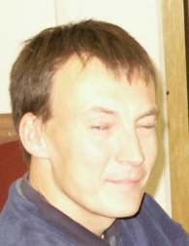
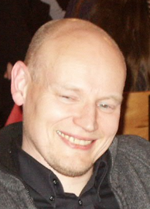
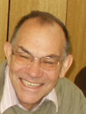

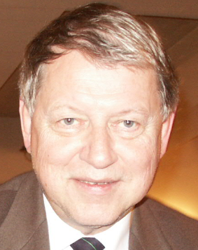
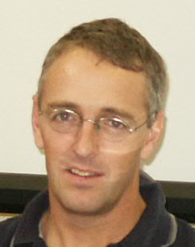
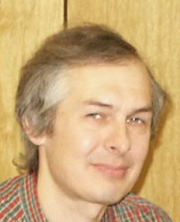
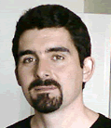
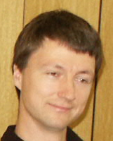
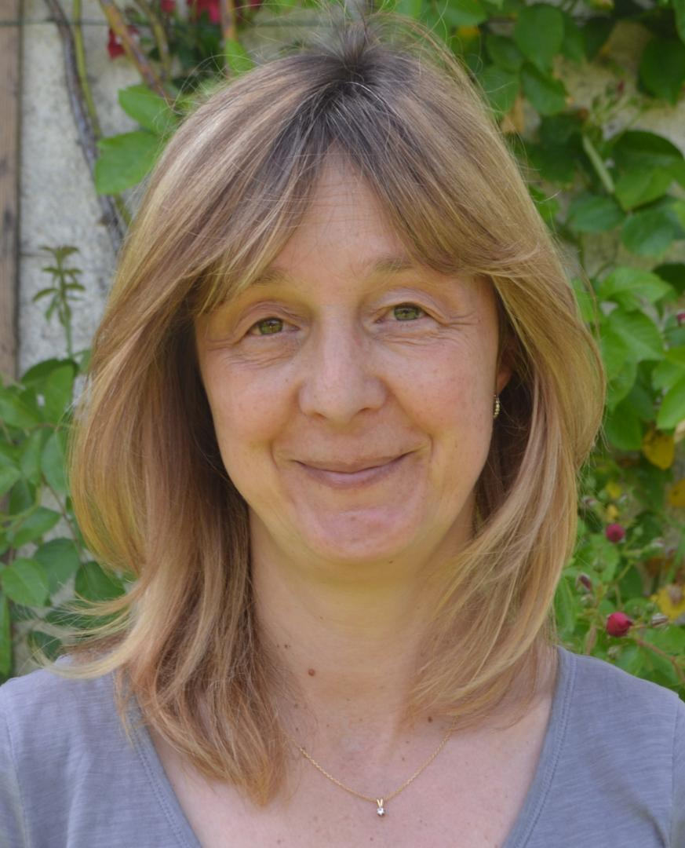
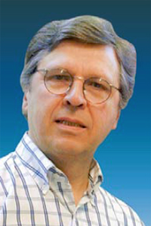
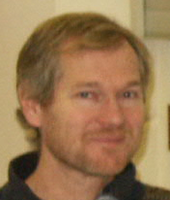
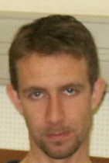
ISOLDE: the Anglo-Saxon Era 2002-2005
Peter Butler*
+ Vikings, Visigoths, Celts, etc.
*University of Liverpool
Notes:
Thomas Nilsson (until Jan 2004) Luis Fraile (from Feb 2004) Helge retired Dec 2004 Earlier picture 1979

Slide 2
REX-ISOLDE consolidation
Position Document October 2002:
upgrade to 4.2 MeV/u
4 new AB staff posts (funded externally)
1 EP post (funded externally)
hall extension
Class A target lab
Addendum to ISOLDE MoU
“The Parties shall meet in June 1st 2006 at the latest in order to decide on the future coverage of costs for the REX –ISOLDE operation. Such decision shall give rise to another Addendum to the MoU.“

Slide 3
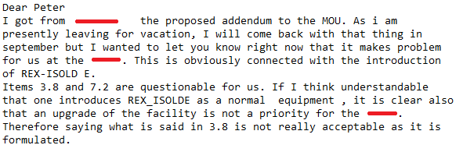
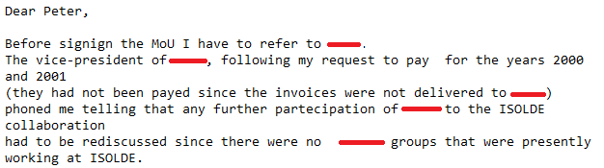
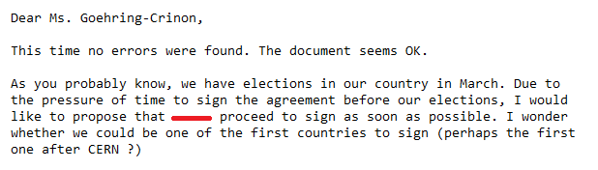
Addendum to MoU
First draft: January 2003 Signed by all: September 2004
July 2003
November 2003
February 2004

Slide 4
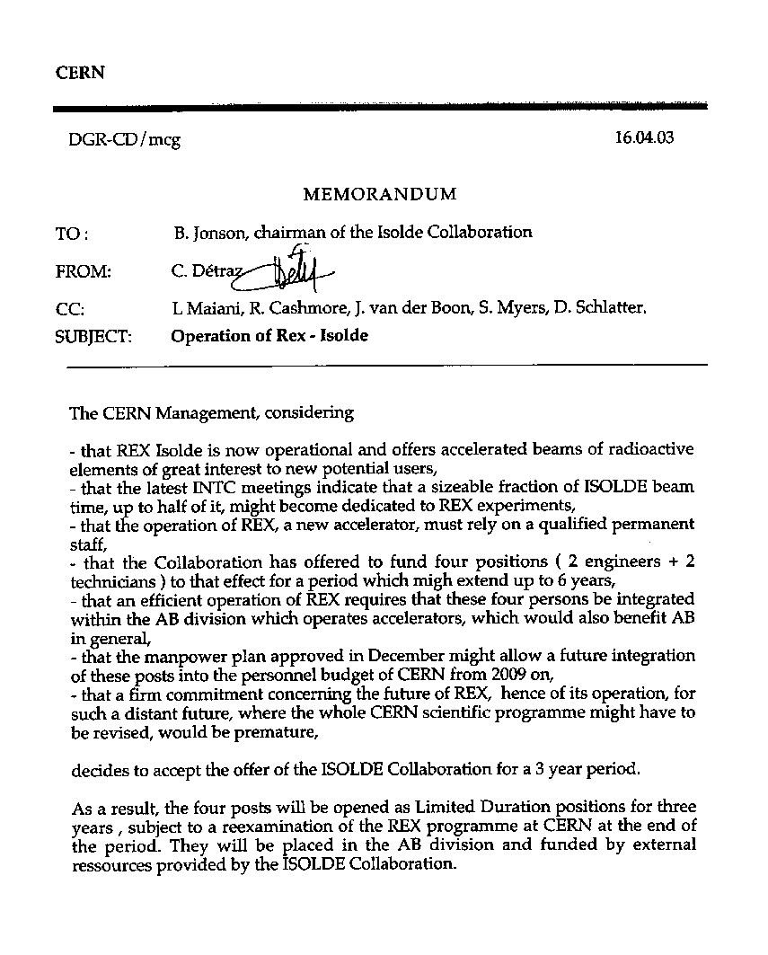
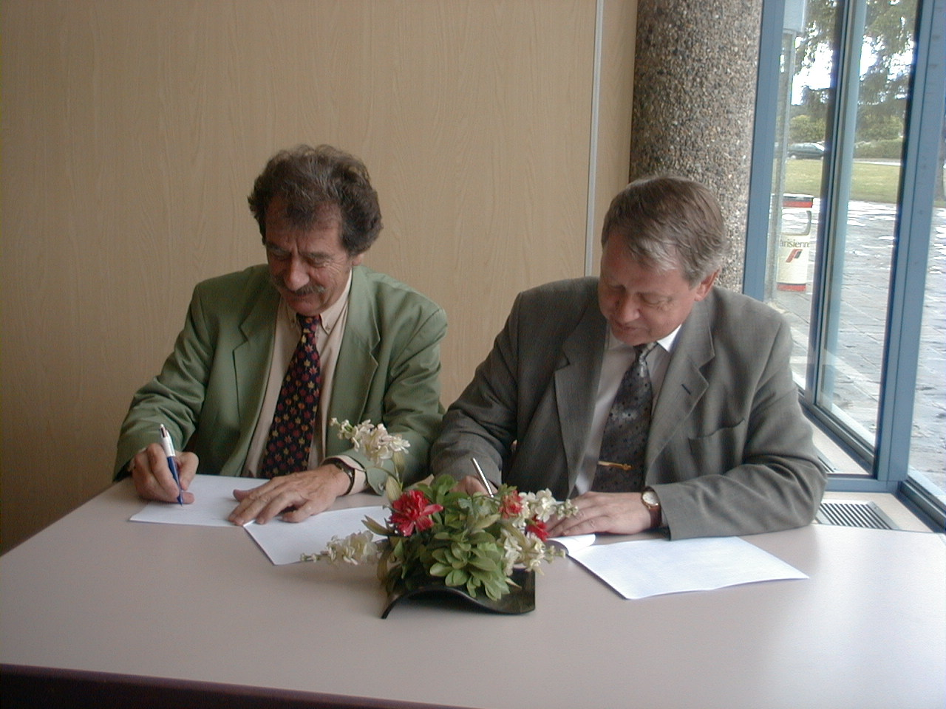
REX consolidation; cont.

Slide 5
REX Upgrade
November 2002: Steering group for the upgrade of ISOLDE (mainly for REX upgrade) founded.
April 2003: REX-upgrade defined and renamed HIE-ISOLDE.
“This enhancement of the ISOLDE facility is called “High Intensity and Energy ISOLDE” or HIE-ISOLDE in this document in order to distinguish it from the existing facility.” [Document dated January 2003]
(earlier name was Super-ISOLDE or S-ISOLDE, Dec 2002)
July 2004: MoU to provide funding for REX upgrade signed by individuals from ISOLDE, Belgium, Denmark, Finland, Germany, Sweden, and UK.
March 2005: First tranche of funding from Leuven for HIE-ISOLDE announced.
June 2005: Case for HIE-ISOLDE gives budget of 15 MCHF (+42 FTE) for upgrade to 5.5 MeV/u, to be ready in 2011.

Slide 6
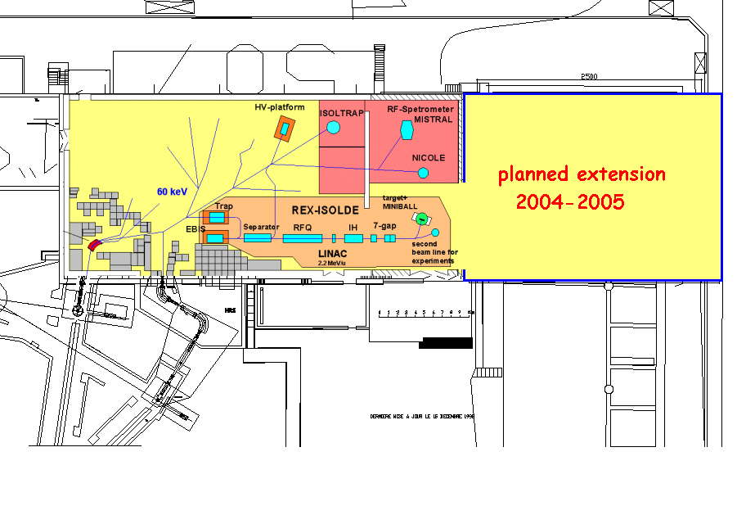
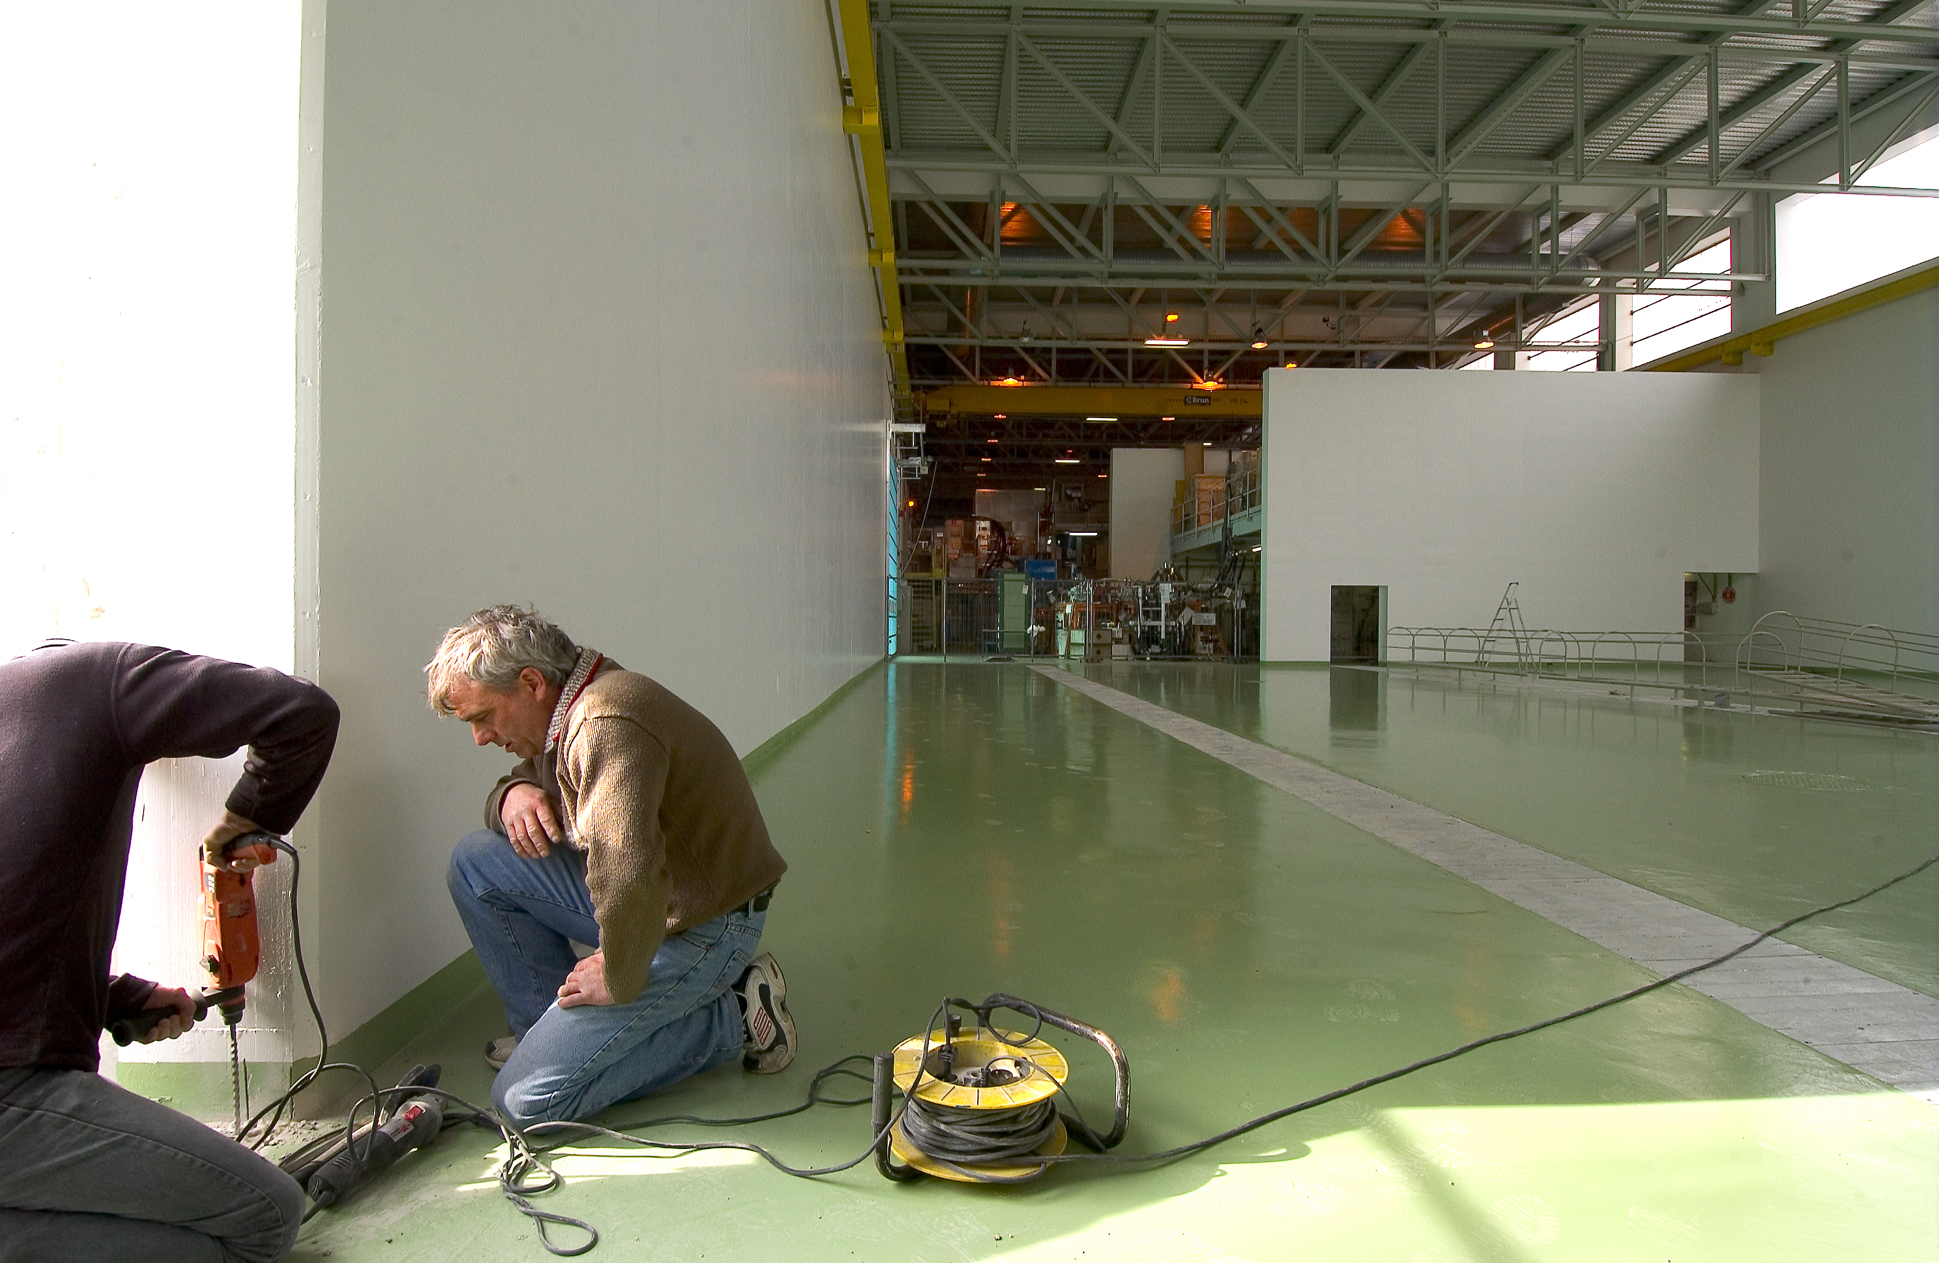
Hall extension
Motivation (January 2003):
add 25m to accommodate extension of REX to 4.3 MeV/u and beyond
Funded from EU overhead, ISCC and CERN (D-G reserve)
Cost 1.8 MCHF - ~ 50% budget overrun because e.g. of steel shortage
April 2005
(HIE-ISOLDE 2015)

Slide 7


EU grants: EURONS & EURISOL
(November 2004)
EURONS (2MCHF) TNA + 3 JRAs
Physicist; scientific administrator
Fellows for Charge Breeder, INTAG & TRAPSPEC
EURISOL (2.7MCHF)
2 Physicists in AB
Fellows for direct and MW targets
  This Design Study will attempt to promote women while recognizing that this does not mean treating them in the same way as men. It will try not to take men’s characteristics, situations and needs as the norm, so that – to have the same opportunities - women are expected to behave like them. It will try to ensure that gender equality means giving equal consideration to the life patterns, needs and interests of both women and men. It will question systematically whether, and in what sense, sex and gender are relevant in the objectives and in the methodology of the Design Study while recognizing that there is no such thing as a universally neutral person. Because sex and gender differences are fundamental organising features of life and society, appreciating these differences has implications in the execution of the Design Study. It will, whenever possible, encourage women’s participation in the tasks and the management structure, and ensure that any infrastructure design addresses women’s needs, as much as men’s needs.

Slide 8
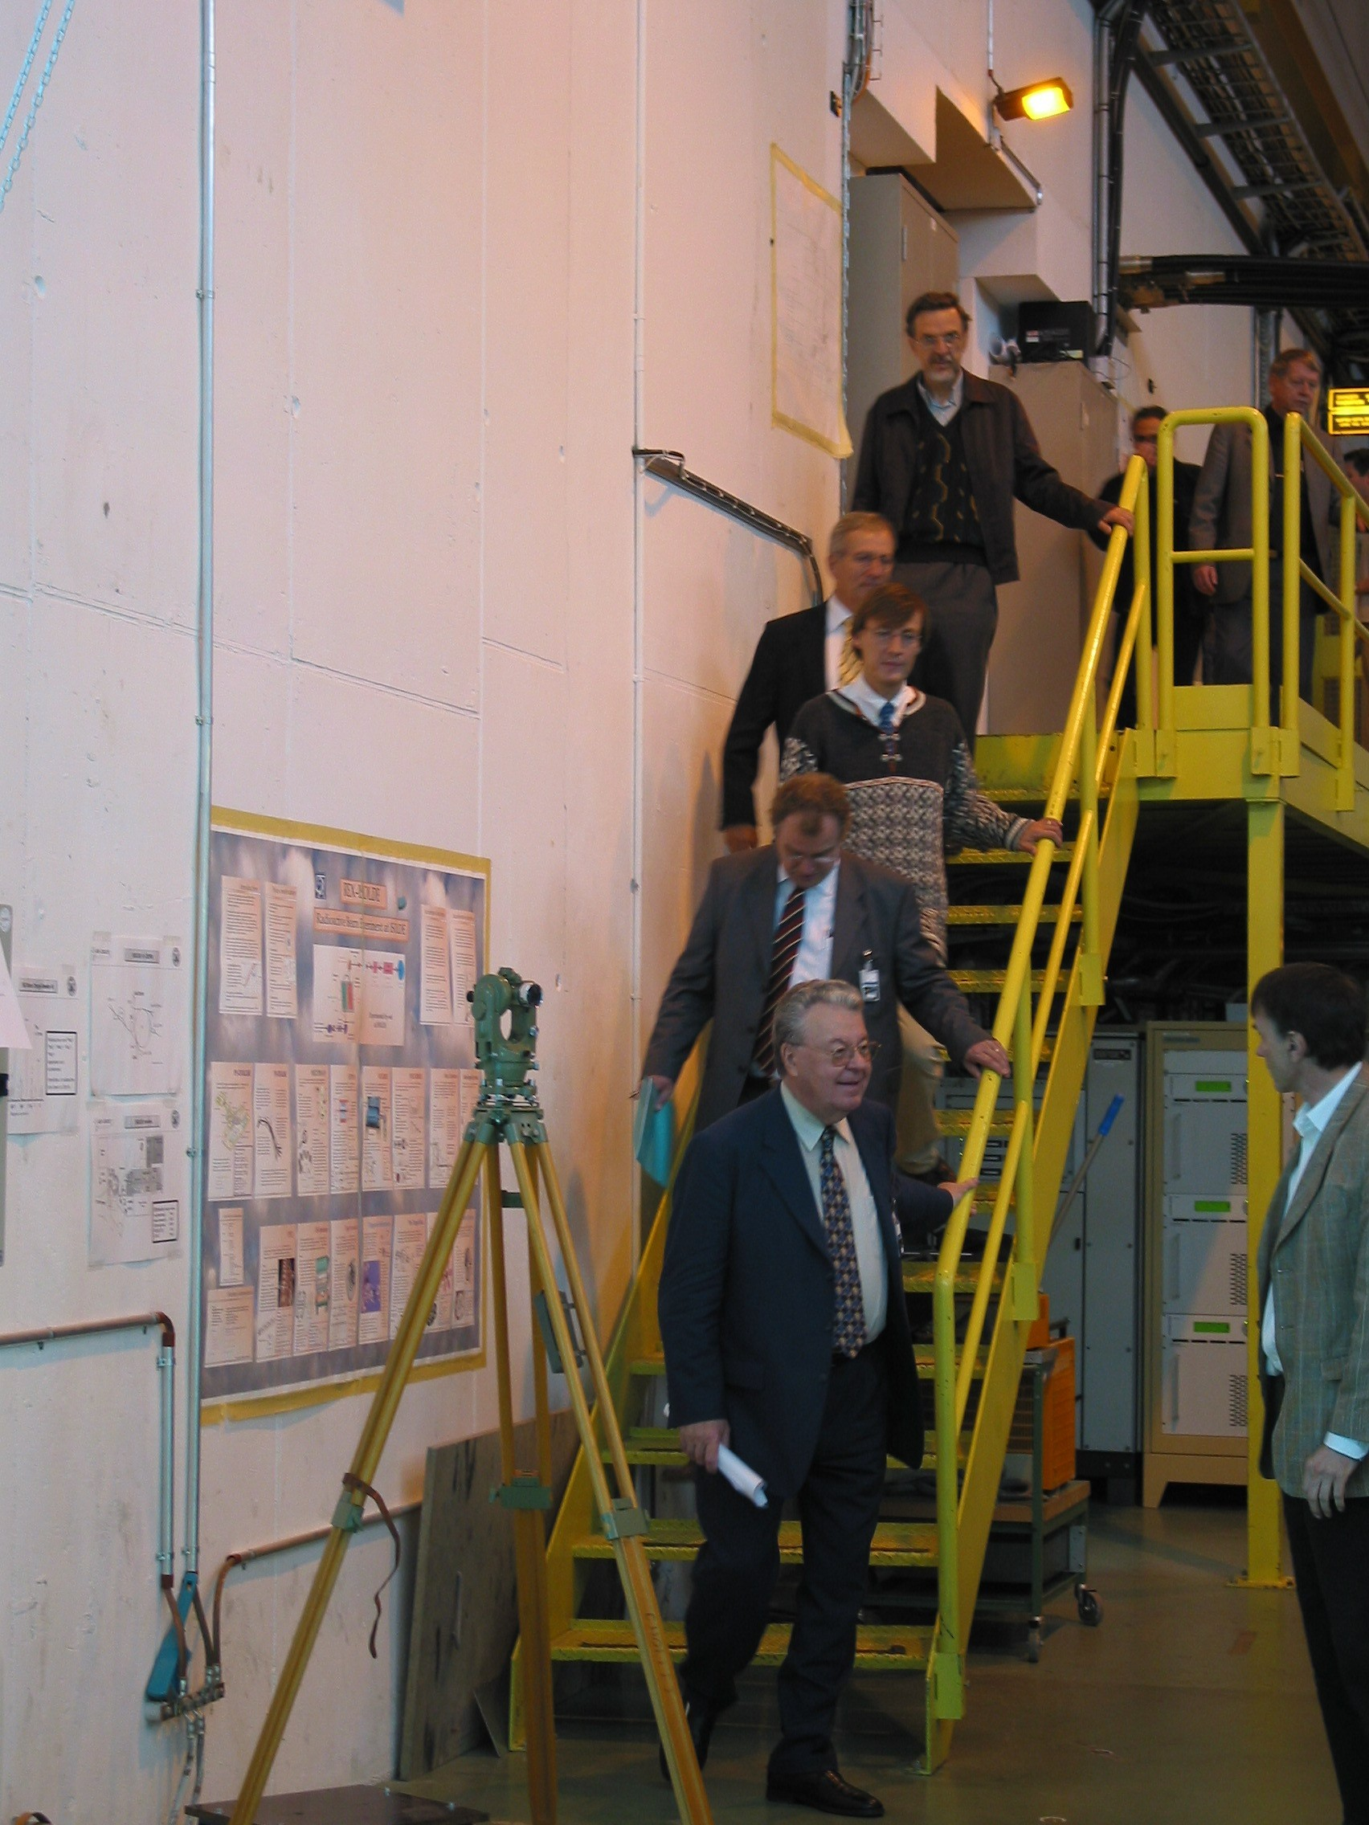
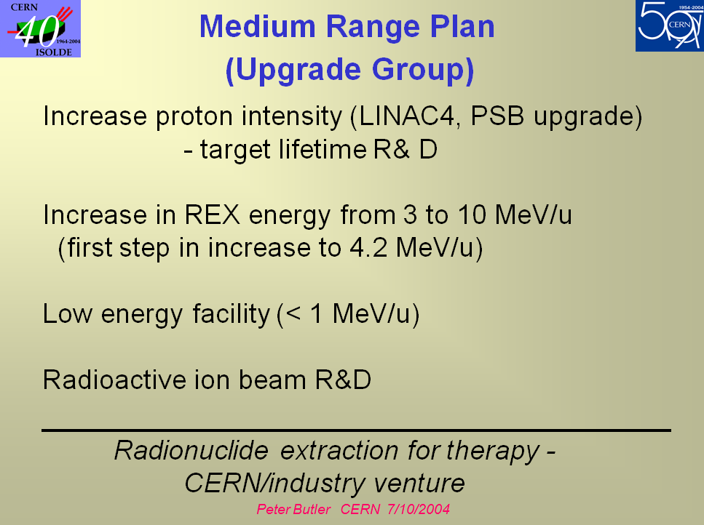
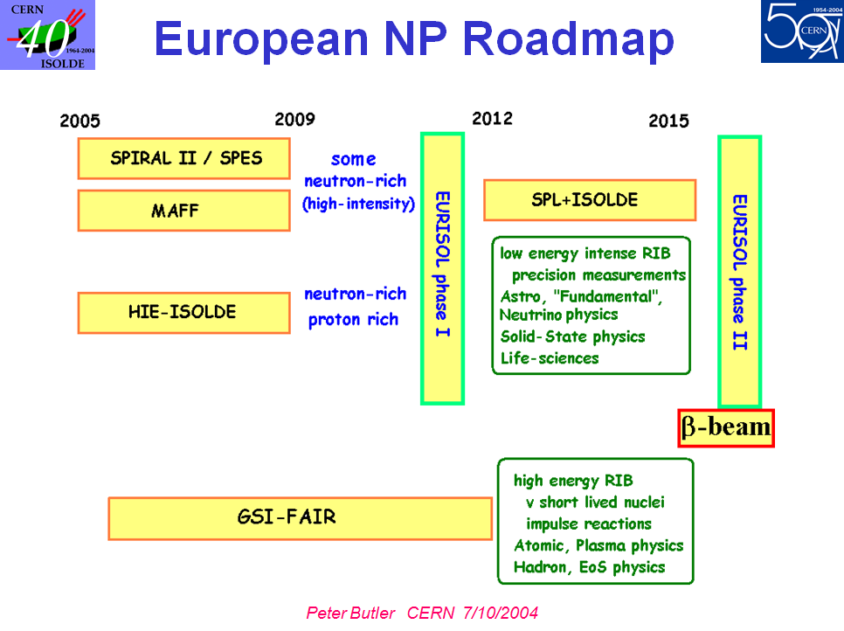
SNAPSHOP OF ISOLDE AMBITIONS
Visit of D-G and CSO
to ISOLDE October 2004
Beyer, Köster and Ravn, July 2004

Slide 9
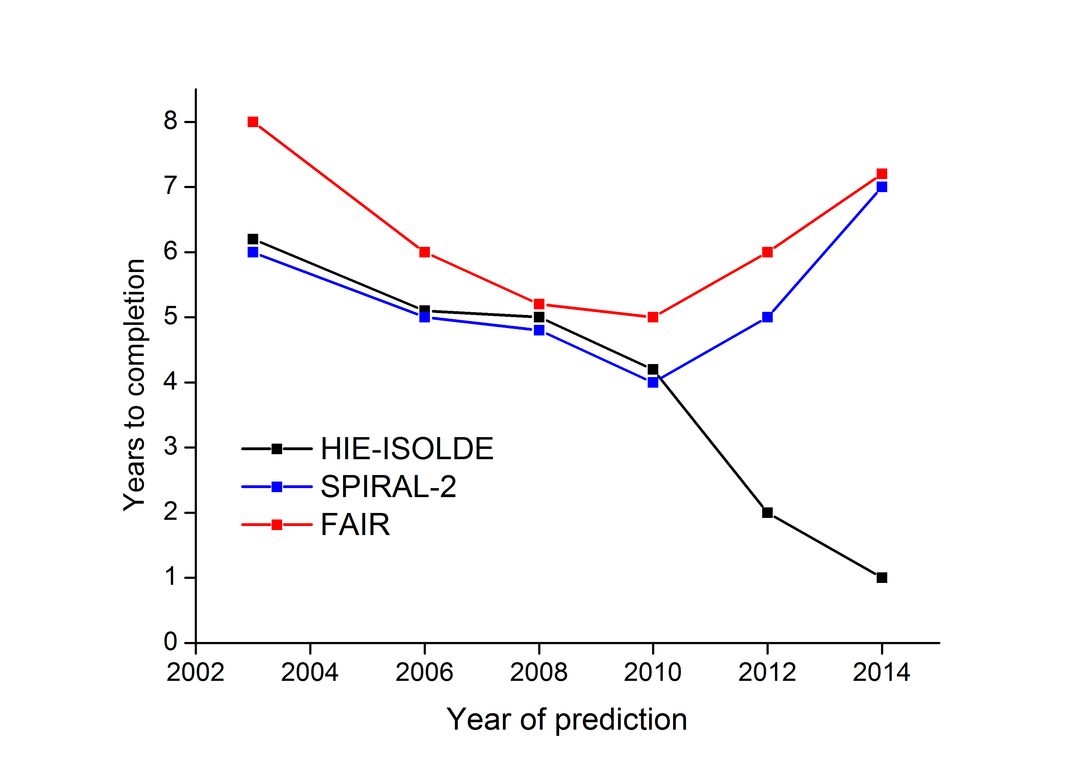
Lies, Damn Lies, and RIB Predictions

Slide 10
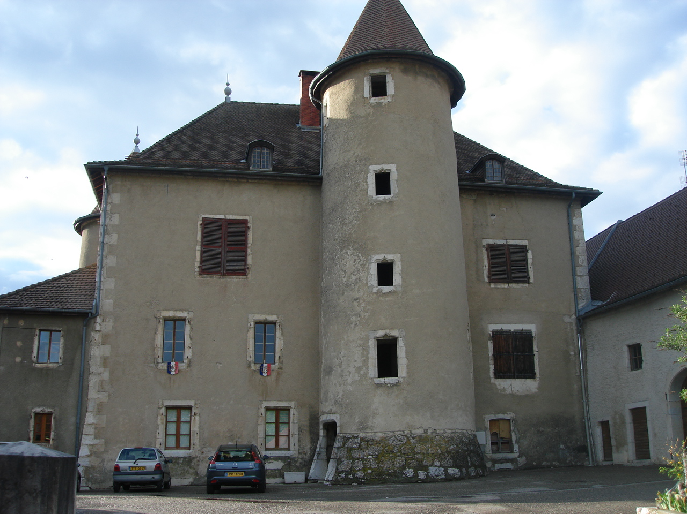
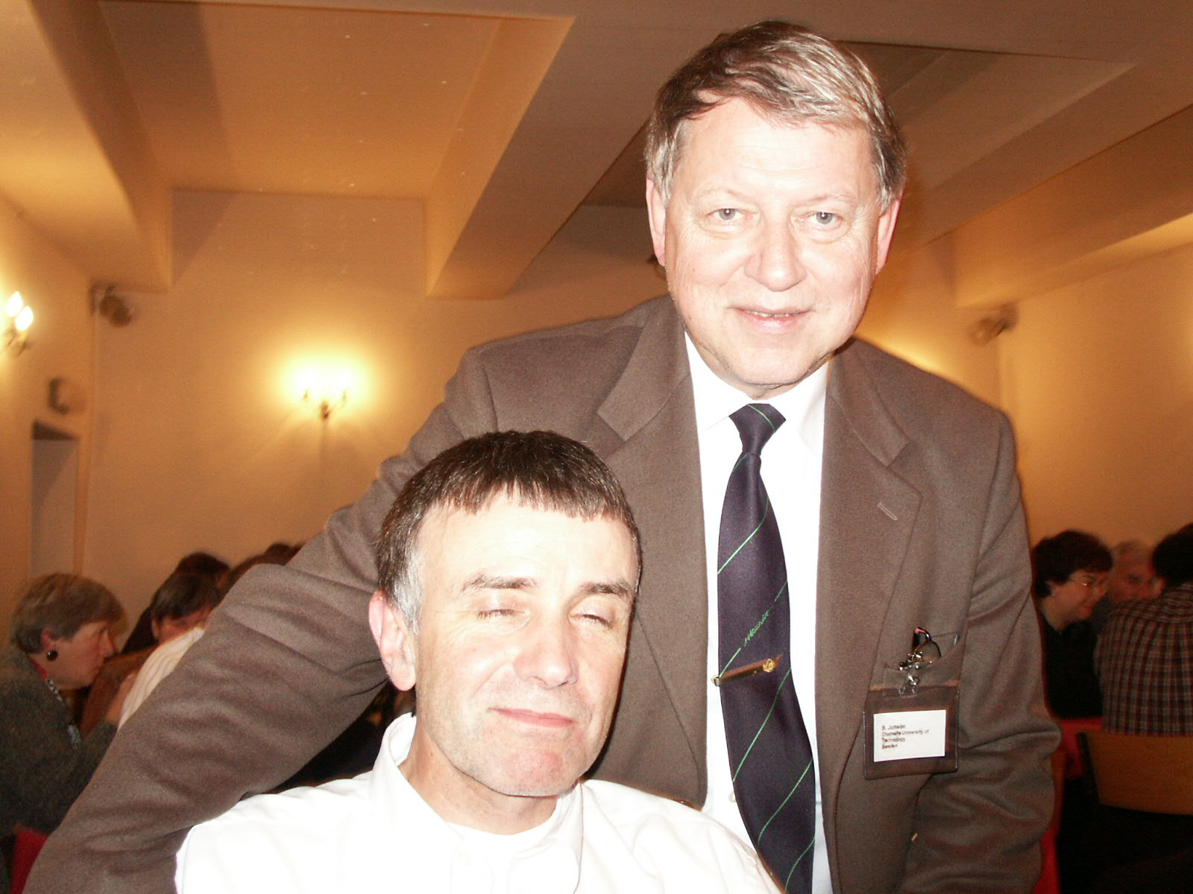
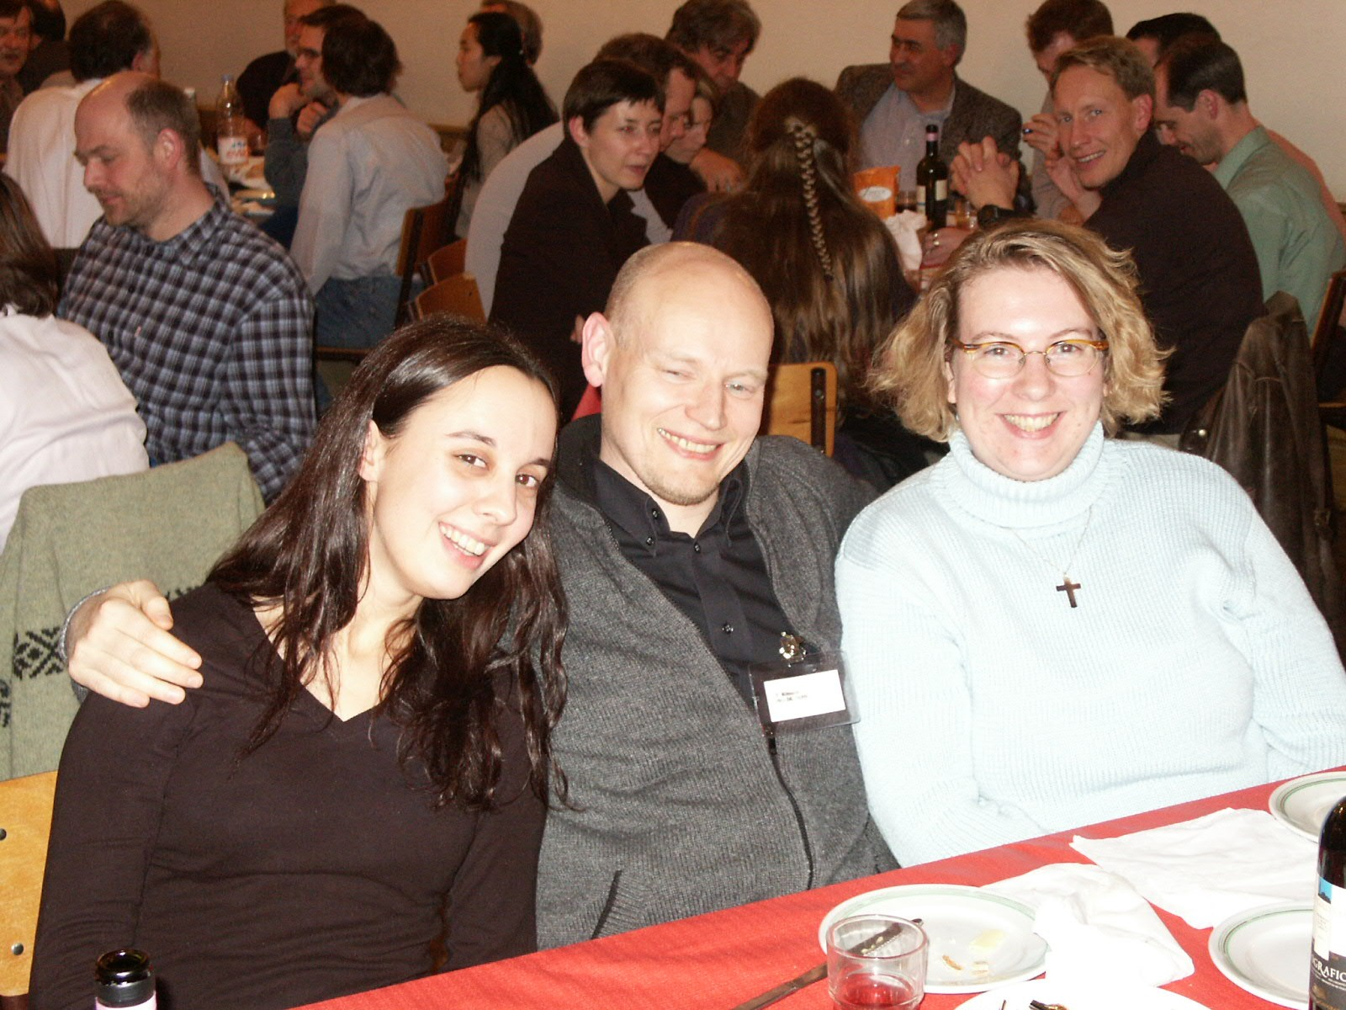
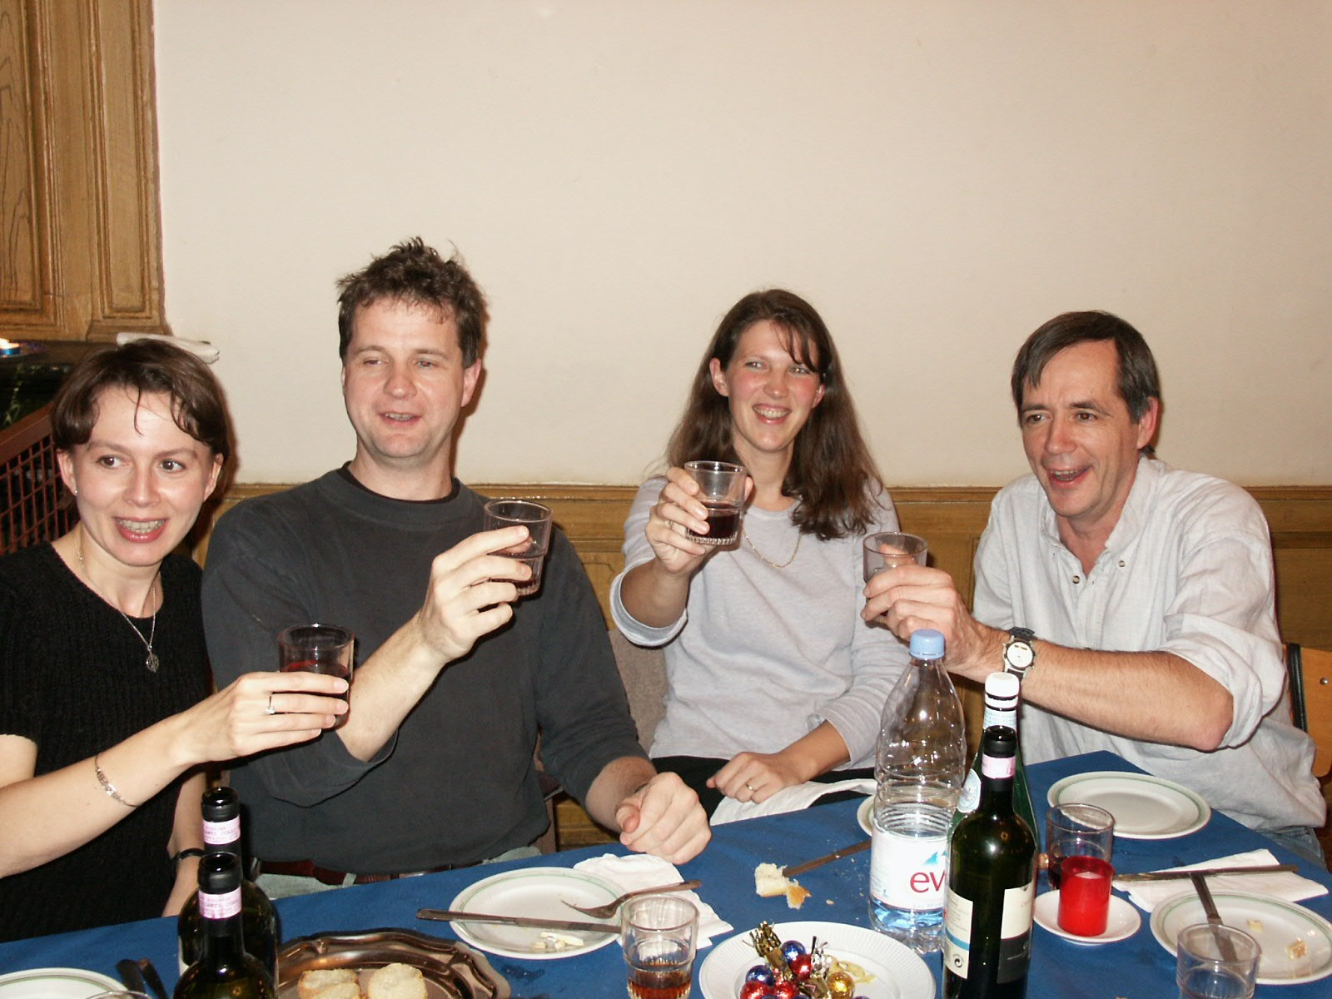
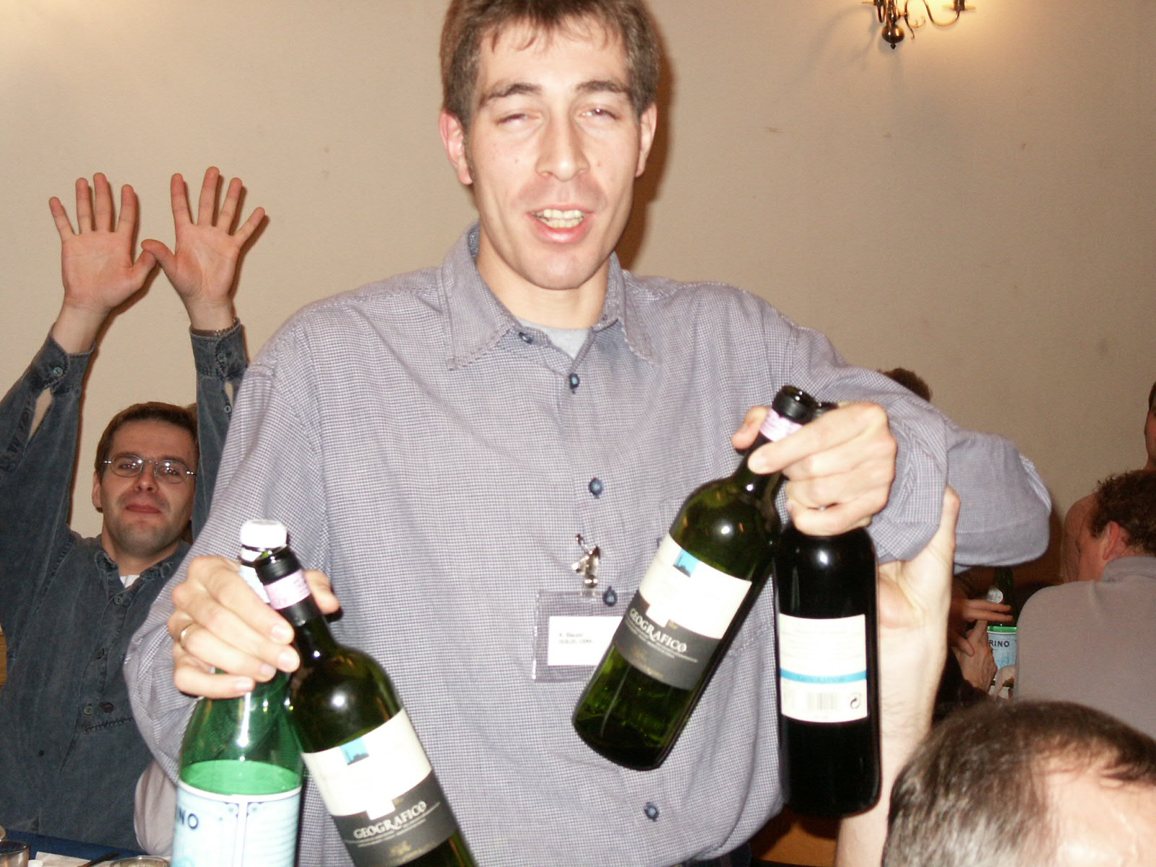
Social Events
Châteaux de Vesancy
(Lindroos Enterprises)
Coordination of ladies
After dinner speech nearly finished
proost/
santé
To
CAEN !
He has to find another 6 bottles

Slide 11
Thank You

Slide 12
Fellows, etc
Alban Kellerbauer
Alex Herlert
Frank Herfurth
Georgi Georgiev
Henrik Jeppersen
(JG) Guilherme Correia
Joakim Cederkall
Klaus Blaum
Marc Dietrich
Luis Fraile
Pierre Delahaye
Serge Franchoo
Thomas Agne
Uffe Bergmann
Ulli Koster
(Thomas Sieber, Fredrik REX staff; Thierry EURISOL post)

Slide 13
ISOLDE COLLABORATION COMMITTEE
ISOLDE upgrade group meets for first time Feb 2003
Spain attends ISCC as full member Feb 2003
ISCC agrees that ISOLDE group leader becomes spokesperson Nov 2004
News of EURONS and EURISOL funding Nov 2004
HIE-ISOLDE introduced to ISCC Feb 2005 (budget of 15 MCHF required)

