Slide 1


LIEBE project:
Design of a molten metal target based on a Pb-Bi loop at CERN-ISOLDE
T. De Melo Mendonca, M. Delonca, D. Houngbo, C. Maglioni, L. Popescu, P. Schuurmans, T. Stora

Slide 2
Outline
Context
LIEBE: design proposed
Prototyping phase – first results
Next steps & conclusion

Slide 3
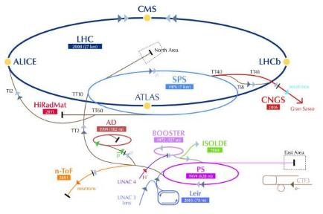
Context (1)
LIEBE? : Liquid Eutectic Lead Bismuth Loop Target for Eurisol
Aim of the target: validation of conceptual design for the Eurisol direct target by developing a prototype for Cern-Isolde,
  Keywords: high power target, short-lived isotopes, diffusion chamber…
Proton beam from PSB:
1.4 GeV
2 µA
3e13 protons/pulse
Cycle: 1.2 s
3 kW average power
Instantaneous power: ≈ 1 GW
Collaboration started in May 2012 between 6 institutes: CEA, CERN, IPUL, PSI, SCK-CEN and SINP.

Slide 4
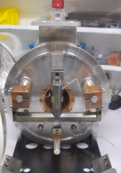
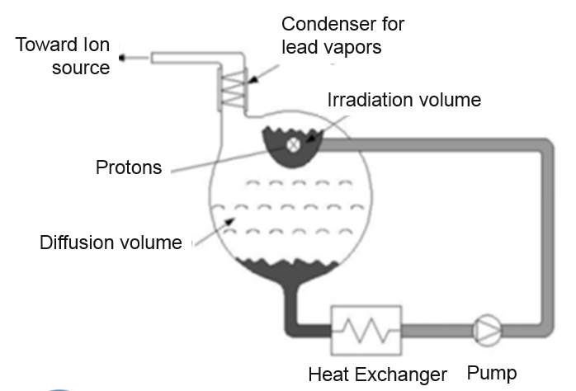
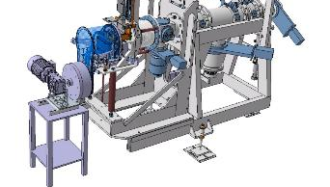
Context (2)
… and a schematic design proposed during Eurisol Design Study…
From a static bath target…
… toward a liquid loop target
Use of LBE
Temperature from 200 ˚C up to 600 ˚C
Design possibly adaptable for other molten materials (La, Sn, salt, …)for Cd, Cs, Ba, Kr, … beams.
Opened Static Isolde molten Salt target, CERN
Design proposed by E. Noah and all, EURISOL 100 kW Target Stations Operation and Implications for its Proton Driver Beam, EPAC,2006
Main challenges:
  High power deposited on target to be evacuated (HEX to dimension at various T)
  Recirculation of liquid through a compatible LBE pump
  High temperature of use (up to 600 deg C)
  Integration in already existing (relatively small) environment
  Monitoring and control

Slide 5
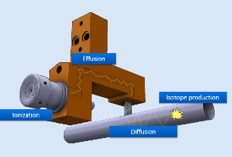
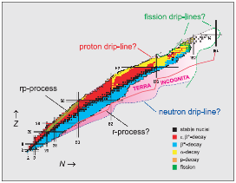
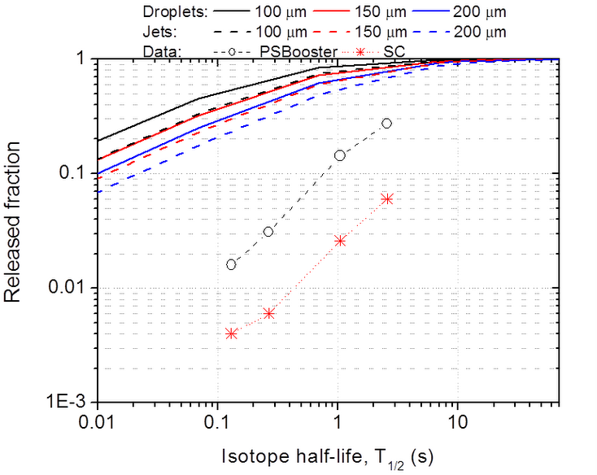
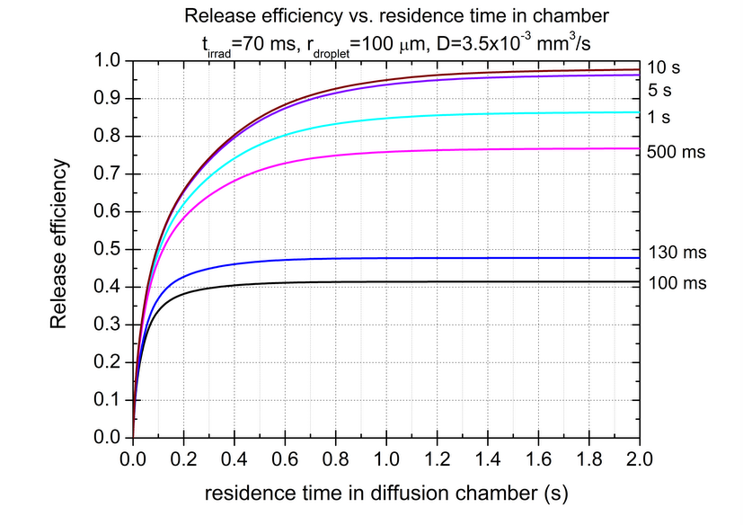
Context (3)
Improving the diffusion process?
Aimed isotopes:
Mercury
Polonium
Astatine
Release by diffusion is maximized for spherical shape (droplets) of 100 µm radius,
Diffusion release fraction of 0,38 for 100 ms in the diffusion chamber and 0,44 for 200 ms in case of ¹⁷⁷Hg (T_{1/2}=130ms)
Gain of factor 10 compared to static unit!
Use of a diffusion chamber
Use of a grid to create the droplets (created from holes of 0,1 mm Ø)
Diffusion: model from Fujioka et al. (NIM 186 (1981) 409)
Data: Lettry et al. (NIM B 126 (1997) 170)
Courtesy T.M. Mendonca, CERN

Slide 6
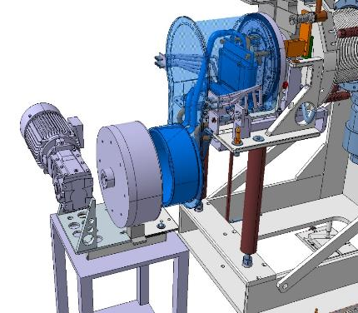
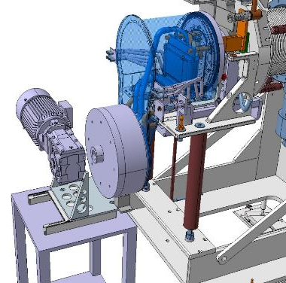
LIEBE: design proposed (1)
Proposed LIEBE design: a « two parts plugged »principle
  Allow the confinement of the LBE while keeping the total weight below the limit fixed by the robot at Isolde (60kg maxi)
Main loop part
Pump/engine part
Unplugged position
Plugged position
Courtesy V. Barozier, CERN

Slide 7
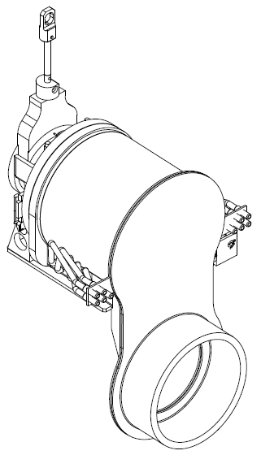
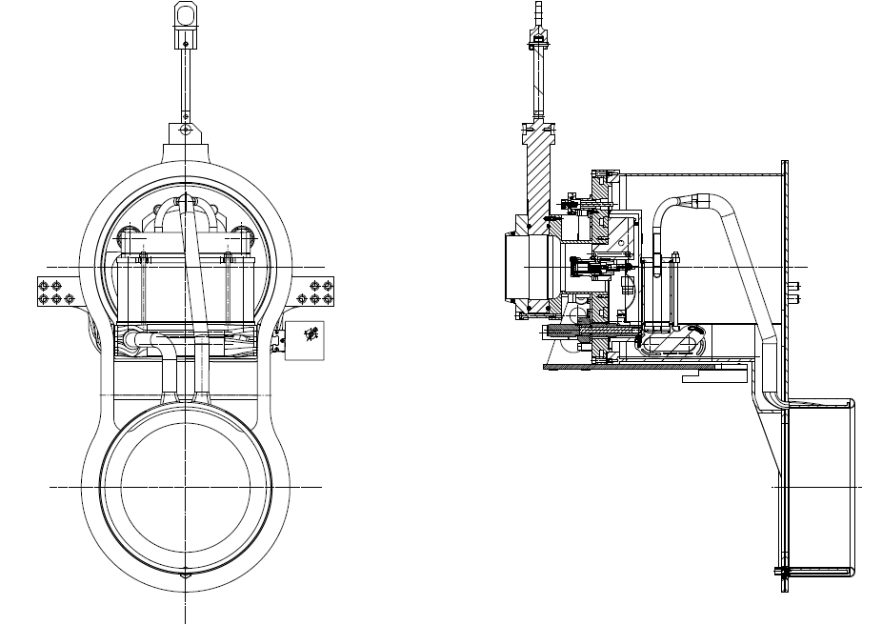
LIEBE: design proposed (2)
Main loop part: some details
Diffusion volume
Ion source
Irradiation volume
Protons
Heat Exchanger
Pump pipes
+ heating elements all along the loop and filling system

Slide 8
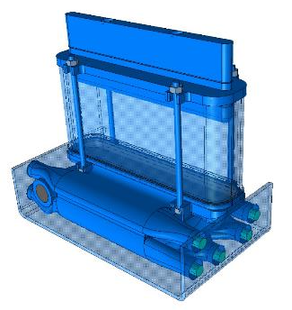
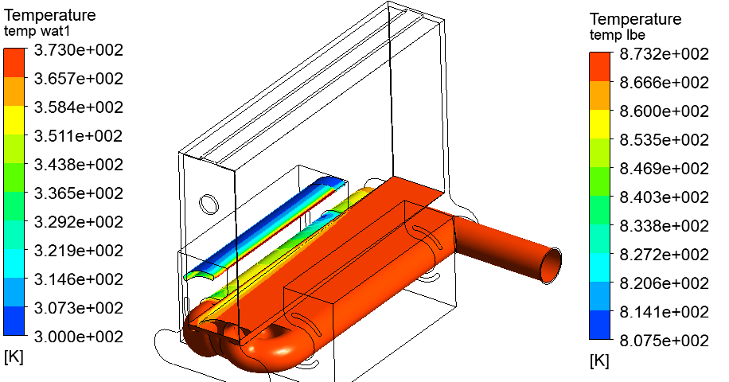
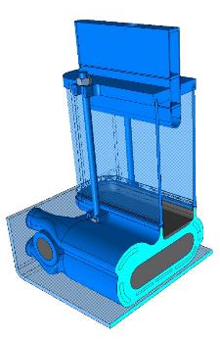
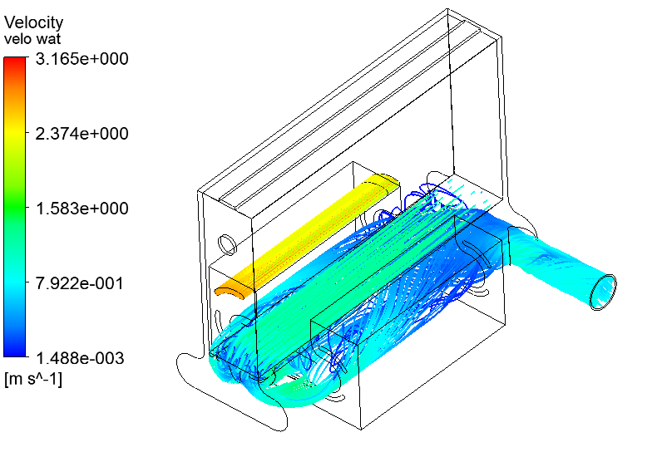
LIEBE: design proposed (3)
HEX: produced by 3D printing
6 water inlets, 4 alimented separately and independently (one per 50˚C or 100 ˚C) + 2 together (from 200 ˚C to 300 ˚C)
Temperatures repartitions foo LBE and water
@ 600 ˚C – CFX analysis
400 ˚C to 500 ˚C
Isolde parameters | Water | LBE
Flow rate (l/s) | 0.22 | 0.23
T _{inlet} (ºC) | 27 | Variable
T _{outlet} (ºC) | < 90 | Variable
300 ˚C to 400 ˚C
550 ˚C to 600 ˚C
200 ˚C to 300 ˚C
Velocity streamlines fro LBE and water @ 600 ˚C
CFX analysis
500 ˚C to 550 ˚C

Slide 9
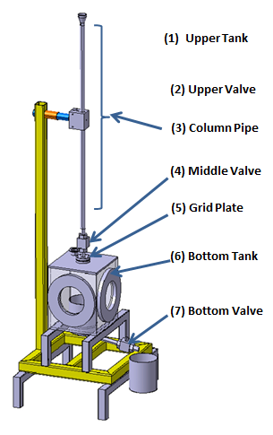
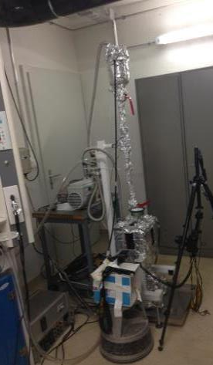
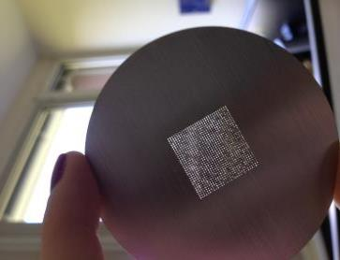
Prototyping phase – first results (1)
What is the proper spacing with LBE?
Volume of LBE per shower known (between the upper and middle valve)
4 grids to be tested (different spacing from 1 mm up to 0.4 mm), holes diameter of 0.1 mm.
5 showers per grids (repeatability)
Camera to take picture (3 per second)
Grid samples
Vacuum pump
Camera
Courtesy D. Grenier & T.M. Mendonca, CERN

Slide 10
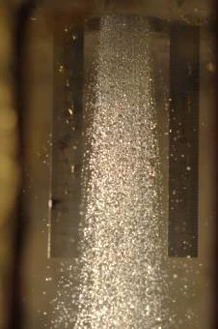
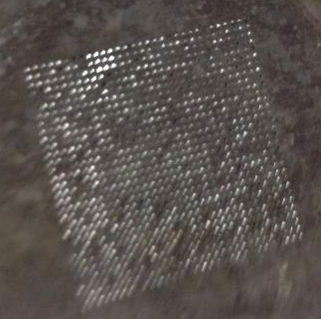
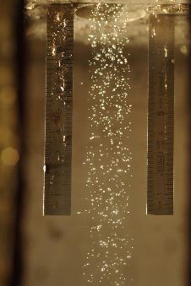
Prototyping phase – first results (2)
Observations:
  Shower feasibility proven: smallest spacing between holes of 0,5 mm for 0,1 mm holes
  Oxidation prevent a proper operation of the grid
  Size of droplets vary between the start and the end of the shower
After the serie of shower
Clogging visible
Shower at start.
Shower at the end.

Slide 11
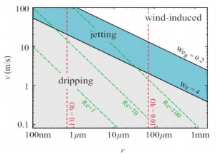
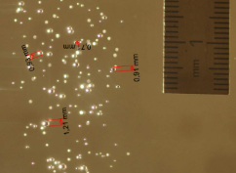
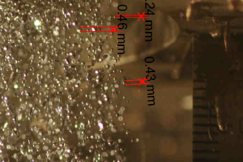
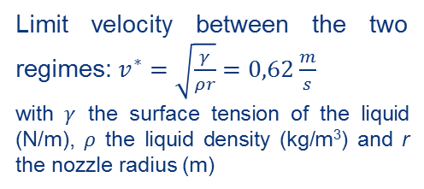
Prototyping phase – first results (3)
Classification of droplet formation regimes
Impact on the dimension of the droplets created
gobbling
Gobbling
Jetting
Hoeve et al. (2010) and C.Clasen et al (2008)
Limit velocity between the two regimes: $v^{∗}=\sqrt{\frac{γ}{ρr}}=0,62\frac{m}{s}$
with $γ$ the surface tension of the liquid (N/m), $ρ$ the liquid density (kg/m³) and r the nozzle radius (m)
Regime | Velocity | Calculated droplet diameter | Average droplet diameter - test
Gobbling | 0 to 0,62 m/s | ~ 1,2 mm | ~ 1 mm
Jetting | > 0,62 m/s | ~ 0,4 mm | ~ 0,4 mm
Good agreement between theory and experimental data (considering the measurements and post processing errors).
To obtain smaller droplets, the outlet velocity should be > 0,62 m/s (jetting regime).

Slide 12
Next steps & conclusion
Finalization of the target design
More prototypes are planned for the upcoming year
A design review report has been produced (June 2014) and will be soon published – the design reviewers validated the proposed design
Many presentations and articles are already available:
  LIEBE project – status report, L. Popescu and all, ECOS-Eurisol Joint Town meeting, talk, 2014
  LIEBE: Design of a Molten metal target based on a Pb-Bi loop at CERN-ISOLDE, M. Delonca and all, talk, High Power Target Workshop 5, 2014
  Integration safety into the LIEBE Pb-Bi loop target at CERN-ISOLDE, A.P. bernardes and all, talk, High Power Target Workshop 5, 2014
  First report on the inventory of radio nucleides in 1.4 GeV proton irradiated thick Led Bismuth Eutectic (LBE) target, S. Lahiri and all, talk, ISOLDE Workshop and Users meeting, 2013
  CFD analysis and optimisation of a liquid lead-bismuth loop target for ISOL facilities, D. Houngbo and all, under submission, NIM-A
  And many others…

Slide 13
Thank you for your attention!

Slide 14
Thanks to all the contributors…
V. Barozier
A. P. Bernardes
L. Gallerani
K. Kravalis
F. Loprete
S. Marzari
R. Nikoluskins
F. Pasdeloup
A. Polato
H. Znaidi
… (and many others…)

Slide 15
Back up slides!

Slide 16
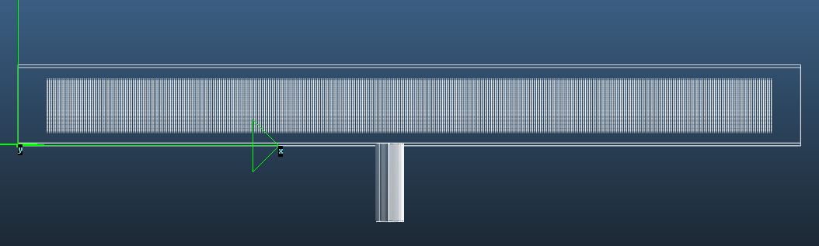
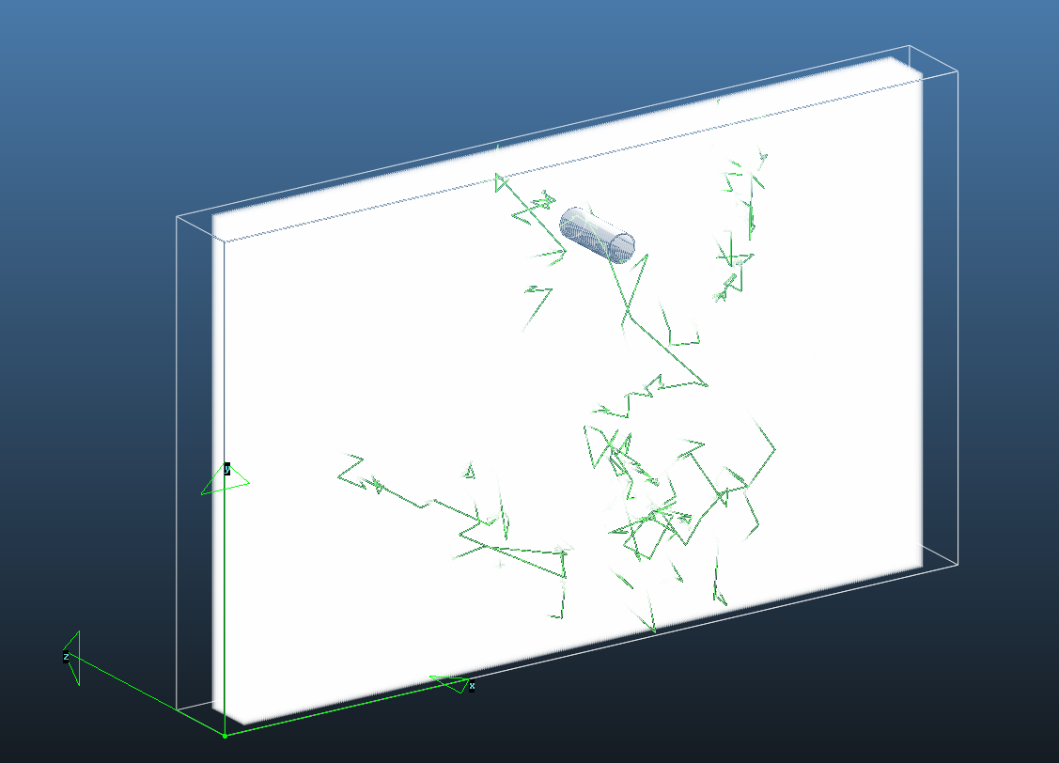
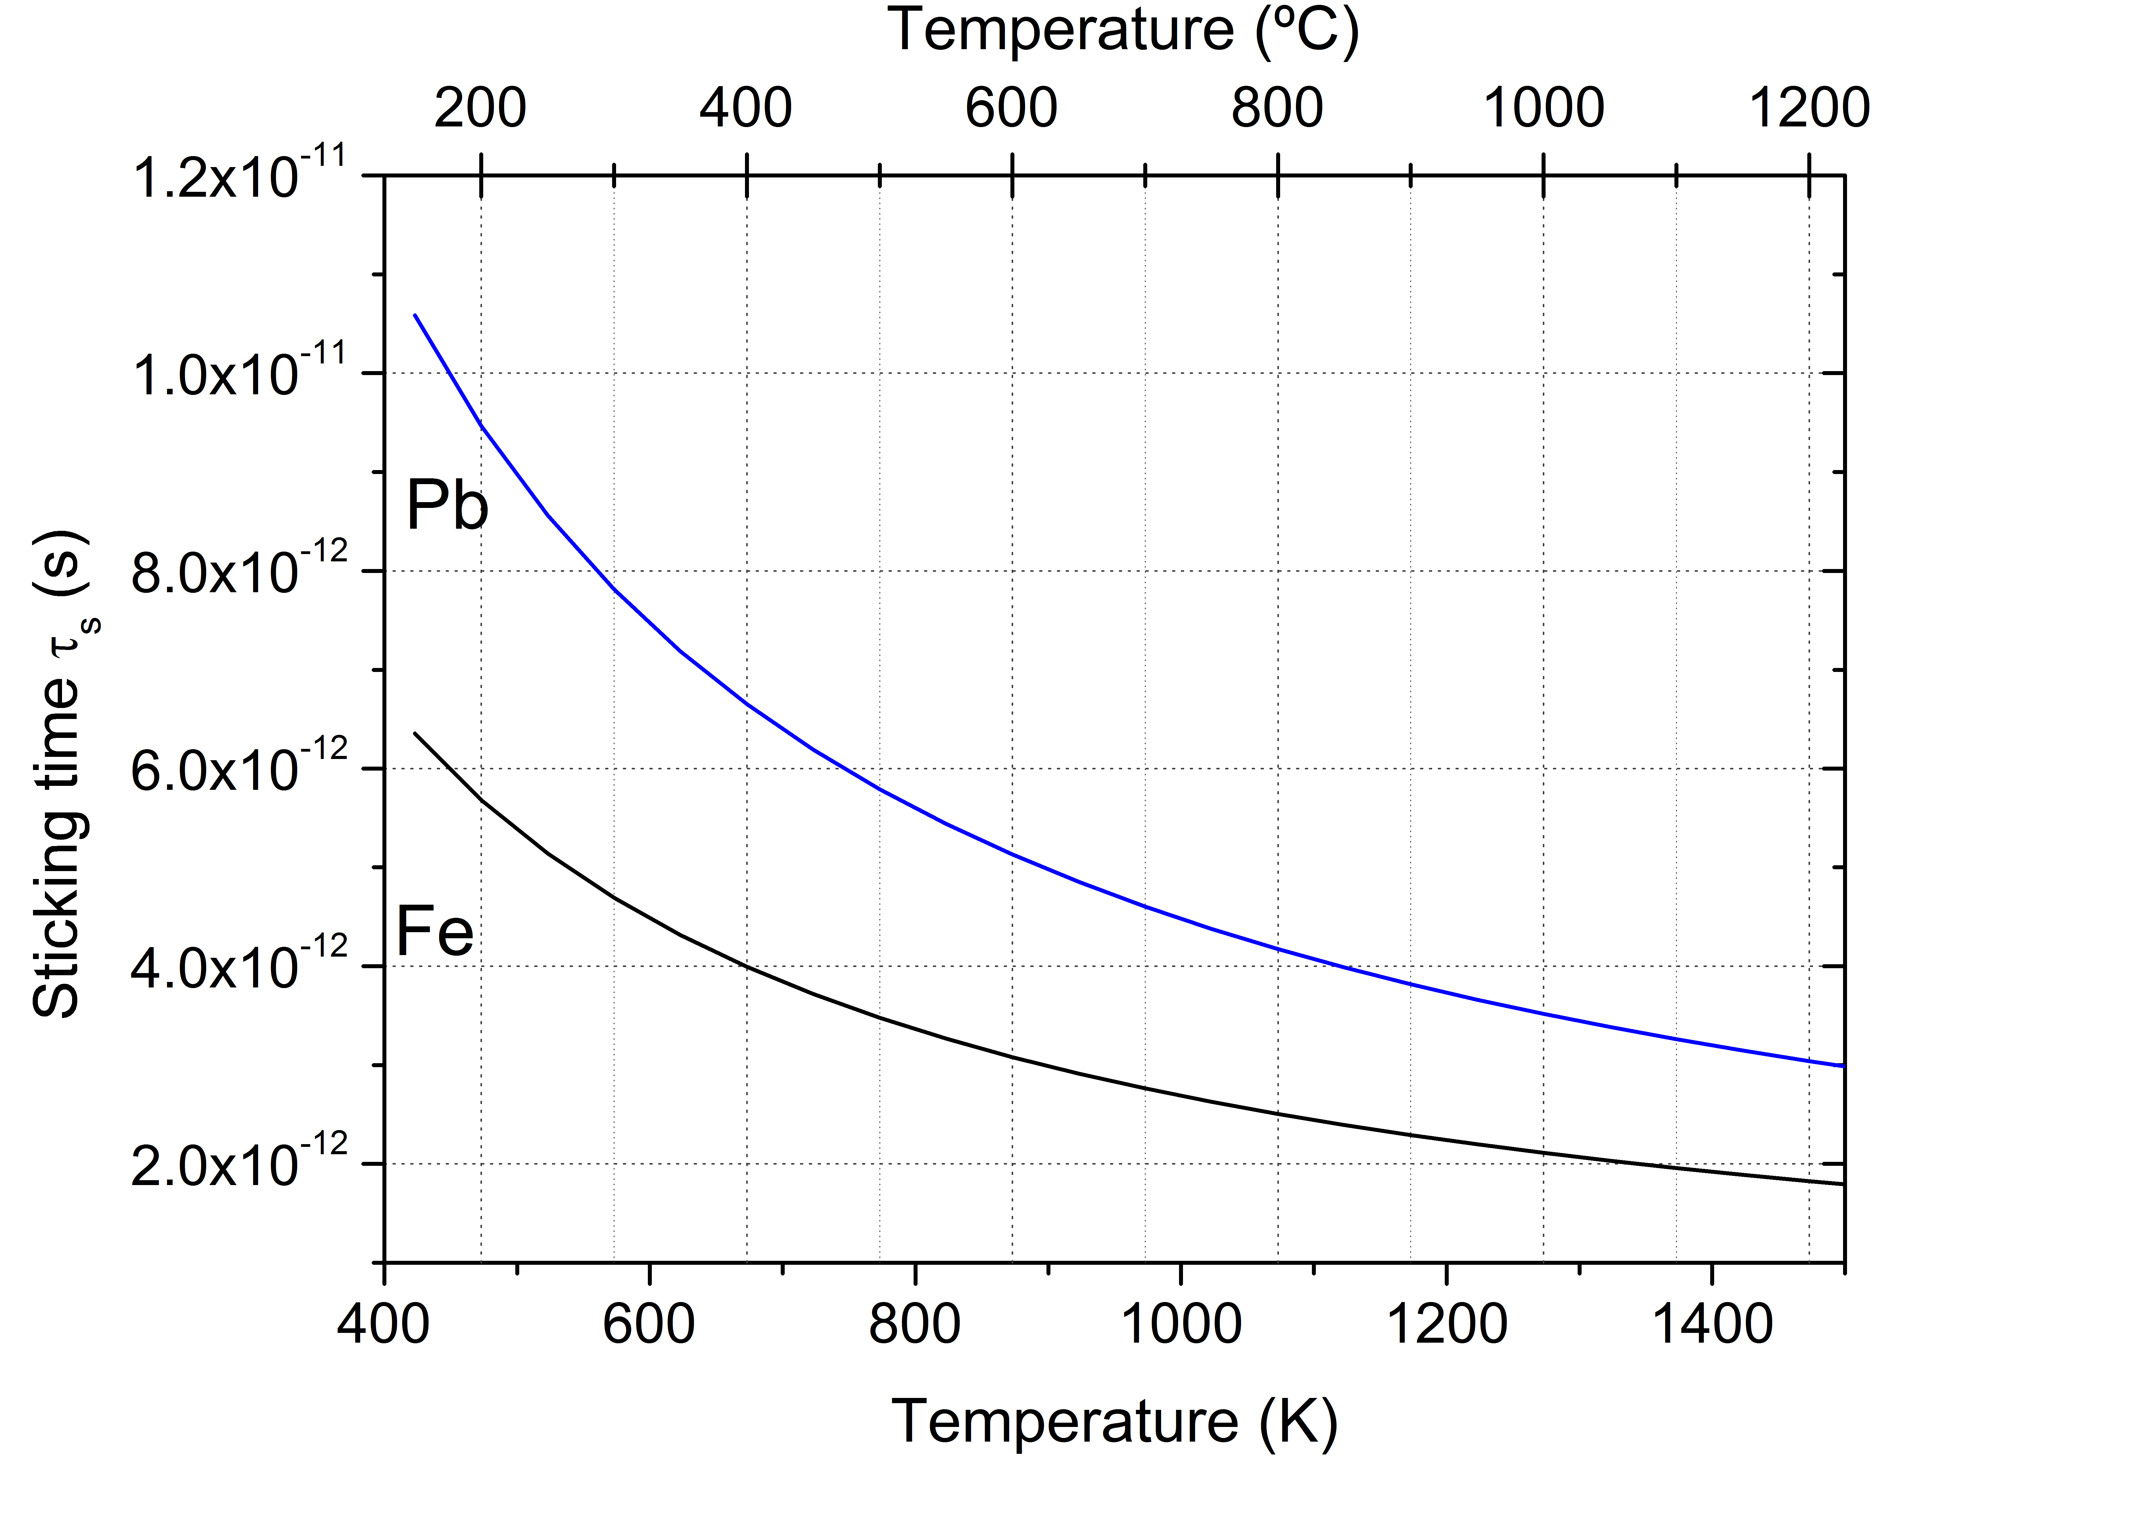
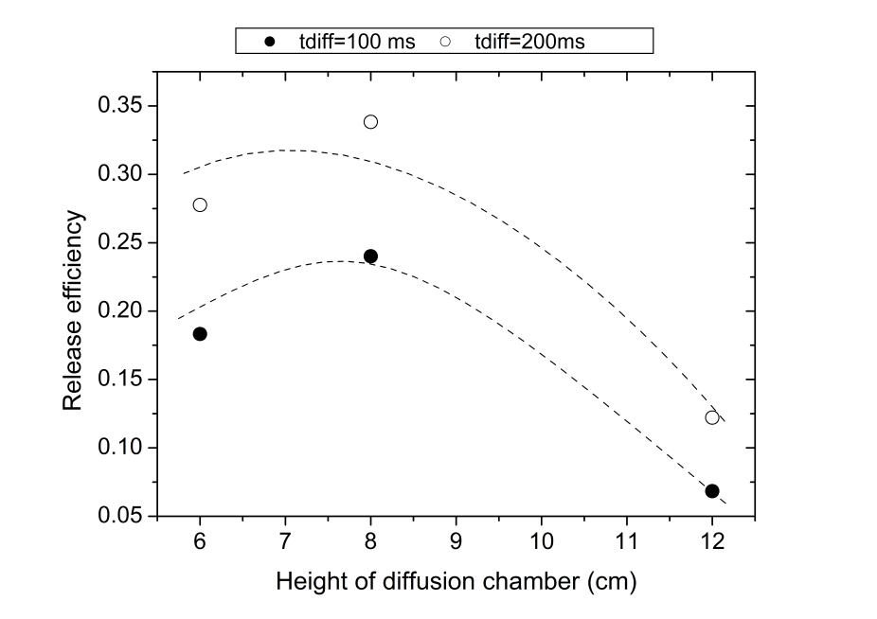
Diffusion/effusion simulations (3)
Effusion: Monte Carlo
  The effusion efficiency is dependent on the geometry of the container/diffusion chamber, the sticking time, the mean free path and number of collisions with droplets and surface of containment.
Sticking times of ~10⁻¹² s – negligible effect in efficiency
Effusion release efficiencies between 22% and 34% for residence times in the diffusion chamber between 100-200 ms
Estimated release efficiencies (diff+eff) of ~ 8% for 100 ms and ~ 15% for 200 ms.
Thanks to T. Mendonca

