Slide 1
CRYRING @ ESR
Slow highly charged ions and antiprotons
  Motivation
  Technical Overview
  Status of installation
Frank Herfurth for the CRYRING working group

Slide 2
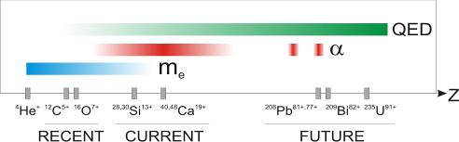
WHY?
HCI
Highly Charged Ions
Elements
Isotopes
+ Matter
Charge radii
FS, HFS
g-factor
e⁻-binding
+ surface
BW effect
α, m_{e}
Lamb-shift
Structures
QED test
+ atoms
Hollow atoms
Charge exchange
Collision dynamics

Slide 3
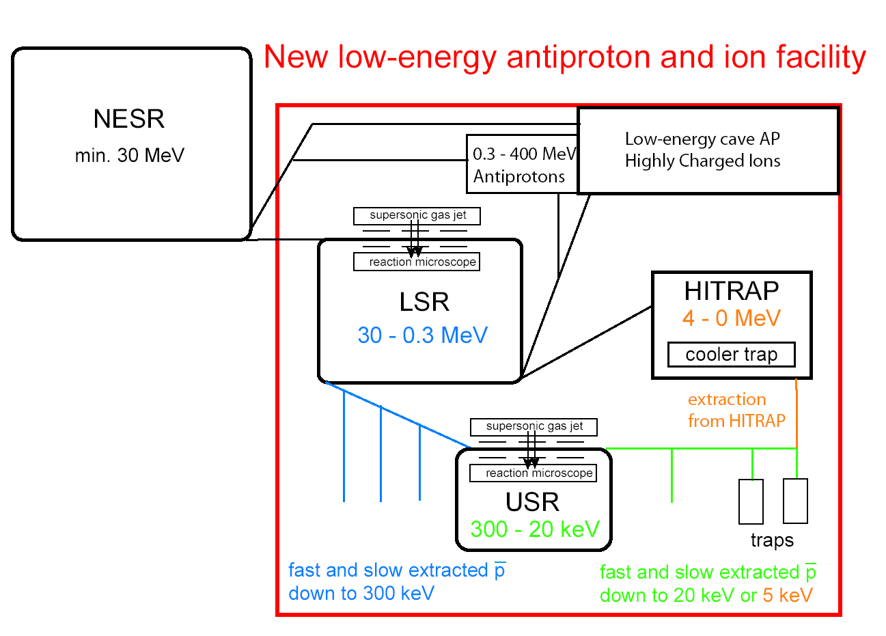
SPARC and FLAIR
Facility for Low Energy Antiproton and Ion Research
Stored Particles Atomic Physics Research Collaboration
Swedish in-kind contribution
CRYRING

Slide 4
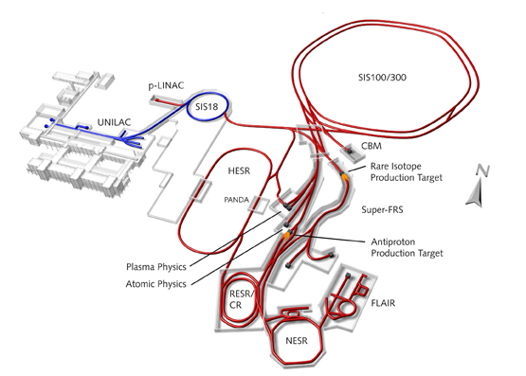
FAIR – SPARC and FLAIR
Atomic physics
Antiproton physics (low energy)
FLAIR
SPARC

Slide 5
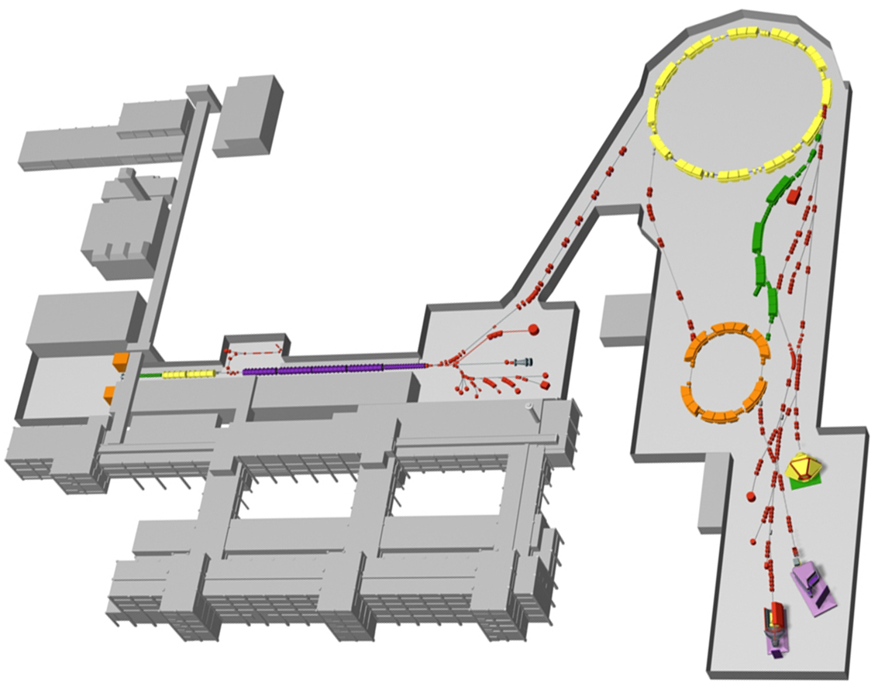
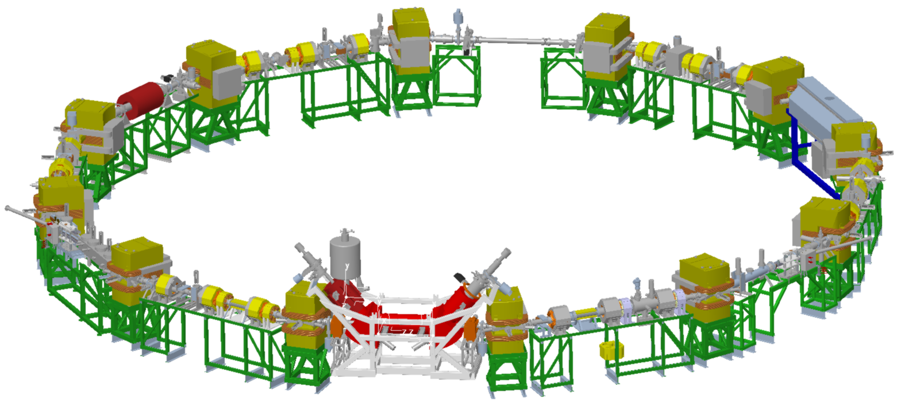
GSI
SIS
400 MeV/u
CRYRING @ ESR
FRS
11 MeV/u
ESR
UNILAC
4 MeV/u

Slide 6
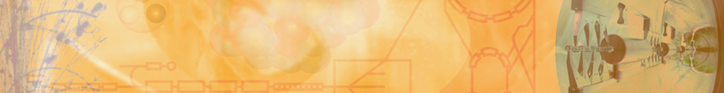
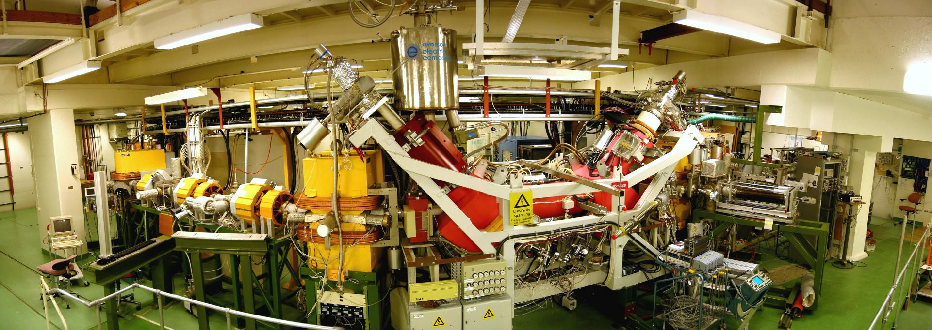

CRYRING in Stockholm (MSL)
Successful operated from 1992 to 2010
Dismantled and shipped to FAIR/GSI in 2012/13

Slide 7
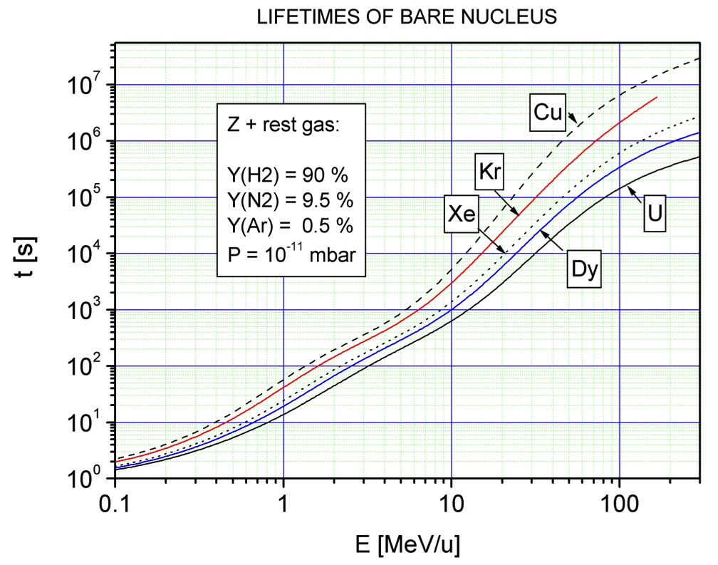
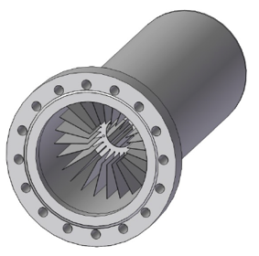
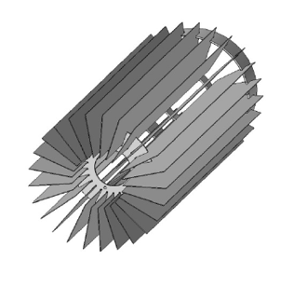
Vacuum & Beam Life Time
Ion pumps
  ~ 10
Cryopumps
NEG pumps
  ~ 100
15 min
V. Shevelko, priv. comm.
3 s
0.3
15

Slide 8
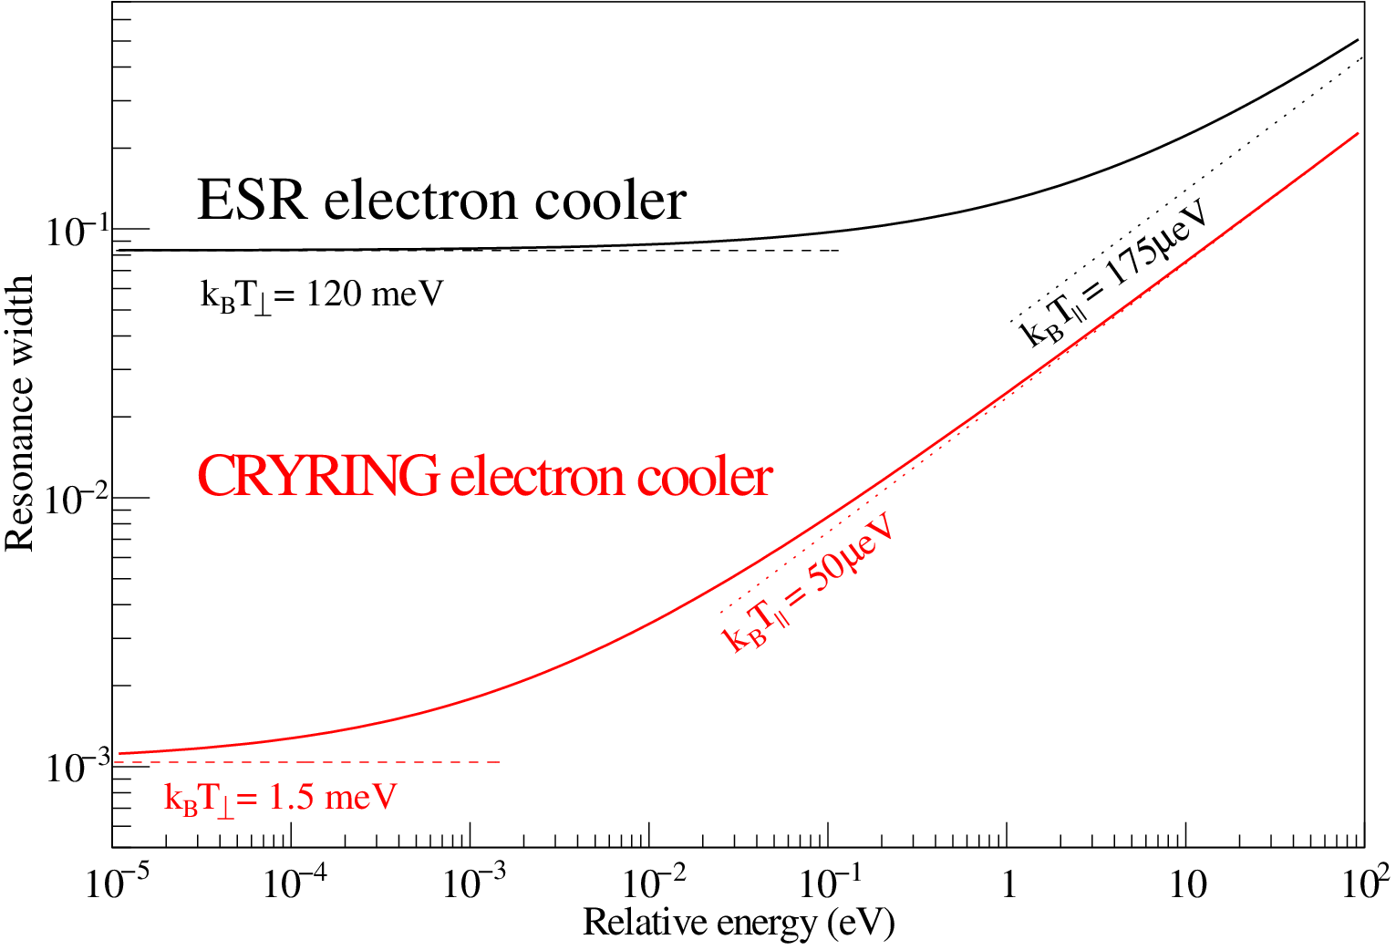
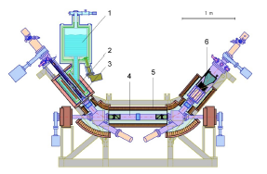
Electron Cooling ESR - CRYRING
C. Brandau priv. comm.

Slide 9
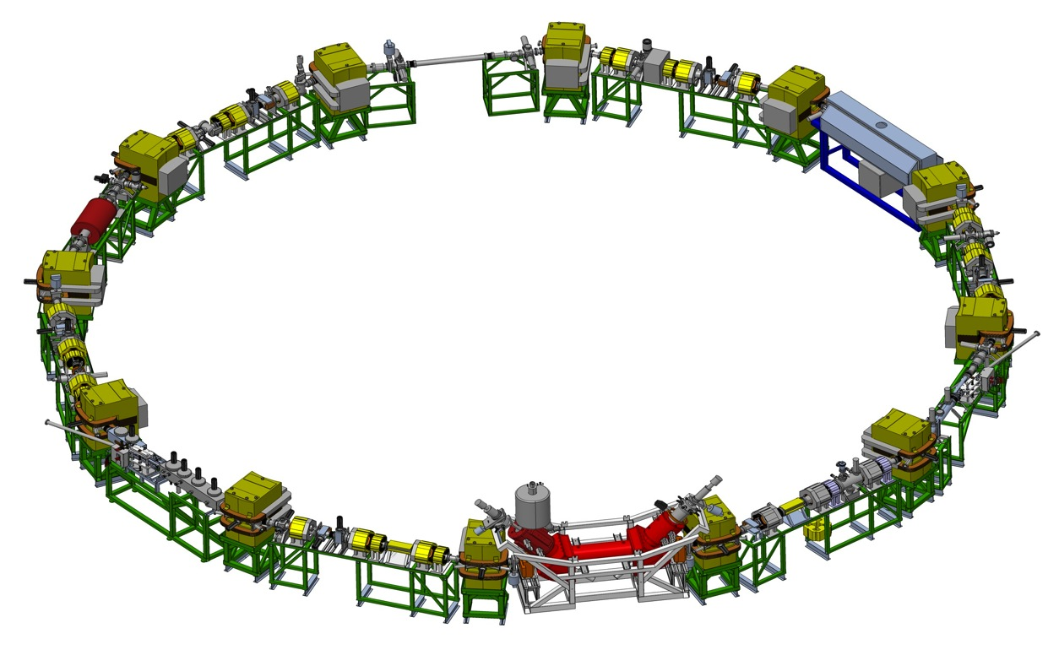
Experiment Equipment
Max. rigidity 1.44 Tm
  15 MeV/u U⁹²⁺
  96 MeV/u protons
Min. rigidity ~ 0.054 Tm
  150 keV/u protons
Particle detectors
Gas jet,
MOTReMi,
EXL ...
Extraction
Injection
Particle detectors
0° port
Microcalorimeter
180° port
Microcalorimeter
Electron cooler

Slide 10
CRYRING @ ESR
Max. rigidity 1.44 Tm
  15 MeV/u U⁹²⁺
  96 MeV/u protons
Min. rigidity ~ 0.054 Tm
  150 keV/u protons
FAIR Research & Development
Detectors and diagnostic systems
FAIR type control system
Training of operators on FAIR type system
FAIR type safety and radiation monitoring/access system
All this with real beam!
Scientific Opportunities
Heavy, highly-charged ions as available at GSI (up to U⁹²⁺) at low energy ~ 100 keV/u .. 10 MeV/u – bridge the energy gap between the ESR (> 4 MeV/u) and HITRAP (<10 keV/u)

Slide 11
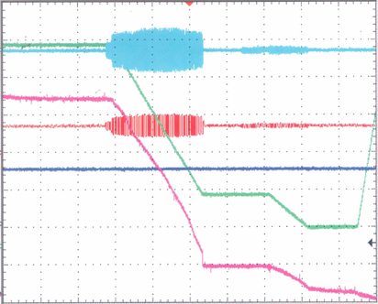
ESR – From 400 to 4 MeV/u
ESR – Experimental Storage Ring at GSI with stochastic and electron cooling
Ni²⁸⁺ 400 → 30 → 4 MeV/u
ESR cycle during recent experiment
signal:
time (s)
RF amplitude
5..20
injection, stoch. cooling
3..10
deceleration 400 – 30 MeV/u
2..6
e⁻ cooling, rebunching
2..5
deceleration 30 – 4 MeV/u
magn.dipole
field
2..5
e⁻ cooling, ejection
3
reset magnets
2 × 10⁷
ion current
40 s
1100 μA → 180 μA → 25 μA

Slide 12
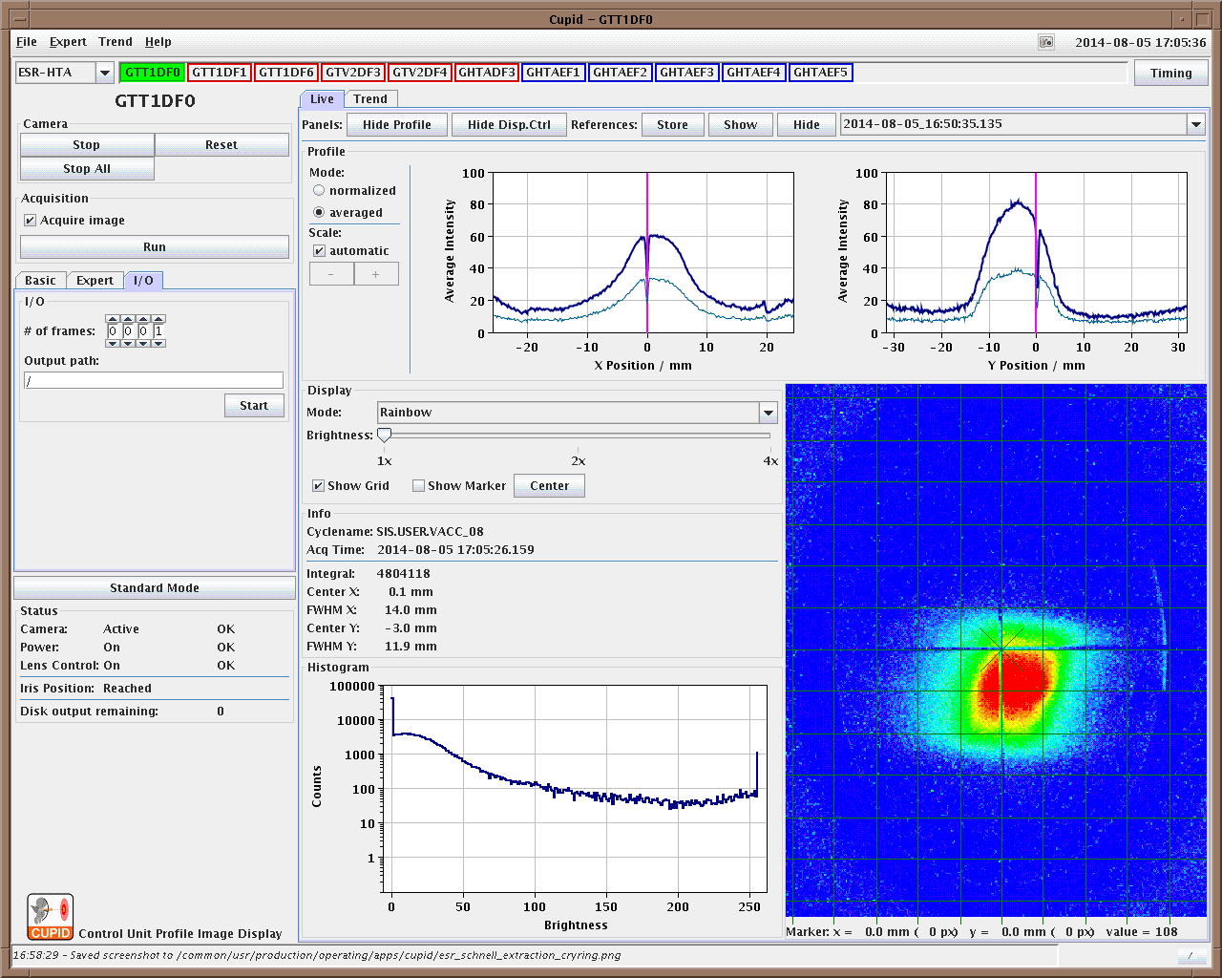
Extraction towards CRYRING
Beam extracted using the injection kicker
Transported beyond the first three dipoles in transfer line
N7+ @ 4 MeV/u
(only ca. 0.6 Tm !)
S. Litvinov, C. Kleffner, M. Steck, F. Nolden, D. Winters

Slide 13
Modification of ESR for CRYRING
Additional Kicker
in the mean time … creative use of existing kicker
Beam line upgrade (ESR – Cave B)
added steering, dipoles; additional diagnostics
Synchronization ESR/CRYRING Kickers/RF
got easier by increasing the diameter of CRYRING to ESR/2
Towards a reduced cycle time
  Requires faster cooling and more flexible control system

Slide 14
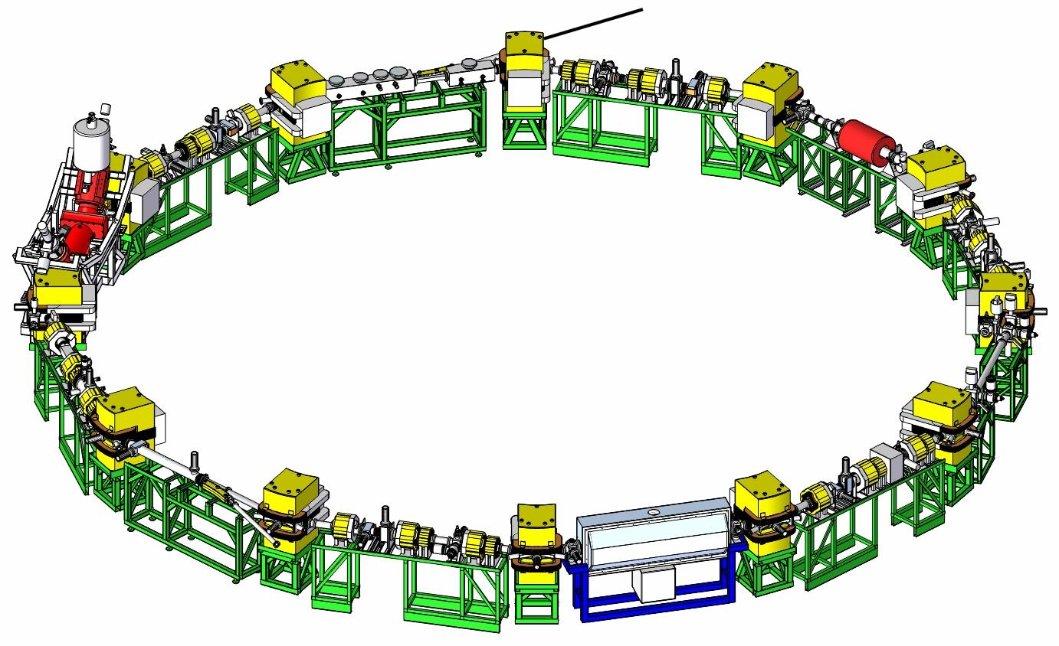
CRYRING modifications toward FAIR/GSI
Injection ≤ 30 MeV/u
≤ 30 MeV/n
Injection kicker magnet
Extraction kicker magnet
Electrostatic extraction septum
Magnetic extraction septum
Extraction
Notes:
CRYRING is now being modified to be suitable for its new role as LSR. A high-energy injection and extraction will be added.

Slide 15
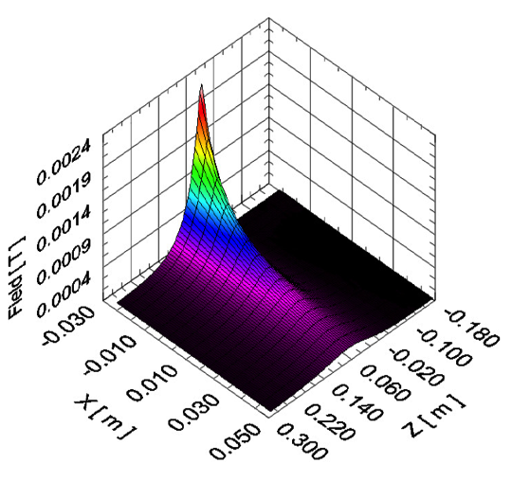
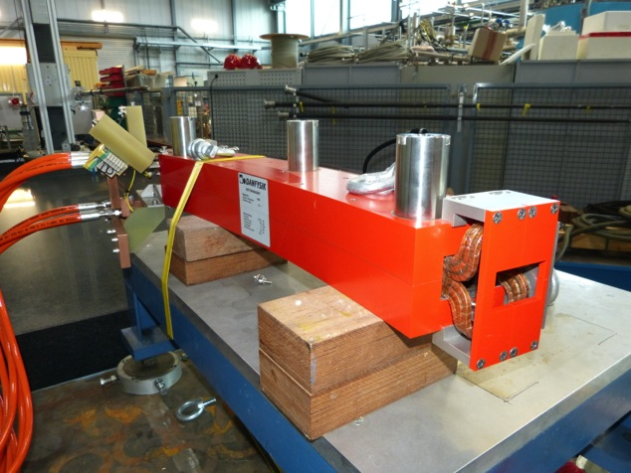
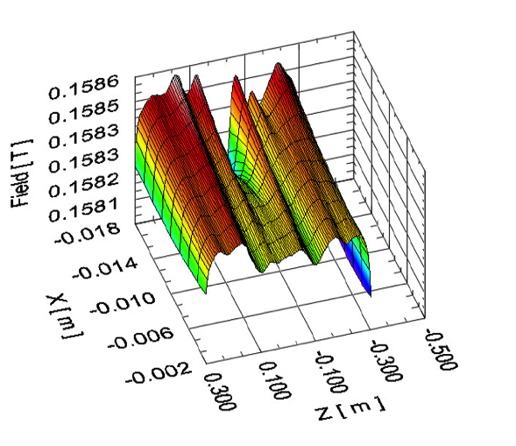
New Injection Septum
Delivered to GSI
Tested up to 1800 Ampere
Stray field measured

Slide 16
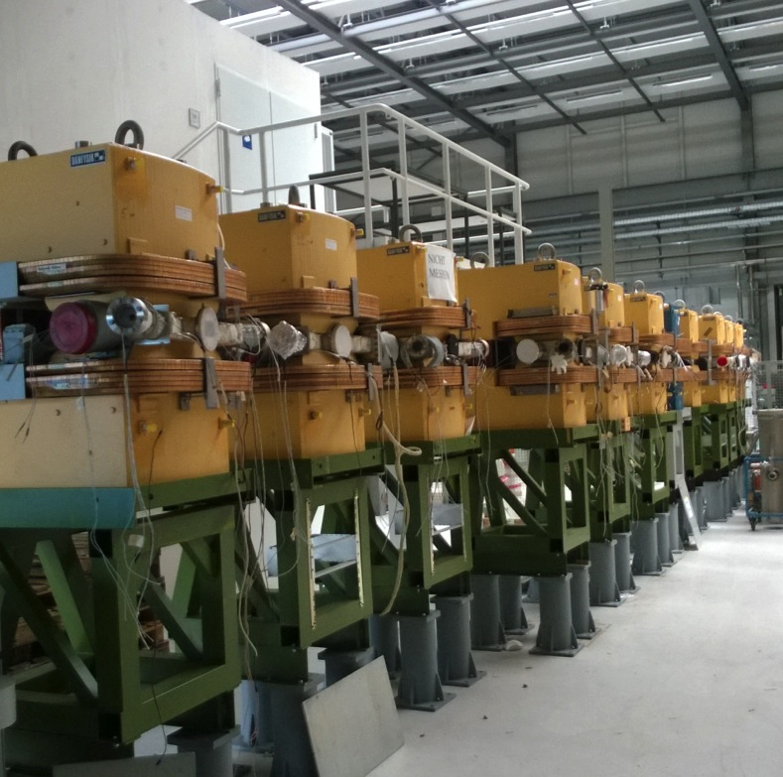
Component Preparation/Repair
Magnets
  Add supports
  Transfer measurements to
  prepare alignment
  Check cooling water flow
Electron Cooler
  Repair transport damage
  Check collector
  Prepare cryogenic test
Others
  Magnetic field measurements
  Adapt to safety rules
  Check heating jackets
  Test diagnostics (IPM, Trafos)
…

Slide 17
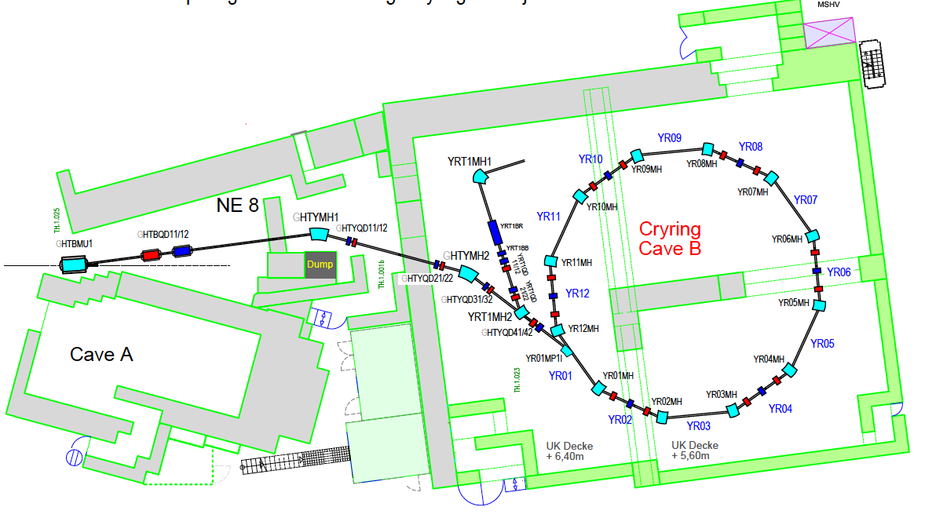
CRYRING @ ESR in “Cave B”
New, 1.44 Tm Beam Line
Modify Cave B

Slide 18
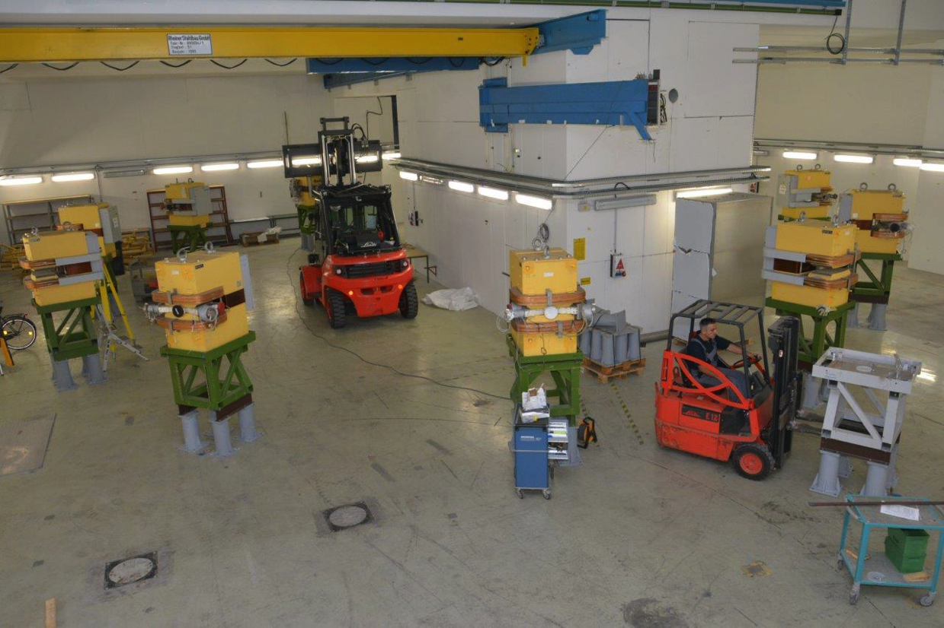
Dipoles installed

Slide 19
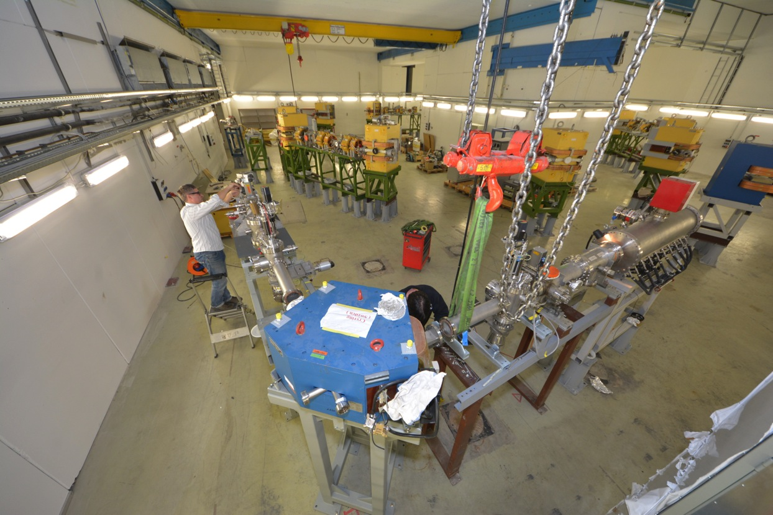
Local Injector being setup

Slide 20
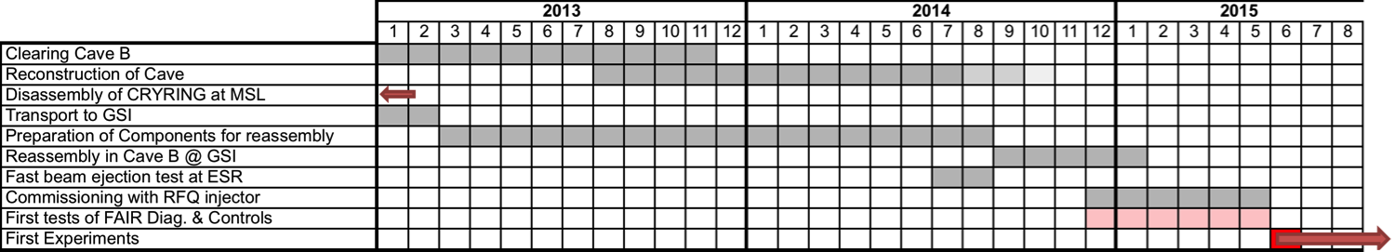
Timeline
Installation started
Continue Installation
Finish cave infrastructure, Install Power Converters
Control system and Diagnostics on track
Beam line ESR – CRYRING prepared

Slide 21
Slow, Heavy, Highly Charged Ions @ GSI/FAIR
400 MeV/u
400 MeV/u
UNILAC
SIS
Stripper
FRS
ESR
Slow, heavy, highly charged Ions … mostly stored but always well controlled
Energy range between 10 MeV/nucleon to sub eV/Ion
10⁵ to 10⁷ heavy, highly charged ions like U⁹¹⁺
Low energy antiprotons in the future
4 K
HITRAP
4 MeV/u
S-EBIT
4 MeV/u … 100 keV/u
CRYRING
10 MeV/u

Slide 22
Slow Antiprotons @ GSI/FAIR
29 GeV/u
? GeV/u
p-Linac
?
SIS100
Pbar Target
ESR
Slow, heavy, highly charged Ions … mostly stored but always well controlled
Energy range between 10 MeV/nucleon to sub eV/Ion
10⁵ to 10⁷ heavy, highly charged ions like U⁹¹⁺
Low energy antiprotons in the future
4 K
HITRAP
4 MeV/u
4 MeV/u … 100 keV/u
CRYRING
10 MeV/u
Beam lines connecting
HESR, CR, ESR under discussion

