Slide 1
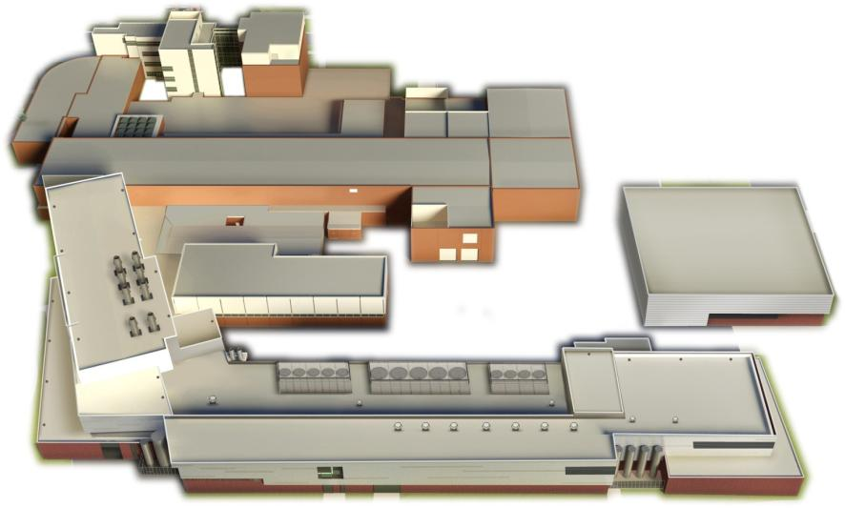


Facility for Rare Isotope Beams under Construction
Georg Bollen
Michigan State University

Slide 2
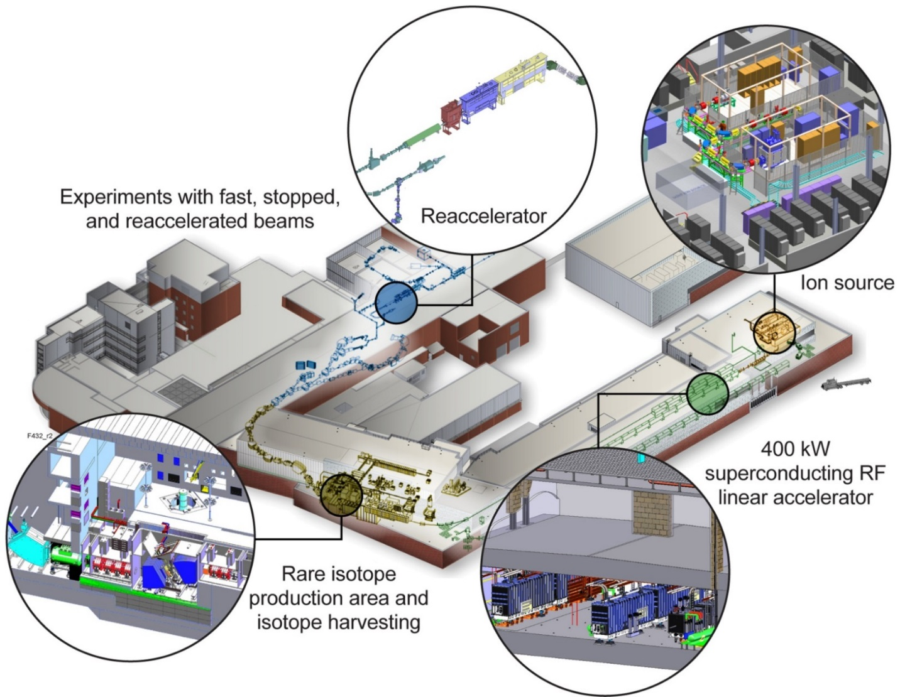
Outline
Facility for Rare Isotope Beams Overview and Science
FRIB Project Status
NSCL Integration
FRIB Users
Summary

Slide 3
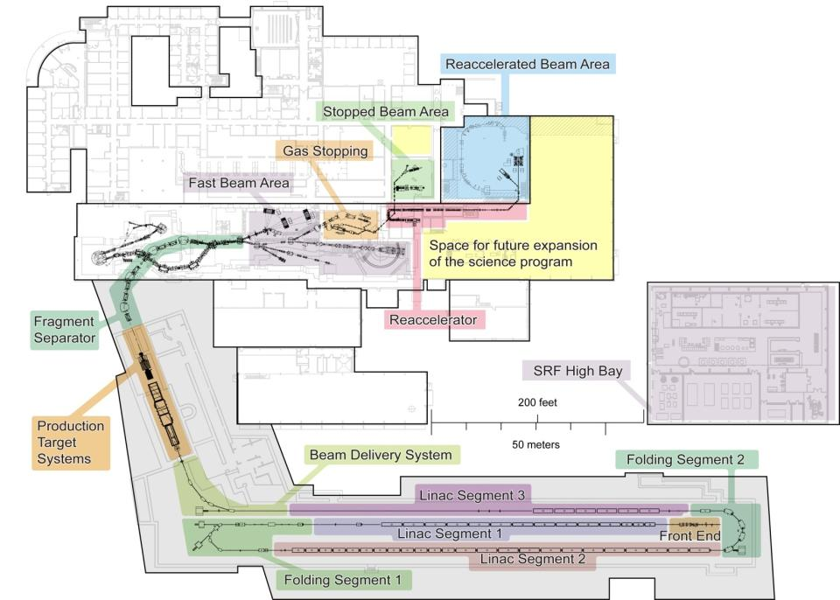
FRIB - Facility for Rare Isotope Beams
World-leading Next-generation Rare Isotope Beam Facility
Rare isotope production via in-flight technique with primary beams up to 400 kW, 200 MeV/u uranium
Fast, stopped, and re-
accelerated beam
capability
Upgrade options
  400 MeV/u for uranium
  ISOL production –
  multi-user capability
NSCL enables pre-FRIB science
NSCL
FRIB project start 6/2009
Civil construction started 3/2014
Technical construction started 10/2014
Managed to early completion 12/2020
CD-4 (project completion) 6/2022
Total project cost $730 million
FRIB
project

Slide 4


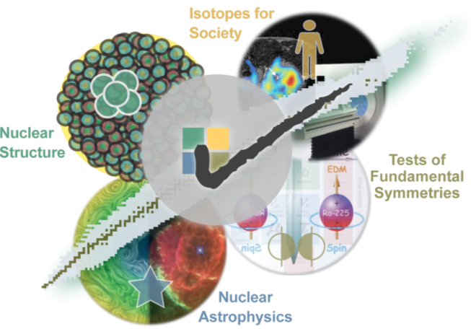


FRIB – Four Science Themes
Properties of nuclei
  Develop a predictive model of nuclei and their interactions
  Many-body quantum problem: intellectual overlap to mesoscopic
  science, quantum dots, atomic clusters, etc.
Astrophysical processes
  Origin of the elements in the cosmos
  Explosive environments: novae,
  supernovae, X-ray bursts …
  Properties of neutron stars
Tests of fundamental symmetries
  Effects of symmetry violations are
  amplified in certain nuclei
Societal applications and benefits
  Bio-medicine, energy, material
  sciences, national security

Slide 5
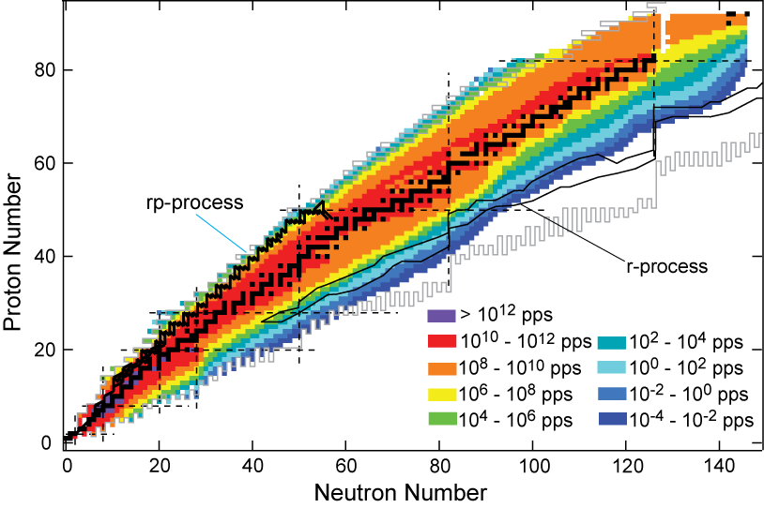
FRIB Rare Isotope Beam Rates
High Beam Rates to Maximize Science Reach
Fast beam rates
Rates are available at http://groups.nscl.msu.edu/frib/rates/

Slide 6
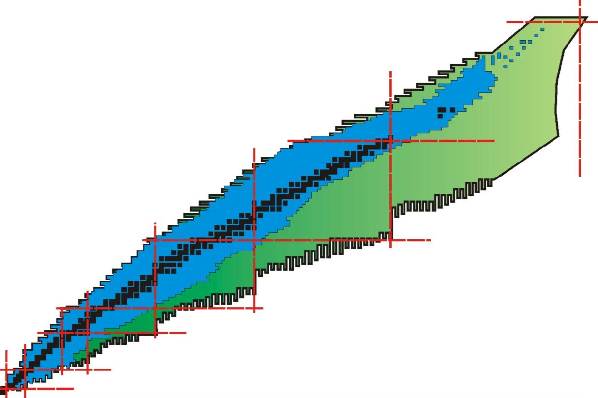
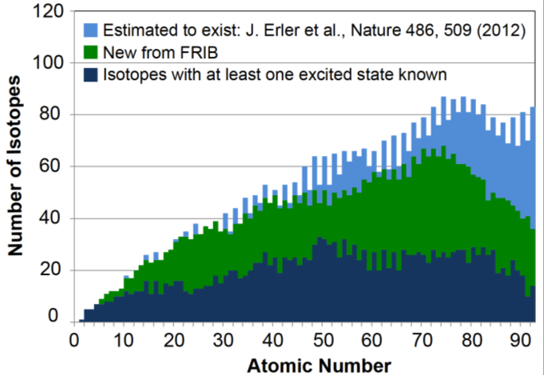
FRIB Beams Will Enable New Discoveries
Available today
New territory to be explored with FRIB
about 3000 known isotopes

Slide 7
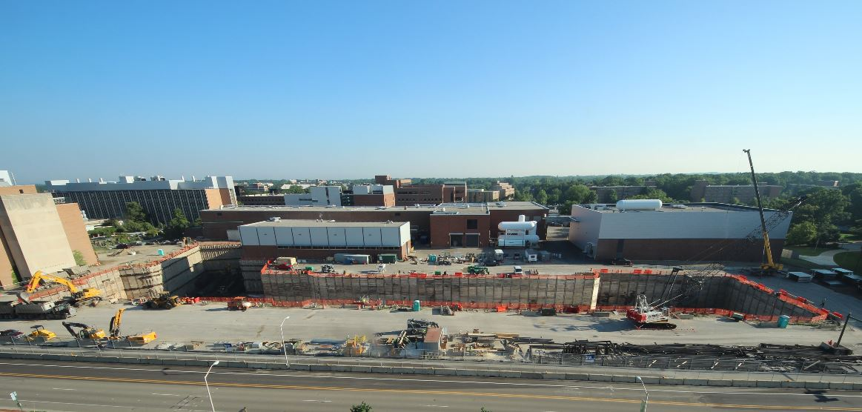
FRIB Civil Construction Underway
Began 3 March 2014
2012
6/2014
Web cameras at www.frib.msu.edu

Slide 8
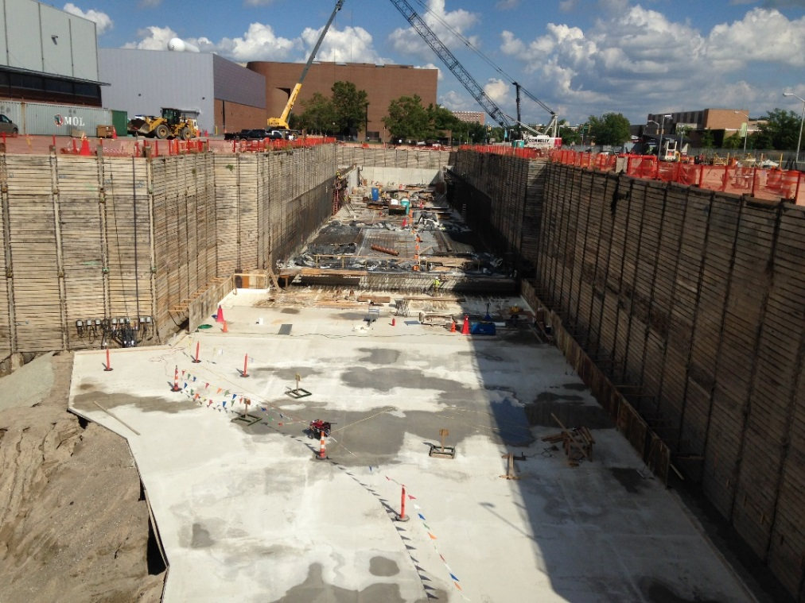
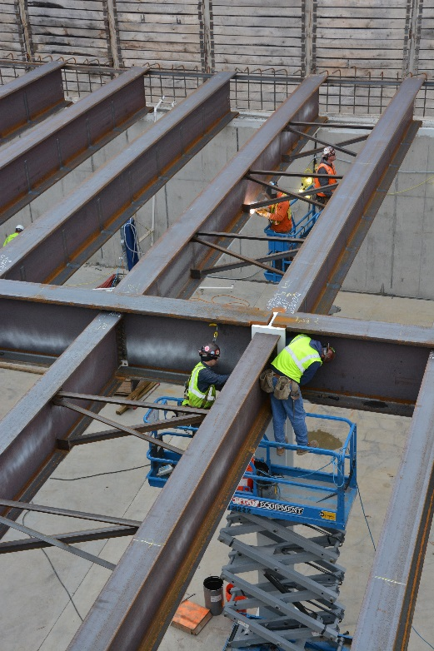
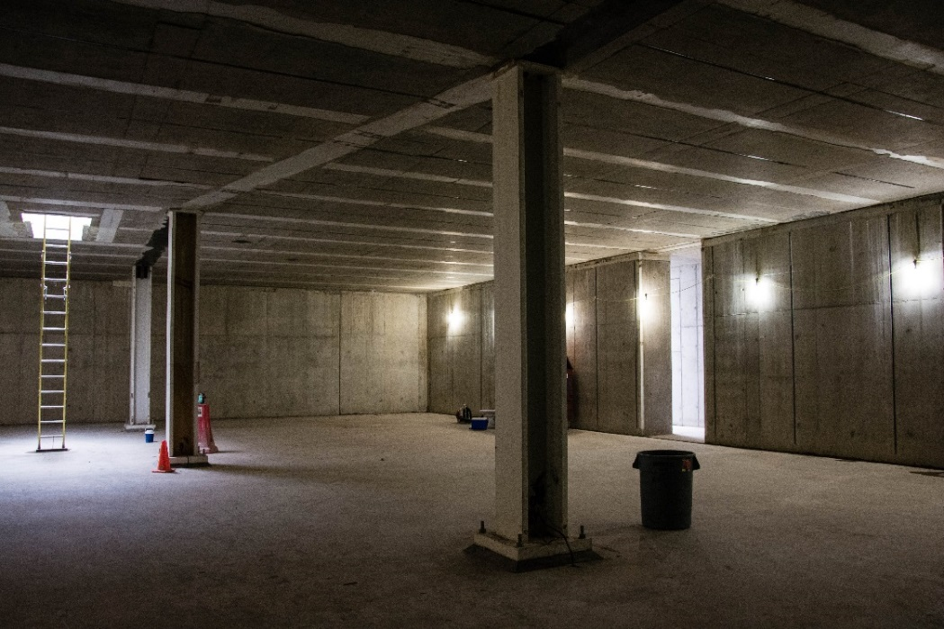
FRIB Civil Construction Underway
9 Weeks Ahead of Schedule
July 2014
Linac tunnel
East end lid complete
Dec 2014

Slide 9
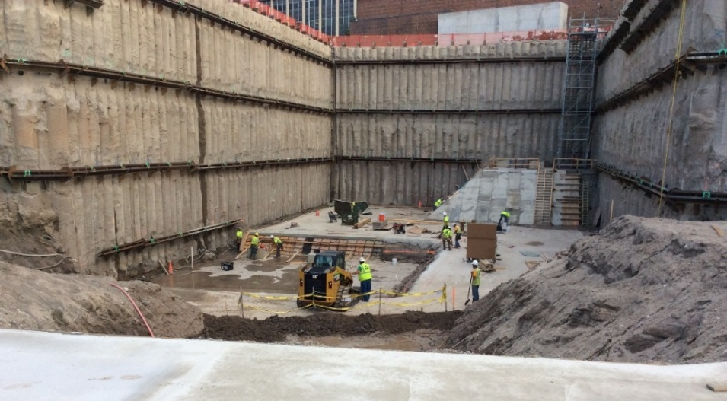
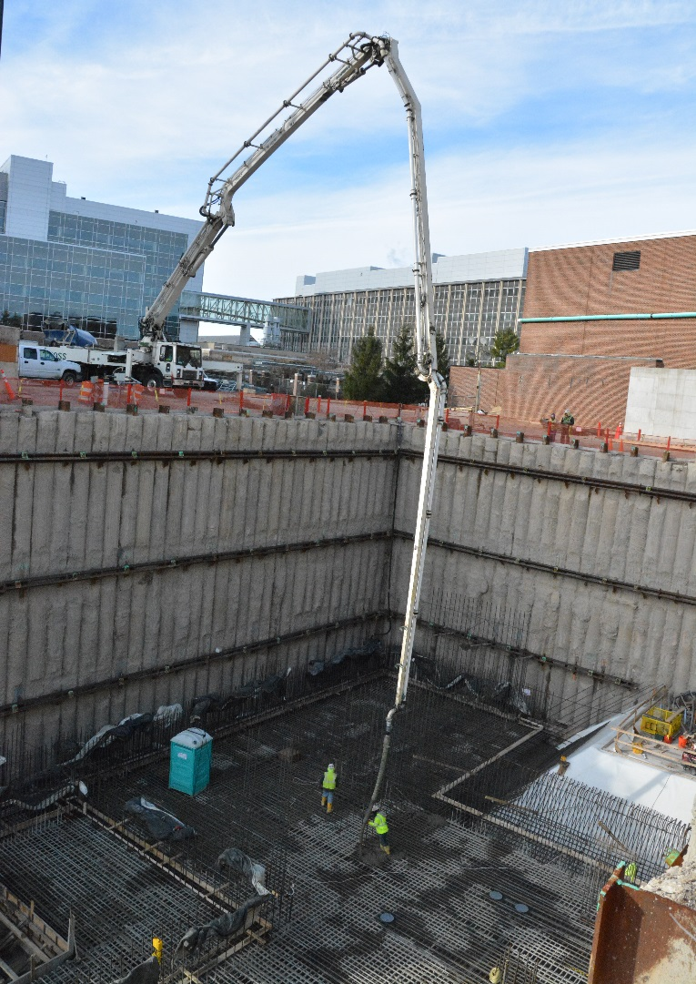
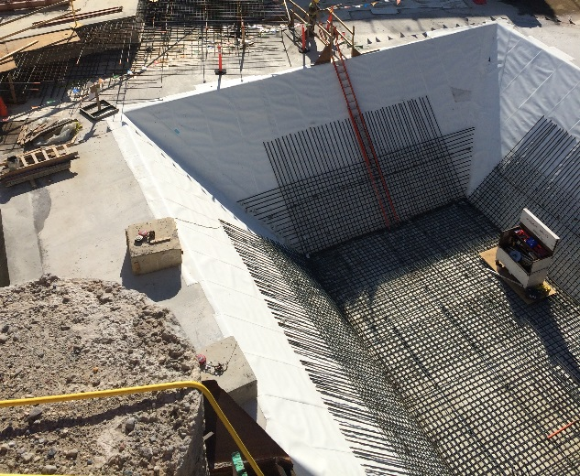
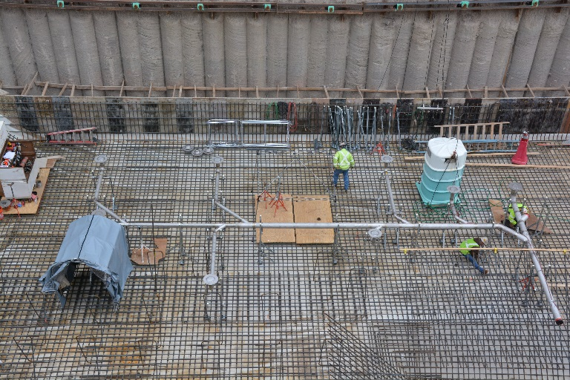
FRIB Civil Construction Underway
9 Weeks Ahead of Schedule
July 2014
Target facility
Dec 2014

Slide 10
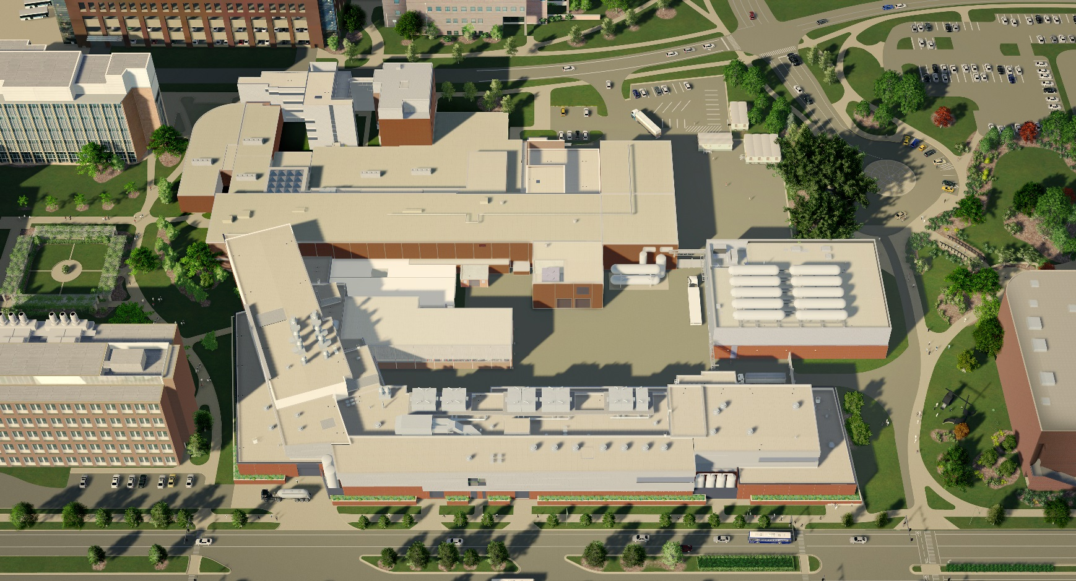
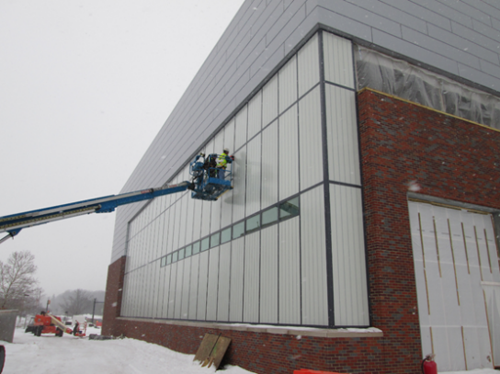
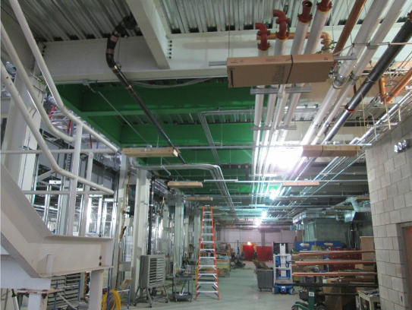
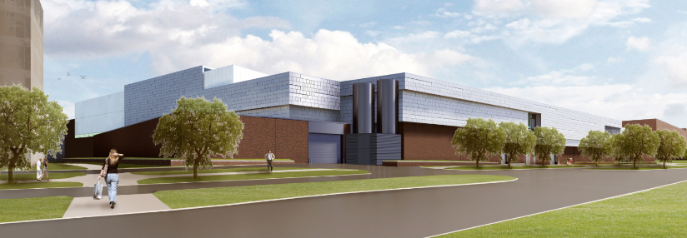
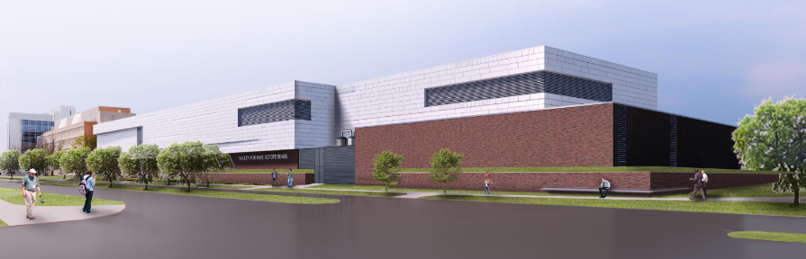
FRIB Construction Underway
SRF highbay
Existing NSCL
Target Facility
LINAC Building

Slide 11
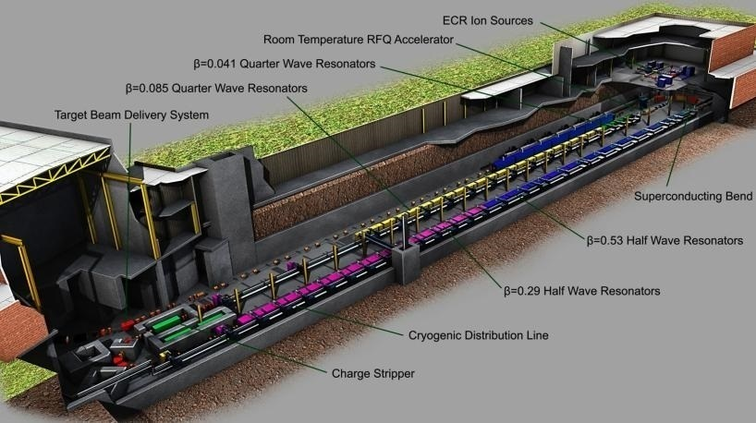
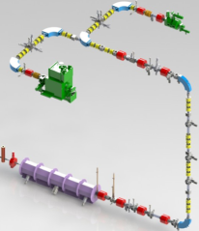
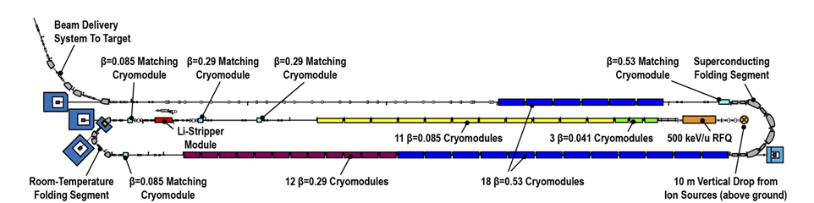
FRIB Accelerator Systems
Superconducting RF Driver Linac
Accelerate ion species up to ²³⁸U with energies of no less than 200 MeV/u
Provide beam power up to 400kW
Energy upgrade to 400 MeV/u for ²³⁸U by filling vacant slots with 12 SRF cryomodules
Provisions for ISOL upgrade

Slide 12
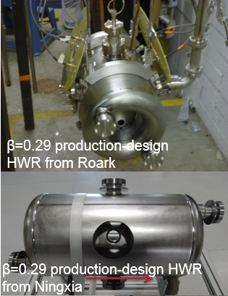
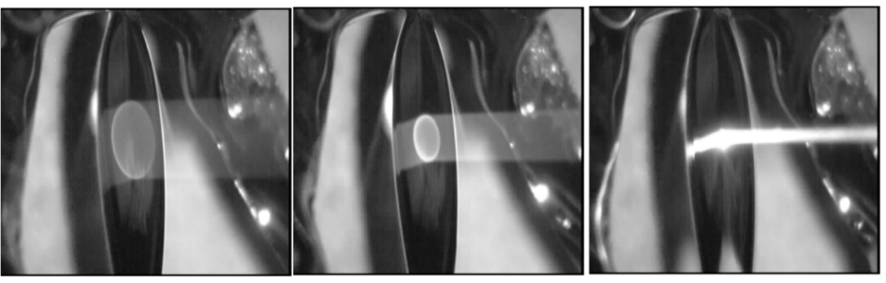
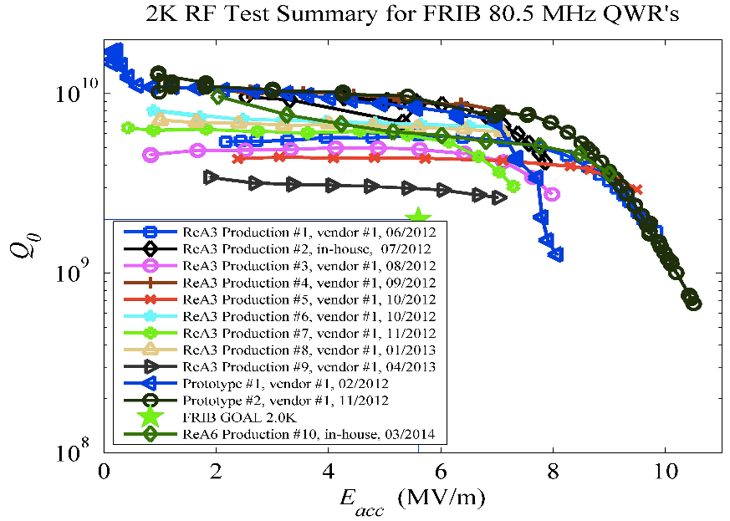
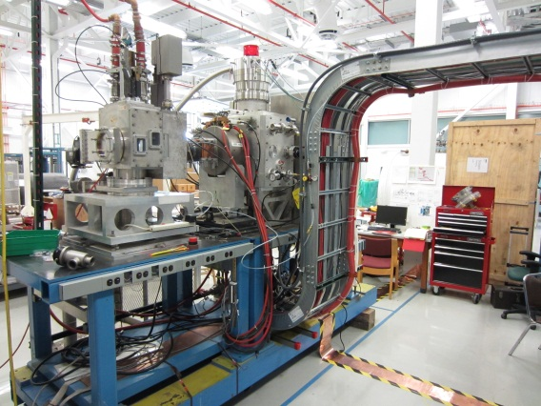


FRIB Accelerator Systems
Cavity preproduction and cryomodule prototyping
underway
  Cavities exceed FRIB performance goals
Charge stripping is technical challenge
  Liquid lithium charge stripping scheme validated
β=0.29 production-design HWR from vendor

Slide 13
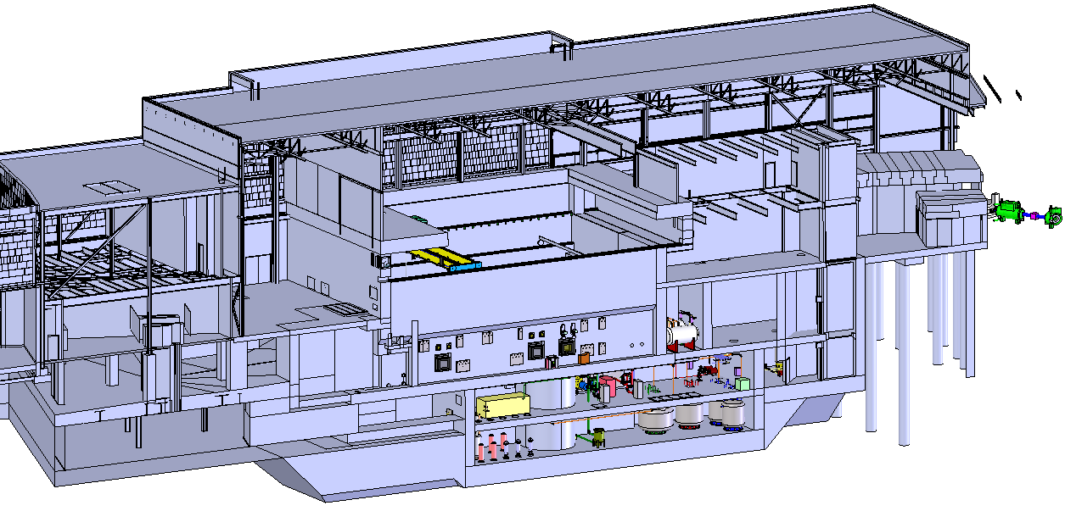
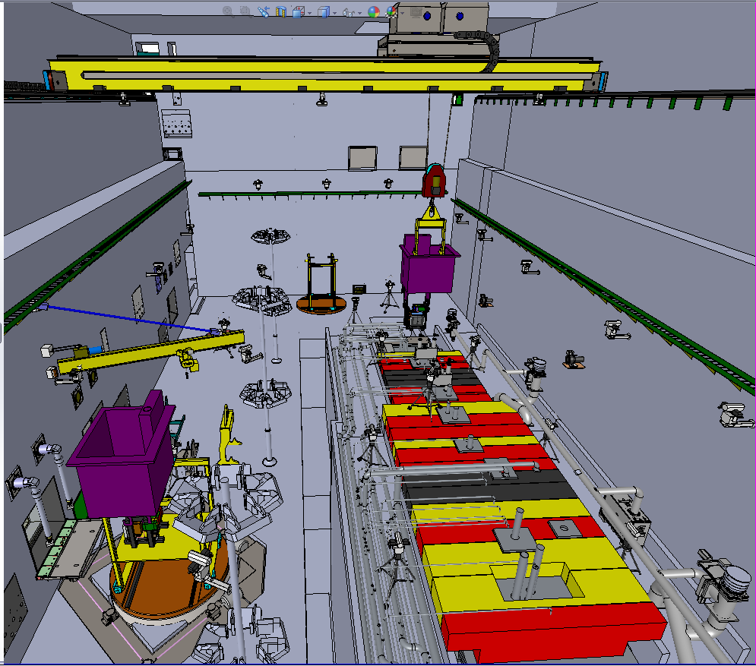
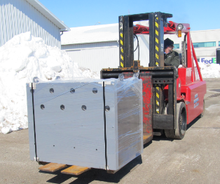
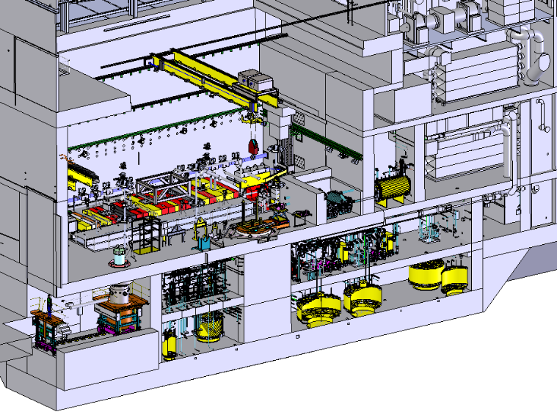
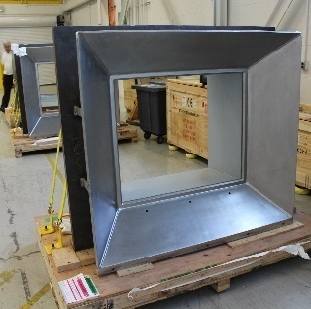

FRIB Rare Isotope Production Facility
Designed for 400 kW Operation
Accommodates first part of fragment separator with target and beam dump
Remote-handling of activated components (target change within 24 h)
Non-conventional utilities

Slide 14
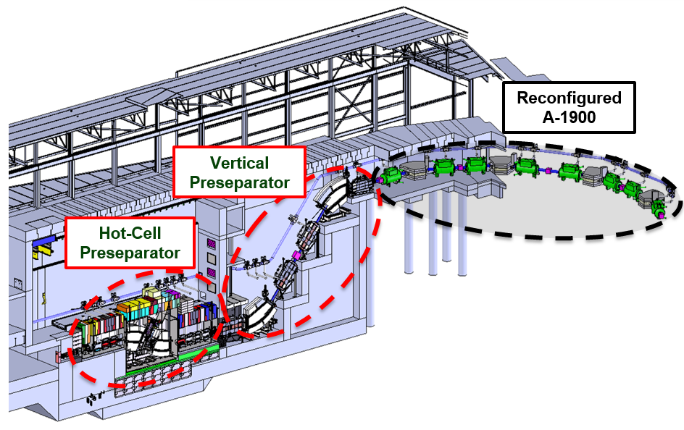
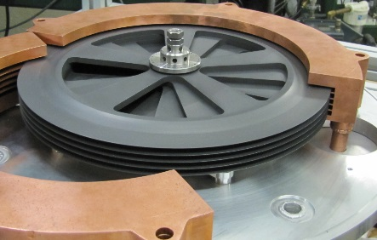
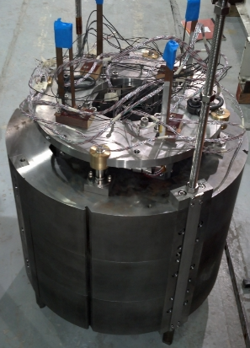
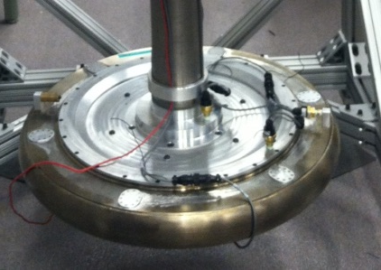

FRIB Fragment Separator
Three Separation Stages
Three stage magnetic fragment separator
  High acceptance, high resolution
  to maximize science
Multi-slice rotating graphite target
Radiation resistant magnets; example
HTS quad
Water-filled rotating beam dump
Final design substantially complete
Magnet fabrication to start early 2015

Slide 15
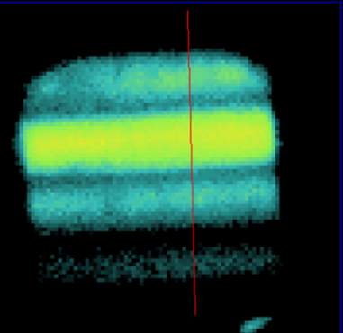
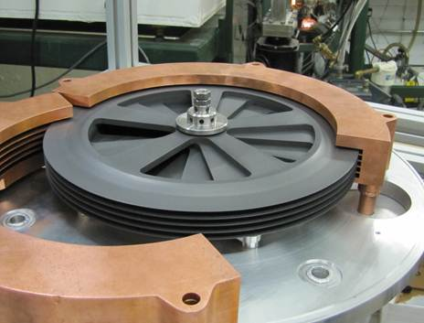
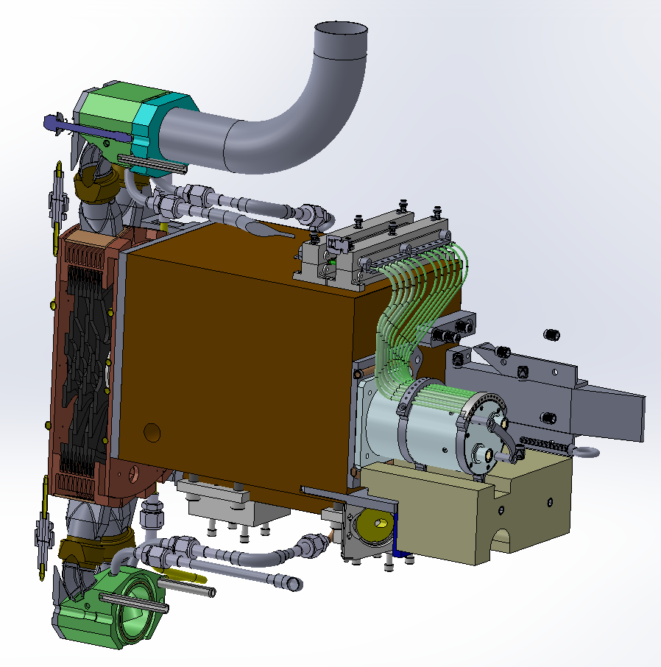
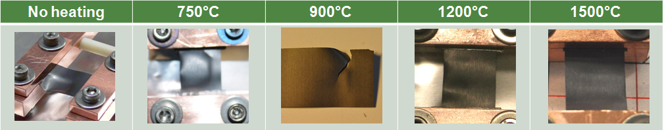
High-power Production Target
High-power Density Challenge Being Met
Production Target
  100 kW beam power loss
  1 mm beam spot → 60 MW/cm³ for ²³⁸U
  Desired lifetime of 2 weeks
Multi-slice rotating graphite target
  5000 rpm, 30 cm diameter
  T_{max} =1900 C, P_{max}/slice=10 kW
Target concept successfully validated
  High power electron beam tests at BINP
  Graphite heavy ion irradiation studies at GSI
Confirmed with additional material tests

Slide 16
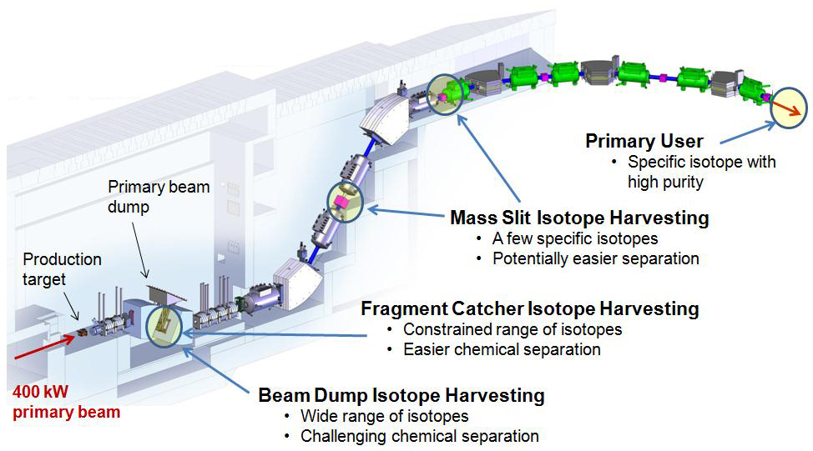
Isotope Harvesting Opportunity at FRIB
Make Best Use of Rare Isotopes Produced
Produce a rare isotope beam for a primary user, for example ²⁰⁰W from a ²³⁸U primary beam
At the same time up to 1000 other isotopes are produced that could be harvested and used for other experiments or applications in a commensal mode of operation
    1st workshop on “Isotope Harvesting at FRIB”, Santa Fe, 2010
    2nd workshop on “Isotope Harvesting at FRIB”,
    East Lansing, 2012
    3rd workshop on “Isotope Harvesting at FRIB”,
    St Louis, 2014
FRIB has provisions for isotope harvesting incorporated in the design

Slide 17
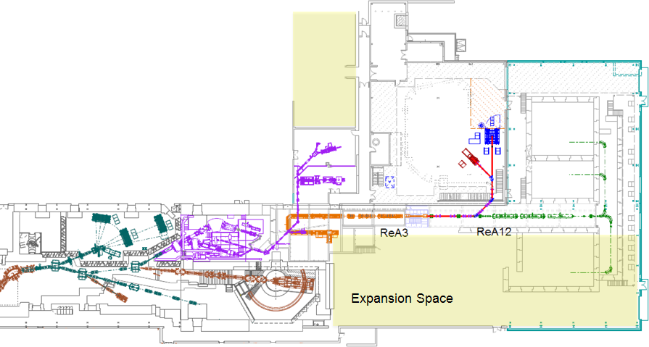
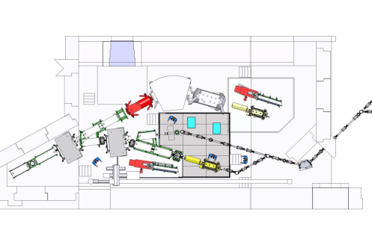
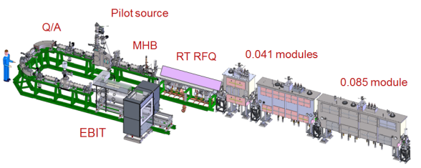
  NSCL Enables pre-FRIB Science
  Fast, Stopped, and Reaccelerated Beams
Beam Stopping
Experimental Areas,
Experimental
Equipment
Reacceleration
New Equipment Development Geared Towards FRIB

Slide 18
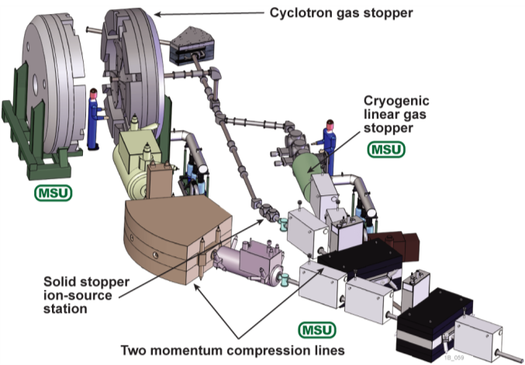
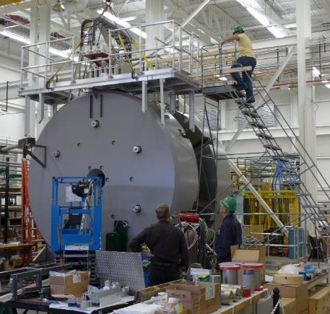
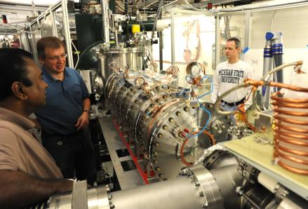

Stopped Beams
Multifaceted approach
  Linear gas stopper (heavier ion beams)
  Cyclotron gas stopper (lighter ion beams)
  Solid stopper (certain elements, highest
  intensity)
Beam stopping developments
  Linear gas catcher (ANL) operational (FRIB R&D)
  Cyclotron gas stopper construction advanced
  (NSF + MSU funded)
  Advanced Cryogenic Gas Stopper underway
  (NSF funded)
Experiments
  LEBIT
  BECOLA
  Double-arm positron
  polarimeter (under
  construction)
Notes:
Now let me talk about areas which are of major importance for FRIB but which are realized as contributions to FRIB.
Stopped beams are one of the pillars of FRIB but also one of the high priorities at the NSCL. Therefore we are in a very good shape and what you see here will be in place and tested well before FRIB comes into operation.
It includes ….
As an intermediate phase we will have 2 linear gas stoppers --- downselect

Slide 19
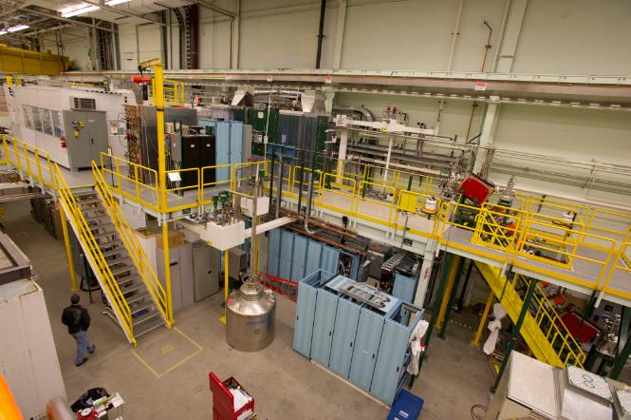
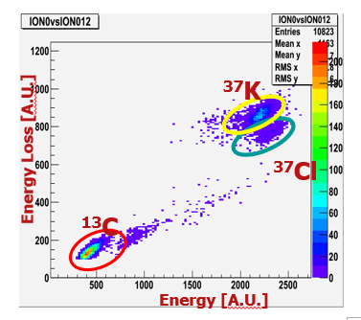
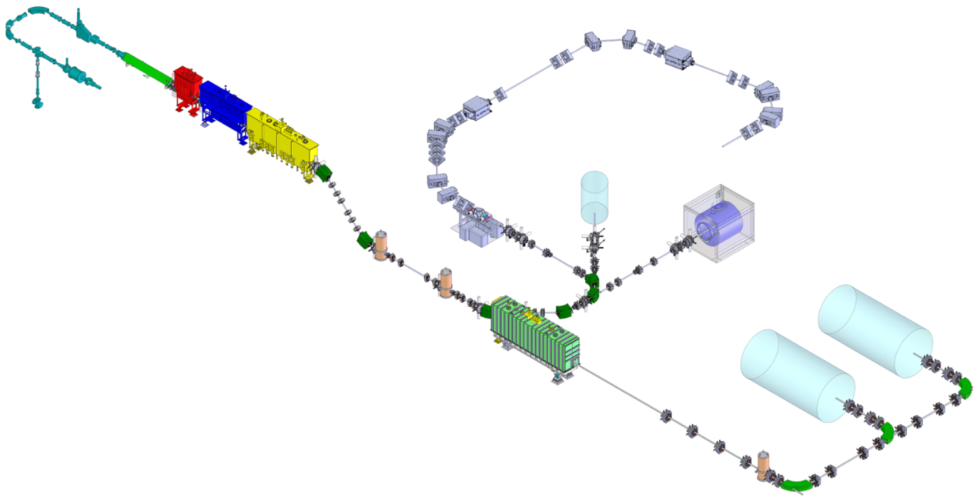


Reaccelerated Beams at NSCL and FRIB with ReA Facility
First radioactive beam experiment with ReA3 August 2013
RFQ
CM1
CM2
SECAR
CM3 (2014)
Stopped beam
ANASEN, SUN, LENDA, SeGA/CAESAR
EBIT CB
JENSA
AT-TPC, …
ANASEN Detector
ReA6
(development)
EBIT/S charge breeder
SRF linac
ReA3 – 3 MeV/u for ²³⁸U
Expandable to >12 MeV/u for ²³⁸U

Slide 20

Experimental Area Expansion and New Experimental Equipment
47,000 sq ft operational when FRIB starts, upgrade space of more than 60,000 sq ft
Experimental Equipment
  Equipment at NSCL (existing or under development): S800, SeGA, MoNA, MoNA-LISA, LENDA, NSCL-BCS, LEBIT, BECOLA, AT-TPC, CAESAR, SUN, ...
  Equipment available in the community and movable (existing, under development, or planned): GRETINA, ANASEN, CHICO, Nanoball, ORRUBA, JANUS, …
  Science driven new equipment developed by FRIB user community: SECAR, GRETA, HRS, ReA12 recoil separator, …

Slide 21


Over 1300 Users Engaged and Ready for Science
Users are organized as part of the independent
FRIB Users Organization (FRIBUO)
www.fribusers.org
FRIBUO has 1350 members (92 U.S. colleges
and universities, 10 national laboratories,
55 countries) as of April 2014
FRIBUO has 19 working groups on
experimental equipment
Low Energy Nuclear Physics Town Meeting and Nuclear Astrophysics Town Meeting, 21-23 August 2014, Texas A&M University
  Preparing input for next Nuclear Physics Long Range Plan
  Joint first resolution
The highest priority In low-energy nuclear physics and nuclear astrophysics is the timely completion of the Facility for Rare Isotope Beams and the initiation of its full science program
β=0.29 production-design HWR from vendor

Slide 22

Summary
FRIB to become a world-leading next-
generation facility for rare isotope science
  Highest-power heavy ion linac worldwide
  High-performance fragment separator
  Fast, stopped, and reaccelerated beams
  Provisions for isotope harvesting
FRIB project makes excellent progress
  Civil construction underway and ahead of schedule
  Technical construction started
NSCL enables pre-FRIB science
  Well tested and optimized experimental equipment when FRIB starts
Strong, growing, and committed FRIB user group in place

Slide 23

FRIB Team and Collaborators
FRIB Project
  FRIB Project Leader: T. Glasmacher
  Accelerator Systems: J. Wei
  Experimental Systems: G. Bollen
  Conventional Facilities: B. Bull
  + FRIB staff
FRIB Laboratory
  FRIB Laboratory Director: K. Gelbke
  FRIB Chief Scientist: W. Nazarewicz
  Associate Laboratory Director for Users: B. Sherrill
Collaborating Institutions
Budker Inst. of Nuclear Physics (Russia)
GANIL (France)
GSI (Germany)
INFN Legnaro (Italy)
KEK (Japan)
RIKEN (Japan)
Sandia
Soreq (Israel)
Tsinghua University & CAS (China)
TRIUMF (Canada)
Argonne National Laboratory
Brookhaven National Laboratory
Fermilab
Jefferson Laboratory
Lawrence Berkeley National Laboratory
Oak Ridge National Laboratory
Stanford National Accelerator Lab.

