Slide 1
Irradiated Si detectors simulation
Status and the next steps
20 November 2014
Vladimir Eremin, PTI
vladimir.eremin@cern.ch

Slide 2
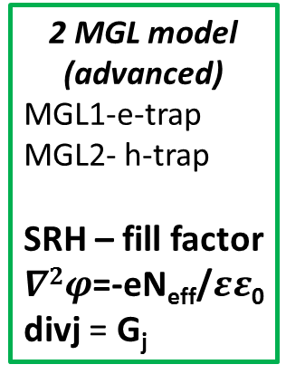
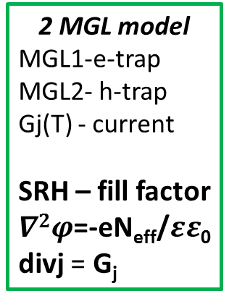
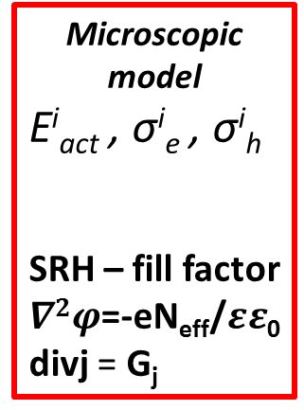

Detector simulation for low voltage operation
Basic strategy:
minimization of the amount of effective parameters
Conditions:
N_{DL} proportional to fluence
σ^{i}_{e} , σ^{i}_{h} – not affected by electric field
No impact ionization
2 MGL model
MGL1-e-trap
MGL2- h-trap
Gj(T) - current
SRH – fill factor
$∇2φ$=-eN_{eff}/$εε$₀
divj = G_{j}
2 MGL model
(advanced)
MGL1-e-trap
MGL2- h-trap
SRH – fill factor
$∇2φ$=-eN_{eff}/$εε$₀
divj = G_{j}
2+1 DL model
MGL1-e-trap
MGL2- h-trap
DL_{tr} - trapping
SRH – fill factor
$∇2φ$=-eN_{eff}/$εε$₀
divj = G_{j}
Microscopic model
E^{i}_{act} , σ^{i}_{e} , σ^{i}_{h}
SRH – fill factor
$∇2φ$=-eN_{eff}/$εε$₀
divj = G_{j}
E(x)[V,T,φ]
E(x)[V,T,φ]
E(x)[V,T,φ]
CCE[V,T,φ]
i(t)[V,T,F]
? ? ?

Slide 3
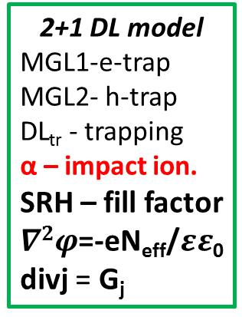
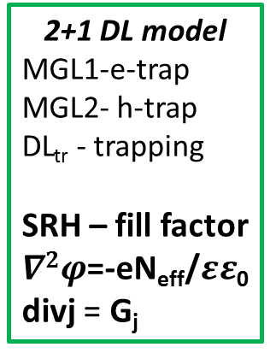
Detector simulation for high voltage operation
2+1 DL model
MGL1-e-trap
MGL2- h-trap
DL_{tr} - trapping
SRH – fill factor
$∇2φ$=-eN_{eff}/$εε$₀
divj = G_{j}
2+1 DL model
MGL1-e-trap
MGL2- h-trap
DL_{tr} - trapping
α – impact ion.
SRH – fill factor
$∇2φ$=-eN_{eff}/$εε$₀
divj = G_{j}
High voltage operation requires
switching on impact ionization.
For SYNOPSIS
Use α(E) as it is default
Simulate up to the high V
E(x)[V,T,φ]
CCE[V,T,φ]
i(t)[V,T,F]
E(x)[V,T,φ] ??
CCE[V,T,φ] ??
i(t)[V,T,F] ??

Slide 4
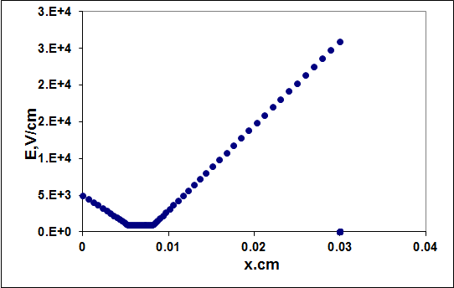
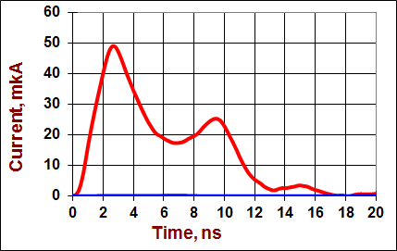
Experimental data for simulation proof
Classic TCT i(x) = 1*q(x)*v_{dr}(x); x=ʃv_{dr}(t) dt
Edge TCT i(t=0, x) = v_{dr}(x); V_{dr}(E) = f(E)
Example of comparison the Data from Ljubljana group
with simulation from PTI group

Slide 5
The main achievements and the future
Strategy based on minimization of effective parameters works
“on - going” steps
1. Comparison of simulated E(x) with the results of edge TCT
2. Extension of the advanced 2MGL model to high voltage detectors operation using
the default parameters of SYNOPSIS
CCE(F) modelling
The new subject – “Inter-strip resistance radiation hardness”
The simulation group is interested on edge TCT data for :
- modelling tools calibration
(non irradiated detectors)
- models development/proofs
(fluence and voltage dependences for irradiated detectors)
Timo Peltola will help to distribute the essential data for the cross-test modelling

