Slide 1

Topsil’s involvement in NitroSil project
Nitrogen impact on vacancy aggregation in silicon single crystals
Michał Kwestarz (PL), Jarosław Jabłoński (PL)
Theis Sveigaard (DK), Christian Hindrichsen (DK),
Leif Jensen (DK)
(PL) Topsil Semiconductor Materials SA, 133, Wolczynska St., 01-919 Warsaw
(DK) Topsil Semiconductor Materials A/S, Siliciumvej 1, 600 Frederikssund
25th RD50 WORKSHOP, CERN GENEVA, Nov. 19-21 2014
www.nitrosil.com

Slide 2
OUTLINE
Introduction to Topsil’s products
  Topsil in brief
  Applications, capabilities
Effect of nitrogen on the properties of Si single crystals
NitroSil project
  Scope
  Topsil’s and ITME’s assignments
Summary

Slide 3
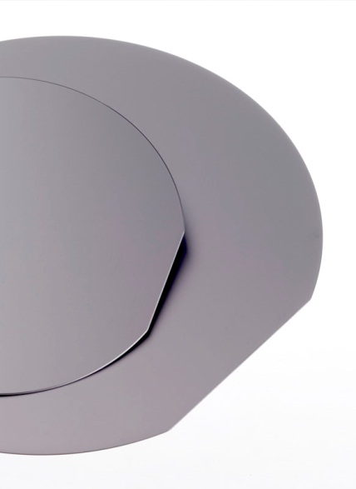
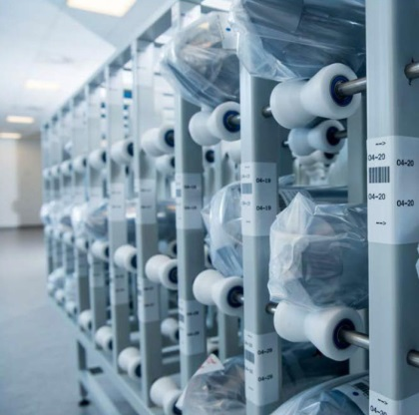
MANUFACTURER OF HIGH PURITY SILICON WAFERS
Specialized manufacturer of ultrapure silicon wafers to the global semiconductor industry
Focus on premium quality silicon for the most demanding purposes
Strong in-house silicon competencies and knowledge base - close cooperation with universities and research institutions world wide
State-of-art technology, facilities and equipment
Long track record, est. 1959 - long term customer relations
Staff of 350 people, turnover of $58 million (2013)

Slide 4
APPLICATIONS,
PRODUCT CAPABILITIES

Slide 5
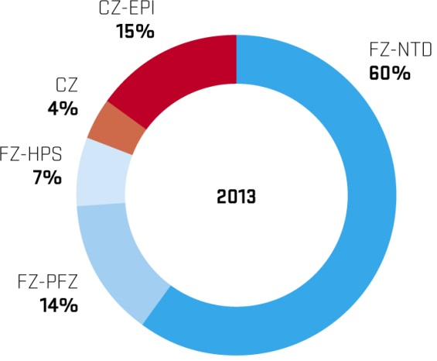
PRODUCT RANGE
Main products for power devices
NTD: Neutron Transmutation Doped float zone silicon for high power devices
PFZ: Preferred float zone silicon for power applications
CZ EPI: EPI coated Czochralski silicon for medium and low power devises
Specialty products:
HPS High Resistivity silicon for detector applications
UHPS Uniform High Purity silicon for silicon drift detectors
HiRes® High Resistivity silicon for communication devises
HiTran® High Transparency silicon for infra red applications
PV-FZ® Photo Voltaic Float Zone for high efficiency solar cells
GaN Silicon wafers for GaN thin film growth

Slide 6



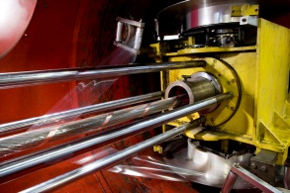
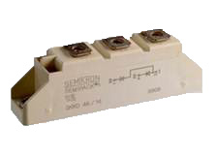




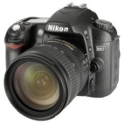
PRODUCTS, APPLICATIONS
8.5 kV
NTD
3.0 kV
PFZ
1.2 kV
CZ-EPI
Courtesy of Toyota hybrid
600V
CZ
5V
Production method, voltage overlap

Slide 7
BASIC PRODUCT CAPABILITIES ≤ 150 MM.
 | Float Zone | Czochralski
Diameter (mm): | 76.2 - 153 | 76.2 - 153
Orientation: | <1-1-1> or <1-0-0> | <1-1-1> , <1-0-0> <1-1-0>
Doping: | n-type (Phosphorous) p-type (Boron) | n-type (Phosphorous) p-type (Boron) Arsenic, Antimony
Oxygen (atm. -3): | 2.0 x 10¹⁶ | 1.0 x 10¹⁸
Resistivity (ohmcm): | HPS 3,500 → 30,000 NTD 20 → 4,000 PFZ 1 → 300 PV-FZ 0.5 → 10 | Epi 0.2 → 70 (Si:As substrate) Epi 0.1 → 80 (Si:B substrate) Higher epi res. on request Cz 0.001 → 60 resistivities
Wafer: | Etched Single side polished Double side polished | Single side polished Double side polished EPI Wafer

Slide 8
FZ 200 MM. PRODUCT CAPABILITIES
PRODUCT KEY PARAMETERS
 | NTD | PFZ | High resistivity material: HiRES®/HPS
Orientation: | <1-0-0> | <1-0-0> | <1-0-0>
Doping: | n-type (Phosphorous) | n-type (Phosphorous) p-type (Boron) | n-type (Phosphorous) p-type (Boron)
Oxygen atoms/cm³ | < 2.0 x 10¹⁶ | < 2.0 x 10¹⁶ | < 2.0 x 10¹⁶
Metals E10 atoms/cm² | < 2 | < 2 | < 2
Resistivity (ohmcm): | 20 – 800 | 20 – 100 | 3.500 – 30.000
Resistivity Tolerance % | < 7% | < 10% | < 50% *
RRV% | < 7% | < 14% | < 60% *
* Tolerances depending on resistivity target, test pattern and type

Slide 9
Effect of nitrogen on the properties of Si single crystals

Slide 10
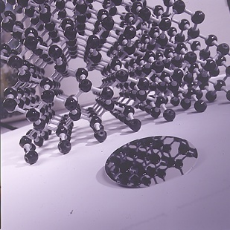
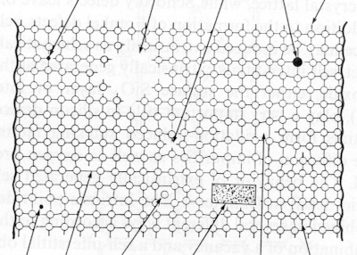
As-grown defects in Si single crystal
Perfect crystal
Non-perfect crystal
Substitutional impurity
Single vacancy
Substitutional
impurity
Vacancy cluster
Interstitial
impurity
Silicon
Interstitial
Precipitate
Edge
dislocation
Dislocation loop
Notes:
Vacancy cluster = Vacancy aggregate

Slide 11
Nitrogen impact on microdefects
V. Voronkov et al. Solid State Phenomena Vols. 131-133 (2008) pp 219-224
Doping of silicon crystals with nitrogen has an effect on the properties of grown-in microdefects
In Si crystals vacancies are agglomerated into voids (the voids are revealed by chemical etching as flow pattern effects)
The void nucleation in FZ crystals occurs at temperature around 1000 ºC
The voids density is at 10⁵ – 10⁷ cm ⁻³
The void may include 10³ - 10⁵ vacancies

Slide 12
Nitrogen atoms in Si lattice
N_{i}N_{i} dimer
two split-interstitials
N_{i}N_{s} pair
N_{s} + split-interstitial
R. Jones et all. Solid State Phenomena 93, (2004) 95-96
Notes:
Nitrogen dimers are dominant

Slide 13
Nitrogen atoms in Si lattice
FTIR Spectra of nitrogen dimer in Si
Courtesy of Barbara Surma ITME
Notes:
Two main lattice vibration modes characteristic for nitrogen pairs in Si.
Experimentally, it was found that, in as grown silicon, nitrogen exists as an N–N pair with a diffusivity three orders of magnitude higher as compared to oxygen at 1100 centigrade. On base of peak height the Nitrogen concentration is calculated.

Slide 14
Nitrogen atoms in Si lattice
Courtesy of Barbara Surma ITME
The nitrogen concentration is determined from the height of the absorption peak at 963 cm⁻¹
using the following calibration formula
[nitrogen concentration [at/cm⁻³] ] = 1.83 +/- 0.24 ) x 10¹⁷ x (absorption coefficient)
Itoh Y et al. Appl. Phys. Lett. 47 (1995) 488-489
Notes:
Two main lattice vibration modes characteristic for nitrogen pairs in Si.

Slide 15
Nitrogen atoms in Si lattice
T. Itoh and T. Abe Appl. Phys. Lett 53 (1988) p39-41
Diffusion coefficient of nitrogen N-N pairs is given by
D=2.7x10³ exp (-2.8 eV/kT) cm³/s
1200 ºC
1100 ºC
1000 ºC
900 ºC
800 ºC
700 ºC
D [cm³/s]
Notes:
TExperimentally, it was found that, in as grown silicon, nitrogen exists as an N–N pair with a diffusivity three orders of magnitude higher as compared to oxygen at 1100 centigrade. On base of peak height the Nitrogen concentration is calculated.
Hi diffusion coefficient is responsible that N-N pairs play role in suppressing excessive silicon interstitials and excessive vacancies in cooling process after the crystal growth.

Slide 16
Nitrogen atoms in Si lattice
W. von Ammon et al. Journal of Crystal Growth 226 (2001) 19–30
N-N pairs are stable up to 1270 °C
Interaction of N-N pairs rather than single nitrogen atoms with vacancies leads to suppression of vacancy aggregation
The following reactions are proposed to be responsible for vacancy annihilation:
(1) I+V 0
(2) 2N_{i} N₂
(3) N_{s}+N_{i} N₂V
(4) N₂+V N₂V
(5) N₂V+I N₂
Notes:
The mechanism which suppreses vacancy aggregates as proposed by Ammon is given by presented equations. This are main reactiors: in the first one the nitrogen dimer captures a vacancy and forms a complex and in the second one the complex reaacts with silicon interstitial releasing the nitrogen pair. As a result the vacancy and interstitial dessapeares.

Slide 17
NitroSil project scope

Slide 18
NitroSil
Topsil and Polish Institute of Electronic Materials Technology (ITME) have teamed up in a scientific project scoped to gain additional insight into nitrogen behavior in float zone silicon. Under the name
of NitroSil, the project is to further investigate nitrogen doping float zone technology and provide a better understanding of nitrogen behavior
in this type of material.
The ultimate goal for the research project is to - in the future -
be able to introduce nitrogen enriched float zone silicon for high - energy particle detectors with increased radiation hardness.
Notes:
Topsil and ITME have teamed up in a scientific project to study and find out if described mechanism is also valid in case of irradiated silicon.

Slide 19
Topsil assignments
Development of FZ Si:N technology
Doping with nitrogen above 1E15 cm⁻³
Making and delivering the high-res standard FZ Si single crystals and nitrogen-enriched single crystals (FZ Si:N)
Thin wafer technology improvement
Making and delivering wafers with low nitrogen concentration and high nitrogen concentration for studies at ITME
Performing temperature/resistivity stability experiments
Notes:
These tasks constitute coherent set of actions comprising industrial studies aimed at achieving of assumed targets. The studies are dealing with all the main technological processes related to fabrication of particle detectors with increased radiation resistance, namely, production of nitrogen enriched high-resistivity silicon crystals, production of nitrogen enriched, thin silicon wafers and fabrication of particle detectors, active region of which is enriched with nitrogen.

Slide 20
ITME assignments with collaboration with KiT and CiS
Determination of nitrogen, oxygen and carbon concentrations
Proton irradiation and study of the radiation defect centers properties
Fabrication, irradiation and studies of radiation defect centers in detector structures
Standard FZ Si and FZ Si:N comparative studies
Notes:
These tasks constitute coherent set of actions comprising industrial studies aimed at achieving of assumed targets. The studies are dealing with all the main technological processes related to fabrication of particle detectors with increased radiation resistance, namely, production of nitrogen enriched high-resistivity silicon crystals, production of nitrogen enriched, thin silicon wafers and fabrication of particle detectors, active region of which is enriched with nitrogen.

Slide 21
Summary

Slide 22
Summary and Conclusion
The mechanism of nitrogen role in suppressing of microdefects formed by vacancies aggregates arising in cooling process of FZ:Si crystals has been presented. We expect that similar effect will occur in the case of irradiation induced vacancy aggregates. The latter will be verified by the studies carried out within the framework of NitroSil project.
After finalizing the project the new Topsil’s product: nitrogen enriched high resistivity FZ silicon wafers will be introduced on the marked of semiconductor materials.
New product is aimed at meeting the long waiting need for radiation hard particle detectors.
Notes:
To sum up: we expect that the effect of nitrogen will occure in the case of irradiation induced vacancy aggregetes. If the result is positive Topsil’s product family will be enlarged with new kind, nitrogen enriched wafers for fabricatation of particle detectors. (~2017)

Slide 23
Acknowledgements
This work has been partially supported by the Polish Centre for Research and Development within the framework of the NitroSil project (ID: 208346) financed by the Program for Applied Research (Contract No. PBS2 / A9 / 26/2014).
www.nitrosil.com
Thank you for your attention

Slide 24
DISCLAIMER
This document has been prepared by Topsil Semiconductor Materials A/S.
Unless stated in this document the following shall apply to the information.
The information, in particular the figures, data and schedules, are preliminary and for discussion purposes only. We do not represent that such information is true, accurate or complete and it should not be relied upon as such. No independent verification exercise has been undertaken in respect of the information.
All information, opinions and estimates in this document are Topsil Semiconductor Materials A/S judgment as at the date of this document and are subject to change without notice. While this information has been prepared in good faith, no representation or warranty, expressed or implied, is made.
The information in this document is supplied on the condition that Topsil Semiconductor Materials A/S, and any related party or employee of Topsil Semiconductor Materials A/S, are not liable for any error or inaccuracy, whether negligently caused or otherwise, or for any loss or damage suffered by any person due to such an error, omission or inaccuracy as a result of such supply.

Slide 25
THANK YOU
MICHAEL KWESTARZ
NitroSil Project Coordinator
Phone: +48 22 835 19 39
Fax: +48 22 865 77 35
E-mail: mk@topsil.com
Topsil Semiconductor Materials SA
133 Wolczynska
01 – 919 Warsaw, Poland
Topsil Semiconductor Materials A/S
Siliciumvej 1
DK-3600 Frederikssund, Denmark

