Slide 1


Design and Fabrication of an Optimal Peripheral Region for the LGAD
Pablo Fernández-Martínez, D. Flores, V. Greco, S. Hidalgo, A. Merlos, G. Pellegrini and D. Quirion
IMB-CNM (CSIC), Barcelona (Spain)
This work is supported by RD50 Collaboration

Slide 2
Talk Outline
Critical aspects of the LGAD design
Optimization of the multiplication junction
Optimization of the junction edge termination
Optimization of the periphery
New production run
Conclusions

Slide 3
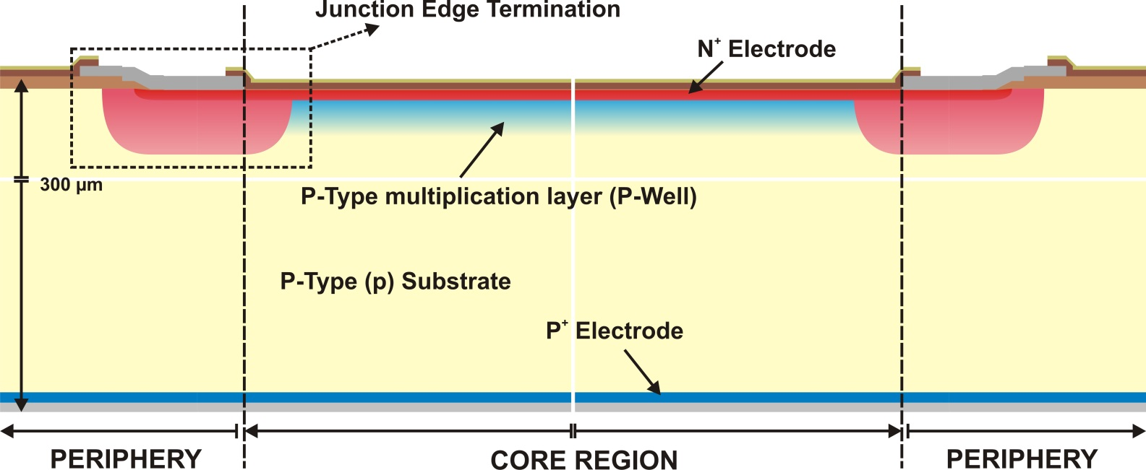
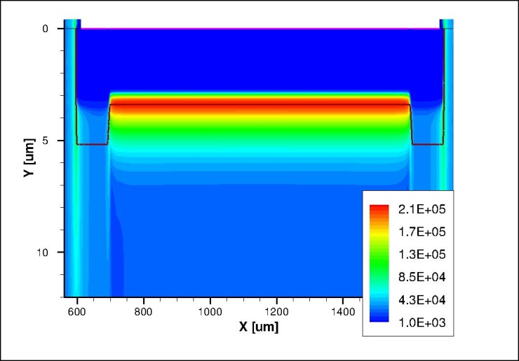

Critical aspects of the LGAD design
Electric Field @ 400 V
N⁺
P
Core Region → Uniform electric field, high enough to activate mechanism of impact ionization (multiplication)
Termination → High electric field confined in the core region
Periphery → (Dead region) Charges should not be collected. Reduction of the leakage currents
π
$$V_{BD}|_{Termination}≫V_{BD}|_{Central}$$

Slide 4
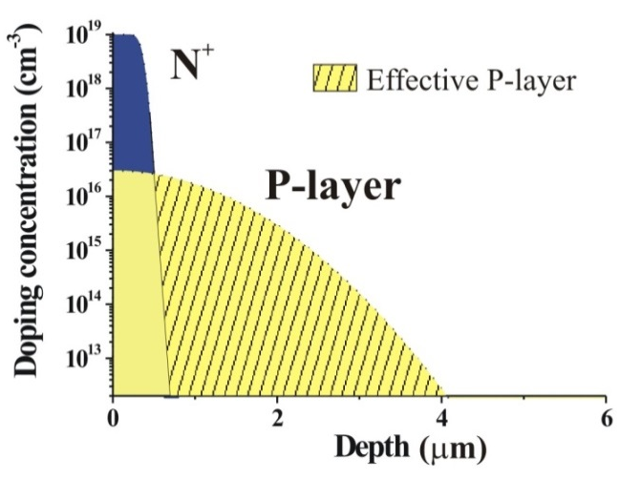
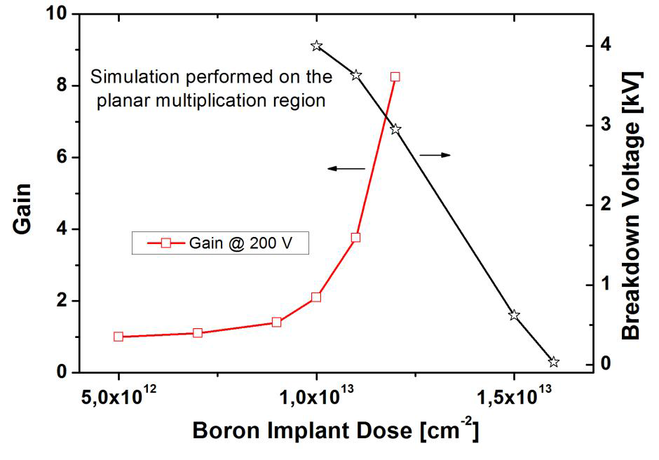
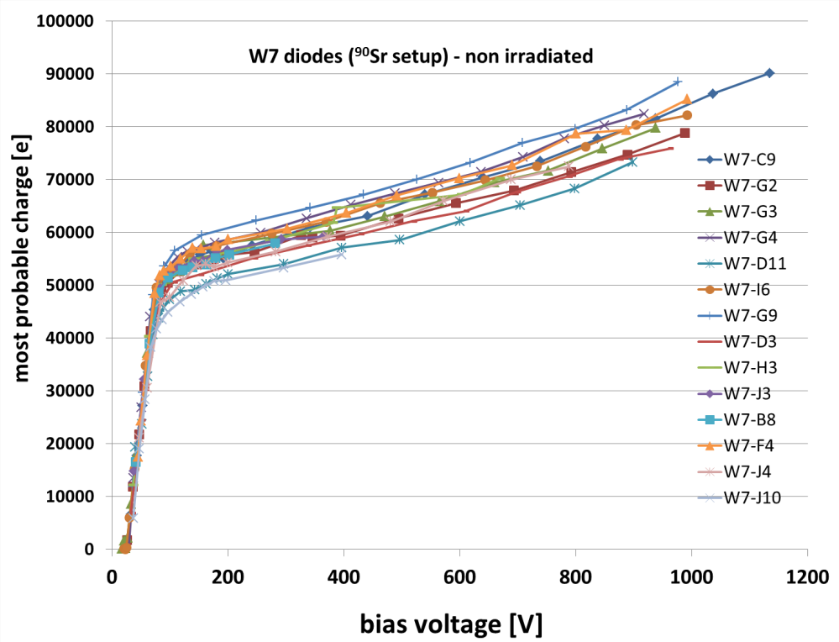
Core region: Optimization of the Multiplication layer
Doping profile of the P and N⁺ diffusions is crucial
Run 6474
Wafers have different gains:
  Good uniformity of gain over the wafer.
Gain = 2÷4

Slide 5
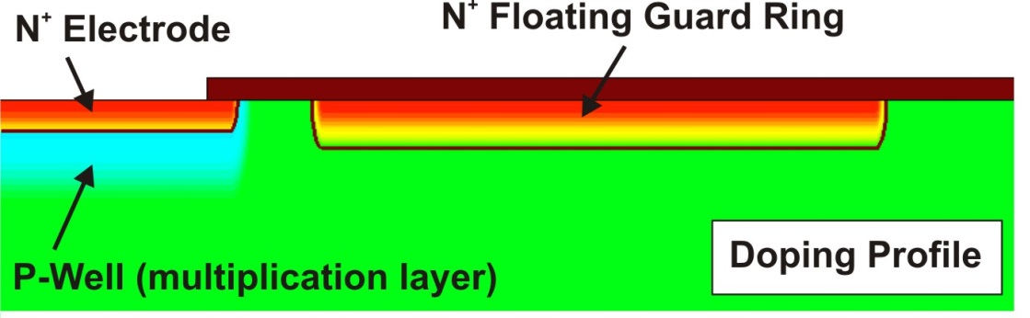
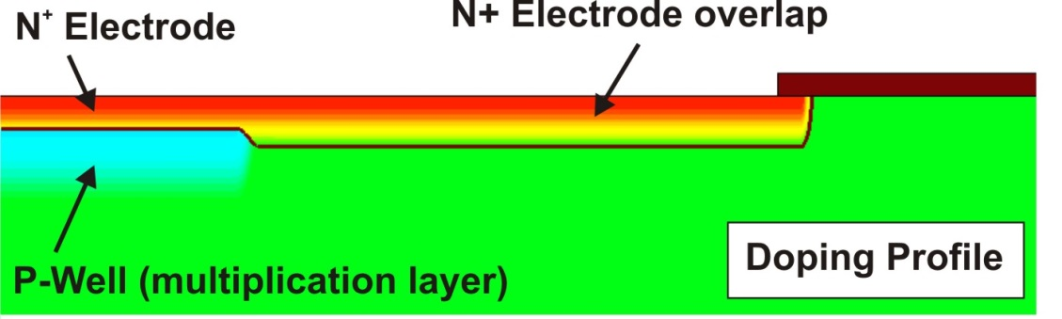
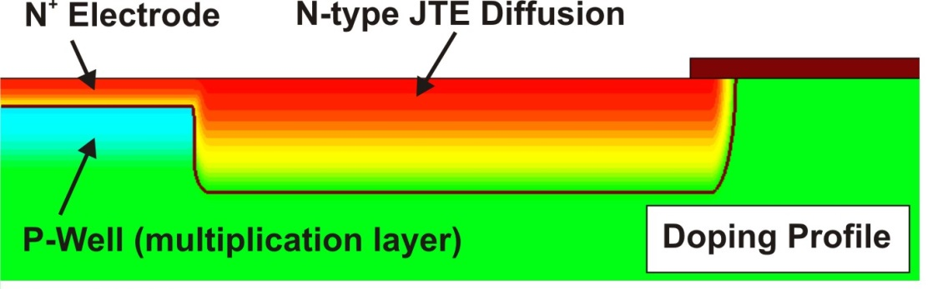
Optimization of the Junction Edge Termination
Three Requirements:
  V_{BD_Core(1D)} < V_{BD_Termination}
  Electric Field Uniformity
  Compatible with segmentation
3 Designs have been analyzed
Notes:
En esta tesis se han evaluado tres estrategias para implementar la terminación.

Slide 6

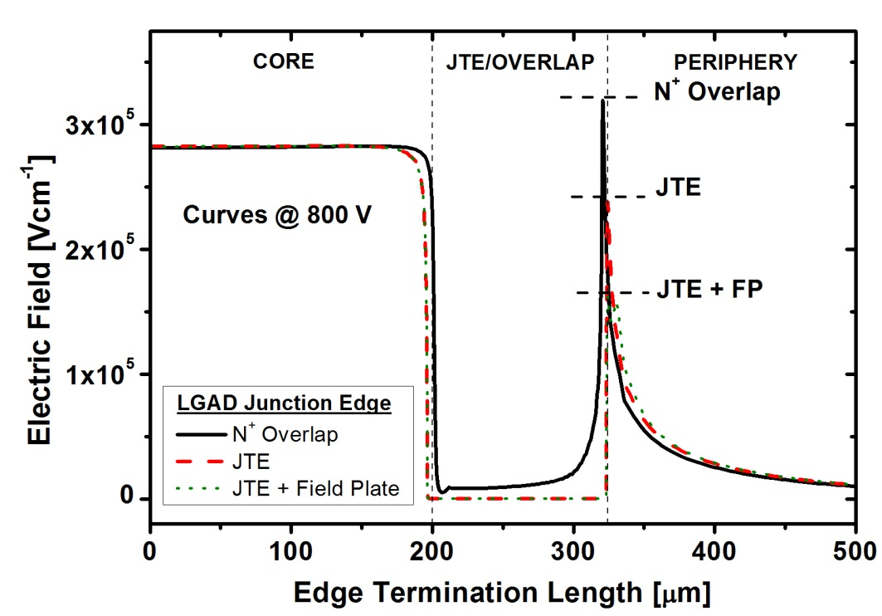
Junction Edge Termination: Deep N-type diffusion
  The electric field peak is reduced at the JTE curvature
  The highest electric field value is located at the main junction (1D)
  → multiplication control
Ec value at the JTE junction is not as low, so the breakdown can be localized at the main junction

Slide 7
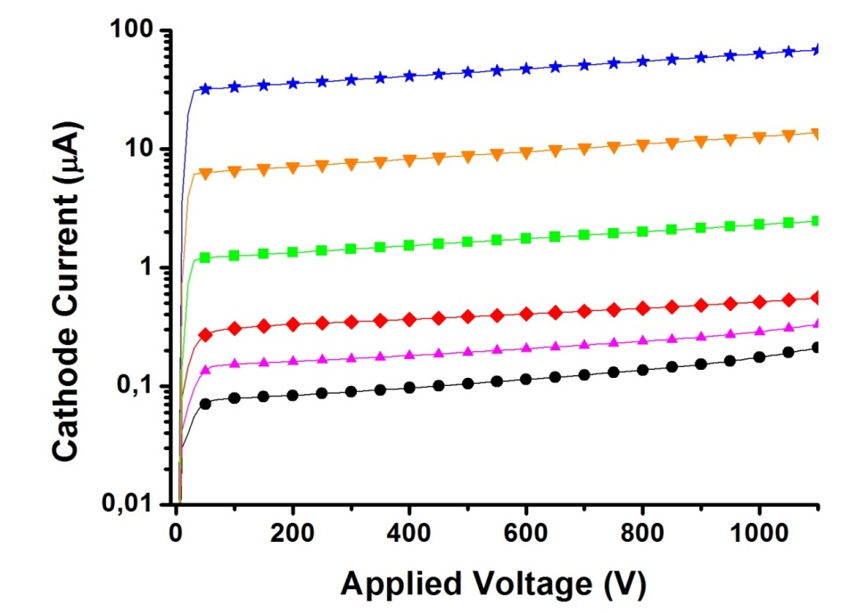
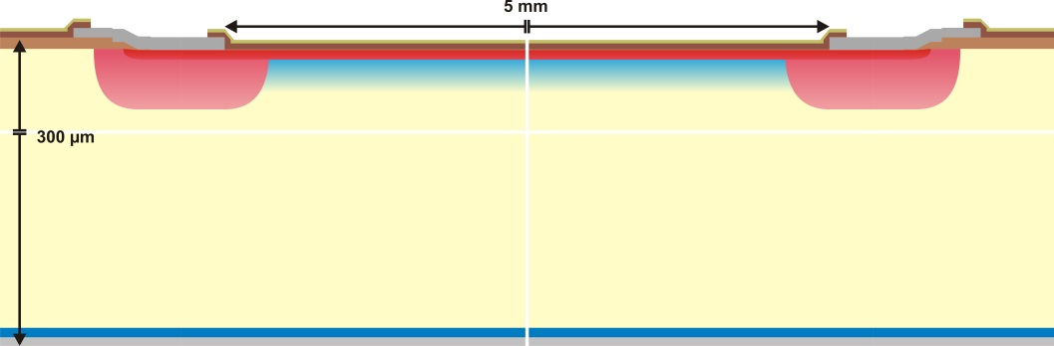
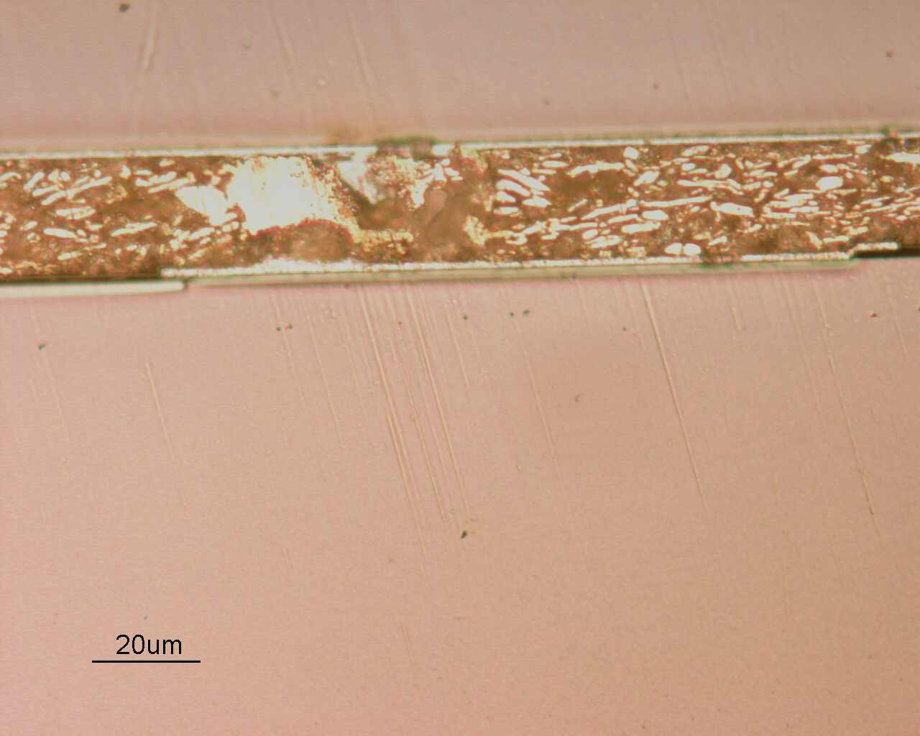
Junction Edge Termination: Deep N-type diffusion
V_{BD} > 1100 V
Runs 6474 & 7062
SiO₂/Si₃N₄
Passivation
Metal
P-type multiplication layer
N-Type Diffusion (JTE)

Slide 8

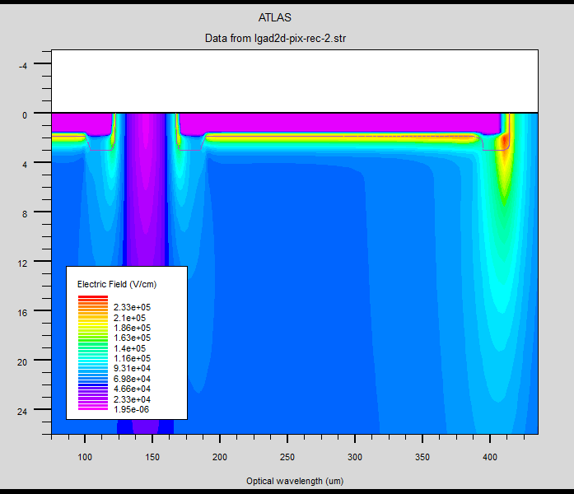
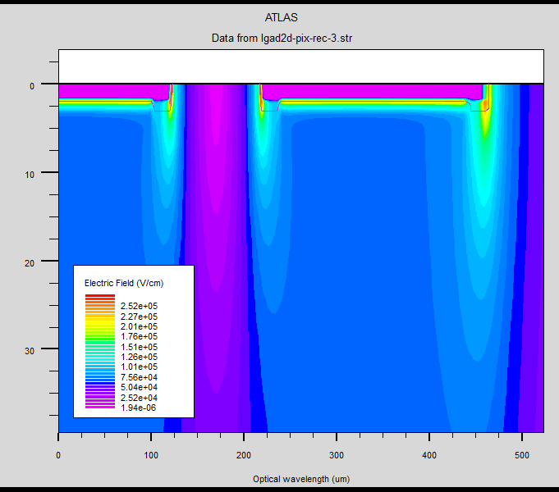
Junction Edge Termination: Segmented devices
Deep N-type diffusion works properly for pad devices
In segmented devices N+ electrode extension seems more convenient
Electric Field in two adjacent strips

Slide 9
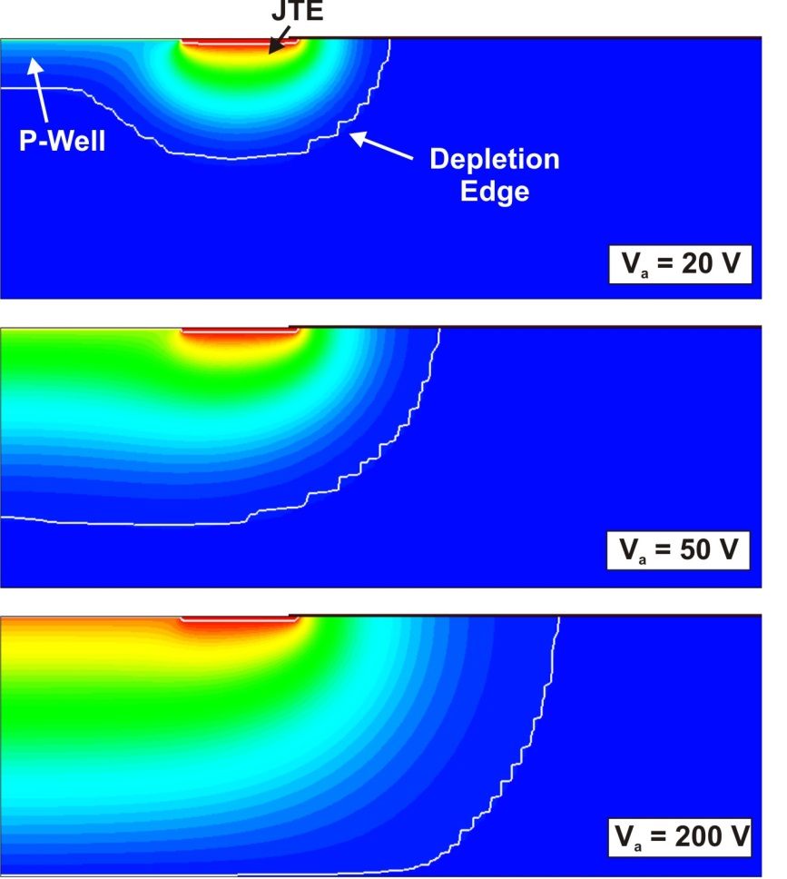
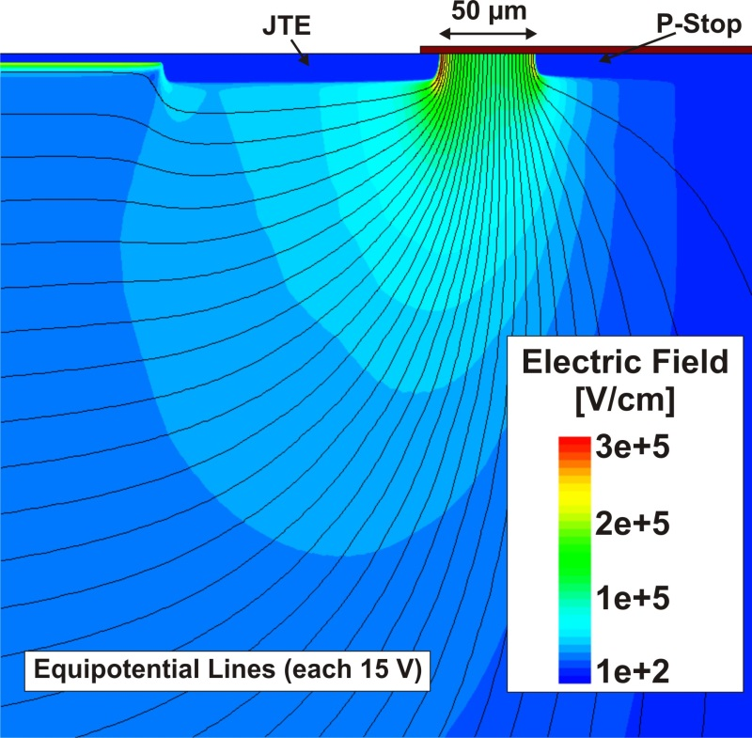
Design of the Device Periphery
Peripheral region should ensure the voltage capability as well as limiting the leakage current.
  After the full (vertical) depletion is reached, a fast lateral depletion of the lowly doped substrate takes place.
A deep P+ diffusion (C-Stop) is needed in the die periphery to avoid the depletion region reaching the unprotected edge
C-Stop
C-Stop
A C-Stop located too close to the edge termination can degrade the voltage capability
C-Stop

Slide 10
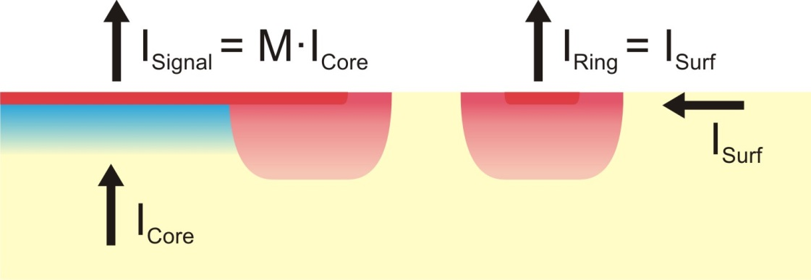
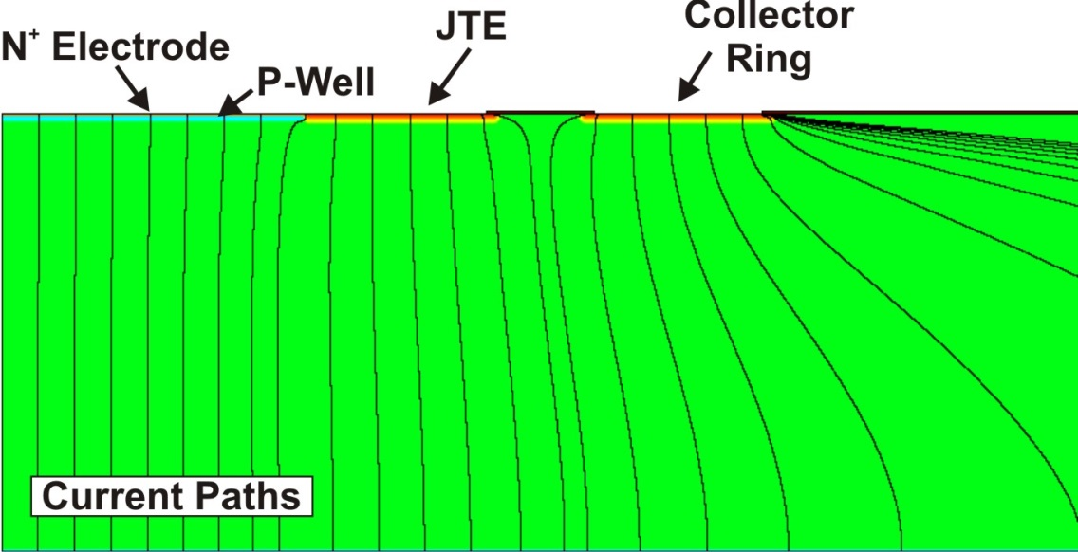
Optimization of the periphery: Guard Ring
Biased guard Ring around the detection region.
  The ring is independently biased to extract the surface component of the current
  Voltage capability is preserved (same curvature as JTE)
Guard ring confines the detection area
Good isolation should be ensured

Slide 11
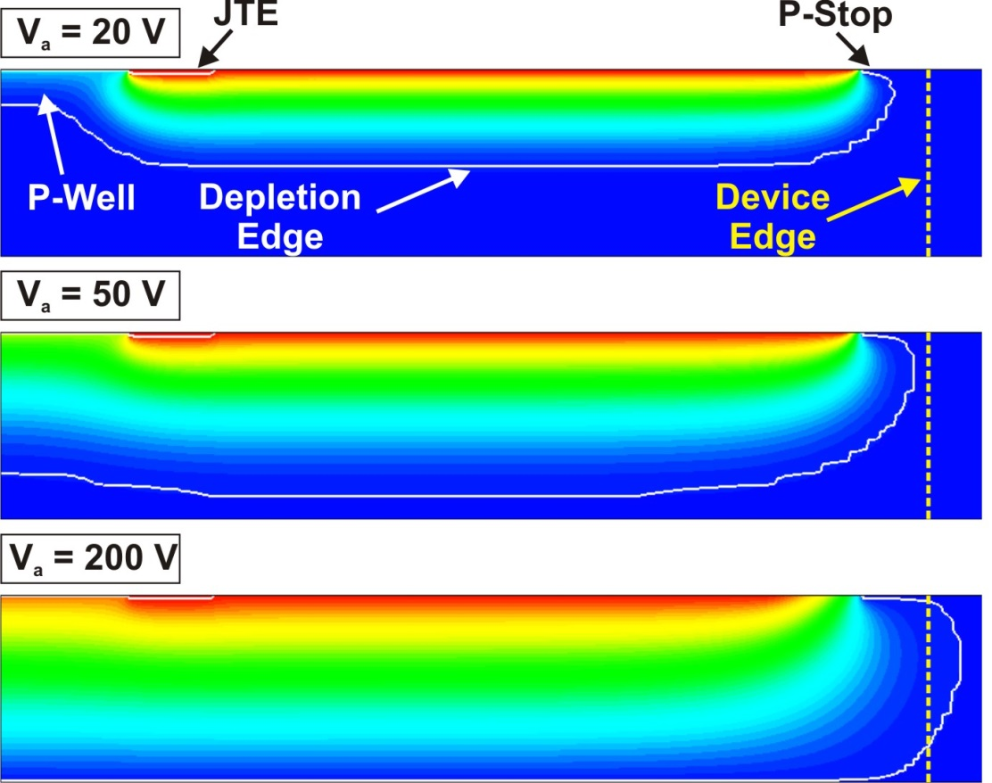
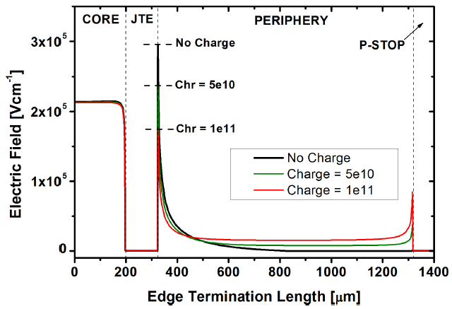
Optimization of the periphery: Positive oxide charges
Field oxides grown in wet conditions (H₂ + O₂) typically have a positive charge density in the range of 5e10 cm⁻²
  Surface inversion of the substrate and modification of the depletion dynamics.
Surface leakage currents

Slide 12
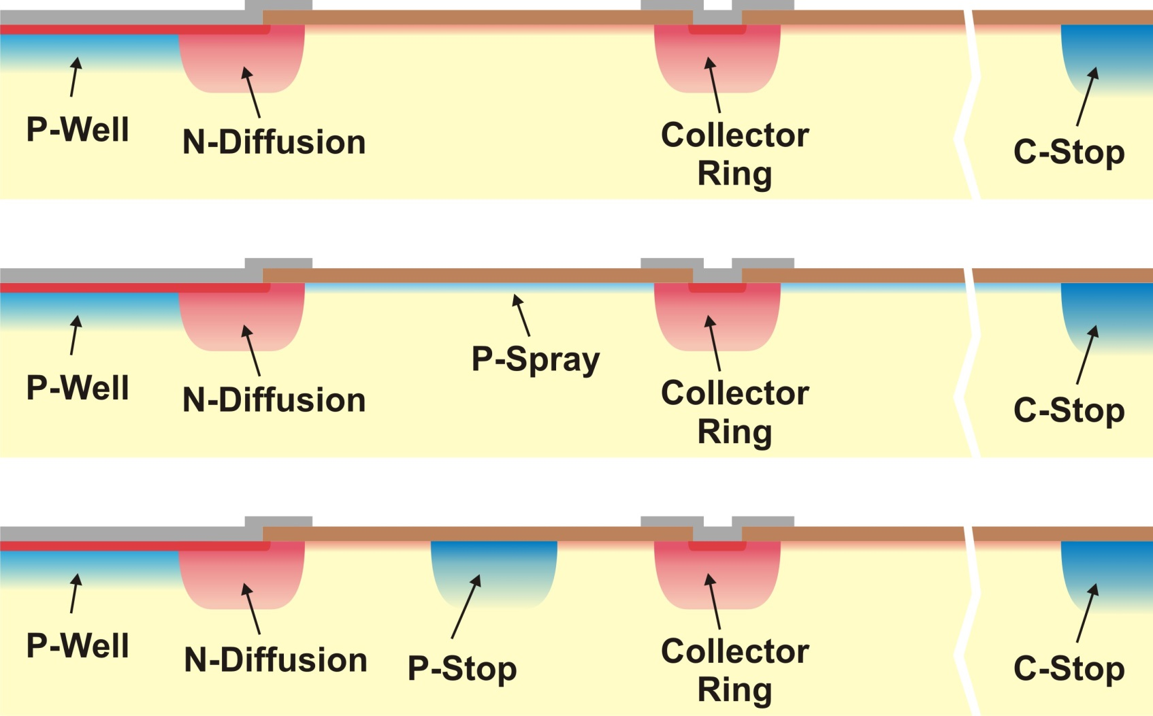
Optimization of the periphery: Strategies
Positive oxide charges (radiation induced or technologically originated) induce surface inversion of the substrate → Current path towards the collector electrode.
Boron blanket implant
P-Spray: Counteracts the inversion
P-Stop: cuts the current path off
Same implant

Slide 13
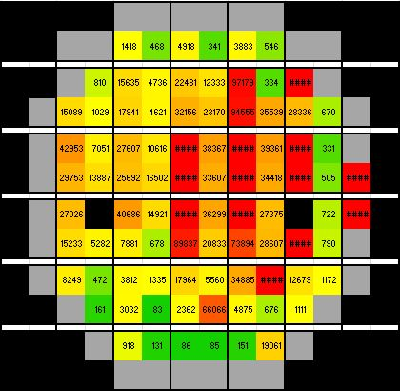
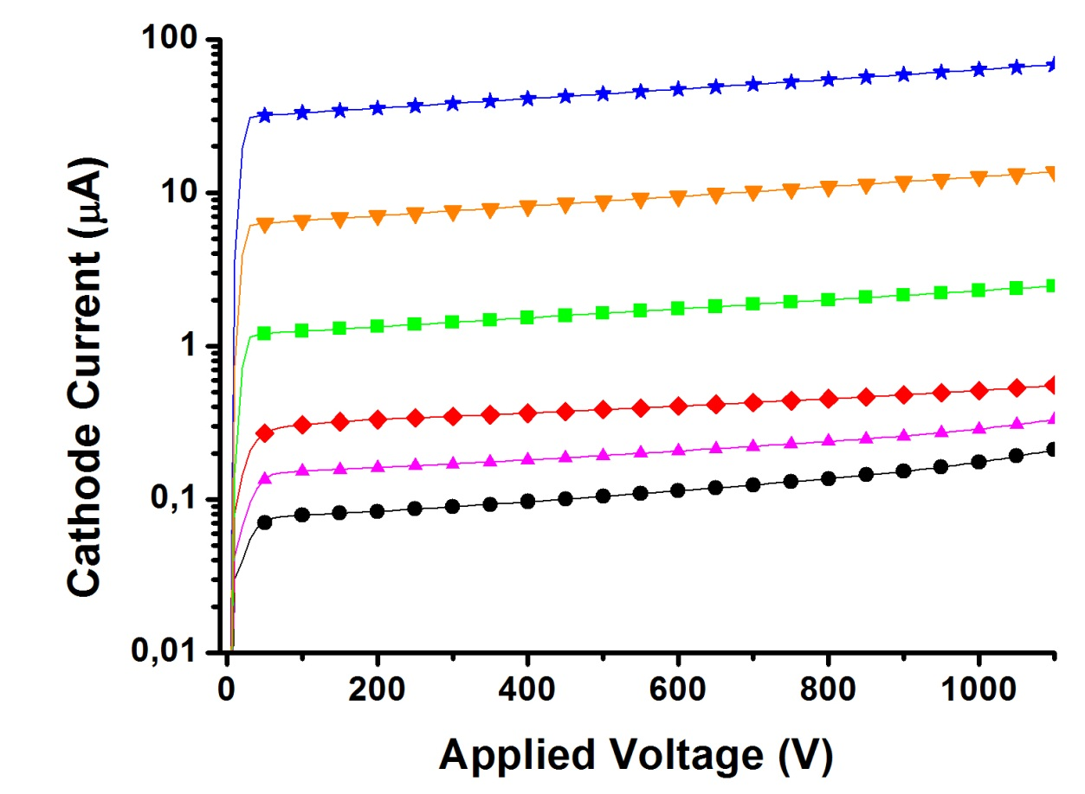
Electrical Characterization: Yield
High Voltage Capability (Breakdown > 1100 V) in all wafers
Leakage current varies from some 10 nA to more 100 µA in devices within the same wafer
Run 6474
High Current Devices
V_{BD} > 1100 V
Low Current Devices
LGAD Wafer (W8 – High Boron Implant)
Guard Ring is short-circuited with N⁺ electrode (inefficient P-Spray)

Slide 14
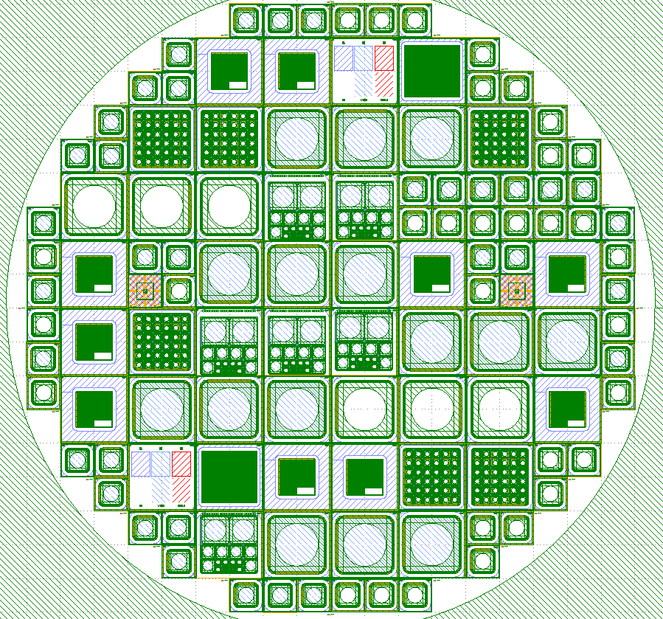
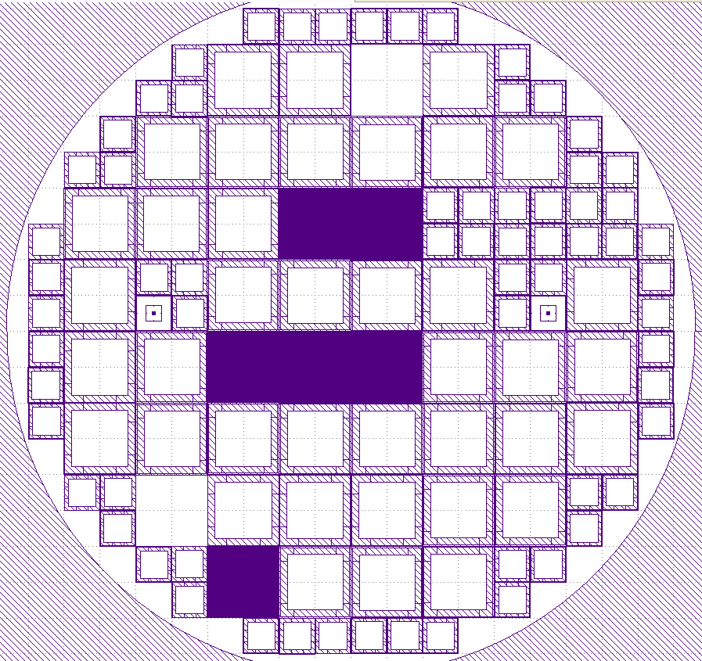
New Fabrication Run
Top Distribution
Back Metallization

Slide 15
New Fabrication Run
IJS Ljubljana
9 LGAD Pad Detectors
  3 (8 x 8 mm multiplication area)
  6 (3 x 3 mm multiplication area)
9 PiN Detectors
  3 (8 x 8 mm active area)
  6 (3 x 3 mm active area)
4 LGAD pStrips Detectors
  32-160-50-06-24
  32-160-62-06-12
  64-80-10-06-24
  64-80-22-06-12
2 PiN pStrips Detectors
  32-160-50-06-24
  64-80-10-06-24
1 FEI4 compatible pStrip Detector
1 Pixelated LGAD Detector (6 x 6 pixels)
1 Pixelated PiN Detector (6 x 6 pixels)
3 LGAD for Timing Applications
  200 um to chip edge
  250 um to chip edge
  800 um to chip edge
1 Specific Test Structure (SPR,SIMS,XPS)
INFN Torino
LAL Orsay
113 Structures
  47 (10 x 10 mm, total area)
  66 (5 x 5 mm, total area)

Slide 16
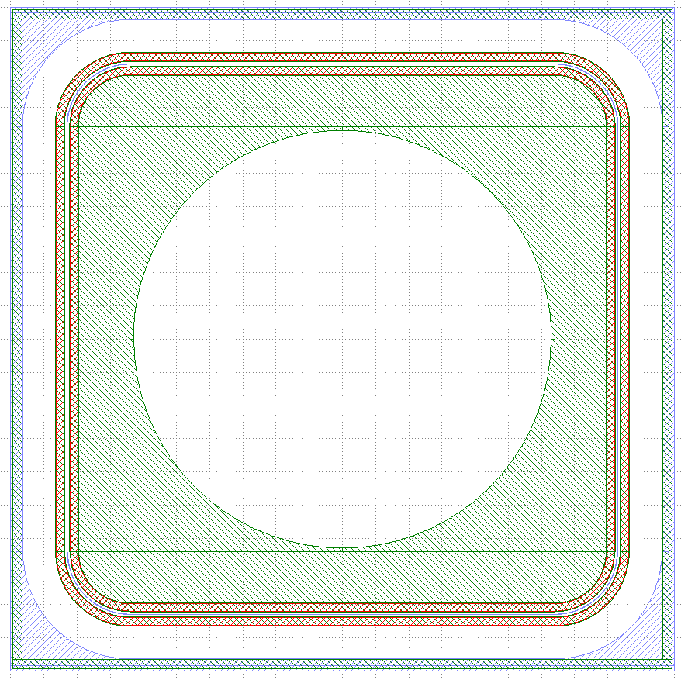
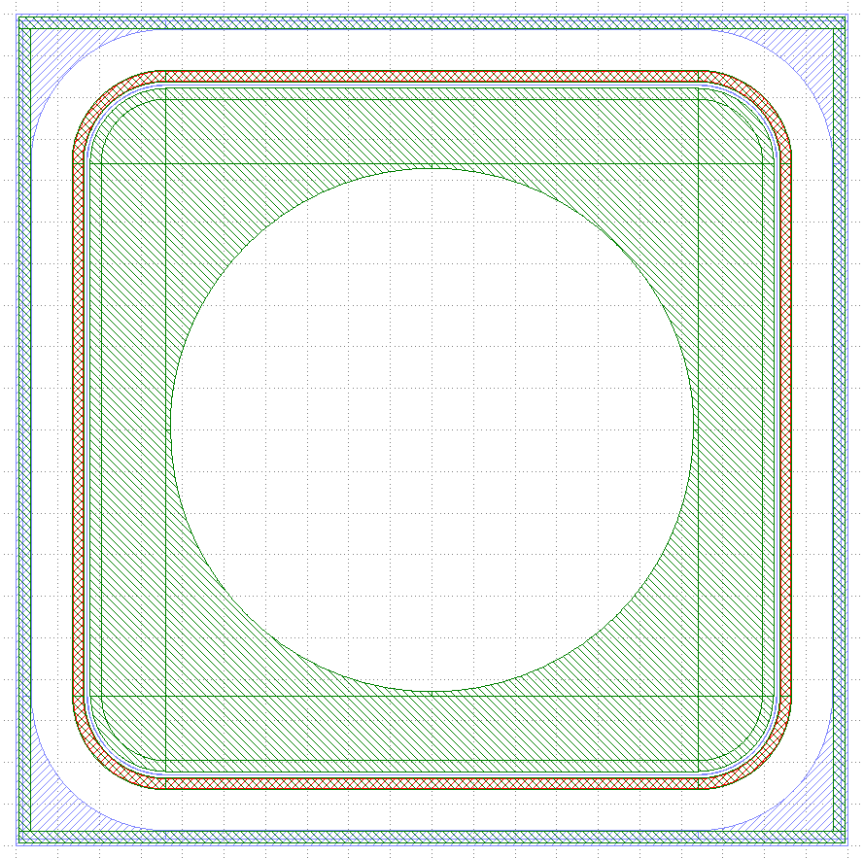
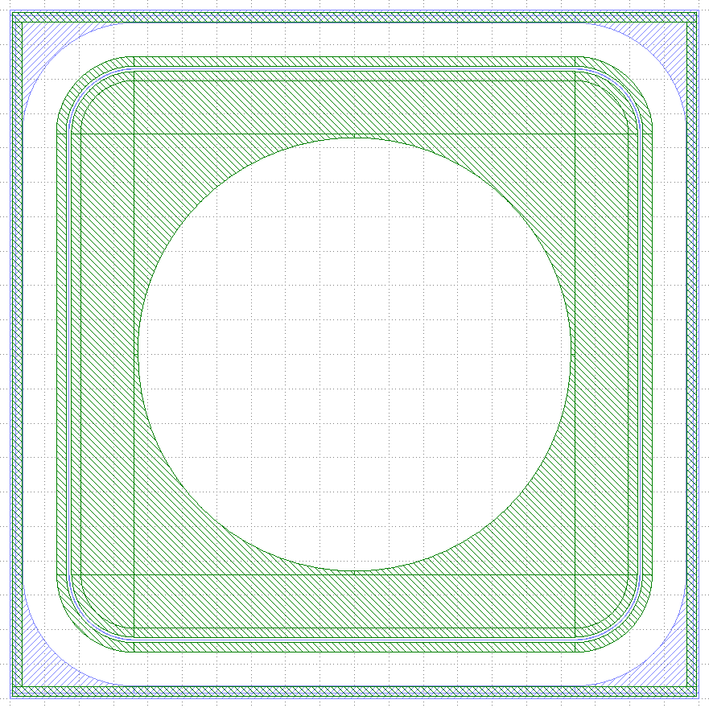
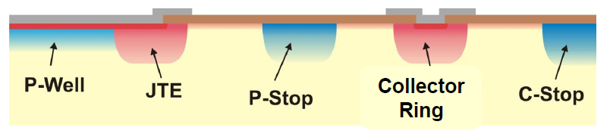
New Fabrication Run: LGAD & PiN pad Detectors
LGAD 1,4,7
LGAD 2,5,8
LGAD 3,6,9
Field Plate
Field Plate
LGAD & PiN Pad Detectors
  Multiplication Area
    8 x 8 mm (Type 1, 2, 3)
    3 x 3 mm
    Termination: * P-Stop + N-Guard Ring (Type 3, 6, 9)
    * P-Stop + N-Guard Ring with JTE (Type 2, 5, 8)
    * JTE + P-Stop + N-Guard Ring with JTE (Type 1, 4, 7)
    * Field Plate 10 µm, 0 µm (Type 7, 8, 9)

Slide 17
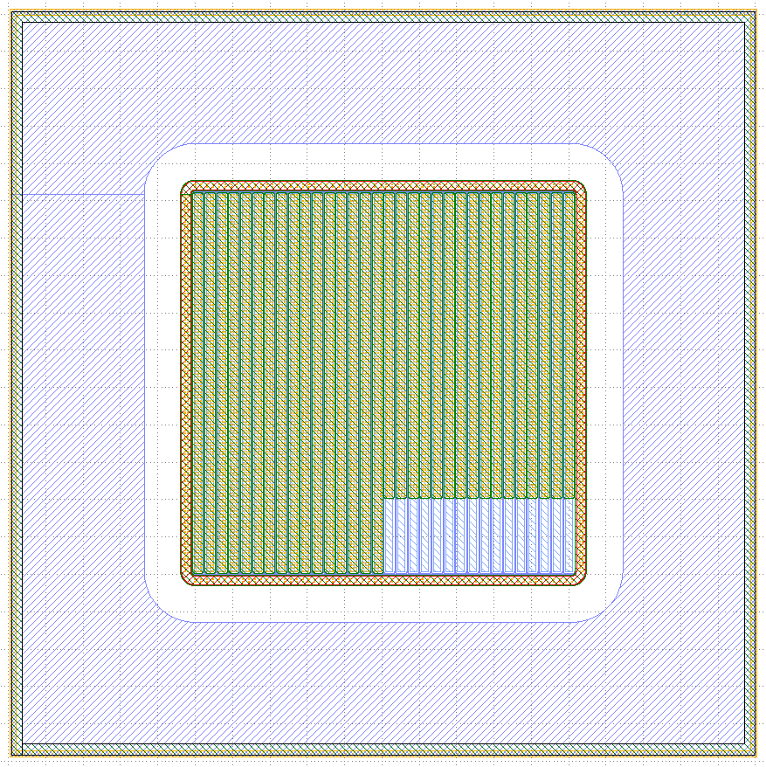
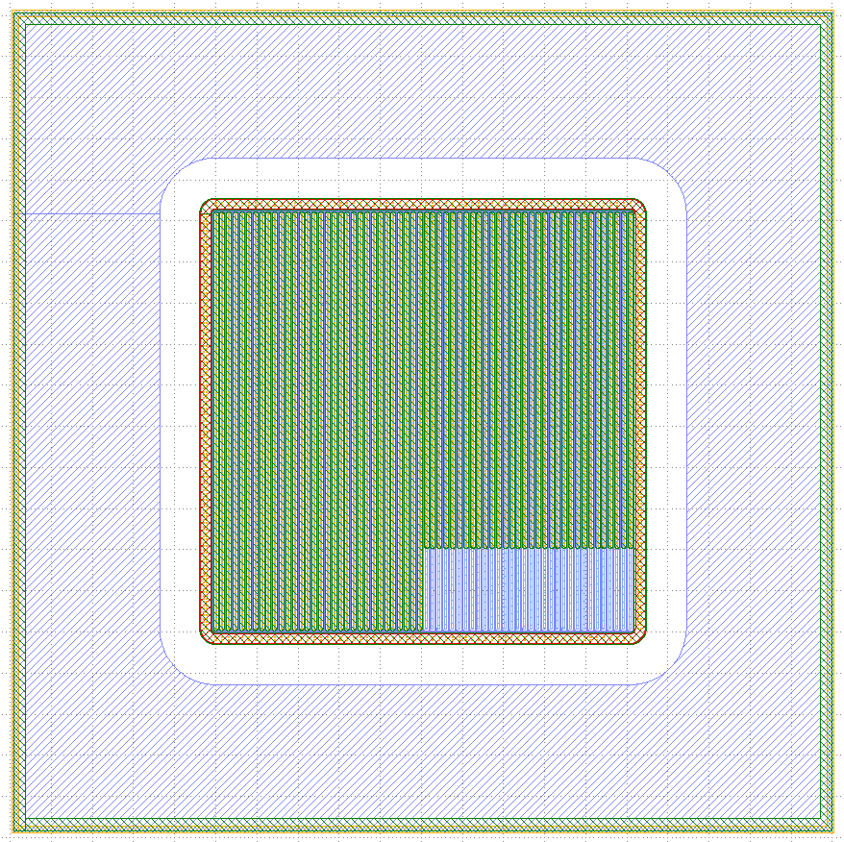
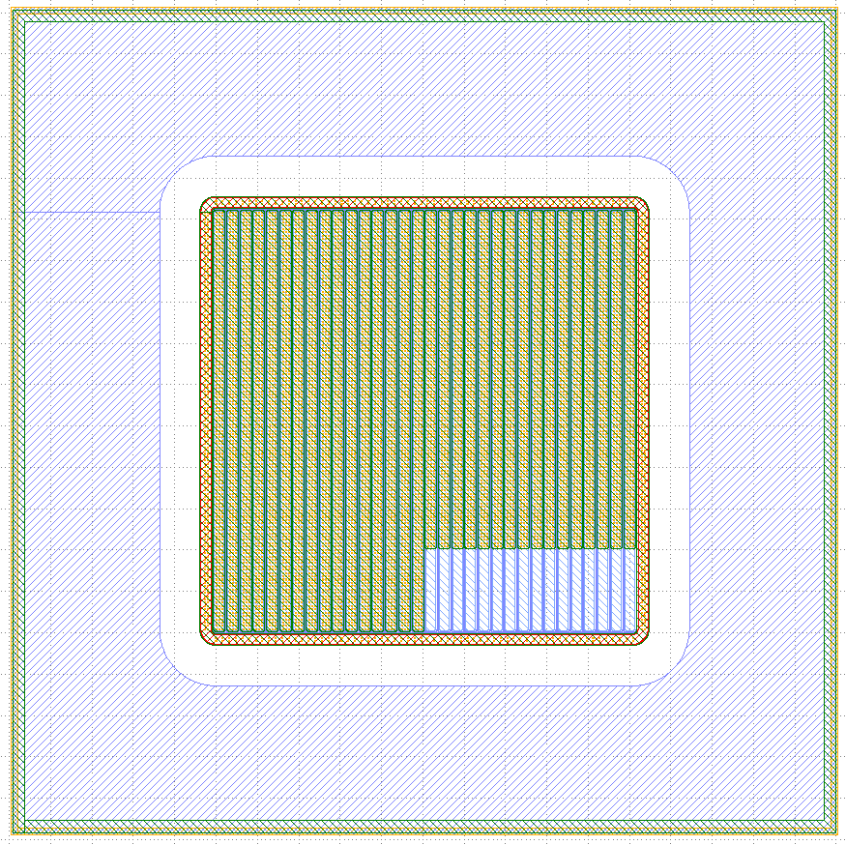
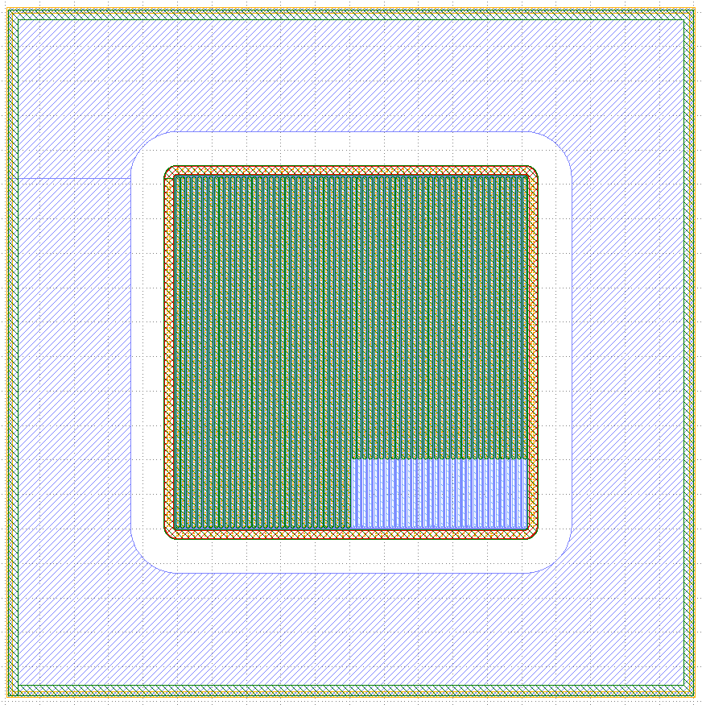
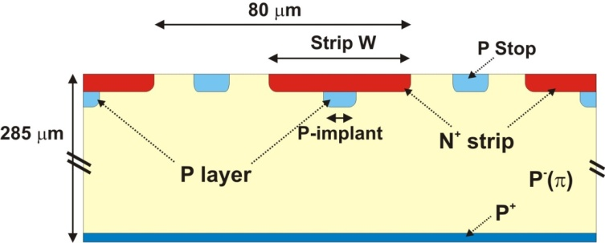
New Fabrication Run: LGAD & PiN strip Detectors
4 LGAD pStrips Detectors
  32-160-50-06-24
  32-160-62-06-12
  64-80-10-06-24
  64-80-22-06-12
2 PiN pStrips Detectors
  32-160-50-06-24
  64-80-10-06-24
Key Legend
  AA-BB-CC-DD-EE
  AA, Channels Number
  BB, Pixel Size
  CC, Multiplication Width
  DD, P-Stop Width
  EE, P-Stop Position
32.160.50.06.24
64.80.10.06.24
32.160.62.06.12
64.80.22.06.12

Slide 18
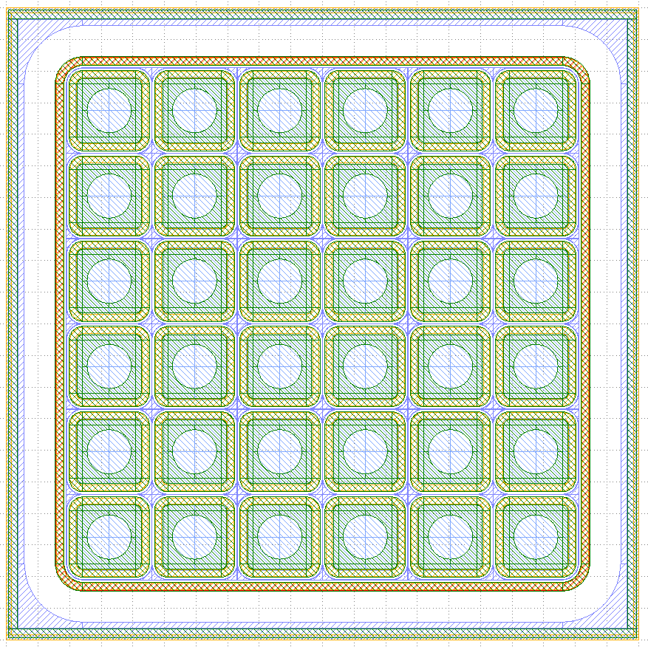
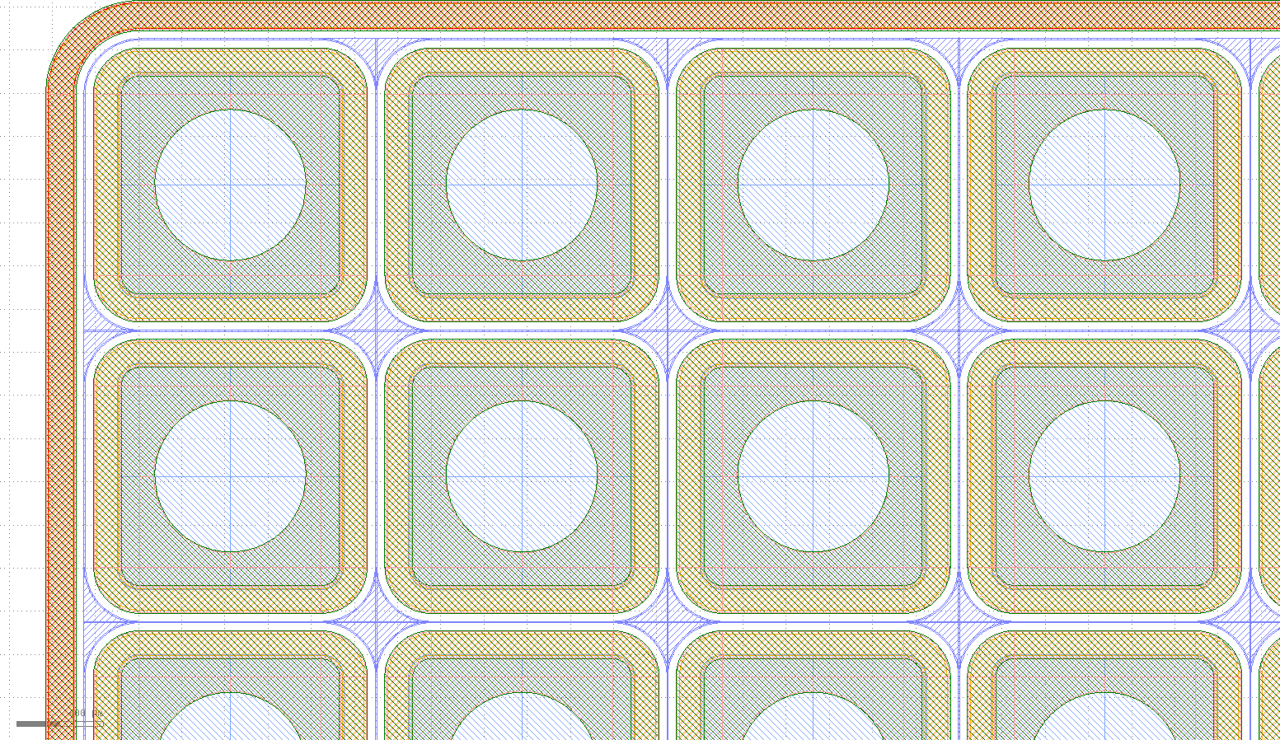
LGAD and PiN Pixelated Detectors
IJS Ljubljana
1 Pixelated LGAD Detector (6 x 6 pixels)
1 Pixelated PiN Detector (6 x 6 pixels)

Slide 19
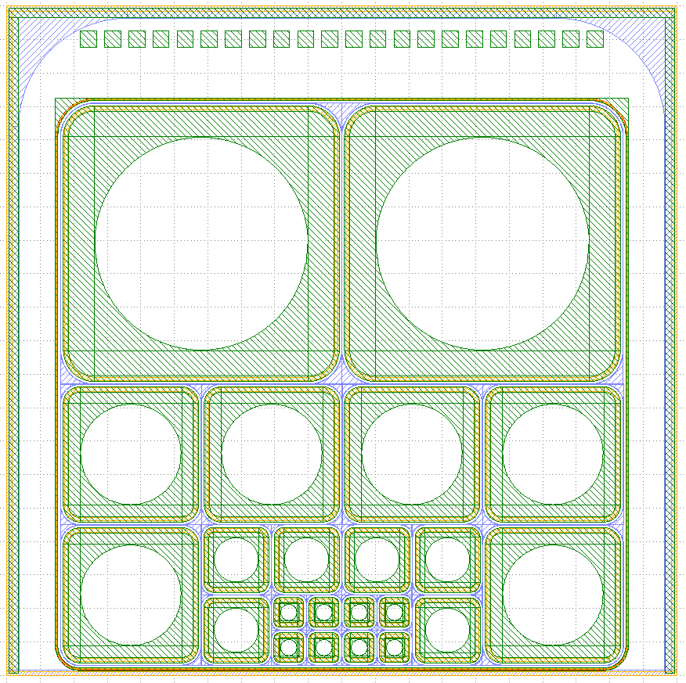
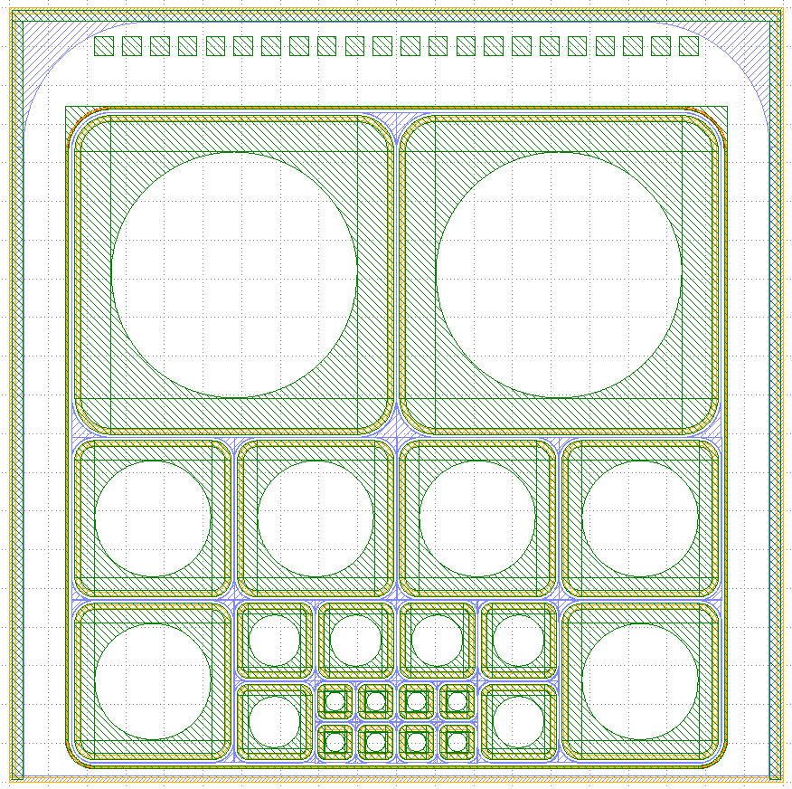
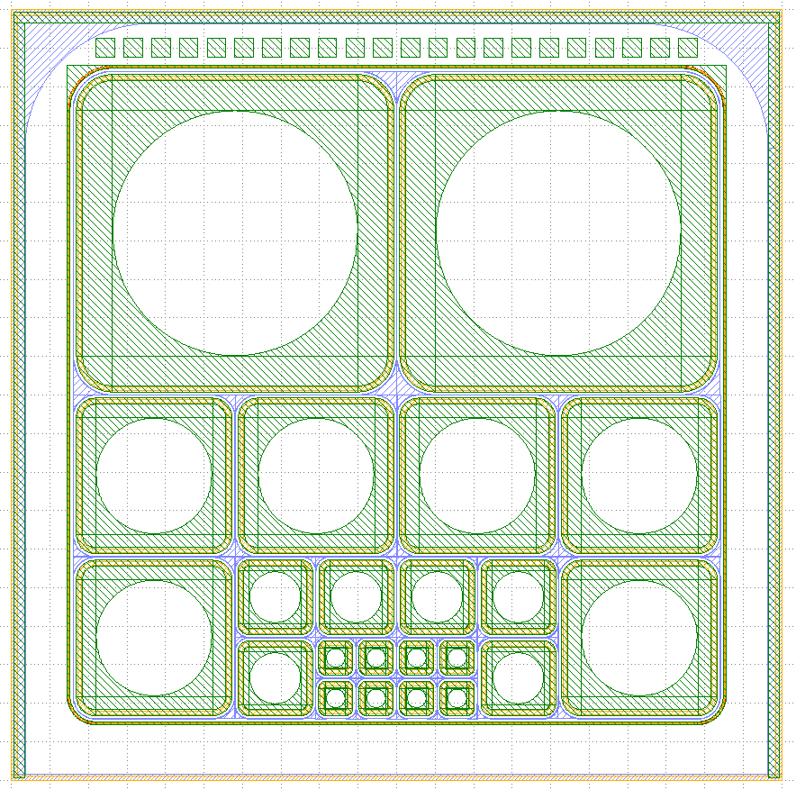
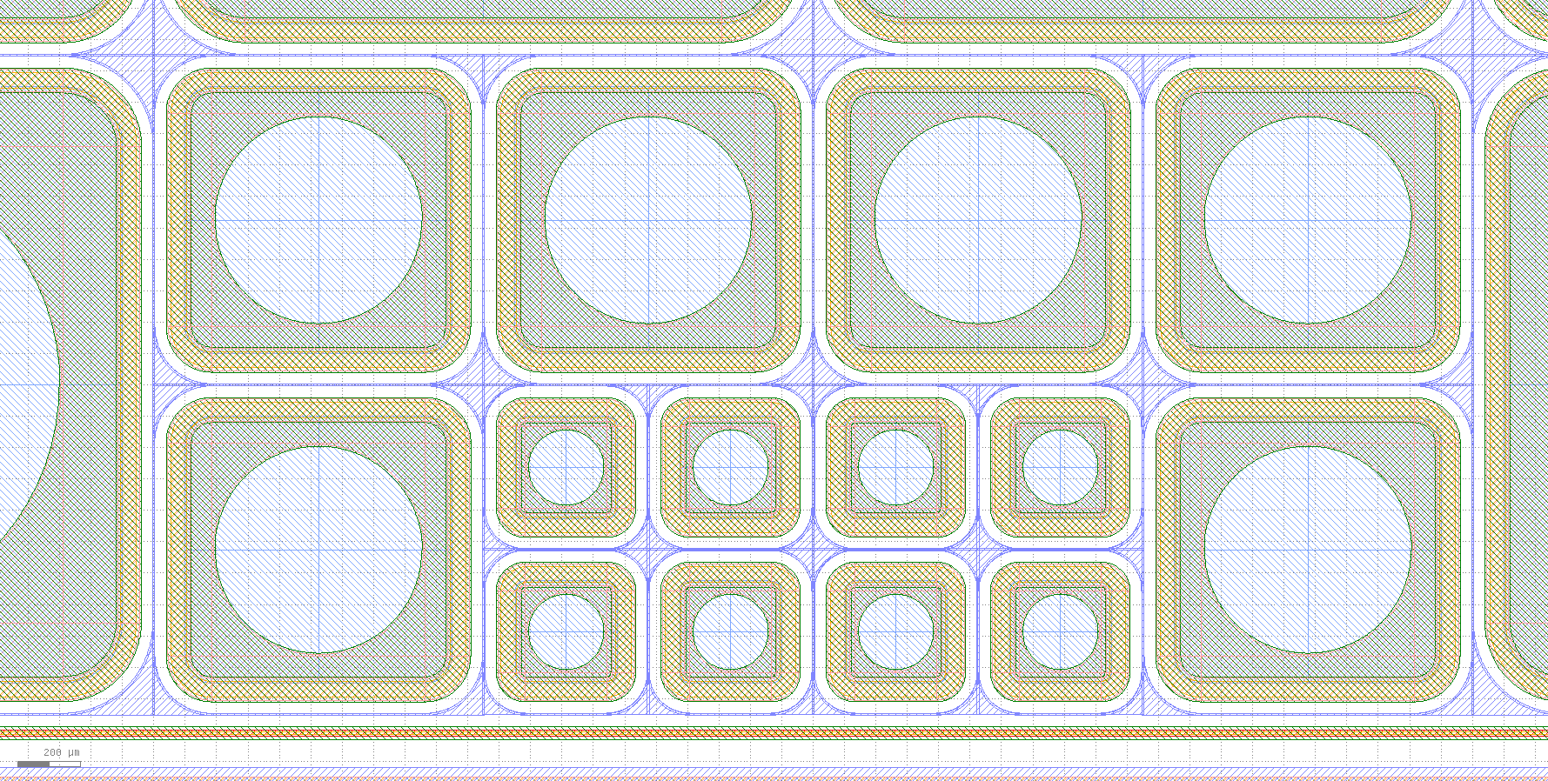
LGAD for Timing Applications
INFN Torino
3 LGAD for Timing Applications
  200 um to chip edge
  250 um to chip edge
  800 um to chip edge

Slide 20
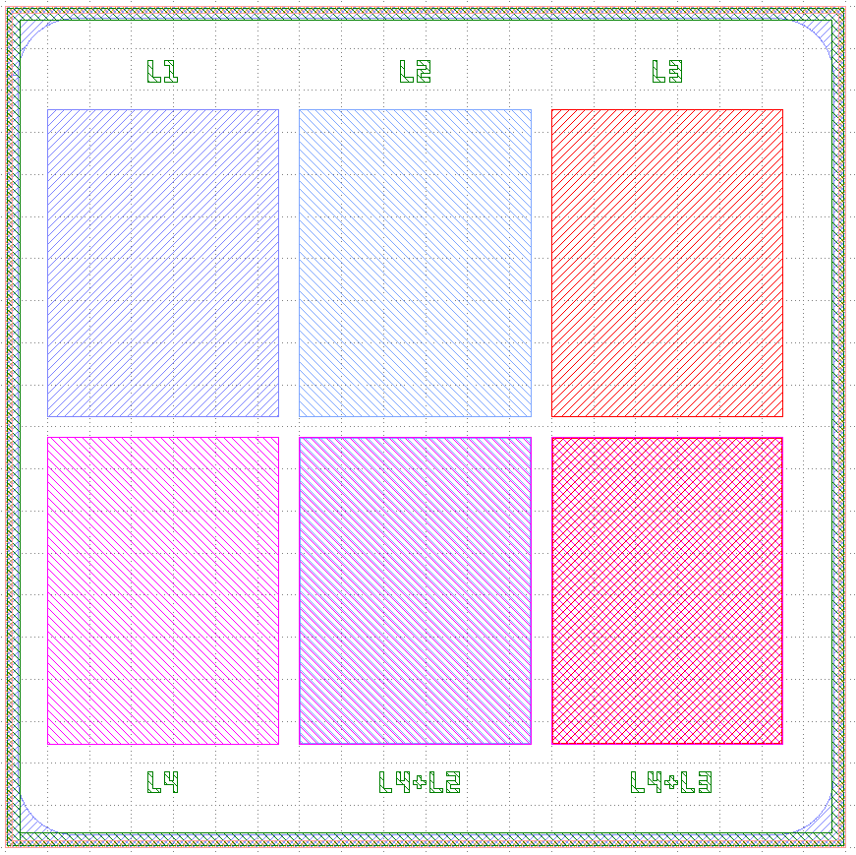
Specific Test Structure. SRP, SIMS, XPS
LAL Orsay
L1 P-Stop, C-Stop Well
L2 P-Well (P Multiplication)
L3 JTE
L4 N-Well
L4 + L2 N-Well over P-Well
L4 + L3 N-Well over JTE
2.75 mm
3.65 mm
Field Plate
Field Plate
N-Well

Slide 21
Conclusions
Optimization of the LGAD peripheral region is crucial for the detector performance
  Edge termination techniques confine the high electric field into the multiplication area and give voltage capability to the detector
  Structures within the peripheral region avoid high leakage currents and degradation
Deep N-diffusion termination technique has proved good performance
P-Spray technique has shown poor effectiveness
New production run at the IMB-CNM include pad and segmented (strip and pixel) designs with an optimized peripheral region based on the P-Stop technique.
300 µm-thick prototypes with the new mask set is now in production. A 200 µm-thick run is on going.

Slide 22
Thank you
Questions?

Slide 23
Back up Slides
Just in case

Slide 24

Optimization of the Multiplication layer
P-type multiplication layer determines both Gain and Breakdown
Higher Boron implant Dose:
  Higher Gain
  Lower Breakdown
Small variations in the Boron implant dose (~ 2 × 10¹² at/cm²) lead to large changes in Gain and Breakdown values
Effective charge and doping value at the junction determine the Gain

Slide 25
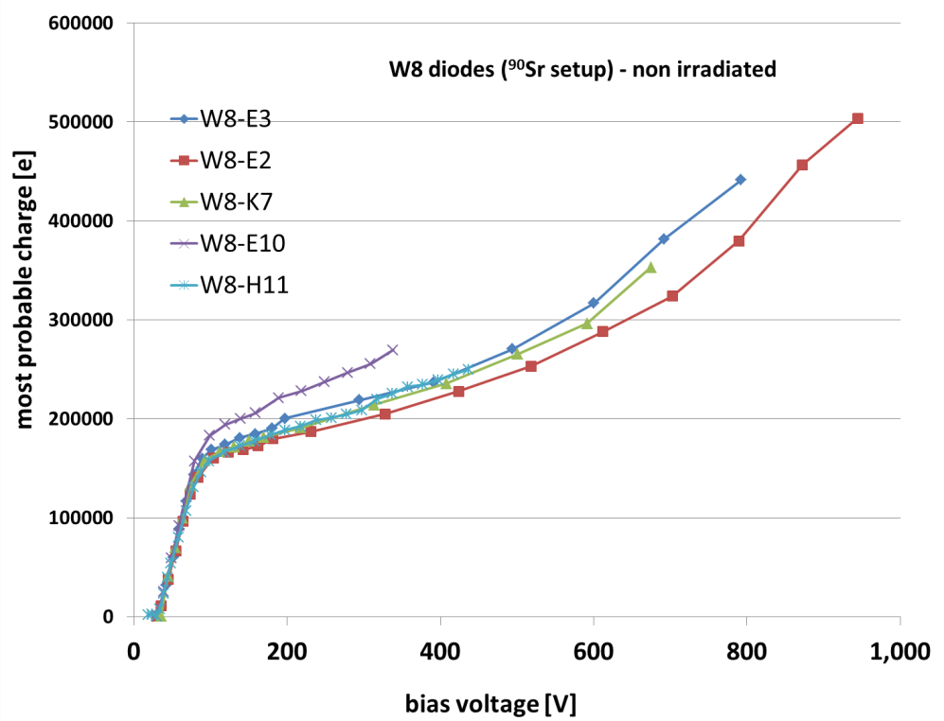
Charge Collection Measurements: Electrons (mips)
Run 6474
Gain = 2÷4
Gain = 8÷20
Medium Boron Implant
High Boron Implant
LGAD diodes with different values of the doping dose of the p-type multiplication layer.
G. Kramberger,
24th RD50 Workshop, Bucharest
W7 → 1.6 × 10¹³cm⁻²
W8 → 2.0 × 10¹³ cm⁻²
Wafers have different gains:
      Good uniformity of gain over the wafer.
      Very good stability of some diodes up to >1000 V.

Slide 26
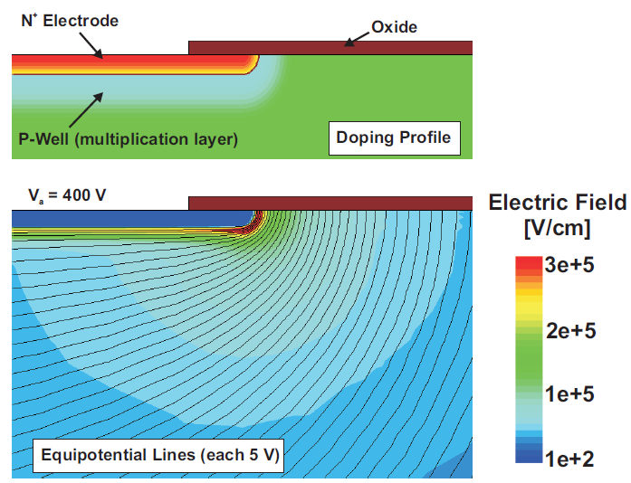
Edge Termination: Why is needed?
The N⁺ shallow contact and the P-multiplication layers have to be locally created with a lithography mask
  The electric field at the curvature of the N⁺/P junction is much higher than that of the plane junction (where Gain is needed)
  Avalanche at the N⁺/P curvature at a very low reverse voltage (premature breakdown)
Shallow N⁺ and P-multiplication layers self aligned
High electric field peak at the curvature
Notes:
Ruptura prematura, porque se alcanza el campo crítico de ruptura en la curvatura.

Slide 27
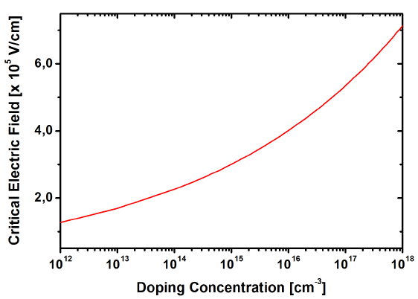
Design of the Edge Termination: Critical Electric Field
P-Multiplication layer
Extrapolated values
P-Substrate
B. Jayant Baliga (2008): Fundamentals of Power Semiconductor Devices

Slide 28
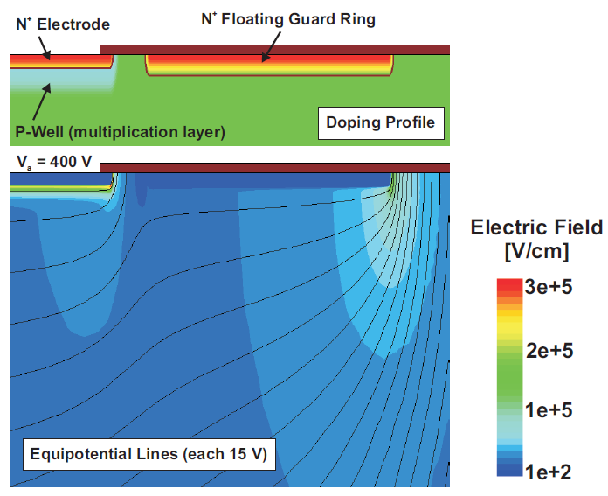
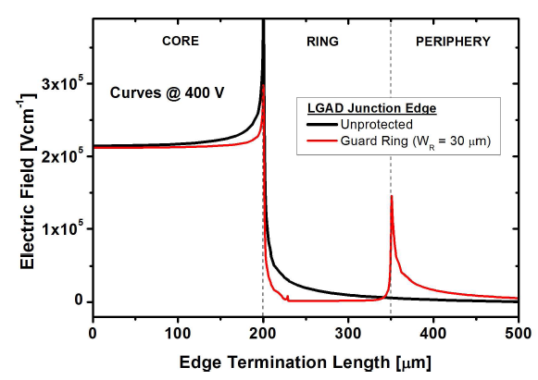
Junction Edge Termination: Floating Guard Ring
The N+ shallow diffusion is used to implement a floating guard ring.
  The lateral electric field distribution is smoothed leading to two peaks (main junction and floating guard ring)
  The electric field peak and the risk of avalanche breakdown at the curvature of the main junction is reduced. Optimization of the guard ring location is needed.
The lower Ec value at the ring junction can lead the termination to breakdown

Slide 29
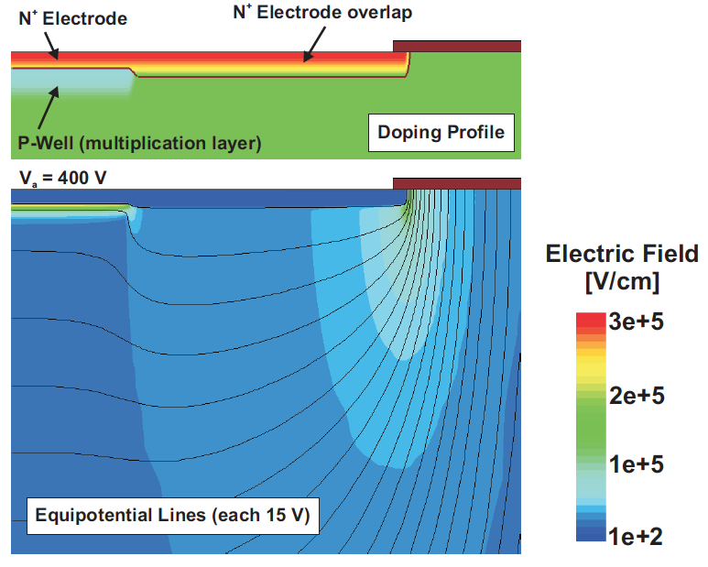
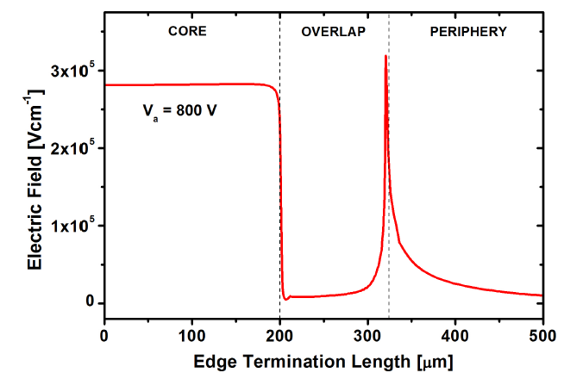
Junction Edge Termination: N⁺ Extension
The N⁺ is used to extend the N+ beyond the edge of the multiplication layer
  Phosphorous diffuses more in the very lowly doped substrate (higher curvature radius and voltage capability).
  The electric field rapidly increases at the plain junction (multiplication).
The lower Ec value at the overlap junction can lead the termination to breakdown

Slide 30

Junction Edge Termination: Junction Termination Extension
Lowly doped N-type Deep diffusion (JTE) around the curvature of the main junction
  Additional (specific) photolithographic step
  The addition of a Field Plate moderates the electric field at the JTE curvature
Field Plate
N⁺ electrode
P type multiplication layer
N Diffusion (JTE)
P type (π) substrate
Resistivity ~ 10 KΩ·cm
P⁺ electrode
Notes:
Finalmente, la terminación JTE es la que mejores resultados nos ha dado

Slide 31
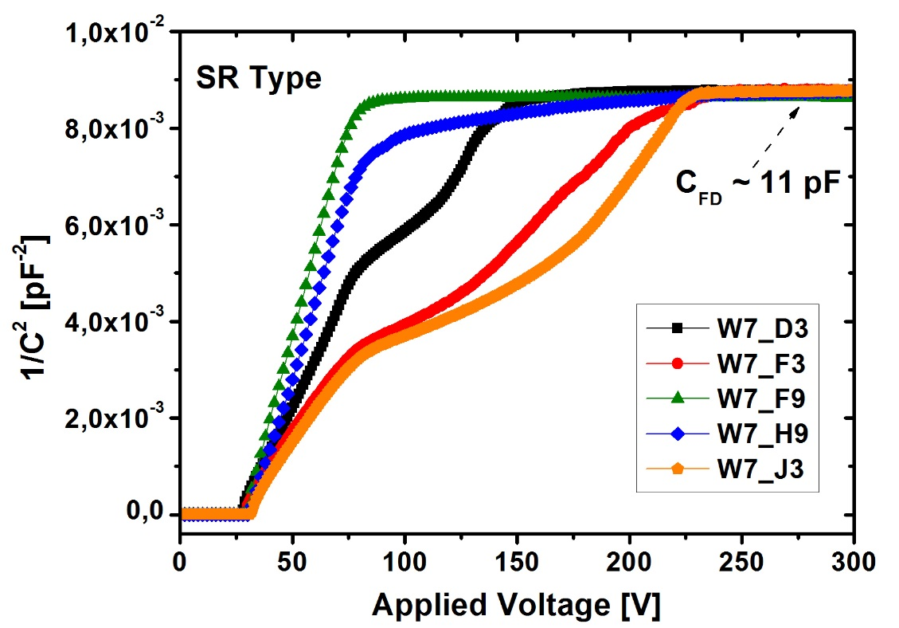
Implementation: Problems at the peripheral region
Run 7062
Leakage current is mostly generated at the periphery
Run 6474
Moderate reduction
Capacitance humps are related with the depletion of the periphery

