Slide 1
E-TCT measurements with laser beam directed parallel to strips
Igor Mandić¹, Vladimir Cindro¹, Andrej Gorišek¹, Gregor Kramberger¹, Marko Mikuž^{1,2}, Marko Zavrtanik¹
¹Jožef Stefan Institute, Ljubljana, Slovenia
² Faculty of Mathematics and Physics, University of Ljubljana, Slovenia

Slide 2
Introduction
in usual E-TCT measurements focused laser beam is directed to the side of the
detector perpendicular to the direction of strips
- IR laser (λ = 1064 nm), attenuation length in Si ~1 mm
- charge is generated below many strips
- carriers drifting to the neighbor strips also induce current on the readout electrode
→ effective weighting field modified:
  instead of peaked weighting field of a strip detector the effective weighting field
is approximately constant E_{w} = 1/D as in pad detectors
  good for measurements of velocity profile:
  charge collection profile of irradiated detector is not as in detector application
if laser beam is directed parallel to strips all carriers (in ideal case) generated along laser
beam drift in the same electric and weighting field -> true charge collection profiles could be
measured
  in reality laser beam divergence smears the measurement
in this presentation some aspects of this measurement technique will be presented

Slide 3
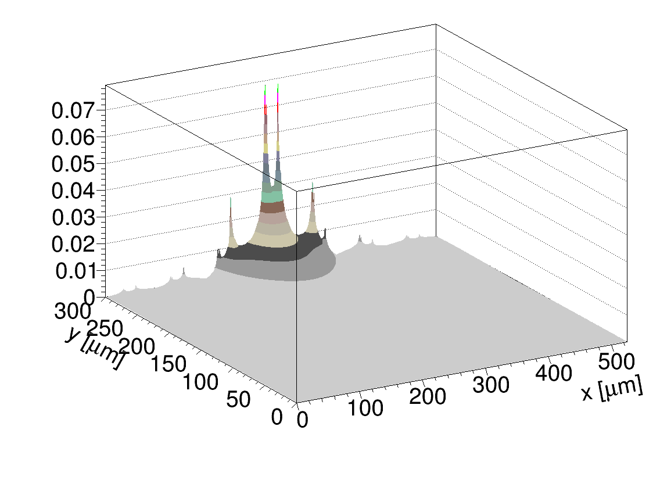
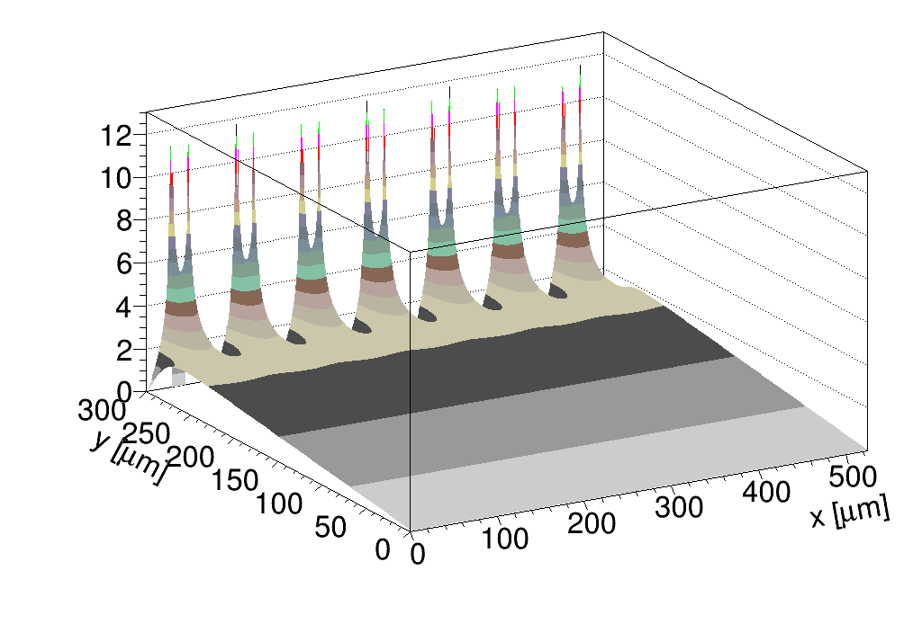
Simulation
KDetSim by G. Kramberger
described in:
G. Kramberger et al., IEEE Trans.Nucl.Sci., Vol 49, (2002), 1717.
G. Kramberger et al., NIM A 457, pp-550-557,2001.
G. Kramberger et al., 2014 JINST 9 P10016
P-type strip detector, pitch 75 um, strip width 20 um
N_{eff} = 4.76e12 cm⁻³ (V_{fd} ~ 350 V)
(approx. Hamamatsu ATLAS12)
Electric field
Bias = 400 V
Weighting field
strongly peaked at the readout strip

Slide 4
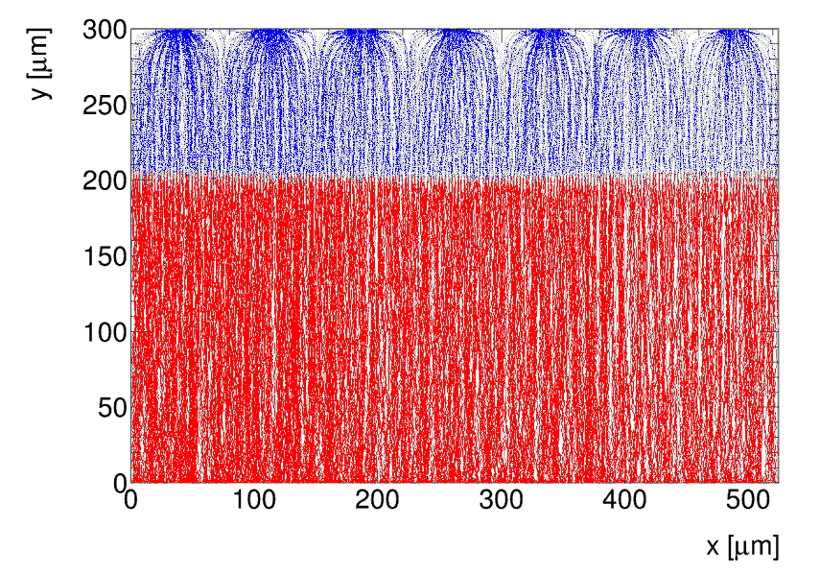
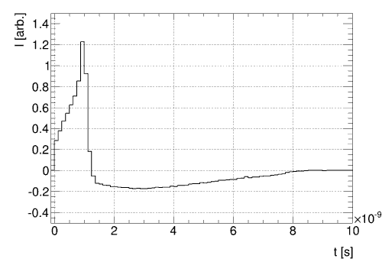
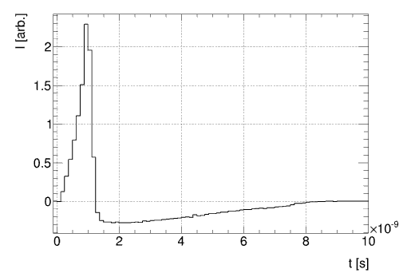
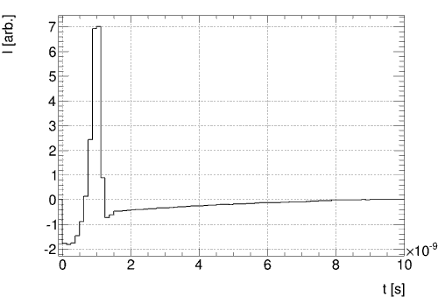
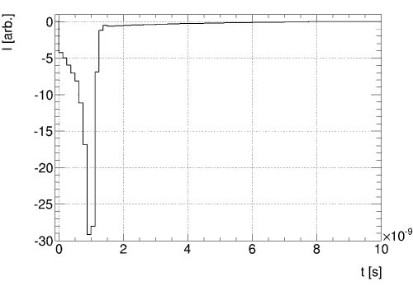
Simulation
standard E-TCT
Readout electrode
Laser
+
+
+
+
…
current pulse on readout strip in E-TCT is induced also by charge drifting under neighbor strips
→ measured pulse is the sum of all contributions

Slide 5
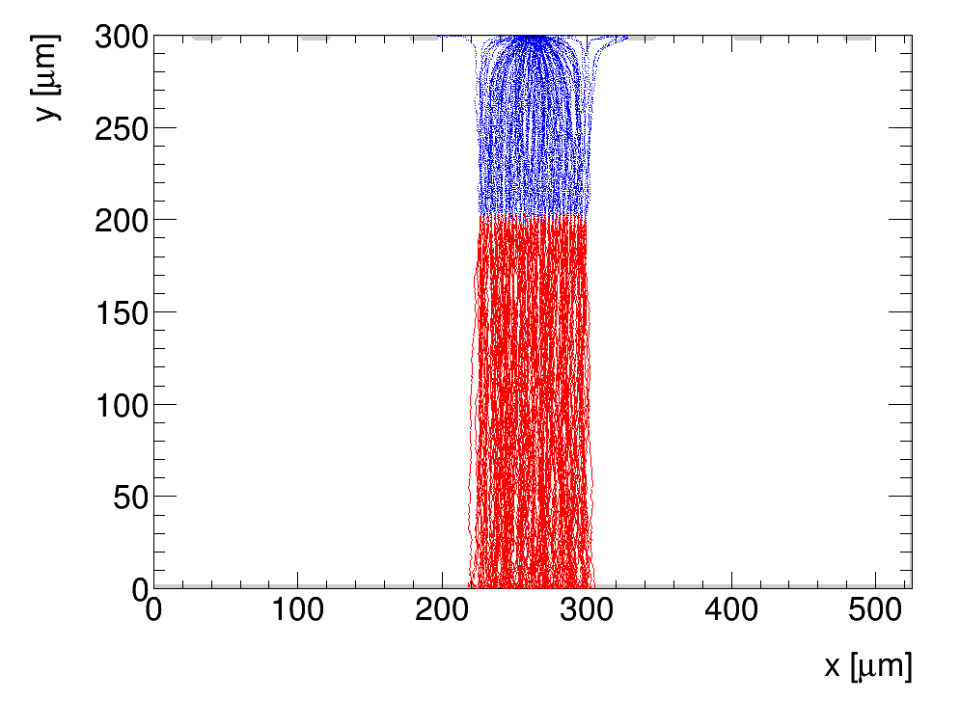
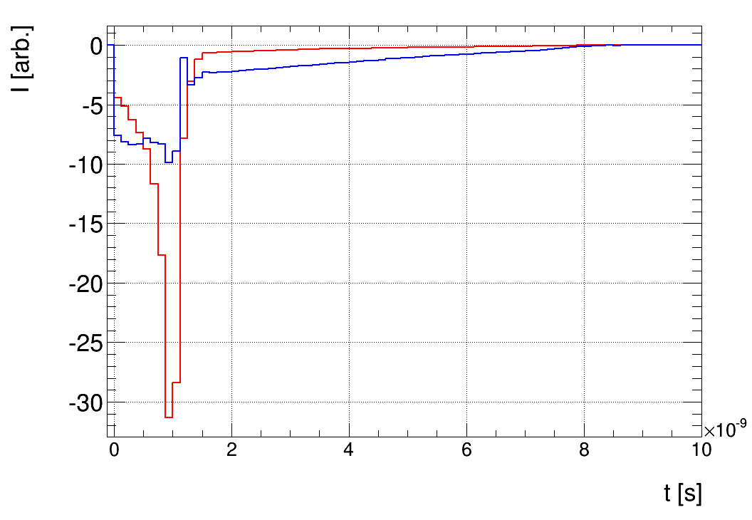
Simulation
Readout strip
Laser
Blue: all charge
Red: only charge under strip
pulses different because of carriers drifting to other strips ➔ reason for effective E_{w} = 1/D in E-TCT
charge (integral of the pulse) same for blue and red pulse before irradiation
➔ in irradiated detector carriers do not drift over whole weighting field because of trapping
➔ charge is not the same for the two cases

Slide 6
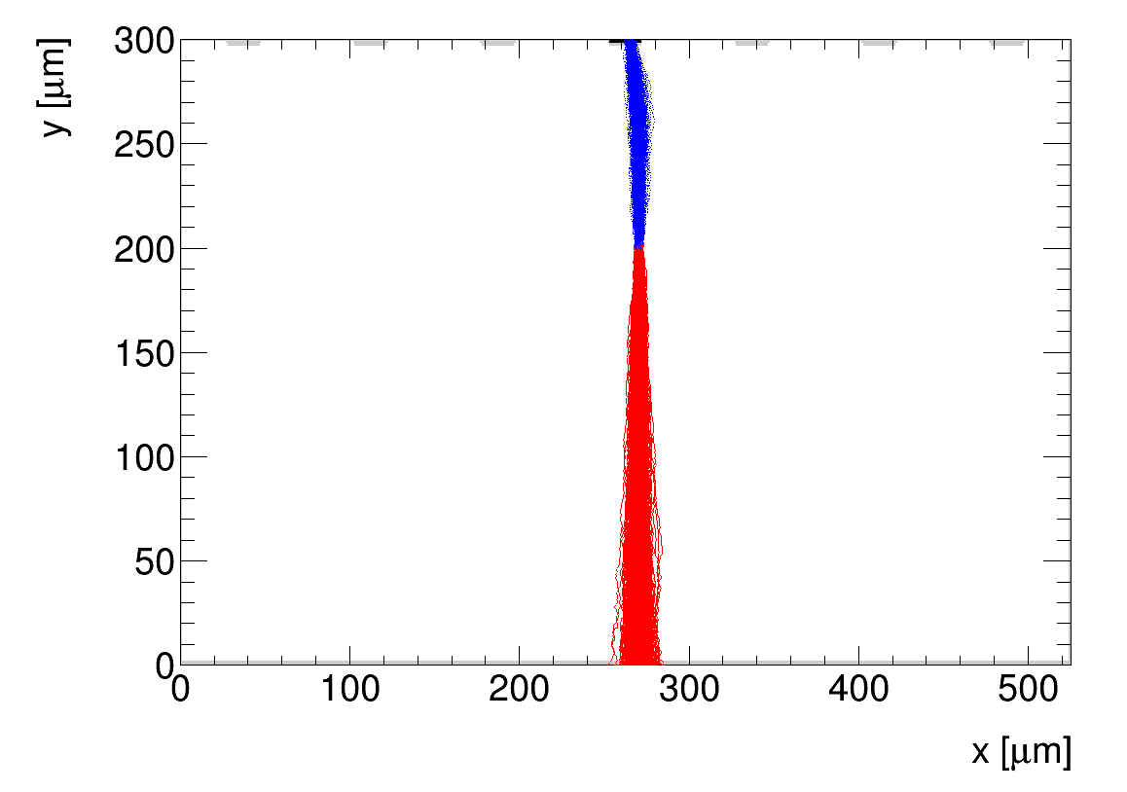
Simulation
laser beam in the direction of strips:
→ “real” strip weighting field
→ “real” charge collection profiles in irradiated strip detectors could be measured
Problem: laser beam divergence
Readout strip
Laser beam spot
Detector depth
Beam direction
scan this area with laser beam :

Slide 7
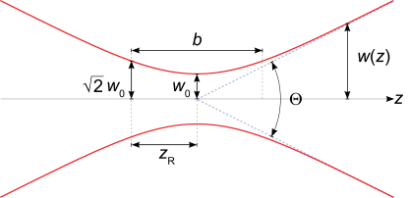
Gaussian beam
- Gaussian beam spot size:
→ initial beam spot radius w₀ = 4 µm ➔ at z = 2 mm radius already w = 48 µm
→ absorption length ~ 1 mm, contribution gets smaller as beam spot grows

Slide 8
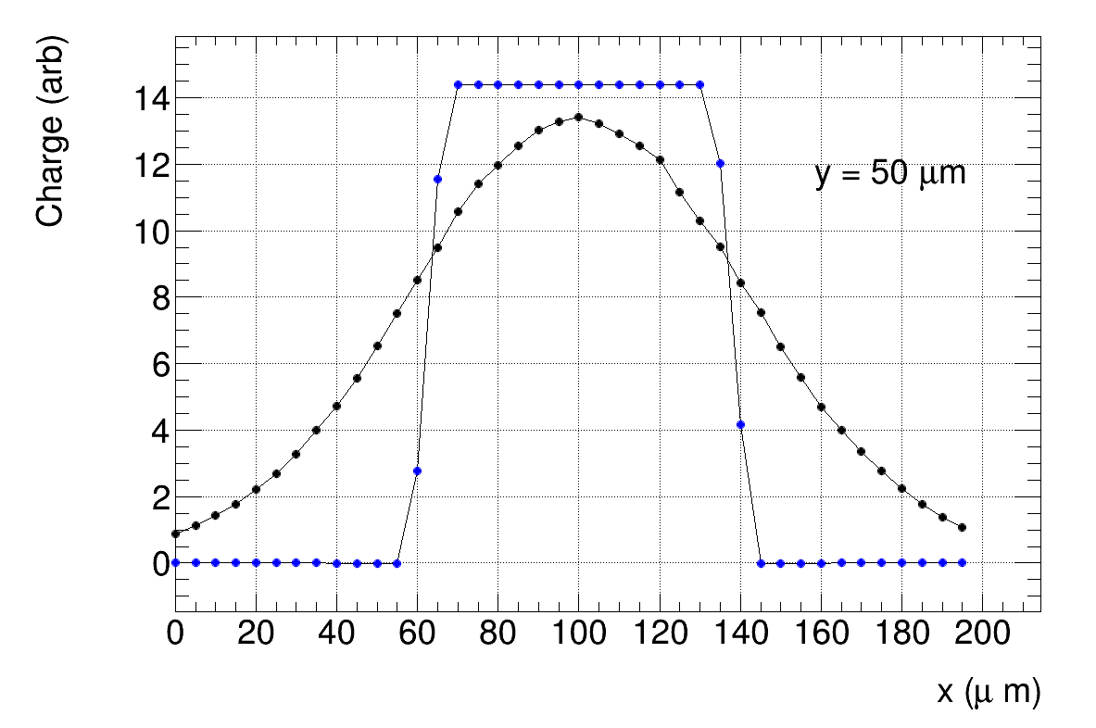
Simulation
compare collected charge - time integral of the induced current pulse
(at depth y = 50 µm) with and without beam divergence
Blue: no divergence
Black: beam divergence
strip
strip
readout strip centre
more than half pitch (35 µm) from the strip centre large effect of beam divergence

Slide 9
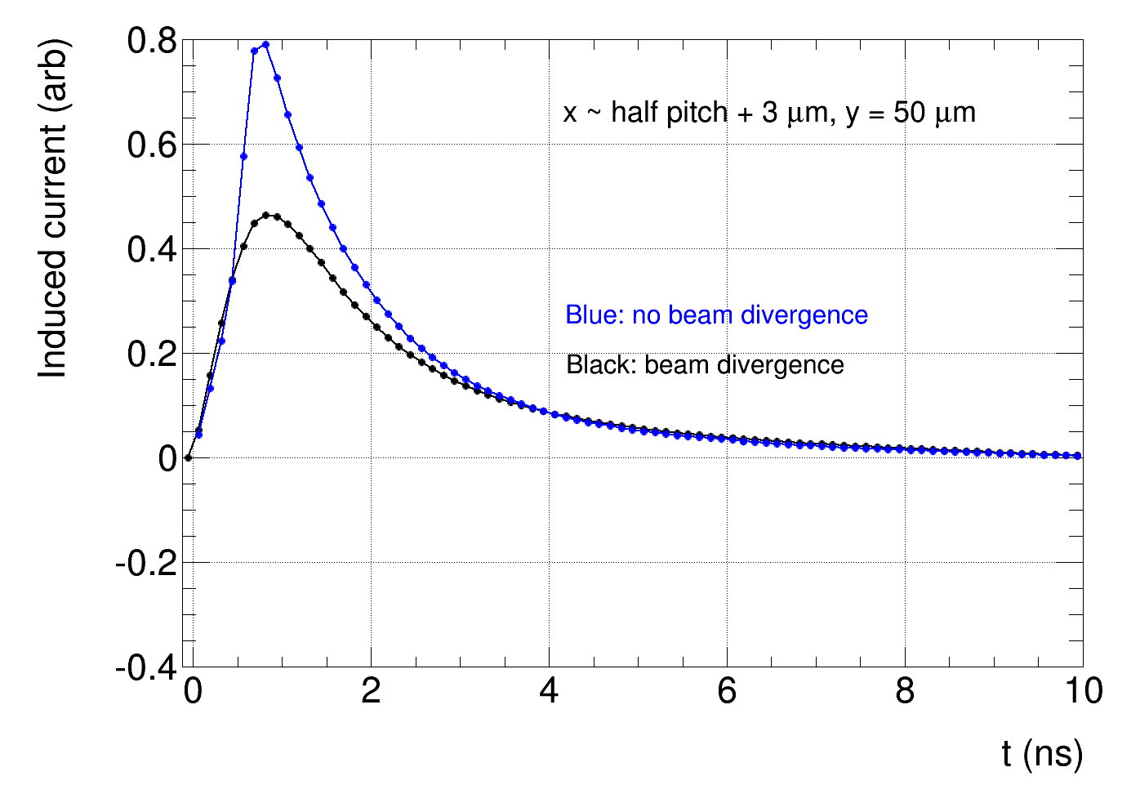
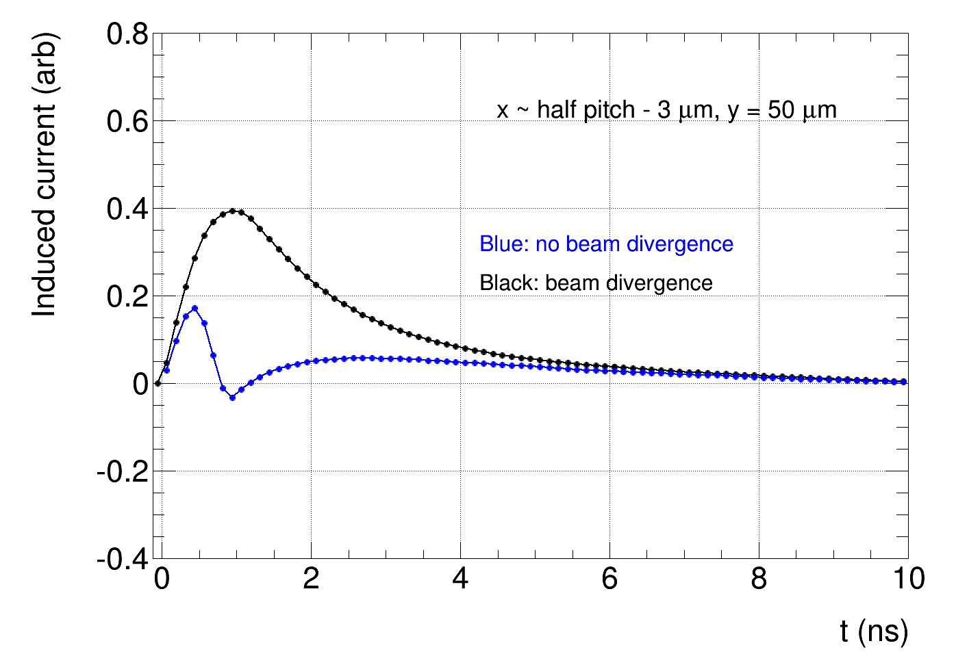
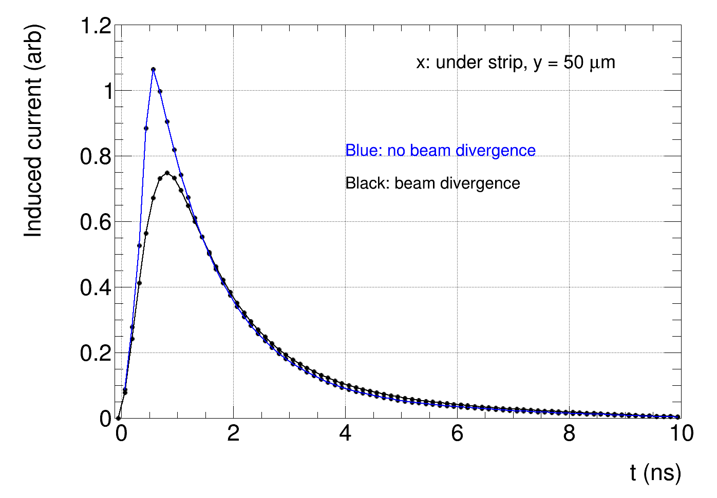
Simulation
compare induced current pulses with and without beam divergence
below readout strip, less than half pitch from the strip centre, differences not dramatic
further away carriers released by diverged beam drifting to the readout strip dominate the pulses

Slide 10
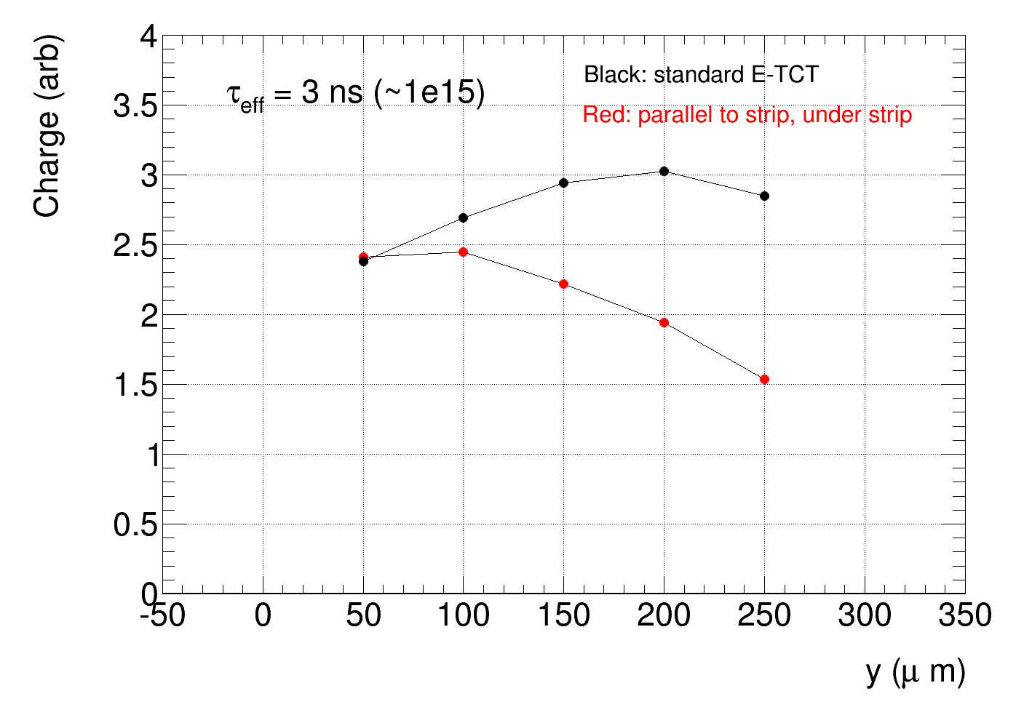
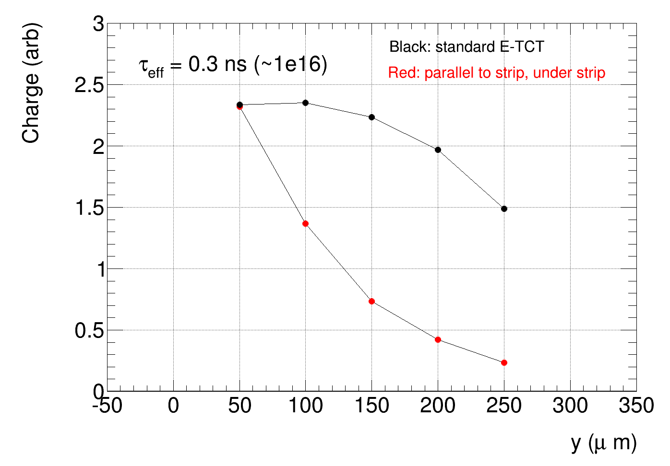
Simulation:
E-TCT measurements with laser beam parallel to strips can be done in the area under strip
→ not too sensitive to beam divergence
compare standard E-TCT and parallel with strips
→ E-TCT parallel with strip: information about charge collection profile in irradiated strip detectors
→ standard E-TCT: weighting field not realistic, overestimated contribution of charge from larger
detector depths
Trapping: multiply induced current pulses with exp(-t/τ_{eff}) and integrate to get the charge:
Warning: electric field here is not realistic and is the same for both trapping time
Charge under readout strip (arb.)
Charge under readout strip (arb.)
Strips
Back plane
Strips
Back plane
depth
depth

Slide 11
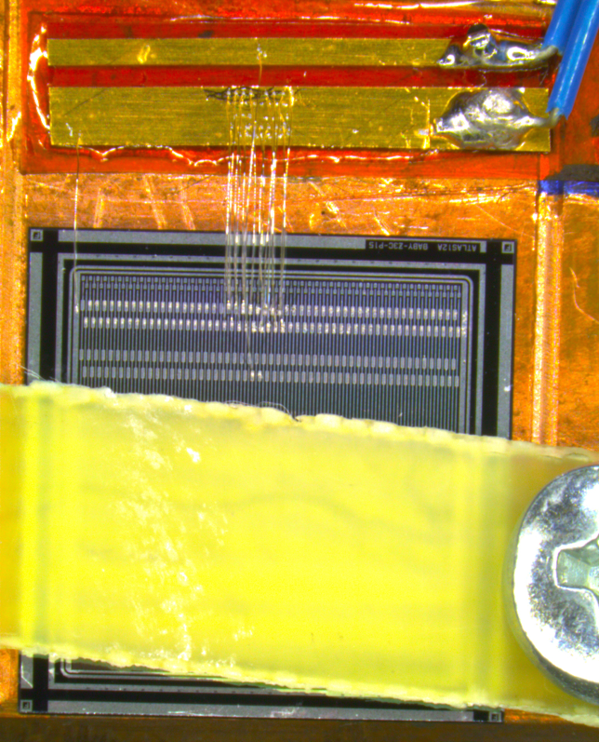
Measurements
Scope
HV filter
HV
HV filter
Laser light
Laser light
Laser light
Atlas12 mini strip detector
n-in-p
pitch 75 µm
V_{fd} ~ 370 V

Slide 12
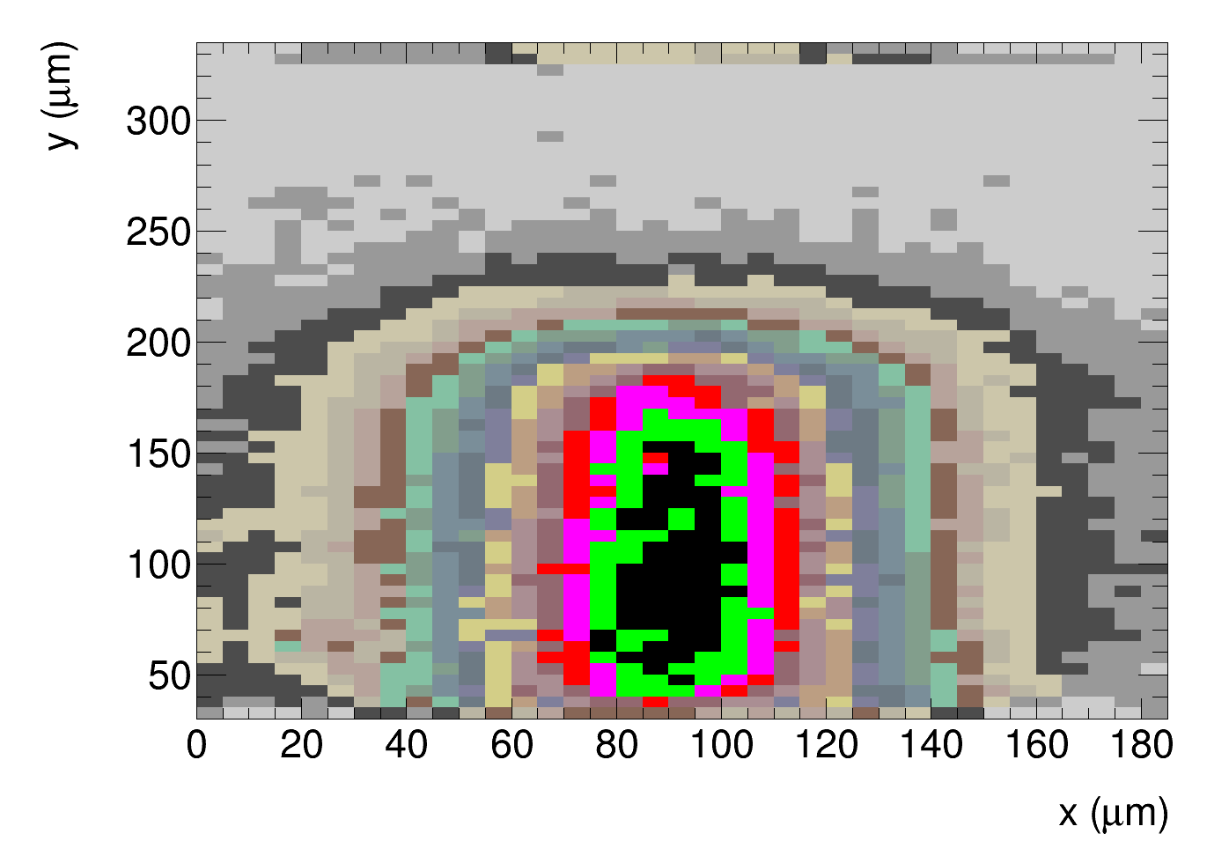
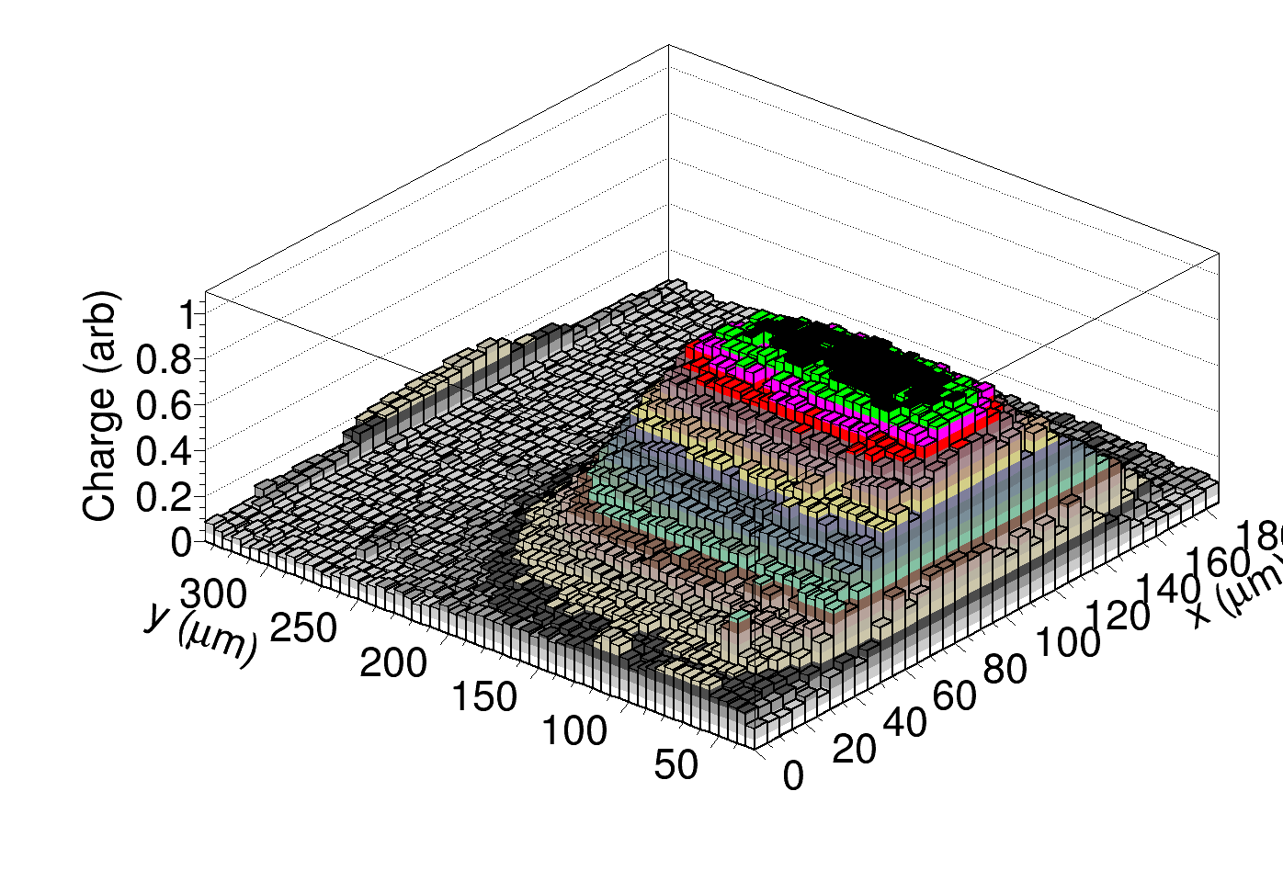
Measurements
charge before irradiation, Bias = 100 V (not fully depleted)
Charge collection profile:
slice under the readout strip
Charge
Lego version
Back plane
Depth
readout strip centre
strip
strip
Beam direction

Slide 13
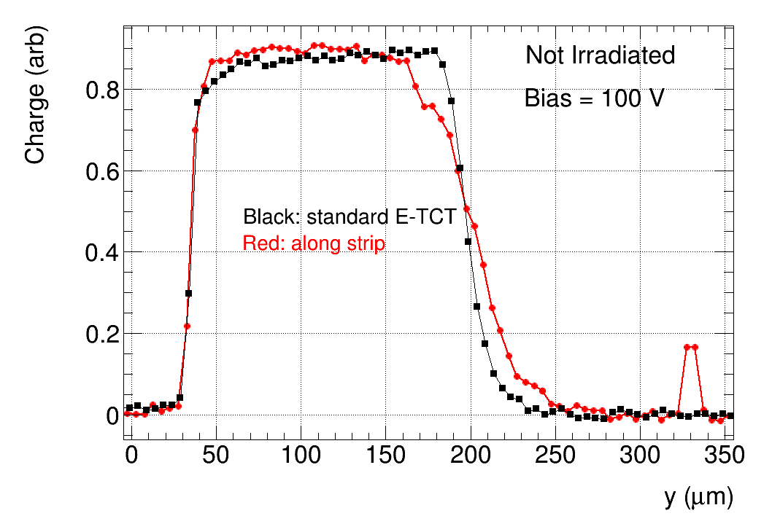
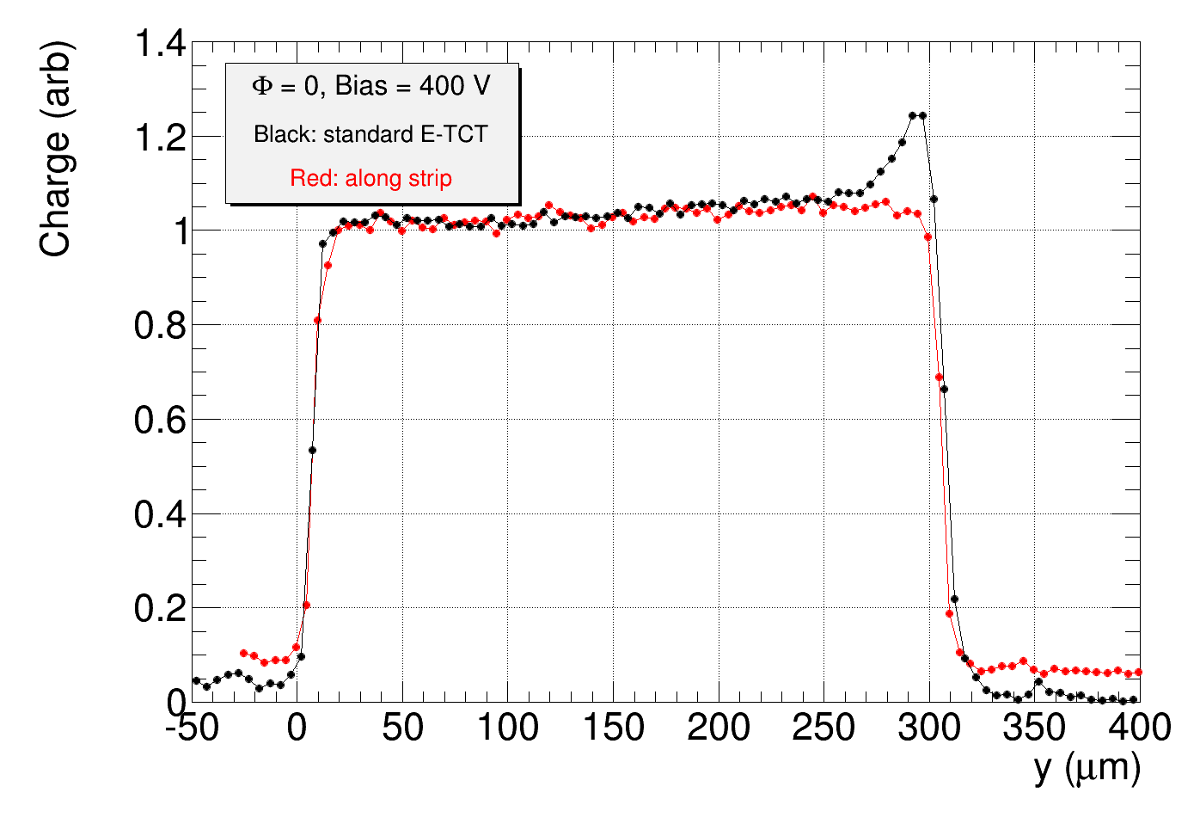
Measurements
compare charge collection profiles measured with standard E-TCT and
with laser parallel to strip:
→ charge collection profiles under strip before irradiation similar
→ beam spread influences also resolution in y direction
Not depleted
(100 V)
Fully depleted
(400 V)
Strips
Strips
Back plane
Back plane

Slide 14
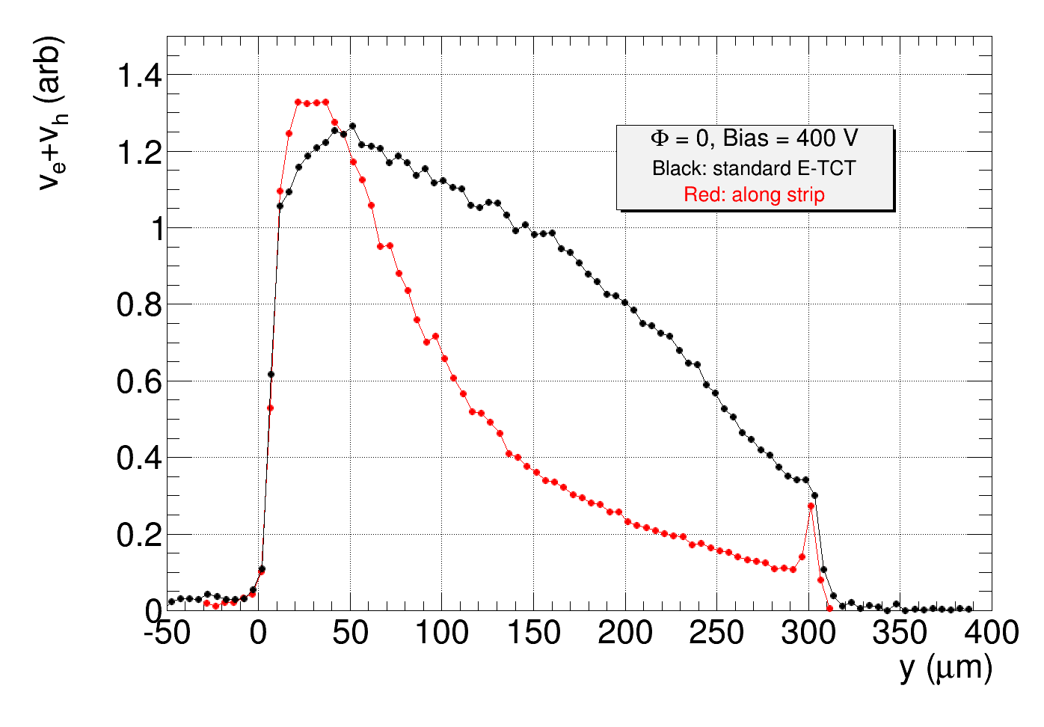
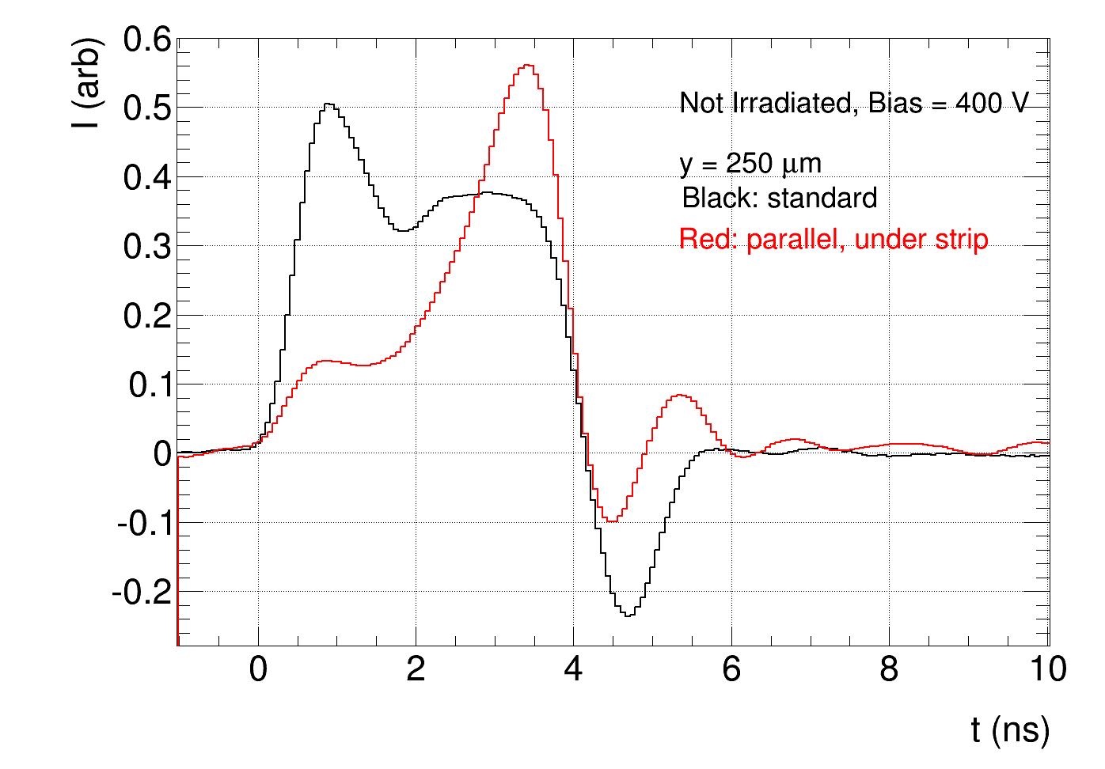
Measurements
velocity profiles and pulses different:
Velocity profile
Pulses at y = 250 µm deep (near backplane)
E_{w} different:

Slide 15
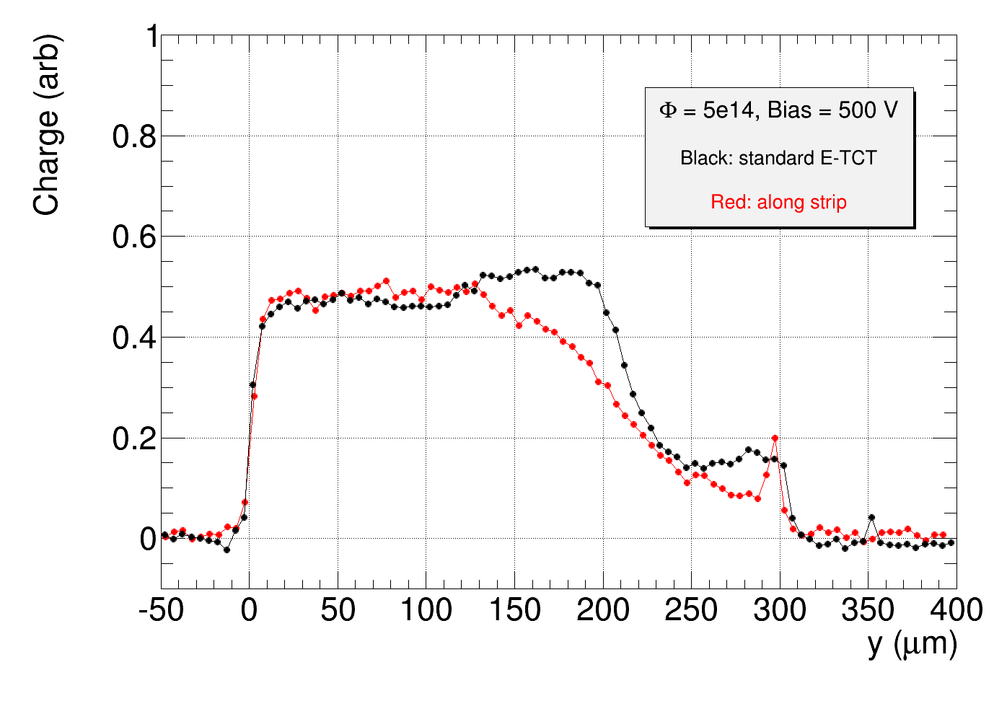
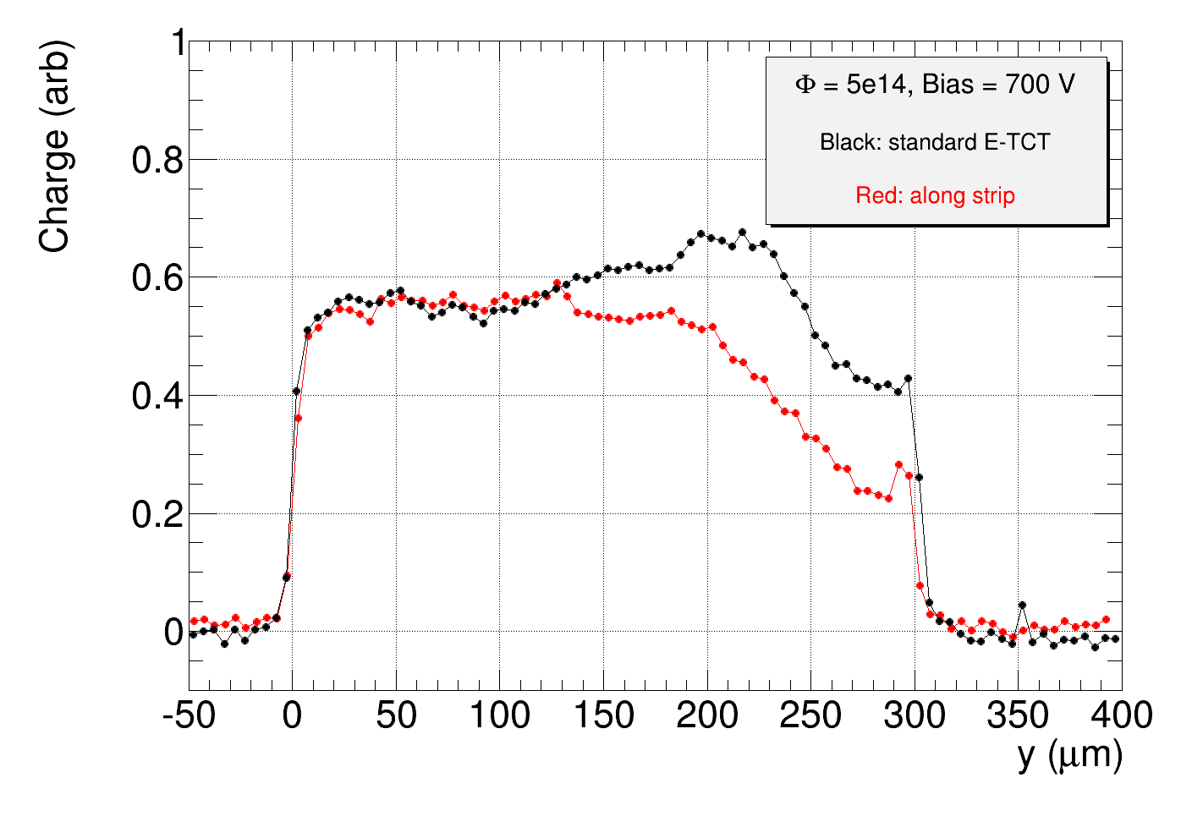
Measurements
irradiated detector Φ = 5e14 n/cm²
normalize to same charge at y = 0 µm for standard and parallel (along strip)
Strips
Back plane
less charge than with standard E-TCT measured near back plane

Slide 16
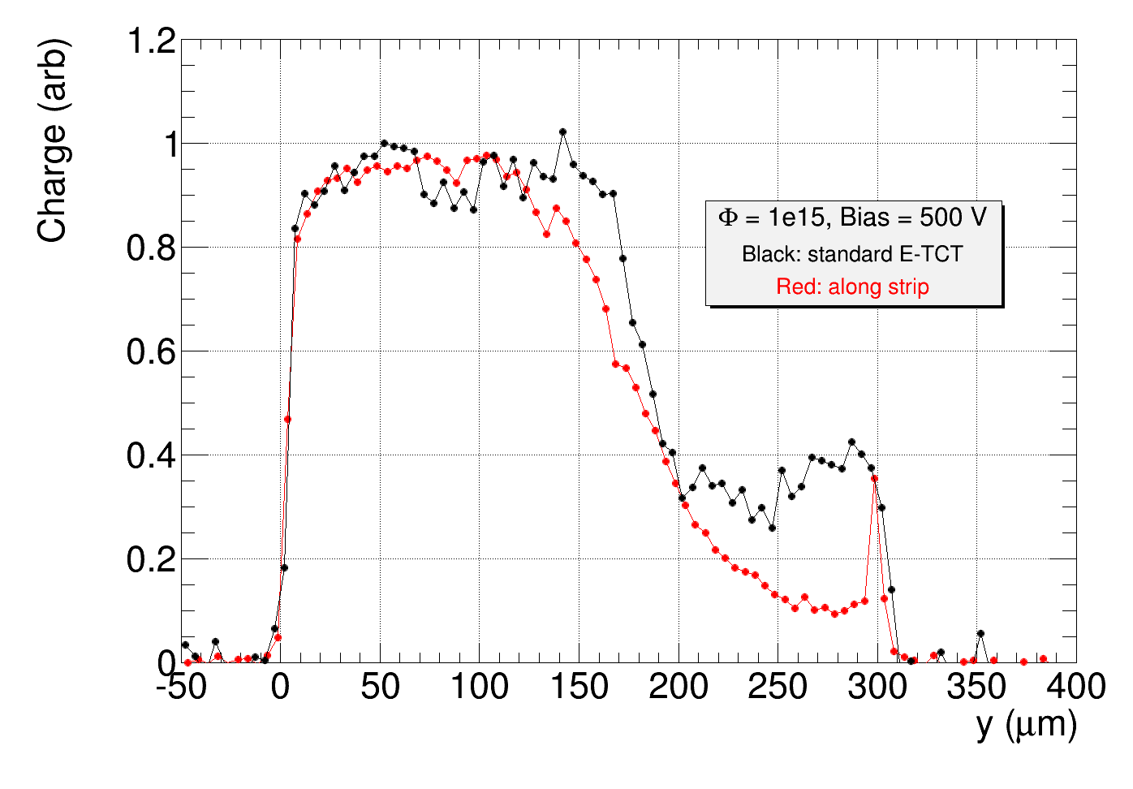
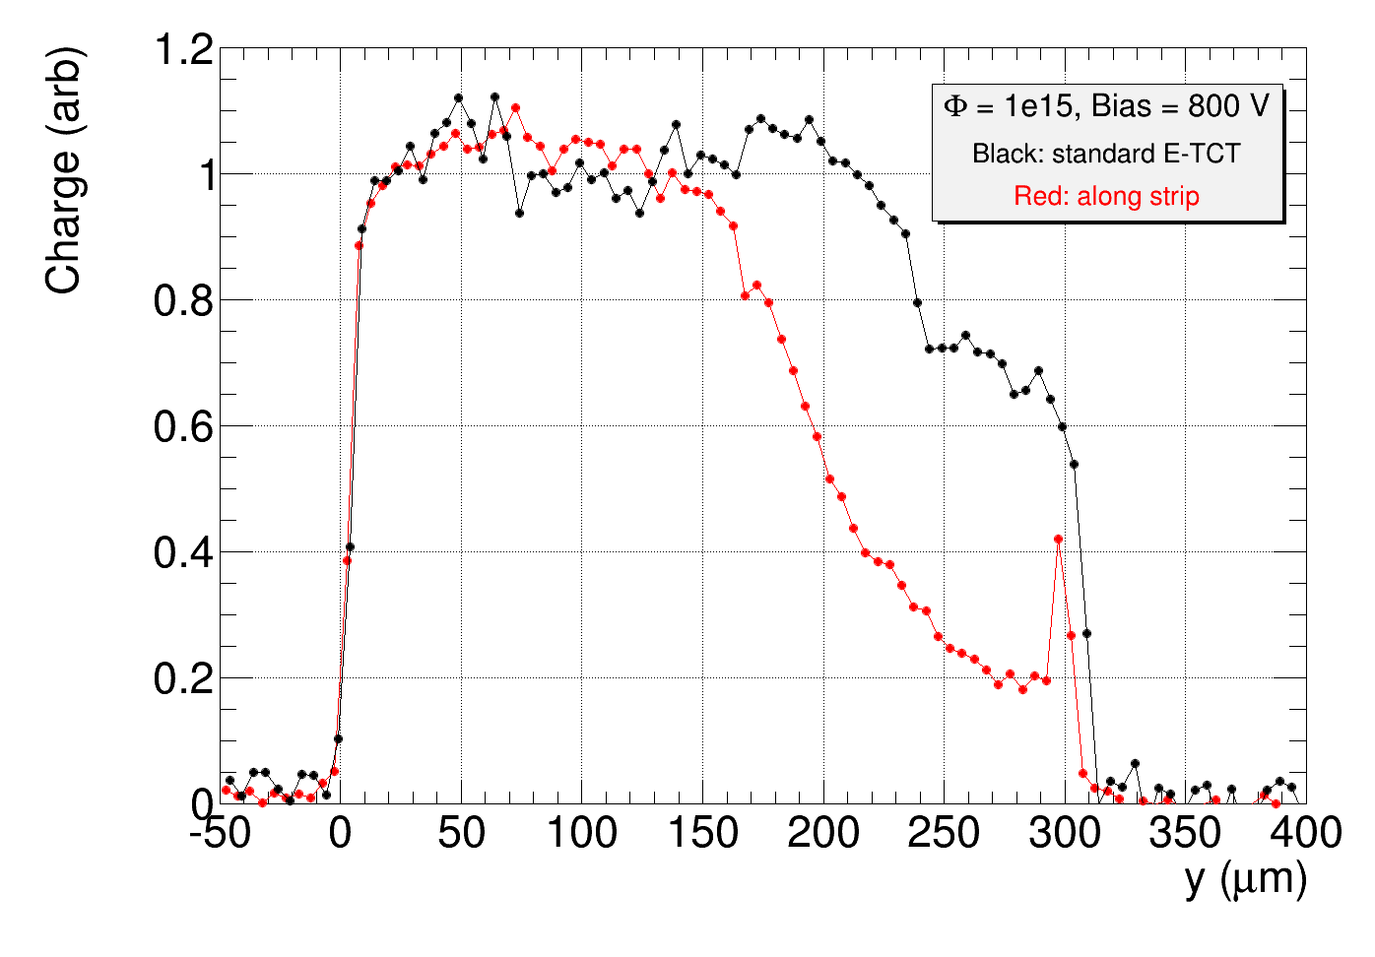
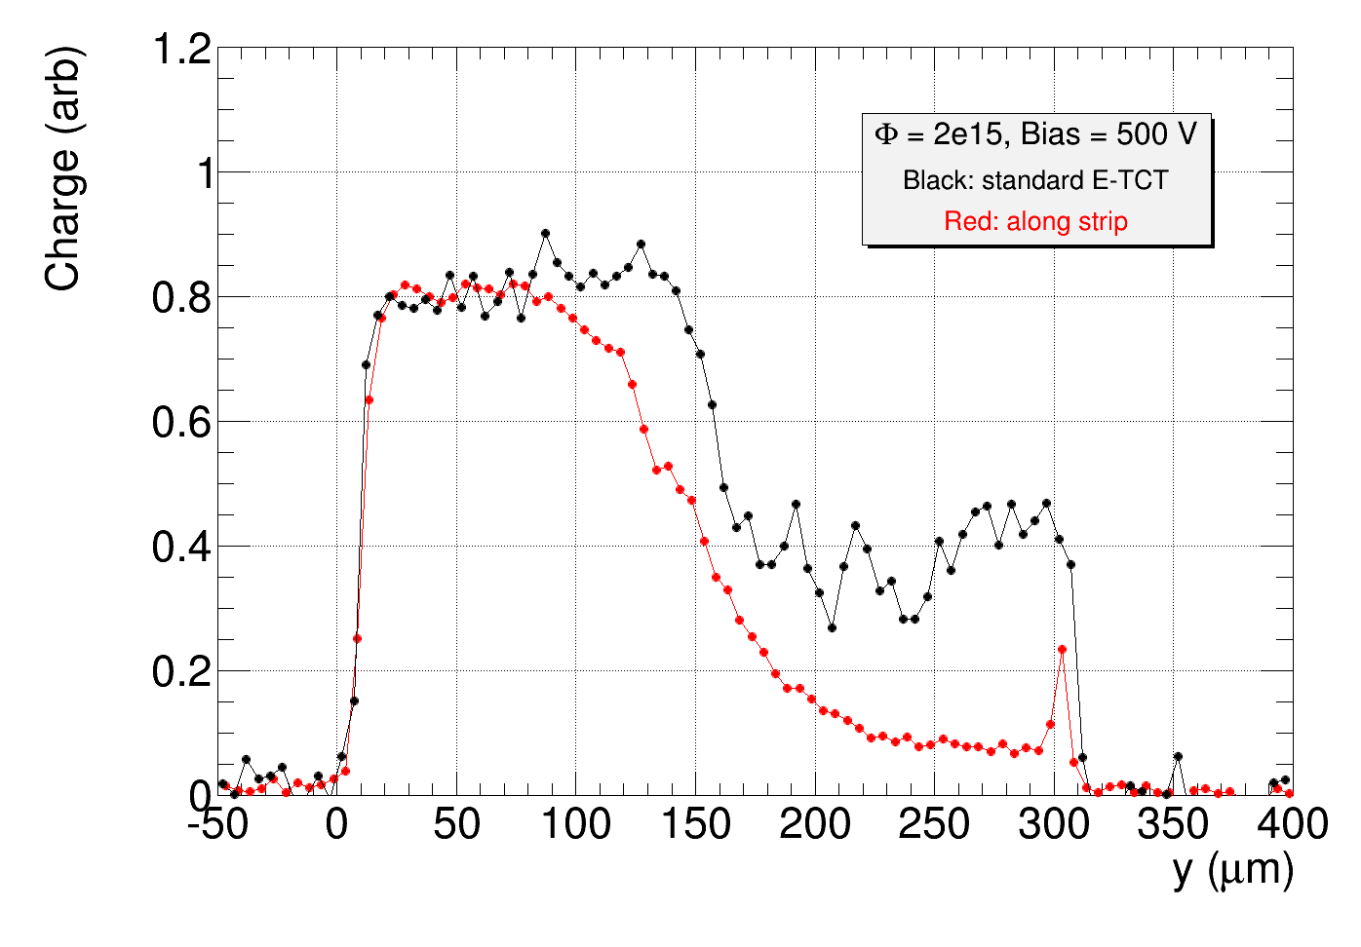
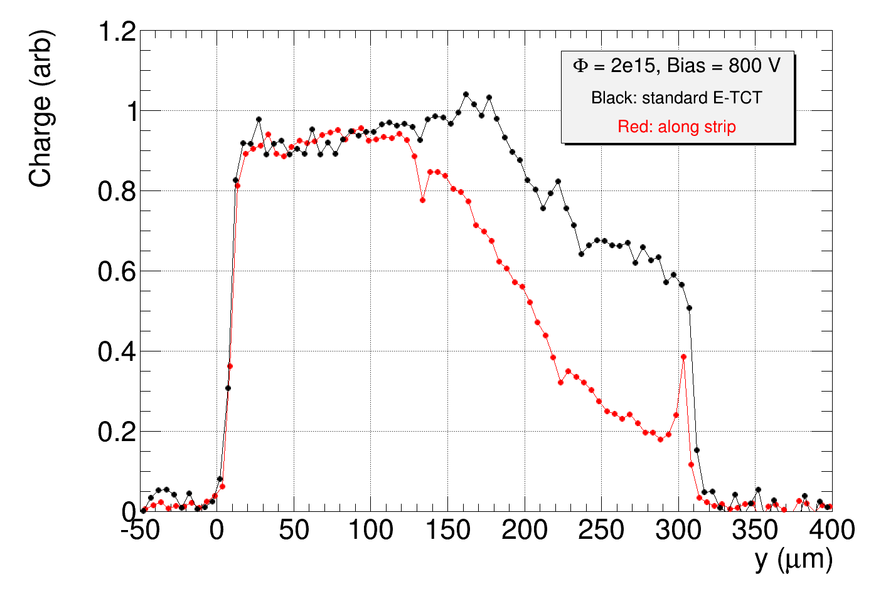
Measurements
higher fluences
1e15, 500 V
1e15, 800 V
2e15, 500 V
2e15, 800 V

Slide 17
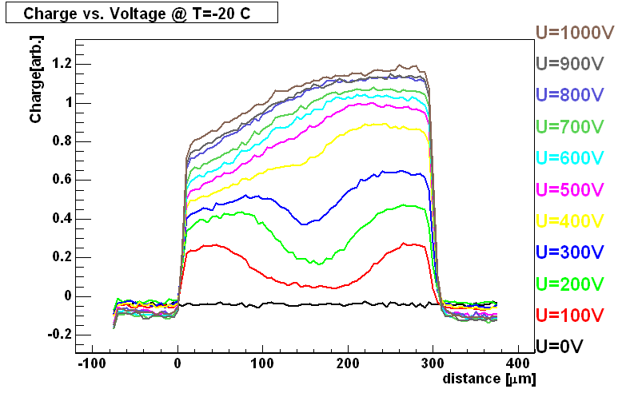
Conclusions
E-TCT with laser light parallel to strips can be used to better estimate
charge collection profiles in irradiated strip detectors compared to standard E-TCT
→ standard E-TCT overestimates contribution of the back side of the detector
→ standard E-TCT good for velocity profiles
because of divergence of laser beam in the detector only limited spatial resolution can be reached
Future work:
try with laser light with shorter penetration depth to get better resolution
measure charge collection profiles with detectors irradiated with 26 GeV protons or pions
where strong double peak field was observed with standard e-TCT:
Example: standard E-TCT charge collection profile
measured with ATLAS07 detector irradiated
with PSI pions to Φ_{eq} = 1.6e15 n/cm2
M. Milovanović, 18thRD50 meeting, Liverpool 2011

