Slide 1




TPA-TCT
A novel Transient-Current-Technique based on the Two Photon Absorption process
25th RD50 Workshop @ CERN
P. Castro¹, M. Fernández¹, J. González¹, R. Jaramillo¹, M. Moll², R. Montero³, F. R. Palomo⁴, I. Vila¹
¹Instituto de Física de Cantabria (CSIC-UC)
²CERN
³Universidad del Pais Vasco (UPV-EHU)
⁴Universidad de Sevilla (US)

Slide 2
Scope of this talk
Here, this talk focused on the experimental results from the first proof-of-concept measurement to study the TCT currents induced by TPA in an RD50-like non-irradiated standard PiN diode.
More details on the basics of the TPA process can be found in this talk by F.R. Palomo (link)
More details on the code TRACS (TRansient Current Simulator) used to compute the theoretical current waveforms in P. de Castro talk (link)

Slide 3
Outline
Motivation and challenges for a TCT technique based on the Two- Photon- Absortion (TPA) process.
Femto-second laser setup:
  Signal size and shape vs. laser power.
  Determining the charge carriers generation volume.
Experimental data vs. simulation for a z-scan in a PiN diode.
Conclusions and outlook

Slide 4
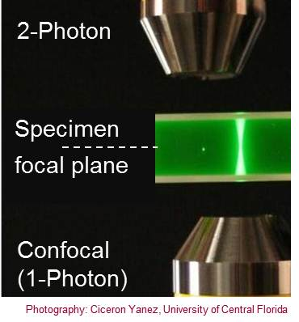
Motivation for a TPA-based TCT technique
"A picture is worth a thousand words”
TPA-TCT is a way to generate very localized electron-hole pairs in semiconductor devices (microscale volume).
TPA-TCT simplifies the arrangement to inject light into the device and the unfolding of the device internal Electric field and other relevant parameters of the theoretical model.
TPA-TCT could provide a novel experimental tool for studying the currently under development small pixel size detectors.

Slide 5
TPA-TCT Proof-of-concept Challenges
Confirm the generation of TPA induced current in a silicon diode with the appropriate laser power.
Determine the dimensions of the charge-carrier’s generation volume.
Compare the experimental TCT current waveforms against the theoretical simulated current waveforms (access its potential as experimental tool to discriminate between different theoretical models).

Slide 6


Experimental arrangement (1)
Pulsed femto laser (at normal incidence) entering the diode junction side (conventional top-TCT configuration)
FEMTO LASER
OPTICAL BENCH
Laser
λ ∼ 1300 nm
P ∼ 50-100 pJ
ΔT ∼ 240 fs
Rate ∼ 1 kHz
Δf ∼ 11 nm
Microfocus
X100 Objective
f 100 mm lens
2.5 GHz DSO
L
CCD
BS
OSC
IA
FSW
BS
S
RL
AMP
OPA
OBJ
IF
VNDF
DUT
PD
TS
SSA
&
DO
FROG
READ OUT
TB
Sourcemeter

Slide 7
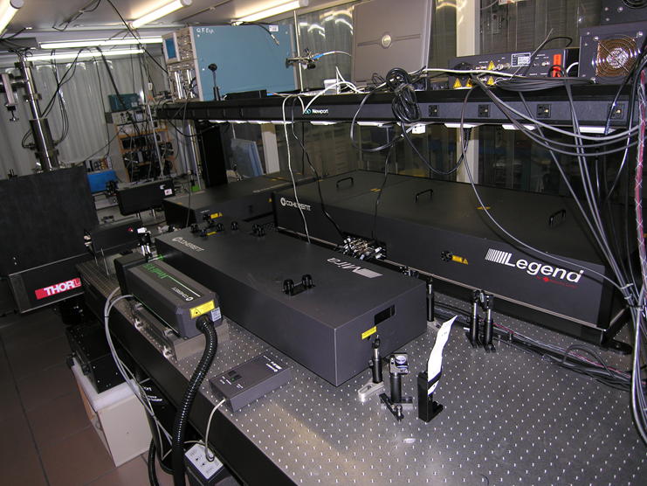
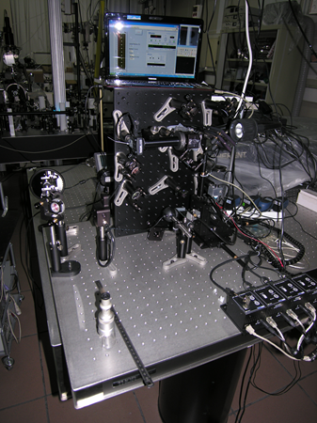

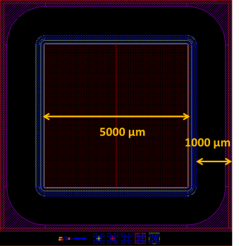
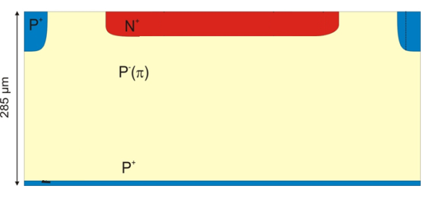
Experimental Arrangement (2)
DUT CNM N-IN-P DIODE
LGAD PIN REFERENCE DIODE
Ref - W9F9

Slide 8
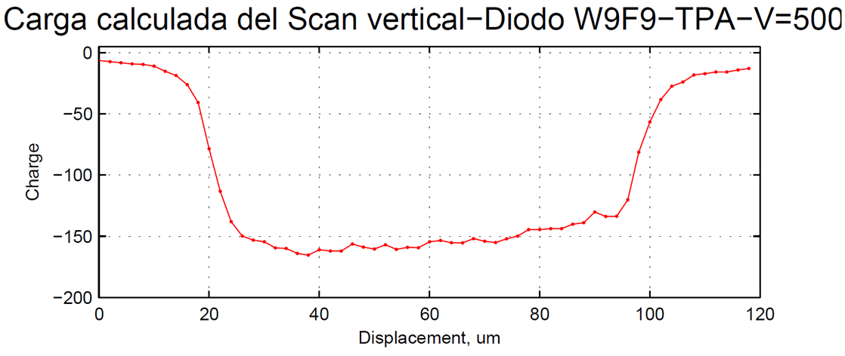
Evidence of TPA-TCT (1)
Z-Scan: vertical displacement of the DIODE perpendicularly to the laser beam (z axis)
Diode
Displacement
80 x n_{index_Si} ∼ 280 um
TPA -> Charge vs z -> plateau (Observed behavior)
SPA (Standard TCT) -> Charge vs z -> no z dependence.

Slide 9
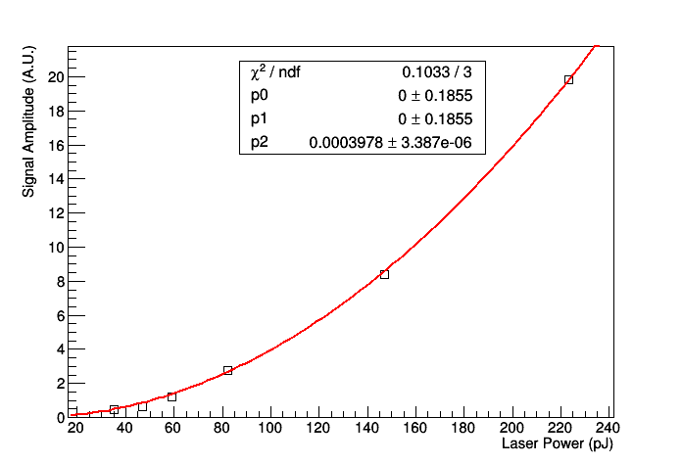
Evidence of TPA-TCT (2)
Pure quadratic dependence between the Signal Charge and the laser power.

Slide 10
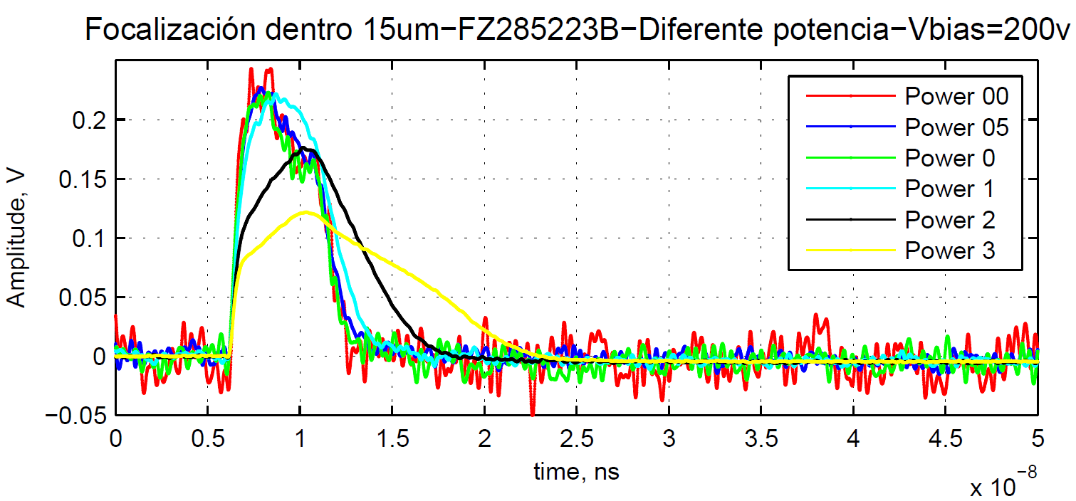
Which is the adequate laser power ?
35 pJ
47pJ
59 pJ
82 pJ
147 pJ
223 pJ
Seconds
Similar pulse shapes for laser pulses up to a power of 60-80 pJ, for higher power values TCT waveform gets wider and wider (likely due to plasma effects).

Slide 11

TPA-TCT Proof-of-concept Challenges
Confirm the generation of TPA induced current in a silicon diode with the appropriate laser power.
Determine the dimensions of the charge-carrier’s generation volume.
Compare the experimental TCT current waveforms against the theoretical simulated current waveforms (assess its potential as experimental tool to discriminate between different theoretical models).

Slide 12
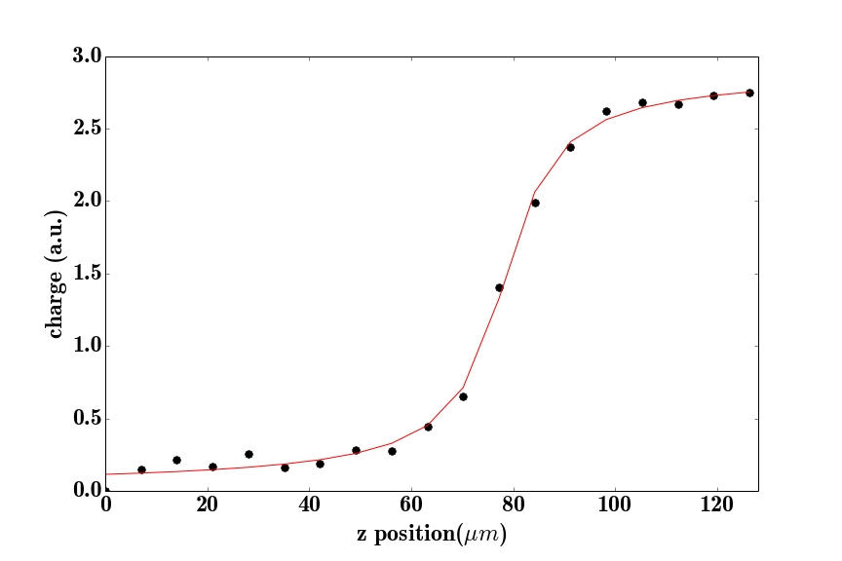
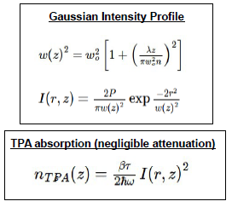
TPA-Induced charge-carriers volume
The laser’s volume of excitation ( e-h pair creation) is fully determined by the laser parameters (λ and W₀) and the TPA cross-section in Silicon (β)
In our case, λ and β are known, a fit of the raising edge of the charge z-scan profile determines W₀
beam waist from the fit
w0 = 0.95±0.05 um

Slide 13
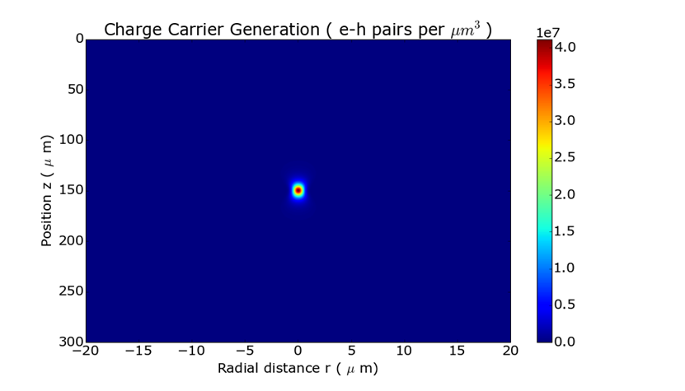
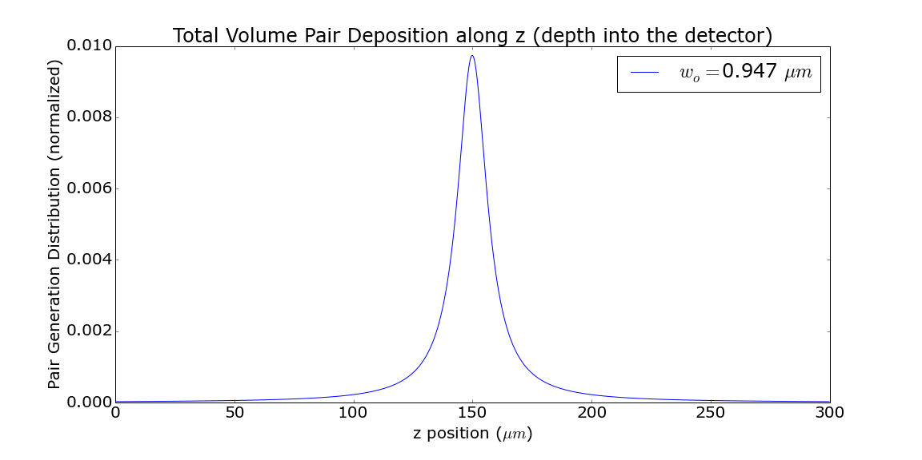
TPA-Induced Charge-carriers volume (2)
Simulation
Simulation

Slide 14
TPA-TCT Proof-of-concept Challenges
Confirm the generation of TPA induced current in a silicon diode with the appropriate laser power.
Determine the dimensions of the charge-carrier’s generation volume.
Compare the experimental TCT current waveforms against the theoretical simulated current waveforms (assess its potential as experimental tool to discriminate between different theoretical models).

Slide 15
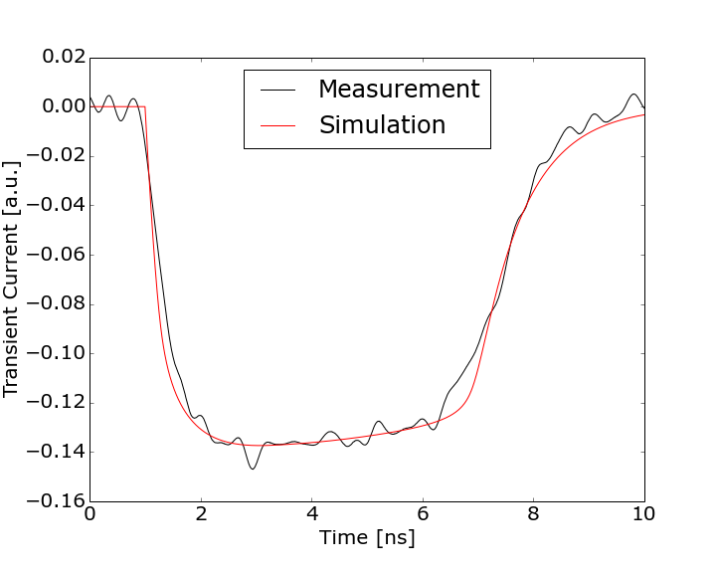
TCT Waveforms: 20um focus depth
NOT a fit just a simulation normalization
CNM N-IN-P DIODE
LGAD PIN REFERENCE DIODE
Ref - W9F9 (500 V bias)
Single Photon Absorption red laser TOP-TCT (hole injection)

Slide 16
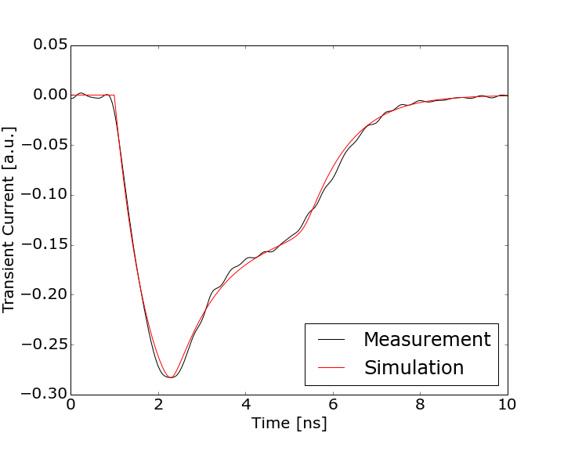
TCT Waveform: 97 um focus depth
NOT a fit just a simulation normalization
CNM N-IN-P DIODE
LGAD PIN REFERENCE DIODE
Ref - W9F9 (500 V bias)
Electrons and holes TCT current contribution distinct from the TCT current shape.

Slide 17
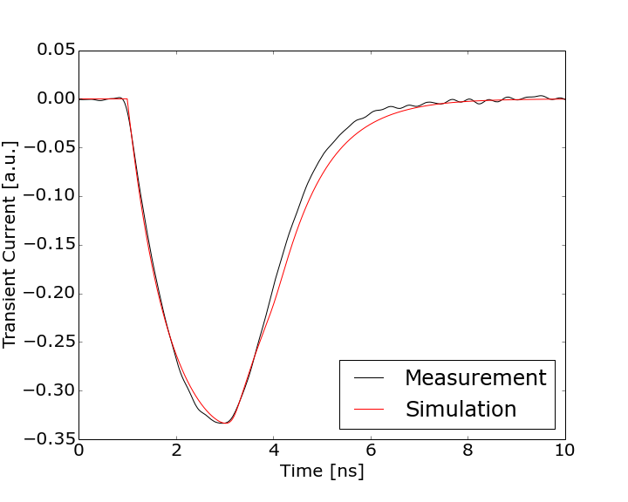

TCT Waveform: focus depth 160um
CNM N-IN-P DIODE
LGAD PIN REFERENCE DIODE
Ref - W9F9 (500 V bias)
Around the minimal pulse width, similar arrival times for electrons and holes

Slide 18
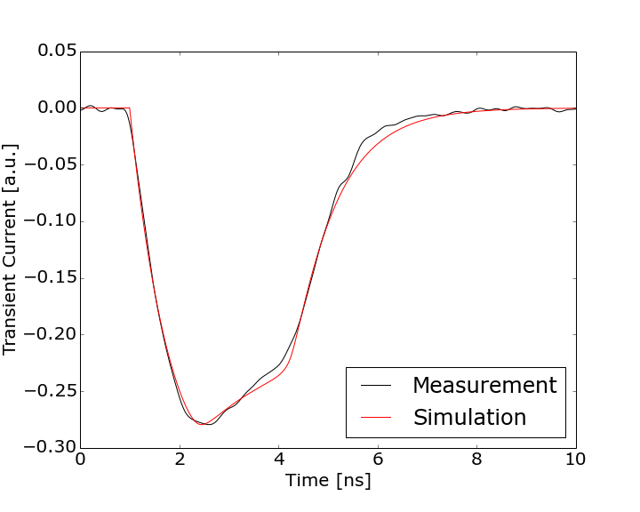
TCT Waveform: focus depth 237um
CNM N-IN-P DIODE
LGAD PIN REFERENCE DIODE
Ref - W9F9 (500 V bias)
TCT wavefrom gets wider again, trailing edge dominated by electrons now.

Slide 19
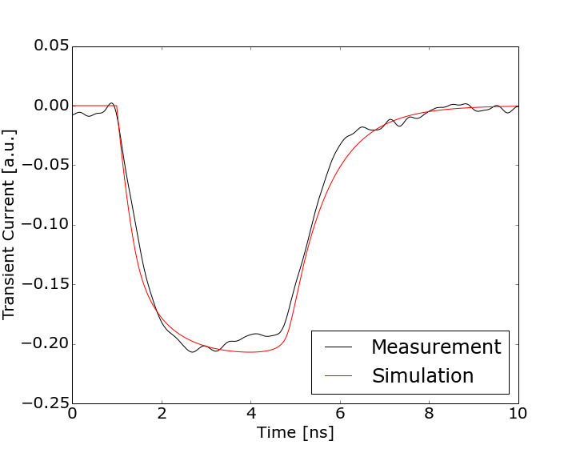
TCT Waveform: focus depth 278um
CNM N-IN-P DIODE
LGAD PIN REFERENCE DIODE
Ref - W9F9 (500 V bias)
SPA - red laser bottom-TCT like signal (electron injection)

Slide 20
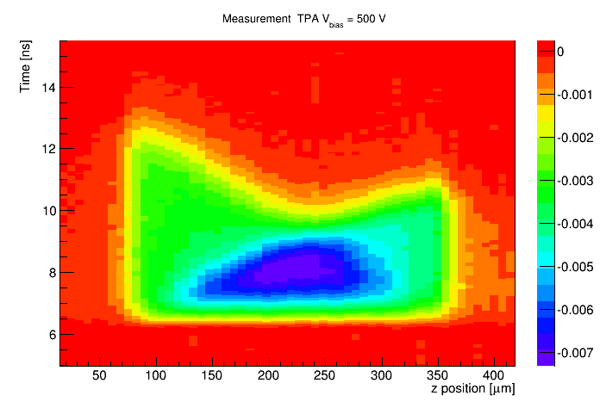
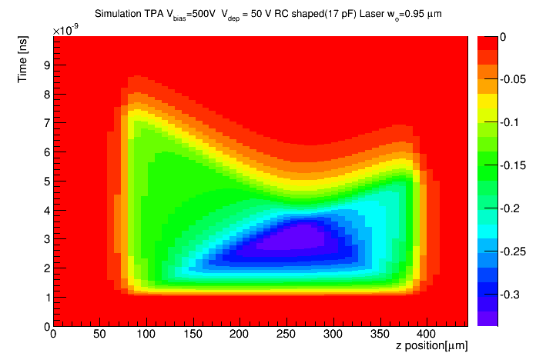
TPA-TCT: Distinct Electron & Hole dynamics
junction
Ohmic contact
Electrons
Holes
Out of the box simulation (no fit): 500 V, RC 17pC, Laser waist 0.95 um, Vdep 50 Volts
Excellent agreement between data (left) and TRACS simulation.

Slide 21
TPA-TCT Proof-of-concept Challenges
Confirm the generation of TPA induced current in a silicon diode with the appropriate laser power.
Determine the dimensions of the charge-carrier’s generation volume.
Compare the experimental TCT current waveforms against the theoretical simulated current waveforms (assess its potential as experimental tool to discriminate between different theoretical models).

Slide 22
Conclusions and Outlook
We have completed the successful proof-of-concept of a novel Transient-Current-Technique based on the Two-Photon-Absortion (TPA) process
Excellent agreement between the experimental data and the simulation points to its potential as tool for disentangling different theoretical models.
Opens up the possibility of a new range of opportunities for boosting the scope of TCT techniques:
  More accurate 3D mapping of E_{field}.
  Simpler unfolding methods.
  More accurate study of pixelated sensors.
  Less relevance of metal-induced beam reflections.
But, still a lot of work and challenges ahead to make it a reliable, accessible and practical diagnostic tool.

Slide 23
THANK YOU !

Slide 24
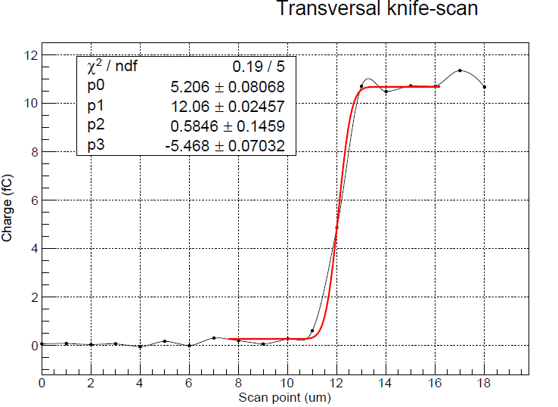
Generation Volume (knife-scan)
Diode
Displacement
Laser waist < than 1 um (accuracy limited by motor displacement resolution)

