Slide 1

LHCb SciFi
The new Fibre Tracker for LHCb

Slide 2
A scintillating fibre tracker can provide
good tracking performance (σ_{hit} < 100 μm)
at very low and uniform material budget
and fast (LHC speed) readout
Outline of this presentation
The LHCb SciFi Tracker
The main challenges
  Building large-size detector modules
  Fibres to survive ionising radiation
  SiPMs to survive neutron field
  Integration (incl. -40 deg.C)

Slide 3
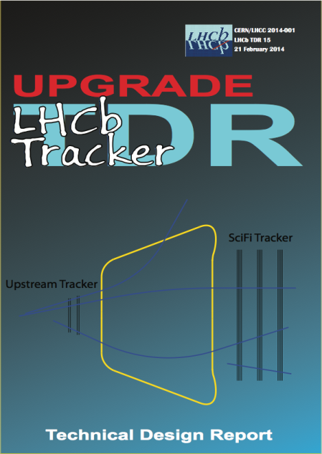
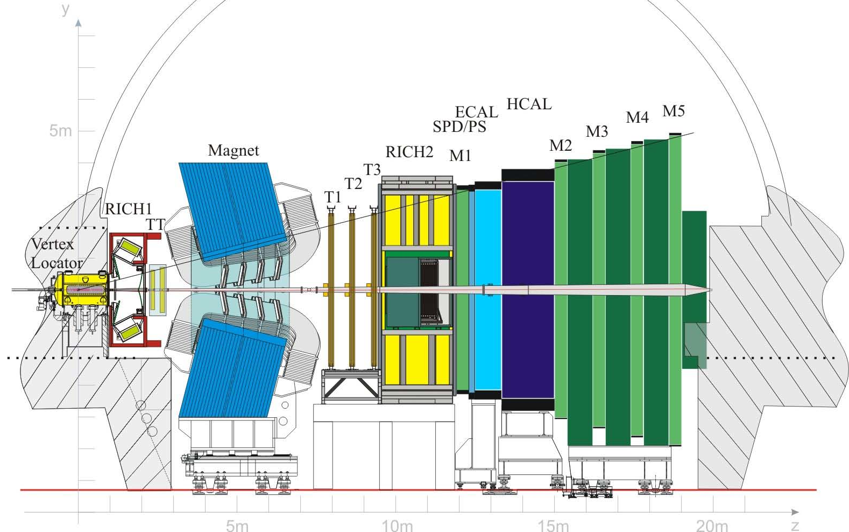
Major tracking upgrade of LHCb
(for after LS2, ≥2020, 50fb⁻¹)
Aim for the same performance at high luminosity (2·10³³ cm⁻²s⁻¹, 25 ns, ν =7.6) as under current conditions (<4·10³², 50 ns, μ=1.7).
New VELO, Si pixel based
New Upstream tracker (UT), Si-μstrip
SciFi Tracker, scintillating fibres
LHCb Tracker Upgrade TDR
CERN/LHCC 2014-001
LHCb TDR 15
Currently in place: Outer Tracker (OT) = Straw tube gas detectors (Ø 4.9 mm)
+ Inner Tracker (IT) = Silicon μstrips (pitch = 200 μm)

Slide 4
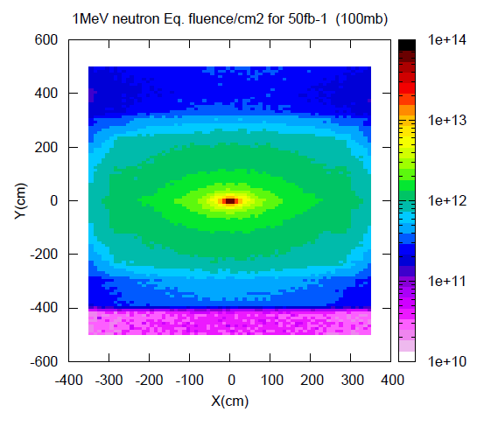
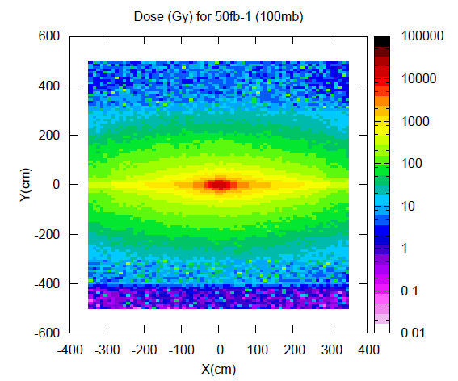
LHCb FLUKA simulation
Main requirements
Detector intrinsic performance: measure x,x' (y,y') with
high hit efficiency(~99%)
low noise cluster rate (<10% of signal at any location)
σ_{x} < 100μm (bending plane)
X/X0 ≤ 1% per detection layer
Constraints
40MHz readout
geometrical coverage: 6(x) x 5(y) m²
fit in between magnet and RICH2
radiation environment:
      ≤ 10¹² 1MeV n_{eq} / cm² at the location of the
      photo-detectors
      ≤ 80Gy at the location of the photo-detectors
      ≤ 35kGy peak dose for the scintillating fibres
→low temperature operation of photodetectors

Slide 5
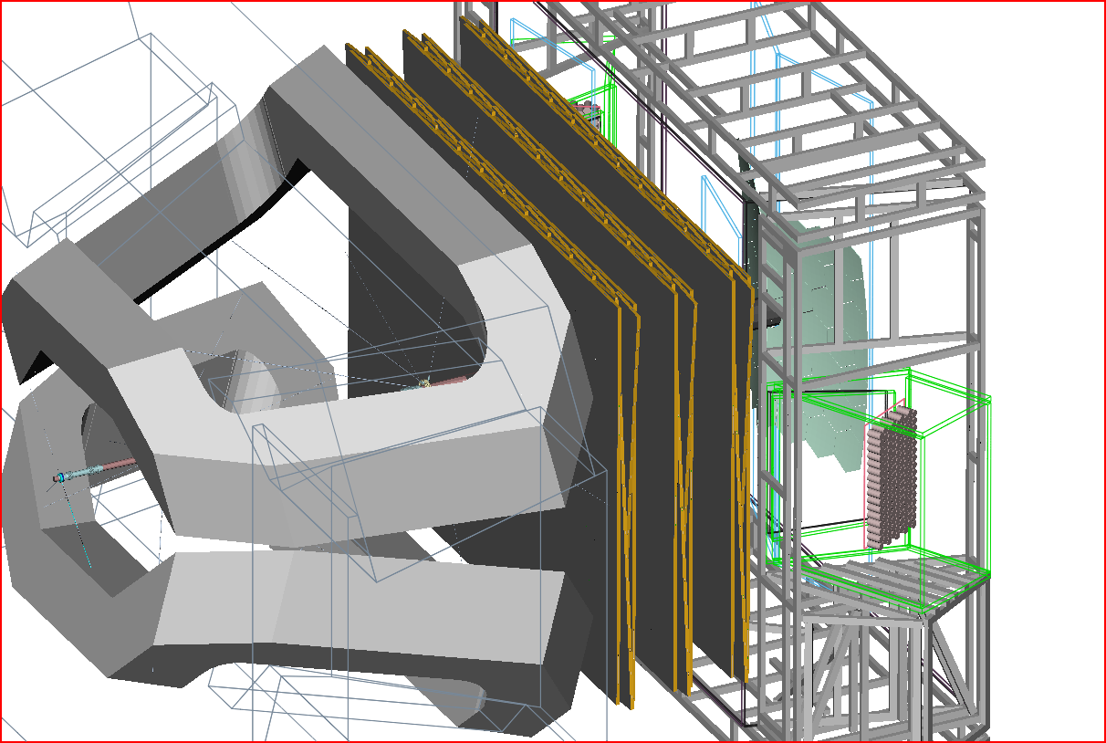
General layout of the detector geometry:
3 stations with 4 planes each X-U-V-X

Slide 6
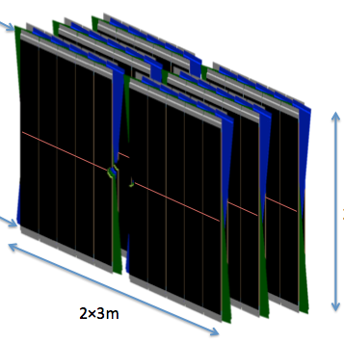
T2
T3
T1
readout
stereo angle ± 5° (prel.)
10 or 12 (almost) identical modules per detection plane
Fibre ribbons (mats) run in vertical direction.
fibres interrupted in mid-plane (y=0) and mirrored
fibres read out at top and bottom
photodetectors + FE electronics + services in a “Readout Box”
1 module
readout
2 x ~2.5 m
~540 mm
2 x ~3 m

Slide 7
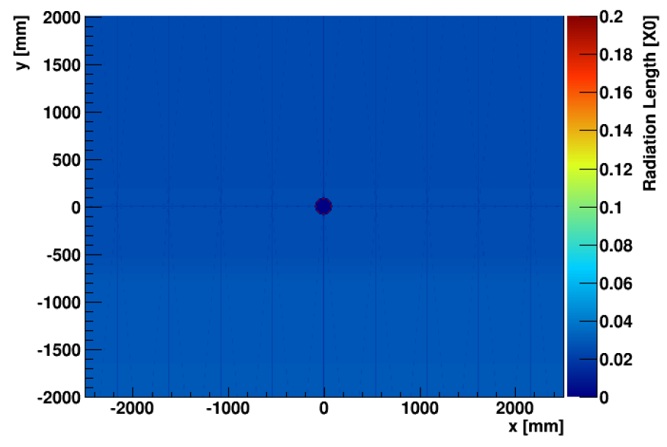
Material distribution X/X₀ of station T1 (with 4 planes X-U-V-X)
<X/X0> = 2.6%
Plot is a bit optimistic: 6th fibre layer in central modules not included
Fibre end pieces in midplane (y=0) not included

Slide 8
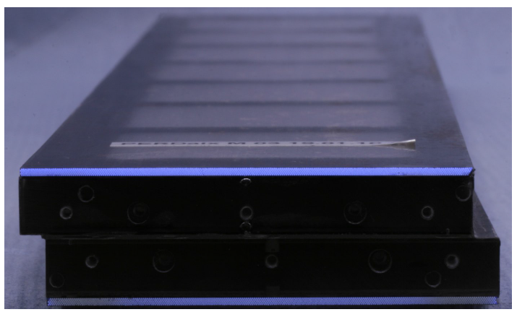
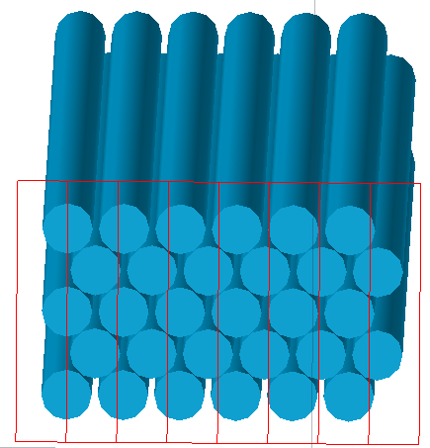
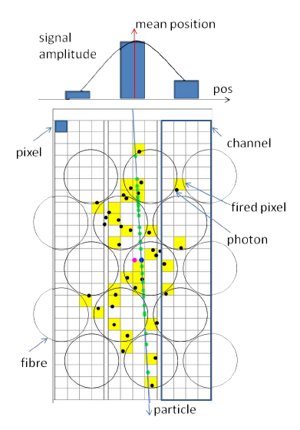
Technology:
Fibres and photodetectors
The SciFi tracker is following the technology developed by the Aachen group for the PERDaix detector (prototype balloon experiment)
B. Beischer et al., A 622 (2010) 542–554
G.R. Yearwood, PhD thesis, Aachen, 2013
PERDaix: 860 mm (L) x 32 mm (W) bi-layer module in stereo geometry.
5 staggered layers of Ø250 μm fibres form a ribbon (or mat)
Readout by arrays of SiPMs. 1 SiPM channel extends over the full height of the mat.
Pitch of SiPM array should be similar to fibre pitch. Light is then spread over few SiPM channels. Centroiding can be used to push the resolution beyond p/sqrt(12).
Hits consist of clusters with typical size = 2. This is an efficient approach to suppress noise hits (=single pixels in 1 channel).

Slide 9
LHCb SciFi module design
SciFi module
What is different from PERDaix?
 | PERDaix | LHCb SciFi
Module length | 39.5 / 86 cm | 2 x 250 cm
Detector surface | 0.25 m² | ~360 m²
Radiation | none | 10⁴ Gy, 10¹² n/cm2
Multiplicity | 1 | A few hundred
Readout | rel. slow | 40 MHz
2 x 250 cm
LHCb SciFi main design parameters
Round double cladded fibres of Ø250 μm, L = 2500 mm, mirrored
13 cm wide fibre mats made of 5 (or 6) staggered layers.
4 mats are assembled on the same support structure and form a 54 cm wide module.
Readout by arrays of SiPMs. 128 channels. Pitch of SiPM = 250 μm.
➔ >10,000 km of fibres
54 cm

Slide 10
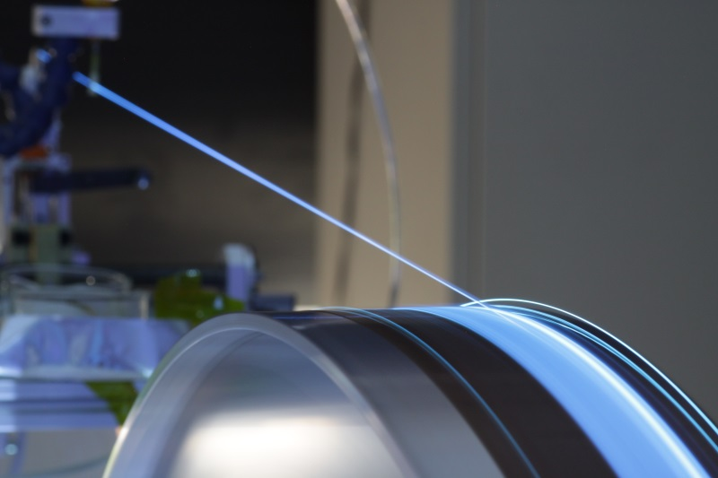
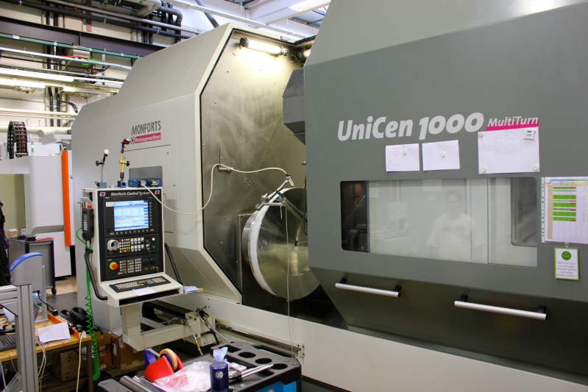
Geometrical precision
Fibre mats are produced by winding fibres, layer by layer, on a fine-pitch threaded wheel
addition of very fluid epoxy glue, TiO2 loaded
feeder
~ Ø 900mm
p = 270 μm
Fibre winding (at Univ. of Dortmund)
Dedicated machine, in-house production
Test winding (at Univ. of Aachen)
Use of a large CNC lathe.
~150 mm

Slide 11
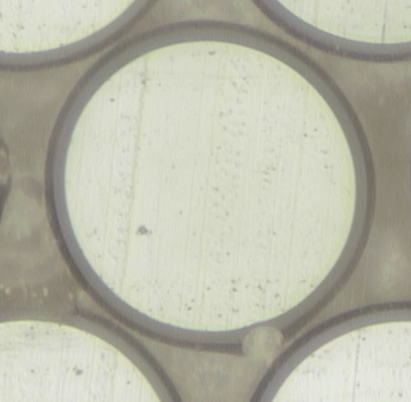
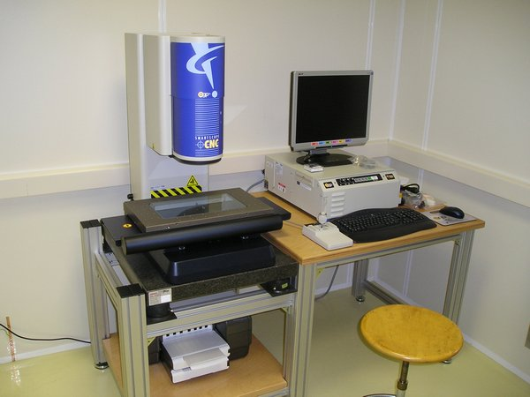
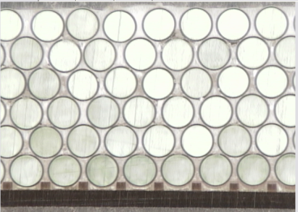
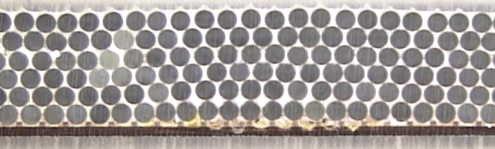
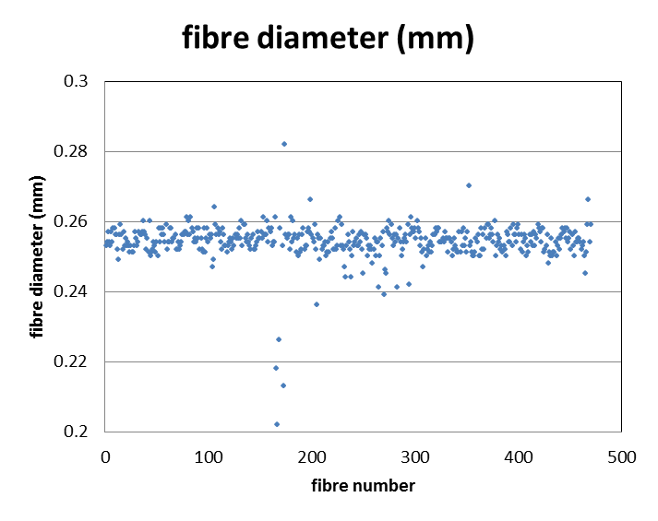
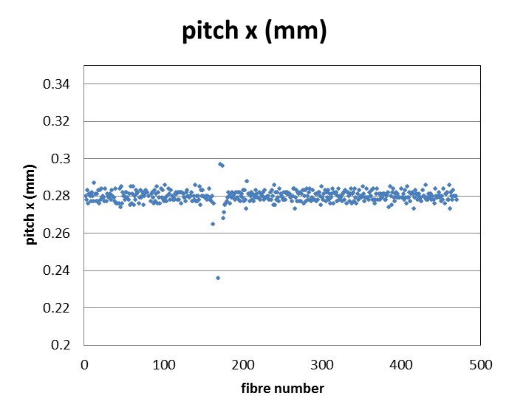
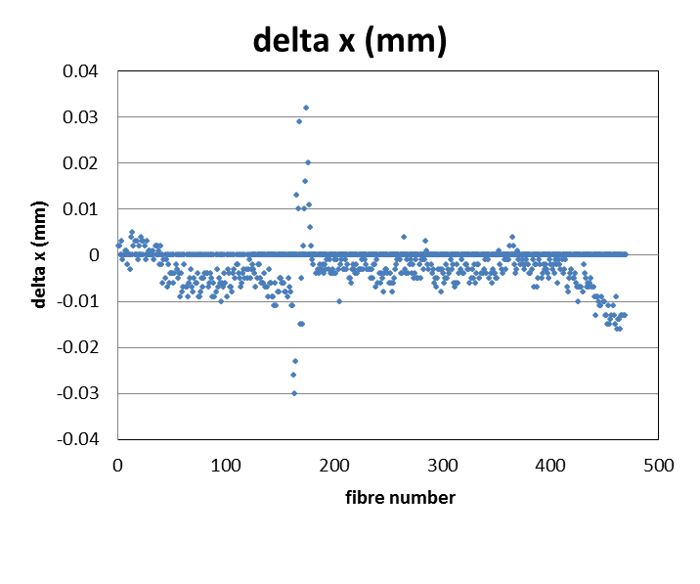
Scan of fibre mat end faces (after cut with diamond tool)
1.5 mm
Optical 3D coordinate measurement machine (CMM) in PH/DT bond lab.
defect
defect
defect
RMS = 4-12 μm
layer 1 - layer 6

Slide 12
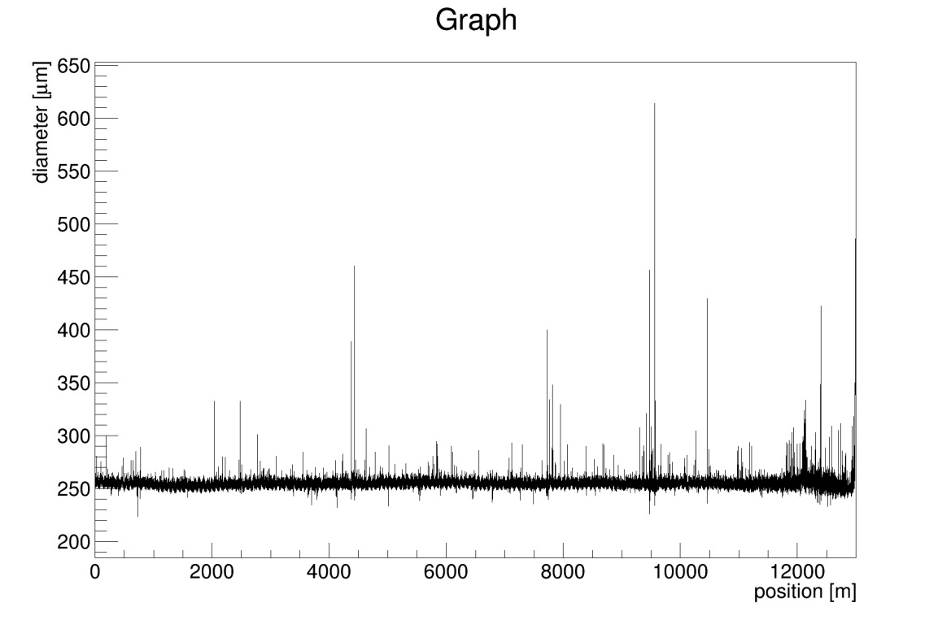
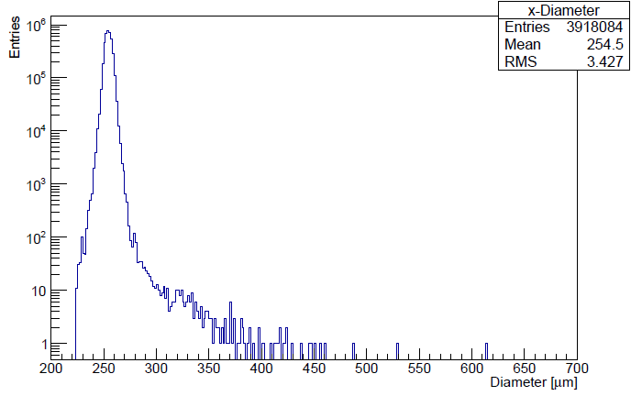
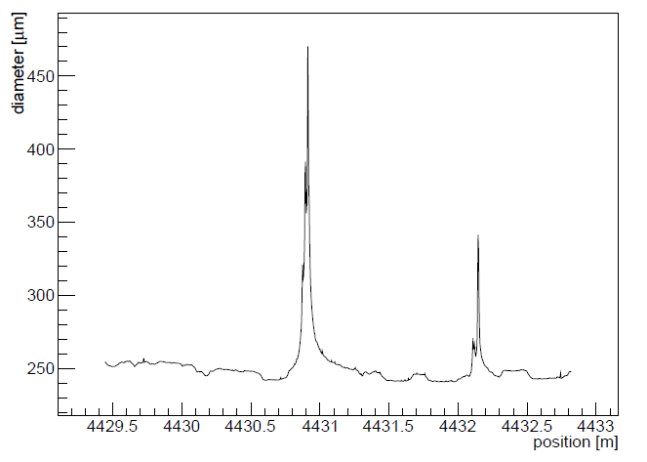
An important parameter: Fibre diameter profile (along fibre)
Plots by P. Hebler, Dortmund.
Over 99% of the length, the fibre diameter is within 250 ± few μm
~4 M measurements along 12.5 km fibre
(1 point every 3 mm), performed with a LASER micrometer.
However, typically once per km, the fibre diameter increases beyond acceptable limits (300 μm). Problem worked on by producer but not fully understood.
These sections are manually removed during winding process, at the position where the mat is anyway cut. Costs time (5') but no performance.

Slide 13
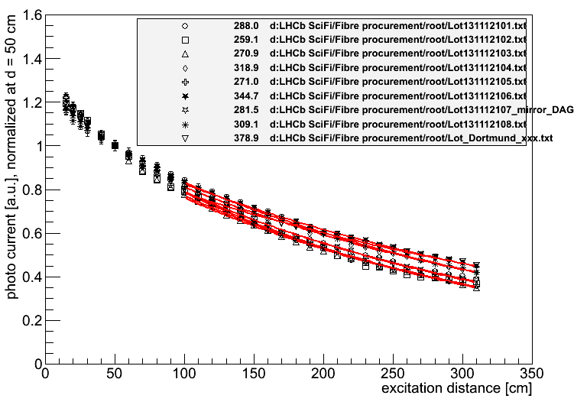
Long modules (2.5 m) are only possible if fibres have long enough attenuation length.
Measurements of 8 spools + older Dortmund sample (unknown Lot no.)
KURARAY SCSF-78, 250 μm, double cladded)
<Λ_{att.} > = 293 cm
(Lot 1-8)
Λ_{att.} in cm
We are currently investigating with Kuraray whether lower or higher concentrations of dopants have a sizable impact on Λ or whether we have to live with Λ~3 m.
Side remark: We are also maintaining / building up relations to 2 other potential fibre producers: Saint-Gobain (Bicron), ELJEN Technologies (new in the SciFi market).

Slide 14
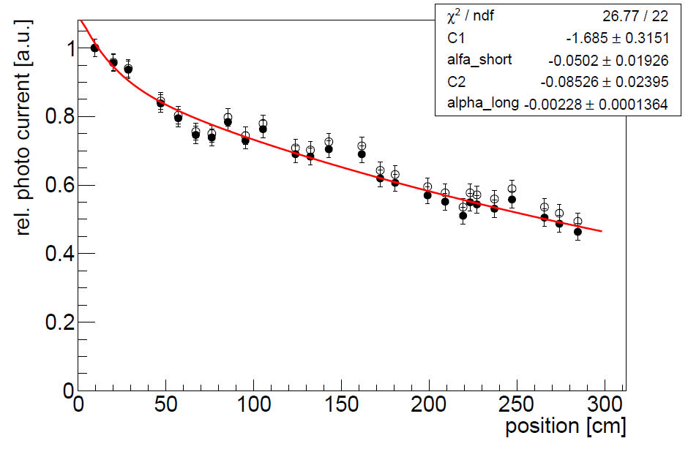
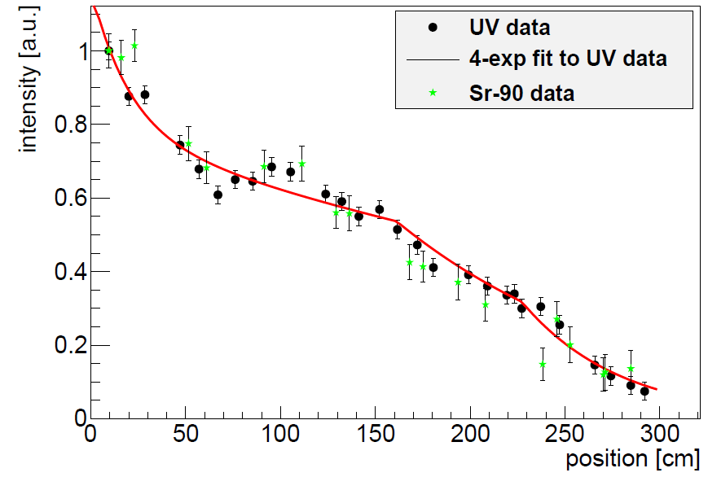
Radiation damage to scintillating fibres
Literature relatively poor and contradictory. In any case: you need to irradiate under conditions which come close to the ones met in the experiment.
Example: LHCb irradiation test (2012)
3 m long SCSF-78 fibres (Ø 0.25 mm), embedded in glue (EPOTEK H301-2)
irradiated at CERN PS with 24 GeV protons (+ background of 5·10¹² n/cm2)
before irradiation
after irradiation
Λ_{l} = 126 cm
Λ_{l} = 439 cm
Λ_{l} = 422 cm
Λ_{l} = 52 cm
0 kGy
3 kGy
at 6.25 Gy/s
22 kGy
at 1.4 Gy/s

Slide 15
Survive the radiation
Ionizing dose:
The fibres get significantly damaged in the central part of the detector (up to 35 kGy).
Hara model →
There is no well-established model to describe Λ(D)/Λ₀ = f(Dose)
Hara model:
Λ(D)/Λ(0) = α+ β log(D)
K. Hara et al., NIM A411 (1998), no. 1 31 .
Describes our data well, but has some weaknesses (can’t include D=0, can become negative)
There is no generally accepted model → Need more low dose data.

Slide 16
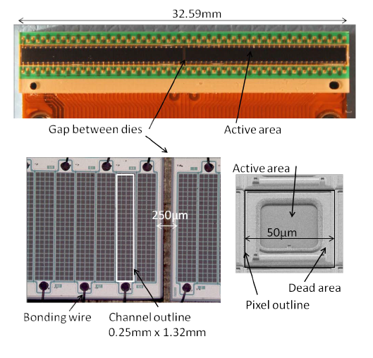
Get enough light → maximise PDE of SiPM
We co-develop with Hamamatsu (JP) and KETEK (DE) 128-channels SiPM arrays, with very similar dimensions.
Photon detection efficiency
PDE = QE · ε_{geom} · ε_{avalanche}
2 x 64
channels
PCB
Flex cable
=f(OV)
ε_{geom} can be optimised by minimising the number of pixels.
ε_{avalanche} can be increased by higher OV.
Both effects must be counter-acted by efficient trenches to control pixel-to-pixel cross-talk.

Slide 17
PDE and cross talk measurements at CERN and EPFL
with trenches
with trenches
with new trenches
(X-talk and after
pulses removed)
(X-talk and after
pulses removed)
Received very recently also new Hamamatsu devices (not yet tested)!

Slide 18
Matching between
KETEK PDE and scintillation spectrum (after irradiation) isn’t perfect yet.
PDE
after full irradiation
Close to SiPM
Mid plane

Slide 19
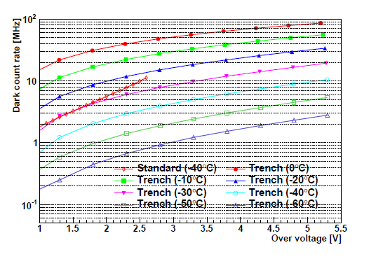
Survive the radiation
Neutrons:
The SiPMs are exposed to 1.2·10¹² n_{1Mev.eq.} /cm² (50 fb⁻¹)
A detailed FLUKA simulation showed that shielding (Polyethylene with 5% Boron) can halve this fluence → tests so far done for 6·10¹¹/cm² .
The SiPMs need to be cooled. Our default working point is -40°C. Noise reduced by factor ~64.
6·10¹¹/cm²
Dark counts are primary noise source.
Keep pixel-to-pixel cross-talk low → avoid double-noise hits (which can seed noise clusters)
Scaled to 0.33 mm²
(The expected neutron fluencies don’t appear to be a problem for the fibres (to be better verified!)).
Hamamatsu 2013 technology (singe channel devices)

Slide 20
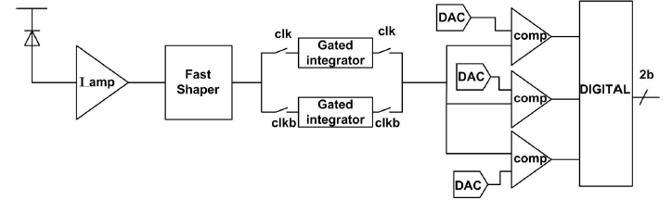
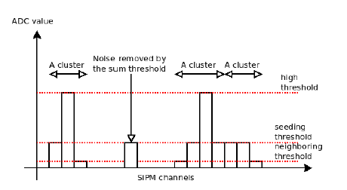
Fast readout with manageable data volume
~0.6 M channels
40 MHz readout rate
Signal propagation time up to 5m · 6ns/m = 30ns → some spill over to next BC
No adequate (fast, low power) multi-channel ASIC available
LHCb develops its own ASIC, called PACIFIC, with 128 (or 64) channels (130 nm CMOS)
P ~ 8 mW/channel
3 hardware thresholds (=2 bits)
seed
neighbour
high
plus a sum threshold (FPGA) are a good compromise between precision (<100 μm), discrimination of noise and data volume.
Compared to analog (6 bit) readout, expect resolution to degrade from ~50 to 60 μm. Marginal impact on p-resolution.
Z_{in} ~20-40 Ω
f_{f} ~ 250 MHz

Slide 21
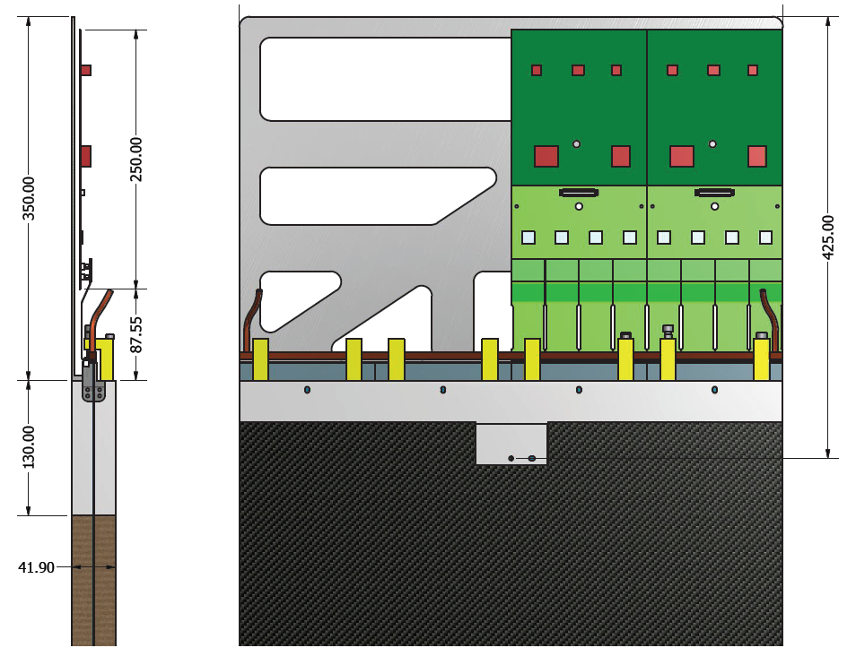
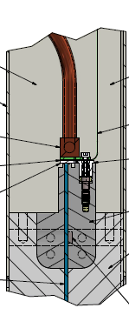
Integration with SiPM cooling in "Readout Box"
fluid supply tube
Readout electronics (warm)
8 x PACIFIC →
Kapton Flexes
Cold
Pipe
T=-40°
SiPM
Large T-gradient (60 K over ~2 cm) poses formidable challenge.

Slide 22
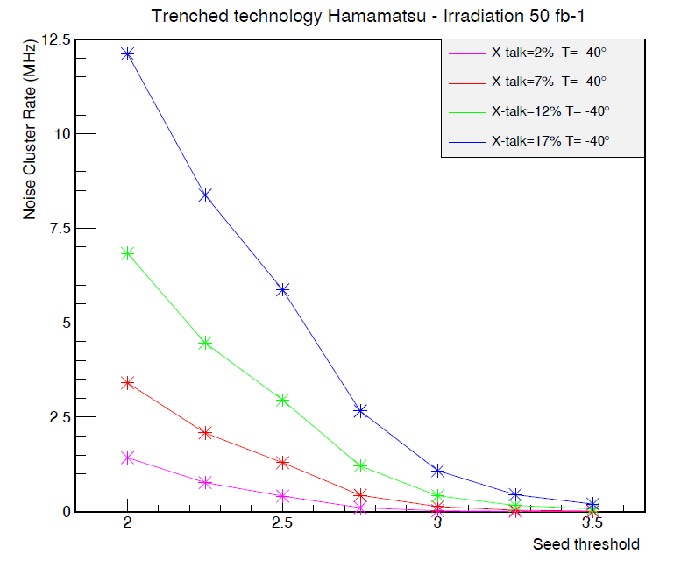
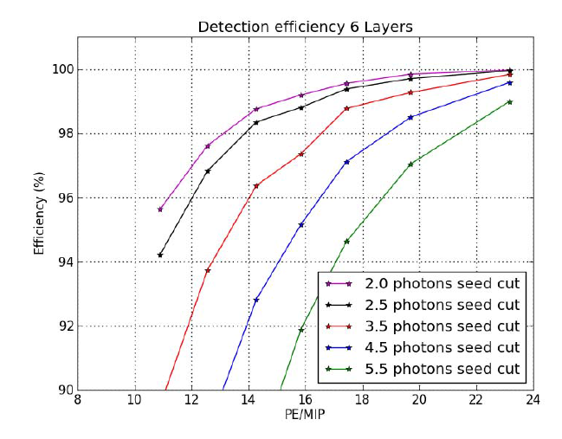
Optimize detection efficiency vs ghost rate
per SiPM (128 ch.)
~ ghost hits
XT=17%
possible working point
XT=12%
XT=7%
XT=2%
considered acceptable
Seed = charge (in p.e.) of a SiPM channel to launch a cluster search
Total cluster charge (in p.e.) for a MIP hit.
Need 16 p.e to guarantee 99% detection efficiency (in single module).
12 p.e. give 96%
Need X-talk <10%

Slide 23
Summary
For the time after LS2, LHCb will replace the current IT and OT detectors by a large scintillating fibre tracker.
The basic technology (small Ø fibre + SiPM readout) has been proven before, but scale, radiation environment and RO speed call for substantial R&D
  Optimisation of fibres (LY, att. Length)
  New SiPM arrays (PDE, XT, radiation hardness)
  Module production techniques
  Readout
  Integration

Slide 24
BACK-UP SLIDES

Slide 25
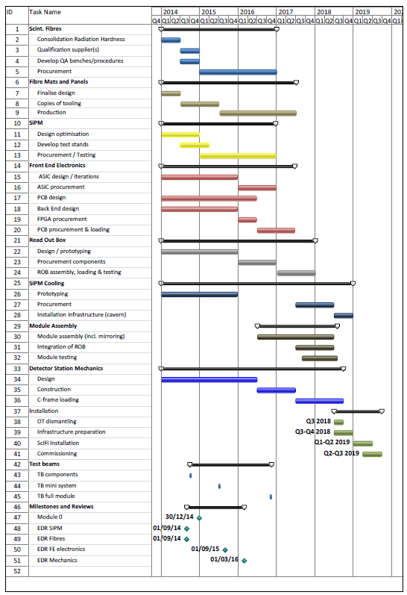

Slide 26

SciFi Tracker: ~20 participating institutes
  Brasil (CBPF)
  China (Tsinghua)
  France (LPC, LAL, LPNHE)
  Germany (Aachen, Dortmund, Heidelberg, Rostock)
  Netherlands (Nikhef)
  Poland (Warsaw)
  Russia (PNPI, ITEP, INR, IHEP, NRC KI)
  Spain (Barcelona, Valencia)
  Switzerland (CERN, EPFL)
  UK (Imperial College)

Slide 27
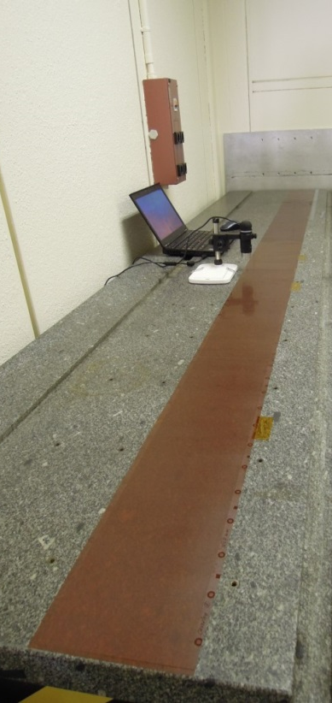
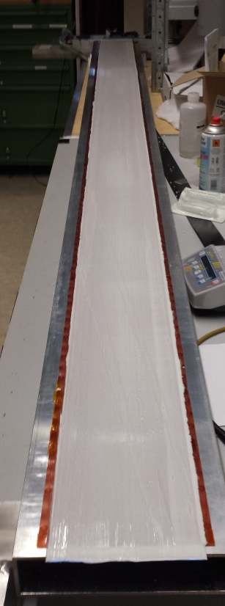
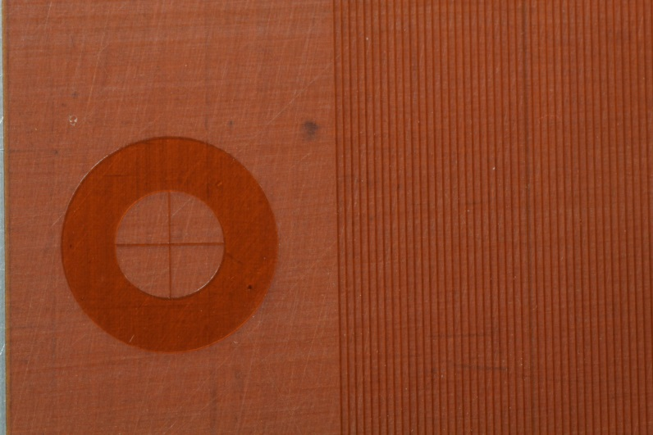
Geometrical precision
Alternative technique: replace thread by a kapton film, structured with coverlay(© Dupont). PCB technique, R. de Oliveira.
p = 270 μm
3 m long and 16 cm wide Kapton film used
for a full-size 6 layer mat (march 2014).
~ Ø 900mm
~150 mm
Kapton film becomes part of fibre mat.
Allows use of precise alignment marks.
Inspection at CERN
After winding at Univ. Dortmund

Slide 28
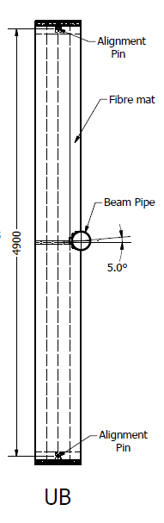
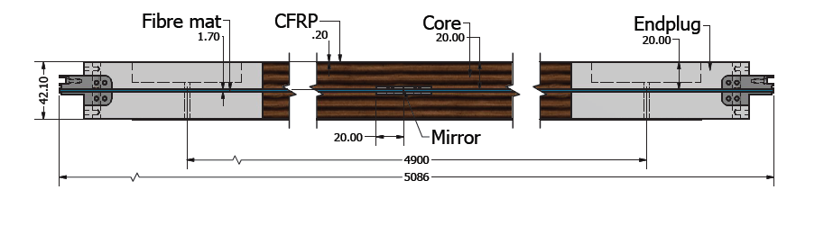
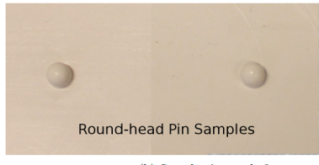
Maintaining the intrinsic fibre precision when building a full detector.
Require overall precision and stability: O(100 μm)
Quite non-trivial! Subject of current studies.
Good ideas and promising results on prototype level exist.
Alignment chain:
Fibres inside mat → thread / coverlay
Sides and end faces of mats need to be cut → rely on epoxy-pins on backside of mat (or markers on coverlay).
Mount mats on support panels → rely on epoxy pins or mat precision
Mount support panels in C-frames → alignment pins.
Offline alignment ☺

Slide 29
A new but still unproven approach for scintillating fibres:
Nanostructured organosilicon luminophores (NOLs)
S.A. Ponomarenko et al. , Enikolopov Institute of Synthetic Polymer Materials, Russian Academy of Sciences
Activator
=
Scintillator
Classical plastic scintillator
(see slide 7)
Spectral
shifter
Activator
Activator
R
Light output is 45-65% relative to the anthracene standard.
Е
Photodetector
Activator
Spectral
shifter
R
Activator
(α, β or γ-
radiation)
Spectral
shifter
Activator
Activator
R >> 1 - 2 nm
New plastic scintillator with nanostructured organosilicon luminophores (NOLs)
Spectral
shifter
Light output is 90-120% relative to the anthracene standard.
Е
Photodetector
activator
L
(α, β or γ-
radiation)
L = 1 - 2 nm << R
Patent RU 2380726 (2010)
29
Notes:
Classical plastic scintillators consist of a polymeric matrix (usually polystyrene or polyvinyltoluene) mixed with two types of luminophores, activators and spectral shifters. Their role is to shift the radioluminescence of the polymeric matrix to a longer wavelength range to avoid the self-absorption and to match the luminescence spectra to a better sensitivity range of the electronic light detectors. This process is not very efficient because of chaotic position of the activator and spectral shifter luminophores relative to each other in the polymer matrix and significant distance between them, which prevents non-radiative energy transfer between them. As a result, the efficiency of the polymeric scintillators is not very high – it leads in the range from 45 to 65% relative to the standard - anthracene crystals.
In this work we were able to improve the light output of plastic scintillators to 90 – 120 % relative to the anthracene standard by combining activators and spectral shifter in one nanostructured organosilicon luminophore (NOL), where intramolecular non-radiative energy transfer from the activators to the spectral shifter takes place. In the NOL the activators and spectral shifter are connected to each other in one molecule via silicon atoms, which fix them specifically in the space at the distance closer than 1-2 nm necessary for efficient Förster energy transfer.

Slide 30
Measurements on scintillator tiles
Comparison of light yield from 5.49 MeV α particles
Comparison of scintillation decay time
"Standard
scintillator"
"NOL
scintillator"
S.A. Ponomarenko et al. , Enikolopov Institute of Synthetic Polymer Materials, Russian Academy of Sciences
Potentially very interesting!
How will the material behave in fibre geometry ?
Radiation hardness ?

Slide 31
Where do we stand ?
Fibre modules
SiPMs
RO electronics
Design
Production
Learned how to make 13 cm wide and >2.5 m long fibre mats. Current focus: machining and precision assembly of mats on panels. Aim to test them in SPS beam in autumn.
64-ch. SiPM arrays from Hamamatsu and KETEK successfully tested. First 128-ch. arrays from KETEK look promising. Expect new arrays from Hamamatsu soon. Increased PDE and(!) reduced XT.
Single channel of PACIFIC being tested. 8-channel version submitted a few days ago. Full scale prototype ASIC in 2015.
Efforts for overall detector design, Readout Box, mechanics getting in full swing. Lots of challenges like beam pipe hole, cooling (insulation, condensation).
Starting to think of tooling, logistics and QA. Mass production of fibre mats and modules will require sustained efforts and tight quality control.

Slide 32
Where do we stand and what can we expect?
Non-irradiated 2.5 m long 5-layer mat + 2011 technology SiPM array,
measured with 1.5 MeV e⁻ in lab (from energy filtered Sr-90 source).
Expected loss due to radiation damage (50 fb⁻¹)
← expected gain from non-irradiated 6-layer mat, 2014 SiPM technology, H.E. hadrons
← measured in lab (Sr-90 e⁻)
SiPM
mirror

