Slide 1



Quench Simulation at GSI

Slide 2
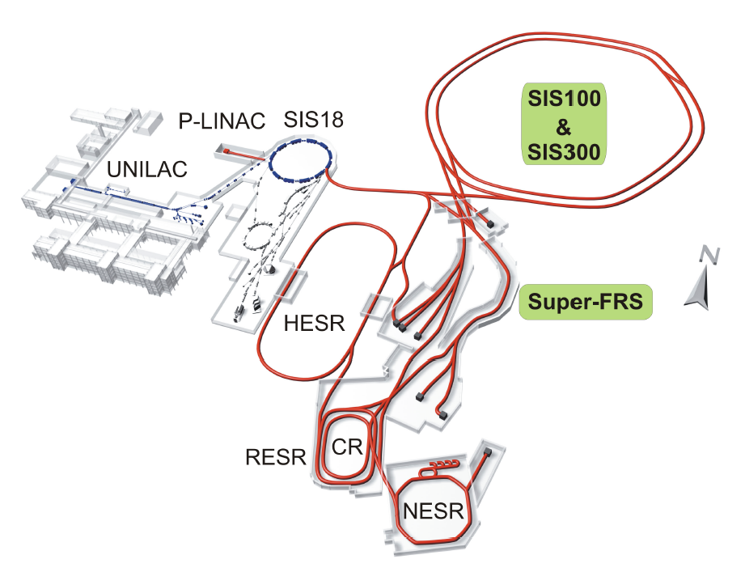
FAIR Project

Slide 3
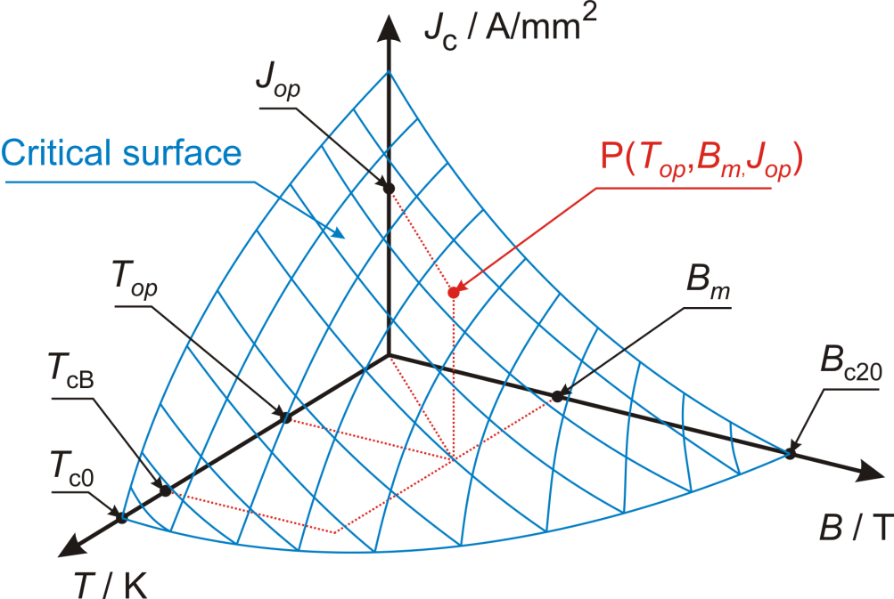
Quench
A sudden transition from the superconducting state to the normal-conducting state.
Quench causes:
conductor movement
eddy currents in the conductor
beam losses
poor cooling

Slide 4
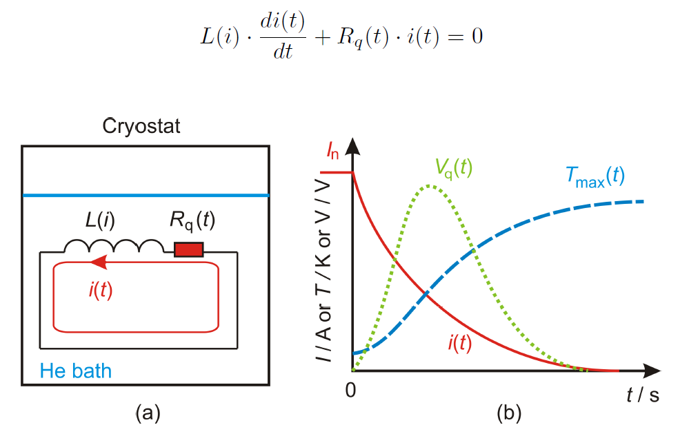
Self-protecting and not self protecting magnets
If max. temp. < 300 (350) K
and
max. voltages
(coil-to-ground, coil-to-coil)
do not damage the insulation
magnet / group of magnets
is self protecting
Quench protection is required
dump resistors, cold diodes, quench heaters etc.
if not

Slide 5
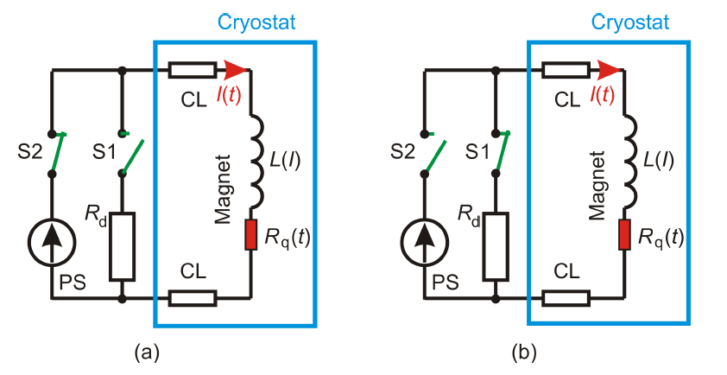
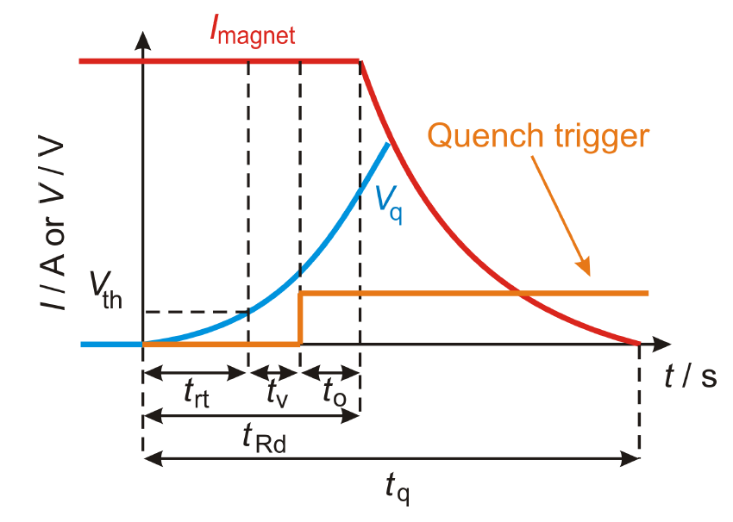


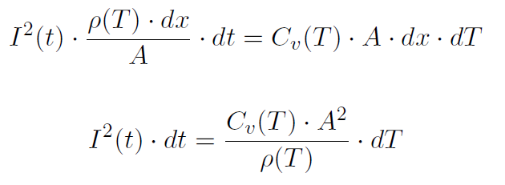
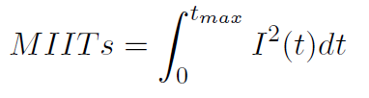
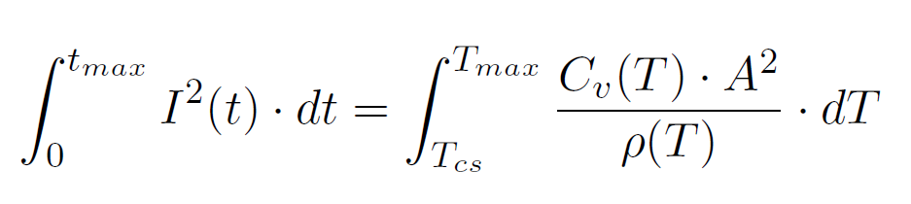
Self-protecting and not self protecting magnets:
Tau and MIITs

Slide 6
Self-protecting and not self protecting magnets
@ FAIR
All Super-FRS magnets - self protecting
SIS100 rings (dipole ring, quadrupoles rings, chromaticity sextupoles - 6 magnets in series, other correctors) – not self-protecting
  single SIS100 dipole almost self-protecting
SIS300 magnets – not self-protecting

Slide 7
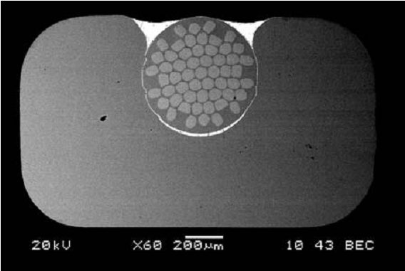
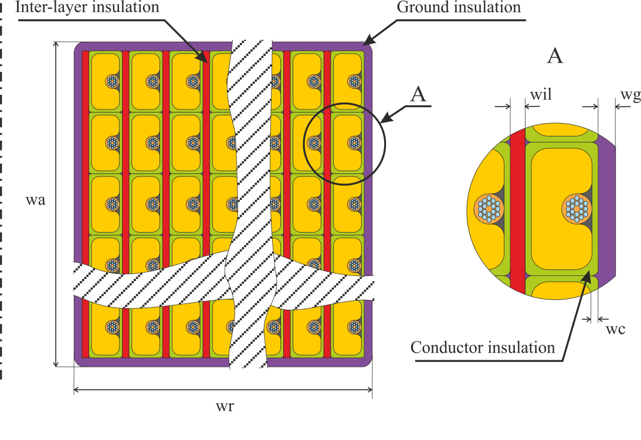
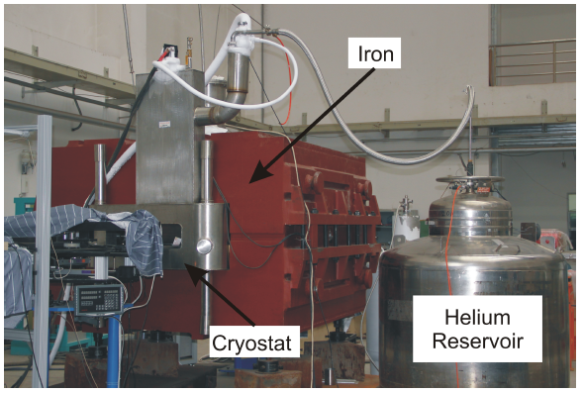
FAIR Project: Super-FRS
Super-FRS dipole (66 um)
Potted coil: 28 layers, 20 turns/layer
In= 232 A, Emag=414 kJ
DC machine
3D Simulation

Slide 8
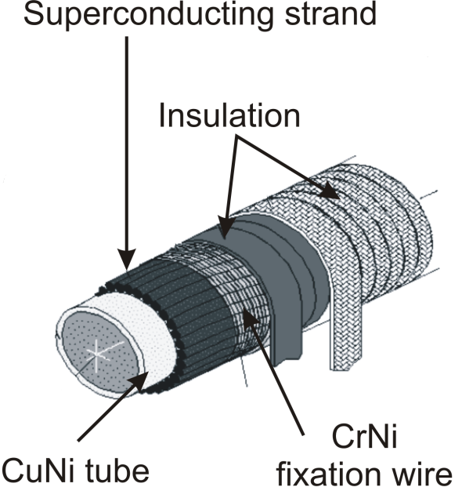
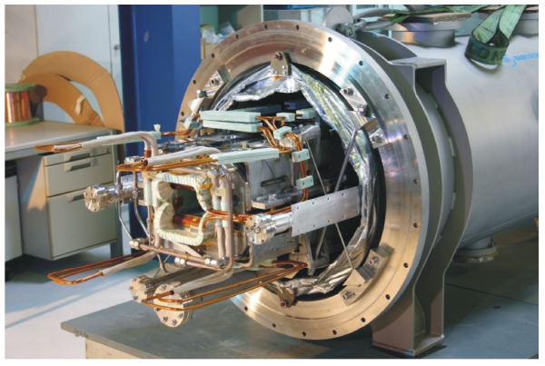
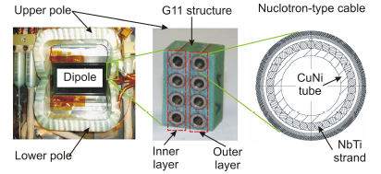
FAIR Project: SIS100
Nuclotron cable
SIS100 dipole (2 layer prototype, 4.3 um)

Slide 9
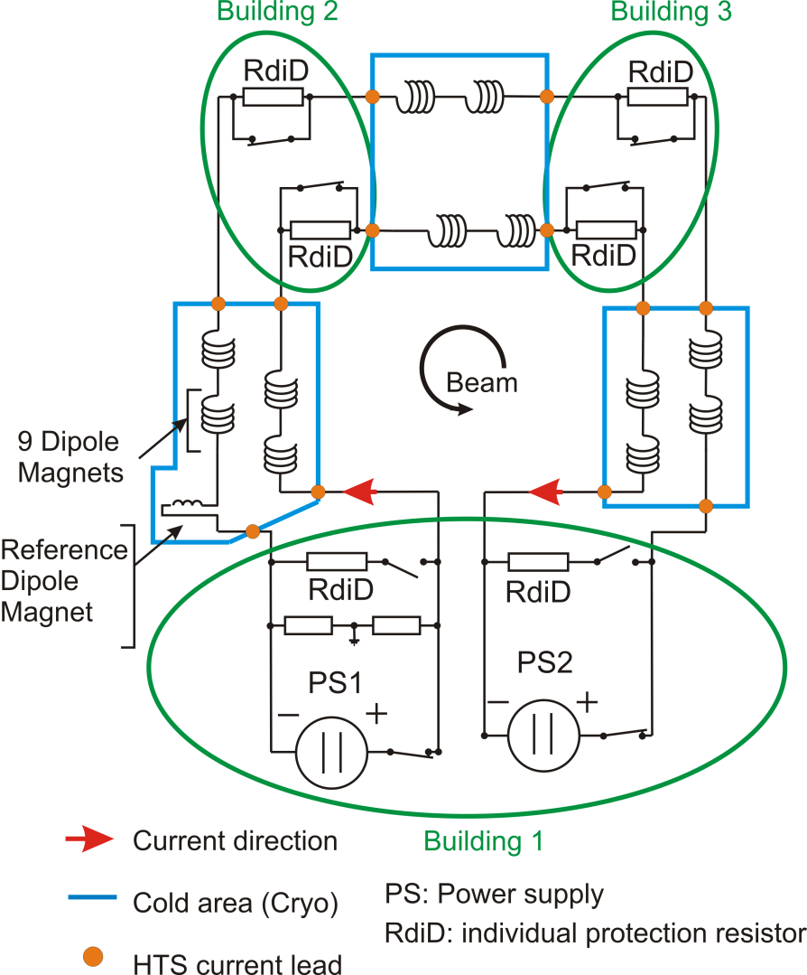
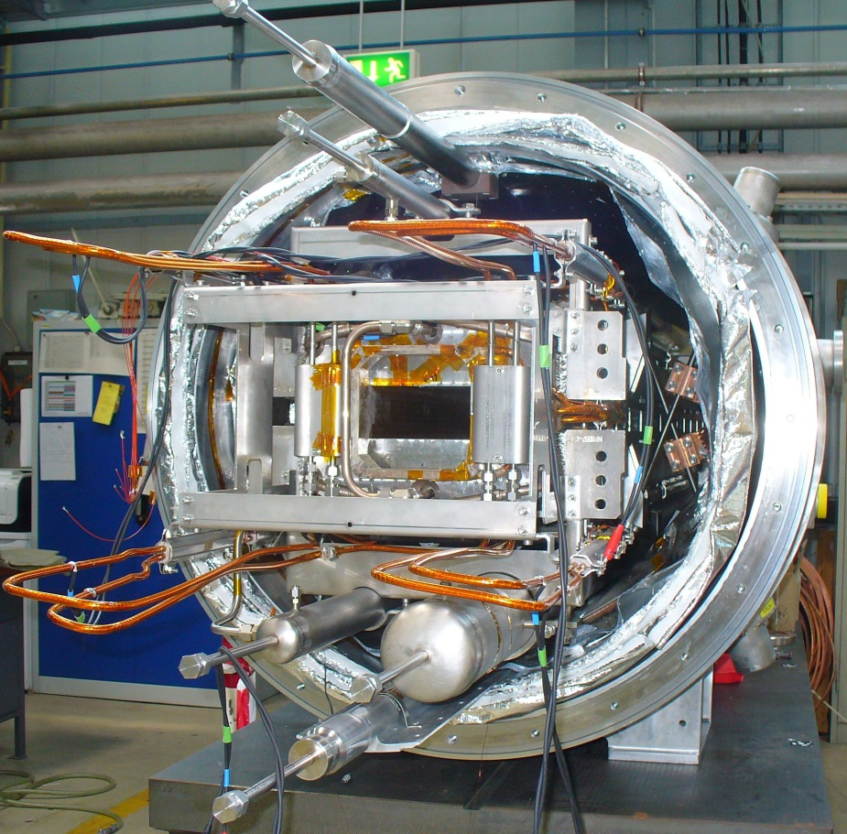

FAIR Project: SIS100 dipole magnets fast cycling 2 T/s -> 28 kA/s, one dipole = 47 kJ
FoS dipole magnet
1D Simulation
Insulated wire
and
23 wires + CuNi tube
109 dipoles in series
13.1 kA, 1.9 T, CuMn matrix in order to reduce AC losses

Slide 10
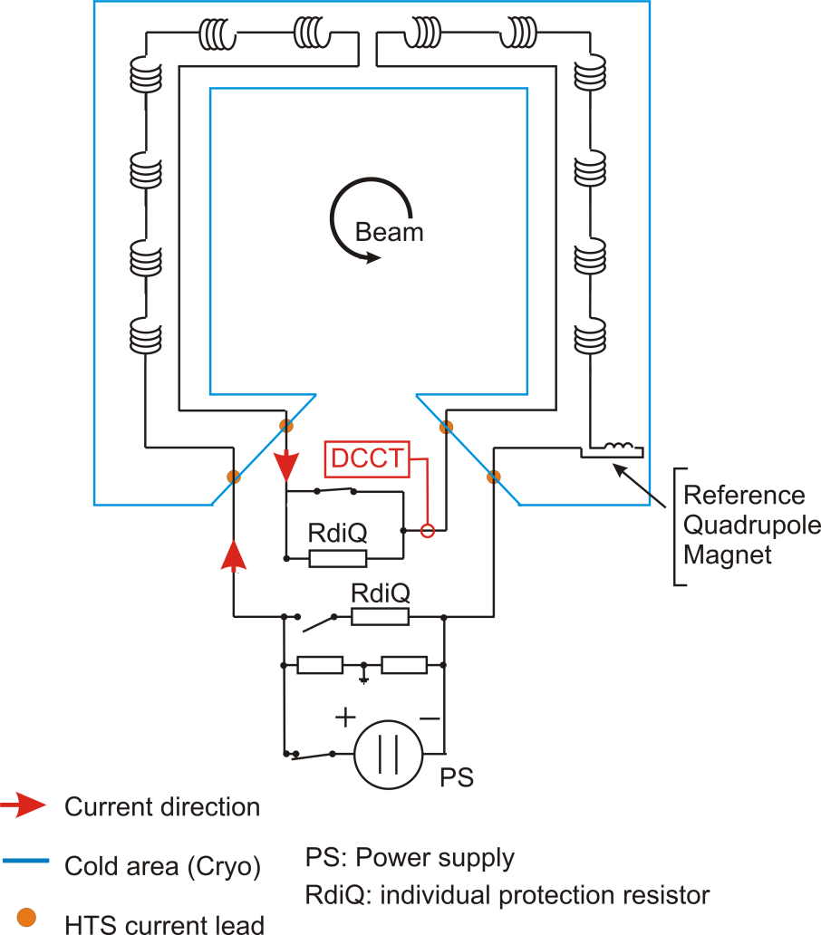
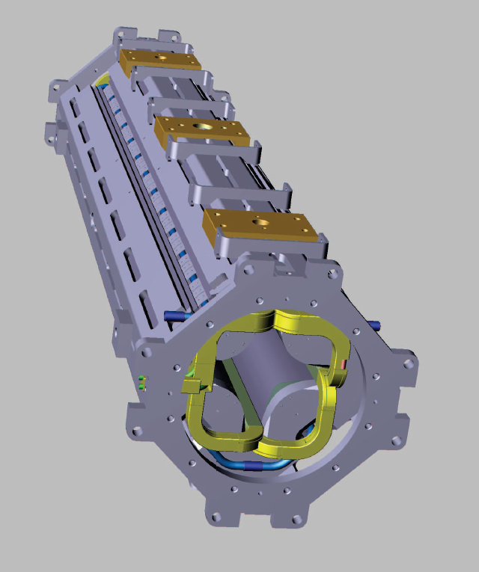
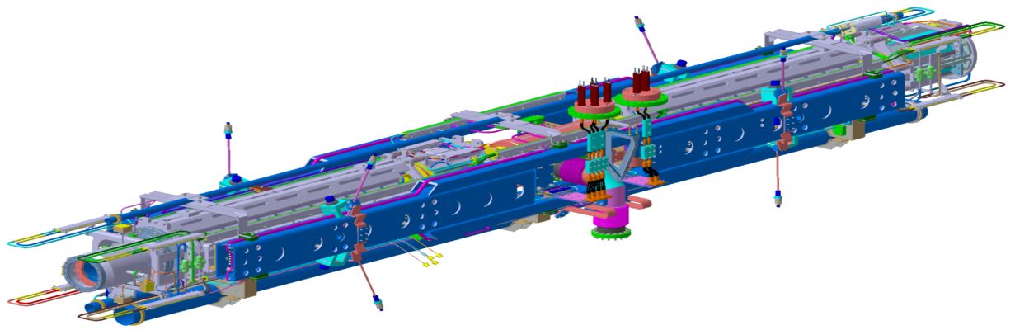
FAIR Project: SIS100 quadrupole magnets
1D Simulation
Insulated wire
and
23 wires + CuNi tube
up to 84 quadrupoles in series
3 quadrupole circuits: QD, F1 and F2

Slide 11
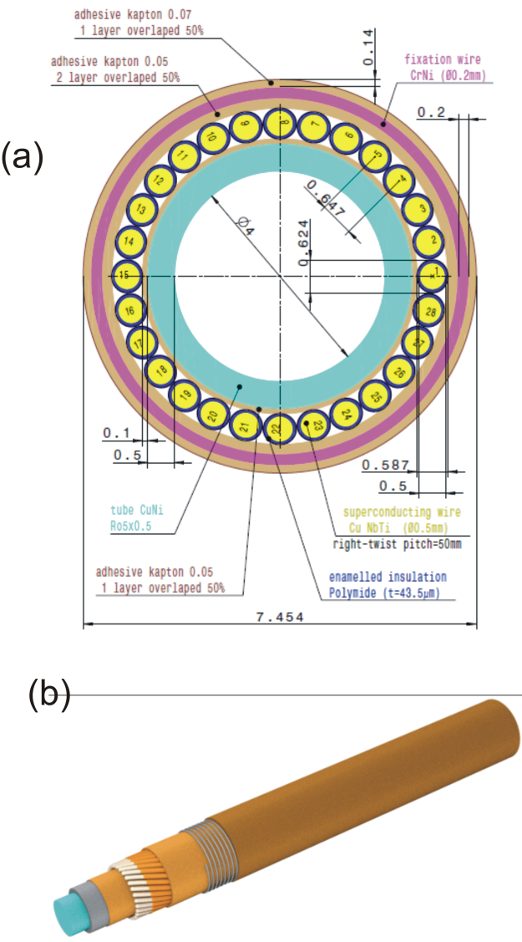
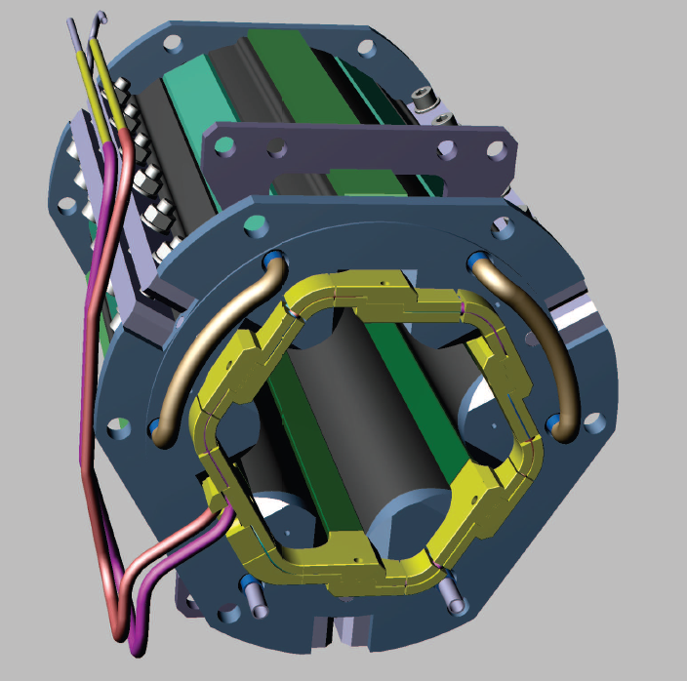
FAIR Project: SIS100 corrector magnets
Chromaticity sextupole magnets
Steering magnets (2 dipoles)
Multipole corrector magnets (Quadrupole + Sextupole + Octupole)
1D Simulation
Insulated wire

Slide 12
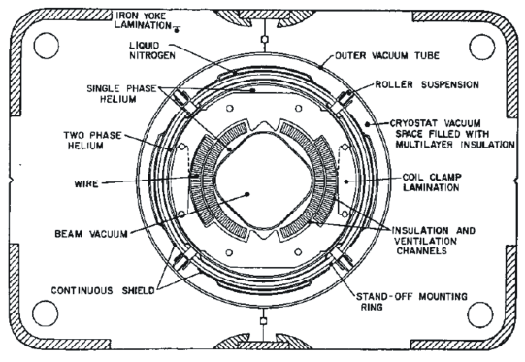
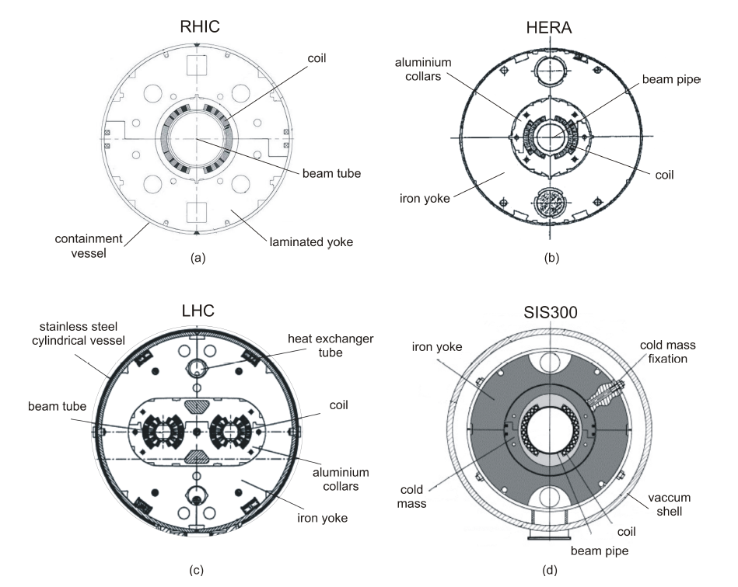
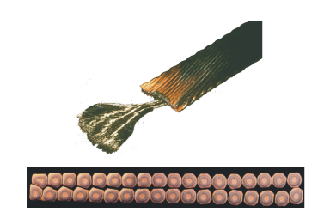
FAIR Project: SIS300
TEVATRON
Rutherford cable
Arjan Verweij’s talk

Slide 13
FAIR Project: other superconducting magnets
High Energy Beam Transfer Line (HEBT)
  SIS300 type magnets (Rutherford cable), line to CBM and beam dump
CBM Dipole
  potted coil, “wire in channel”, similar to Super-FRS, 5.15 MJ
Quadrupoles of HEDgeHOB final focusing system (Rutherford cable)

Slide 14
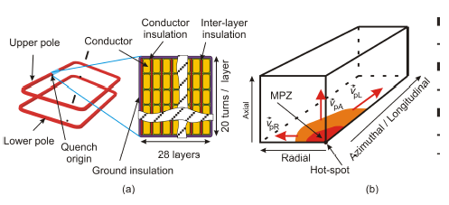
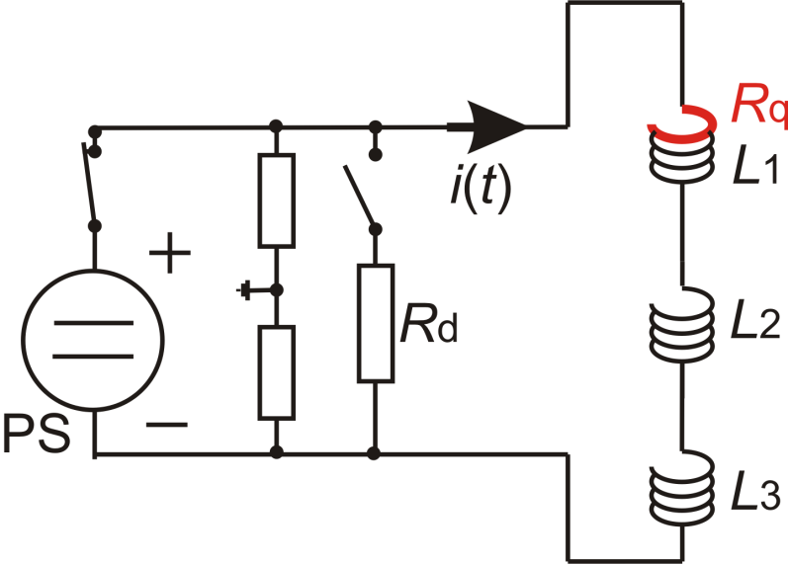
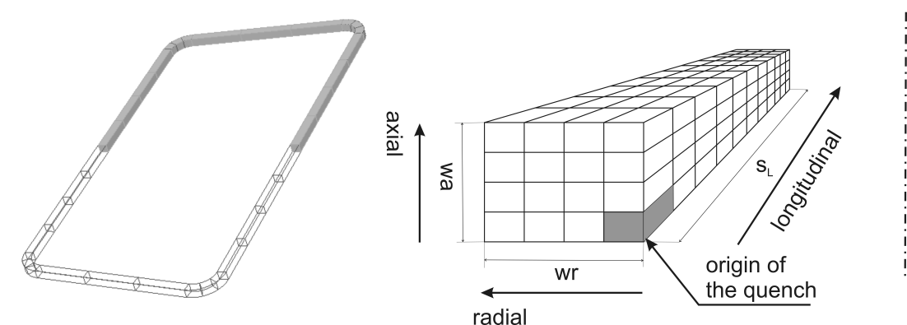

GSI Quench Program
@ microscopic scale
@ macroscopic scale

Slide 15
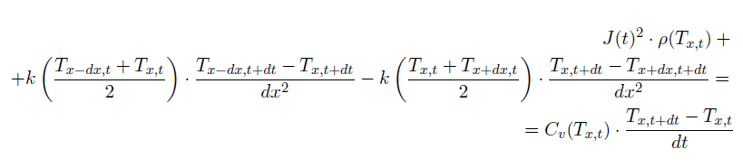
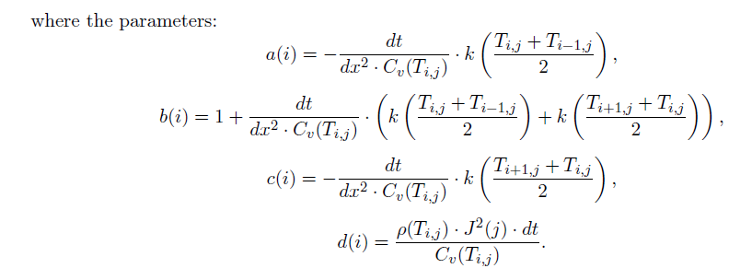
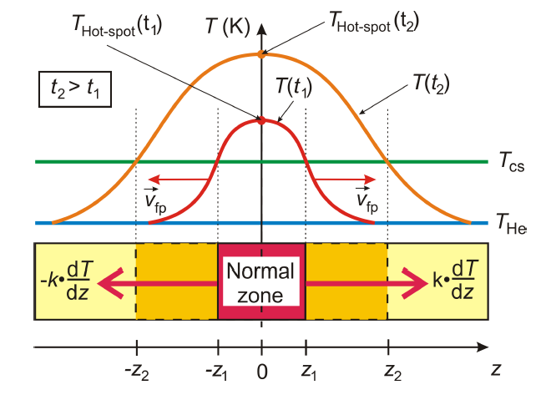
Heat-balance equation (implicit method)
i – position
j – time

Slide 16
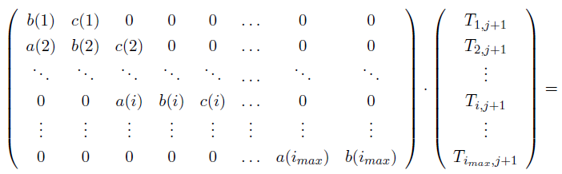
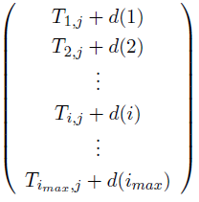

GSI Quench Program
Equation matrix
Initial temperature profile is known!
i – position
j – time
we compute:
then electrical equation is updated
to avoid high jumps in temperature, an adaptive time stepping algorithm is applied (max dT is fixed)

Slide 17
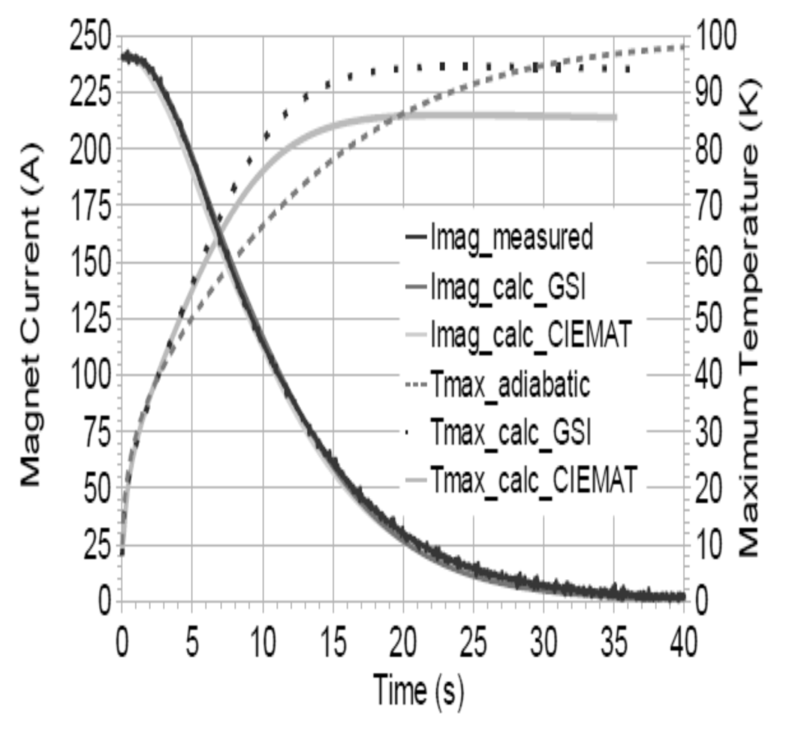
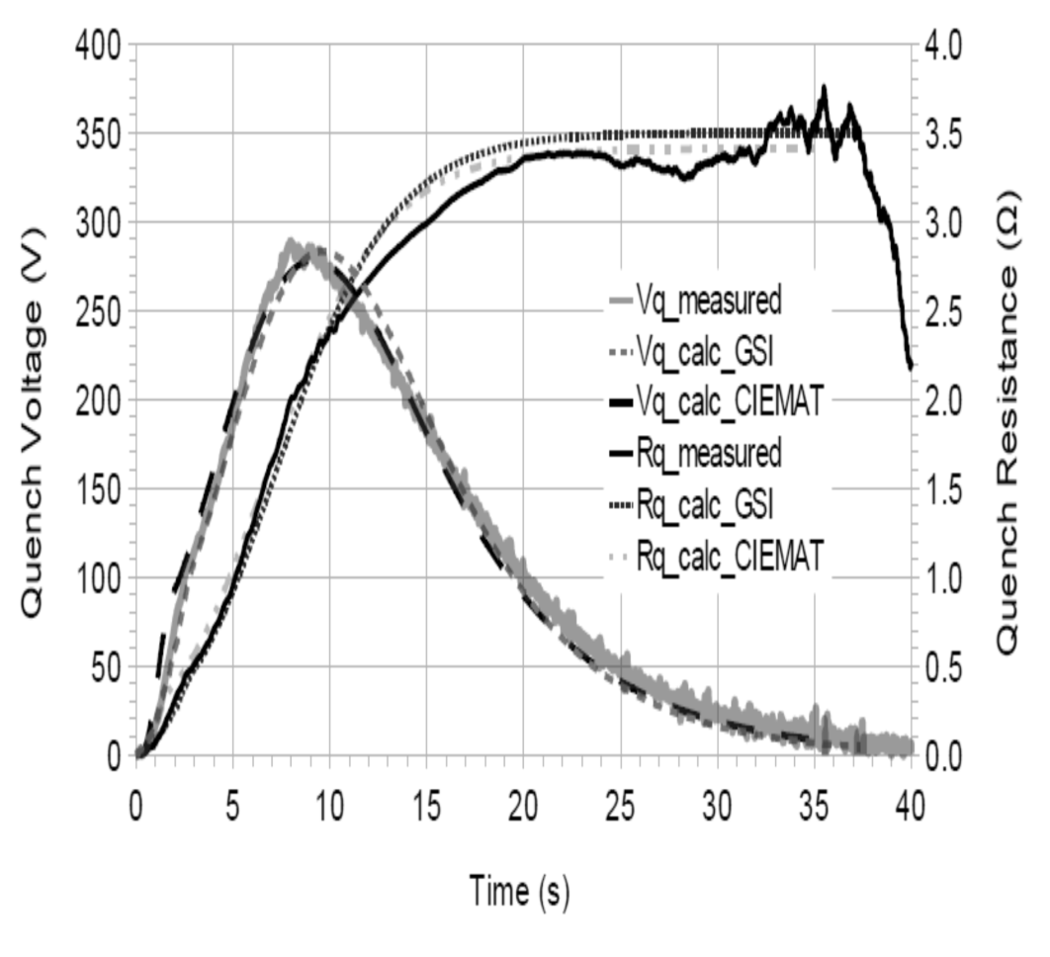
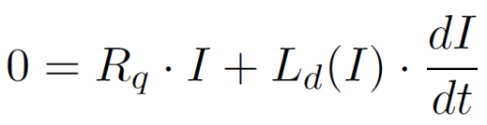
3D Simulation vs. measurements
Super-FRS dipole (prototype)

Slide 18
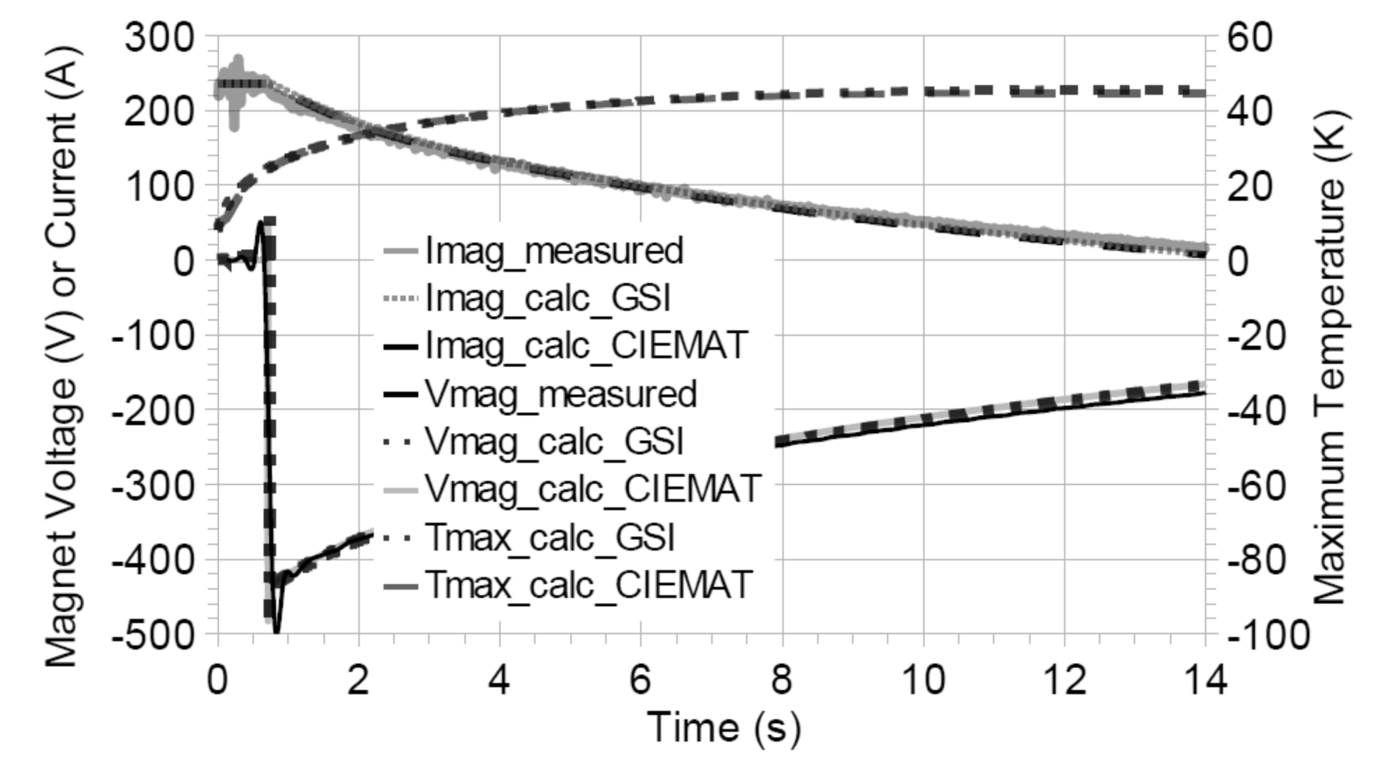
3D Simulation vs. measurements
Super-FRS dipole (prototype)

Slide 19
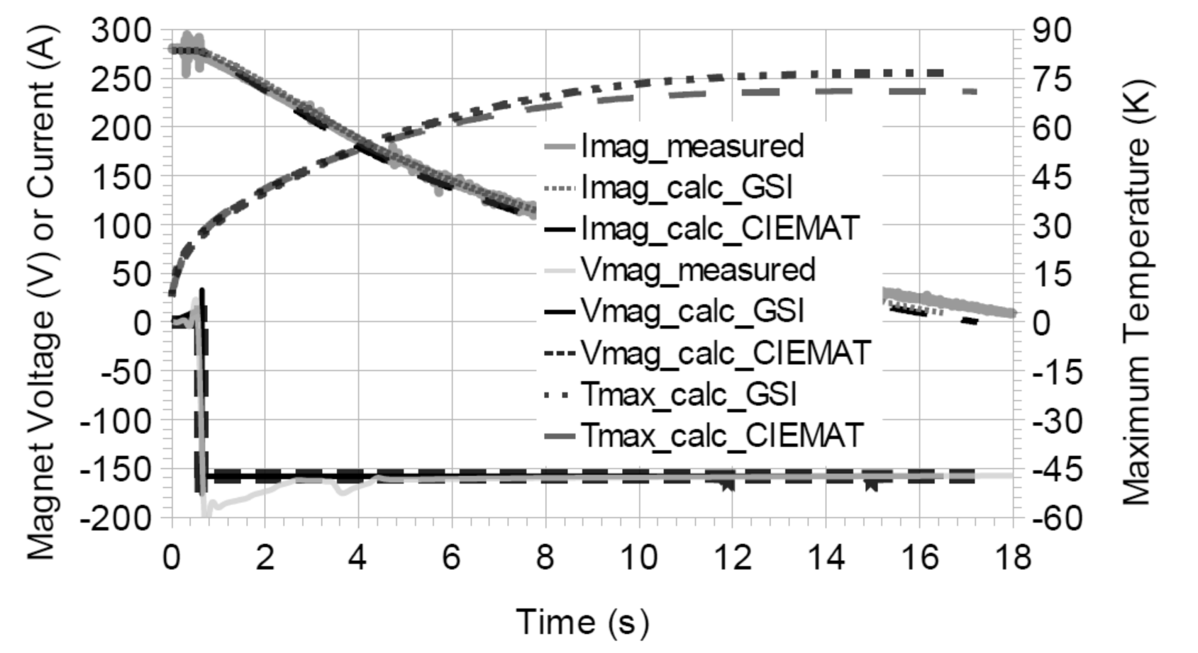
3D Simulation vs. measurements
Super-FRS dipole (prototype)

Slide 20

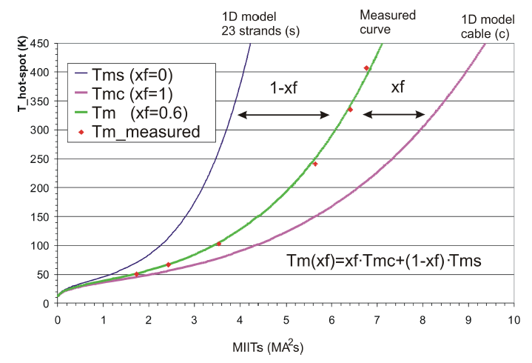
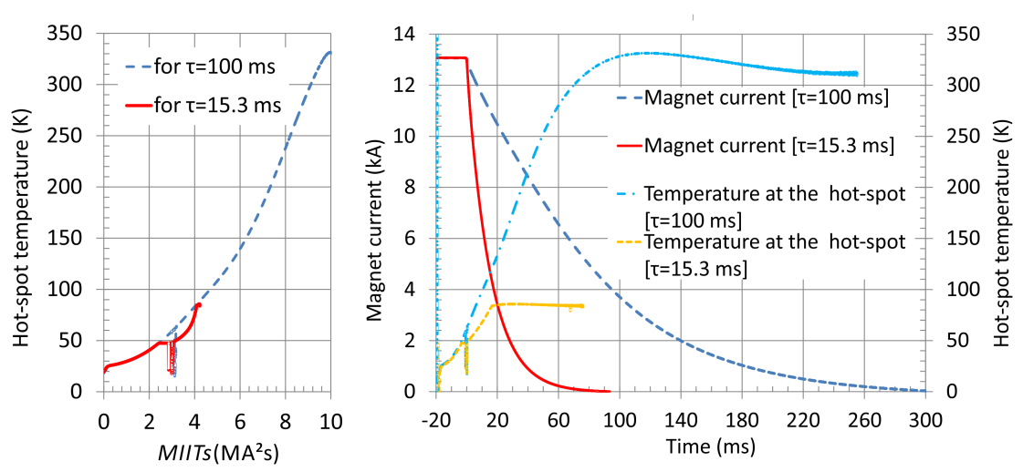
1D Simulation vs. measurements:
SIS100 FoS dipole and 2 layer prototype
2 layer prototype
FoS dipole

Slide 21
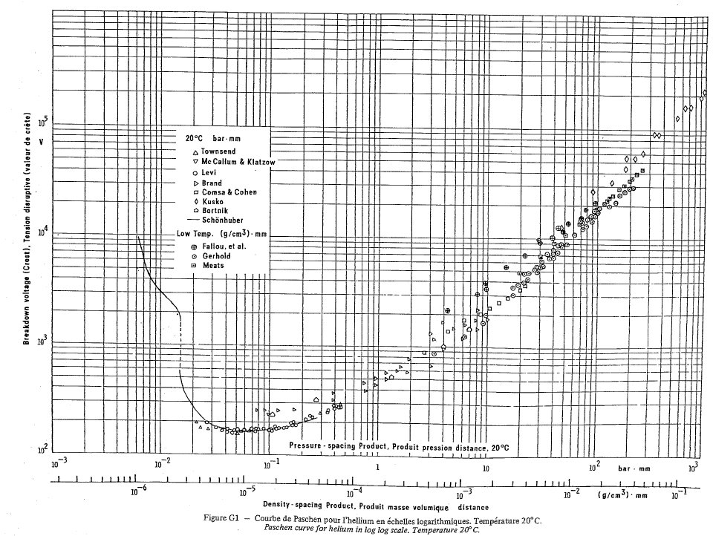
Conclusion
One need to perform at least simplified quench calculation before the experiment.
Expected max. temp. and max voltages (coil-to-ground and coil-to-coil) need to be known in advance safety of the machine and personnel!
Tmax < 300 (350) K, sometimes lower < 100 K; High Voltage (HV)! Insulation? Electrical sockets?
HV? He gas in the cryostat? Paschen effect!
Small change in MIITs value
corresponds in a big change in Tmax.
Quench calculation is a part of the machine design!

Slide 22
Thank you for attention!

Slide 23
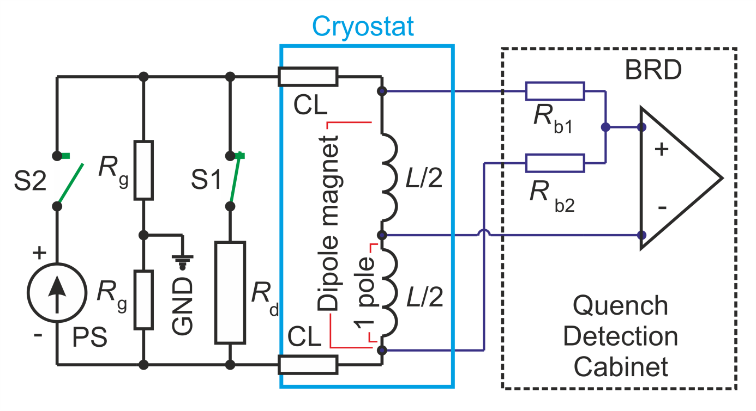
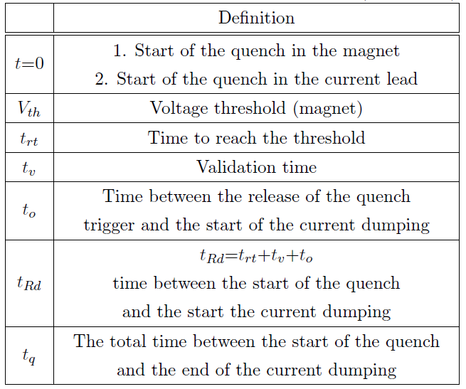

Quench Detection

