Slide 2
2-D Quench Simulation Framework
Michał Maciejewski
Emmanuele Ravaioli
TE-MPE-PE
18.08.2014
Notes:
Good afternoon and thanks for coming.
I have a pleasure to present today summary of project I did together with Emmanuele Ravaioli.
I will describe automated object oriented simulation framework.

Slide 3

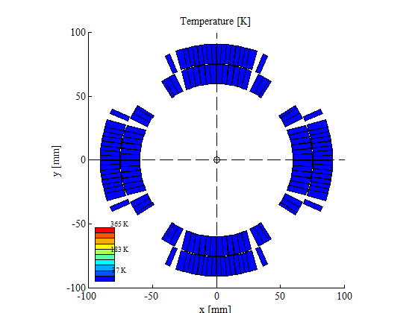

Outline
Introduction
Requirements
Architecture
Results
Summary
Notes:
During this presentation I’d like to answer the following 5 questions
What? – What is a purpose of this framework, what are we simulating
Why? – Why we need models and
How? – How it is implemented
How? – How does it performs and what are the results
What’s next? – Where we are now, and what are the plans for the future

Slide 4
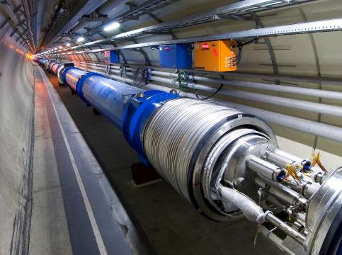
Motivation
Simulation of electro-thermal transient in S.C. circuits is needed in order to
design electrical circuits with S.C. magnets,
assess the performance of existing ones,
study new protection methods.
Notes:
(electrical transients, quench back, quench limits, Ohmic loss, heat propagation, coupling loss, etc)
()
Study of new protection methods, Design of electrical circuits with S.C. magnets
New magnet model ready in 1-2 days; complete simulation run in < 1 hour
Approach: Find smart ways to reproduce complex behaviors with a limited number of equations / components
Understand the physics
Reproduce complex problems with simple lumped-element circuits of inductors, resistors, etc
Rely on existing solvers (PSpice, Simulink, Simplorer, etc) to couple together and solve equations from different domains
Very efficient in terms of time required to solve the problem

Slide 5
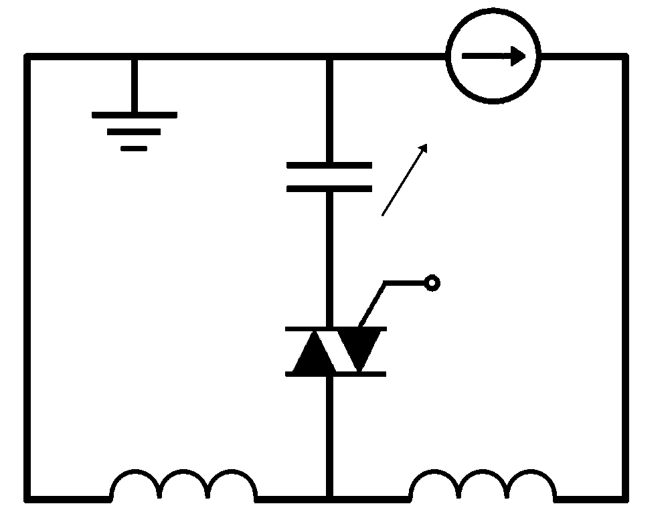
Motivation
Current
Change
Coupling
Loss
Induced
Quench
Magnetic Field
Change
Coupling-Losses
(Heat)
Temperature
Rise
QUENCH
EU Patent EP13174323.9, June 2013.
E. Ravaioli et al., MT23, 2013.
E. Ravaioli et al., EUCAS11, 2013.
E. Ravaioli et al., CHATS-AS, 2013.
E. Ravaioli et al., SuST, 2014.

Slide 6
Dynamic Sub-network
Electrical Sub-network
M_{i,j}
dI/dt
dB/dt
ISCL
L_{d}
IFCL
U
OHM
I
T
T>T_{CS} !
R_{el}
C_{th}
R_{th}
h_{He}
Thermal Sub-network

Slide 7
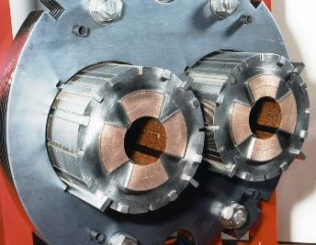
S.C. Magnets Modelling - Approach
W_{cable}
l_{coil}
h_{cable}
d_{strand}
We use lumped-element dynamic electro-thermal model
Then poles are split into cables. Each cable is represented in electrical and thermal domain.
The model calculates inter-filament and inter-strand coupling loss.
All physical and magnetic properties are supposed to be homogeneous in the same block.
Magnet properties are assumed to be homogeneous along the longitudinal direction (2D model) and are split into poles/half-poles
Notes:
We are modeling electrical and thermal behavior of superconducting magnets.
We are using 2D models. Hence the magnet is splitted into poles or even half-poles. This we call electrical part. And each electrical part is then divided into cables. Hence we can have maximum 36 cables.
We can also divide model into electrical parts.
Different connection order
We are modeling IFCL (x,y), ISCL, and take into account material properties, etc.

Slide 8
Challenges
Different levels of detail
  entire circuit→ magnet→ cable→ strand→ filament
Different physical domains
  electrical, thermal, dynamic effects
High flexibility needed
  different magnet configurations, protection schemes
Quick simulations
  model development in 1-2 days, simulation runs < 1 hour
Notes:
Approach:
Find smart ways to reproduce complex behaviors with a limited number of equations / components
Understand the physics
Reproduce complex problems with simple lumped-element circuits of inductors, resistors, thermal masses etc
Rely on existing solvers (PSpice, Simulink, Simplorer, etc) to couple together and solve equations from different domains
This approach is very efficient in terms of time required to solve the problem

Slide 9
Framework Requirements
Quench Simulation Framework
Parametric
sweep
Automatic
Design
Fast Model Development
Modularity
Scalability
Components library
Notes:
Modularity – user may want to connect different devices to the magnet.
Scalability - often the limit to the number of blocks wasn’t set by the software but by the time required to copy/paste hundreds of elements!
Library of reusable components – much faster to fix problems, and update all elements
Convenient User Interface -
Automatic Model Design – all blocks should be placed and connected on the schematic
Parametric Sweep – to simplify parameters selection

Slide 10
Framework Architecture
GUI/Excel
MATLAB (Application)
Simulink (Solver, library)
Notes:
We started with developing library of reusable components in order to firstly validate Pspice and Simulink in order to prove that the new software can handle the simulations.
However, since Simulink is a part of Matlab environment we can write some code to do the job for us – automate the process.
We decided to use Excel to describe the models, as it is a convenient tool. In the end we just give an Excel sheet to the user to play with model parameters, circuit configuration, etc.
This way it is clearly defined what are the developer duties, and what the user is responsible for (create input file according to some rules).
Now, I’d like to describe all layers from bottom to top and give you some brief explanation of their spiritus movens.

Slide 11
Components library
Thermal Mass (NbTi/Nb3Sn, Cu, G10, Kapton)
Hot Spot Calculation (NbTi/Nb3Sn)
Conductive Heat Transfer (Kapton, G10)
Helium Cooling
Quench Resistor (NbTi/Nb3Sn, Cu)
Inter-filament Coupling Loss in X/Y direction
Inter-strand Coupling loss
Dynamic effects (Inductance depends on current)
CLIQ
Diode
Current Lead
Energy
Extraction
Power Converter
Quench Heater
Superconducting Magnet
Quench Protection
Other
Notes:
Our main focus is on the Superconducting magnets – as described already we model thermal and electrical behavior.
Additionaly we are capable of connecting to the magnet different quench protection methods like CLIQ, Energy Extraction, Quench Heaters or a Diode.
Finally,

Slide 12
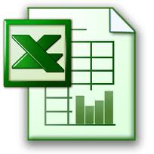

MATLAB Application
Black box
Thermal Mass
Helium Cooling
Heat Exchange
Quench Resistor
CLIQ
…
Simulink Model
Objects
Input Excel
Results Analysis
Notes:
We need some a priori knowledge about how the elements are connected.
What the user cares about is selection of parameters/structure/components and then the analysis of results.

Slide 13
Main Application Modules
Parametric Sweep
Parallel Computing
Report Generation
Simulation Control
Executable Modules

Slide 14
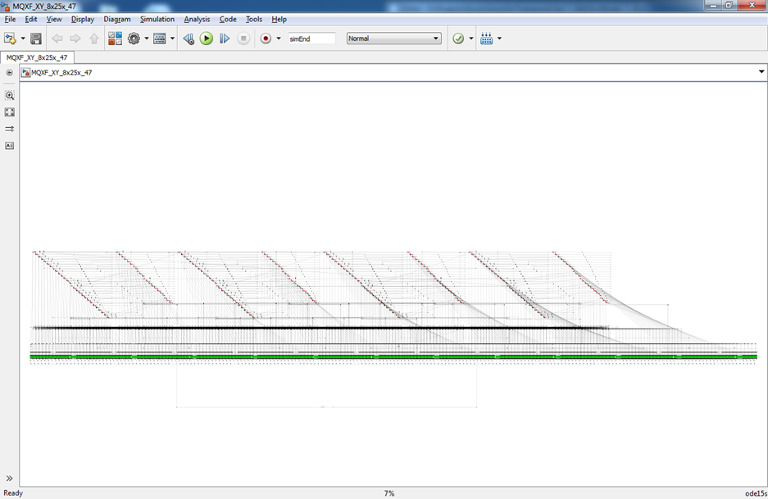
Coupling
Loss
Induced
Quench
27”

Slide 15
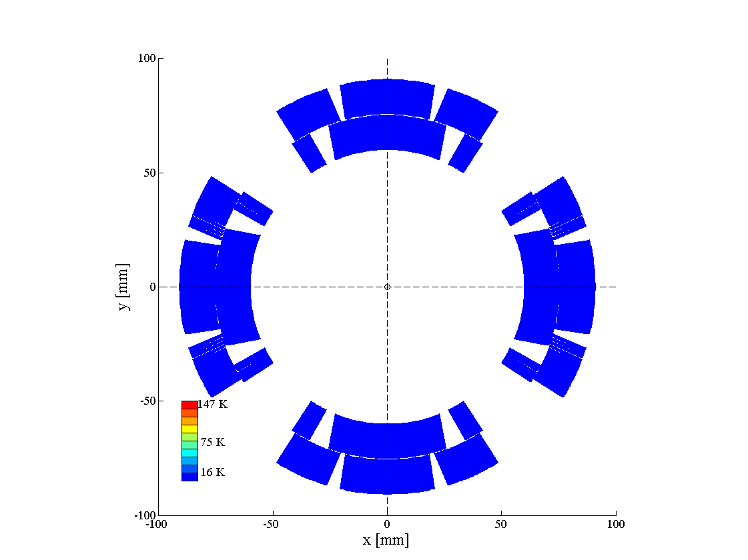
HQ02b Test Results – Currents
2
1
Current in the two sides of the magnet
4
3
Simulated 2D
Temperature Profile
Electrical and thermal transients well reproduced by the model
Current discharged by CLIQ

Slide 16
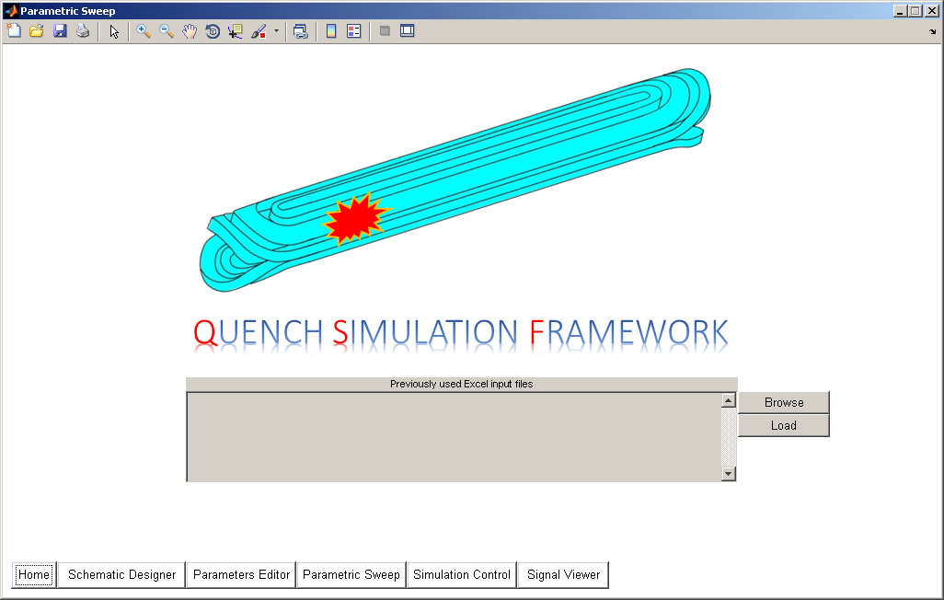
Graphical User Interface
Notes:
In order to improve users performace we are also going to build the Graphical User Interface.

Slide 17
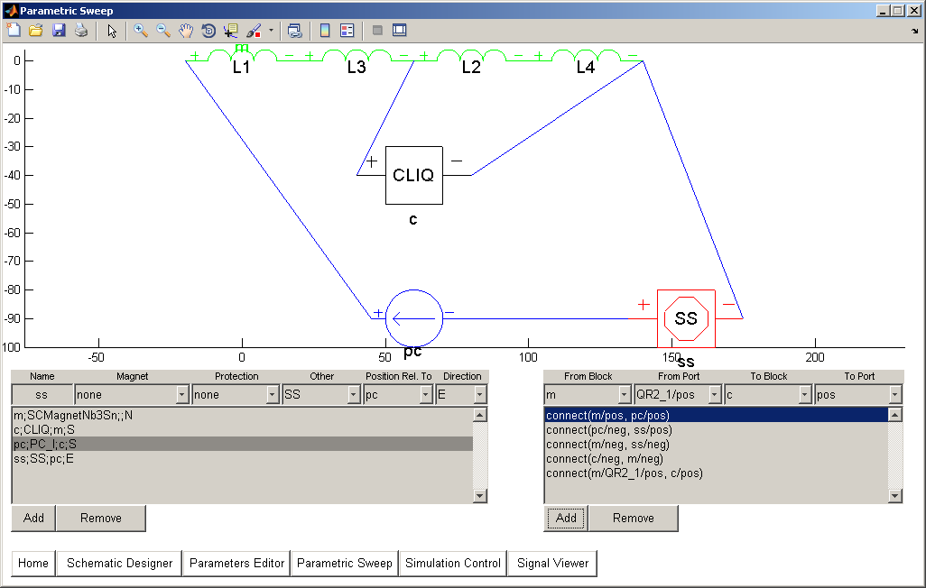
Schematic Editor – Netlist
Notes:
We can imagine the following circuit composed of the two magnets, connected to power converters by current leads. The magnets are bypassed by antiparallel diodes and additionally protected by the CLIQ.
Currently we are developing a well-known concept of netlist – using simple function to connect electrically or thermally the elements everyone can write simple statements that describe the model and create any custom circuit.

Slide 18
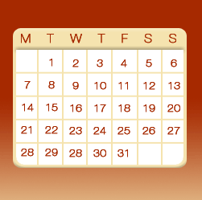

Summary – time savings
Quench Simulation Framework
Standard Approach

Slide 19
Summary
Model results successfully validated against PSpice simulation results and/or against tests
Same physics contained in the “hand-made” PSpice models is now contained in
highly-efficient, easily created Simulink models
No experience with Simulink needed to run simulations
QSF makes it easy to simulate various magnet types and new quench protection schemes
OOP and Design Patterns enabled to develop clean and maintainable code

Slide 20
Future Work
Parameters Optimization
Quench Initiation (2D+1 geometry)
Solenoid Geometry
Components optimization
Improve Magnetic Field Calculation (remove ROXIE/Soleno dependency)
Validation with results from new magnets

Slide 21
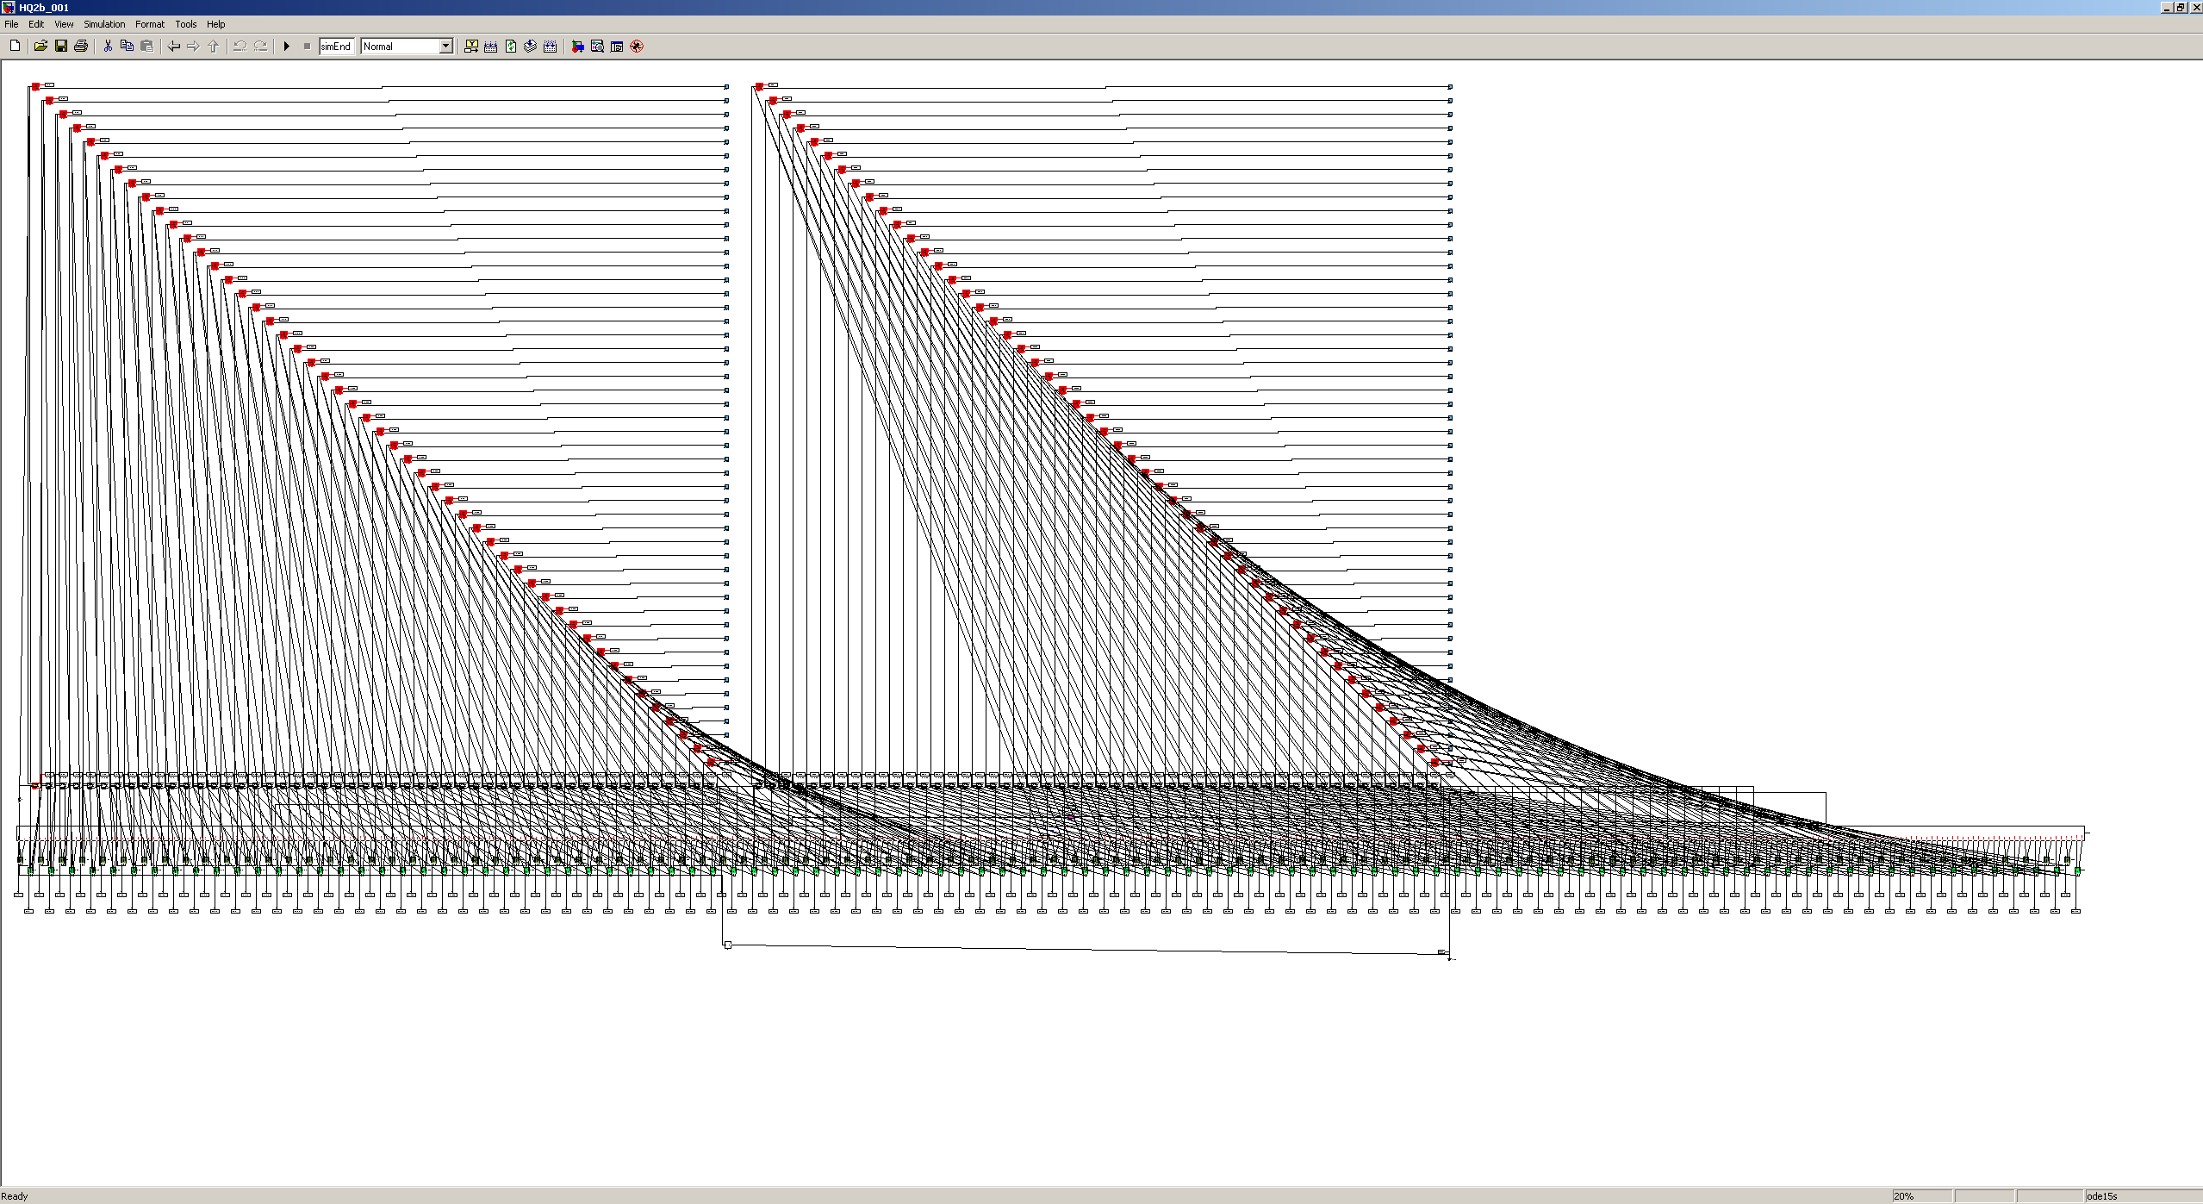
Thank you for attention!

