Slide 2
Quench Simulation for LHC Magnets – Challenges&Goals
B. Auchmann, TE-MPE, August. 2014

Slide 3
Overview
Magnet-level quench simulations
  Practical example: simulation of symmetric quenches in MB.
  Consequences of shortcomings
More real-world problems in the accelerator.
What is the strategy to tackle all of the above?

Slide 4
Preamble
The challenge of quench simulation:
  to model all relevant physical phenomena
  with adequate accuracy
Check 1:
  Measured quantities can be reproduced
  with all material- and model-parameters within the range of uncertainty,
Check 2:
  The model can be used for the same parameter set to extrapolate a magnet’s quench behavior to different working points.
Only if the above criteria are met, can we be confident to simulate internal states and reproduce observable and hidden behavior.
Any deviation from this path, and any filling in of unknown and unobservable parameters, must be on the conservative side.

Slide 5
How we simulate a quenching MB
Coil discretization
  Transversal:
    1 node per half-turn, lumping together
    cable, insulation, and helium,
    1 conductance per insulation layer.
    Surrounding structure is neglected.
    Heaters as single nodes, connected
    to turns and He bath.
  Longitudinal:
    Up to 100 subdivisions for full magnet.
    No coil ends (2-D mag. field).

Slide 6
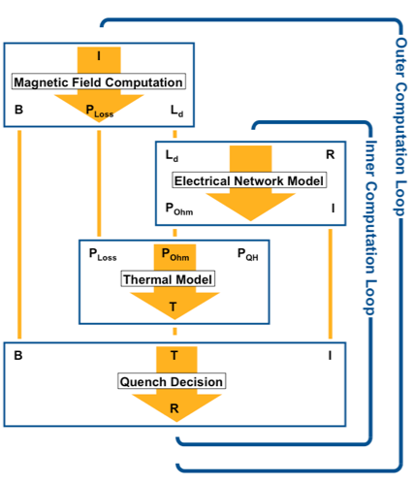
How we simulate a quenching MB
Time discretization
  Explicit 4-th order Runge-Kutta
  with adaptive time stepping.
  The quench front determines
  the step size in the entire
  magnet.
  Typically 1-10 µs for Nb-Ti
  magnets, and 0.1-1 µs for
  Nb₃Sn magnets → tens of
  thousands of steps.
Coupling
  Outer loop only updated after
  significant change in current.

Slide 7
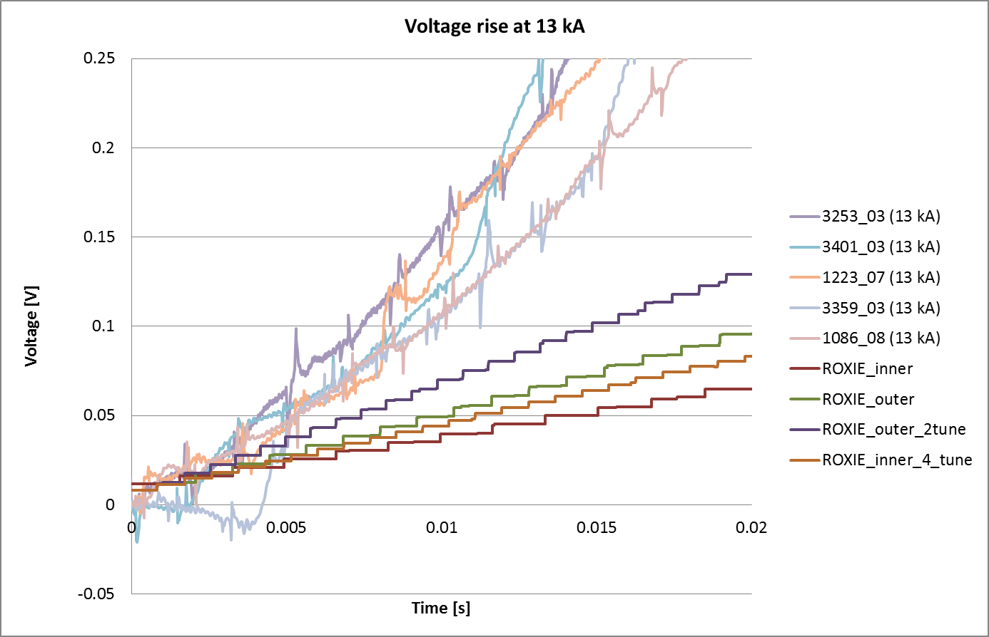
How we simulate a quenching MB
Step 1: tune the longitudinal model to fit measurement.
  A predictive model would require to include both, thermal and fluid-dynamics aspects of helium physics.
  Convergence would require step sizes of 1-5 mm.
  Tuning factors for models with 5-cm steps: 2-4.

Slide 8
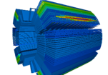
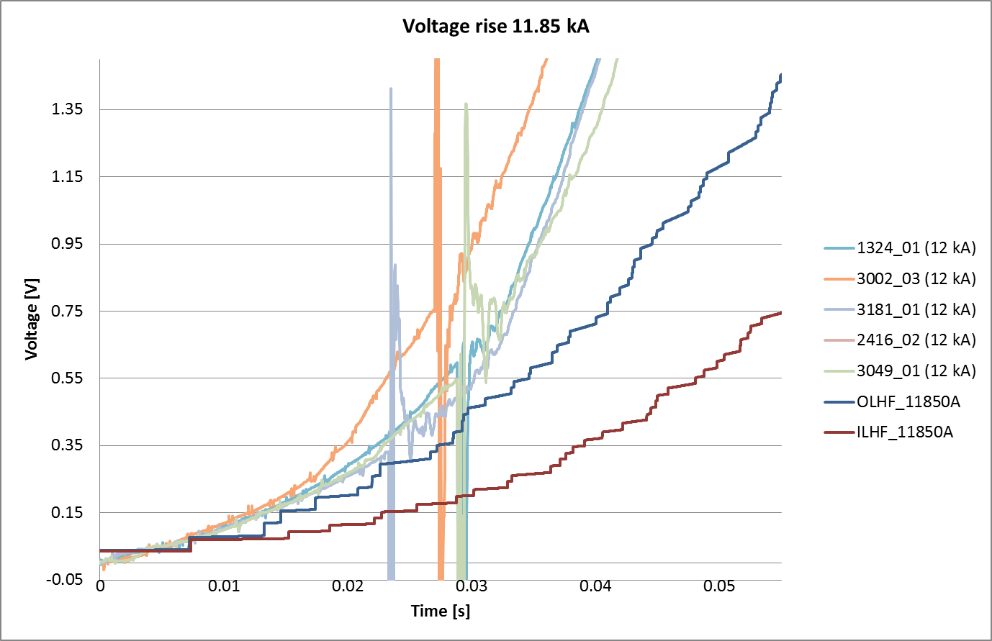
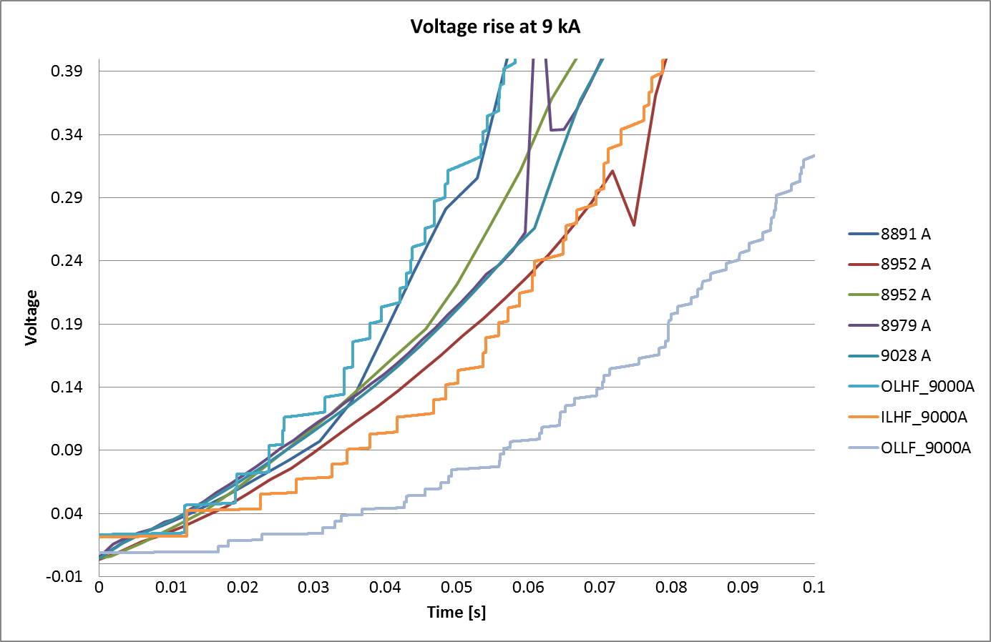
How we simulate a quenching MB
Step 2: Tune the transverse model
  Missing detailed helium model (microchannels in the insulation, helium in the Rutherford cable voids) and missing measurement data make this the least predictive part of the model. Tuning by factor 20!!! Does not scale properly with current. The most important effect is neither well known by measurement nor from the model.
Step 3: Note the time to reach threshold.

Slide 9
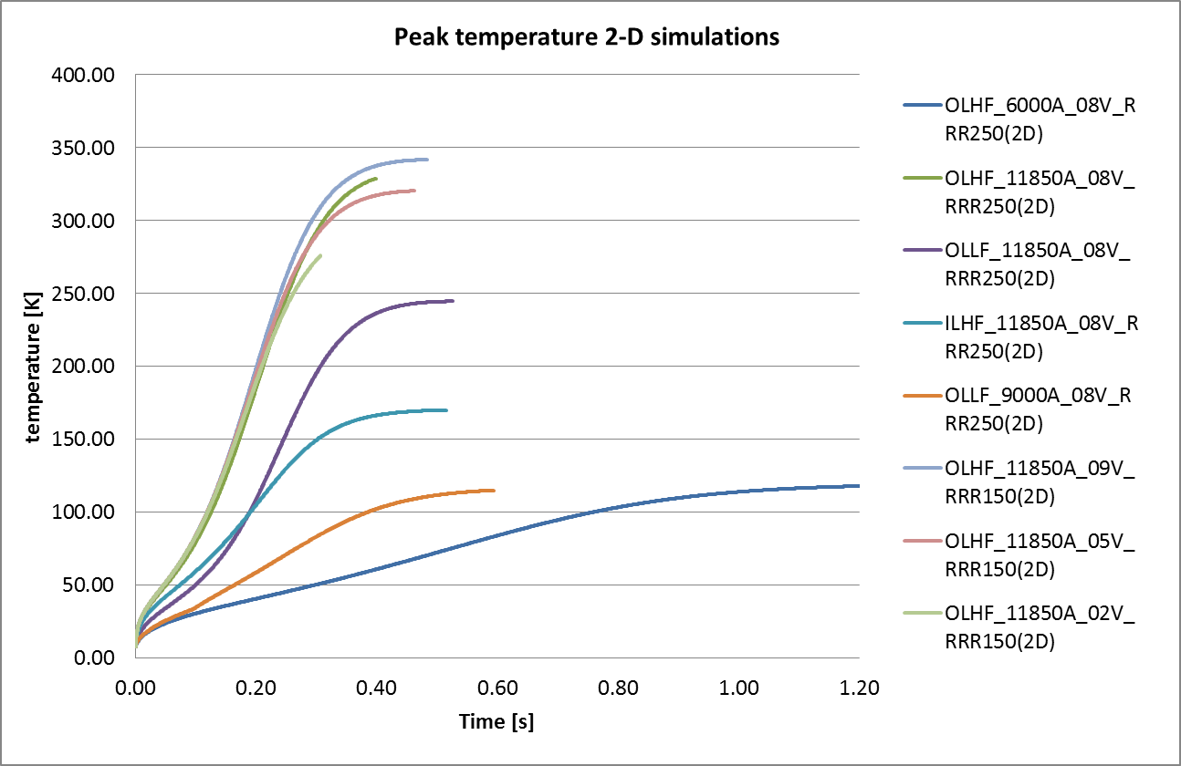
How we simulate a quenching MB
Step 4: Tune heater-efficiency model based on measurement data.
  Missing helium model, contact resistances makes tuning by factor ~2 necessary.
Step 5: 2-D simulation with hard-coded detection delay from 3-D simulation.
SymQ Threshold | Time to reach threshold
0.1 V | 0.007 s
0.2 V | 0.0132 s
0.5 V | 0.022 s
0.8 V | 0.0293 s
0.9 V | 0.0297 s
NB: The simulations were performed for one aperture and the SymQ measures the voltage across both apertures.

Slide 10
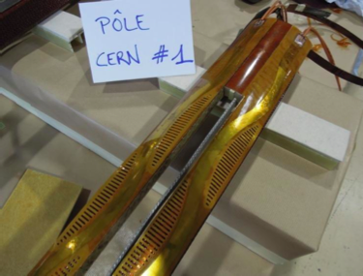
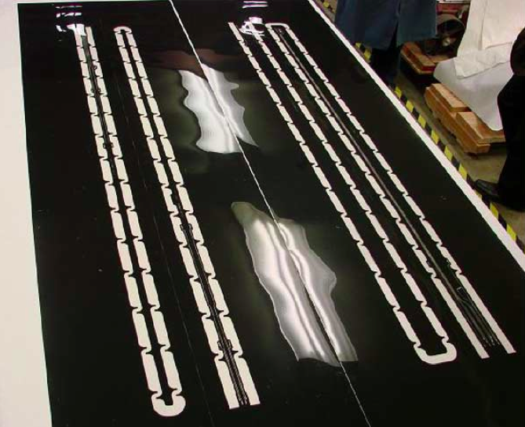
Consequences
D1 without heaters
  Consequence: Model vs. measured hotspot discrepancy of ~200 K. Applies to all helium-cooled magnets without heaters (with defective heaters). Hesitation to use spares, magnets with defective heaters.
Qualify the 11-T protection scheme for the LHC
  Consequence: Critical for magnet R&D program. Validation of the design will come only after many years of R&D. May build more prototypes than necessary.
Estimation of safe current levels and thresholds in 600 A circuits
  Consequence: Limitations of the operational reach of the LHC.
adiabatic
calc.

Slide 11
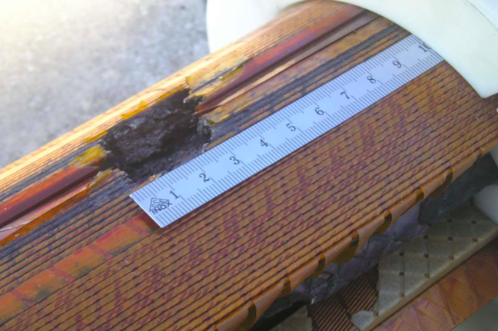
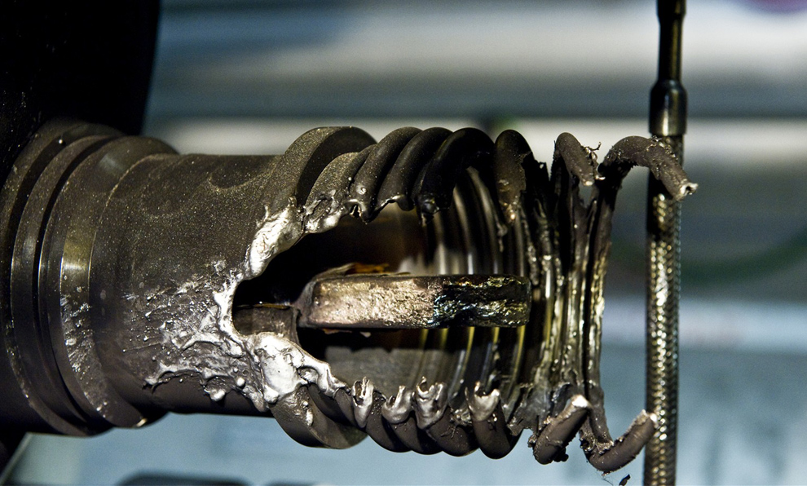
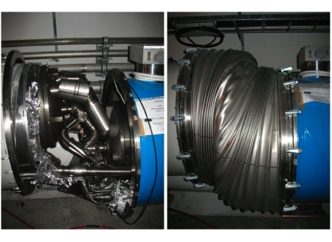
What if we fail?
 | E | M_{cu} | v_{20 t}
MB | 7 MJ | 9.6 kg | 95 km/h
RB | 1100 MJ | 1515 kg | ~Mach1
beam | 300 MJ | 413 | 620 km/h

Slide 12
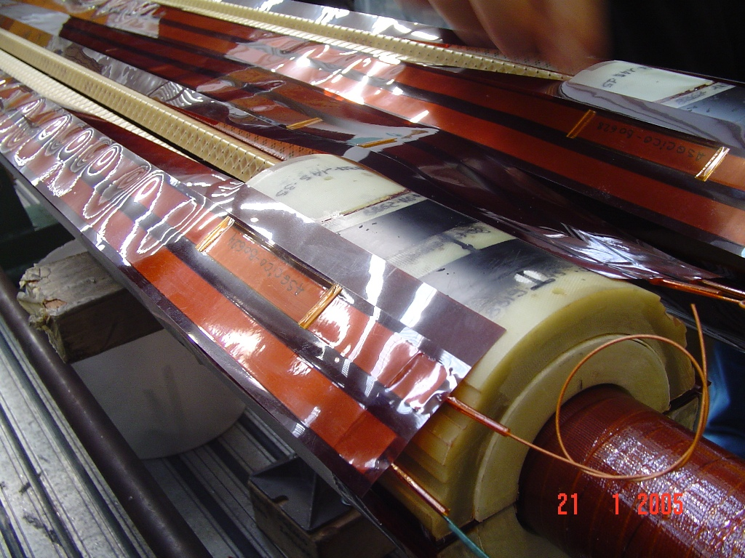
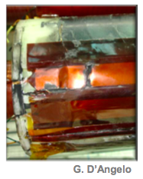
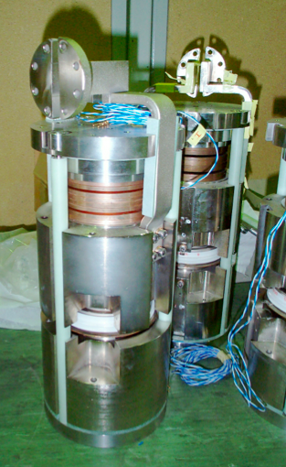
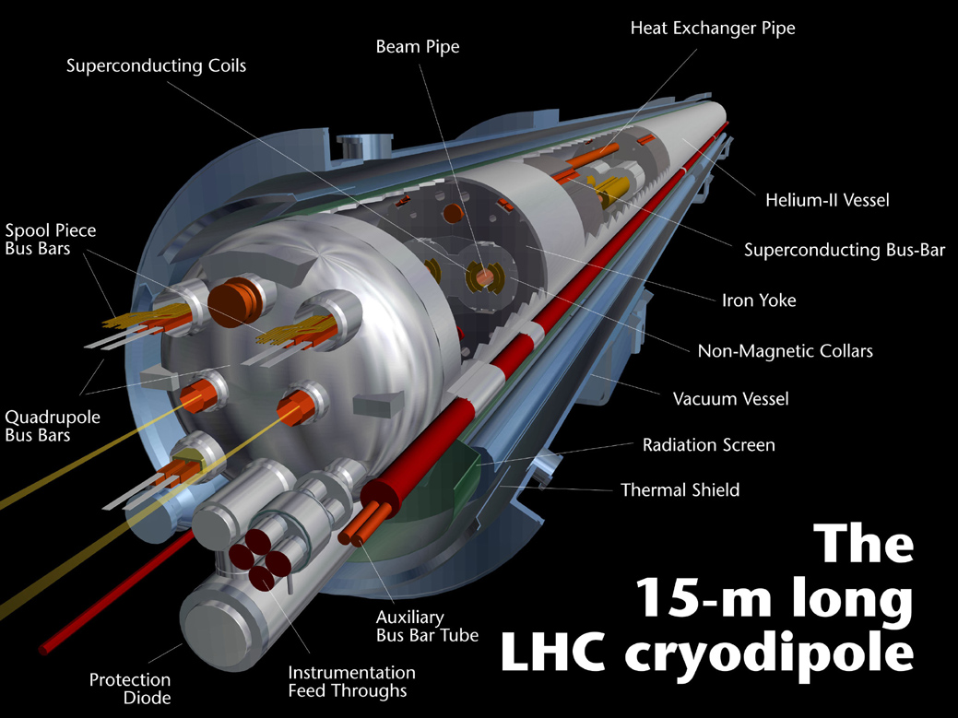
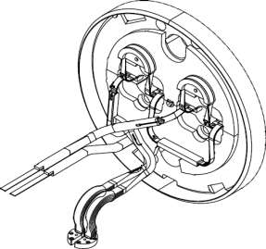
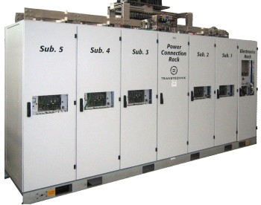
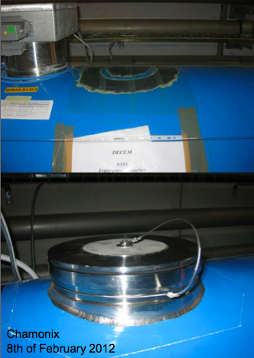
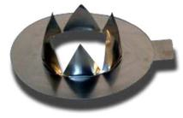
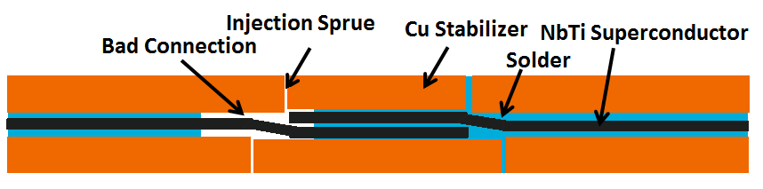
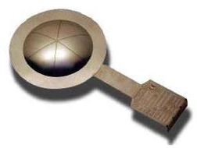
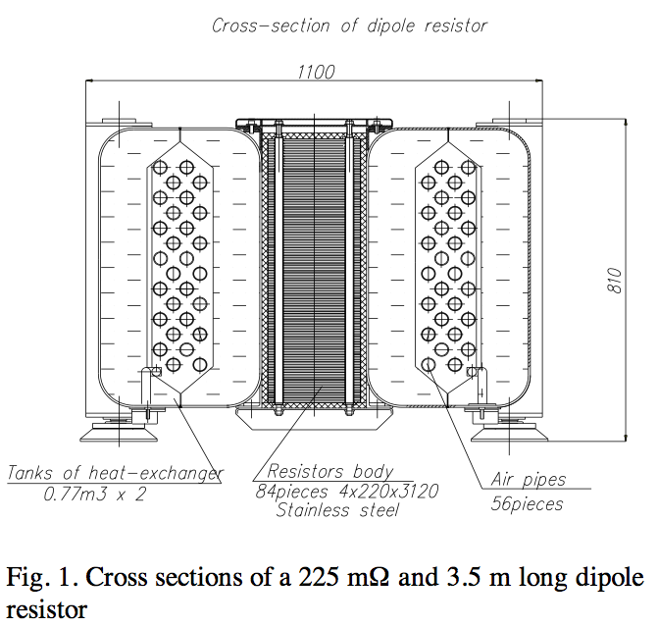
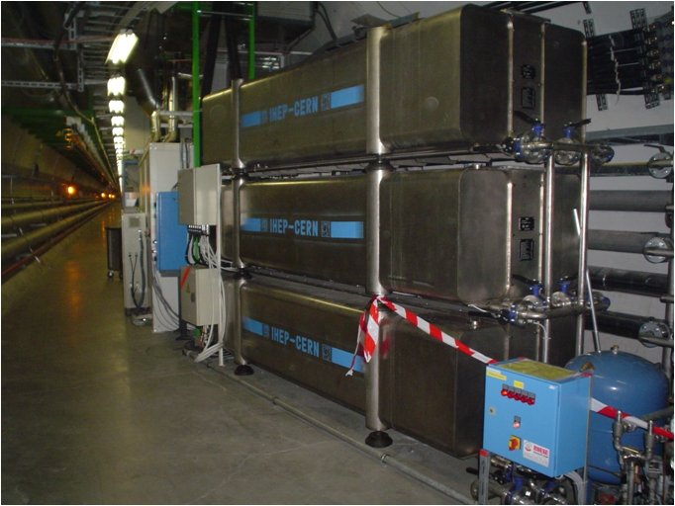
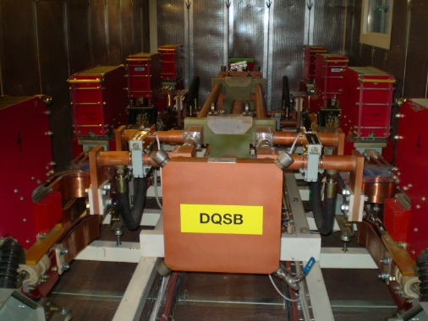
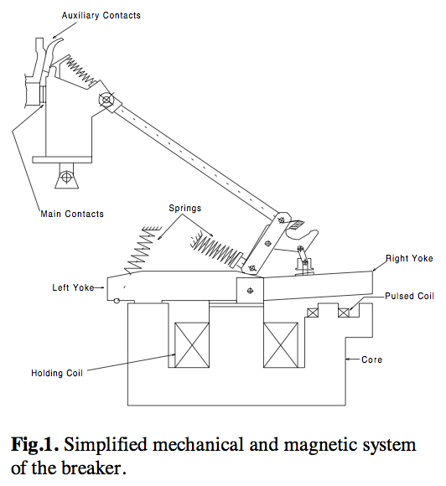
Some real-world aspects
heaters
diodes and diode leads
steel
copper
kapton
cable
pressure
valve
power converters
busbars & splices
dump resistor
switch

Slide 13
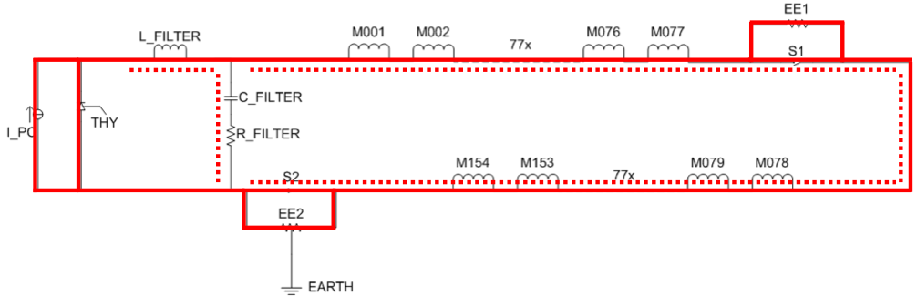
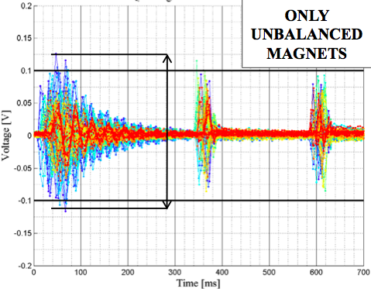
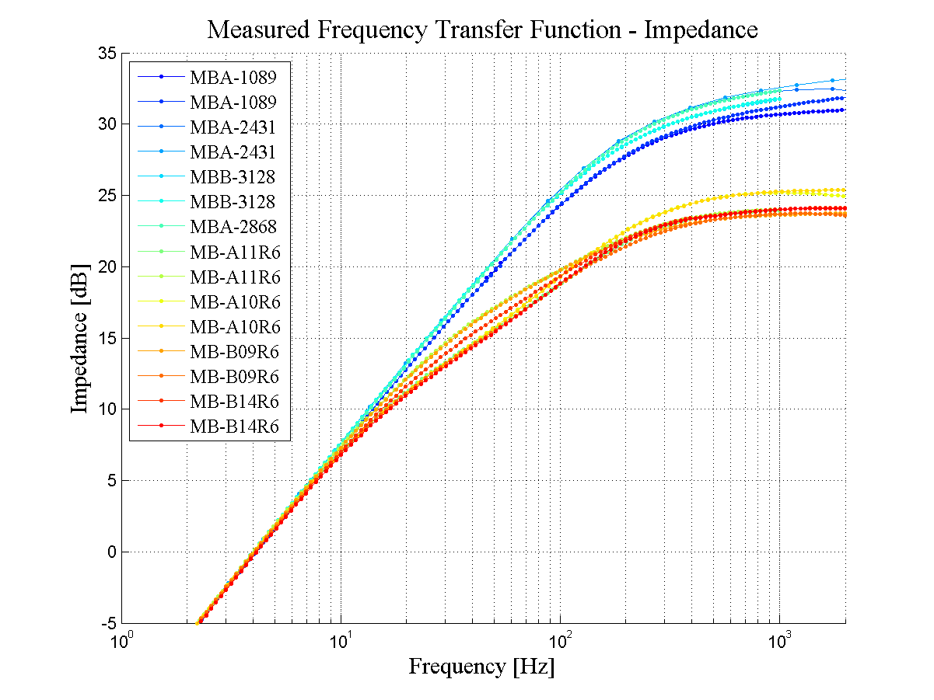
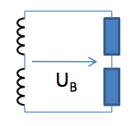
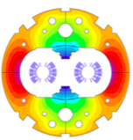
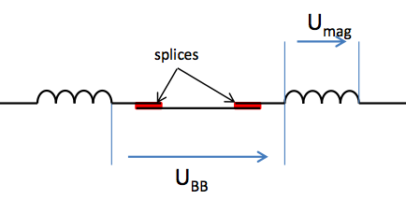

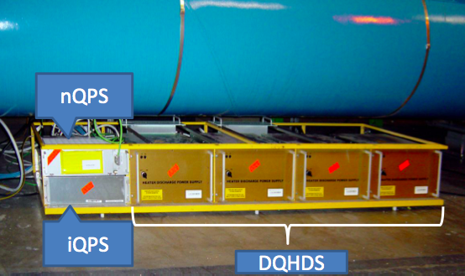

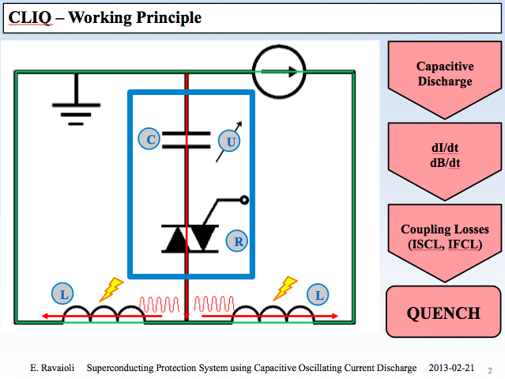
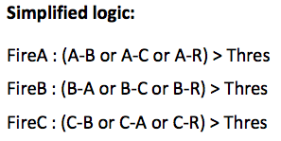
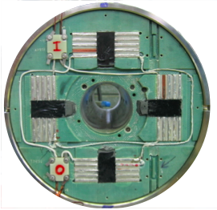
Other EM effects
transmission line effects
FTFs
Reddish → Tunnel
Bluish → SM18
Why are the FTF measured
in the tunnel different
from the ones in SM18?
QPS detection system
CLIQ system in case of heater failure?
magnets with short circuits.

Slide 14
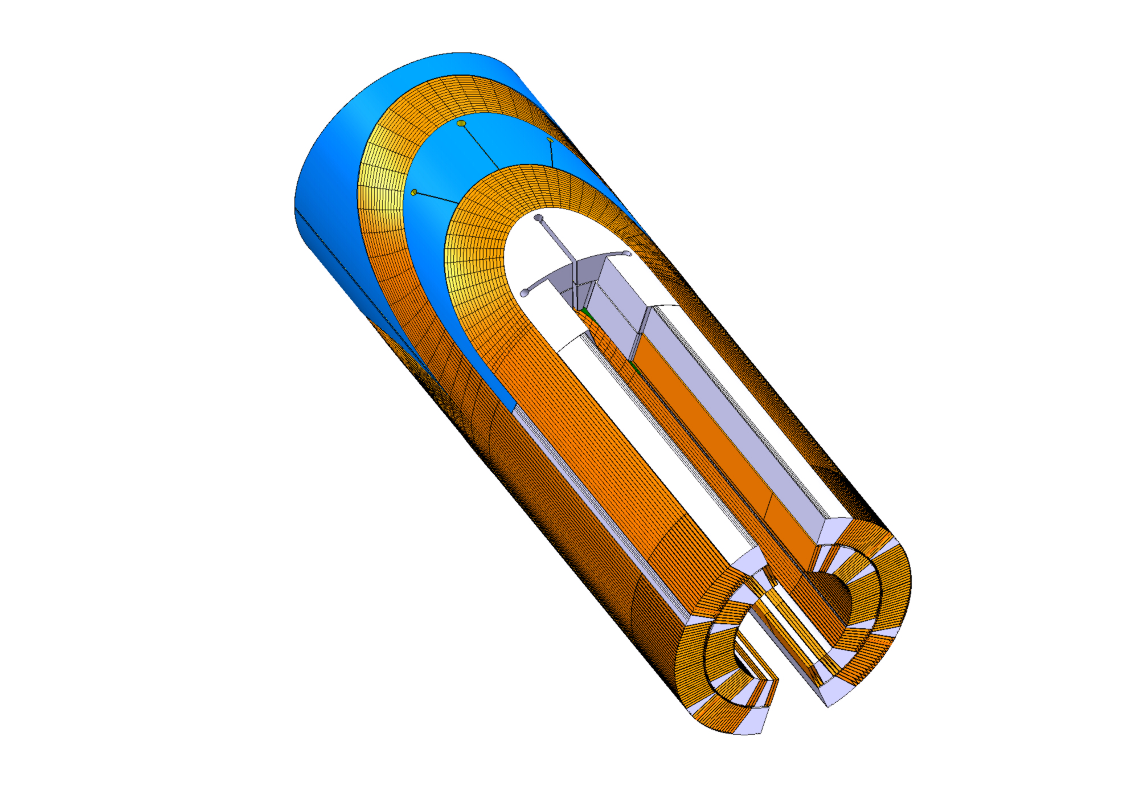
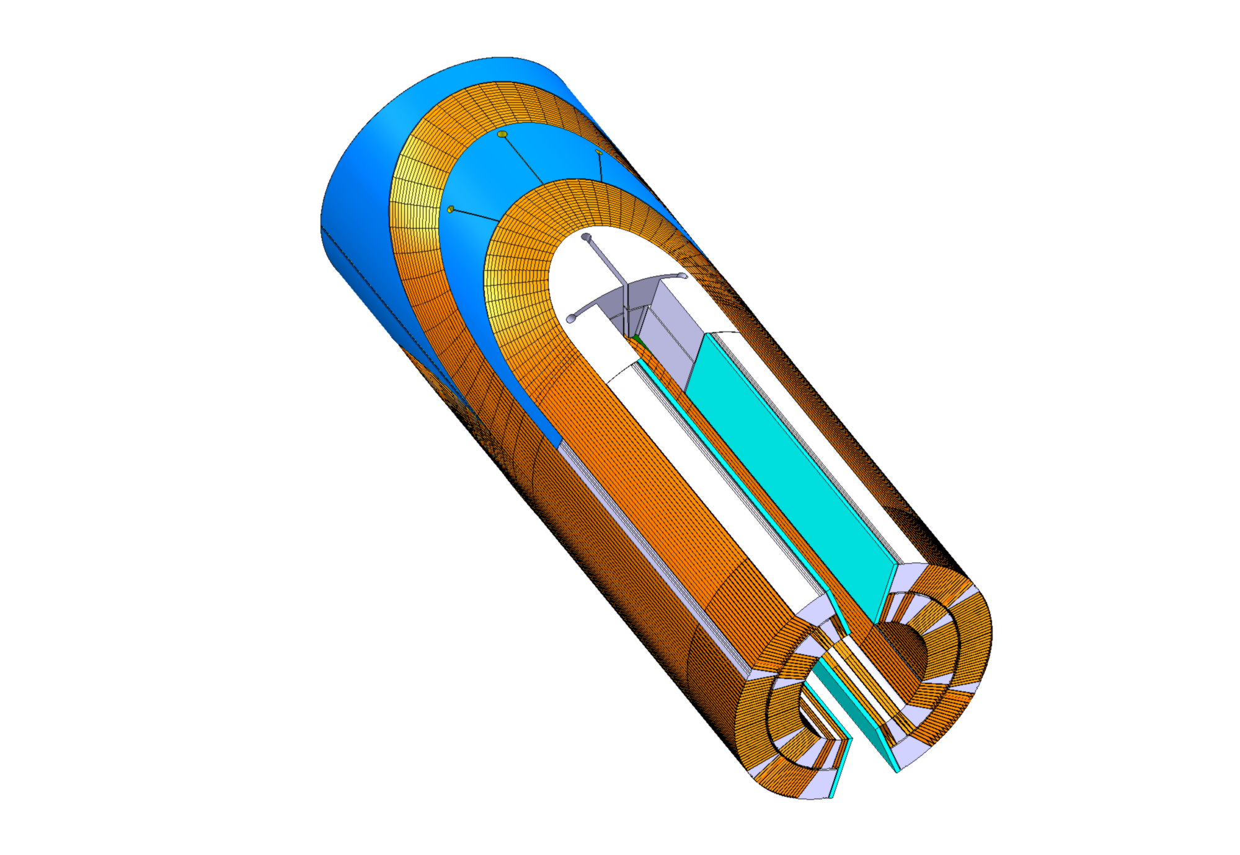
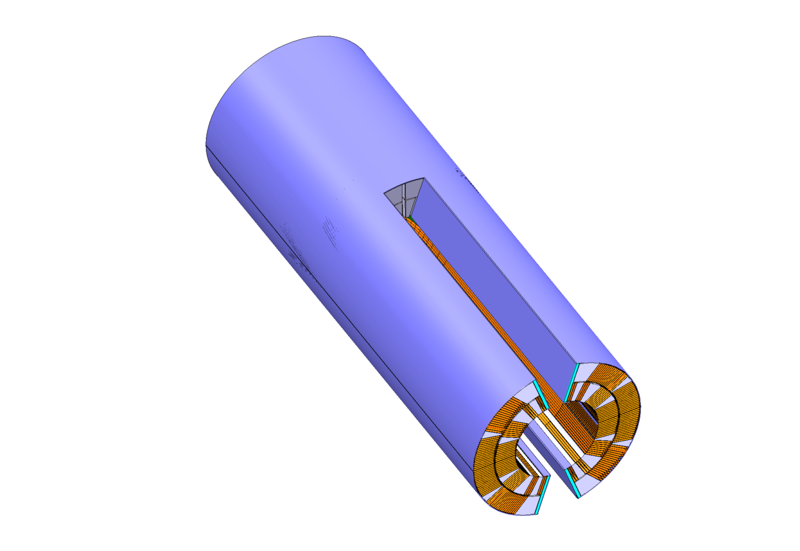
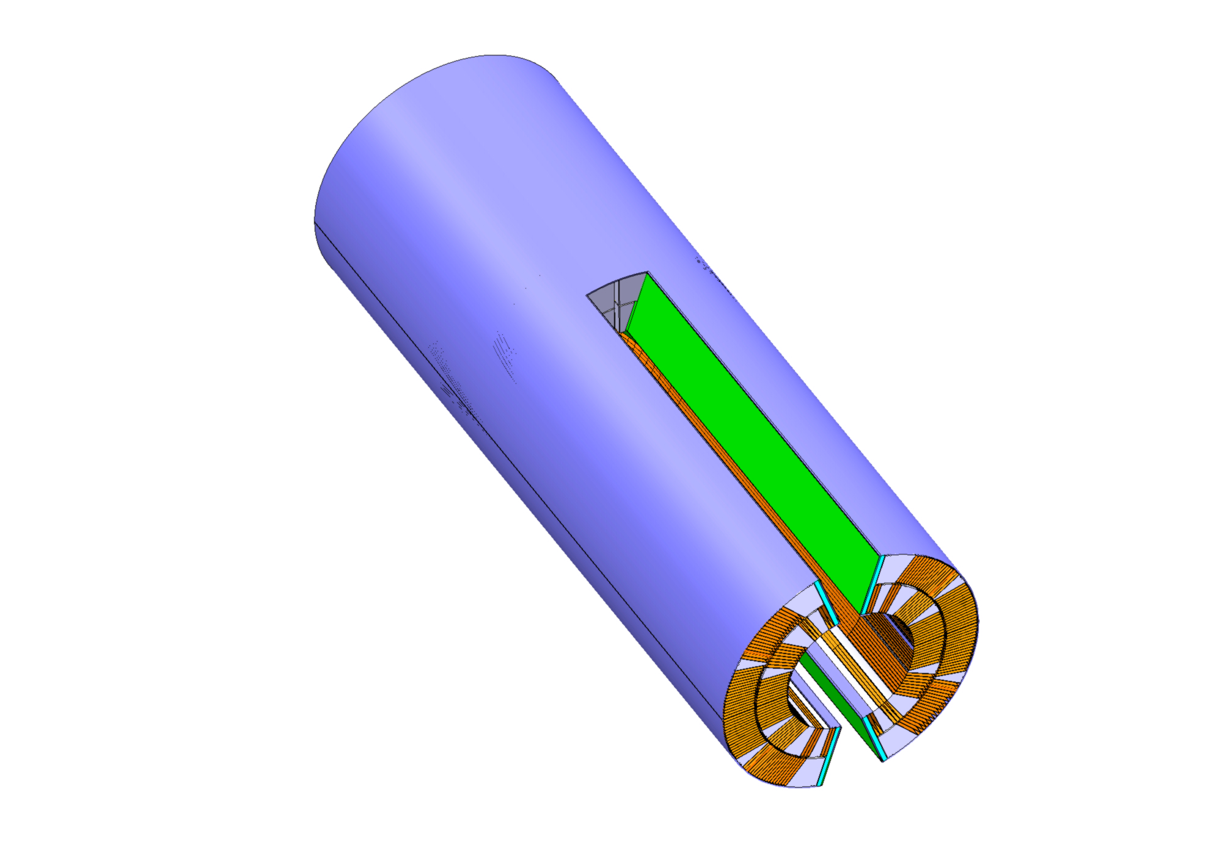
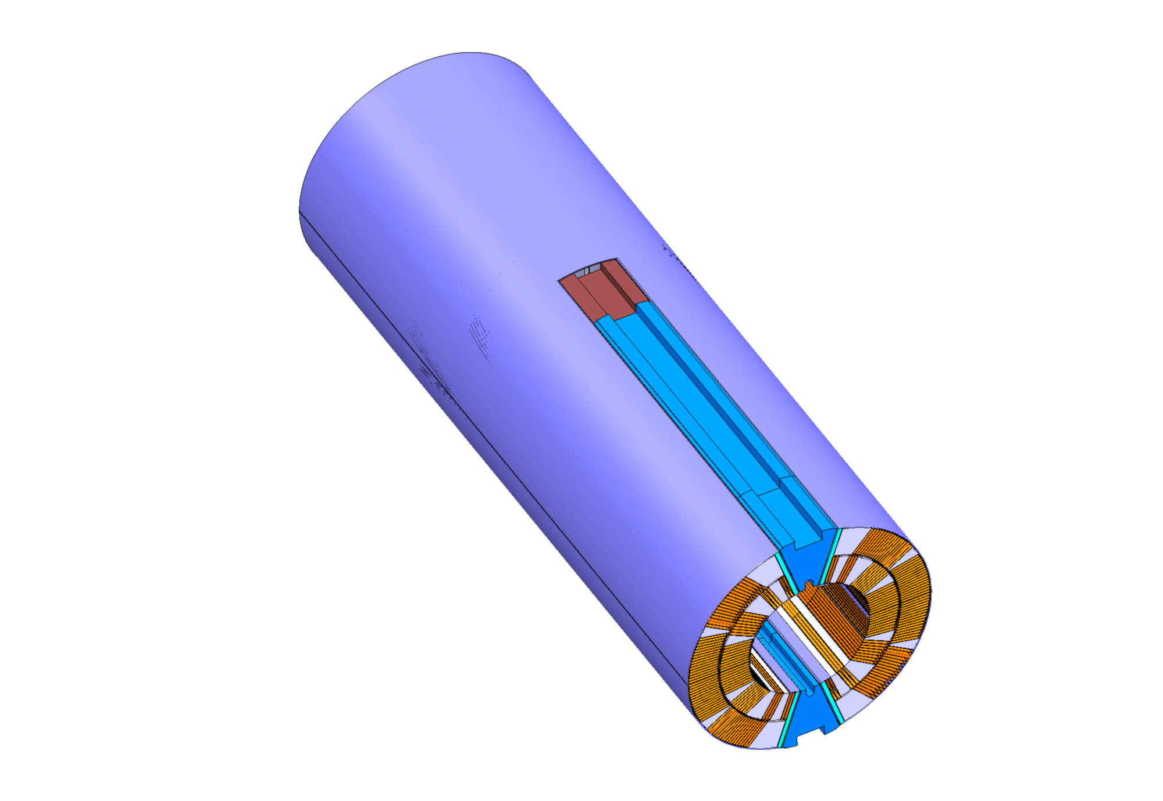
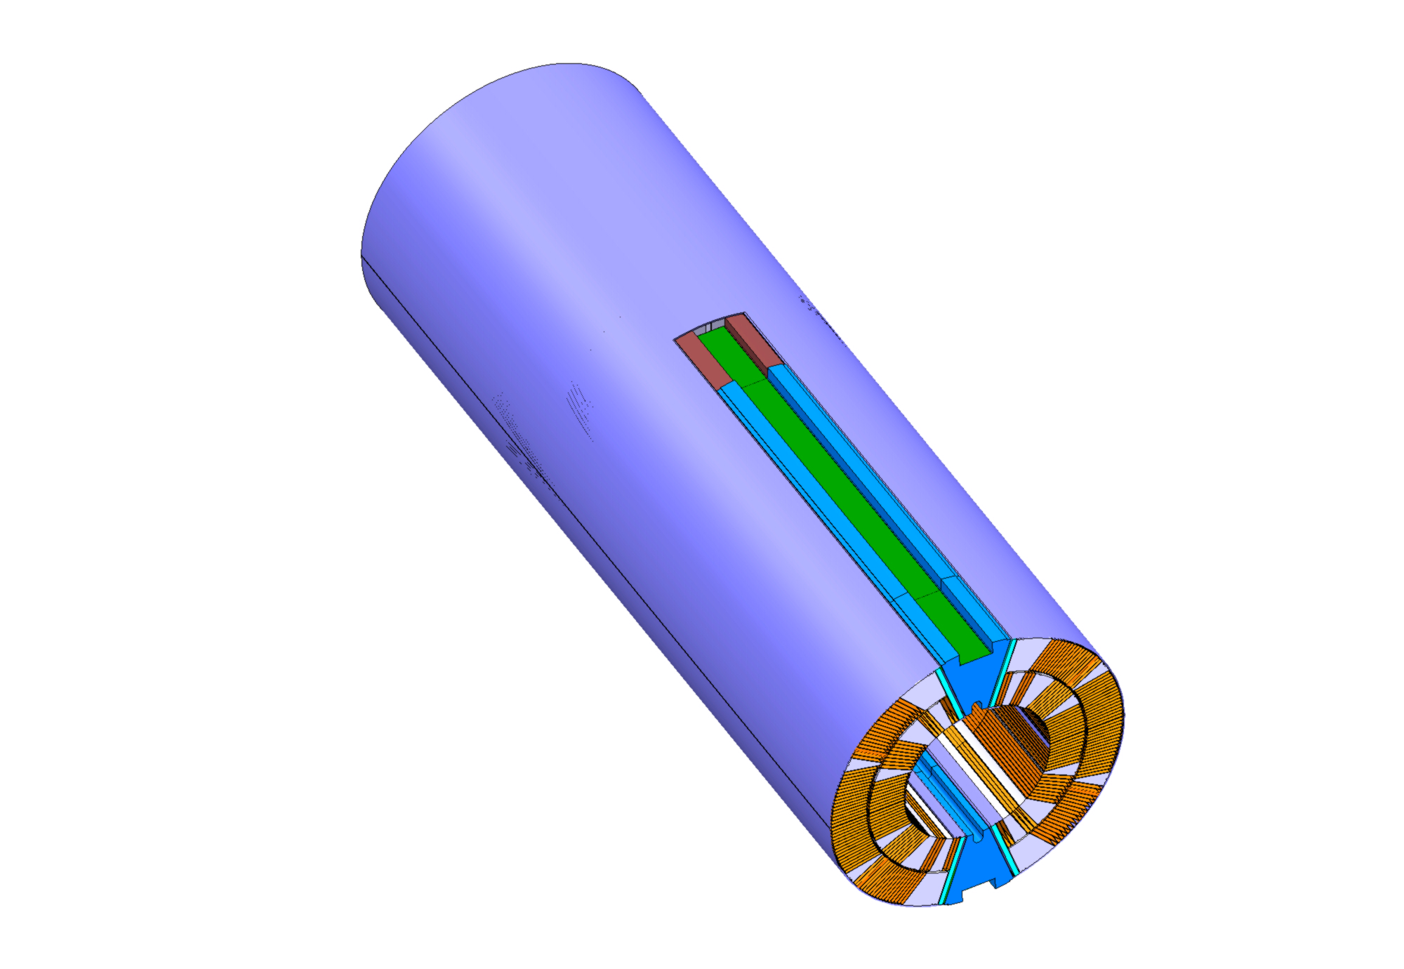
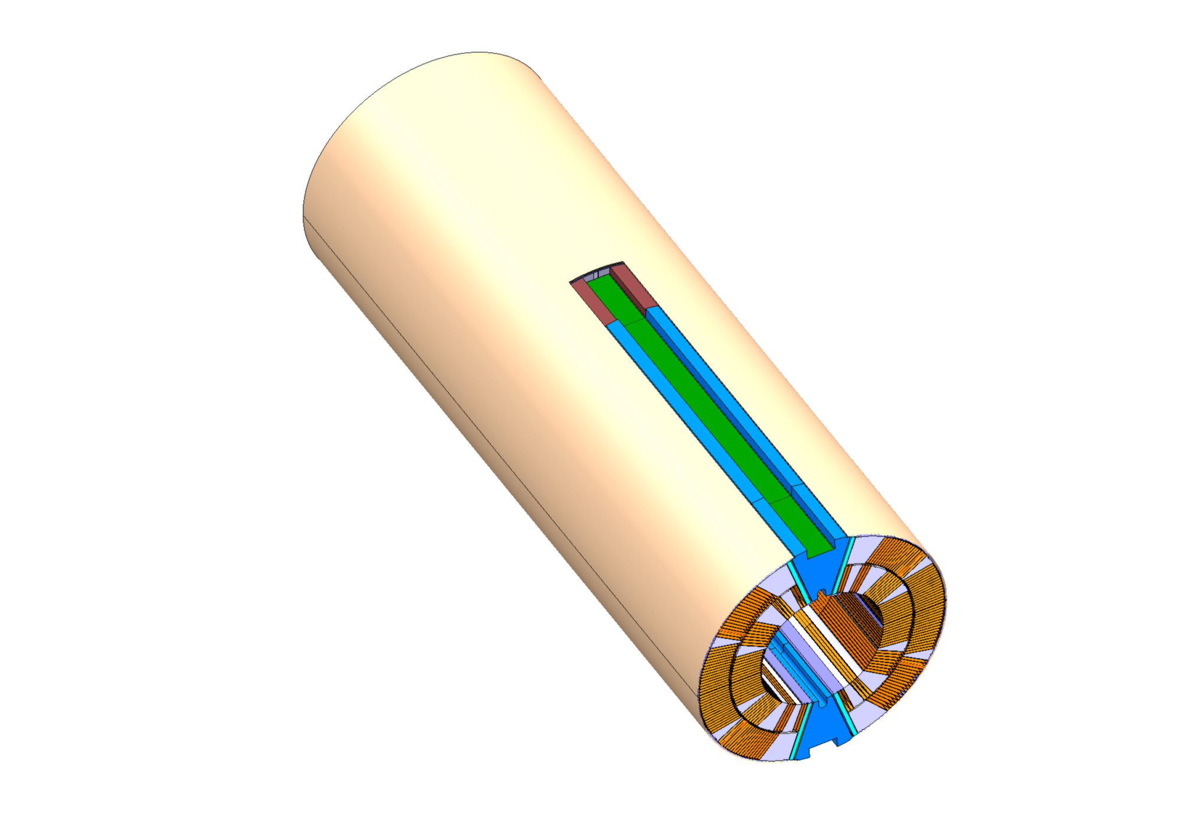
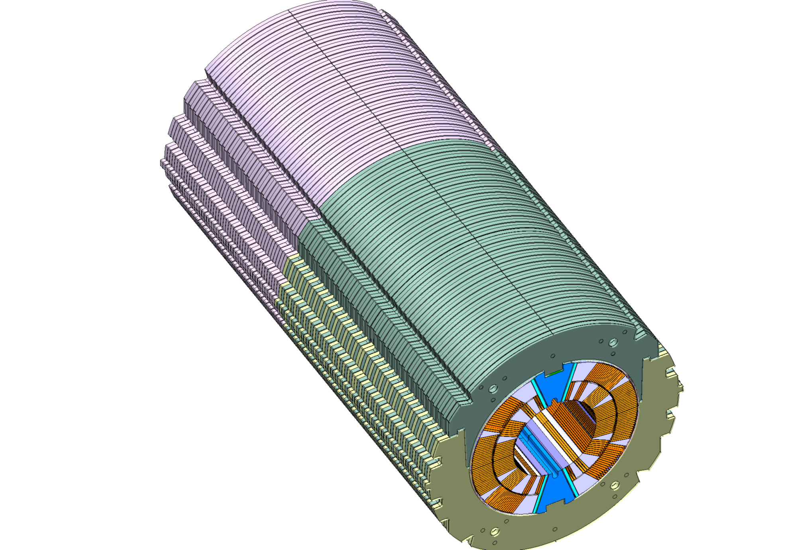
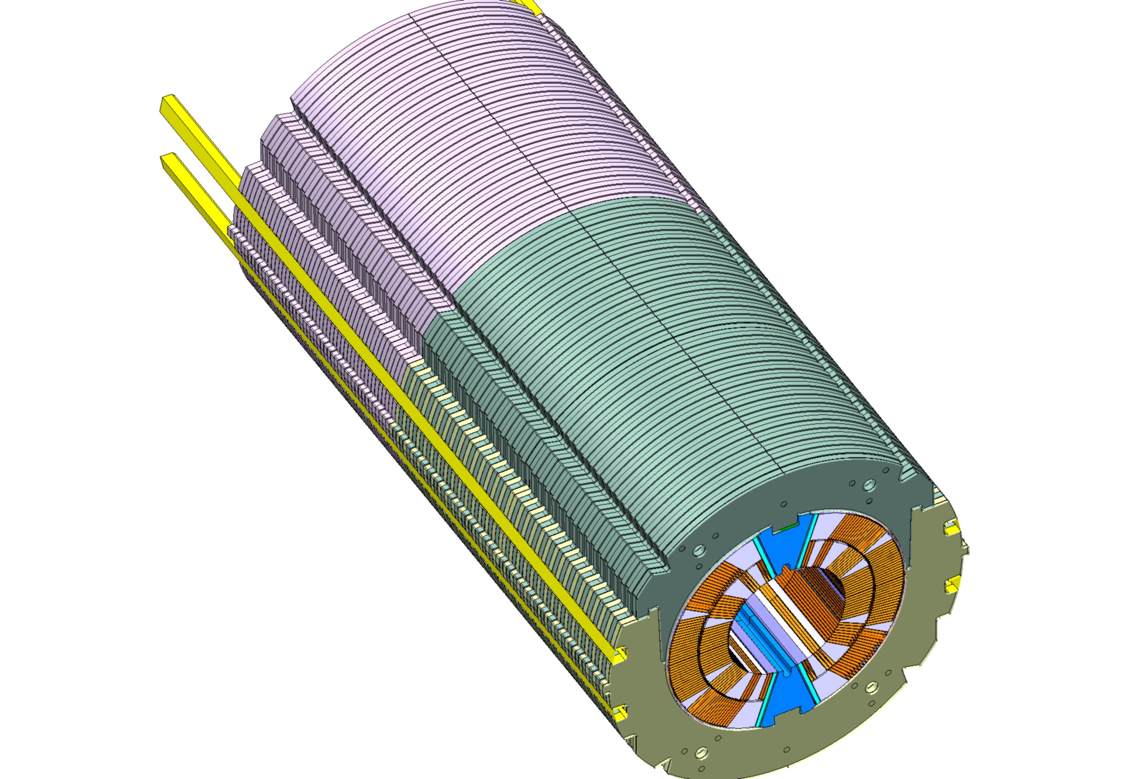
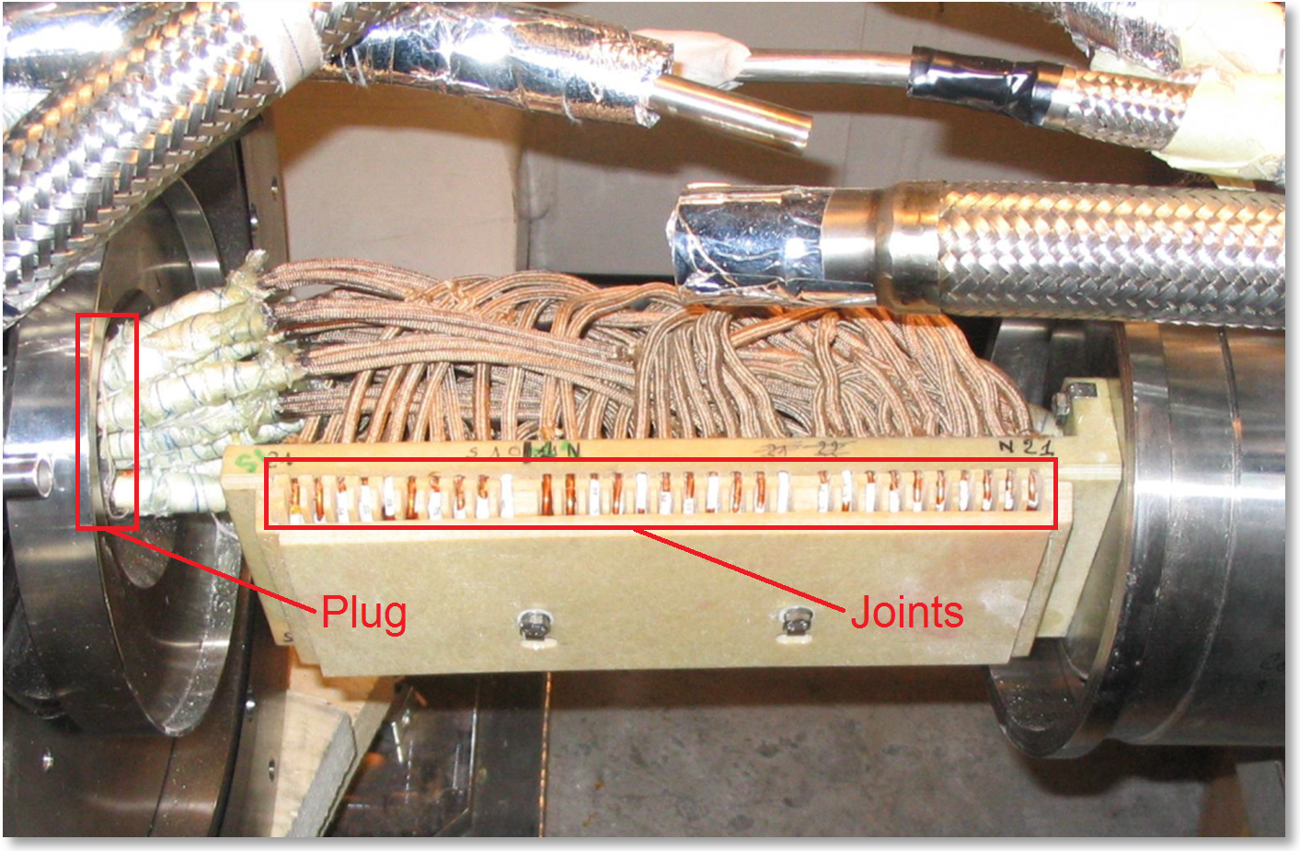
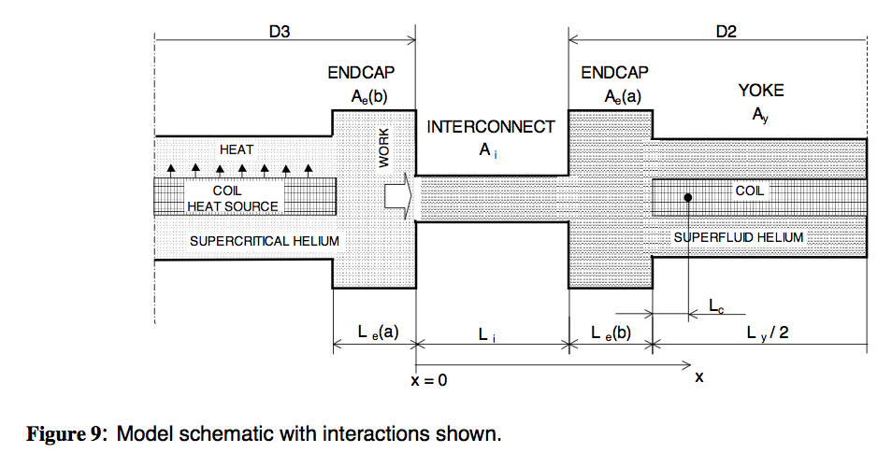
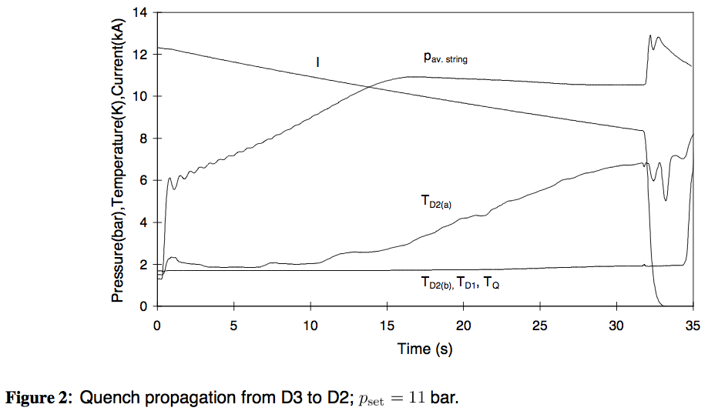
Some more real-world aspects
Mech. and elec. elements
A mutual-coupling and quench
protection problem
Magnet-to-magnet propagation.

Slide 15
Recap real-world features
Every aspect mentioned above may at any point in the next 20 year require specific attention and modeling.
The modeling depth for specific aspects needs to be adjusted from problem to problem.
The problems of proper coupling, adequate modeling depth, efficiency, and convergence are common to all investigations.

Slide 16
Commonalities/Differences
Most problems have in common:
  Multi-domain
  Multi-scale
  Multi-physics
  Multi-rate
  Need for post-processing
The differences lie in:
  Data source for geometries (CAD, FEM, custom coded)
  Modeling depth (scale, method)

Slide 17
Goals strategic
Framework that allows to develop models for the next 15 years.
Simulate quenches in MB with numerical convergence.
Lay the foundations to improve physics in quench models in a sustainable way.
Avoid maintenance of a large number of different programs.
Build a strategic partnership with relevant university institute.

Slide 18
Goals tactical
Co-simulation core providing
  Iteration algorithms
  Interpolation algorithms
  Fast material updates
  Theory of system coupling (coupling terms, coupling metrics, coupling methods)
Set of bench-marked solver tools providing variable modeling depth.
Post-processing setup for network and mesh-based models in multi-domain, multi-rate setting.
Pre-processing interfaces.
Validation with R&D magnet data.

Slide 20
Goals tactical 2
Surrogate models with experimental validation
Hybrid FEM
Sensitivity analysis

