Slide 2


Beam observation monitors in ELENA ring at CERN
Presented by
Nikoloz SHARMAZANASHVILI
(In framework of collaboration between CERN and GTU)

Slide 3
Subjects
Introduction
- General overview of AD (Antiproton decelerator) at CERN
- ELENA ring – objectives and capacities
Beam observation monitors (BOM)
  - Electronics/image processing
  - Mechanical composition
  - Magnetically coupled Push pull device as a new technology under implementation at CERN

Slide 4
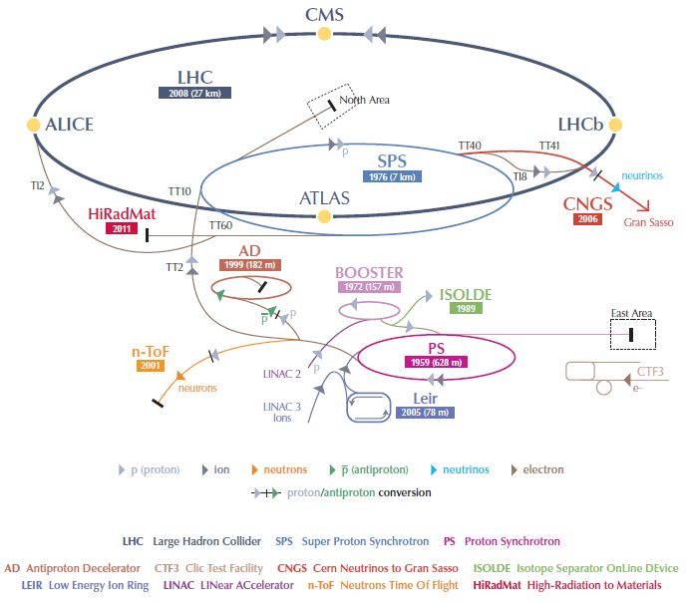
Accelerators @ CERN
AD Hall
-
Antiproton decelerator

Slide 5
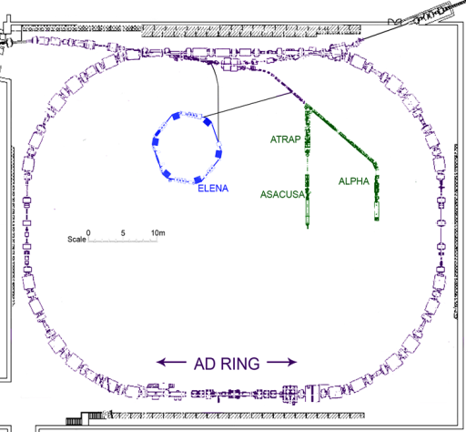
Introduction to AD
Objectives
Study is focused on trapping antiprotons.
Performing spectroscopy on antihydrogen atoms and to investigate the effect of the gravitational force on matter and antimatter.
Unites five experiments
ATHENA/ATRAP/ASACUSA/ACE/ /ALPHA/AEGIS.

Slide 6
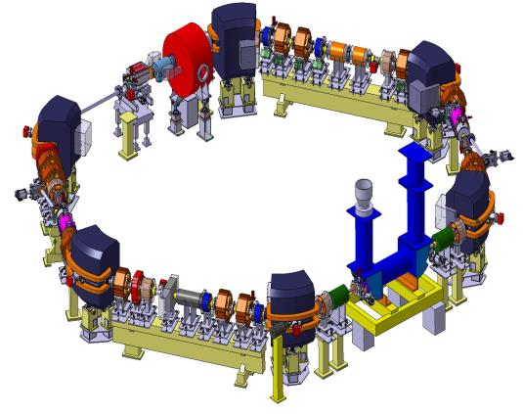
Introduction to ELENA ring
ELENA
Compact ring for cooling and further decelerating antiprotons delivered by AD, (assembled within AD ring)
Unique facility delivering low energy antiproton beams of highest quality.
Equipped with beam cooling – leading to high deceleration efficiency and resulting an increased number of antiprotons.

Slide 7
Beam observation monitor
To optimize and calibrate injection and circulating beam profiles
Composed of two screen in/out systems
Situated on cross section of AD and ELENA beam lines
Vacuum pressure – 3e⁻¹²mBar
Mass – 100kg

Slide 8
Electronics and image processing

Slide 9
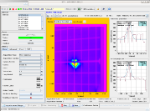
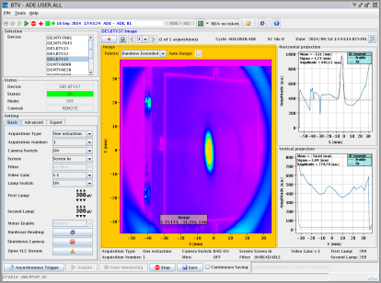
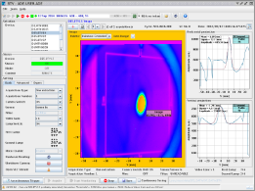

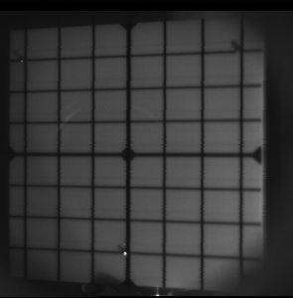
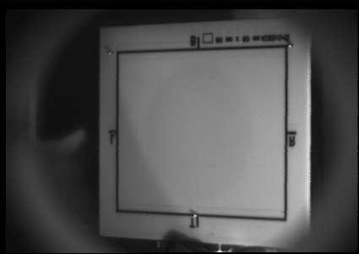
Electronics and image processing
Measurement examples
AD extraction line
These measurements validated the use of BTV instruments for AD extraction lines (BASE + ELENA)
Screen Type : Al2O3:CrO2
Thickness : 1mm
Calibration marks: No grid anymore to better optimize
the S/N with image digitalization

Slide 10
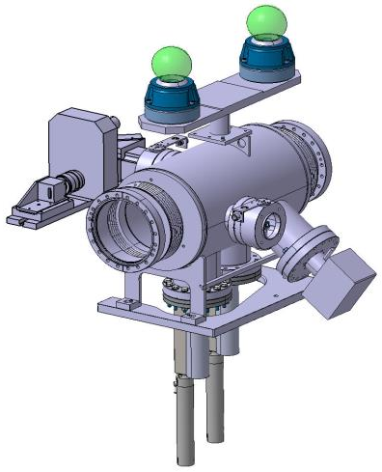
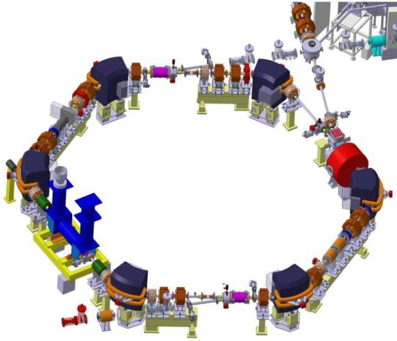
BOM position in ELENA ring
Intersection of beam from AD to ELENA

Slide 11

BOM mechanical aspects
Composition
Two hydro formed bellows
Two magnetically coupled in/out systems
(MPPL – 100- P)
NEG pump - non evaporable getter
(NEXTorr D1000 -10)
Total length constraint of the vessel – 622mm
Diameter – 250mm
Thickness – 3mm
Material – stainless steel 316LN.1.4429
2 viewports
Two optical systems – BTV SI – LHC

Slide 12
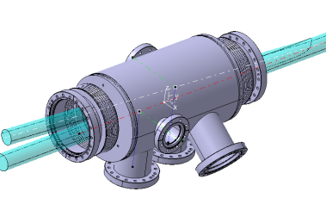
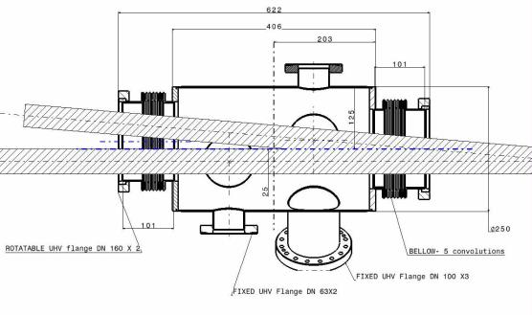
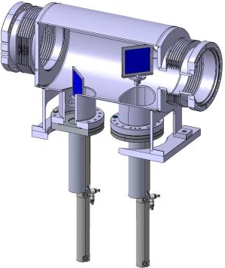
BOM mechanical aspects
Beam line profile within BTV
(Top view cut)
Injection line
Circulating line
Magnetically coupled in/out systems

Slide 13
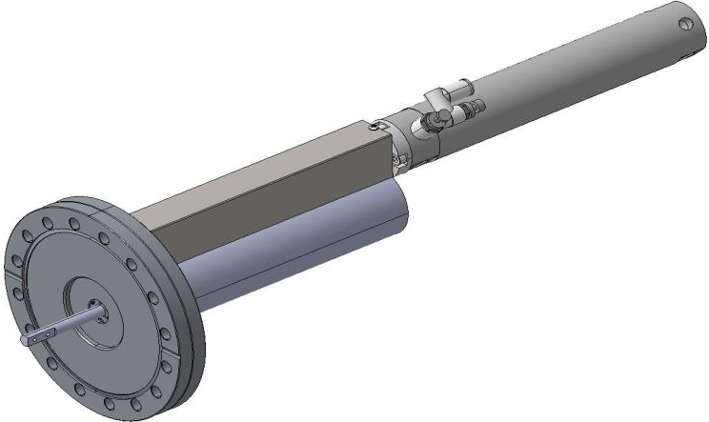
Screen in/out system
Magnetically coupled Push Pull device (Linear motion) from UHV Design
MPPL 100 – 100 – P
Pneumatic system
Single acting, spring extend/return
(CDG1BN32) from SMC
SMC – CG1 series
Pneumatic System
Spring extend/return

Slide 14
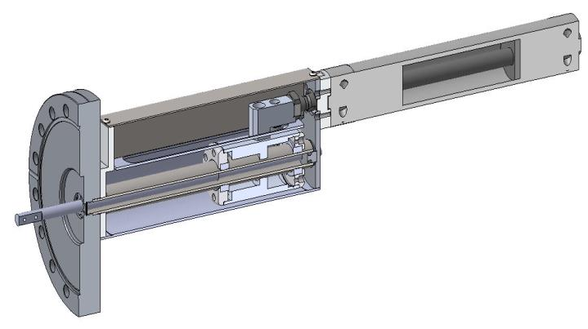
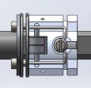
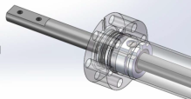
Screen in/out system
Connection structure of Drive thimble with pneumatic Rod
Device description:
Provides linear motion of the vacuum shaft.
Vacuum shaft and Drive Thimble are magnetically coupled.
Both the driver and the follower consist of arrays of equal numbers of permanent magnets with poles.
Removes the need for edge-welded bellows ‘stacks’, incorporated within traditional ‘push/pull’ designs - their elimination maximises vacuum integrity!
Unlike a bellows-sealed device, the MPPL is not subject to the thrust due to vacuum, resulting in smooth free-moving operation.
Note : Connection structure of Drive Thimble also serves as a Anti – Rotation tool and assures linear movement of inner Vacuum Shaft !

Slide 15
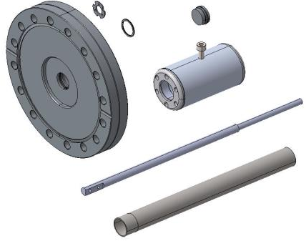
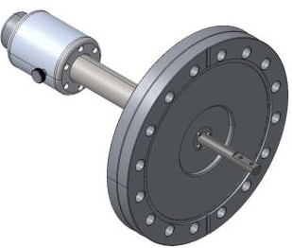
Screen in/out system
Assembly components:
Inner Vacuum shaft
Drive Thimble
Flange DN100 – 316LN
End Cap
Position Locking screw
Advantages:
Extremely resistant to demagnetization
No thrust due to vacuum
Guaranteed linear motion
Good temperature stability (maximum use temperatures between 250 °C (523 K) and 550 °C (823 K); Curie temperatures from 700 °C (973 K) to 800 °C (1,070 K)

Slide 16
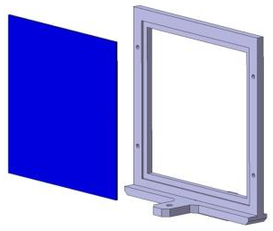
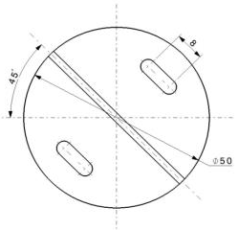
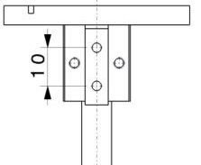
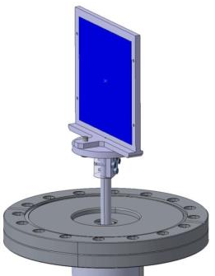
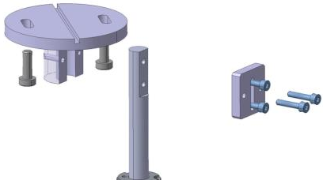
Screen support structure
Side View
Support for Screen frame

Slide 17
Conclusions
Need of new instrumentation for the injection line optimization from AD to ELENA ring.
Implementation of new technology for the mechanical systems – replacing bellow motioned devices by magnetically coupled ones.
The tests to approve new technologies are under progress in framework of collaboration between GTU and CERN.

Slide 18
In collaboration with:
S.Burger (CERN) – project coordinator
R.Sautier (CERN) – design and testing
N.Sharmazanshvili (GTU) – design and testing

