Slide 1
The LBNE 35 ton Membrane Cryostat
David Montanari
Neutrino Cryogenics Requirements Meeting
24 September 2014
Notes:
Good morning Ladies and Gentlemen, I am David Montanari from Fermilab.
I will be talking about the experience with the 35 ton membrane cryostat.

Slide 2
Outline
Introduction
Design parameters
Membrane construction
Instrumentation
Commissioning
Performance
Lessons learned
LBN
Summary
Notes:
Here the outline of the talk.
READ.

Slide 3
Introduction
The Long-Baseline Neutrino program wants to build a very large liquid Argon detector using membrane cryostat technology with passive insulation to do neutrino physics.
The LBNE-FD is currently a 34 kton total Fiducial Mass at 4850L of Homestake Mine in Lead, SD, USA (~1.5 km underground). Phased approach: presently, at first 2 x 7,134 m³ membrane cryostats, followed by 2 x ~15,100 m³.
Required LAr purity: less than 200 parts per trillion (ppt) Oxygen equivalent contamination (electron lifetime greater than 1.4 ms) to operate very delicate Time Projection Chambers (TPCs) inside the LAr volume.
To ensure that membrane cryostat technology is suitable for this experiment, we have built and successfully operated the LBNE 35 ton prototype, a ~28 m³ membrane cryostat, the first and only membrane cryostat for scientific purpose and available to scientists.
Notes:
Why are we doing this??
READ.

Slide 4
Technical goals
The technical goals of this prototype are:
  To demonstrate the membrane cryostat technology (thermal performance, feasibility for LAr, leak tightness). ✔
  To demonstrate that we can achieve the purity requirements in a membrane cryostat without evacuation. ✔
  To achieve and maintain purity requirements during filling, purification and maintenance mode. ✔
Notes:
READ.

Slide 5
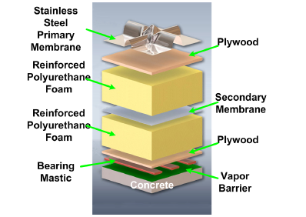
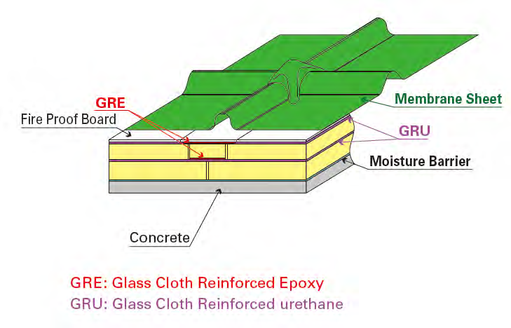
Membrane Cryostat Design
Membrane
Fireproof board
Insulation (2 Layers)
Secondary Barrier
Vapor Barrier
Concrete
IHI Membrane Technology
(used in 35 ton prototype)
GTT Membrane Technology
Nominal Panel Size
1m x 3m x 1.2 mm thickness
Nominal Panel Size
3m x 8m x 2 mm thickness
ES&H Comment: Foam layers are fire retardant. Plywood or calcium silicate board protects foam from
heat during primary membrane welding.
Note: IHI has only tested the secondary barrier containment and implemented it in the LBNE 35 ton prototype.
Notes:
How does a membrane cryostat works??
We have two known vendors: GTT and IHI.
Their products are different, but the concept is very similar.
We have:
A stainless steel membrane (1.2 mm for GTT , 2.0 mm for IHI)
A fireproof board (plywood with GTT, Calcium Silicate with IHI)
A first layer of insulation (Polyurethane foam)
A secondary barrier to protect the insulation from potential spills of liquid from the inside (metallic for GTT, epoxy for IHI)
A second layer of insulation (Polyurethane foam)
Concrete

Slide 6
Existing papers
Three papers have been written on the design, construction and operations of the LBNE 35 ton membrane cryostat prototype:
  “First Scientific Application of the Membrane Cryostat Technology”, CEC 2013, Anchorage, AK.
  “Results from the Commissioning of a LAr Membrane Cryostat Prototype for LBNE”, Cryogenics 2014, Prague, Czech Republic.
  “Performance and Results of the LBNE 35 ton Membrane Cryostat Prototype”, ICEC 2014, Enschede, The Netherlands.
Notes:
READ.
In the interest of time we will not discuss design and construction again and we will focus on operations.
This is the 3-D model of the cryostat.
BRIED DESCRIPTION.

Slide 7
3-D Drawing
Notes:
READ.
BRIED DESCRIPTION.

Slide 8
Design Parameters
Design Parameter | Value for LBNE 35 ton | Value for Far Detector (One cryostat)
Total LAr Volume / Mass | 27.70 m³ / 38.6 ton | 6,758 m³ / 9,290 ton
Inner dimensions (flat plate to flat plate) | 4.0 m (L) x 2.7 m (W) x 2.7 m (H) | 28.5 m (L) x 15.6 m (W) x 16.0 m (H)
Depth of LAr | 2.565 m (5% under Plate A) Total ullage 11%, including neck. | 15.2 m (5% ullage)
Insulation thickness | 0.4 m polyurethane foam | 0.8 polyurethane foam
Primary membrane | 2.0 mm thick 304 corrugated stainless steel | Vendor’s design
Secondary barrier system | 0.1 mm fiberglass | Vendor’s design
Vapor barrier | 1.2 mm thick carbon steel | Vendor’s design
Reinforced concrete layer | 0.3 m thick (Free standing) | 0.5 m thick (Against the rock cavern)
LAr temperature | 89 K +/- 1 K | 89 K +/- 1 K
Operating gas pressure | 70 mBar (~1.0 psig) | 130 mBar (~1.9 psig)
Vacuum | No vacuum | No vacuum
Design pressure | 207 mBar (~ 3 psig) | 350 mBar (~ 5 psig)
Leak tightness | 1E-06 mBar x liter / second | 1E-06 mBar x liter / second
Heat leak | < 13 W/m² | < 10 W/m²
Duration | 10 years | 20 years
Thermal cycles | 50 full cycle (cool down and total warm up) | 50 full cycle (cool down and total warm up)
Design codes | Fermilab ES&H. Applicable parts of JGA RP-107-02, ACI 318. | Membrane cryostat standard relative to country of origin
Notes:
Here we have a list of the design parameters of the 35 ton and the current version of the LBNE-FD.
Please note that only one of the two Far Detector cryostat are listed here.
In the interest of time, we are not reading them all.
I just would like to point out few of them.
READ the highlighted.

Slide 9
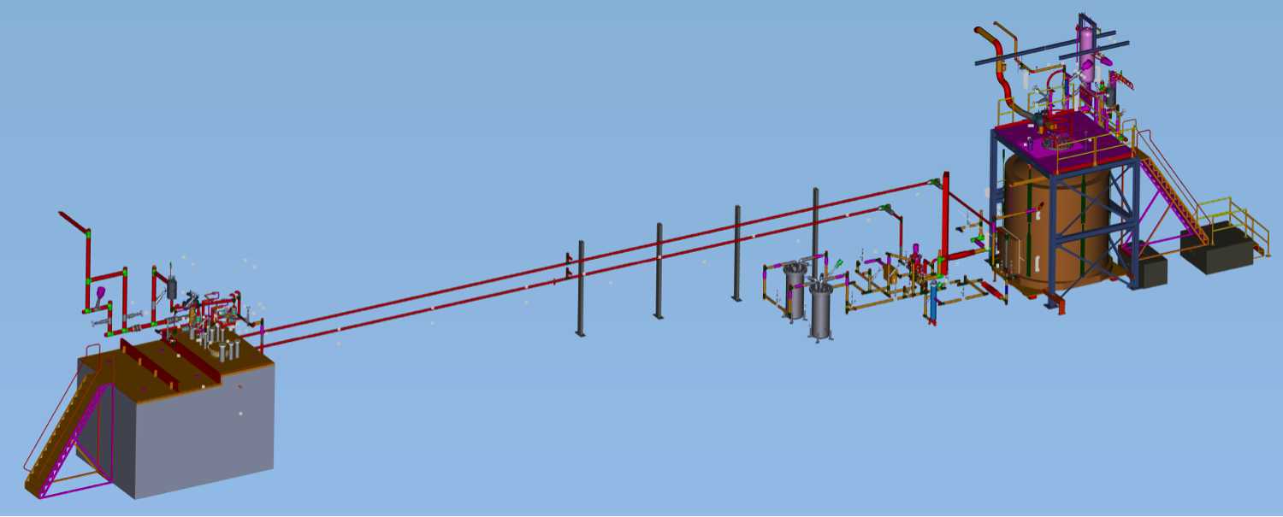
Layout
LBNE 35 ton Cryostat
LAPD
Process piping
Process piping
LAPD/LBNE LAr purification/filtration system
1.3-2.6 vol change/day
LAr/GAr transfer lines
LAr/GAr transfer lines
North
Notes:
Here we have the layout of the experimental hall.
DESCRIBE

Slide 10
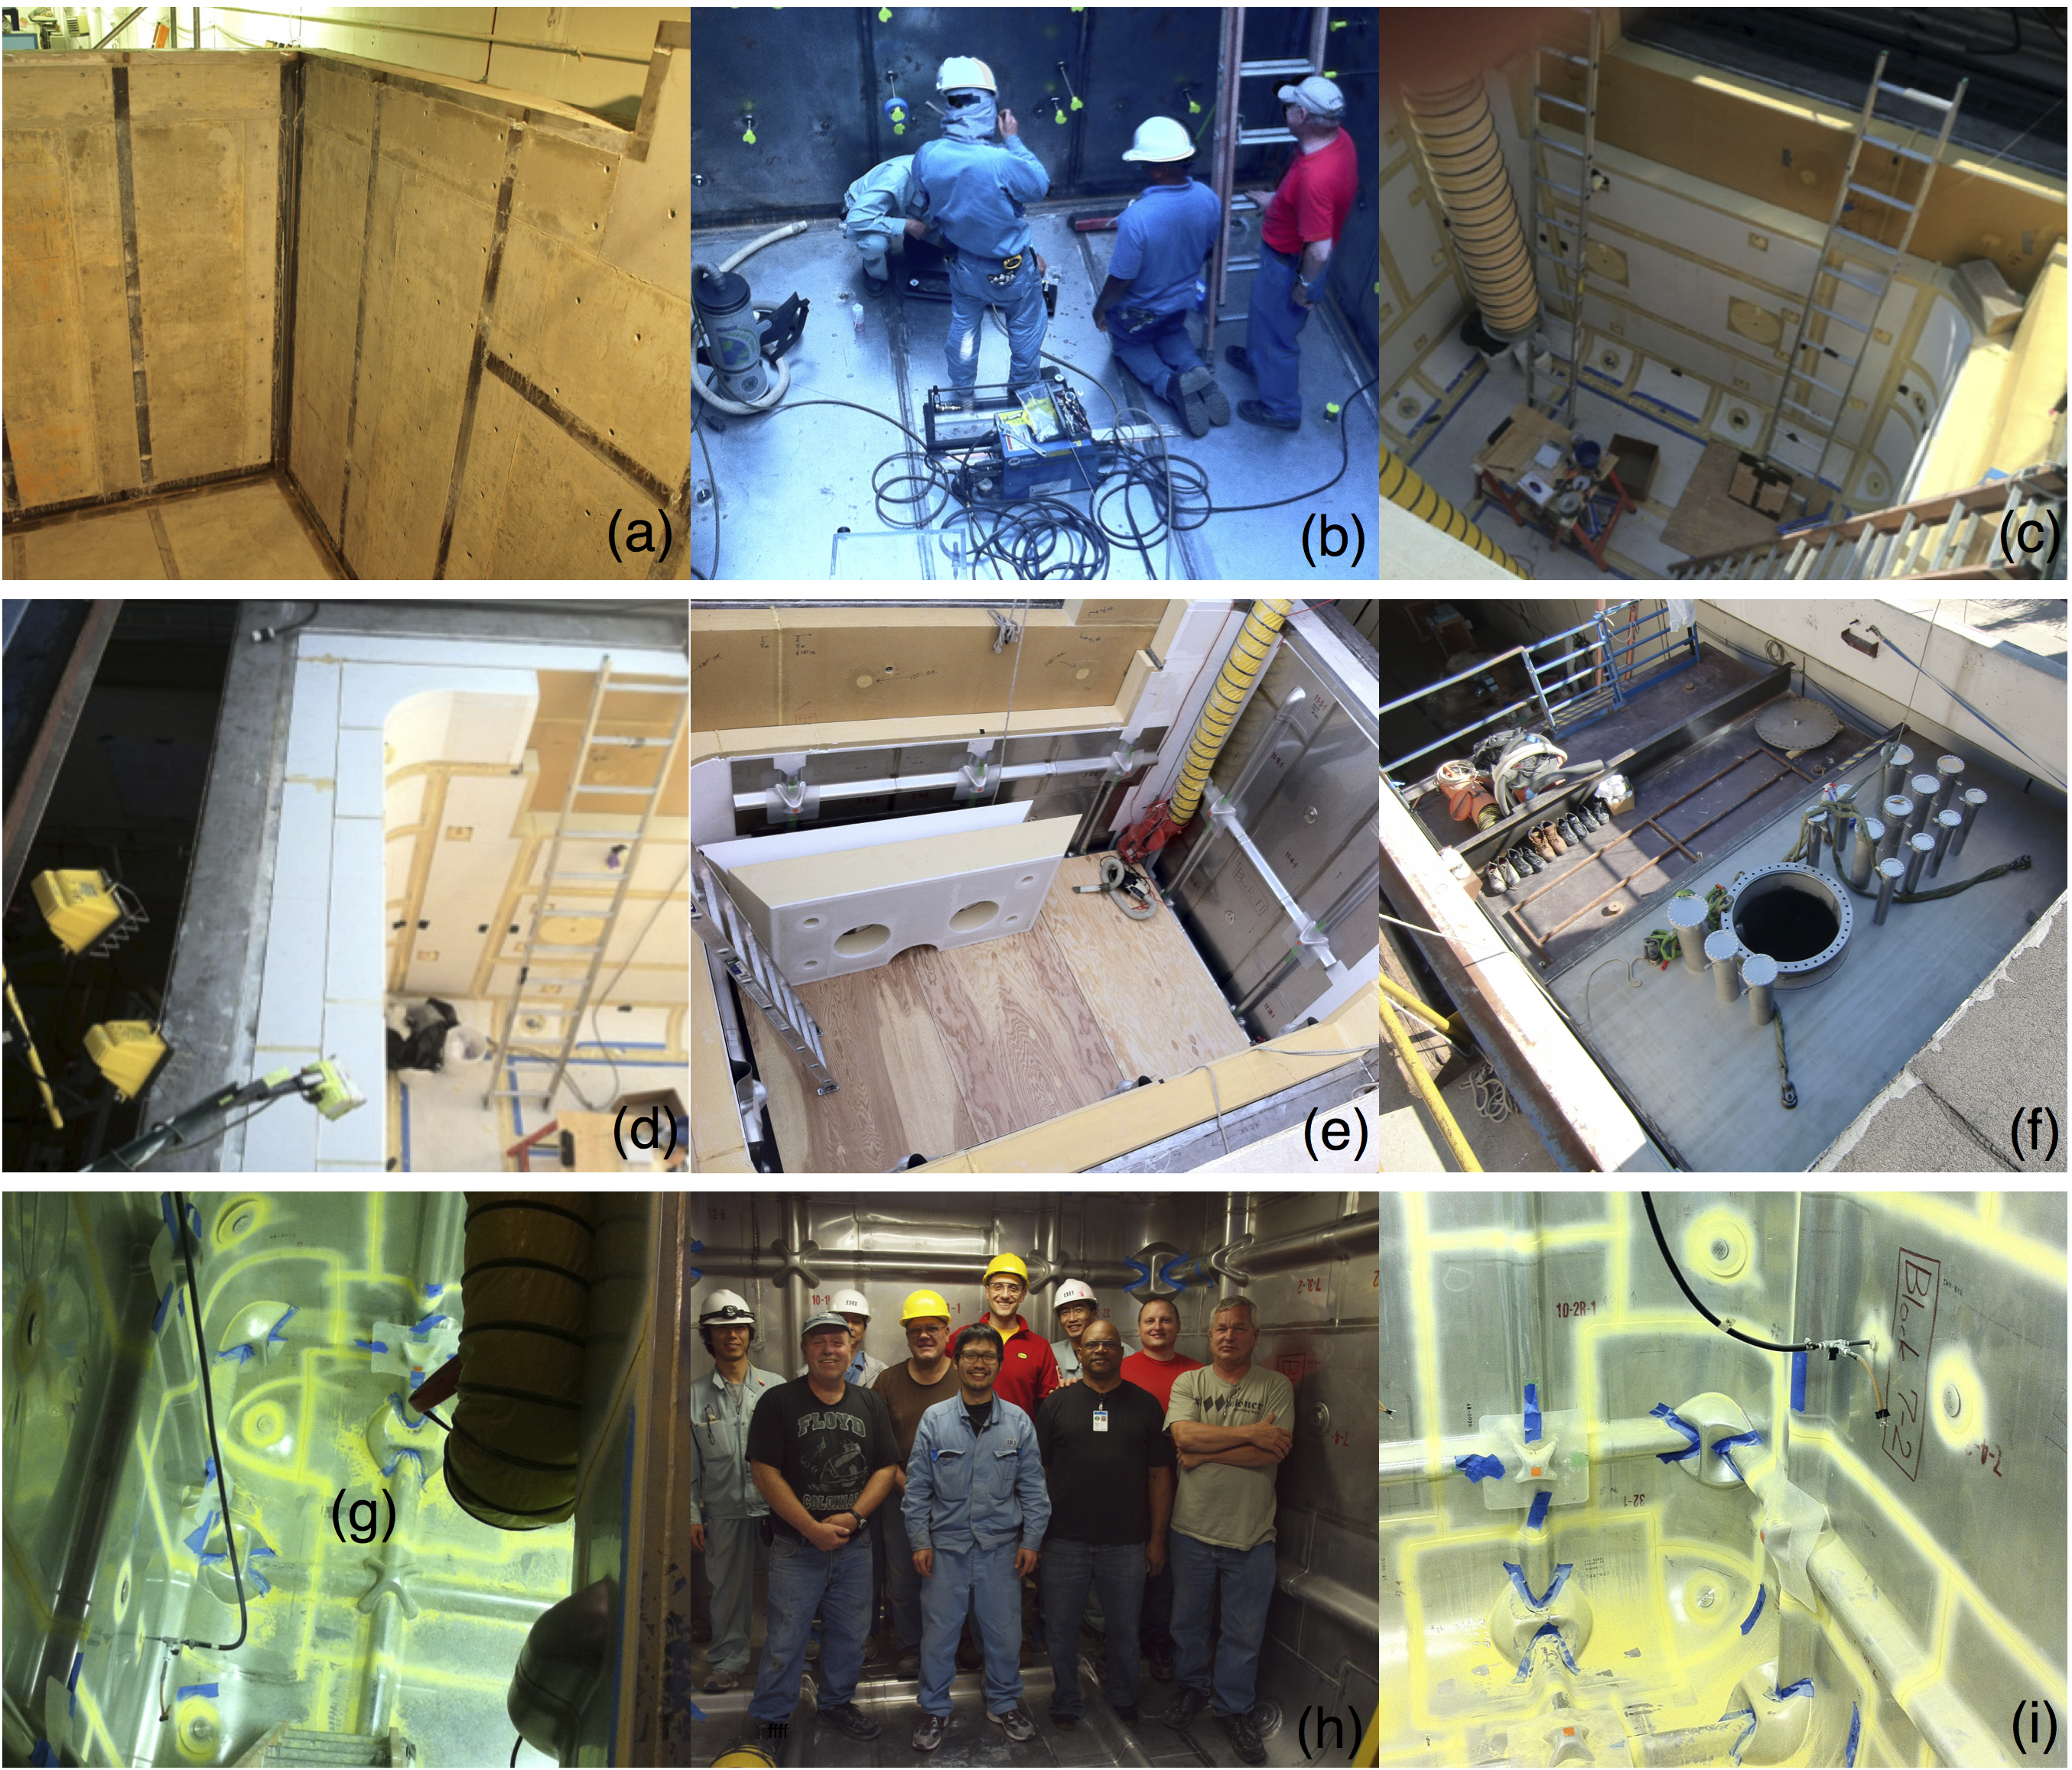
Membrane cryostat construction
Notes:
Here some pictures taken during the construction of the tank.
Brief DESCRIPTION.

Slide 11
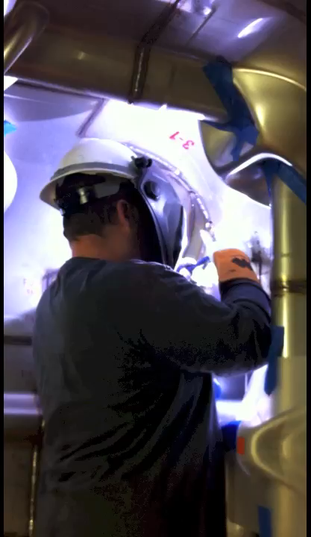
Membrane welding

Slide 12
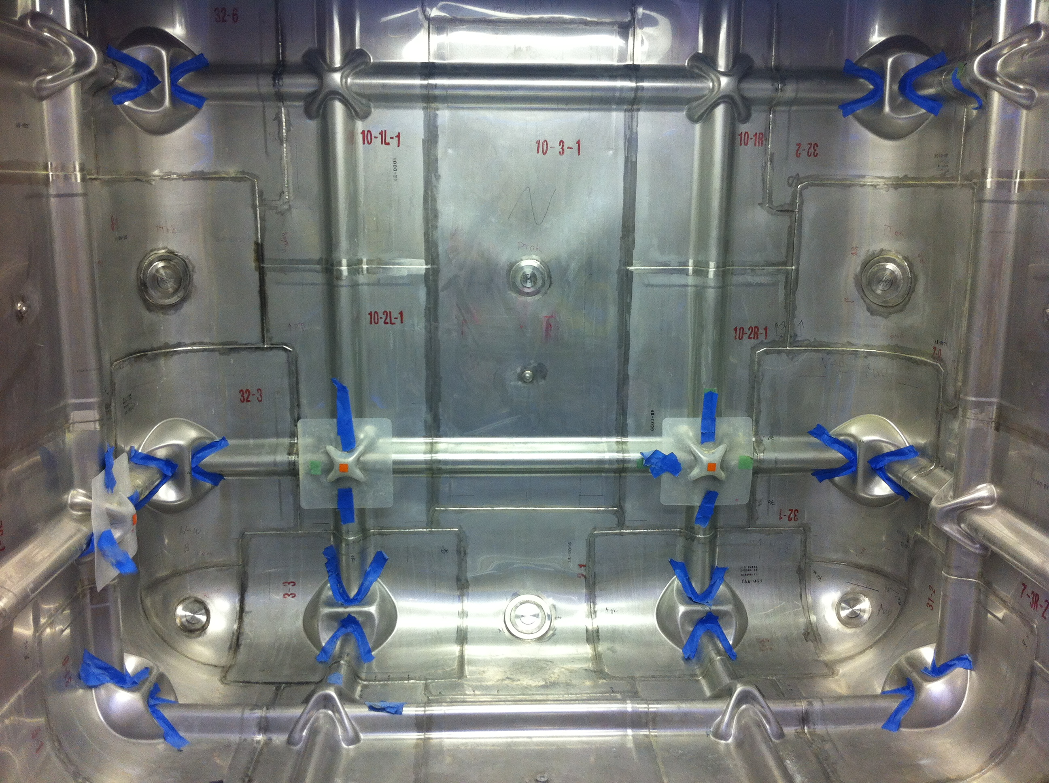
Inside view

Slide 13
Specialized instrumentation for LAr requirements
In-tank Purity Monitors (not foreseen in SBN/LBN)
  Double gridded ion chambers: cathode to cathode grid, cathode grid to anode grid (the drift region), and anode grid to anode.
  The cathode, a gold-plated aluminum plate, is illuminated by ultra-violet (UV) photons from a Xenon flash lamp.
  Photons liberate electrons from the gold layer into the LAr.
  The electrons drift towards the cathode grid that is 1.8 cm from the cathode.
  The electric current from this drift between the cathode and the cathode grid is integrated in external electronics and represents the electron charge Q_{c} that was emitted from the cathode.
RTD Spoolers (not foreseen in SBN/LBN)
  Translating temperature sensors that measure small temperature gradients in LAr.
  Consist of a small diameter chain and a circuit board with 3 temperature sensors in the tank moved by an external stepper motor.
Gas Sniffers (needed in SBN/LBN)
  Internal capillaries (three) at three different elevations to sample GAr during piston purge sequence.
  Gas is sent to Water and Oxygen monitors to measure the contaminants during the purge.
Notes:
This is a list of the specialized equipment that was installed.
READ only main bullets.

Slide 14
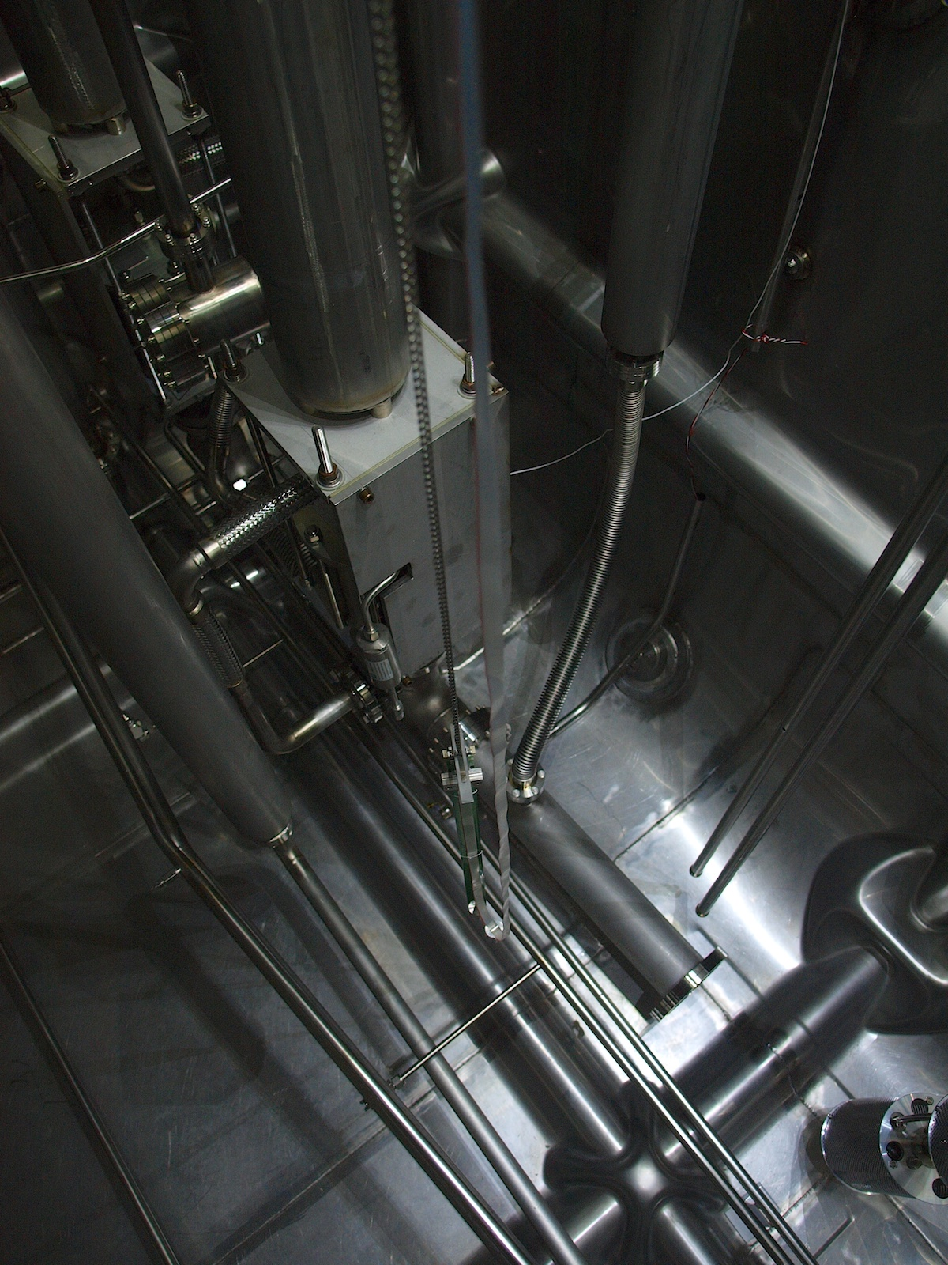
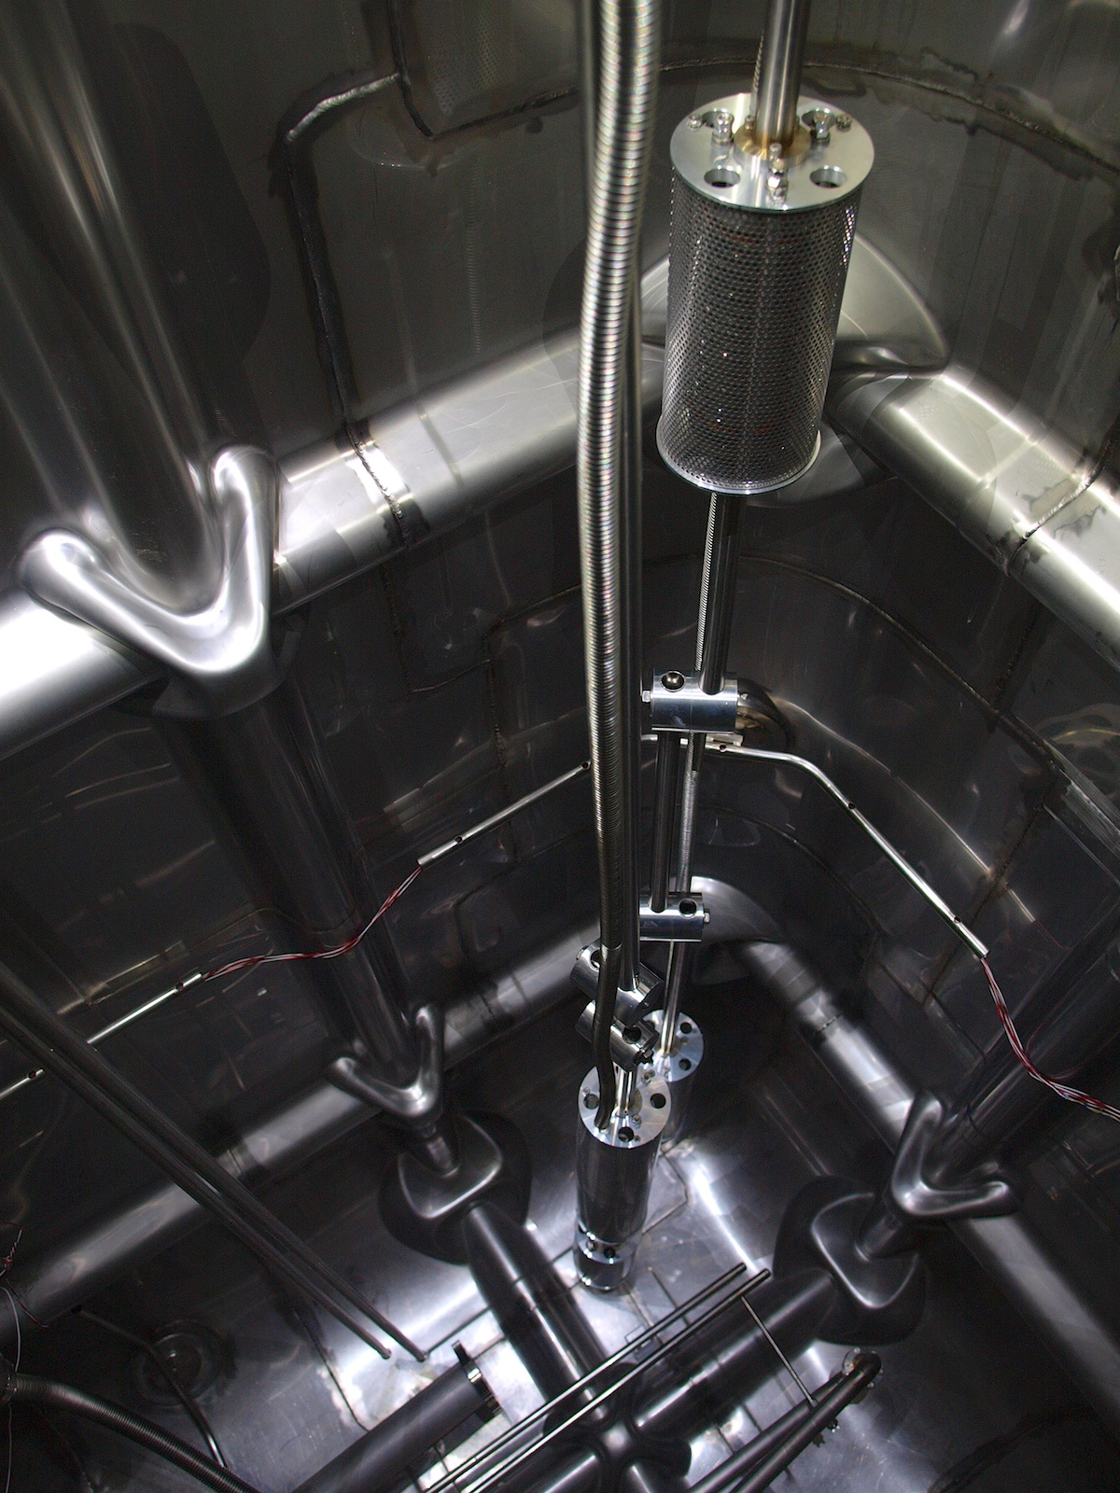
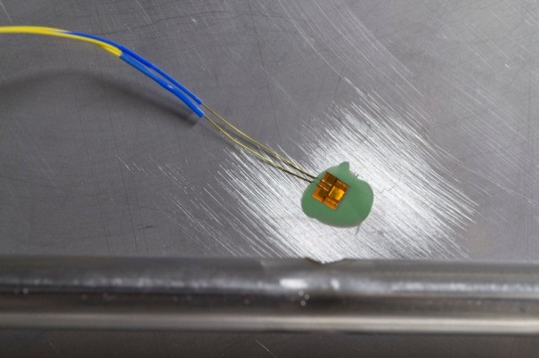
Pictures of instrumentation
Submersible pumps
Purity Monitors at two different elevations
Translating RTDs
RTD flush mount to membrane

Slide 15
Commissioning Steps
Due to the purity requirement of < 200 ppt Oxygen equivalent special commissioning steps are taken to reduce O2, H2O, and N2 content.
  Piston Purge (eliminates need for evacuable vessel):
    Introduced GAr to bottom of vessel and move through vessel faster than back diffusion rate (open loop).
    Reduced the contamination to ppm O2, N2, H2O.
  Gas recirculation:
    Circulated filtered GAr through membrane cryostat (closed loop).
    Reduced the contamination to fraction of ppm O2, H2O.
  Cool down at < 10K/hr rate (membrane manufacturer’s guideline) using manifold system that delivered to the bottom of vessel.
  Fill with LAr and start continuous LAr purification.

Slide 16
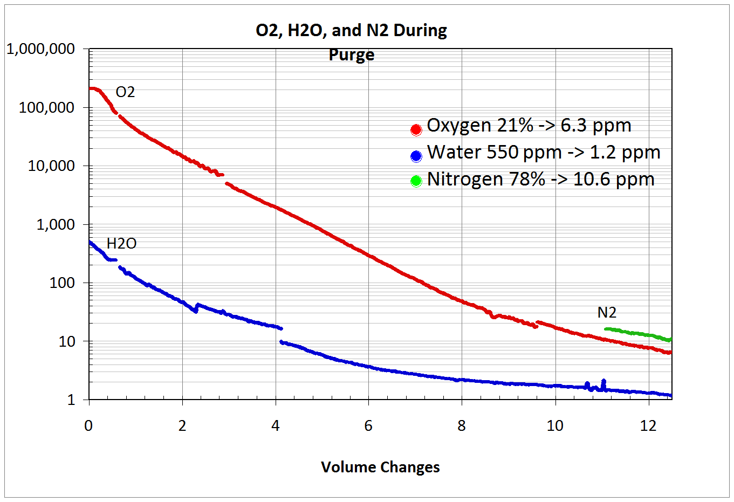
Step 1 – Piston purge
GAr speed: 1.2 m/hr
Ppm
10 volume changes/day
Purge gas is vented to atmosphere.
Notes:
Here the First step of the commissioning/operations:
The PISTON PURGE.
GAr is slowly (1.2 m/hr) flown from the bottom to the top to push all the impurities out.
We were able to reduce the contaminants to parts per million (ppm).

Slide 17
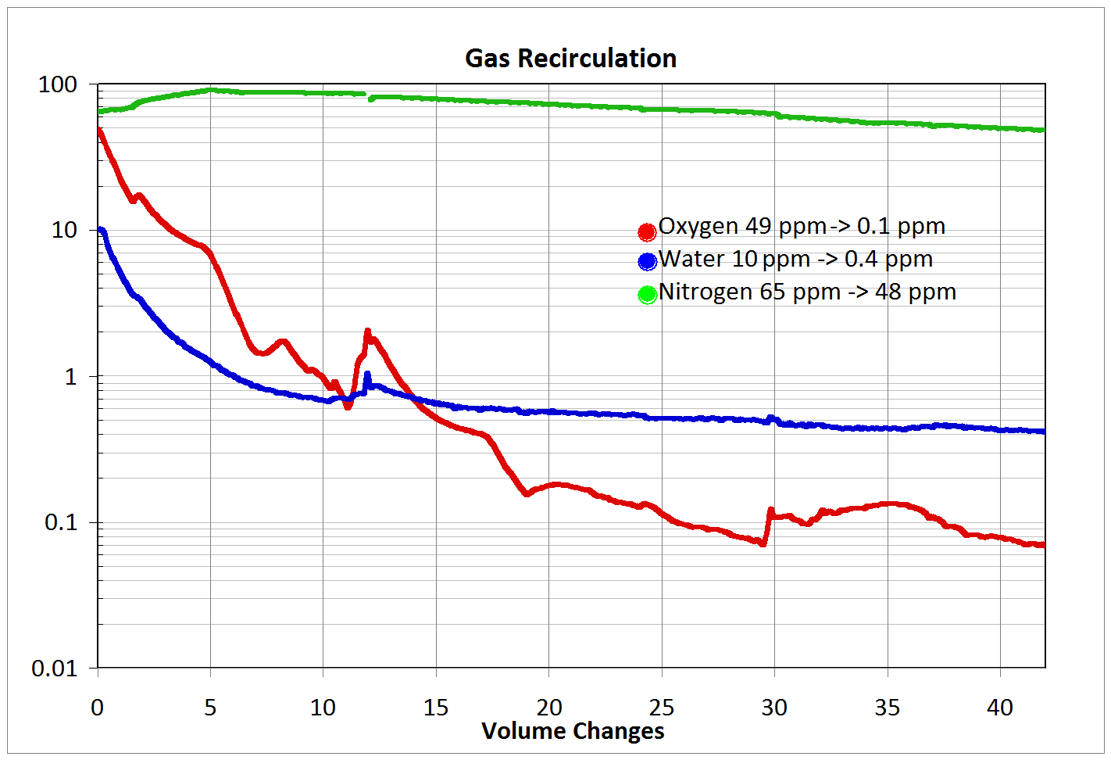
Step 2 – Gas recirculation
7.5 volume changes/day
Ppm
Notes:
Second STEP: Gas recirculation.
The GAr is no longer vented, but purified through the filters and sent back to the tank.
O2 and H2O went down to fraction of ppm.
N2 did not change much, but it was not important.
It will still be diluted during the LAr filling and O2 and H2O are the contaminants that need to be removed to 200 ppt.

Slide 18
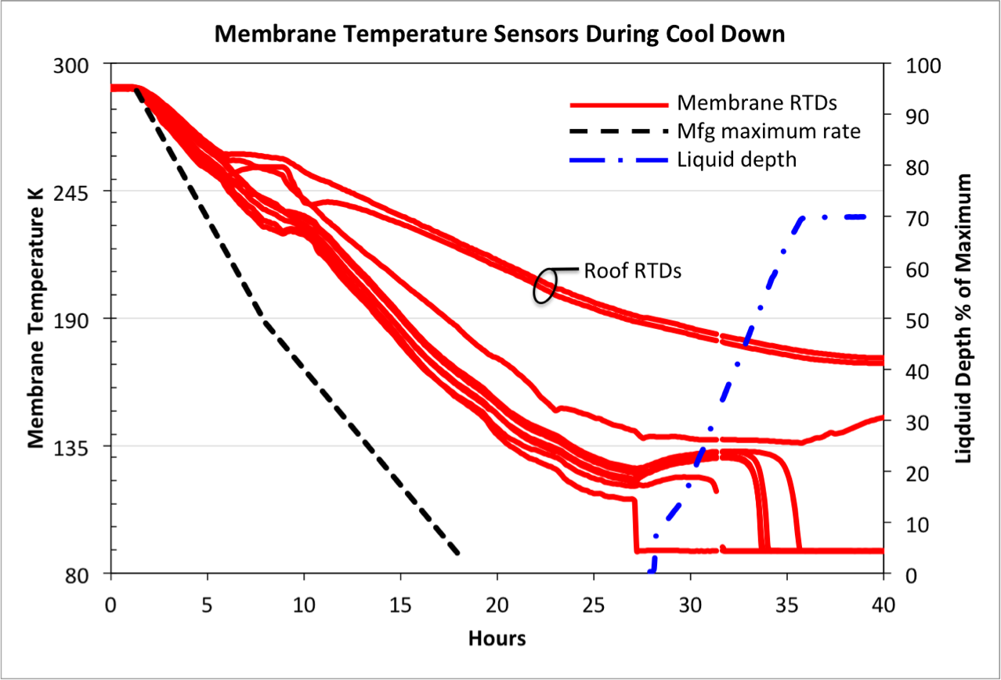
Step 3 – Cool-down and filling
Start cool down
Start LAr filling
Filling completed
Notes:
Step 3: Cool down and filling.
We have followed the manufacturer’s guideline for the cool down: < 10 K/hr to cool down the membrane.
As you can see from the plot we were safely within the limits.
Here we start accumulating LAr and the actual filling began.
We used LAr from the LAPD experiment, whose thank is a little smaller, therefore we only reached 70% full.
At which point the operations started.
We later filled the tank all the way up to the top.
Details of the cool-down model are presented in Mark’s talk.

Slide 19
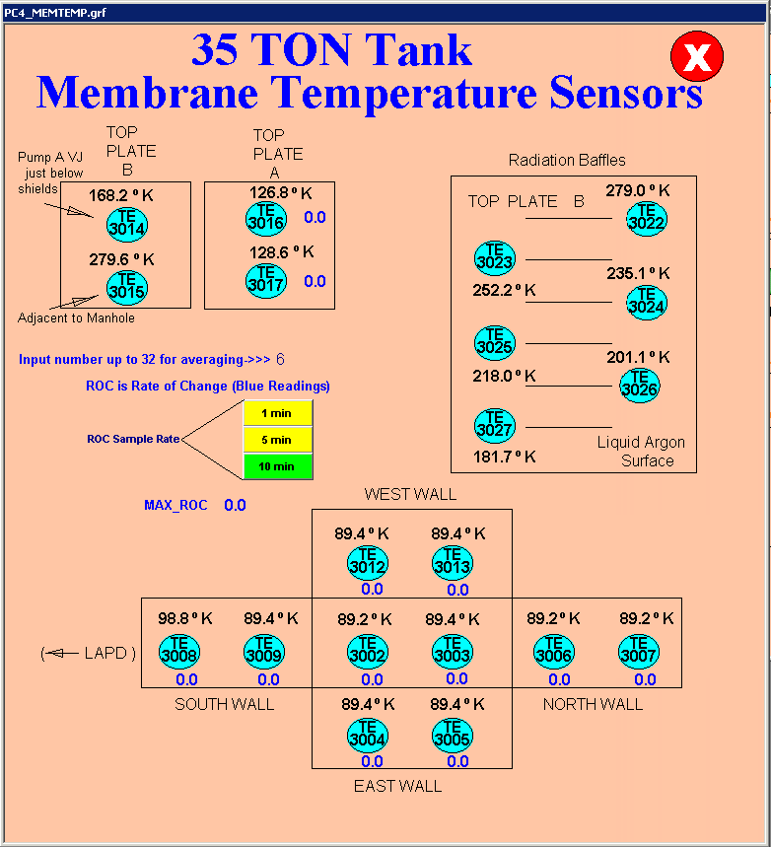
Temperatures
Temperatures of 35 ton (Feb 3, 2014).
Membrane and plates with full tank.
North
Notes:
Here we have a plot of the temperature sensors inside the tank during operations, when the tank was full.

Slide 20
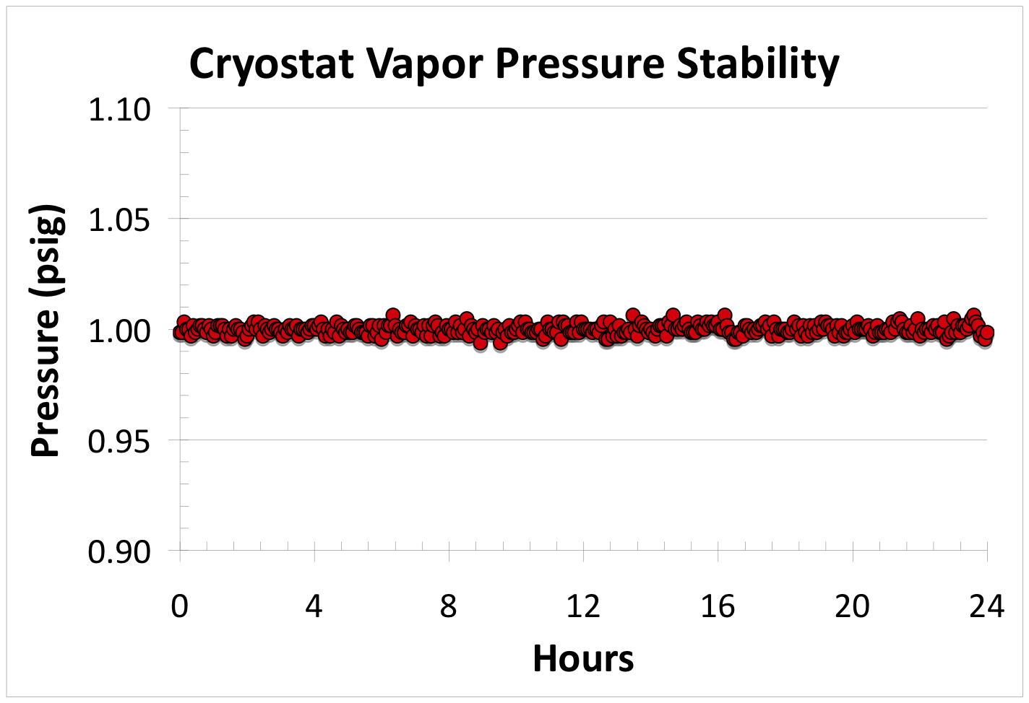
Cryostat vapor pressure stability
+/- 0.41 mBar (0.006 psi)
Notes:
The vapor pressure is VERY stable.

Slide 21
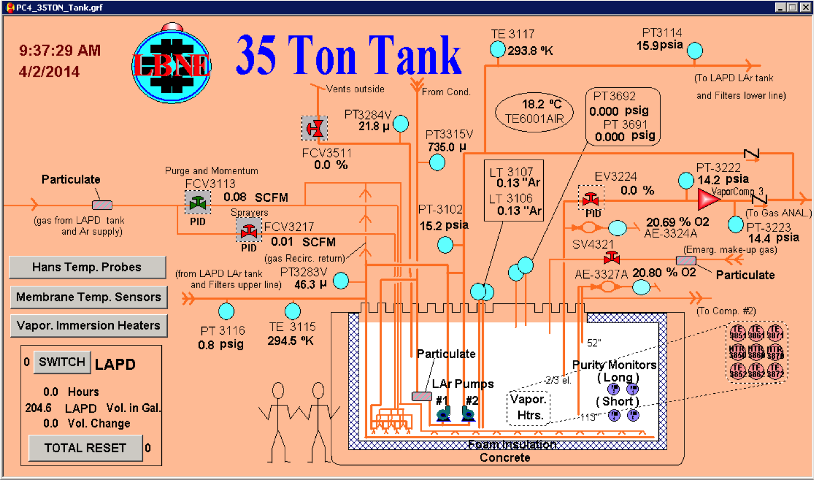
Snapshot of GE Fanuc ‘iFix’ Screen

Slide 22
Lessons learned from construction
Unexpected R&D, even though we specifically and explicitly requested IHI to list all items that required R&D or that were different from their standard practice, and we were told there was nothing. E.g.: Secondary membrane and sub-secondary membrane, manual application of liquid PUF, use of new style vacuum boxes, use of fireproof paste, use of stainless corner pieces, use of membrane anchors in corner pieces, …
Size matters: IHI was not familiar with small constructions. It is much easier to build a large tank than a small one!! → They just scaled everything down. But it does not work: the effect of the corners is much larger and there are many more limitations, in space, multitasking, etc.
Schedule had no contingency and was never realistic: no cleanup time, did not account for confined space, going in/out of the tank or the limited space inside the tank.
It was not a pre-assembled kit: field work, fit-up and adjustments on the field → need shop, tools and machinist(s) on-site.
Strongly suggest to use specialized labor for installation (Not in-house).
Notes:
READ.

Slide 23
Lessons learned from operation
Dielectric breaks:
  Cryostat needs to be electrically isolated (LBN/SBN requirement).
  At cryo temperature (below ~200K) we have developed and Ar gas leak into vacuum insulating sleeve around cryo-piping.
  We have attached vacuum pumps to compensate the leakage (but it short-circuited the isolation grounding scheme).
  Solution identified, non implementable in 35 ton phase 2 (Needed for LBN/SBN).
Purity Monitors were found to be very sensitive to microphonics.
  No problem → no in-tank purity monitors foreseen for SBN/LBN.
No evidence of E&M interference due to the LAr pumps.
Vacuum Relief Valve:
  The membrane cryostat has a very low maximum allowable external pressure (1.4 mBar or 0.02 psig).
  We have developed an air leak through the teflon seal, which was then fixed for phase 1 and 2.
  No problem → need a different Vacuum Relief Valve.
LAr pumps:
  See Mark’s talk.
Notes:
READ main points.

Slide 24
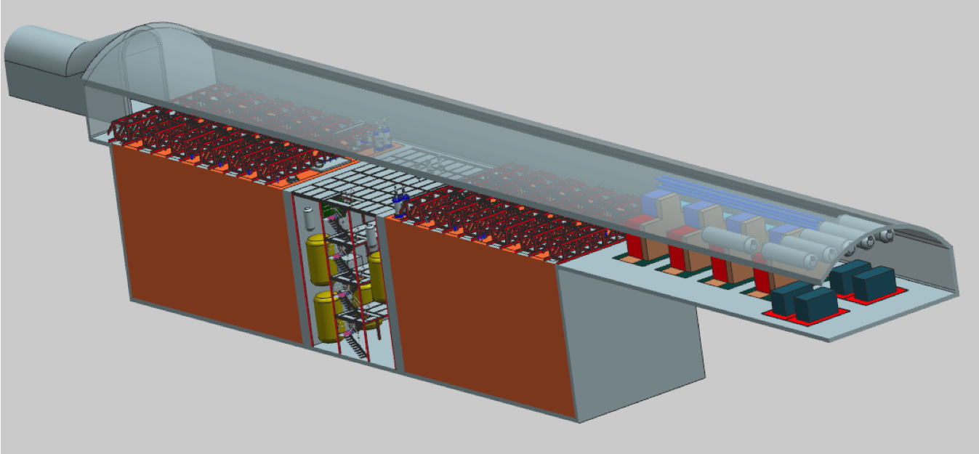
LBN Far Detector current design
2 x 6,758 m³ LAr each
RFP documents for cryostat design, procurement and supervision during installation approved by DOE, but process put on hold while waiting for LBN internationalization per P5.
Notes:
This is the current design for the LBN Far Detector.
It will most likely change, I would just like to give the flavor of the work that has been done and the capabilities that might be available.

Slide 25
Main differences
Size! Advantage from the manufacturer’s point of view. They are used to large vessels where they determine the number of workers. We were limited by ES&H constraints (confined space) and the physical size of the tank.
Location: underground versus above ground.
Support: cryostat lays against the rock (not free standing).
Heat leak: lower. Far Detector has thicker insulation.
LAr pumps in pump towers or outside.

Slide 26
Value engineering on cold roof
VE-026
LBNE DocDB n. 9546
Goal: to reduce the contamination in the ullage by engineering a system that maintains the temperature of the roof ≤ 100 K.
LBN has allocated resources to study such a system and test it in the SBN cryostats for eventual implementation in LBN.
Notes:
READ.

Slide 27
Modeling
We have performed several simulations:
  Piston purge
  Cool down
  Temperature profile inside the LAr
  Velocity profile of the LAr due to convective currents
All models have been validated in LAPD and LBNE 35 ton prototype: they correctly predict the actual profiles.
Notes:
In brief, a lot of modeling has been done on the Far Detector configuration.
READ.

Slide 28
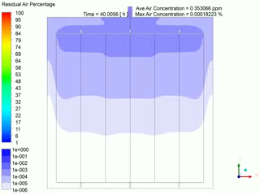
Simulation of purge method for 10 kton cryostat
Notes:
This is one example: the purge method in a 10 kton cryostat.

Slide 29
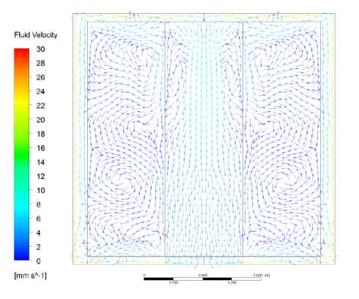
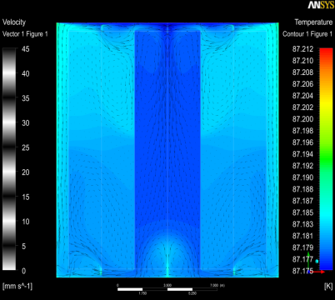
3 D Model for 10-kton Velocity & Temperature Profile
T profile verified in LAPD and 35 ton prototype
Notes:
Models of Velocity and Temperature profile inside the cryostat:
They are both pretty uniform, with the temperature varying by less than 0.1K.
Both verified in LAPD and 35 ton.

Slide 30
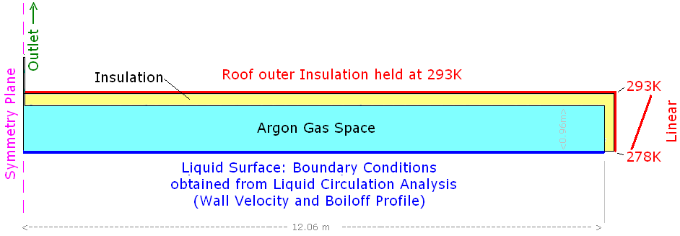
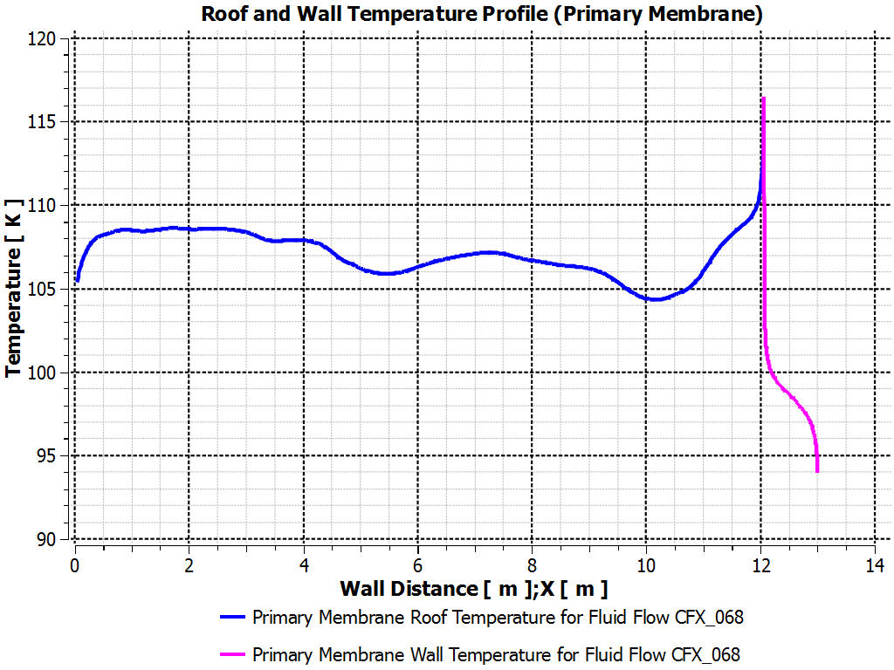
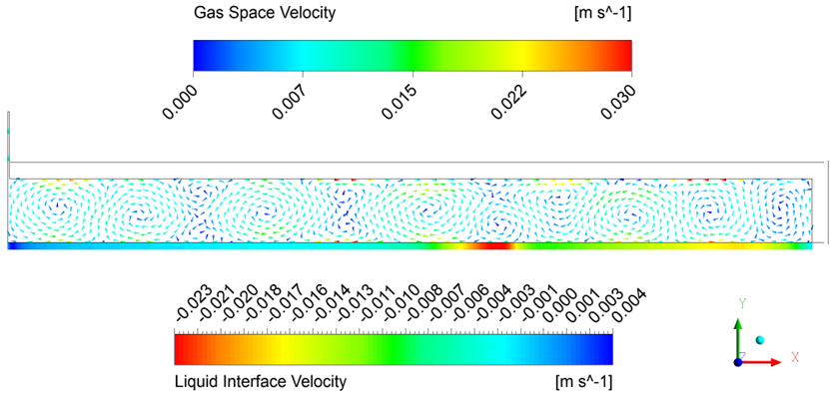
A key to Purity: Temperature in the Gas Space
The average roof temp is 107 K with hot spot in corners (half-width models).
Important note: Out gassing is highly temperature dependent and is not an issue if <120 K (LAPD + Materials Test Stand).
120 K
Nozzles/Penetrations are only source of outgassing
T distribution have been validated by LAPD/35 ton results
Notes:
Simulations of the T distribution in the ullage.
The average roof temperature is 107K with a peak at 116K along the wall, lower than the critical threshold for outgassing of 120K.
It is important to notice that the simulations of the temperature distribution have been validated by the LAPD tests.
The conclusion is that nozzles and penetrations are the only source of outgassing.

Slide 31
Impurity Profile
Notes:
Model of the Concentration of the impurity inside the cryostat, normalized to one (1).
The expected purity of the LAr is pretty uniform.

Slide 32
Summary
A membrane cryostat was designed by Fermilab engineers for the LBNE project in collaboration with IHI Corporation of Tokyo, Japan.
We have successfully fabricated and operated the first membrane cryostat for scientific application (and first on the US soil) and its cryogenic system.
We have measured and calculated ~1,500 W total of heat leak (~12.5 W/m²). Requirement was < 13 W/m²
We have achieved the technical goals of the prototype, which were:
  to demonstrate the membrane cryostat technology in terms of thermal performance, feasibility for liquid argon and leak tightness. ✔
  to demonstrate that we can achieve and maintain the purity requirements in a membrane cryostat without evacuation and using only a controlled gaseous Argon purge. ✔
  to demonstrate that we can achieve and maintain the purity requirements for the liquid Argon during filling, purification and maintenance mode using mol sieve and copper beads filters. ✔
We have measured 2.5-3 ms lifetime (equivalent to 100 ppt Oxygen equivalent contamination). LBN requirement is 1.4 ms lifetime (200 ppt).
We have applied this knowledge and the lessons learned to the preparation of an RFP package for the design, procurement and supervision during the installation of a 10 kton (Fiducial Mass) Far Detector for LBN.
Notes:
READ.

Slide 33
Purity
2.6 volume changes/day
Top off tank using D0 LAr (covers PrM4)
Switch to Pump B
Notes:
Step 4: Measure purity and electron lifetime.
This plot shows the electron lifetime (as measured by two of the four purity monitors submerged inside the tank at different elevations).
Purity Monitor 2 is long (deep inside the liquid).
Purity Monitor 4 is short (high in the liquid), therefore it started measuring only after topping off the tank with LAr.
It took only 5.5 volume changes to reach 1 ms lifetime and about 15 to reach the design specifications.
After that the purity continues to increase up to 2.5-3 ms, which correspond to 100 ppt O2 equivalent.

Slide 34
Thanks!
David Montanari
Neutrino Cryogenics Requirements Meeting
24 September 2014

Slide 35
Backup

Slide 36
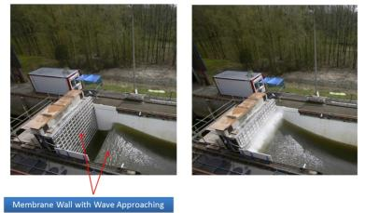
Technology
Selected Membrane cryostat technology:
  Cost effective for > ~1,000 m³ tanks.
  Commercially used with LNG and in much harsher conditions than the 10 kton detector (LNG tankers, sloshing).
  Meets the requirements of LAr storage; has feed through capability.
  Robust design, safe and reliable (see history throughout the world).
  No need to build a evacuable vessel because purge method allows for low ppm levels to be achieved without pumping down (35 ton proto) .
Two vendors that we are aware of: IHI (Japan) and GTT (France). At present we have Intellectual Property issues with GTT, but a solution might exist if GTT uses a company as a EPC.
Notes:
READ.

Slide 37
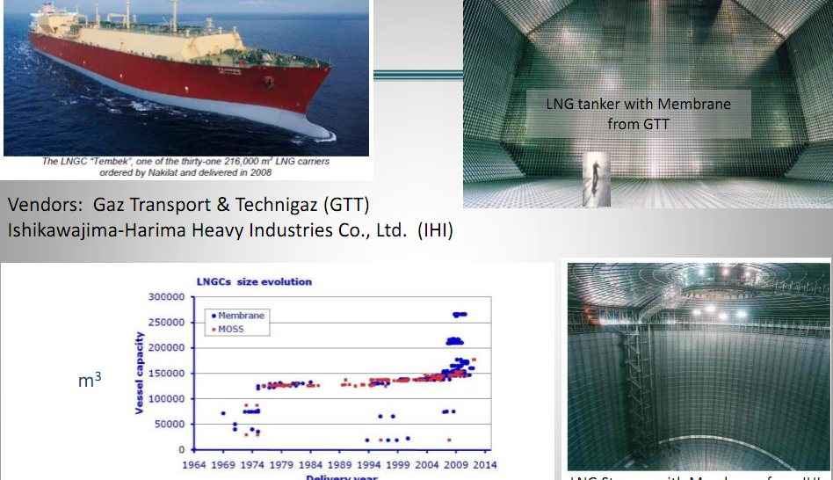
Membrane cryostat technology
Each LBNE cryostat
is 7,100 m3
Notes:
Here we have photos of two examples of the technology:
An LNG Ship tanker from GTT
A land base storage tank from IHI
Both are quite bigger than what LBNE plans to do.

Slide 38
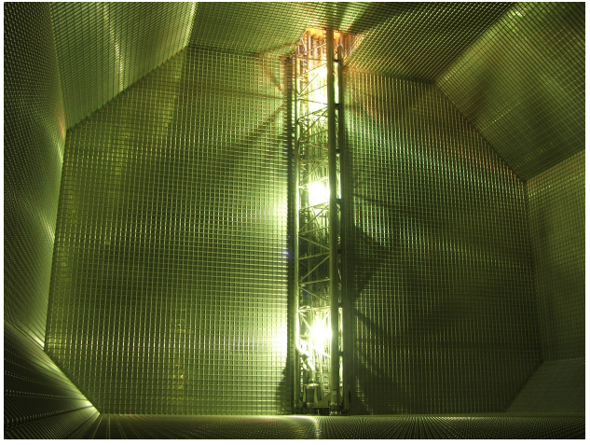
LAr pump (GTT tank)
Removable pump at the bottom of the vessel

Slide 39
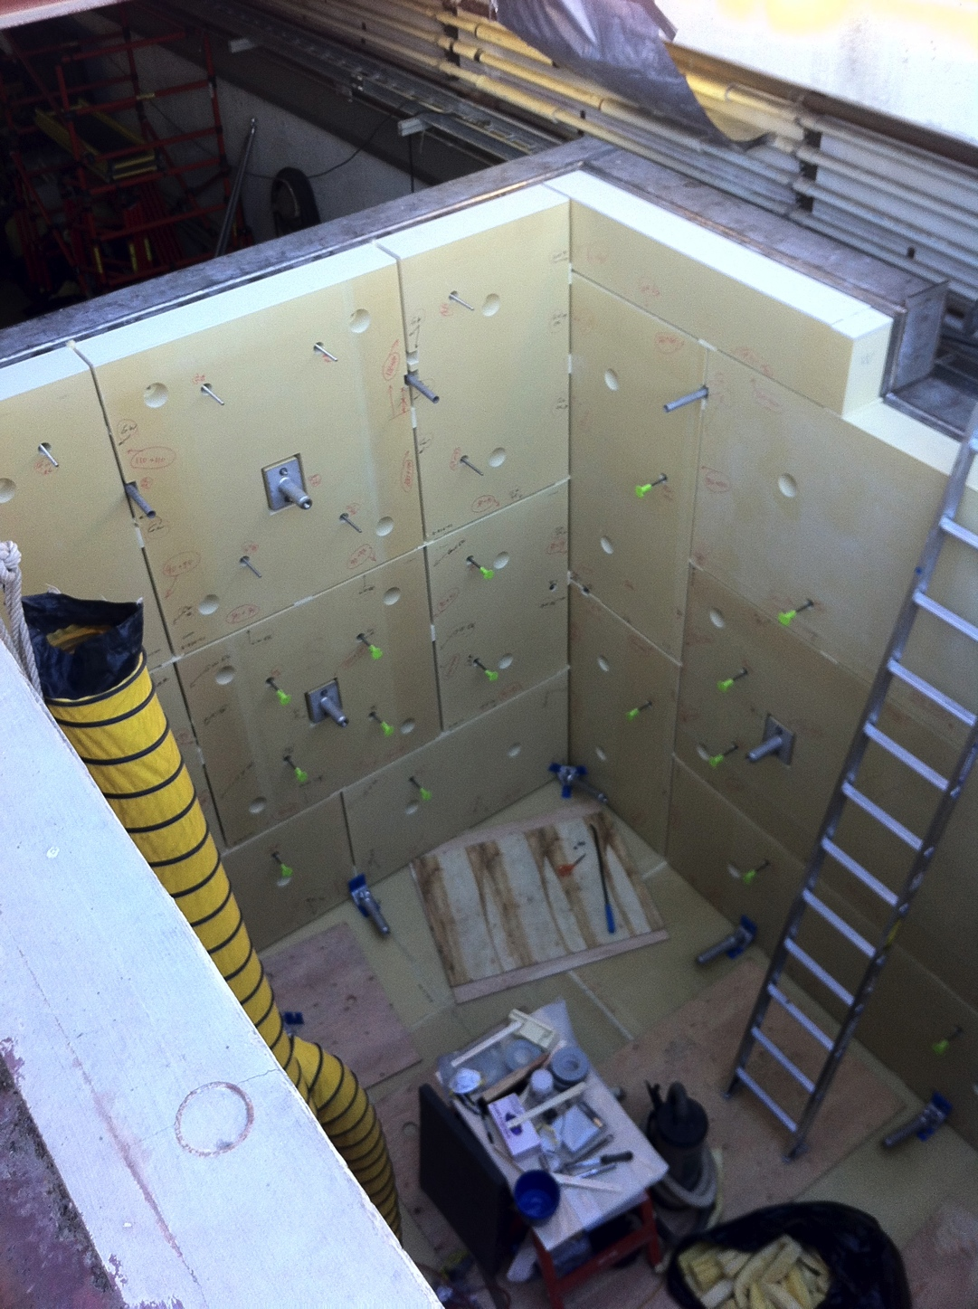
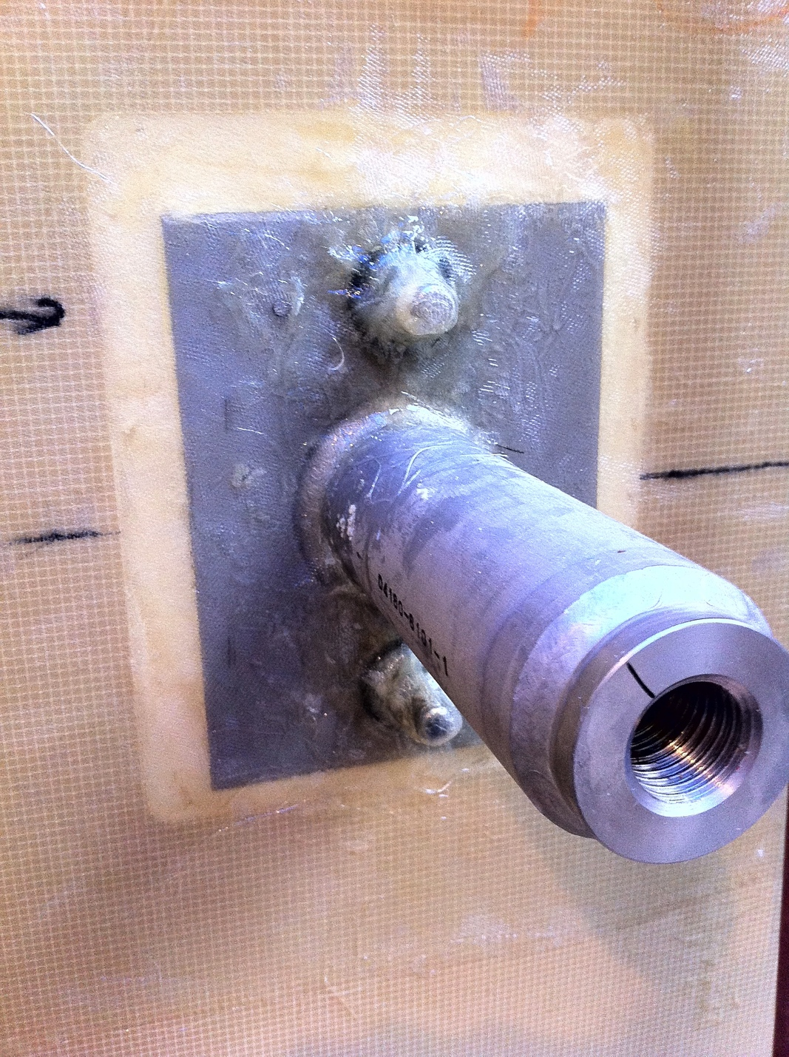
Installation details
Installation of insulation
Membrane anchor

Slide 40
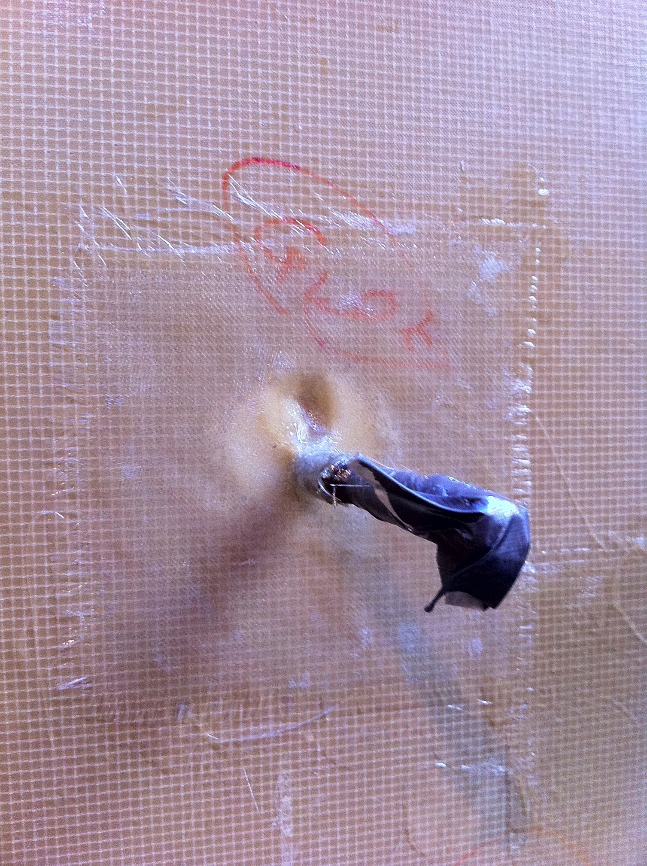
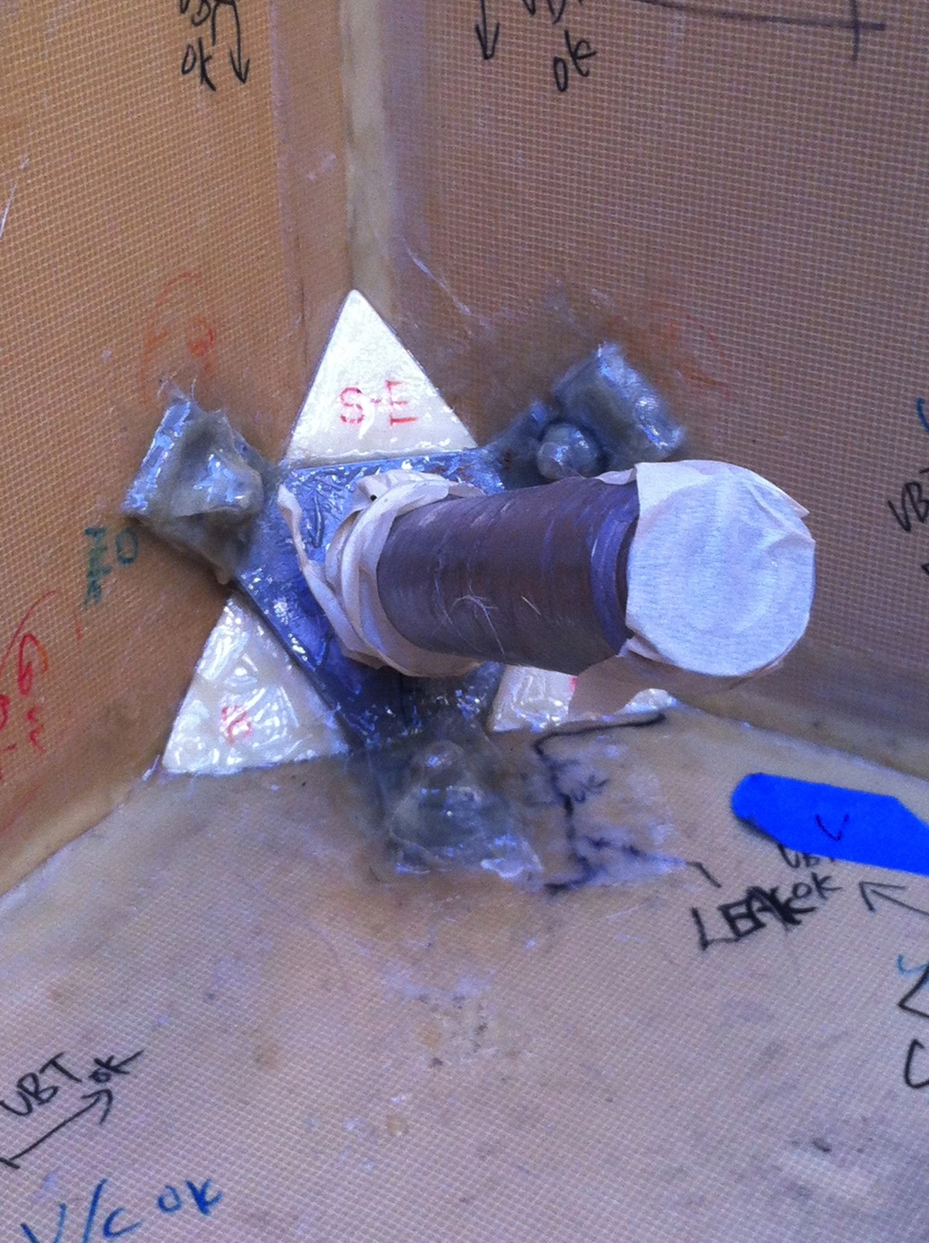
Installation details
Insulation anchor
Membrane anchor

Slide 41
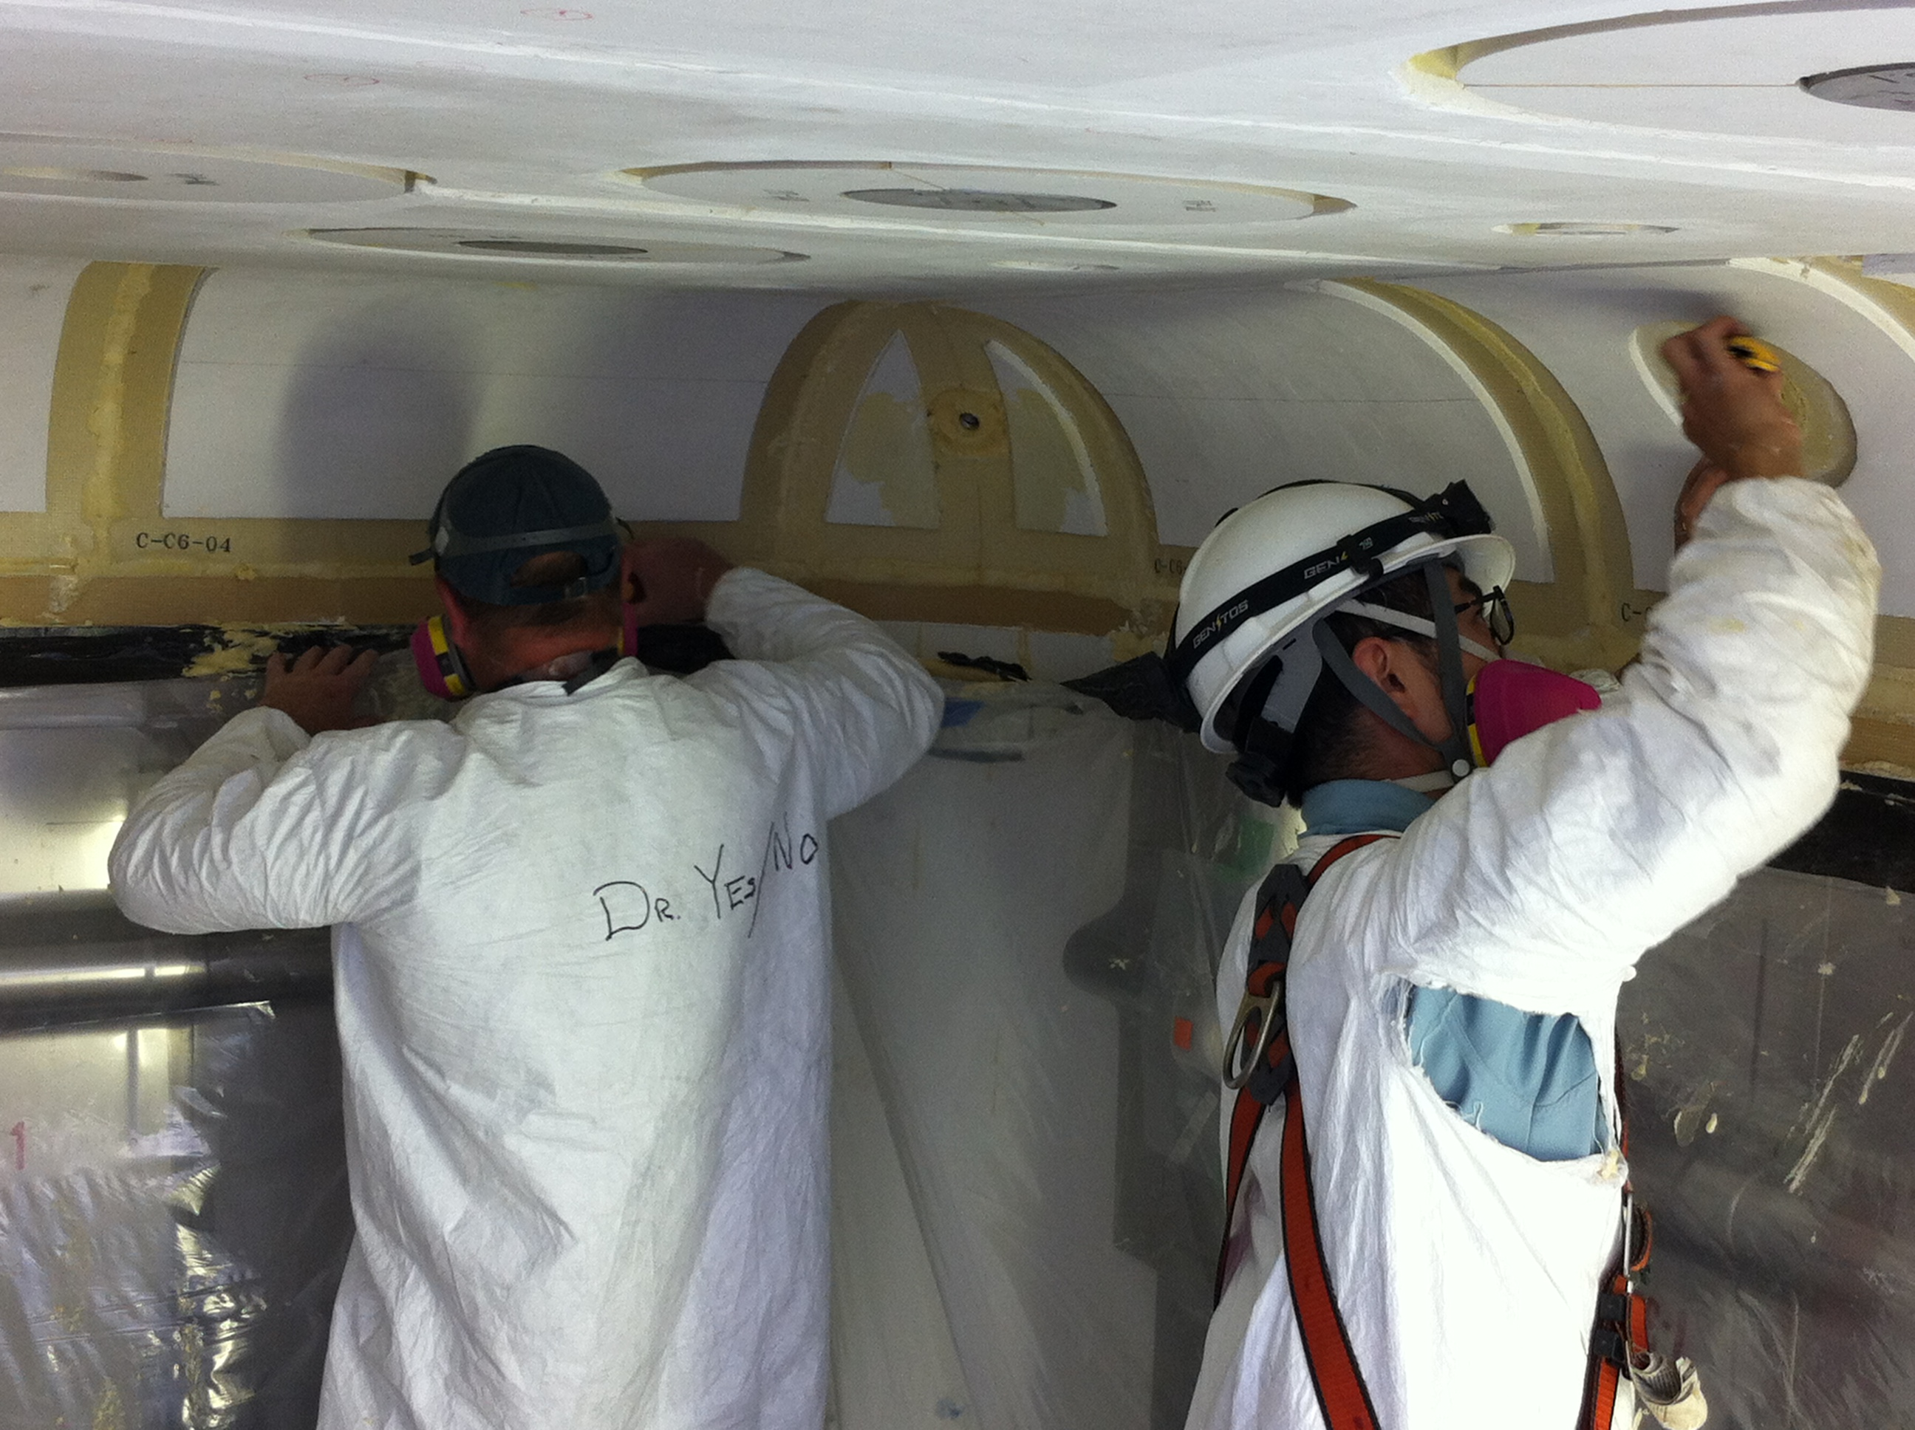
Installation of fireproof board on corners of roof

Slide 42
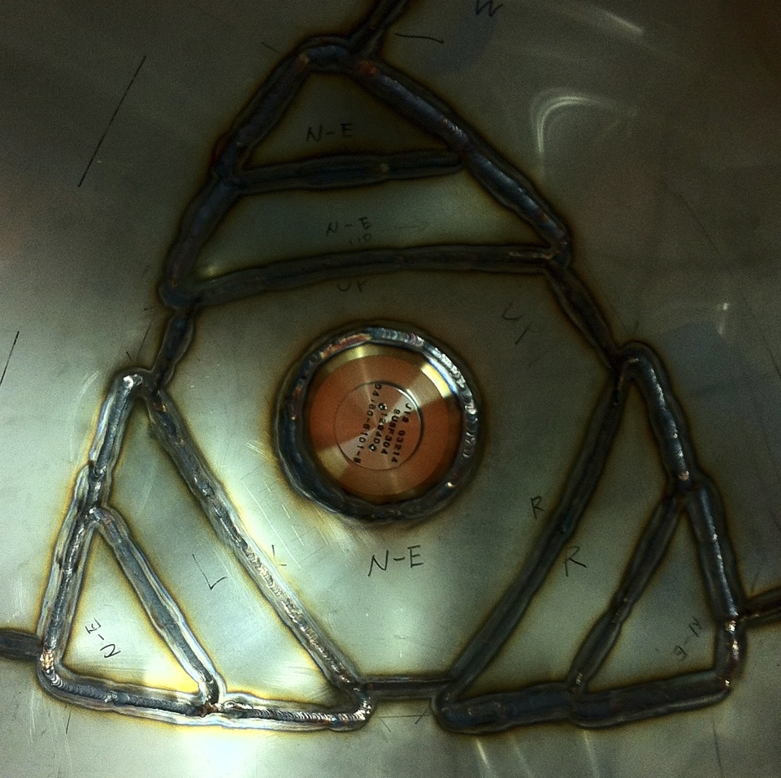
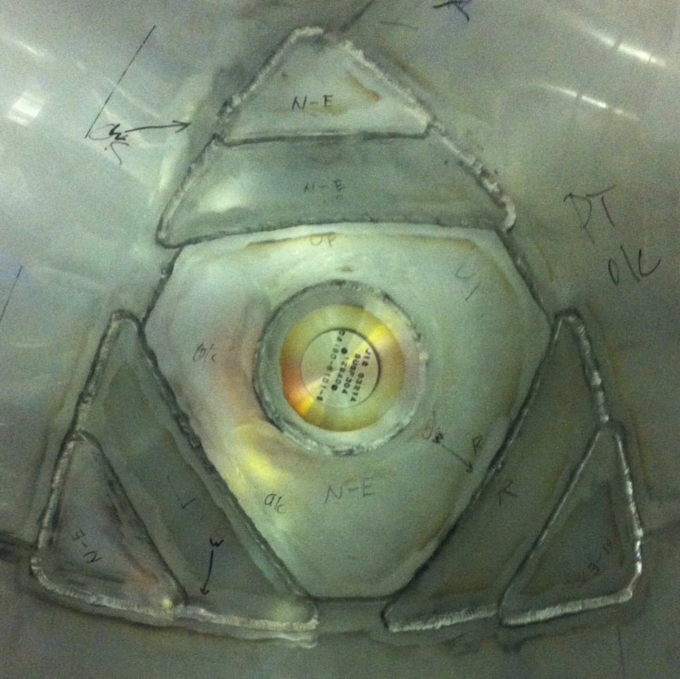
Corner Element
Corner Element after Welding
Corner Element after Polishing

Slide 43
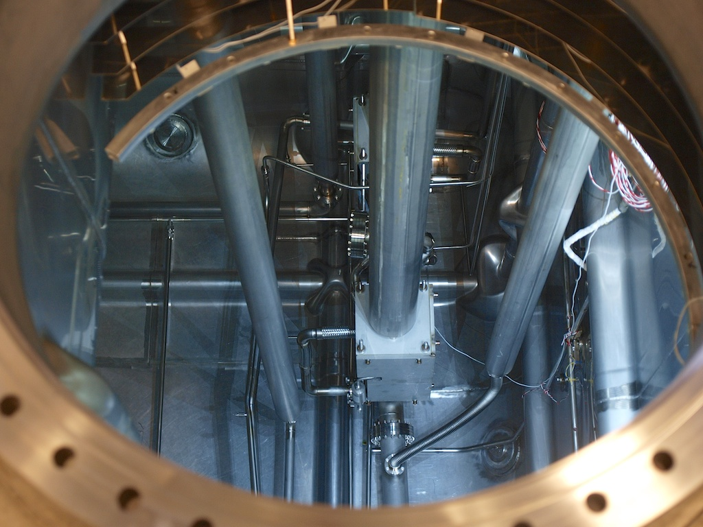
View through the man-hole

Slide 44
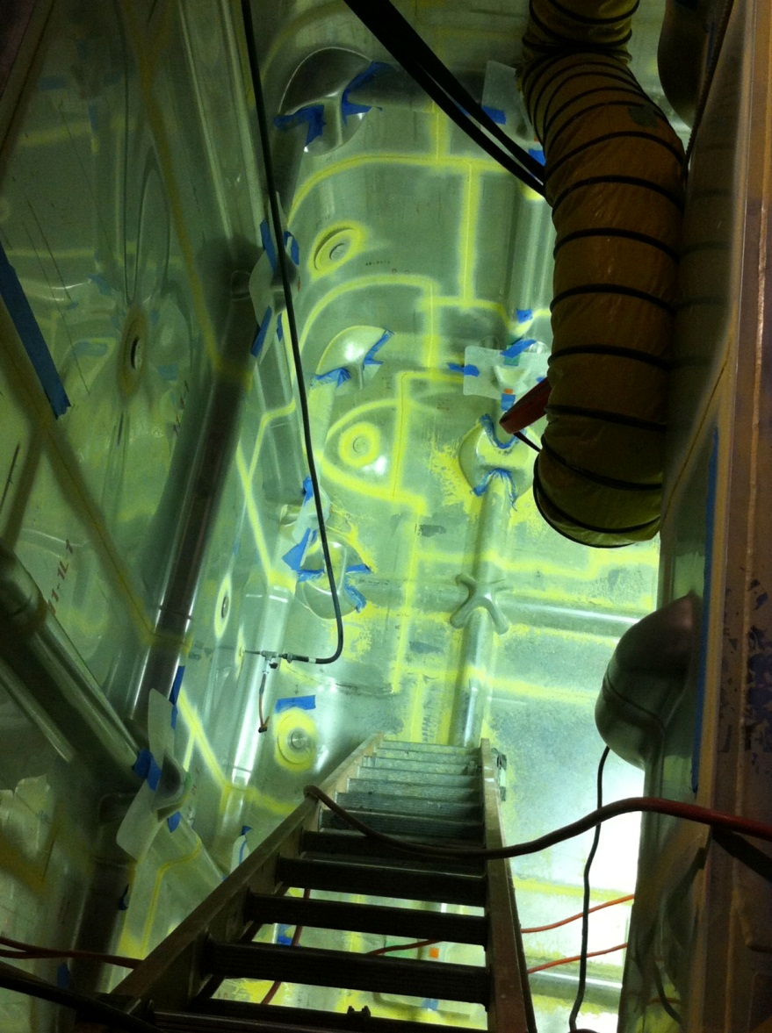
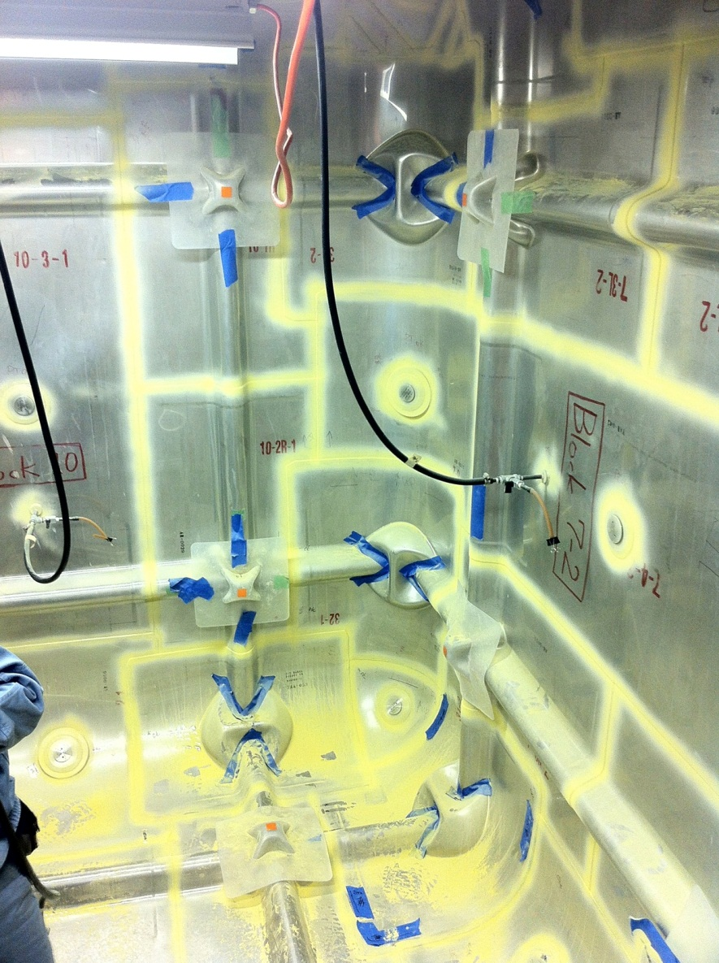
Ammonia leak check
NH3 developer paint at night
NH3 developer paint

Slide 45
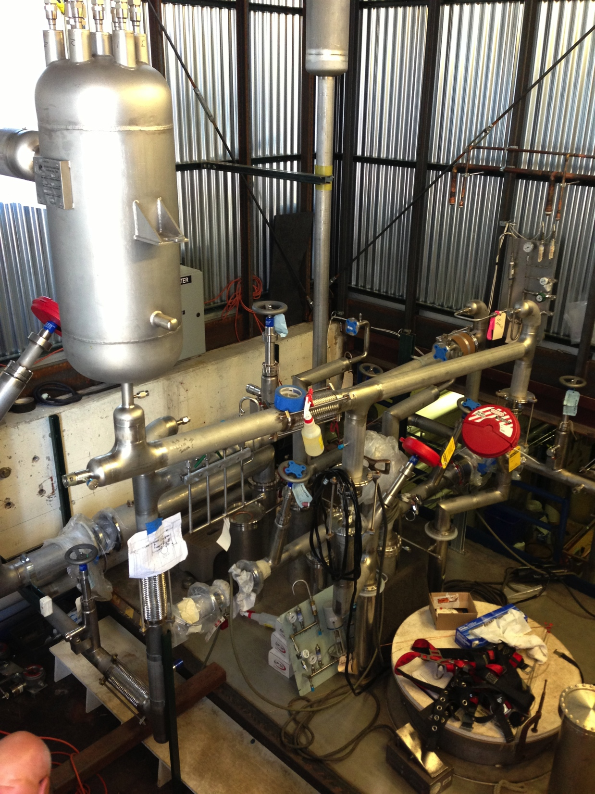
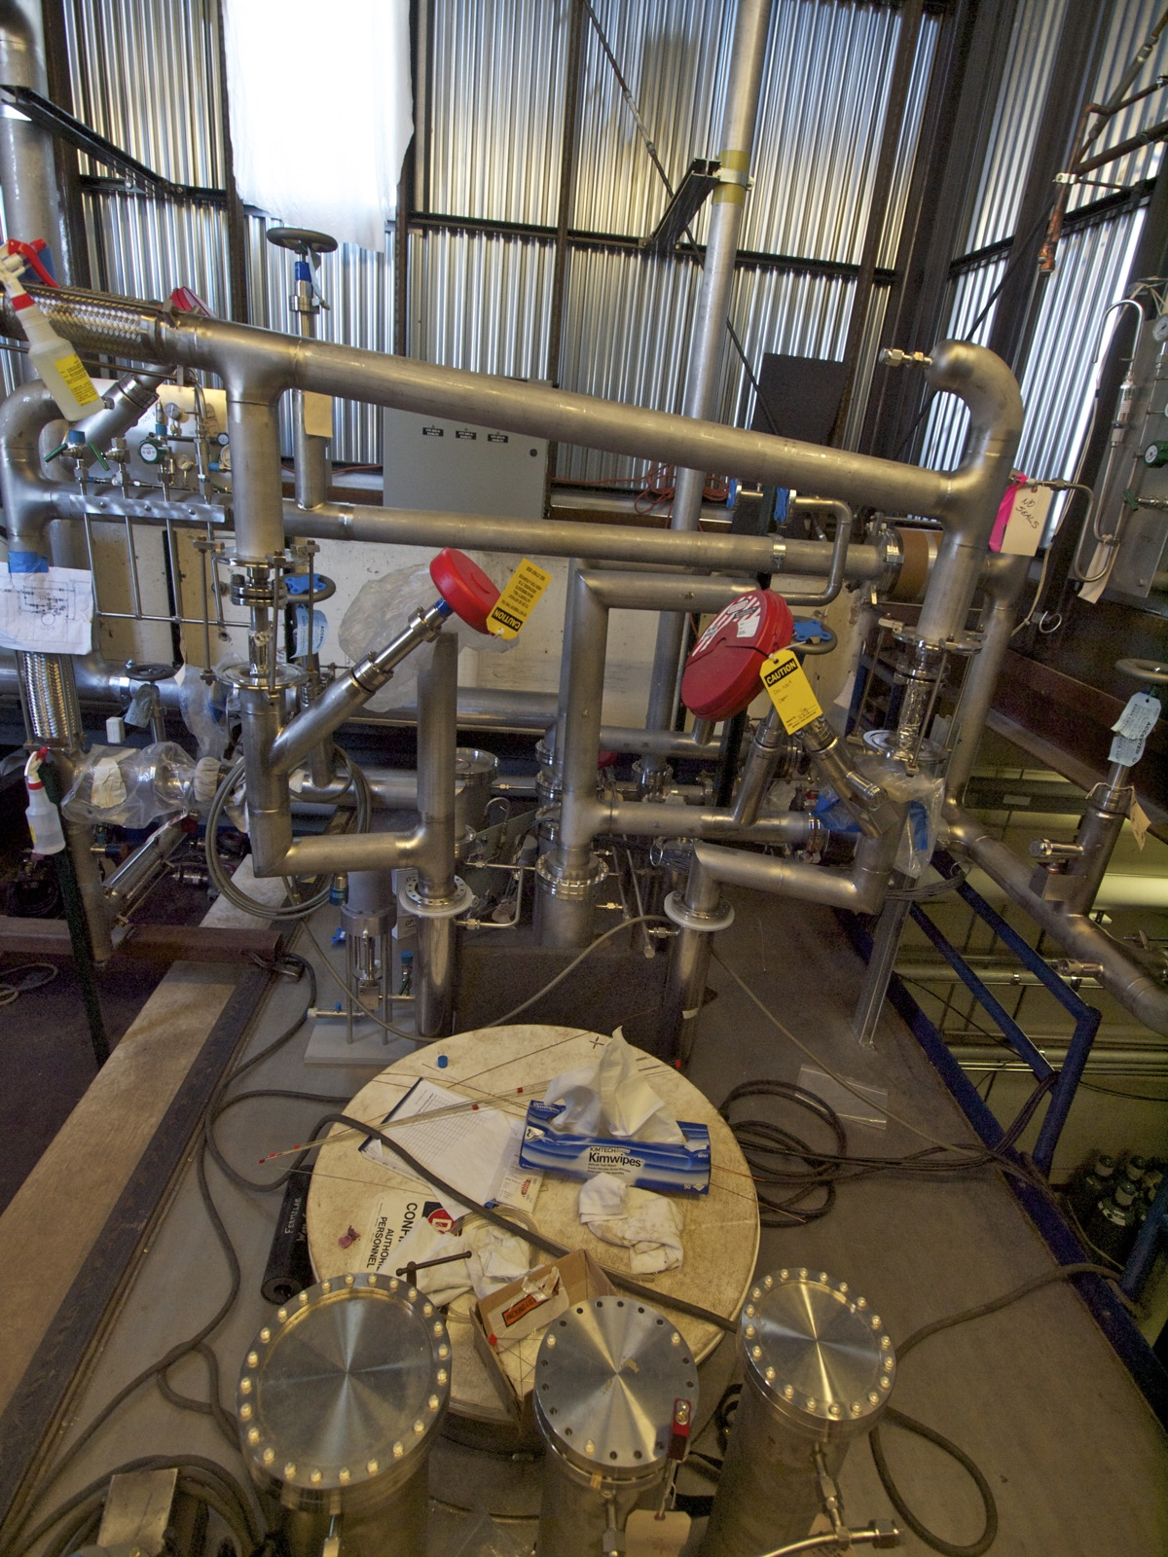
Cryogenic System top view
Top of the Tank with Ar Condenser
Top of the Tank

Slide 46
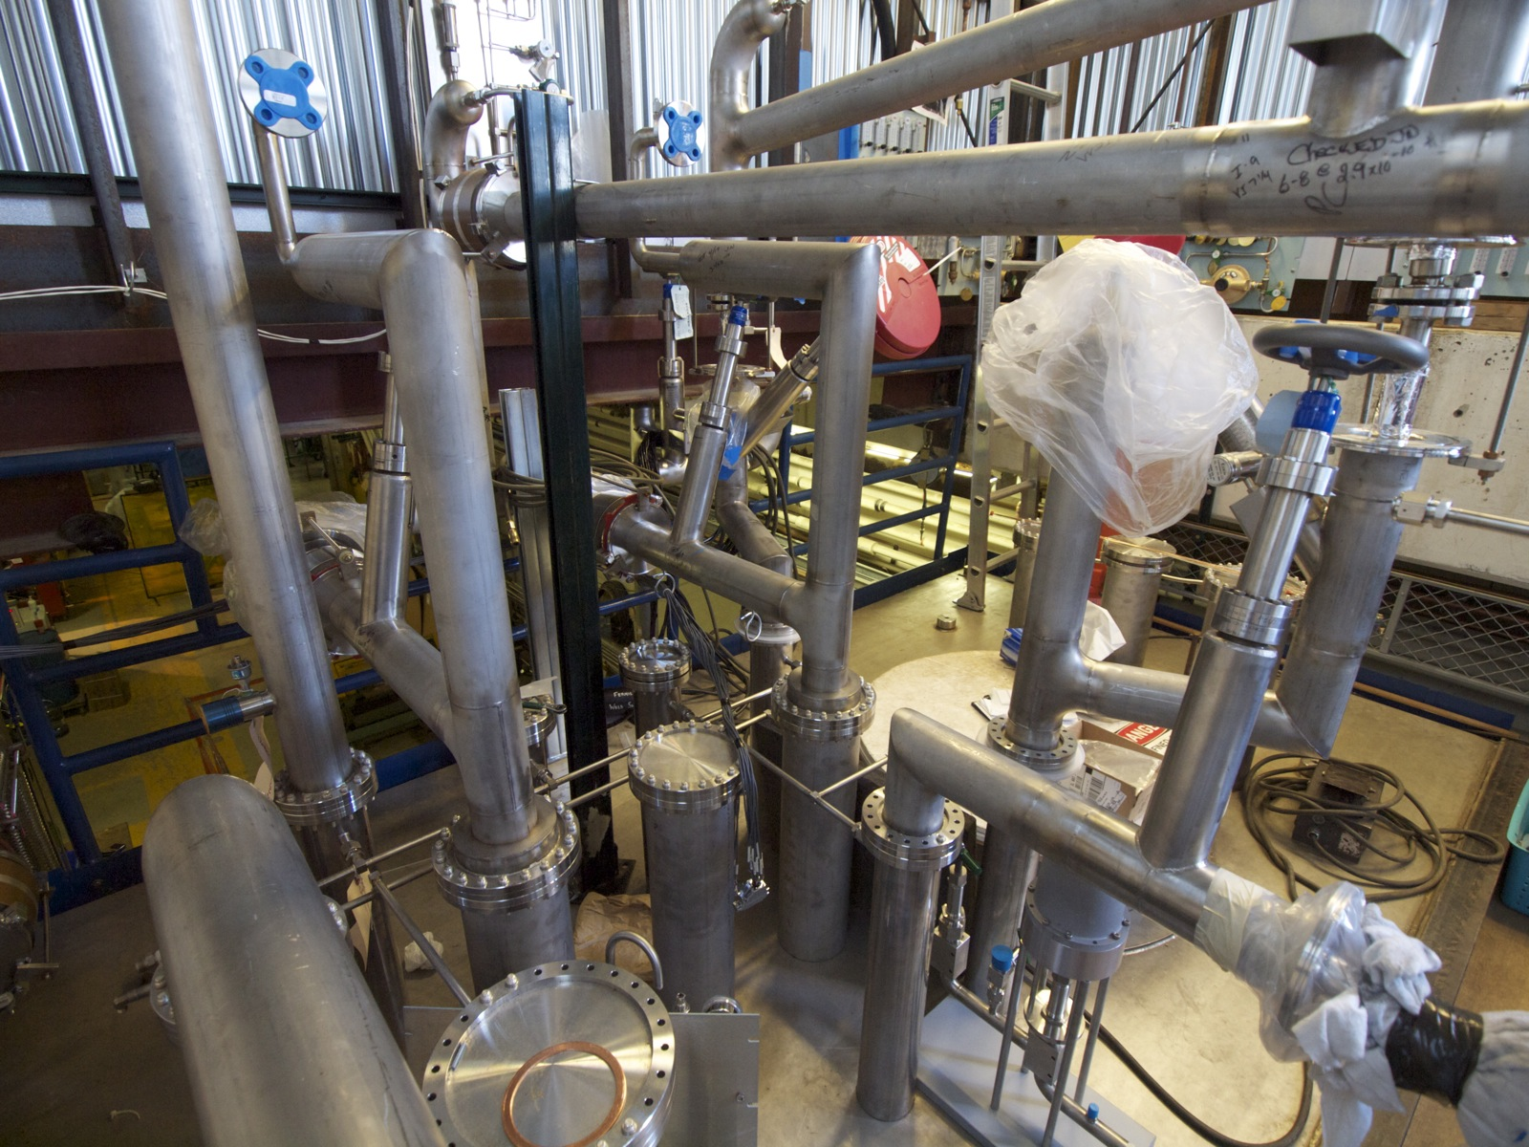
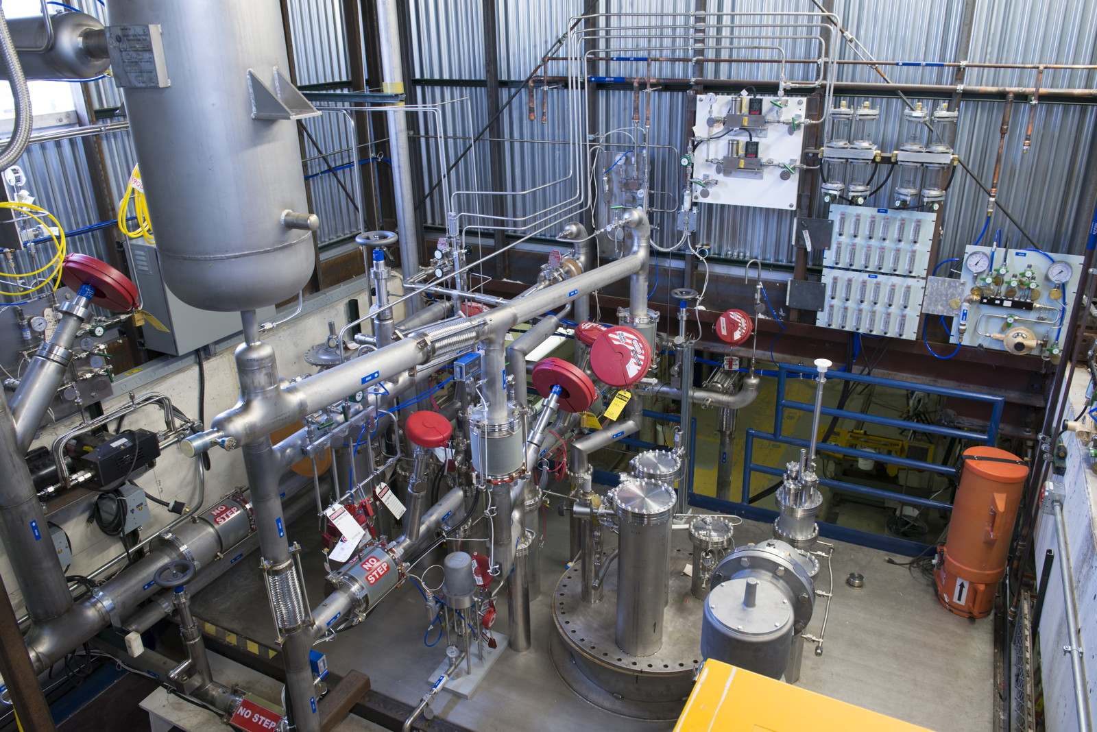
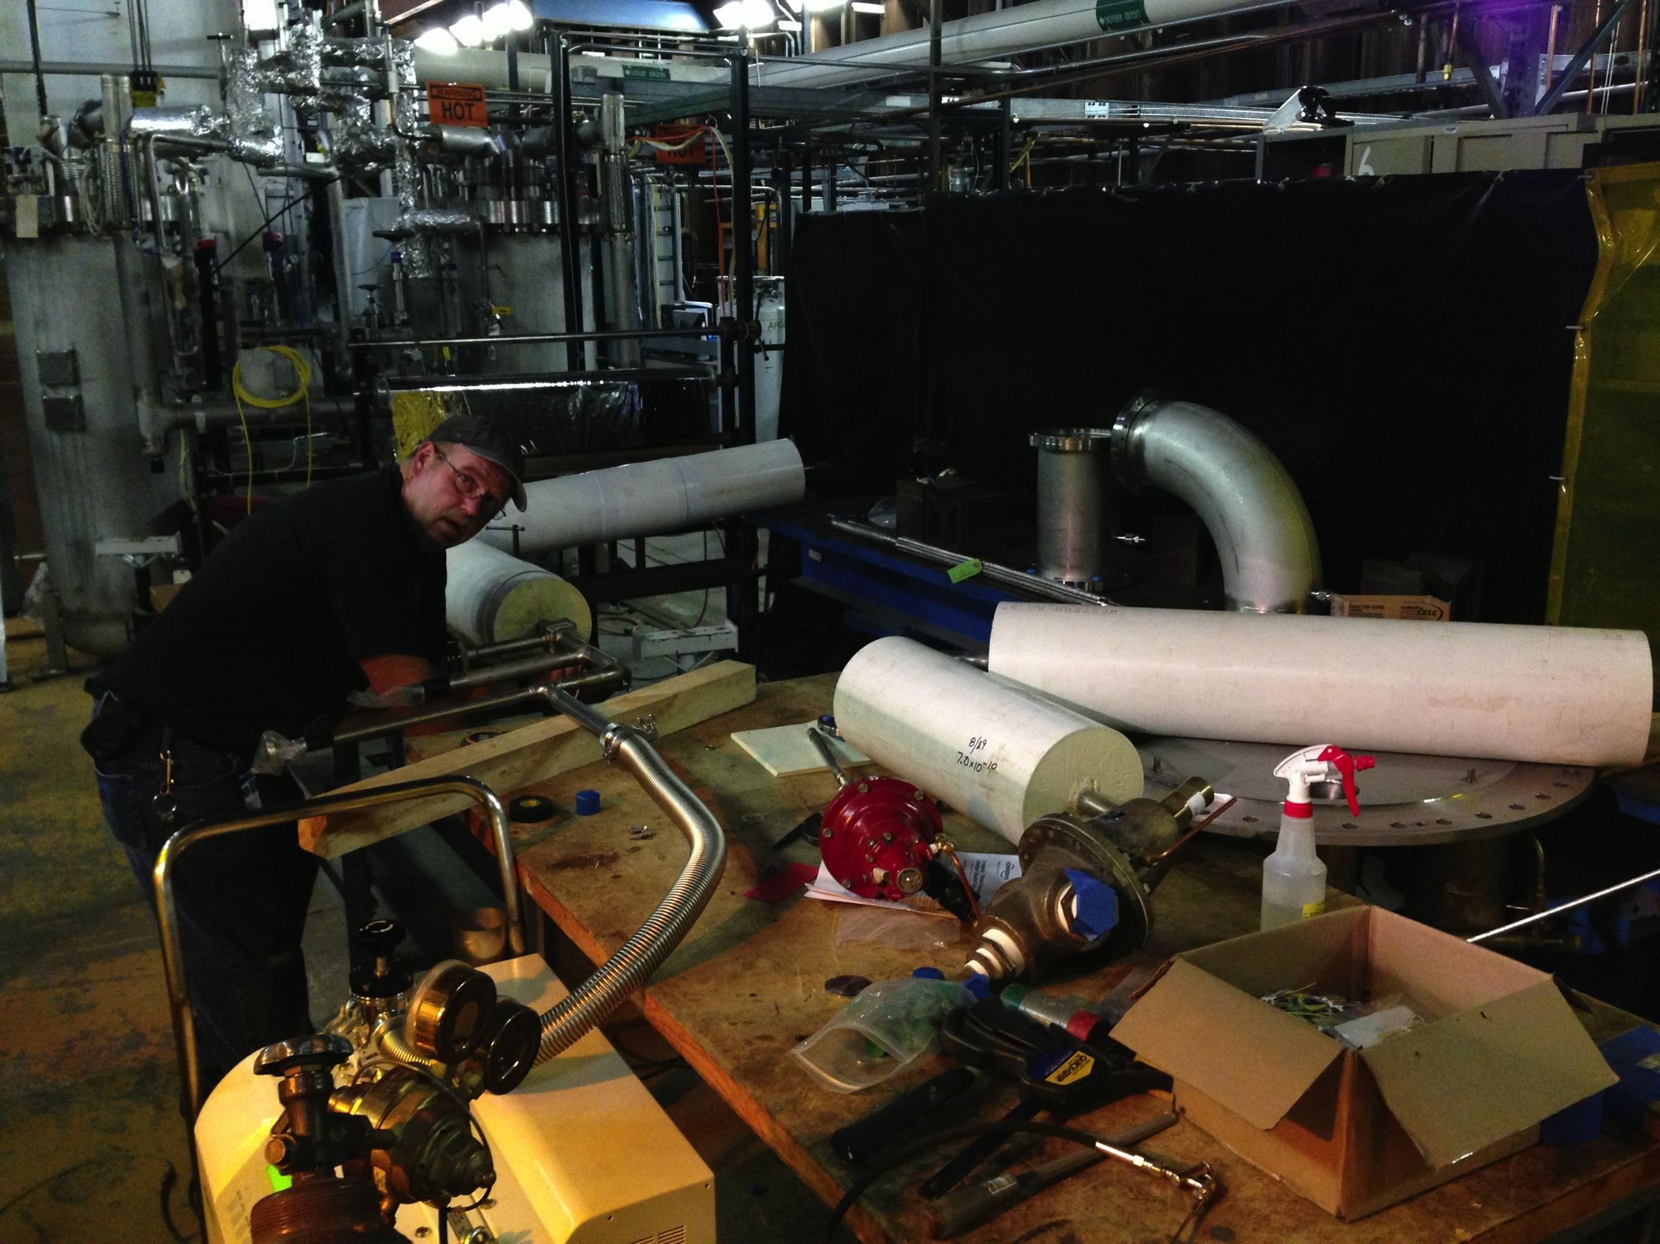
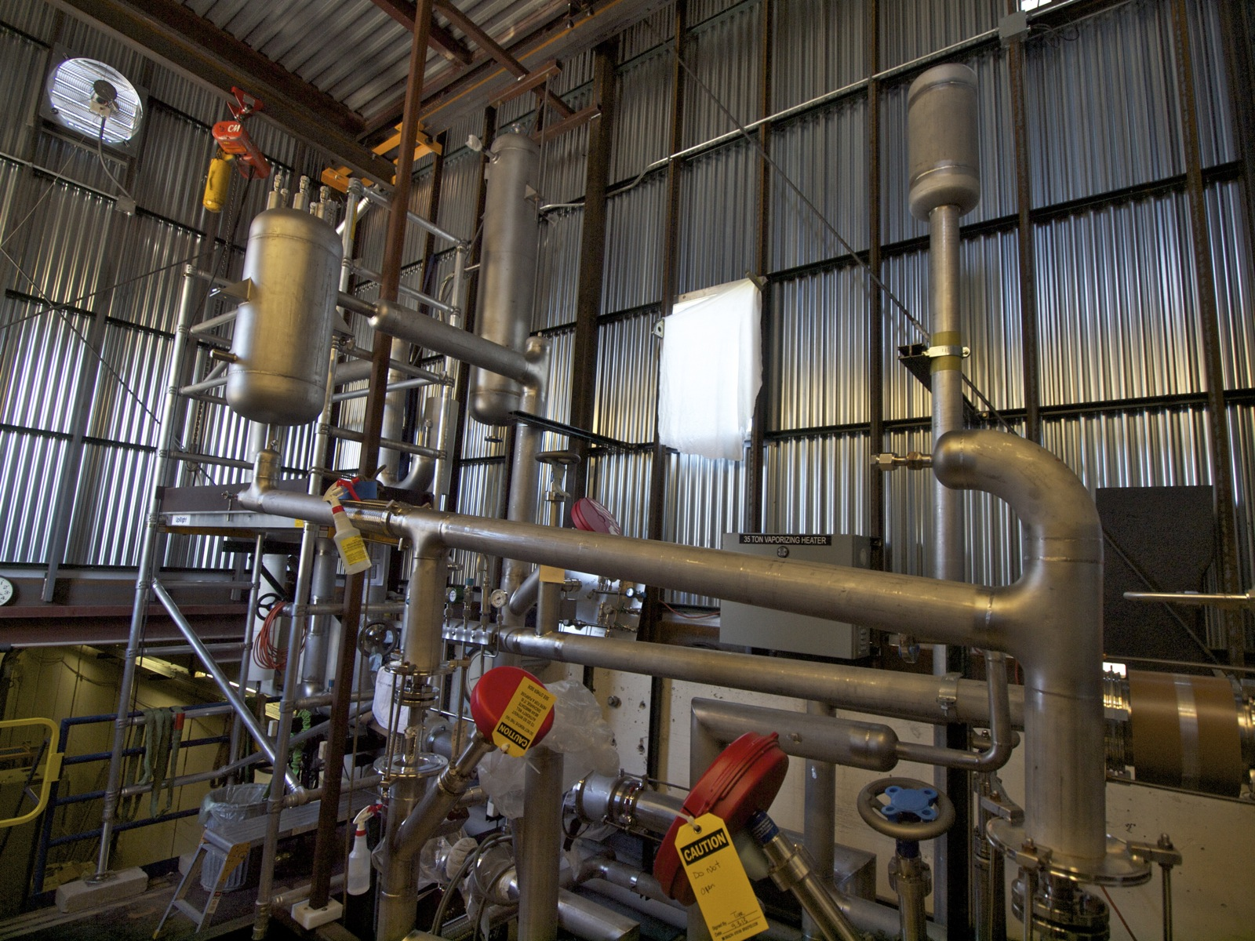
Cryogenic system construction
Notes:
Photos taken during the construction of the cryogenic system.

Slide 47
Cool-down and sprayers
Instead of using cold argon gas, the cryostat will be cooled with liquid/gas sprayers. These sprayers will spray liquid argon through the central hole and gaseous argon through the two angled holes. This creates a flat spray pattern of cold argon gas and extra liquid which will evaporate in the fluid volume, creating additional cooling power. Also additional straight gas sprayers will be used to provide momentum and mixing in a more efficient manner, causing the cryostat fluid space to have a relatively steady circulation pattern, and a forced convection dominated type flow. This figure shows one sprayer with water spraying through all orifices.

Slide 48
35 ton Proto Schedule – Vapor Barrier
Scheduled: ~8 days.
Actual duration: ~31 days.
Why?
  IHI anticipated our welders would be working at a much greater rate than reality --> rate of welding and number of hours of welding.
  Need to form a unified team of IHI, PPD Engineering, PPD techs, and TD welders.
  Ammonia leak check did not work because the concrete was still full of moisture which dissolves the Ammonia--> switched to Helium leak check in sniffer mode.
R&D:
  Use of new style vacuum boxes to test the vapor barrier.
Notes:
READ

Slide 49
35 ton Proto Schedule – Insulation
Scheduled: ~20 days.
Actual duration: ~40 days.
Why?
  IHI estimated much more people working inside the tank (8-10) --> limited to 4 for ES&H and practical reasons (more people simply did not fit).
  Procedures were antiquated and time consuming (IHI only tested the Secondary Barrier concept and the liquid insulation to fill the joints between panels. They are not part of the regular construction process).
R&D:
  Secondary membrane and sub-secondary membrane only tested, never implemented in an actual cryostat.
  Manual application of liquid PUF (i.e. filling of gaps between vertical insulation panels).
  Use of new style vacuum boxes to test the secondary membrane.
  Use of fireproof paste to join adjacent fireproof boards.

Slide 50
35 ton Proto Schedule – Membrane
Scheduled: ~13 days.
Actual duration: ~28 days.
Why?
  IHI underestimated the duration of fit-up and tack for the corner elements, which are curved and spherical and were never used by IHI before (the normal construction process uses flat pieces modeled in such a way to have an octatetracontagon (48-gons) approximate a circumference; and the same for the floor).
  Procedures were not optimized for the shape of panels and very time consuming (needed long adjustable rods to push the edges of two adjacent panels against each other for tack welding).
R&D:
  Use of stainless steel corner pieces.
  Use of membrane anchors in corner pieces.
Notes:
READ

Slide 51
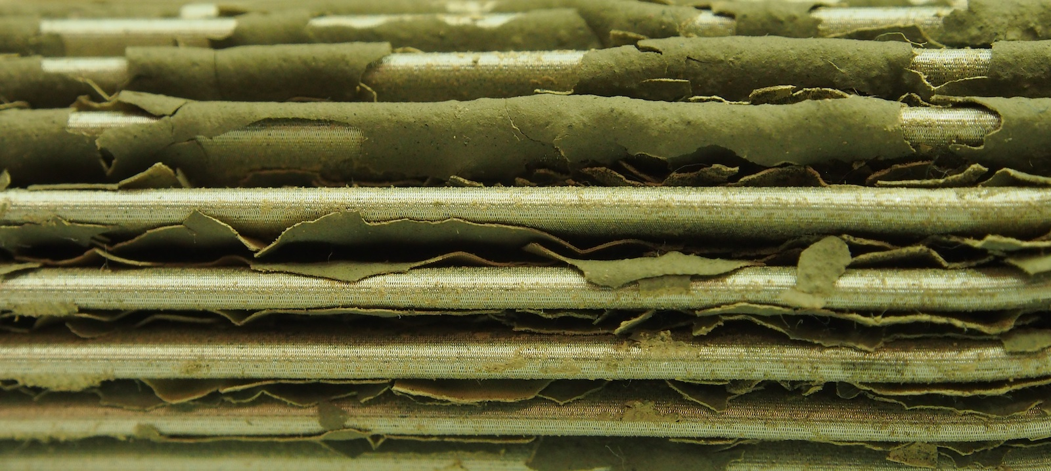
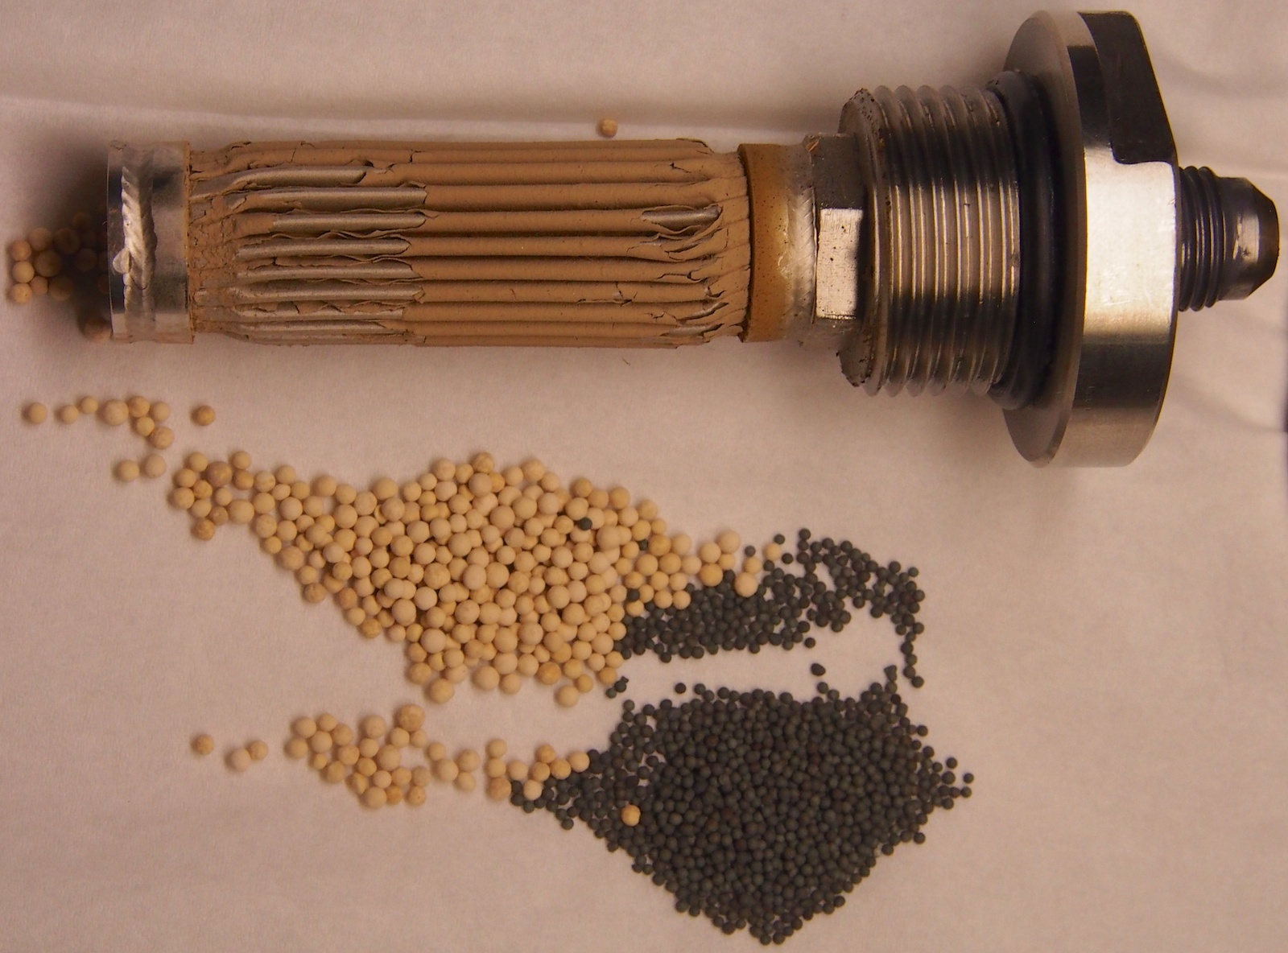
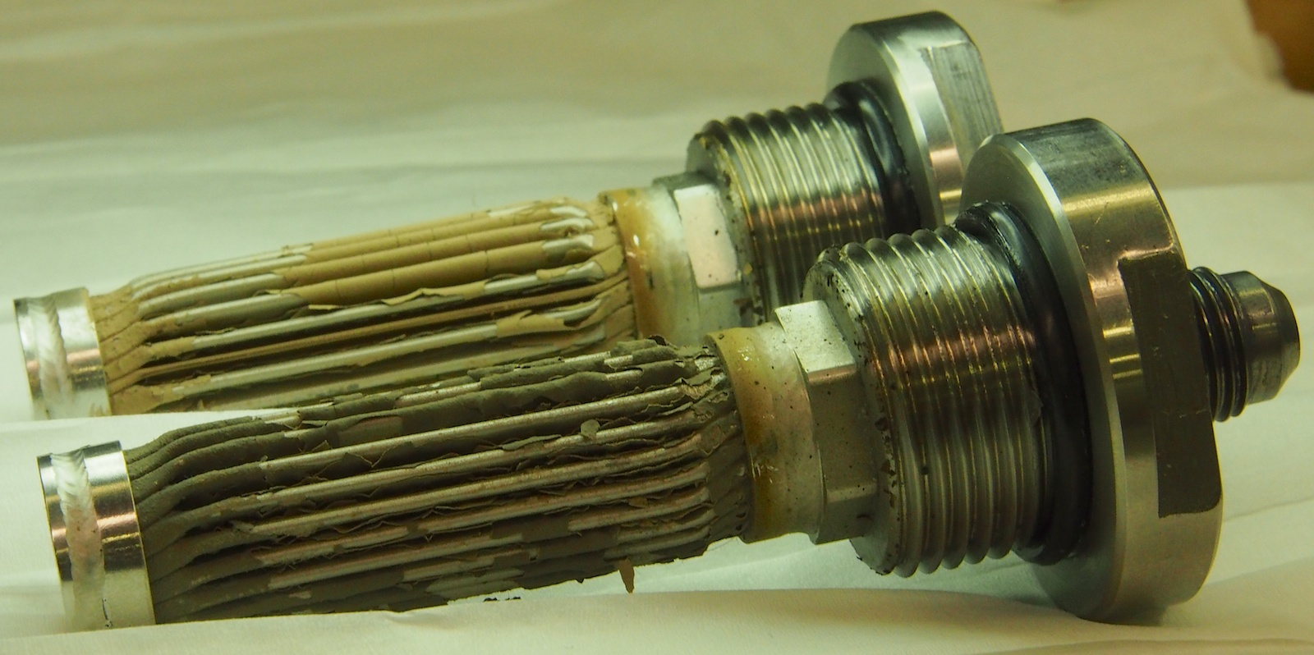
Lessons learned – LAr submerged pumps
Potential bearing failure as one of the two pumps failed after ~770 hrs.
We believe that when the pumps were shut off, gas bubbles formed inside the long LAr transfer lines, transported back molecular sieve crumbles and clogged these filters. They are on the line that takes a little LAr from the discharge to the motor and bearings.
Pump B (the one that failed) shows a darker material over the yellowish one. We believe that is bearing material worn down by the lack of coolant caused by the clogged filter.
Still investigating.
Pump B
Filters from the discharge to the motor and bearings
~10 cm
Pump A
Pump A
1.7-2.4 mm
Pump B
0.6-1.4 mm
Notes:
READ and point.

Slide 52
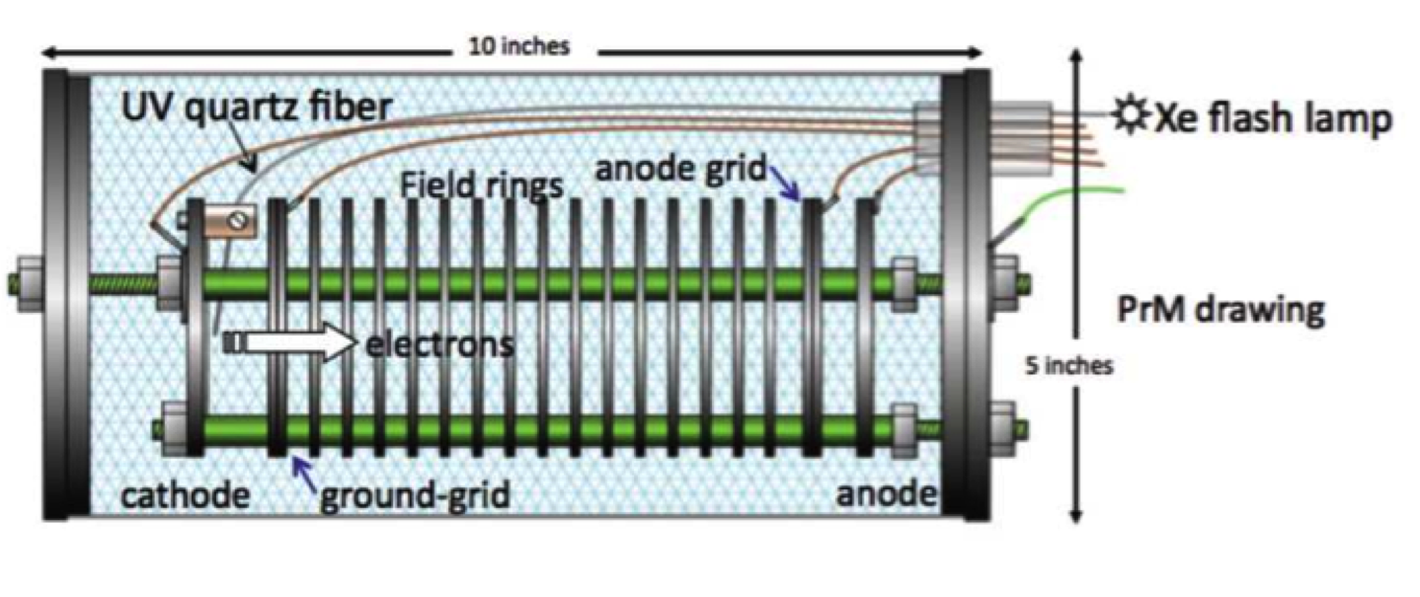
Drawing of purity monitor
Anode grid ~0.2, 0.3 kV
less than anode
~ -100V
0V
+1->3 kV
Notes:
The drawing of a Purity Monitor, based on ICARUS design.

