Slide 1
LAr1-ND Cryostat proposal
David Montanari
Neutrino Cryogenics Requirements Meeting
24 September 2014
Notes:
Good Morning Ladies and Gentlemen,
We will now talk about the LAr1-ND Cryostat proposal.

Slide 2
Outline
Introduction
Requirements
Current model
Outstanding issues
Design choices
Summary

Slide 3
Introduction
The Short-Baseline Neutrino Program (SBN) at Fermilab will study neutrino properties using a combination of detectors:
  existing MicroBooNE
  new LAr1-ND (Near Detector)
  a refurbished ICARUS T600 (Far Detector)
These slides describe the current thoughts on the cryostat for the LAr1-ND detector.
The base design is a membrane cryostat of 129 m³ (LAr volume) or 180 ton LAr Mass.
The cryostat will be housed in a new dedicated building next to the SciBooNE enclosure, where the cryogenic system will be located. The two buildings will be connected with a tunnel through which interconnecting lines will connect the cryostat to the cryogenic system.
Note: it may be possible to increase the sensitivity by increasing the LAr volume. We have looked into extending the width to 5.75 m (from 4.4) , that is 168 m³ LAr volume. This will allow the insertion of two (2) 2.5 m wide APAs instead of one (1) 3.65 m wide.

Slide 4
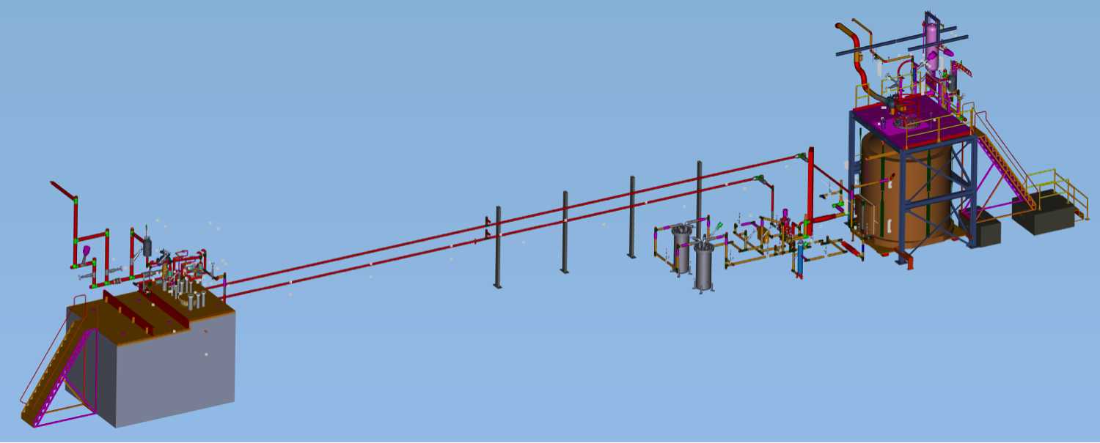
Layout for LAr1-ND similar to the LBNE 35 ton prototype
LBNE 35 ton Cryostat
LAPD
Process piping
Process piping
LAPD/LBNE LAr purification/filtration system
1.3-2.6 vol change/day
LAr/GAr transfer lines
LAr/GAr transfer lines
North
  This is the 3D model of PC-4 with the LBNE 35 ton and LAPD.
  We plan to do the same with LAr1-ND and the cryogenic system.
Notes:
Here we have the layout of the experimental hall.
DESCRIBE

Slide 5
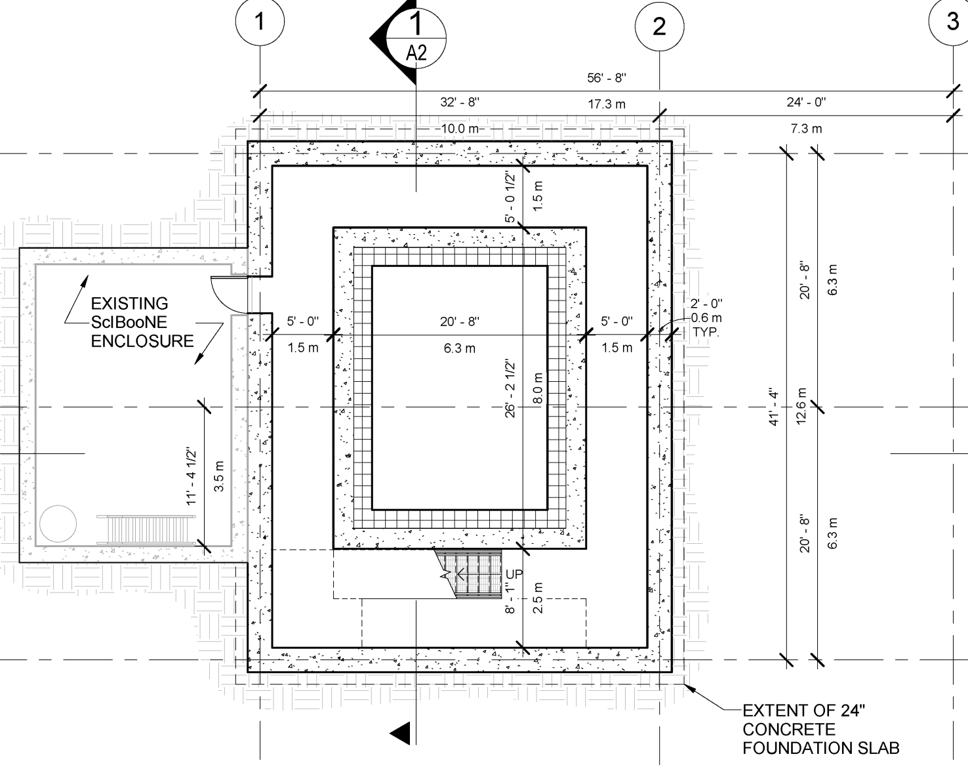
Near Detector Building – Plan view at detector level
Wetland Delineation – June 2014
From S. Dixon, Sep 16 ,2014
Notes:
Point to location of Cryostat and Cryogenic System.

Slide 6
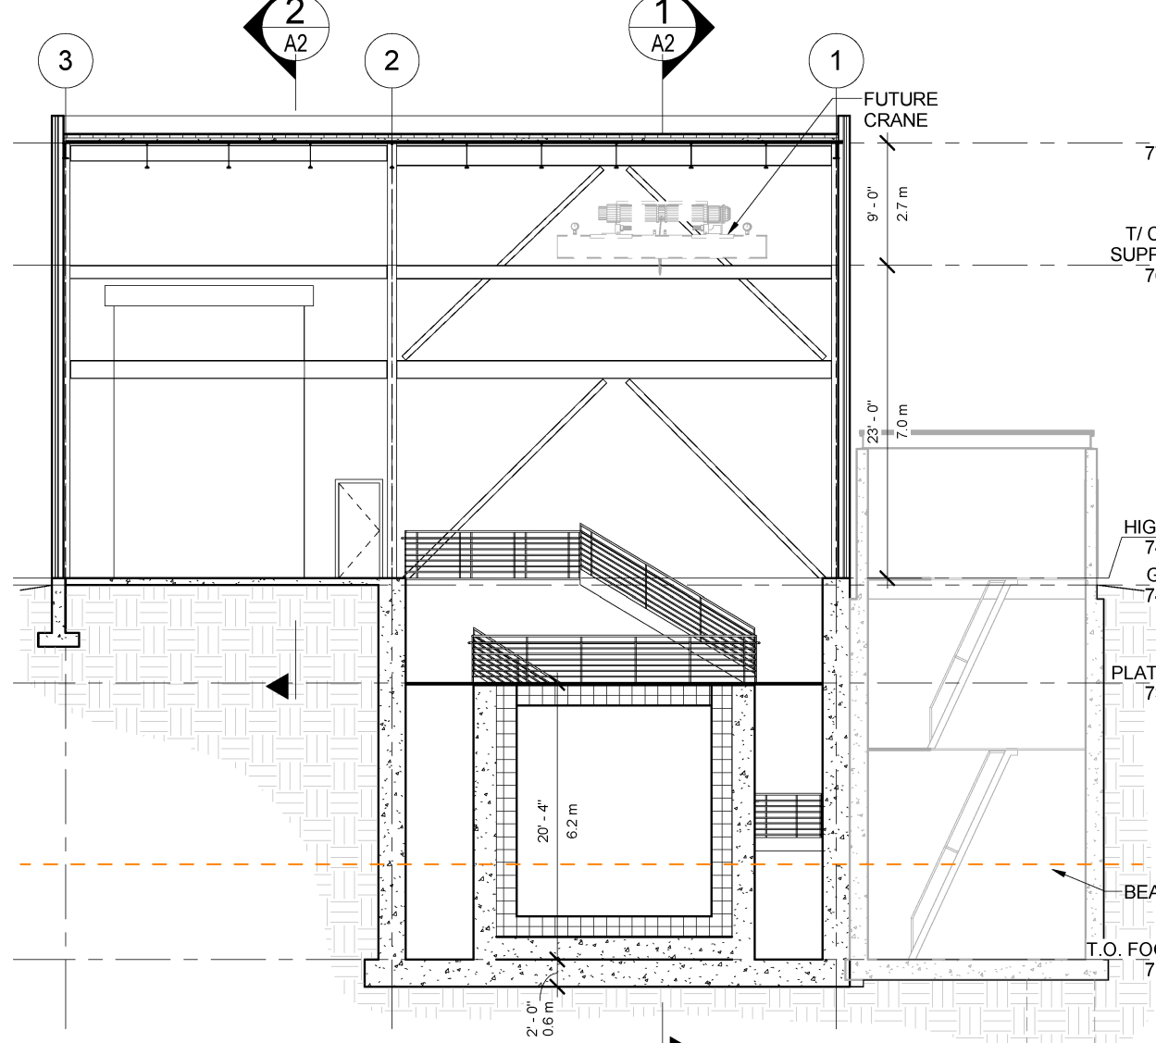
Near Detector Building – Section view
From S. Dixon, Sep 16 ,2014

Slide 7
Cryostat requirements – 1
Parameter | Value
Type of structure | Membrane cryostat
Membrane material | SS 304/304L, 316/316L or equivalent. Other materials upon approval
Fluid | Liquid Argon (LAr)
Outside reinforcement (Support structure) | Self standing concrete/steel enclosure with embedded heaters to prevent concrete from freezing (Floor + Sides)
TPC size | Length: 4.0 m (+ 2 x 0.21 m frame) Width: 1 x 3.65 m OR 2 x 2.5 m (negligible frame) Height: 4.0 m (negligible frame)
Minimum clearance of TPC from the sides | 0.35 m
Minimum clearance of TPC from floor | 0.40 m
Depth of LAr above TPC | 0.40 m (assumes tank filled all the way to the top)
Minimum depth of liquid argon | 4.80 m
Minimum inner dimensions Physics requirements. Assumes NO ullage. | 4.4 m (W) x 6.1 m (L) x 4.8 m (H) 5.75 m (W) x 6.1 m (L) x 4.8 m (H) →Two APAs instead of one (flat plate to flat plate)
Maximum static heat leak | 15 W/m²
Operating gas pressure | Positive pressure. Nominally 1.0 psig (~70 mbar).
Design Pressure | 5.0 psig (~350 mbar) + LAr head

Slide 8
Cryostat requirements – 2
Parameter | Value
Design Temperature | 77 K (liquid Nitrogen temperature for flexibility)
All surfaces in the ullage during operations | ≤ 100 K
Max noise/vibration/microphonics inside cryostat | LAr pump preferably outside the cryostat
Accessibility after operations | Capability to empty the cryostat in 30 days and access it in 60 days
Lifetime | 10 years (5 years of run + 5 years potential upgrade)
Thermal cycles | 20 cool down and total warm-up
Note:
The cold ullage (≤ 100 K) and LAr pump outside cryostat are VE for LBN, which supports the engineering as part of the SBN program.

Slide 9
Cryostat infrastructure requirements
Parameter | Value
Free area around the perimeter of the cryostat installation (if self standing) | Minimum 0.92 m per FESHMN
Lay down space | Equivalent to one cryostat footprint
Crane coverage | Over the cryostat and the lay down space
Crane capacity for TPC (Not including top of cryostat) | 5 ton
Minimum hook height above the neck of the cryostat for TPC installation | 5.75 m
Note:
The minimum hook height needed to install the top cap with the TPC already anchored underneath is 6.00 m over the side walls.

Slide 10
Cryostat top requirements
Parameter | Value
Configuration | Removable metal plate reinforced with trusses anchored to the membrane cryostat support structure. Contains multiple penetrations of various sizes and a manhole. Number, location and size of the penetrations TBD. Provisions shall be made to allow for removal and re-welding six (6) times.
Plate/Trusses non-wet material | Steel if room temperature. SS 304/304L or equivalent if at cryogenic temperature.
Wet material | SS 304/304L, 316/316L or equivalent. Other materials upon approval.
Fluid | Liquid Argon (LAr)
Design Pressure | 5.0 psig (~350 mbar)
Design Temperature | 77 K (liquid Nitrogen temperature for flexibility)
Inner dimensions | To match the cryostat
Maximum allowable roof deflection | 0.018 m
Maximum static heat leak | 20 W/m² (Greater than sides/bottom to allow for the penetrations)
All surfaces in the ullage during operations | ≤ 100K

Slide 11
Cryostat top requirements – 2
Parameter | Value
Additional design loads | Top self-weight TPC (~2,300 kg total, ~385 kg on each anchor if six anchors) TPC anchors (TBD) Live load (488 kg/m²) Electronics racks (400 kg in the vicinity of the feedthroughs) Services (150 kg on every feed through)
TPC anchors | Capacity: 1,000 kg each anchor. Number and location TBD (Minimum six, two per TPC).
Grounding plate | 1.6 mm thick copper sheet brazed to the bottom of the top plate (LBN proposed design).
Lifting fixtures | Appropriate for positioning the top and the different parts that constitute it.
Cold penetrations | Minimum 2. Location and design TBD.
Lifetime | 10 years (5 years of run + 5 years potential upgrade)
Thermal cycles | 20 cool down and total warm-up

Slide 12
Cryostat grounding/isolation requirements
Parameter | Value
Isolation | The cryostat membrane and any supporting structure, whether it is a steel structure or a concrete and rebar pour, shall be isolated from any building metal or building rebar with a DC impedance greater than 300 kohm. All conductive piping penetrations through the cryostat shall have dielectric breaks prior to entering the cryostat and the top plate.
Grounding | The cryostat, or “detector” ground, shall be separated from the “building” ground. A safety ground network consisting of saturated inductors shall be used between detector ground and building ground. Parameters TBD.
Top plate grounding | If the cryostat is contained within a concrete pour, the top plate shall be electrically connected to any rebar used in that pour, and the rebar shall be conductively tied at regular intervals. Parameters TBD. The top grounding plate shall be electrically connected to the cryostat membrane by means of copper braid connections. Each connection shall be at least 1.6 mm thick and 63.5 mm wide. The length of each connection is required to be as short as possible. The distance between one connection and the next one shall be no more than 1.25 m. The layout can follow the profile of several pieces of insulation, but it shall be continuous. The DC impedance of the membrane to the top plate shall be less than 1 ohm.
Note:
This is what we are developing for LBN-Far Detector and the test of TPC at CERN.

Slide 13
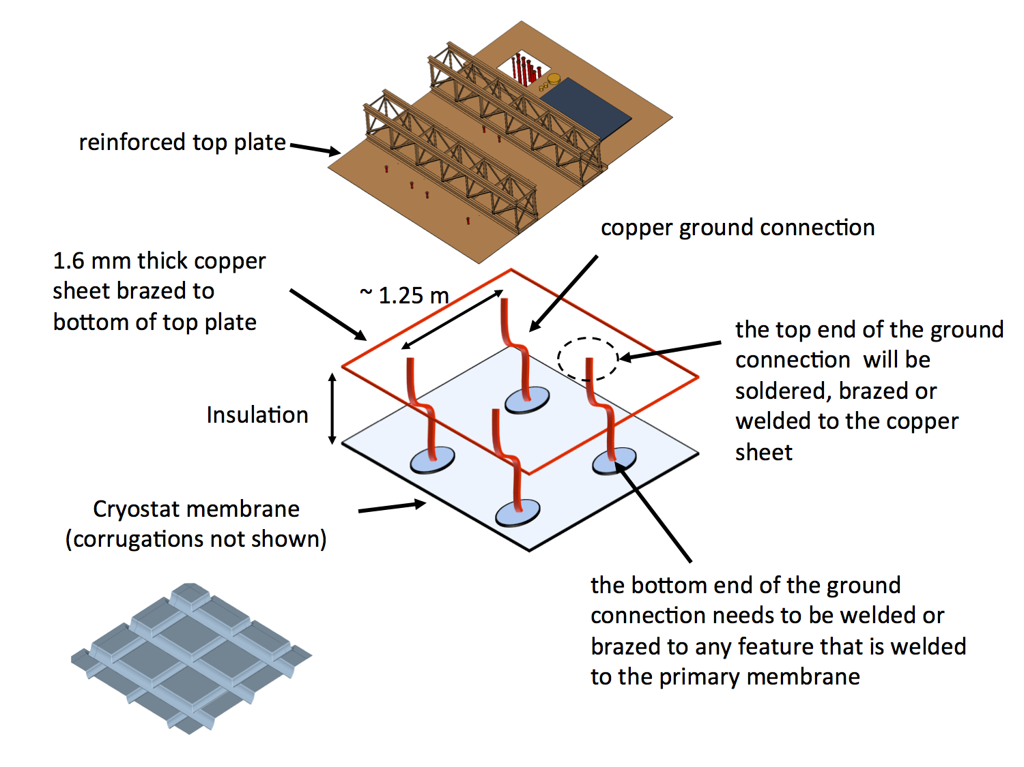
Top plate grounding layout
Note:
This is what we are developing for WA105 and LBNF-Far Detector.

Slide 14
LAr1-ND 129 m³ model (based on 35 ton)
This shows model of 129 m³ or 180 ton LAr total mass.
Note the Top Plate here is just a sample with fewer penetrations.
Corrugations of the membrane are not shown.
Heaters are embedded in the concrete floor and sides to maintain the temperature.
Assumption: A larger cryostat would increase the internal width from 4.4 m to 5.75 m.
  This is the 3D model of LAr1-ND based on the 35 ton concept.
  A possible alternative is to have a single removable plate at the top with the TPCs hung from underneath and potentially installed prior to the installation of the top.

Slide 15
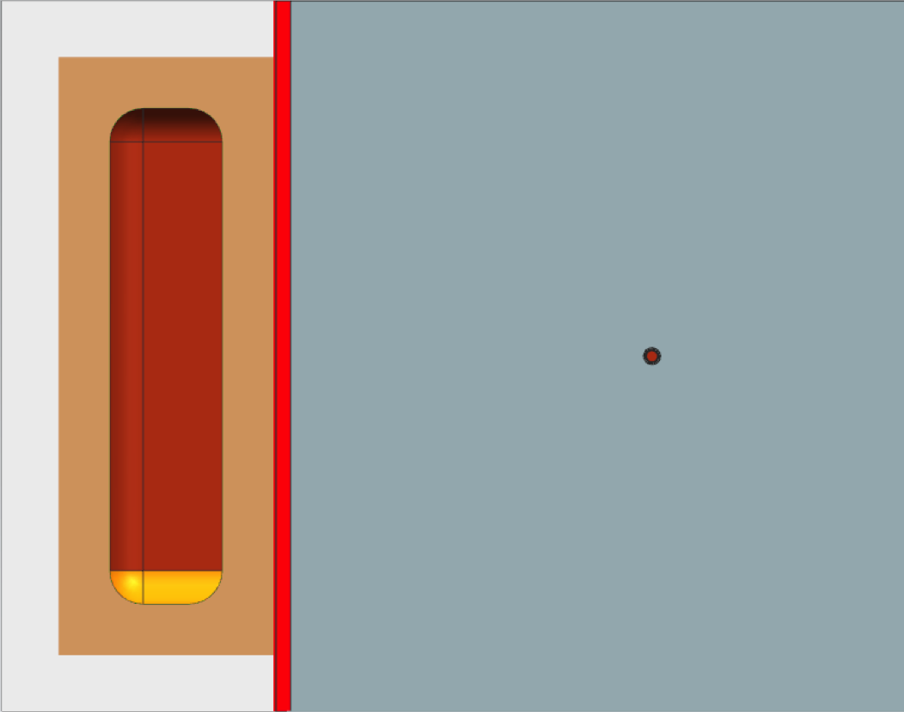
Top view
The Top Plates must be re-designed for LAr1-ND
4,400 mm
4,900 mm
5,900 mm
8,000 mm

Slide 16
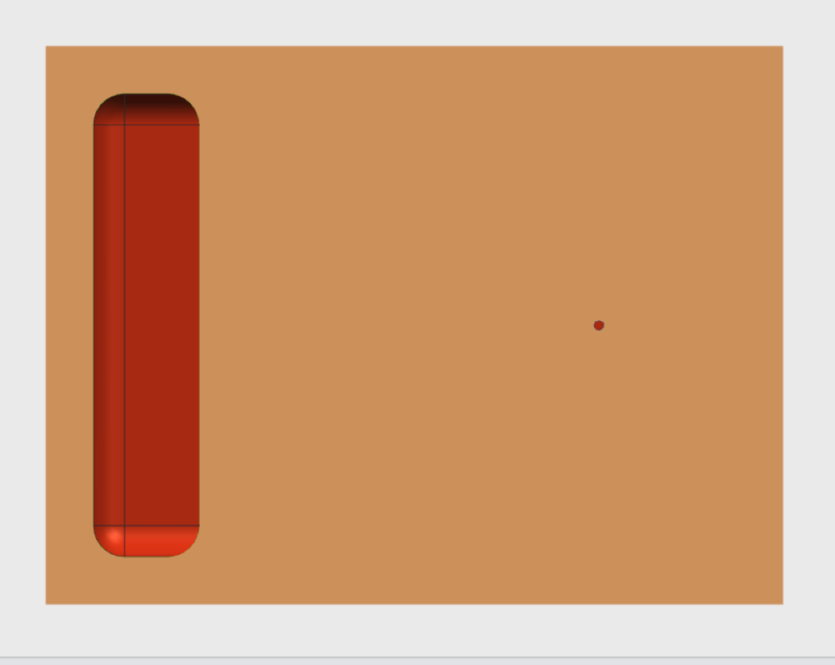
Top view
Important for LBN: desired side penetration for LAr pump
500 mm Concrete
1,000 mm
4,400 mm
7,000 mm
Notes:
REPLACE w SH Top View

Slide 17
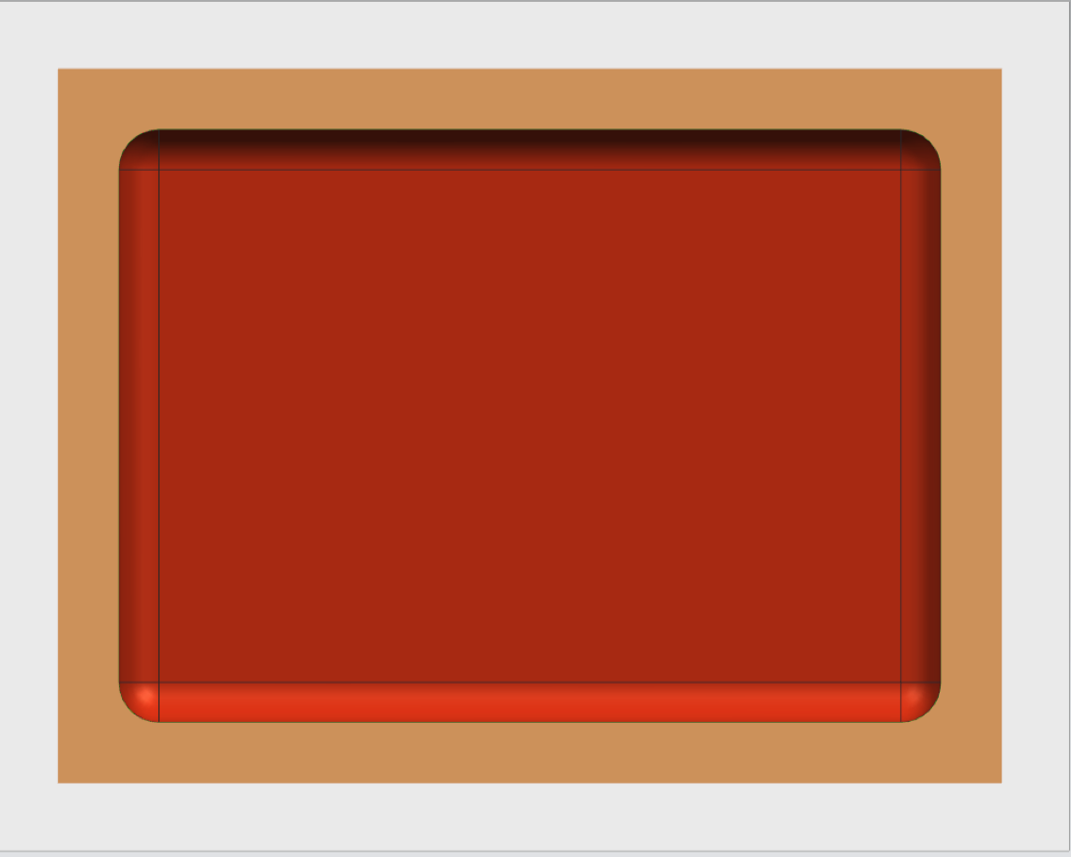
Top view
Important for LBN: desired side penetration for LAr pump
Insulation 450 mm
APA
CPA
APA
3,650 mm
TPC not to scale
4,000 mm
Notes:
REPLACE w SH Top View

Slide 18
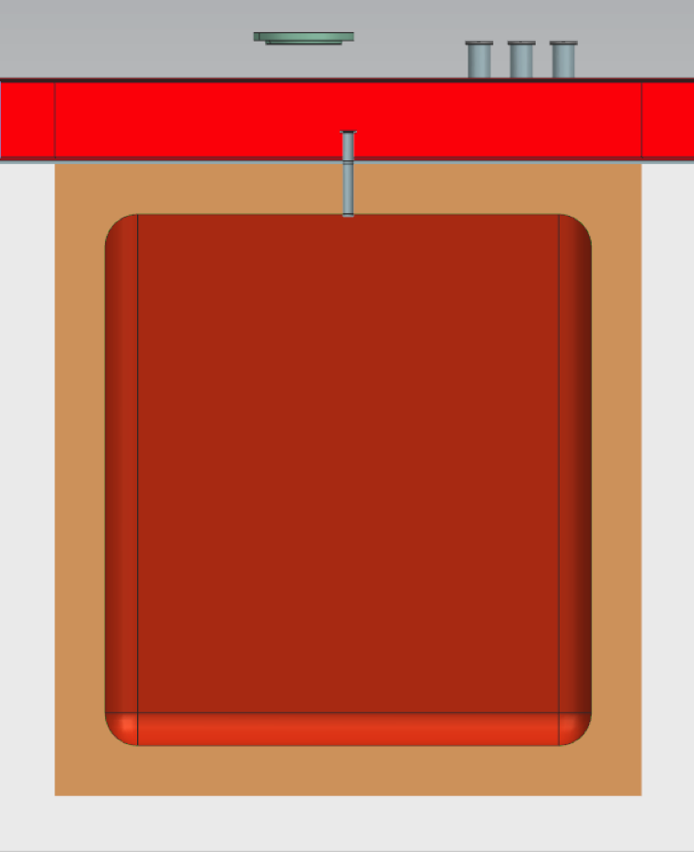
Side view
Insulation 450 mm
The HV feedthrough does not have to be in the center of the CPA in this view
4,800 mm
Beam
TPC not to scale
4,400 mm
Notes:
REPLACE with SH Side View

Slide 19
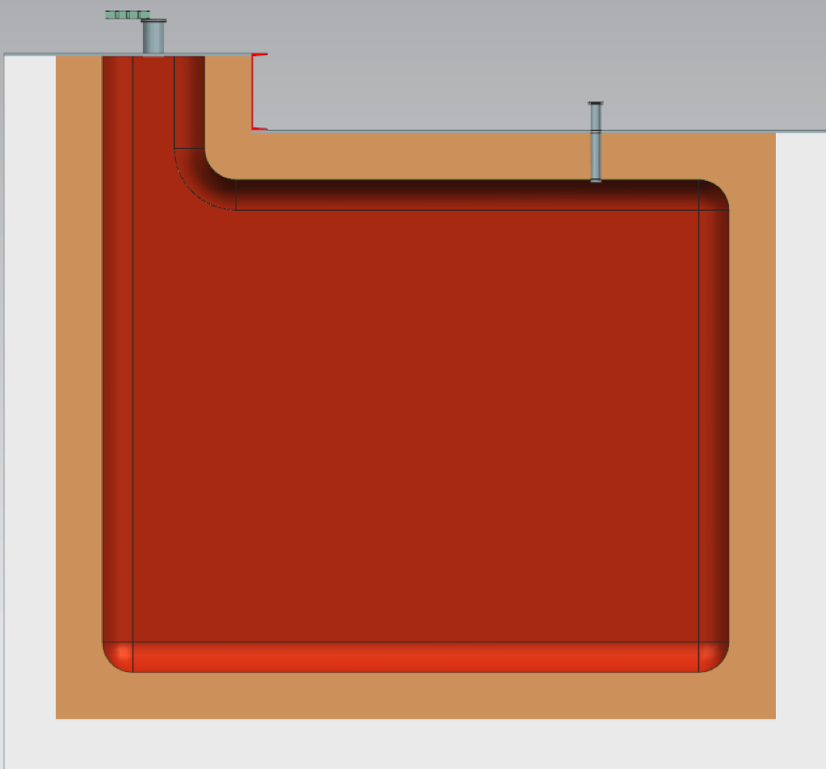
Back view
1,000 mm
Insulation 450 mm
1,200 mm
Desired side
penetration
for LAr pump
APA
CPA
APA
4,800 mm
4,000 mm
TPC not to scale
Notes:
REPLACE with SH Back View

Slide 20
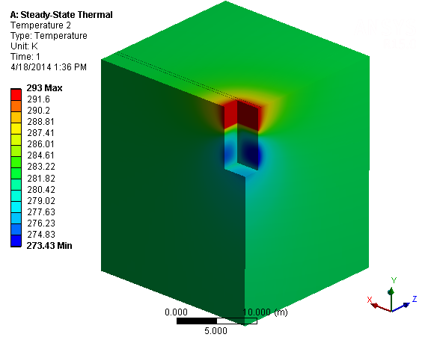
Temperature profile in concrete soil with heaters
With 400W Floor Heater and 200W Large Side Heaters (800W Total) the concrete along the sides reaches a minimum temperature of ~273K. If the structure if free standing and is does not lay against the soil, the temperatures will be even higher.

Slide 21
Outstanding issues
Installation and integration of TPC in cryostat:
  How will the TPCs be installed? From inside the cryostat or outside and then just lower the top in place?
  Do the cryostat dimensions need to be revised to account for installation of the TPCs?
  Does the location of the openings (feedthroughs and hatch) need to be modified?
  How do we connect the cables to the feedthroughs?
  How do we test the APAs during installation?
  Studies on how to keep all surfaces at a temperature lower than 100 K.
  Studies on how to minimize noise in the vicinity of the wires.
LAr Pump (Outside):
  Need to see how to isolate the pump electrically and mechanically from the TPC. Issues with electronic noise and microphonics.
  Check with Fermilab safety that cryogenic review panel is ok. We believe it it ok.
  Check grounding scheme.
Ability to make modifications after run for 5 years
  Access the tank. Replace the electronics ??

Slide 22
Design choices
Concrete/metal support structure or reinforce the building walls and use them as support ?? In any case there will be a heating system in the support structure to prevent it from freezing.
If the building walls are used as cryostat support, what are the optimum cryostat/building dimensions ??
  Same cryostat and smaller building
  Same building and larger cryostat
  Something in between
Top plate similar to 35 ton with Plate A/B or single plate with TPCs hung underneath assembled somewhere else and transported in place only for final installation ?? Schedule advantage.
In any scenario it is possible to divide the cryostat in three parts:
  Support structure (concrete or metal or building)
  Membrane cryostat (bottom + sides)
  Top plate (with penetrations, but also insulation and membrane)

Slide 23
Summary
Preliminary thinking has been done on the layout of LAr1-ND cryostat for two different sizes: base option (129 m³) and enlarged version (168 m³) that will accommodate two 2.5 m wide APAs. Other larger options were evaluated and discarded for cost considerations.
The requirements for the membrane cryostat are being developed (based on the TPC).
Cryogenically the system ‘feels like’ the 35 ton system at Fermilab’s PC-4 but placed in separate facility.

Slide 24
Closing remark
Fundamentally there are no foreseen issues related to increasing the cryostat size. There are increased costs for the cryostat (as well as the cryogenic system). They will scale with cryostat surface (and heat leak and purification flow rate).
Two design issues are key:
  1) How does the TPC installation/integration happen ??
  2) How do we keep the surfaces of the ullage at T ≤ 100 K ??

Slide 25
Thanks!
David Montanari
Neutrino Cryogenics Requirements Meeting
24 September 2014

Slide 26
Backup

Slide 27
Current schedule
The goal is to have the detector ready for commissioning in the fall of 2017 and to take beam data in Apr 2018.
From the proposal submitted to the PAC in Jul 2014:
Milestone | Date
Near Detector cryostat engineering study contracted | Nov 2014
LAr1-ND technical proposal submitted for peer review | Mar 2015
LAr1-ND Cryostat procurement contract issued | Dec 2015
Start cryostat assembly for Near Detector at Fermilab | Oct 2016
Start LAr1-ND detector installation | Apr 2017
Start detectors cooling and commissioning | Nov 2017
Start data taking with beam | Apr 2018

Slide 28
Feedthroughs
TPC HV FT:
  warm FT right on top of the Cathode plane with its own nozzle.
  Ullage region of the HV needs to be connected to the ullage region in the “chimney” to maintain stable liquid level in the HV nozzle.
Signal Baseline:
  Warm FT, “MicroBooNe” Style.
  Option: Long “Cold” FT dipping into the liquid. Eliminates the exposed cables in the gas region. Needs to be designed.

Slide 29
Current list of penetrations
Liquid level probe(s).
LAr Out (to LAr pump through the side of the tank)
LAr In (from pump discharge through purification system)
Cool-down ports (depending on cool down method)
GAr purge inlet
GAr purge outlet
GAr to condenser and vent valves
Low P make-up GAr
PSV
VSV
LAr cool-down
T sensors
T sensors Feedthrough
Miscellaneous Feedthrough (LED lights, etc.)
TPC Signal Feedthroughs (warm or cold ??)
TPC HV feedthroughs (on center of cryostat)
Photon detectors
Calibration(s)
Purity Monitor(s)?
Glass window view port ??
Sampling ports
LN2/GN2 heat exchanger ports
Instrumentation & Diagnostics ??
Spare ports

Slide 30
Heat leak summary
 | 129 m³ Estimated Heat Leak (kW) | 231 m³ Estimated Heat Leak (kW)
Base of Cryostat | 0.356 | 0.641
End Walls of Cryostat | 0.560 | 1.008
Side Walls of Cryostat | 0.777 | 0.777
Top Plate A | 0.277 | 0.499
Radiative Heat Load through Neck of Top Plate B | ~ 0.326 (from 35 ton estimate) | Assume ~ 0.587 (from 35 ton estimate)
TPC or Electronics | TBD | TBD
LAr Pumps | TBD | TBD
HV Feed through | TBD | TBD
Piping | TBD | TBD
Total | ~2.2 kW + TBD | ~3.5 kW + TBD

