Slide 1
The European XFEL Project – lasers for user experiments
Hamburg, November 12, 2014
Max Lederer, Laser Group European XFEL
max.lederer@xfel.eu
Notes:
How to edit the title slide
Upper area: Title of your talk, max. 2 rows of the defined size (55 pt)
Lower area (subtitle): Conference/meeting/workshop, location, date,
your name and affiliation,
max. 4 rows of the defined size (32 pt)
Change the partner logos or add others in the last row.

Slide 2
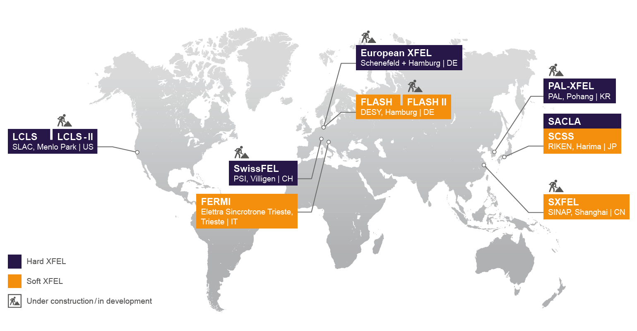
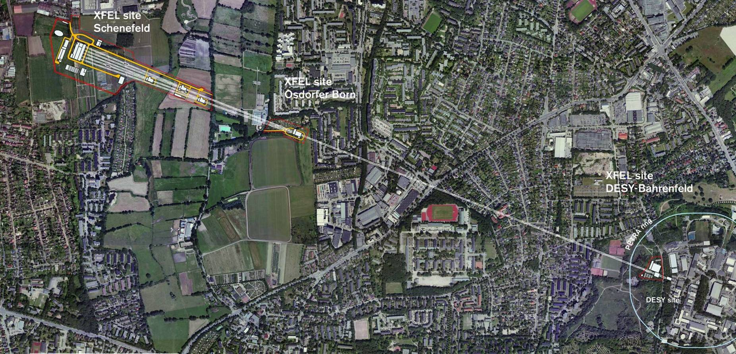
European XFEL mission
International multi-user facility for FEL research by a multi-disciplinary science community using ultrashort soft & hard X-ray FEL pulses.
  User proposed experiments: peer-review, invitation, support
  Basic science: establish the foundations for future high-tech applications
  Multidisciplinary: physics, chemistry, biology, materials sciences, geo-sciences, ...

Slide 3




















European XFEL as international project
Partner countries
  GmbH under German law
Total project cost
  Construction (2009-2017) 1.15 B€(2005)
  Operation (≥2017) ~100 M€/yr
    ~4800 hrs/yr x-ray FEL beam delivery
Partners & In-Kind contributions (~50%)
  About 30 different contributions
  Accelerator is biggest object
    DESY: coordinator of the Accelerator Consortium
  Responsibilities construction and operation:
    DESY → Accelerator & tech. Infrastructure;
    XFEL.EU → X-ray units & scientific user program

Slide 4
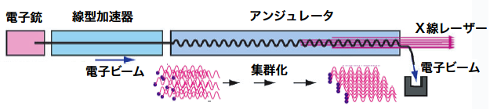
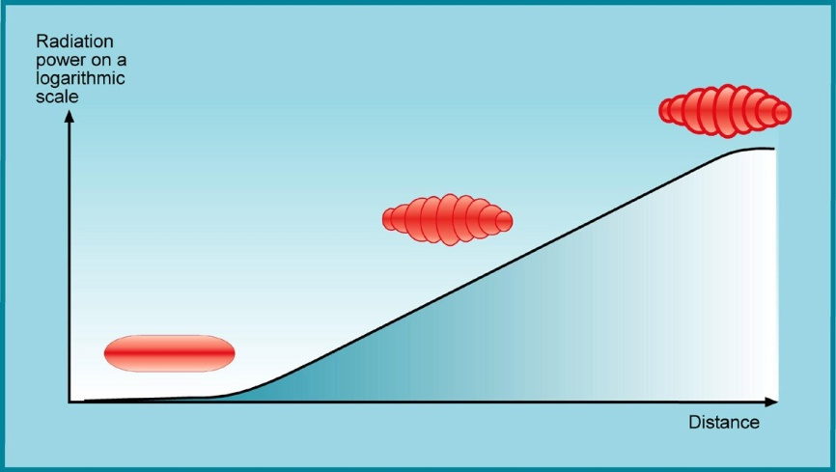
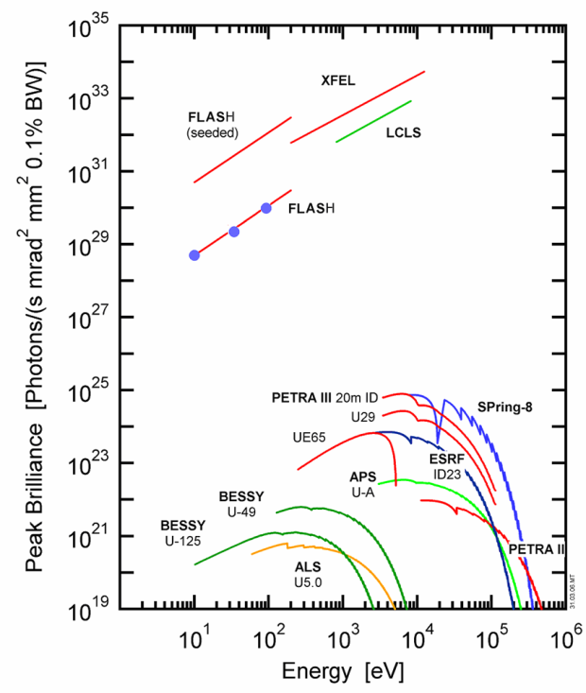
X-ray Free-Electron Laser (XFEL)
Electron-
injector
Super-conducting
electron accelerator
Undulator
(periodic magnet arrangement)
X-ray FEL
beam
Electron
beam
Electron beam
Micro-bunching
λ_{x-ray}
Micro-bunching
Light generation in
the undulator:
SASE:
Self-Amplified Spontaneous Emission
Synchrotrons vs. XFELs
  10³-10⁴×shorter light pulses
  10⁶×higher flux density
  Full transverse coherence
X-ray
FELs
Intensity
≙ ca.100fs
Synchrotron
X-ray sources
e⁻ - bunch
Time
≙ ca.100fs
➔New scientific applications

Slide 5
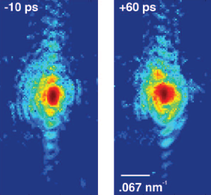
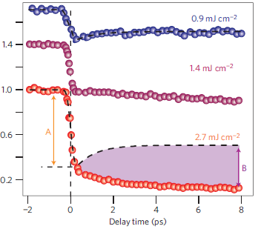
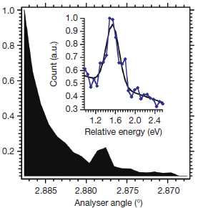
New science capabilities
Imaging and structure determination
  Use high coherence & flux
  Nano-scale objects
  Single molecules or cells
Ultrafast processes
  Use extremely short x-ray pulses
  Photo- & reaction chemistry
  Condensed-matter phase transitions
Non-linear processes and extreme states
  Higher order x-ray processes
  X-ray excitation of matter
High peak & average flux applications
Au nanocrystals
Clark et al.,
Science 341, 56 (2013)
Insulator-metal-transition
De Jong et al.,
DOI: 10.1038/NMAT3718
Non-linear mixing
Glover et al.,
Nature 488, 603 (2012)

Slide 6
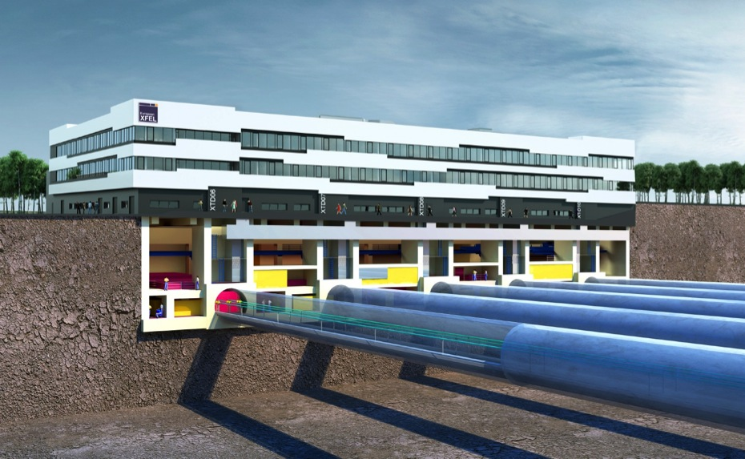
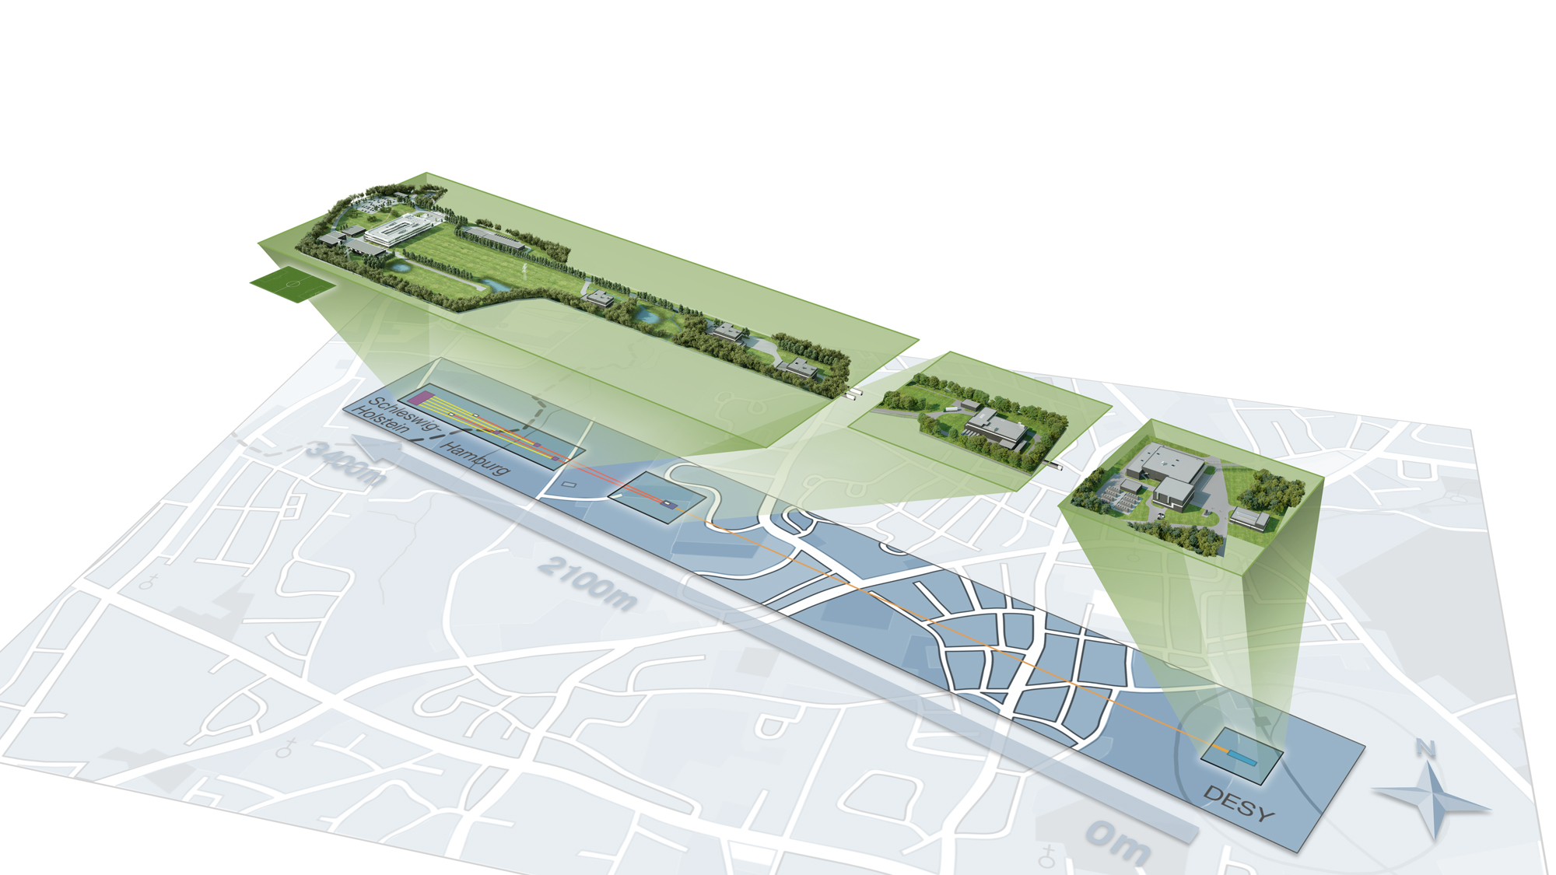
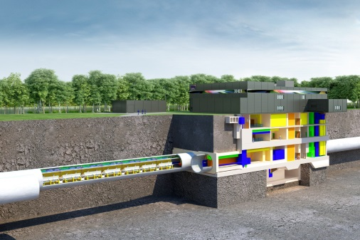
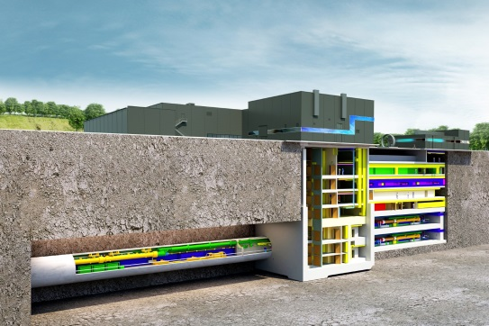
Facility overview
Osdorfer Born campus:
Kicker
Schenefeld campus: underground experiment hall with main building
DESY-Bahrenfeld campus:
Injector
Schenefeld campus:
Experiment hall and main building

Slide 7
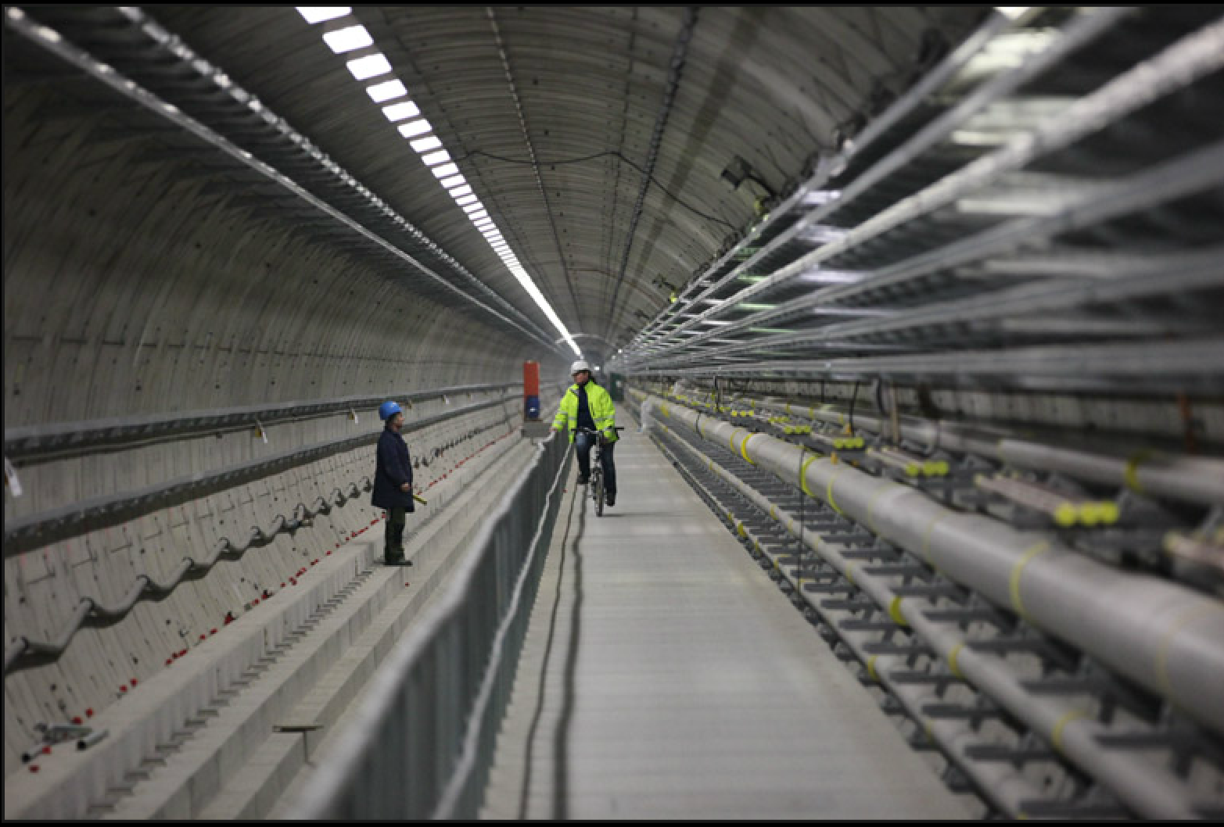
LINAC-Tunnel with infrastructure

Slide 8
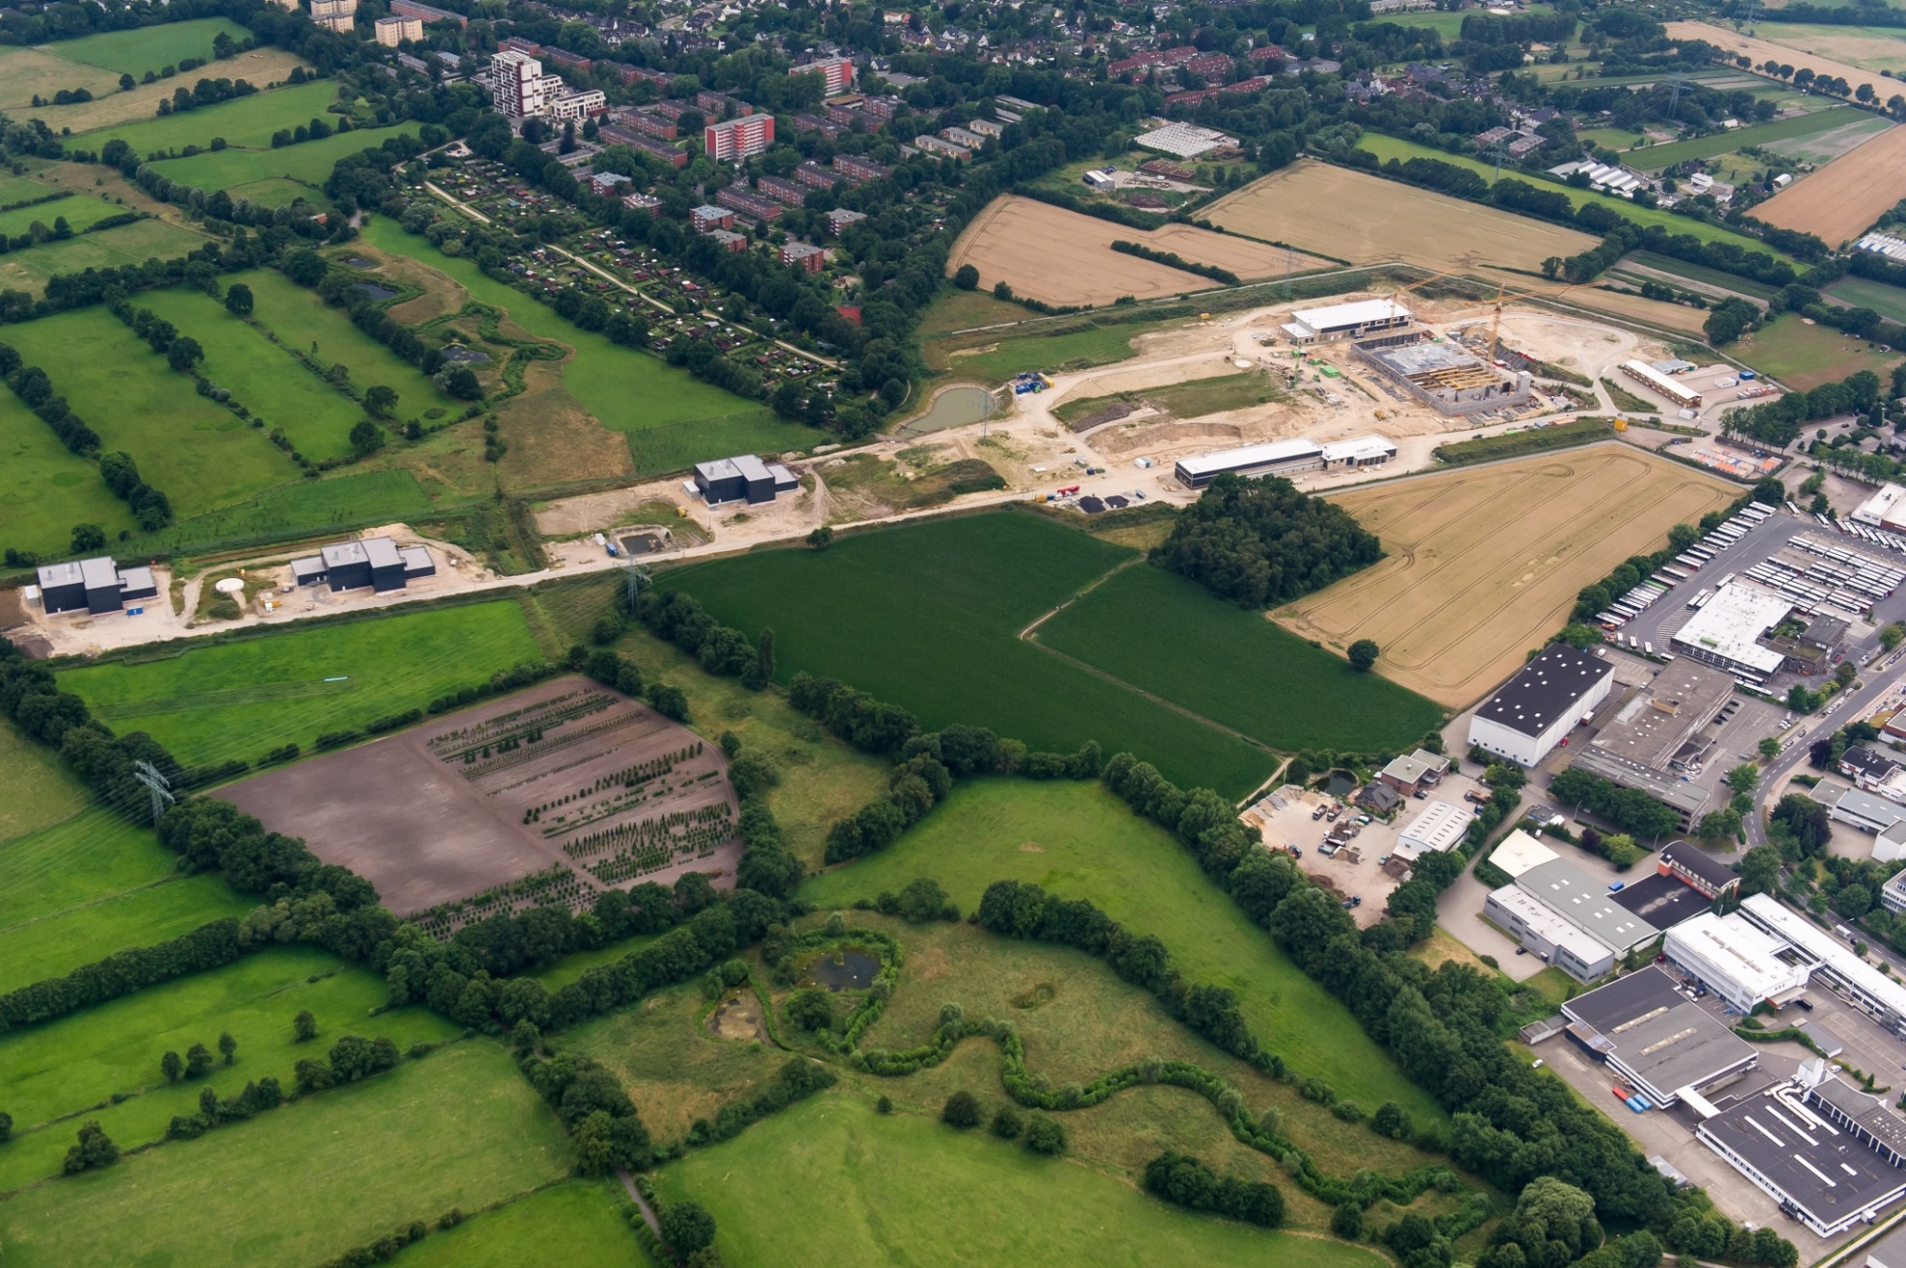
Bird’s eye view of Schenefeld campus, Juli 2014

Slide 9
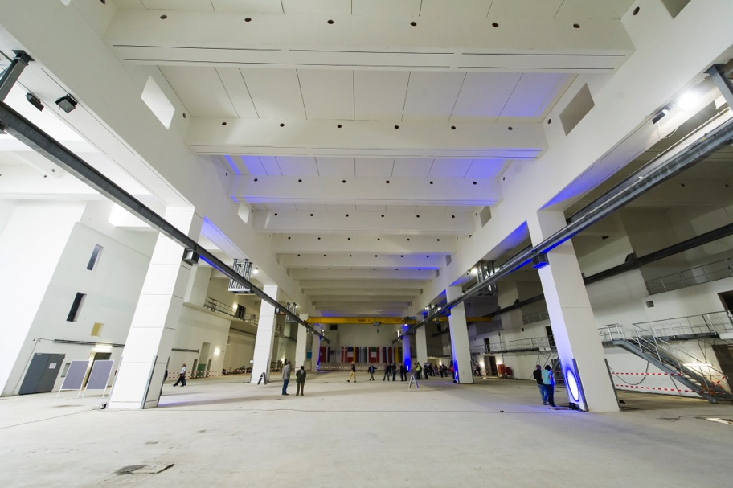
Experiment hall, June 2013
24 April 2013

Slide 10
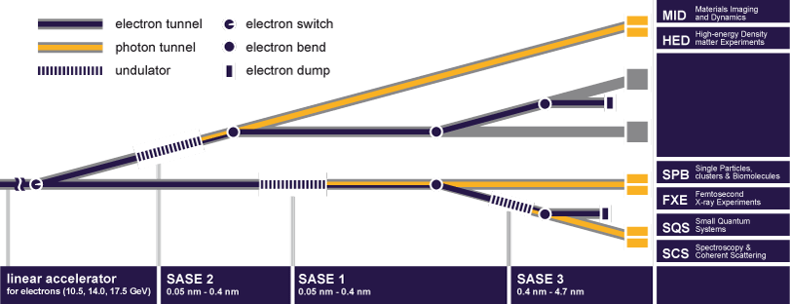
X-ray FEL delivery to 6 science instruments
Provision to add 2 more FEL sources and additional scientific instruments

Slide 11
Lasers for European XFEL user experiments

Slide 12
European XFEL experimental laser plans
Experiment Hall
Types of experimental lasers:
PP (pump-probe):
  sub-15…100fs, 0.2mJ, 10Hz burst, 0…4.5MHz, 800nm
MAL (molecular alignment):
  sub-20fs, 3…10mJ, 10Hz burst, 800nm („kick“)
  or
  1J-class, 10Hz or burst, ns („adiabatic“)
TUNE (tuning, freq. conversion):
  UV…mid-IR, THz
TW (Terawatt):
  <30fs, >1Hz, 100 Terawatt–class laser, Ti:sapphire
SHOCK (high energy):
  100J … kJ-class ns-laser, exponential ramp
PW (Petawatt):
  30fs, 1Hz, Ti:sapphire
MID
HED
SASE 2
TW
PP
TUNE
PP
SHOCK
PW
U1
PP-type
high rep-rate
U2
HE/HI-type
FXE
SPB
SASE 1
PP
MAL
TUNE
PP
MAL
TUNE
SCS
SQS
Baseline
HIBEF User Consortium
SASE 3
PP
MAL
TUNE
PP
MAL
TUNE
Notes:
Before you start editing the slides of your talk change to the Master Slide view:
Menu button “View”, Master, Slide Master:
Edit the following 2 items in the 1st slide:
1) 1st row in the violet header:
Delete the existent text and write the title of your talk into this text field
2) The 2 rows in the footer area: Delete the text and write the information
regarding your talk (same as on the Title Slide) into this text field.
If you want to use more partner logos position them left
beside the DESY logo in the footer area
Close Master View

Slide 13
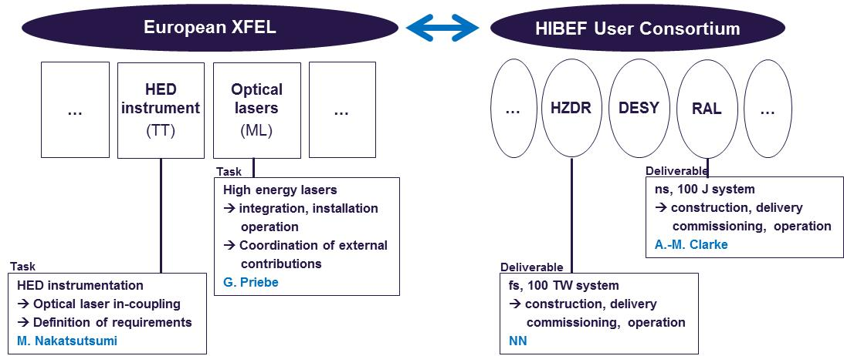
HE / HI – type lasers
Helmholtz international Beam-line for Extreme Fields (HiBEF)
Carsten Baehtz
  HiBEF contributions:
    HI-laser: 100 TW / 10 Hz laser system (industry, Ti:sapphire)
    HE (ramped compression): 100 J / 10 Hz laser system (RAL, DiPOLE 100-X)
    External laser building, chamber, spectrometers, diagnostics, etc.
  XFEL groups:
    Integration effort

Slide 14
Pump-probe laser
European XFEL pulse timing
10Hz electron bunch trains
(with up to 2700 bunches à 0.1…1 nC) => eff. rep-rate: 27kHz
600 μs
t
100 ms
100 ms
100 fs
Photon pulses
Δt = 220 ns
≈ 100 fs
FEL
process
t
t
t
4.5 MHz
Pump-probe laser development goals as set in 2010:
Synchronized few-cycle laser pulses with energy up to the few mJ-level
10 Hz bursts (600µs) with intra-burst rep. rate up to 4.5MHz
    What is the development strategy with highest likelihood for success?

Slide 15
European XFEL pump-probe laser concept: NOPA
sync via fiber
and OBC
x-ray - optical
laser overlap
4.5MHz
1MHz
200kHz
800nm, 0.2 … 3mJ,
4.5 ... 0MHz,
15 … 100 fs
20W @
4.5MHz
AOM
Compressor
super-
continuum
var.
prechirp
NOPA 1
NOPA 2
NOPA 3a
NOPA 3b
XF2
1030nm
Soliton
seeder
Δτ =
0-5ns
burst-mode
all-fiber CPA
front-end
Δτ
ΔΘ
SHG
SHG
SHG
SHG
XF1
control
system
4W @
4.5, 1 or 0.2MHz
Yb-pre-amp
(burst-mode)
Yb-booster 1
(burst-mode)
Yb-booster 2
(burst-mode)
PC
Compressor
sub-ps
1030nm, 4 … 100mJ, 4.5 … 0MHz
sub-ns
400 W
7 kW
20 kW
    Complex (sub-)systems with challenging requirements
    Scientific user facility: ideally combine high flexibility with high up-time
    System aspects: integrated control system, reliability
    No commercial off-the-shelf solutions, high risk, highly customized
    Project constraints (time line, resources, …)
    Multiple installations
A. Dubietis, G. Jonusauskas, and A. Piskarskas, “Powerful femtosecond pulse generation by chirped and stretched pulse parametric amplification in BBO crystal,” Opt. Commun. 88, 437–440 (1992)
G. Cerullo and S. De Silvestri, “Ultrafast optical parametric amplifiers,” Rev. Sci. Instrum. 74, No. 1 (2003)
R. Riedel, A. Stephanides, M. J. Prandolini, B. Gronloh, B. Jungbluth, T. Mans, and F. Tavella “Power scaling of supercontinuum seeded megahertz-repetition rate optical parametric chirped pulse amplifiers,” Opt. Lett, 39, 1422-1424 (2014)
M.J. Lederer, M. Pergament, M. Kellert, and C. Mendez, “Pump–probe laser development for the European X-Ray Free-Electron Laser Facility,“ Paper 8504-20, SPIE Conference on Optics and Photonics 2012, 12–16 August 2012, San Diego, invited talk.

Slide 16
XFEL PP-laser development strategy
    Select technologies and define in- and ex-house efforts (2011)
    Choose SME for long-term and close OEM-type collaboration
        e. g. Laser Impulse GmbH / IDIL, OneFive, Amphos GmbH, Adamietz, Layertec, …
        Two-way know-how transfer
        Influence design solutions
        Participate in development
    Strictly project-focussed approach
        XFEL laser group: 10 Scientists and engineers
        Cover all aspects of project:
          laser development
          industry and intra-project interfacing
          lab-, facility- and operations-planning
          Installation, commissioning, operation, experiment facilitation
PP-Laser specification goals
System level (in)
Ti:Sapphire OPA
NOPA OPCPA
Pump-pulse power amplifier (ex/in)
InnoSlab Cryo-Yag Thin-Disk
Front-end amplifier (ex/in)
Yb-all-fiber Yb-Rod-type fiber Yb-Regen
Seeder front-end amplifier (ex)
Yb-fs-oscillator TiSa
Seeder NOPA (in)
TiSa Super-continuum
Control hard and software (in)
µ-TCA, Beckhoff, Karabo
Pulse on demand (in/ex)
AOM, PC

Slide 17
Example: InnoSlab high power burst-mode amplifiers
    Goal: 20kW burst power, 10Hz (20Hz), 600µs, 0.1…4.5MHz
    SME: Amphos GmbH
SASE 1
first x-ray
2011
2012
2013
2014
2015
2016
2017
Q1 | Q2 | Q3 | Q4 | Q1 | Q2 | Q3 | Q4 | Q1 | Q2 | Q3 | Q4 | Q1 | Q2 | Q3 | Q4 | Q1 | Q2 | Q3 | Q4 | Q1 | Q2 | Q3 | Q4 | Q1 | Q2 | Q3 | Q4
Feasibility
Prototype development
Start of installation at SASE 1
Evaluation and debugging of 20kW booster chain at XFEL laser-lab
Follow-up development with XFEL involvment
Production of 3 systems (5kW)
Production of 3 systems (20kW upgrade)
    Timeline: consistent with facility plans

Slide 18
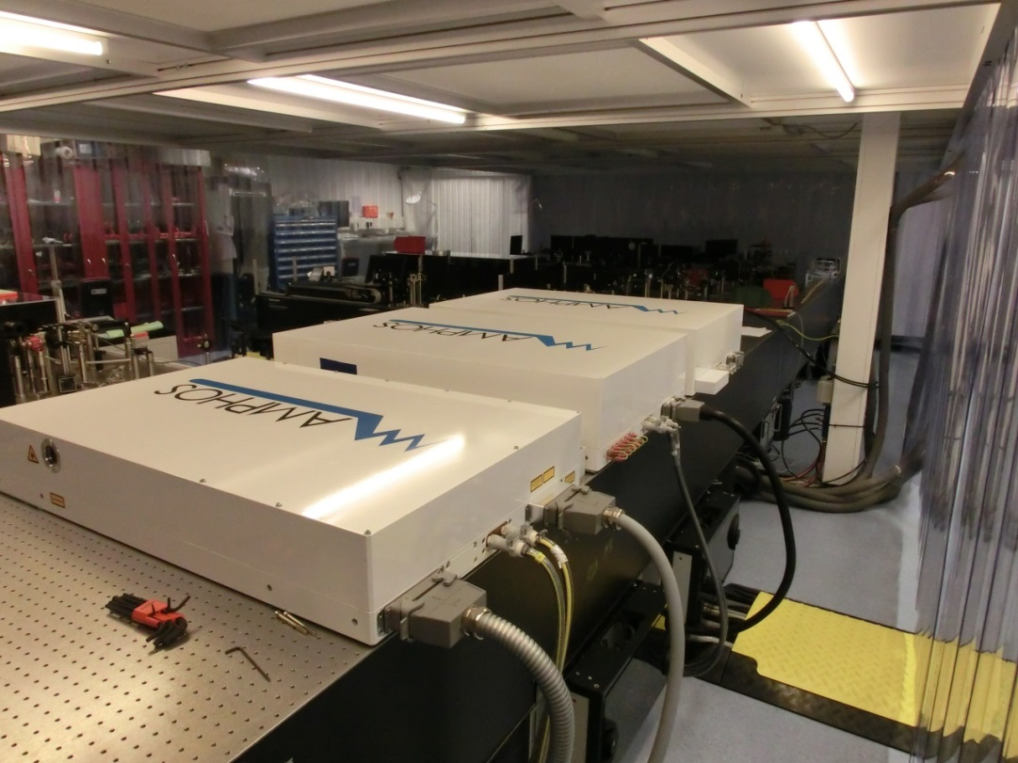
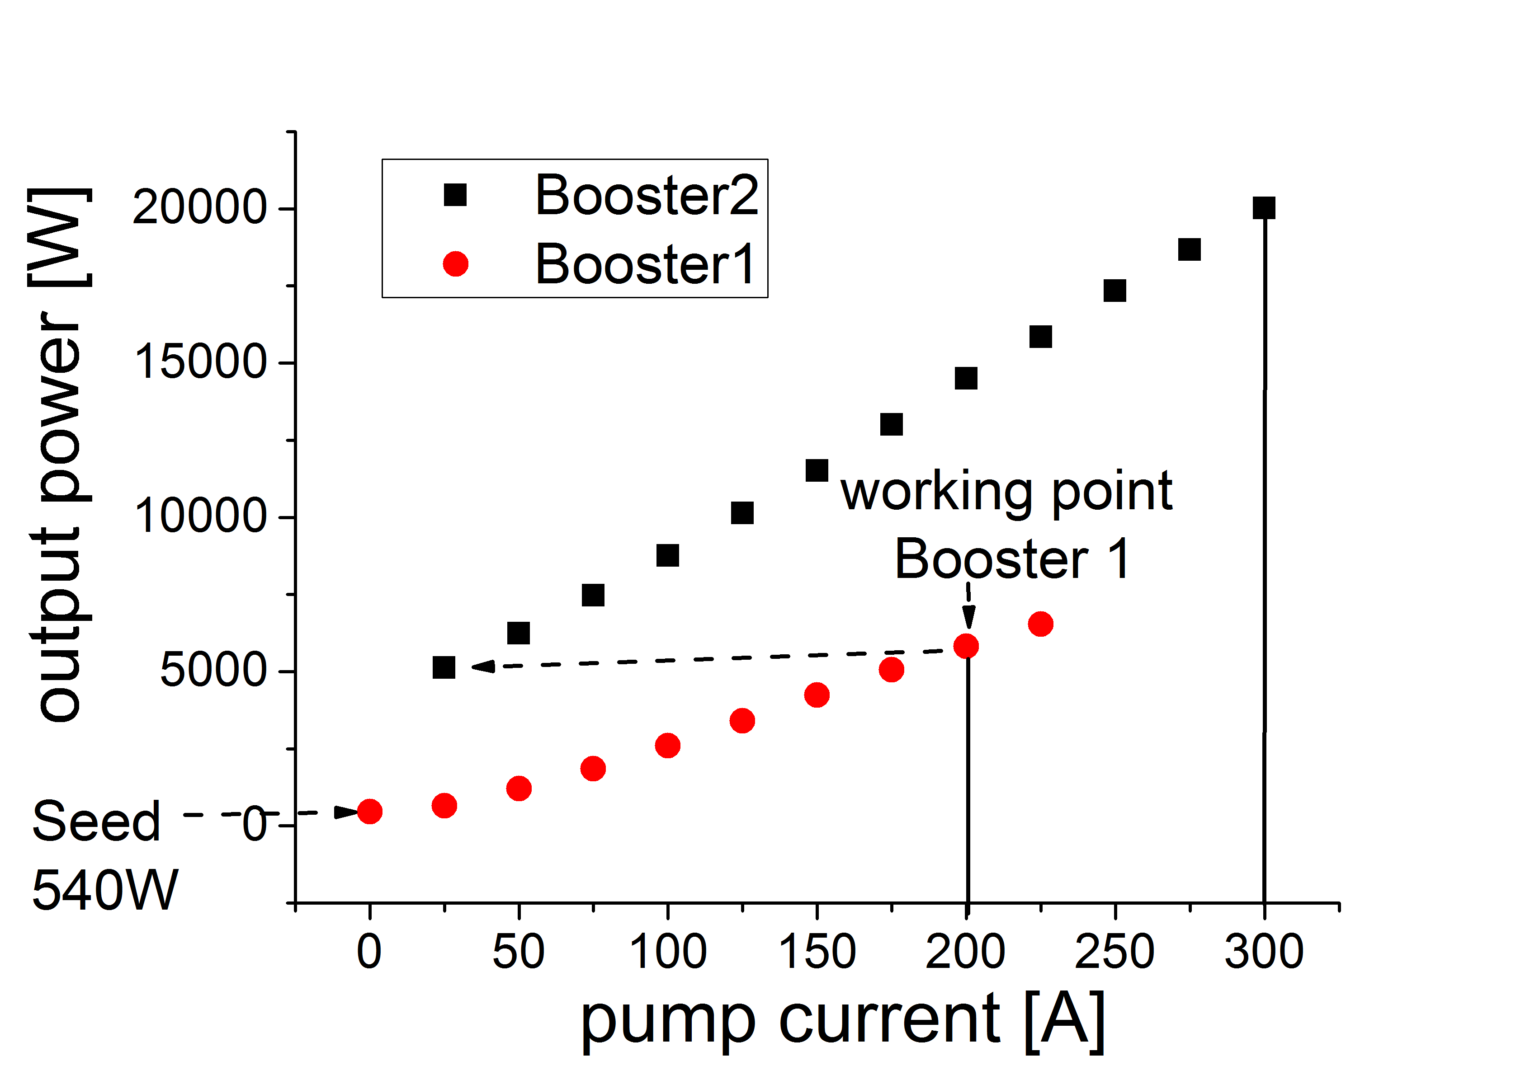
Example: InnoSlab high power burst-mode amplifiers
Measured slope of booster stages 1 and 2
20kW
System installed
20kW (during burst) is reached
Remaining issues: mainly beam quality => require follow-up development.
Mitigation: NOPA experiments continue with 5kW beam from booster 1.

Slide 19
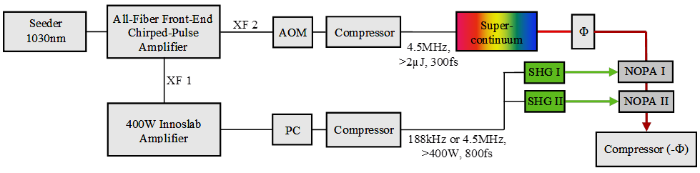

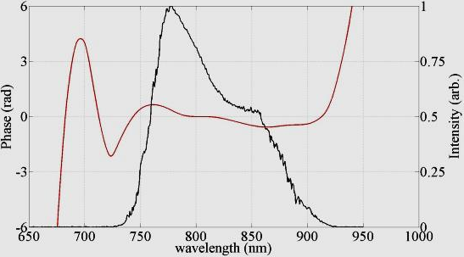
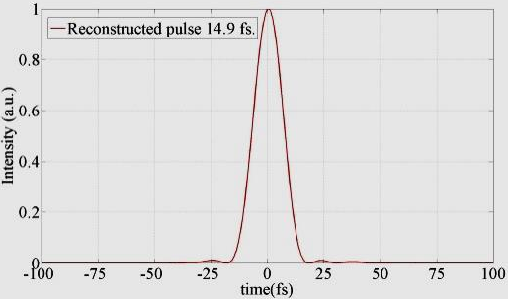
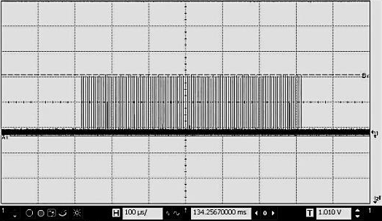
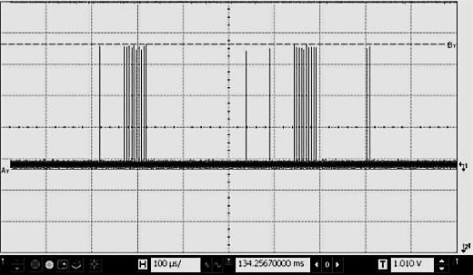
Status of pump-probe laser NOPA R&D
diff. lim.
15fs
600µs burst
Some features:
180µJ per pulse, 34W average power during burst
Nearly transform limited pulses: 15fs … 75fs
100nm tuning for longer pulses
200kHz and 4.5MHz intra-burst operation
Identical performance from BBO and LBO
Arb. sequence
High power burst-mode optical parametric amplifier with arbitrary pulse selection
Optics Express, Vol. 22, Issue 18, pp. 22202-22210 (2014)

Slide 20
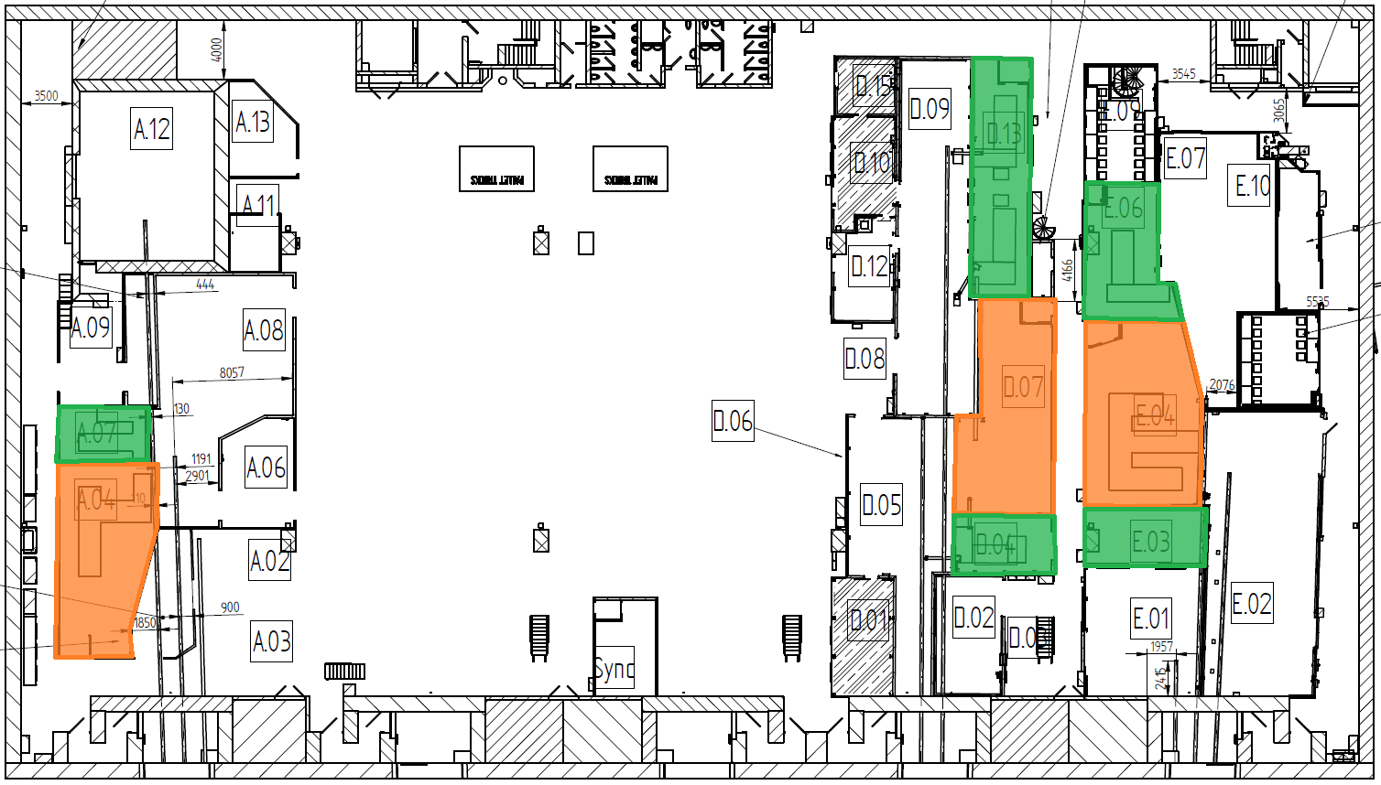
Laser locations in Experimental Hall
SASE 2
SASE 1
SASE 3
PP-Laser
Hutches
Instrument Laser
Hutches

Slide 21
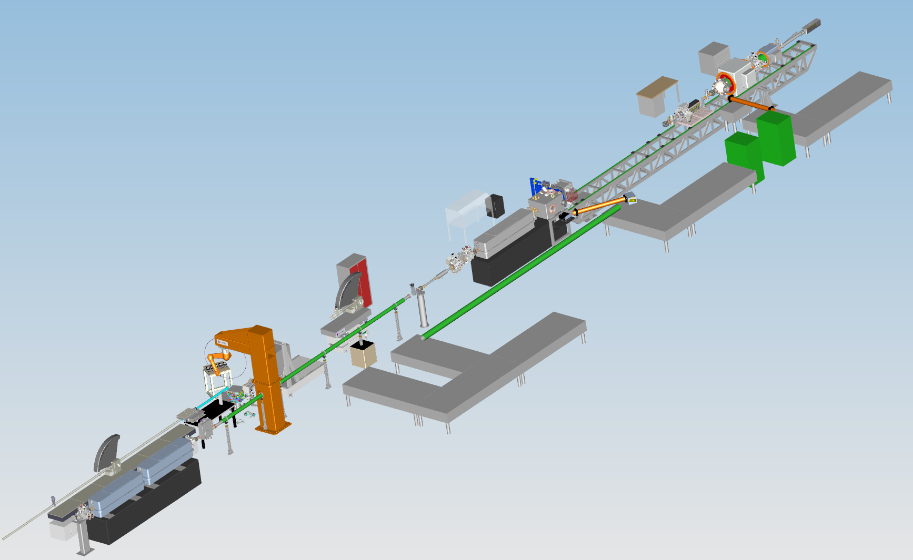

SASE 1: Laser area (PP, FXE, SPB)
SFX instrument
SFX - laser
hutch
SPB instrument
SPB - laser
hutch
FXE instrument
PP - laser
hutch
FXE - laser
hutch

Slide 22
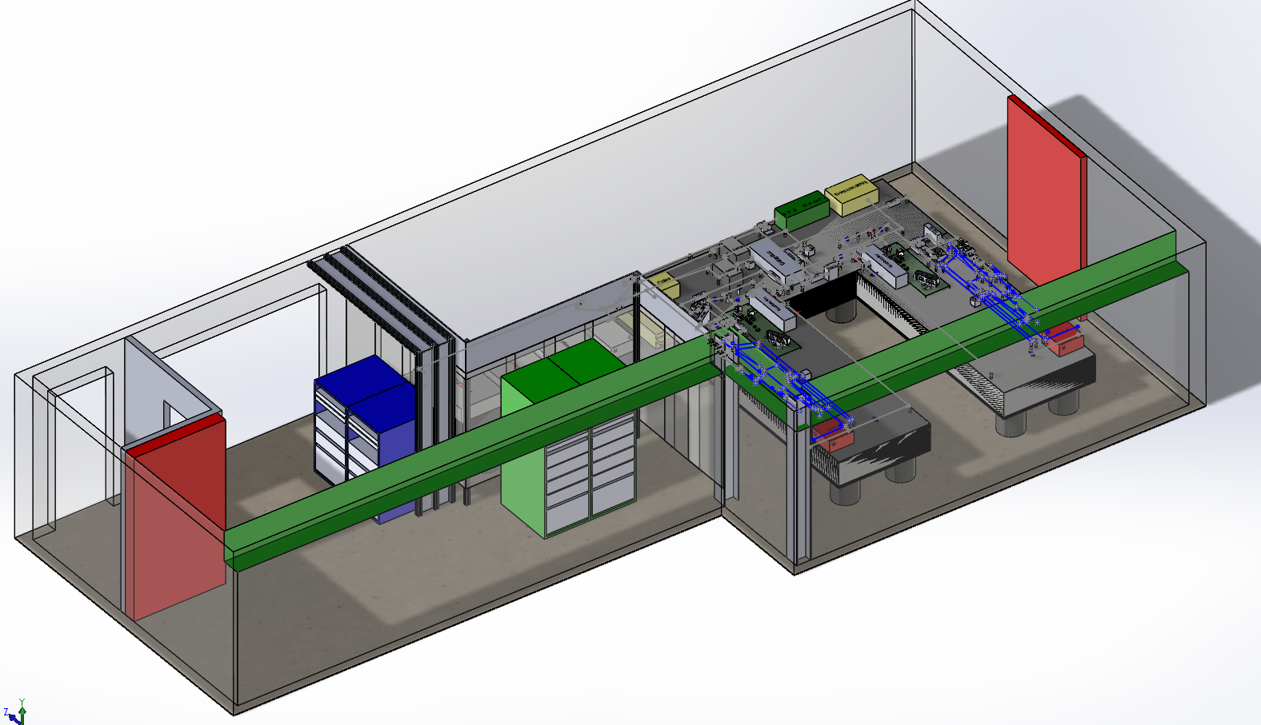
Laser hutch for SASE 1
Different climate zones:
  Air-condition in preparation/rack area (+/- 0.5 K)
  Precision climatisation in laser area (+/- 0.1 K)

Slide 23
Summary I
Start-up of European XFEL is in full swing
  Civil construction completed
  Installation of accelerator started
  First x-rays: end of 2016
  Early users: 2017
  Ramp-up x-ray delivery to ~4.800 hrs per annum
  Dedicated instruments and trained staff support users in complex FEL exp.

Slide 24
Summary II
Lasers for European XFEL user experiments
  Pump-probe laser highly specialized => development at European XFEL
  Strategy: mixed in- and ex-house developments, involving suitable SMEs and OEM-style collaborations
  Development and installation schedule in agreement with current facility plans
  HE/HI lasers planned to be contributed by user consortium „HIBEF“
    Laser group to coordinate integration into HED-instrument
    RAL: DiPOLE 100-X (10Hz, 100J, ns-laser for ramped compression)
    Industry: 100TW, 10Hz, Ti:sapphire

Slide 25
Thank you!!

