Slide 1
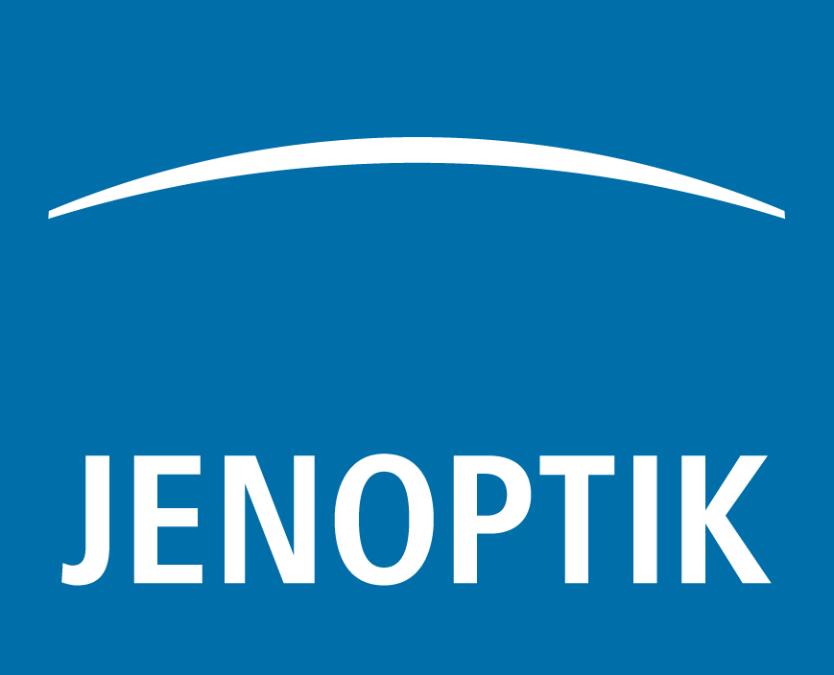
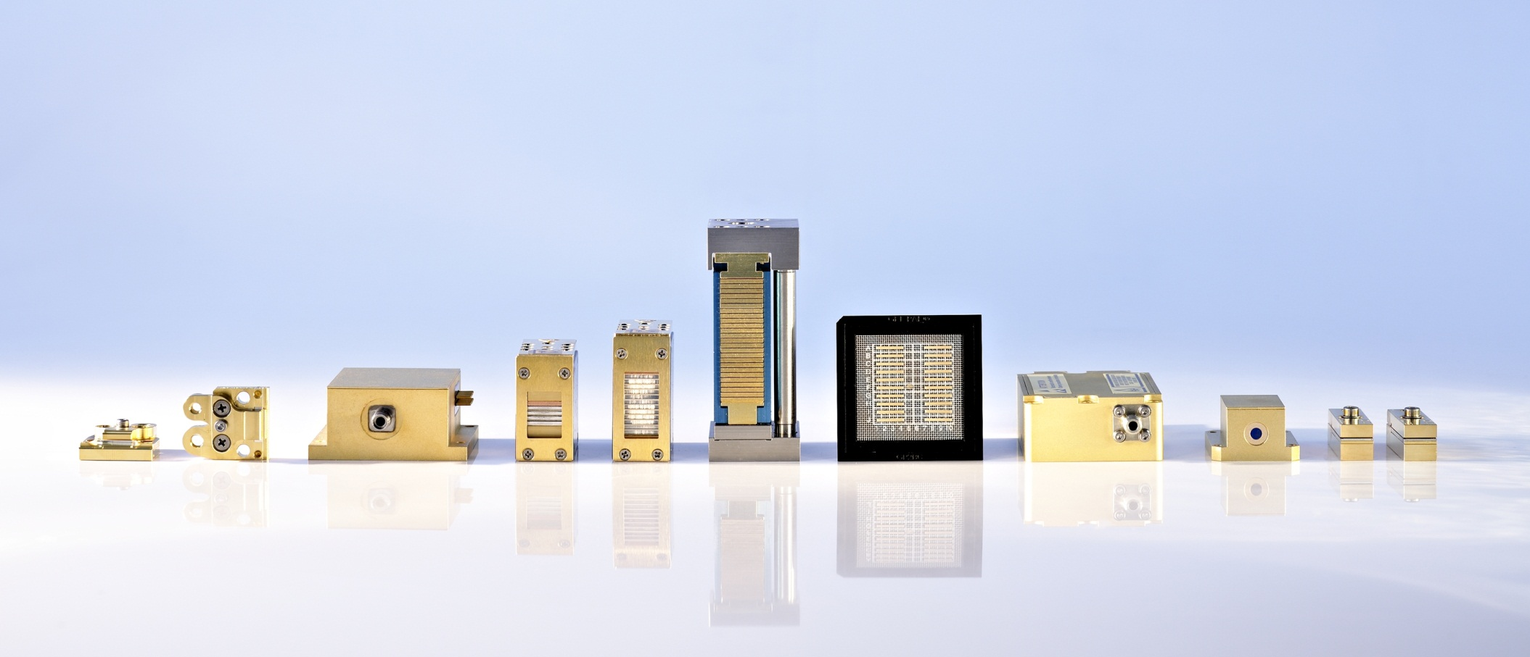

Laboratory performance and industrial quality:
Pump diodes for High-Energy Lasers
Speaker Martin Wölz

Slide 2
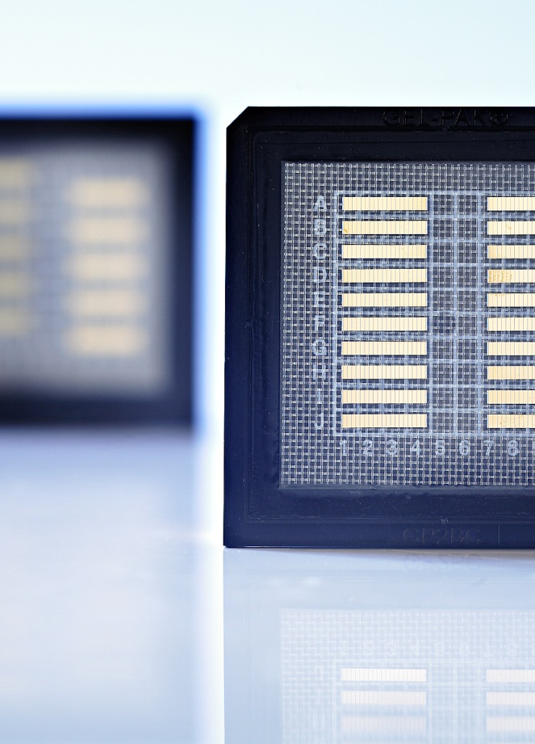
Outline
JENOPTIK AG
Research-to-industry transfer: Diode Lab GmbH
Laser diodes for HEC-DPSSL
Laser diode stacks
Outlook: mass production

Slide 3
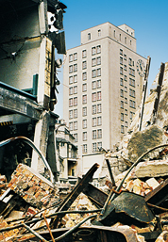
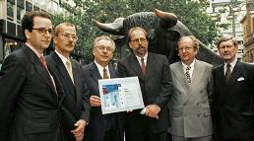
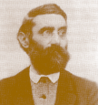
JENOPTIK AG
History
Carl Zeiss Jena GmbH
gives rise to the creation
of Jenoptik GmbH.
  17,000 employees are dismissed
  Demolition, renovation
  and development of
  former Zeiss
  production sites
1846/1866
1945 - 1948
1991
1996/1998
Carl Zeiss University mechanic and entrepreneur; founded the workshop for precision mechanics and optics in Jena in 1846
Ernst Abbe
Innovator and reformer; in 1867 scientific director of and in 1875 partner in the Zeiss workshop
1945/46: Transfer of patents and dismantling of parts of the company
by the U.S. and Soviet armies.
1946: A new Zeiss Company is founded in Oberkochen.
The Zeiss plant in Jena, East Germany, is converted into state property.
In 1996
Jenoptik GmbH was
converted into a joint
stock corporation.
Going public: June 16, 1998
Notes:
3

Slide 4
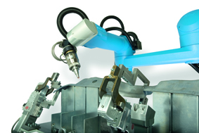
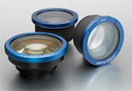
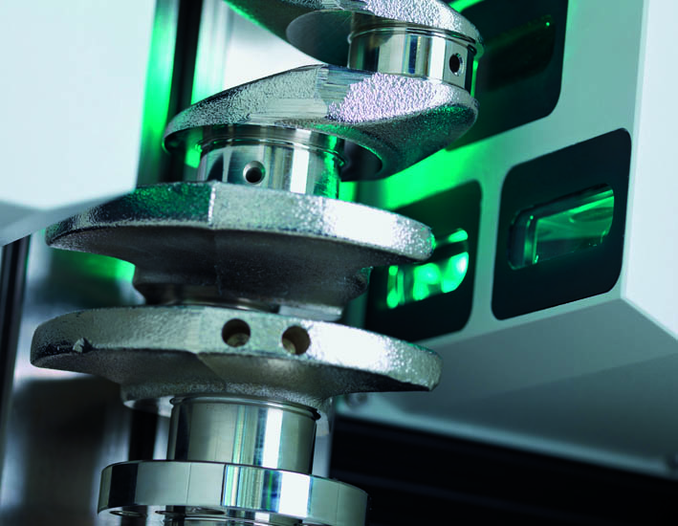
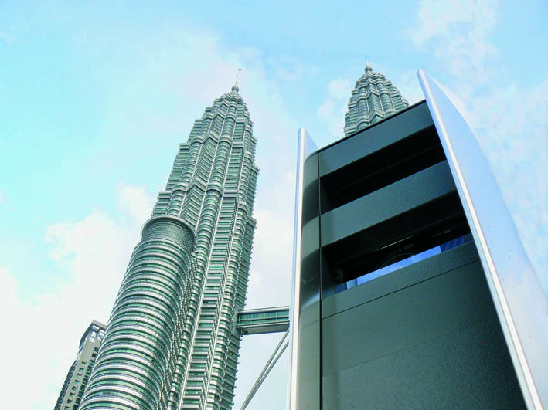
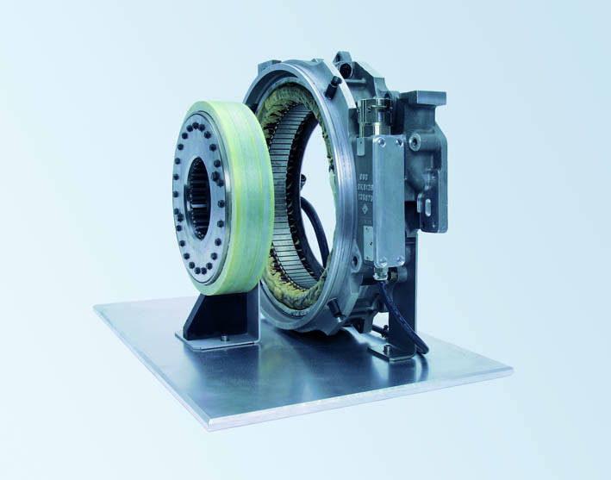
JENOPTIK AG
Divisions and Business Units
Corporate Center
Corporate Center
Lasers & Material
Processing
Optical
Systems
Industrial
Metrology
Traffic
Solutions
Defense &
Civil Systems
Key Figures 2013
Lasers
Laser
Processing
Systems
Optics
Micro Optics
Optoelectronic
Systems
Roughness
and contour
measurement
Form
measurement
Dimensional
measurement
Equipment
Service
Providing
Mechatronics
Sensor Systems
 | Sales (M€) | EBIT (M€) | Employees
Jenoptik Group | 600.3 | 52.7 | 3433
Lasers & Optical Systems | 224.7 | 24.6 | 1391

Slide 5

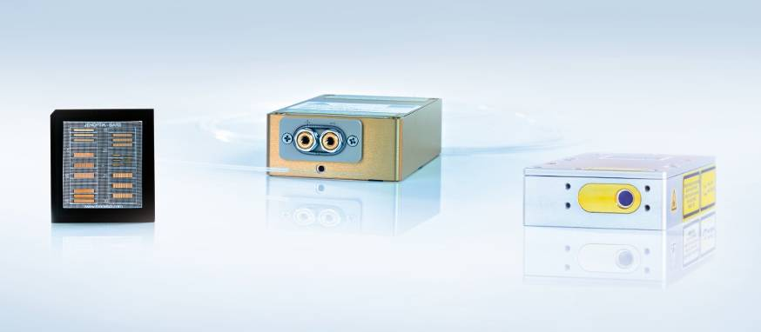
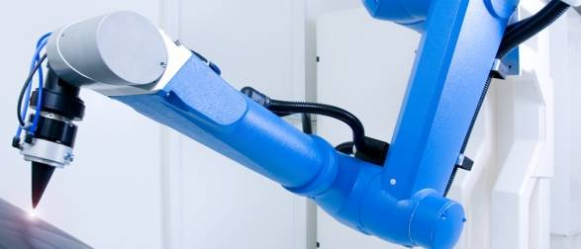
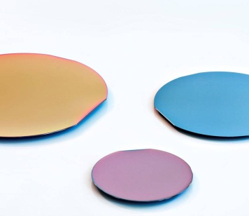
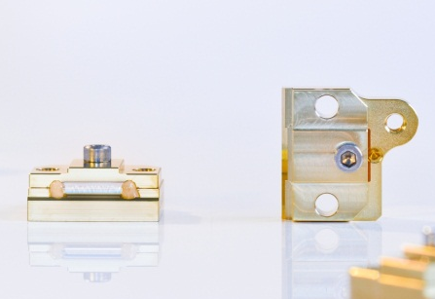
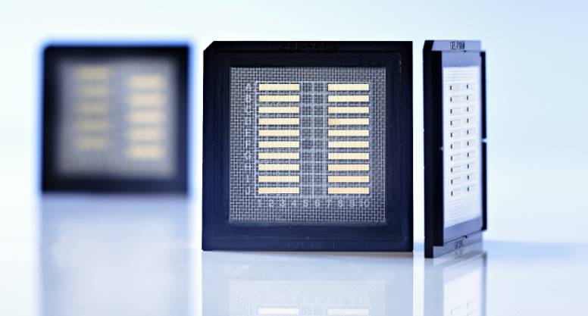
JENOPTIK Division: Lasers & Material Processing
Business Unit: Lasers
Lasers
Laser Processing Systems
Epitaxy
Processing
Mounting
JENOPTIK Diode Lab GmbH
Berlin
Notes:
5

Slide 6
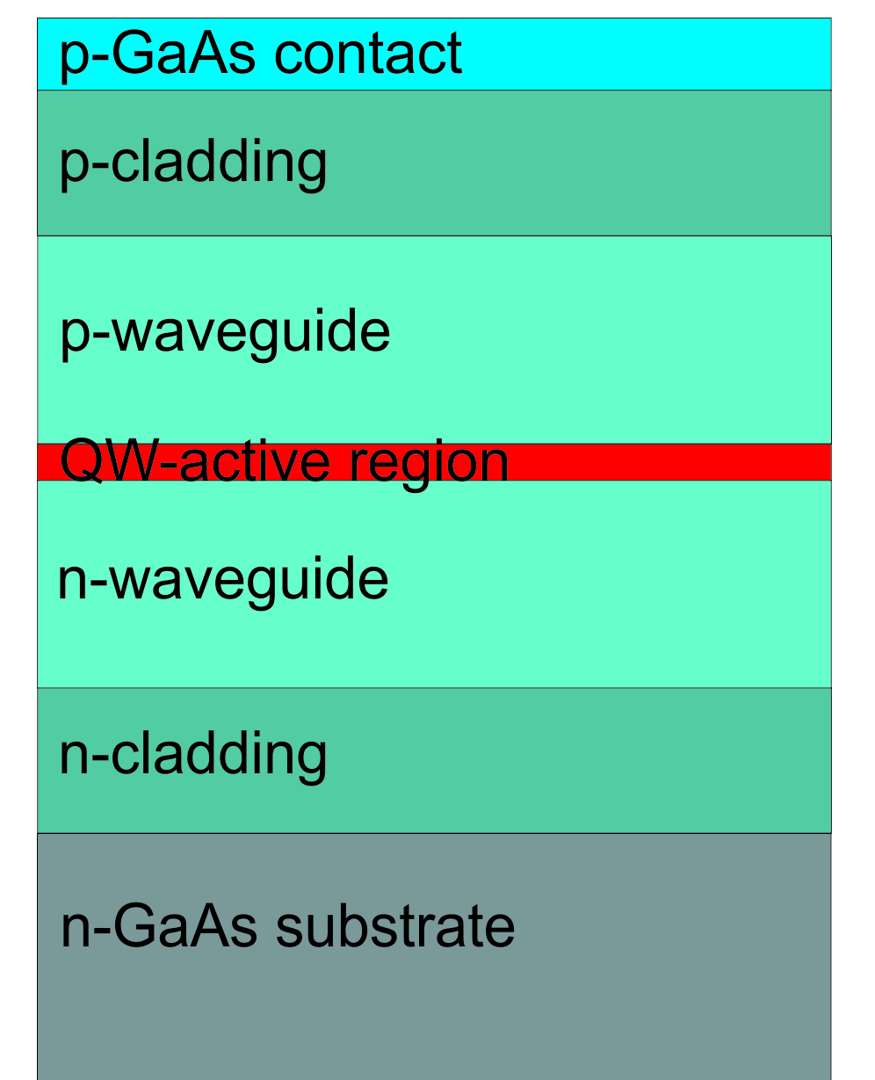
Introduction
Semiconductor laser diode bar
Diode laser
fill factor = emitter width / pitch
Notes:
1) beam divergence:
slow axis – lateral / fast axis – vertical
2) fill factor
Herstellung:
Großserienproduktion
Methoden und Geräten der Siliziumtechnologie (Speicher- und Prozessorproduktion)
Hoher Automatisierungsgrad
Geringer Personalaufwand
Hoher F&E Aufwand
Umfangreiches technologisches „Know-How“ notwendig
Hochtechnologie - Produkt

Slide 7
Outline
JENOPTIK AG
Research-to-industry transfer:
JENOPTIK Diode Lab GmbH
Laser diodes for HEC-DPSSL
Laser diode stacks
Outlook: mass production

Slide 8

Research-to-industry transfer
JENOPTIK Diode Lab GmbH
1997 Joint diode laser development
2002 Formation of JENOPTIK Diode Lab GmbH
- transfer research results into production
- employees from FBH join new company
- FBH shares clean-room facilities
2004 8 types of high-power diode lasers qualified for production
decision to build independent production facility
2006 20 employees
2007 Start of production
2009 Acquisition of TES AG epitaxial services
2014 47 employees
JENOPTIK Laserdiode GmbH
experienced in LD packaging,
test and qualification
leader in laser diode development
Public projects
BRIMO
HEMILAS
Recruiting
Development contracting
Notes:
aus Vortrag 12.1.2010
Zusammenarbeit FBH – JENOPTIK AG seit 1997
Ferdinand-Braun-Institut: Dem weltweit führenden Institut auf dem Gebiet der Laserdioden – Entwicklung
JO Laserdiode GmbH: Eine Firma mit exzellenter Erfahrung in der Montage, Test und Qualifikation von Hochleistungs-Laserdioden
Ergebnis: Entwicklungsmuster mit hervorragenden Eigenschaften
2002: Entscheidung der JENOPTIK AG zur Gründung einer eigenen Firma:
Ziel: Weiterentwicklung der Forschungsmuster zu Produkten
Februar 2002: Gründung der JENOPTIK Diode Lab GmbH
Von 2002 bis 2004: Produktentwicklung
Enge Zusammenarbeit mit FBH und der JENOPTIK Laserdiode GmbH
Nutzung des Reinraum und der technologischen Ausrüstung des FBH in 2 Schichten
Mit unseren eigenen Mitarbeitern (aus Industrie und FBH)
Mit unserem eigenen technologischen Equipment für kritische Prozess-Schritte
Erfolgreicher Abschluss der Produktentwicklung und Qualifizierung von 8 verschiedenen Typen von Hochleistungs- Laserdioden
2004 Entscheidung zum Aufbau einer eigenen Fertigungsstätte
2005 Entscheidung zur Standortwahl zu Gunsten des WISTA-Standortes
2007 Fertigungsaufnahme in neuer Fertigungsstätte
2009 Kauf und Integration des Zulieferers TES AG

Slide 9
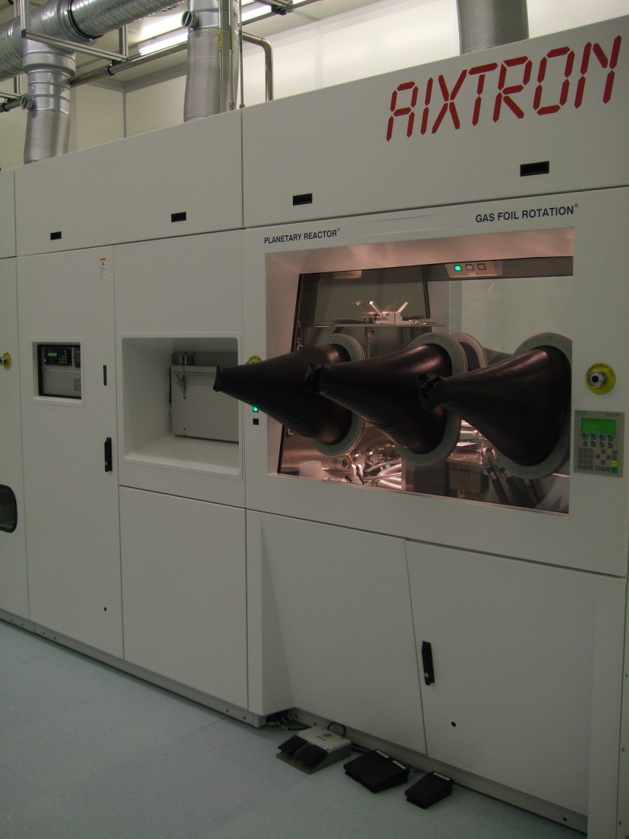
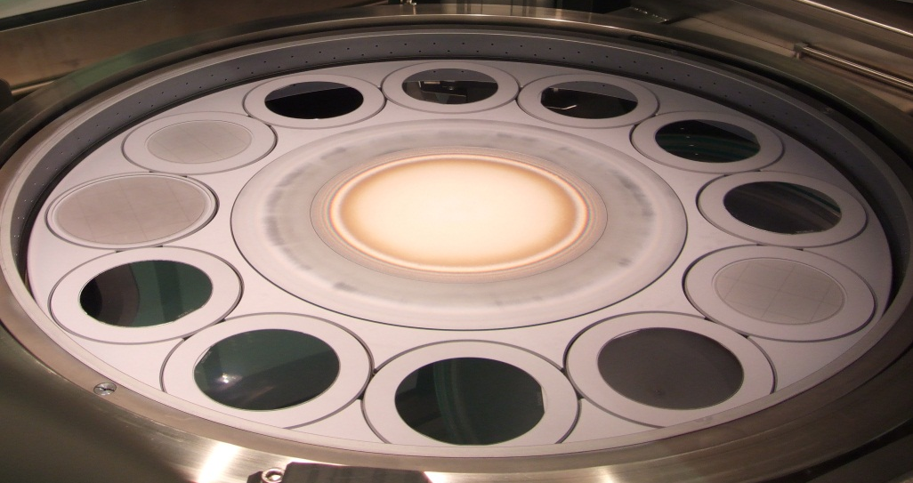
Epitaxy Capabilities at JDL
    Two multiwafer planetary reactors
        12 x 3" or 4"
        8 x 3" or 4"
    Layer characterisation:
    HRXRD, C-V profiling, EL, PL, SEM, (SIMS)
    Foundry services
    Certified to ISO 9001:2008
9

Slide 10
Reproducibility
Electro-optical characteristics
wafer-to-wafer wavelength reproducibility: better than 1 nm

Slide 11
Reproducibility
Electro-optical characteristics
808 nm, 50% FF, 1.5 mm
Stability over 2.5 years : σ slope ± 1 % σ I_{th} ± 3 %
M. Zorn et al., Proc of SPIE 7918-27 (2011)

Slide 12
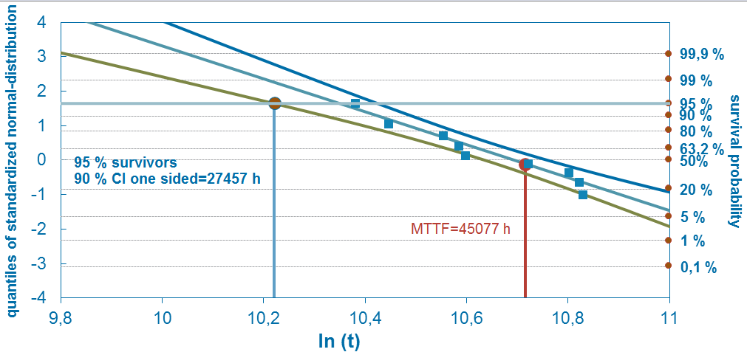
Reproducibility
Reliability
808nm, 50%, 2mm
27000 h min. lifetime (95% of devices degrade less than 20%)
45000 h MTTF
20% degradation limit

Slide 13
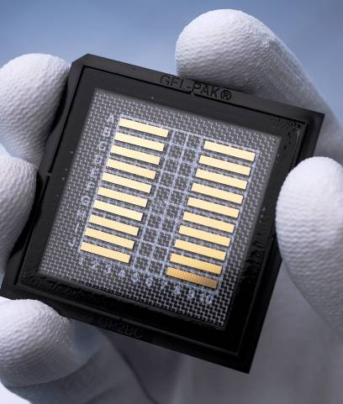
Jenoptik Diode Lab GmbH (JDL)
Semiconductors: Laser Bars & Single Emitters
Laser epitaxial structure design
InGaAlAsP / GaAs-Epitaxy (MOVPE)
GaAs-process line
Facet-Coating process
Single Emitter (SE) and Laser Bar
Wavelength: 760 nm – 1060 nm
Power range
- Single emitter CW: 12 W
- Bar CW: 200 W
- Bar QCW: 500 W
(QCW = Quasi Continuous Wave,
pulsed operation)
Bare bar sale
laser diode bars
Notes:
13

Slide 14
Outline
JENOPTIK AG
Research-to-industry transfer: Diode Lab GmbH
Laser diodes for HEC-DPSSL
Laser diode stacks
Outlook: mass production

Slide 15
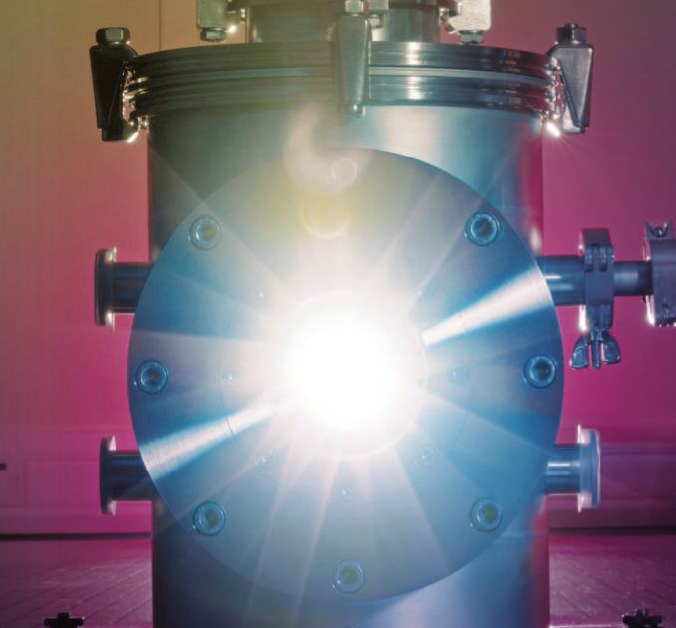
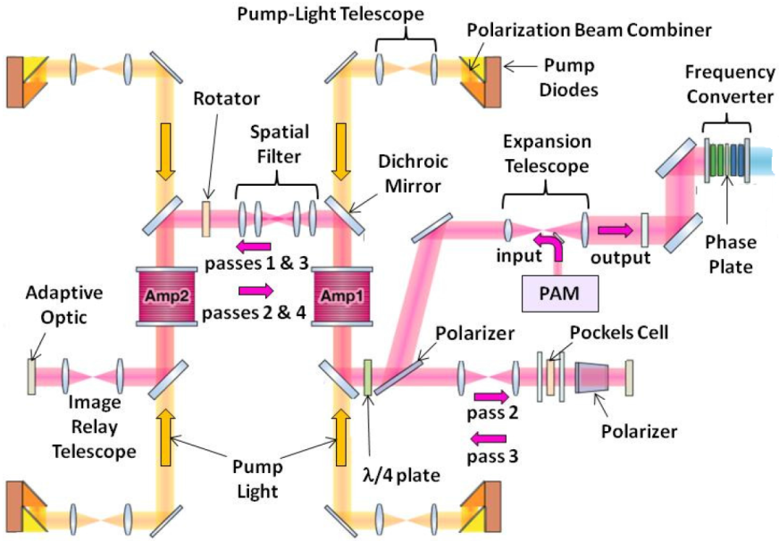
What can we do for high energy class lasers?
  Mason et al., 7th HEC-DPSSL Workshop (2012)
  Mercury design
  10 J, 10 Hz: DiPOLE prototype
    Yb:YAG 200K, 940nm, 1.2ms QCW
    40 kW pulse power from 192 bars
  100 J …
  Erlandson et al., Opt. Mater. Express 1, 1341 (2011)
  LIFE pump architecture
    200 J, 10 Hz: ELI Beamlines L3
    Nd:glass RT, 880 nm, 300µs QCW
    3.2 MW pulse power, ca. 10.000 bars
Increase the power density of QCW bars !
Notes:
from HEC-DPSSL 2014
Today you have heard news about two projects than relied initially on laser bars from Jenoptik Diode Lab:
1) this morning Marco Hornung: POLARIS status (aktive 25er Stacks)
2) after lunch Klaus Ertel: DiPOLE status (passive 8er Stacks)

Slide 16
JDL New generation QCW bars
Reducing semiconductor “cost per Watt”
New chip generation (NG)
vertical design
Targets
  increased P_{op} per chip area
  decreased “cost per Watt”
Vertical structure (epitaxy)
designed by FBH:
Pietrzak et al., Proc. of SPIE 896528 (2014)
  better carrier confinement
  → high internal efficiency η_{i}
  → higher P_{op}
  thick waveguide
  → narrow fast axis divergence

Slide 17

New generation quasi-CW 880 nm Bars (II)
Better efficiency → reduced “cost / Watt”
phenomenological model (char. Temp.)
Erbert et al., Top. Appl. Phys. 78, Springer (2000)
input parameters T₀, T₁
$$I_{thres}∝e^{ΔT/T_{0}}$$
$$η_{diff}∝e^{ΔT/T_{1}}$$
Notes:
P_{op} ↗, L(η_{max}) ↗

Slide 18

New generation quasi-CW 880 nm Bars (II)
Better efficiency → reduced “cost / Watt”
recall phenomenological model based on char. Temp.
input parameters T₀, T₁
new generation (NG) structure has efficiency maximum for smaller chip
$$I_{thres}∝e^{ΔT/T_{0}}$$
$$η_{diff}∝e^{ΔT/T_{1}}$$

Slide 19
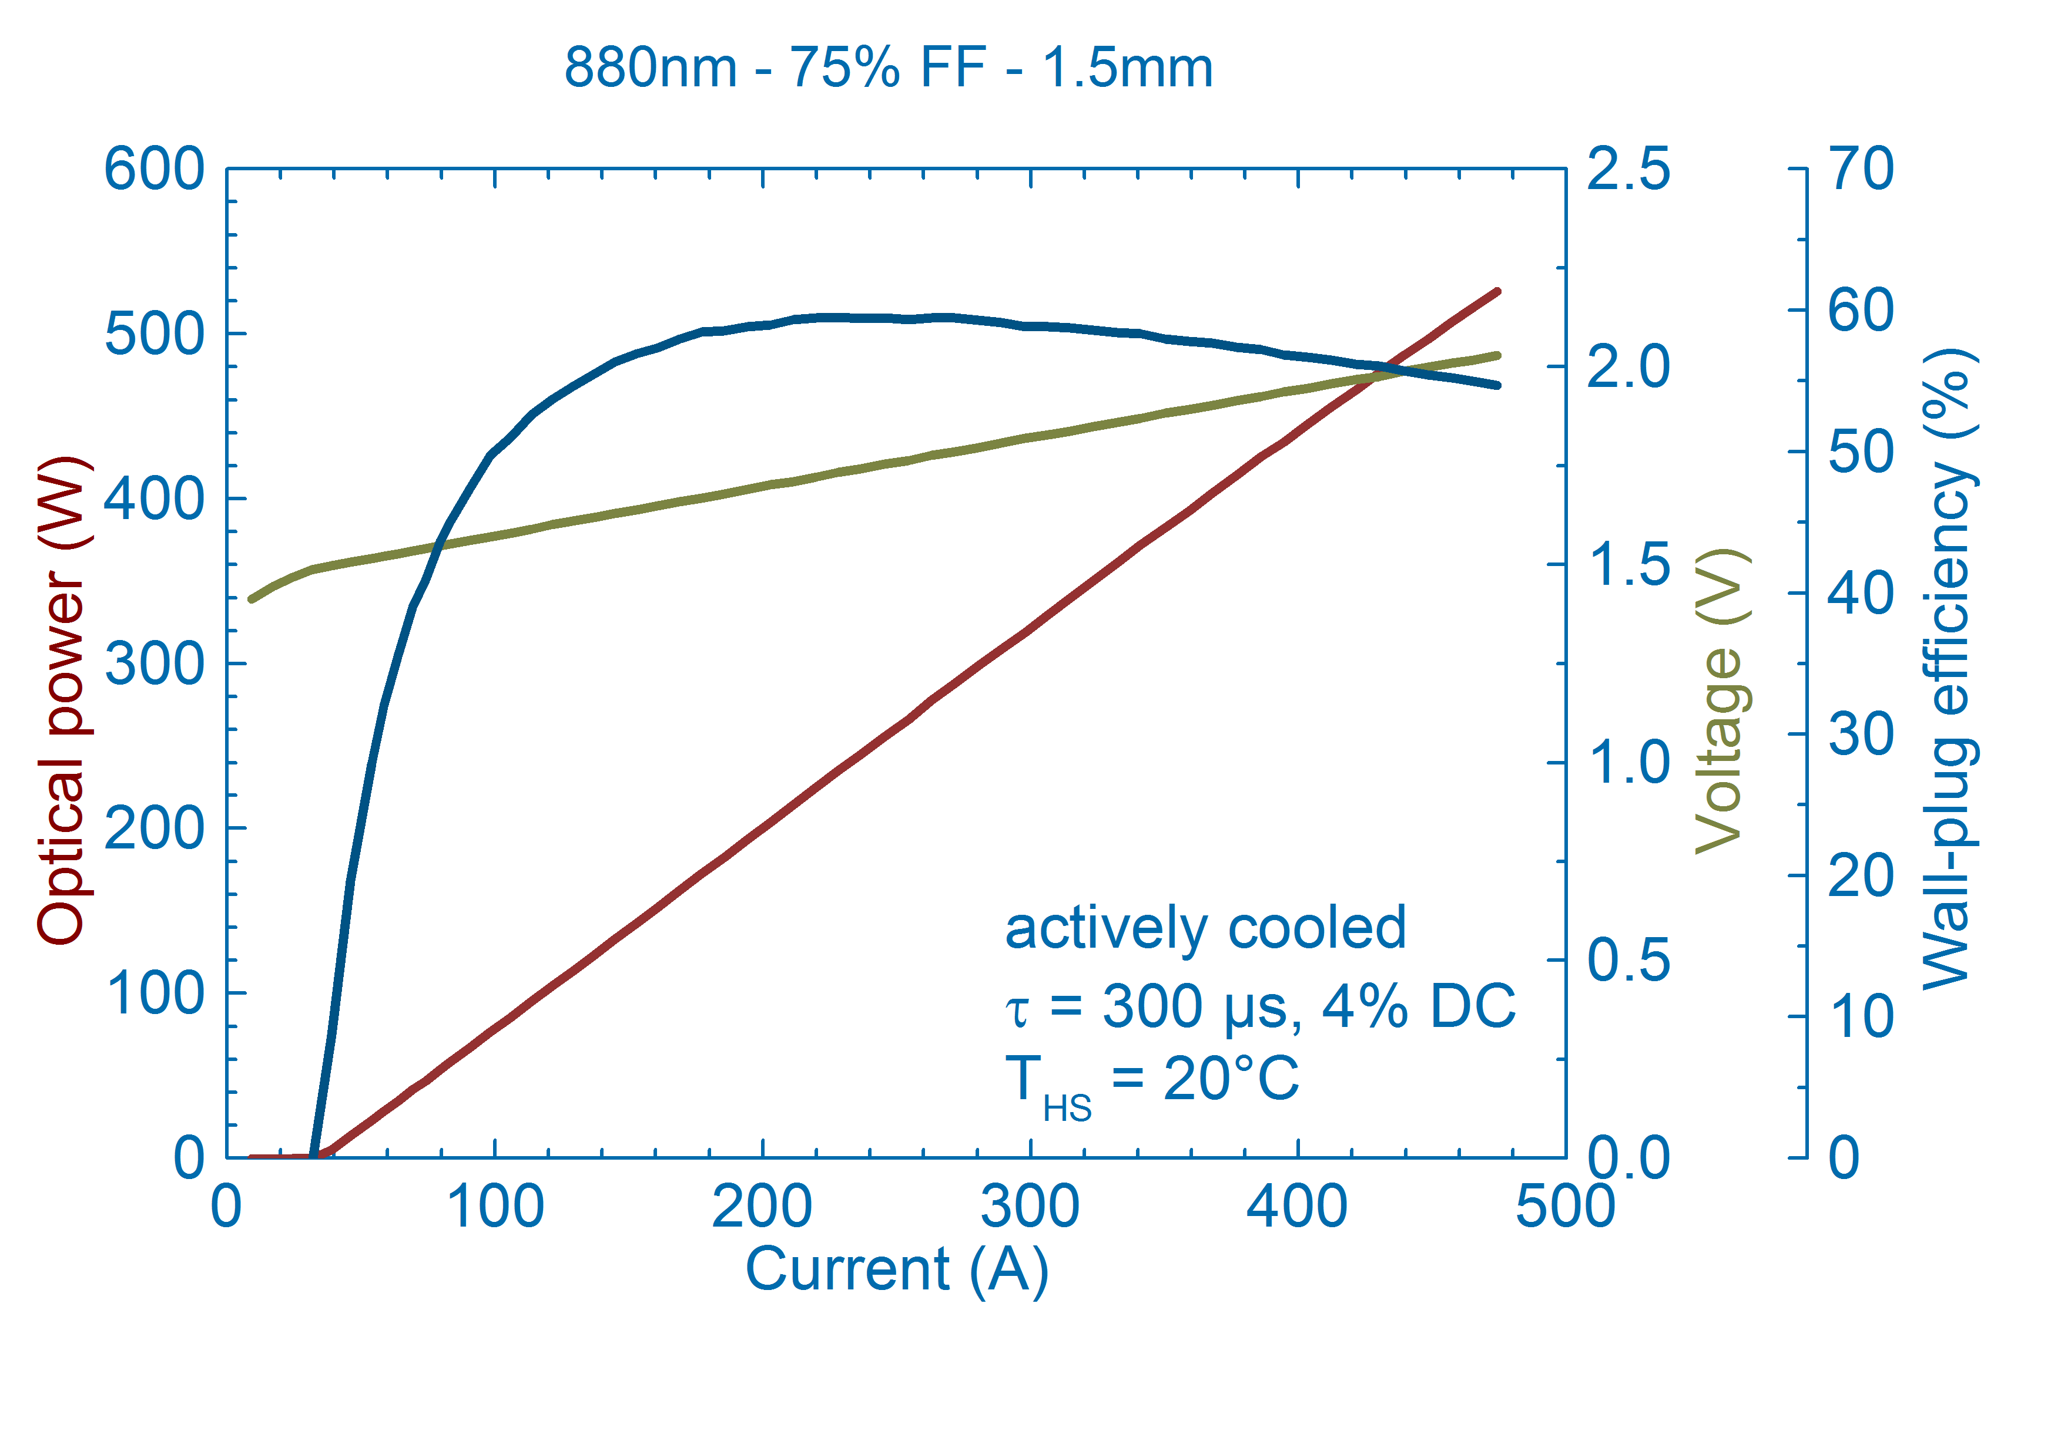
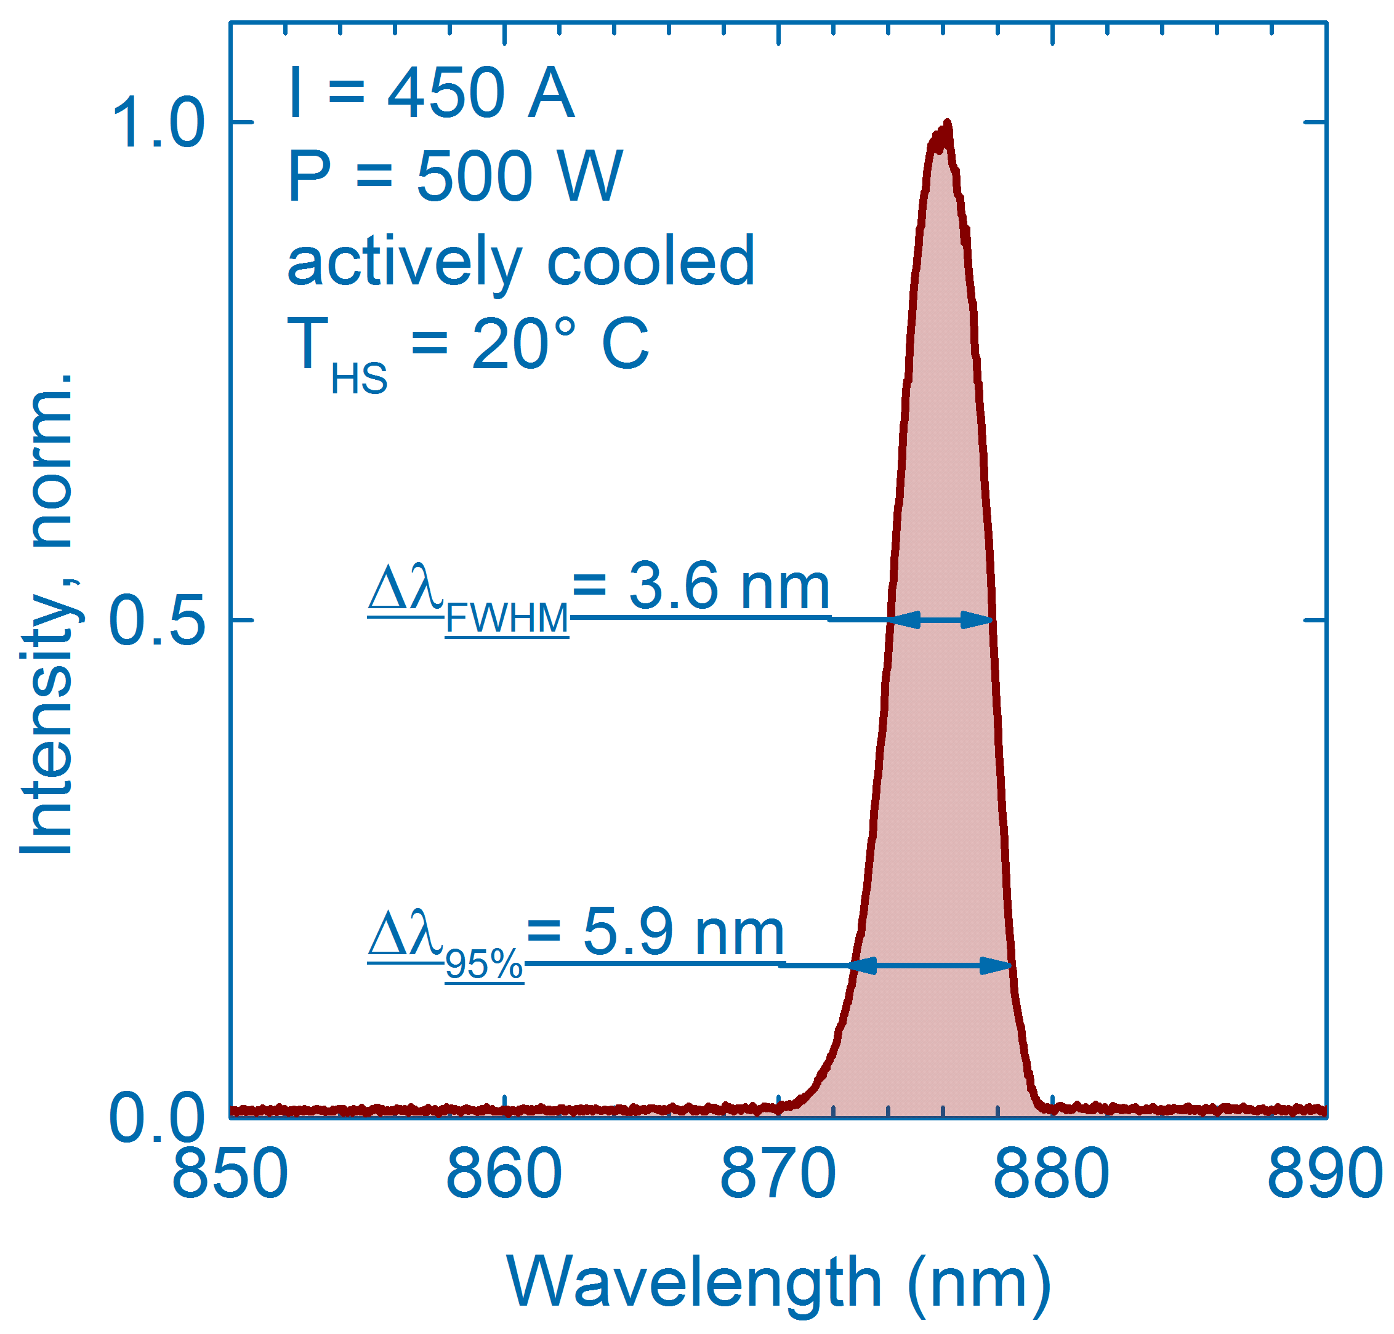
New generation quasi-CW 880 nm Bars (III)
Power-voltage-current characteristic
P_{op} = 500 W
I_{op} = 450 A
S_{op} = 1.21→1.17 W/A
WPE_{max} = 59.5%
WPE_{op} = 55%
75% FF, L=1.5 mm (37 Emitters, W = 190 µm)
JDL-BAB-75-37-880-TE-500-1.5

Slide 20
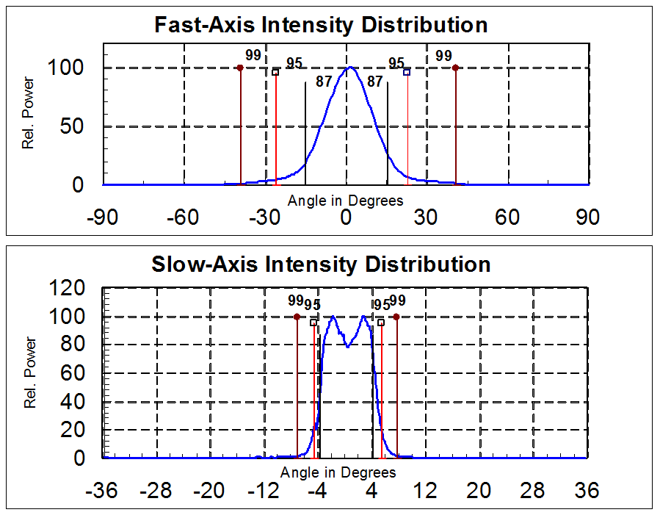
New generation quasi-CW 880 nm Bars (IV)
Far-field profiles
Measured at:
I= 400A (300µs, 10ms, T=25°C)
Fast axis:
θ_{FWHM} = 20.5°
θ_{95%} = 47.0°
Slow axis:
θ_{FWHM} = 8.3°
θ_{95%} = 10.0°

Slide 21
New generation quasi-CW 880 nm Bars (V)
Lifetime test
device under test: JDL-BAB-75-37-880-TE-500-1.5 on microchannel cooler
conditions: 485A, 300µs, 100Hz (3% d.c.), 25°C
0.8 Gshots as of Oct, 2014, ongoing

Slide 22
Outline
JENOPTIK AG
Research-to-industry transfer: Diode Lab GmbH
Laser diodes for HEC-DPSSL
Laser diode stacks
Outlook: mass production

Slide 23

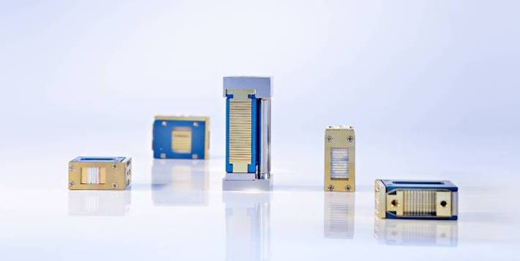
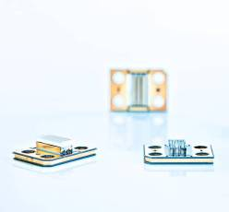

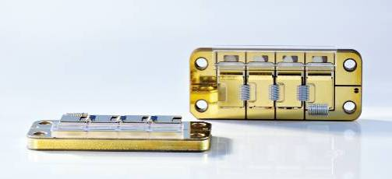
Diode Laser Stacks
Features
  Used in direct applications, laser pumping, medical and research applications
  4 to 25 laser bars vertical
  2 to 4 bars horizontal
  cw power per bar:
  50 – 80 W l 808 nm
  50 – 120 W l 9xx nm
  qcw power per bar:
  100 – 300 W l 808 & 9xx nm
  Capacity: thousands p.a.
Vertical Diode Laser Stacks
qcw Stacks
Horizontal Diode Laser Stacks
Notes:
23
23

Slide 24

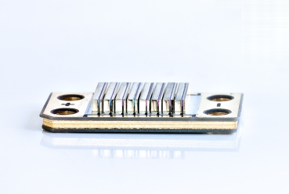

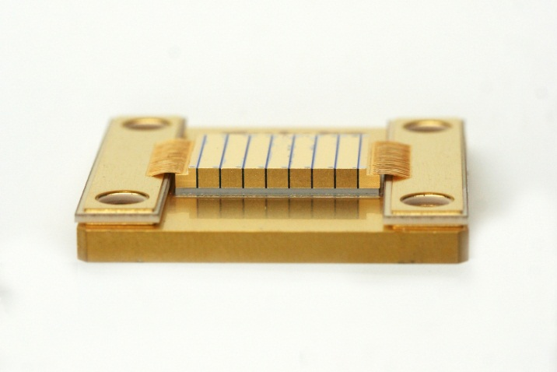
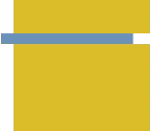

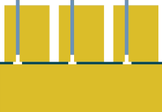
Passively cooled QCW laser diode stacks
QCW, quasi continuous wave, pulsed operation, t ≈ ms
Semiconductor laser in stationary operation
Low duty cycle → thermal equilibrium not reached → high pulse power
JenLas® QCW
Catalog product
Lab demonstrator
CTE-matched
New cost-efficient mounting technology
Flexible arrangement of laser emitters

Slide 25
Passively cooled laser diode stacks for pulsed operation
880 nm QCW bars
8 x in series
next generation
JenLas® QCW stack technology
t_{p} = 300µs
DC 1%
3%
6%
10%
operating
point
thermal roll-over
limit

Slide 26
Outline
JENOPTIK AG
Research-to-industry transfer: Diode Lab GmbH
Laser diodes for HEC-DPSSL
Laser diode stacks
Outlook: mass production

Slide 27
Outlook: mass production
GaAs-based laser diodes
Laser confinement nuclear fusion schemes challenge laser diode supply world-wide
Lesson learned from red LED ramp-up:
world-wide capacity can be doubled in two years if supported by demand
(or by government programs)

Slide 28
Summary
Jenoptik Diode Lab GmbH
FBH spin-off
development, production and bare bar sale
new 500W laser bars for QCW operation
next generation laser diode stacks
  JenLas® QCW
  standard layout available summer 2015
880 nm

