Slide 1
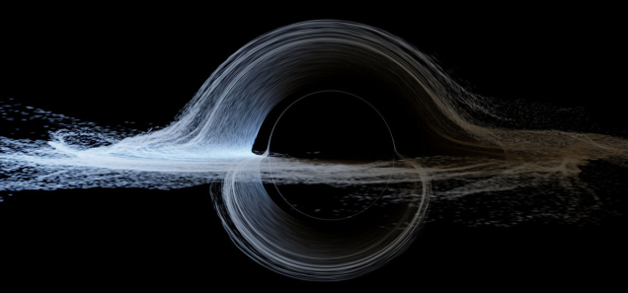
Measuring the Innermost Stable Circular Orbits of Supermassive Black Holes
Presented by: George Chartas
Notes:
Innermost Stable Circular Orbit (ISCO): That radius inside of which free circular orbital motion is not possible;

Slide 2








In collaboration with:
Chris Kochanek (OSU)
Carter Rhea (CofC)
Xinyu Dai (OU)
Ana Mosquera (USNA)
Jeffrey Blackburne (OSU)
Bin Chen (FSU)
Chelsea MacLeod (IfA)
Christopher Morgan (USNA)

Slide 3
Dissecting an Accretion Disk
Direct imaging of accretion
Indirect Mapping Methods
Light travel time arguments
Reverberation Mapping of the Broad Line Region
Microlensing of the Continuum Emission from the Accretion Disk
Microlensing of Fluorescent Emission Lines from the Accretion Disk

Slide 4
Imaging a Black Hole
Credit: Kip Thorne
A fast-spinning black hole (left) moving in front of the star field shown on the right (courtesy of Kip Thorne and the Double Negative visual-effects team).
Light rays from the background stars are gravitationally lensed.
The dark silhouette of a black holes’ event horizon is more than doubled in apparent size thanks to the bending of light rays by the hole’s gravity. Sgr A*’s horizon will appear to span a mere ~55 microarcseconds
Kip Thorne: The Science of Interstellar
Notes:
Notice the flattening on the left edge of the shadow due to light rays moving with the rotation of space and thus emitted close to the event horizon. The right side of the shadow is bulged because light rays from this part of the disk are moving against the whirl of space.

Slide 5
Imaging Sgr A*
Because of gravitational lensing a black hole will appear larger than its true diameter.
Credit: Doeleman et al. 2008
Sgr A* was observed in April 2007 using a three station VLBI array (ARO/SMT, CARMA, JCMT) at a wavelength of 1.3mm (Doeleman et al. 2008).
Solid line for non-spinning black hole + lensing, dashed line no lensing effects. The observed size is smaller than the minimum apparent size.
This can be explained by compact emission from the approaching side of an accretion disk.
Notes:
Arizona Radio Observatory ARO
SMT Submillimeter Telescope (Arizona)
Combined Array for Research in Millimeter-wave Astronomy CARMA (Inyo mountouns in Eastern California)
James Clerk Maxwell Telescope

Slide 6
Dissecting an Accretion Disk with Microlensing
Direct imaging of quasars using submm VLBI is not possible due to their large distances. Microlensing, however, can resolve:
Structure of AGN Accretion Disks
The sizes of the Optical and UV regions of AGN
Comparison with Thin Disk Theory
Use the distribution of shifts of the Fe line to infer the ISCO, a, and i
Structure of AGN Coronae
The sizes of X-ray emitting coronae of AGN

Slide 7
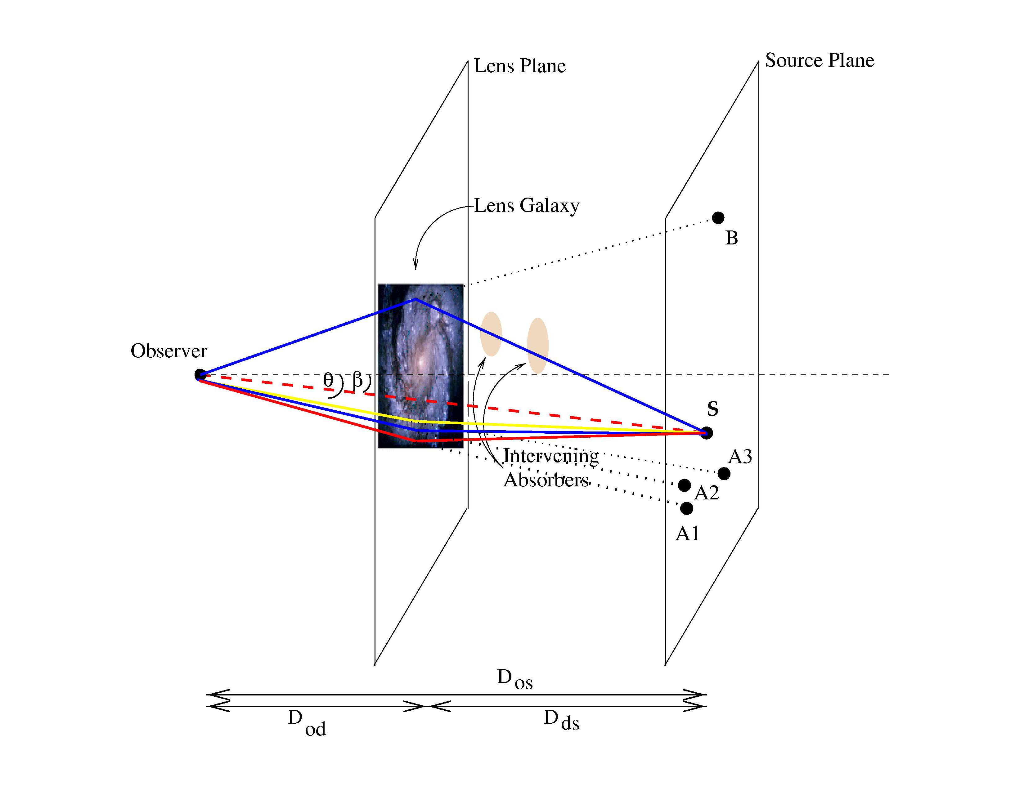
Dissecting an accretion disk with microlensing
Microlensing is the bending of light produced by the individual stars in the lensing galaxy.
Microlensing variability occurs when the complex pattern of caustics produced by stars in the lens moves across the source plane.
The characteristic scale of these caustic patterns is the Einstein radius.
Conceptual diagram of the deflection of light in a 4 image gravitational lens system.

Slide 8
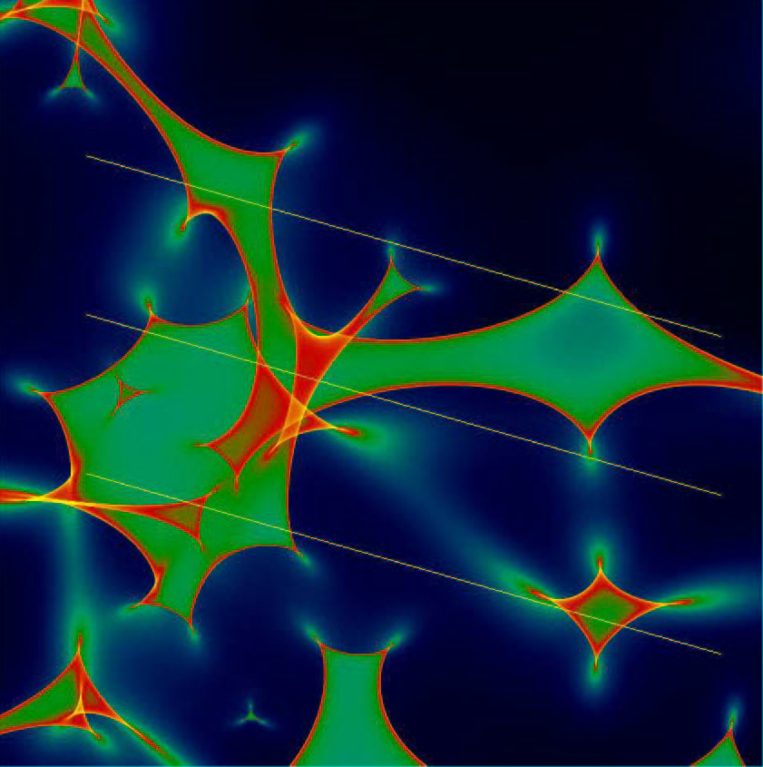
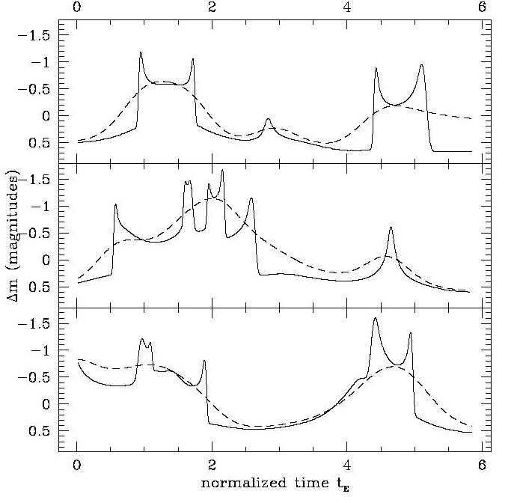
Dissecting an Accretion Disk with Microlensing
Figures from J. Wambsganns, Gravitational Lensing in Astronomy
Simulated magnification pattern in the source plane, produced by a dense field of stars in the lensing galaxy. Simulation applies to image A of Q2237+0305.

Slide 9
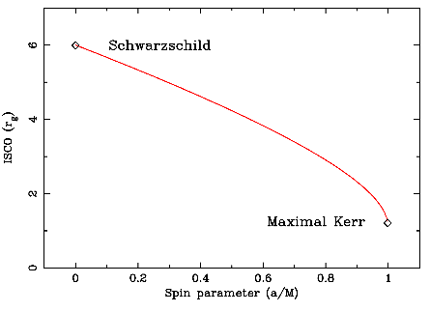
ISCO and Size of Accretion Disk at Wavelength λ
Thin accretion disk theory predicts that the characteristic size of the accretion disk at wavelength λ scales as
and the disk temperature scales as:

Slide 10
Dissecting an Accretion Disk with Microlensing
Microlensing Model
The main free parameters of a microlensing model are :
the scale lengths of the emission regions,
a microlens mass scale,
a mass fraction of the local surface density comprised of stars, and
a velocity vector describing the motion of the AGN regions across the microlensing caustics.
The microlensing analysis includes the creation of many random realization of the star fields near each image and the generation of magnification maps.
Dynamic Microlensing
- Simulations that allow for movement of the stars between epochs also provide constraints on the inclination of the accretion disk and the direction of motion of the caustics

Slide 11
Dissecting an Accretion Disk with Microlensing
We are performing multiwavelength monitoring of several quasars :
RX J1131-1231 (z_{s} = 0.66, z_{l} = 0.30)
Q J0158-4325 (z_{s} = 1.29, z_{l} = 0.317)
SDSS0924+0219 (z_{s} = 1.524, z_{l} = 0.39)
Q 2237+030 (z_{s} = 1.60, z_{l} = 0.04)
HE 0435-1223 (z_{s} = 1.689, z_{l} = 0.46)
PG 1115+080 (z_{s} = 1.72, z_{l} = 0.31)
SDSS1004+4112 (z_{s} = 1.734, z_{l} = 0.68)
QSO 1104-1805 (z_{s} = 2.32, z_{l} = 0.73)
with the main scientific goal of measuring the emission structure near the black holes in the optical\UV and X-ray bands in order to test accretion disk models.
X-ray monitoring observations were performed with Chandra
Optical (B, R and I band) observations were made with the SMARTS Consortium 1.3m telescope in Chile.

Slide 12
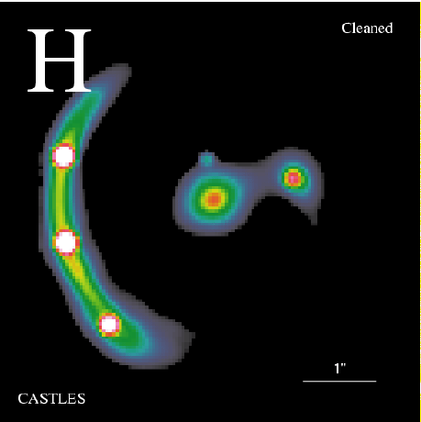
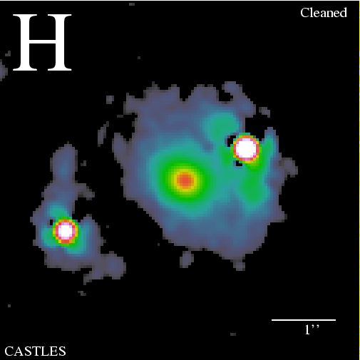
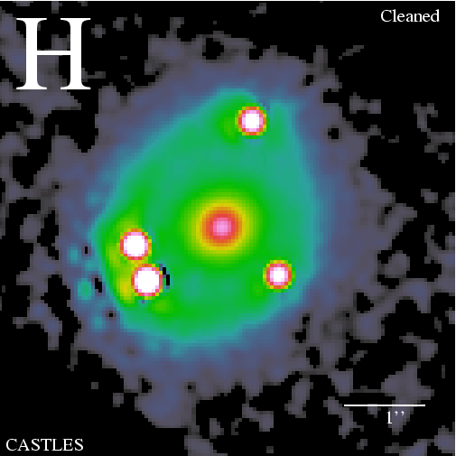
Dissecting an Accretion Disk with Microlensing
A HST image of quasar
RX J1131-1231
z_{s} = 0.658, z_{l}=0.295
A HST image of quasar
HE 1104-1805
z_{s} = 2.32 , z_{l} = 0.73
A HST image of quasar
PG 1115 +080
z_{s} = 1.72 , z_{l} = 0.31

Slide 13
Dissecting an Accretion Disk with Microlensing
Images in the 0.2 - 10 keV bandpass of the Chandra observations of
RX J1131-1231 and HE 1104-1805.

Slide 14
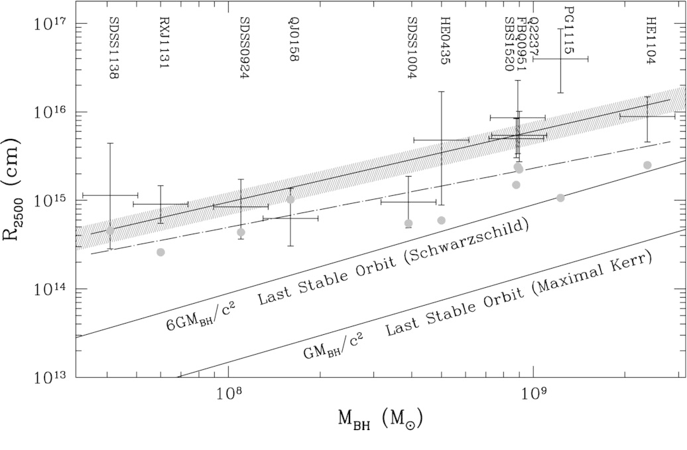
The Quasar Accretion Disk Size versus Black Hole Mass
Morgan et al. 2010
Notes:
The microlensing method applied to the optical and UV light curves of images of lensed quasars places constraints on the sizes of the accretion disks at their respective rest-frame wavelengths.
The majority of the X-ray continuum of quasars is dominated by non-thermal radiation of the X-ray corona with a smaller contribution from the disk. Measurements using the microlensing method to fit the X-ray light curves of the images of lensed quasars place constraints on the size of the X-ray hot corona.

Slide 15
X-ray half-light radii of quasars as determined from our
microlensing analysis versus their black hole masses.
Chartas et al. 2015

Slide 16
Structure of z = 0.66 quasar RX J1131-1231

Slide 17
Structure of z = 0.66 quasar RX J1131-1231
RX J1131−1231 has been monitored 38 times over a period of 10 years with the Chandra X-ray Observatory. As reported in Chartas el al. 2012, redshifted and blueshifted Fe Ka lines have been detected in the spectra of the lensed images.
Notes:
We interpret the shift of the Fe line as resulting from general relativistic and special relativistic Doppler effects.

Slide 18
X-ray Microlensing of Fe Kα line in Image C of RX J1131

Slide 19
X-ray Microlensing of Fe Kα line in Image C of RX J1131

Slide 20
Individual Microlensing Events in RXJ 1131-1231
Caustic crossing an accretion disk (face-on case)

Slide 21
Individual Microlensing Events in RXJ 1131-1231
The amplification of the emission region of radius r=1 and thickness dr by a caustic as a function of the distance of the caustic from the center of the ring. The curves show dr/r = 0.025, 0.1, 0.5, 1 corresponding to solid, dotted, dashed, and dash-dot lines.

Slide 22
Generalized Doppler Shift
The observed energy of a photon emitted near the event horizon of supermassive black hole will be shifted with respect to the emitted rest-frame energy due to general relativistic and Doppler effects.
Where the Doppler shift is:
A, Σ, and Δ are defined as
Notes:
For a given inclination angle i, the angle between the direction of the orbital velocity v_{φ} of the plasma and our line of sight is assumed to range between a minimum and maximum value that will depend on the inclination angle i, and the angle between the caustic direction of motion and the projection of our line-of-sight onto the disk plane.

Slide 23
Extremal shifts (g_{min}) of the Fe Kα line energy for spin values ranging between 0.1 and 0.998 in increments of 0.1. Horizontal dashed lines represent the observed values of the shifts g=E_{obs}/E_{rest} of the most redshifted Fe Kα line components of the two epochs. The model can reproduce the observed shifts for i = 65°, and θ_{caustic} = 185°.
Notes:
The extreme values of the normalized energy shifts g = Eobs/Erest of the two lines can be used to roughly constrain the radius of the emitting material
The value of g will range between extremal values that depend on the inclination angle i, the caustic crossing angle, if the caustic is approaching or moving away form the BH, and the spin of the black hole.

Slide 24
g-distribution method
The value of g will range between extremal values that depend on the inclination angle i, the caustic angle θ_{caustic}, and the spin of the black hole.
Triggering on a single microlensing event and monitoring the shifts of the Fe line during a single caustic crossing is very difficult from a practical sense.
The g-distribution method relies on determining the distribution of Fe line shifts from the spectra of individual lensed images obtained from a large number of X-ray observations.
The g-distribution is expected to show sharp cut-offs. The low energy cut-off is sensitive to the ISCO and the high energy cut-off is sensitive to the inclination angle.

Slide 25
g-distribution method
Notes:
We find that the iron line is detected in 58 out of the 152 spectra (38 epochs × 4 images) at ≥ 90% confidence and in 18/152 spectra at ≥ 99% confidence.
One important feature of this iron line energy-shift distribution in the significant cut- off of the distribution at a rest-frame energies of ∼ 3.9 keV and ∼ 7.4 keV for iron lines detected at ≥ 99% confidence.

Slide 26
Conclusions
Using the microlensing method we find that the X-ray emitting hot coronae of quasars have sizes of order 10r_{g} and the optical regions have sizes of order 100r_{g}
The sizes of the optical accretion disks of quasars as inferred from microlensing are 2-3 times larger than what is predicted by think disk theory
The Fe Kα line varies in energy and strength during microlensing events. We use the distribution of the Fe line shifts to infer the inner most stable orbit, the inclination angle, and the spin of quasars.
Notes:
Optical sizes of accretion disks at 2500A ̊ inferred from our microlensing analysis are a factor of 2–3 larger than those predicted by thin disk theory. This result is consistent with recent measurements of continuum lags in nearby Seyferts NGC2617 (Shappee et al. 2014) and NGC5548 (Edelson et al. 2015).

