Slide 1


Boltzmann dynamics, temperature dependence of energy loss and coalescence: Towards an understanding of the R_{AA} and v₂ for D-Mesons
F. Scardina
University of Catania
INFN-LNS
V. Greco
S. K. Das
S. Plumari
The 31th Winter Workshop on Nuclear Dynamics

Slide 2
Outline
The puzzling Relation between
R_{AA} and v₂ for Heavy Flavors
      T-dependence of the interaction
      Transport vs Fokker-Planck approach
      Hadronization: Coalescence and Fragmentation
cc angular correlation
The 31th Winter Workshop on Nuclear Dynamics

Slide 3

Introduction Heavy Quarks
HQ are ideal probes to study the QGP
M_{HQ} >> Λ_{QDC} (M_{charm}≅1.3 GeV; M_{bottom} ≅ 4.2 GeV)
M_{HQ} >> T
Before the first experimental results at RHIC:
It was expected HQ not dragged
by the expanding medium:
- spectra close to the pp one-> large R_{AA}
- small elliptic flow v₂

Slide 4
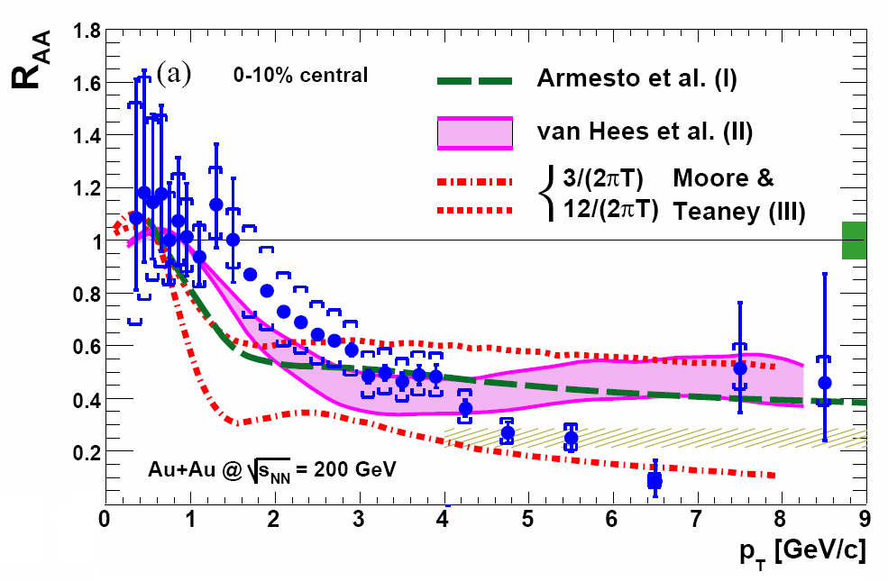
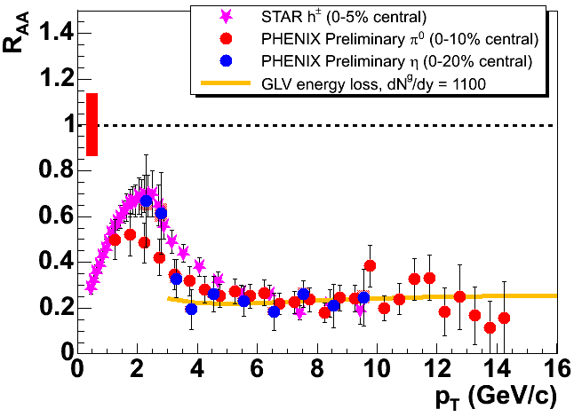
R_{AA} of Heavy Quarks
RHIC
[PHENIX: PRL98(2007)172301]
Small R_{AA} not so different from that of light flavor

Slide 5
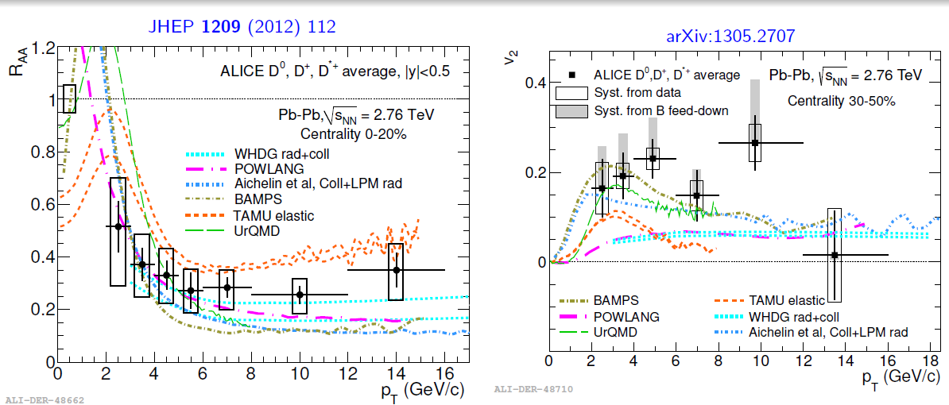
R_{AA} and V₂
Again at LHC energy heavy flavor suppression is similar to light flavor: small R_{AA}, large v₂

Slide 6
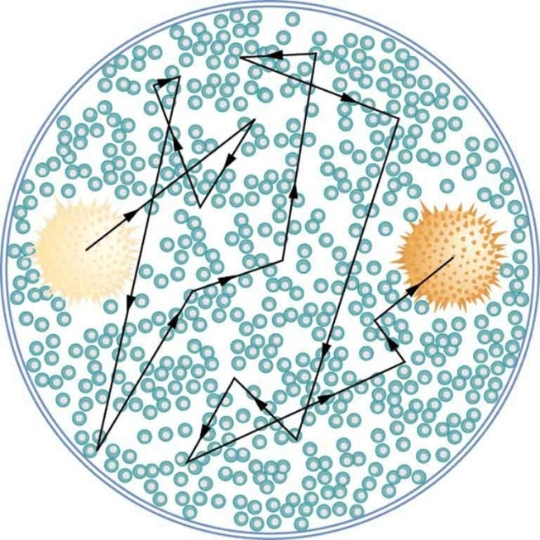
Standard Description of HQ propagation in the QGP
Fokker-Plank approach
Langevin simulation
in Hydro bulk
The interaction is encoded in the drag and diffusion coefficents
Evaluated from scattering matrix |M|²
drag evaluated from pqcd -> R_{AA} larger than exp. data
-> v₂ smaller than exp. data
Heavy Quark strongly dragged by interaction with light quarks, the real cross section is a K factor larger?

Slide 7
R_{AA} and v₂ correlation
The larger k the smaller the R_{AA} ,the larger the v₂
It is possible to reproduce R_{AA} multiplying the drag by a k-factor
It is not possible to reproduce both R_{AA} and v₂ with the same k-factor
Reproducing both is not only an issue of the strength of the interaction
The temperature dependence of the interaction plays a rule
This is general, seen also for light quarks
[Scardina, Di Toro, Greco, PRC82(2010)]
[J.Liao and E. Shuryak PRL 102 (2009)]

Slide 8
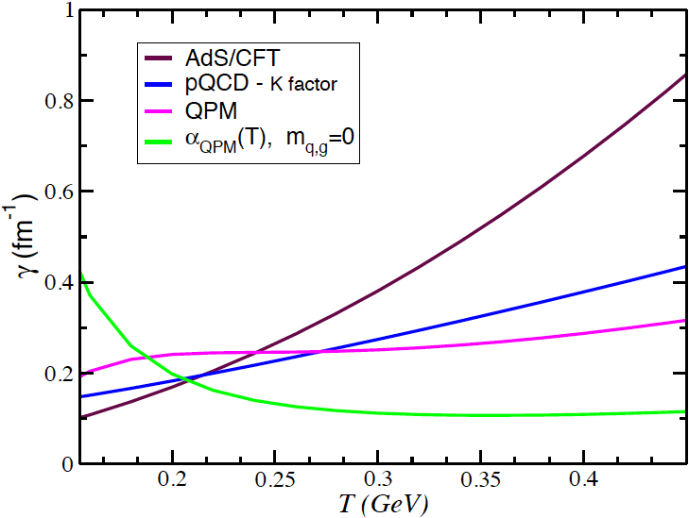
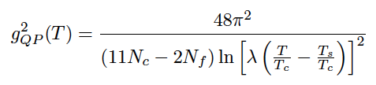


T- dependence of the Drag Coefficient
Drag Coefficient
pQCD (Combridge cross-section)
AdS/CFT
[Akamatsu-Hatsuda-Hirnao,
PRC79 (09) 054907]
[S. K. Das PRC89 (2014) 054912]
Quasi-Particle-Model (fit to lQCD e,P)
a_{QPM}(T) , m_{q,g}=0
we mean simply the coupling of the QPM, but with a bulk of massless q and g
[S.Plumari et al PRD 84 094004 (2011)]

Slide 9
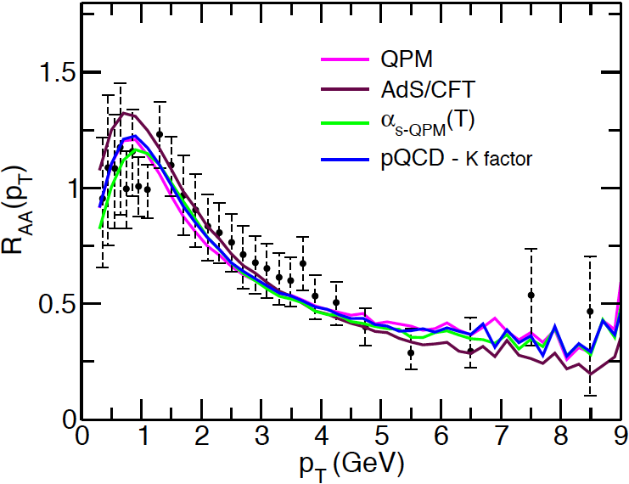
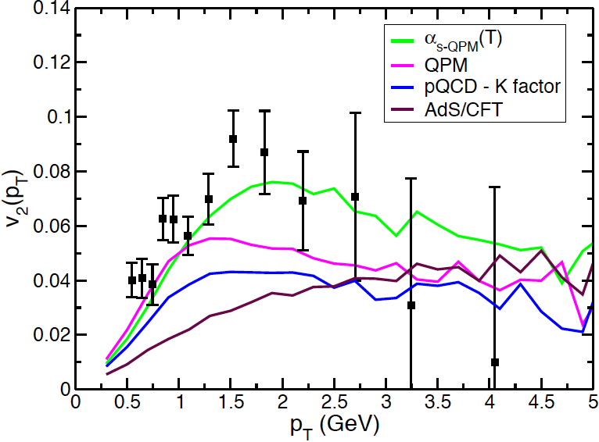
Impact of T-dependence of the Drag
Au+Au@200AGeV, b=8 fm
Interaction rescaled to have very similar R_{AA} for all the cases
Only D fragmentation
R_{AA}(p_{T}) well reproduced whatever is the T-dependence
At fixed R_{AA}(p_{T}) -> v₂(p_{T}) quite larger if T -> T_{c}

Slide 10
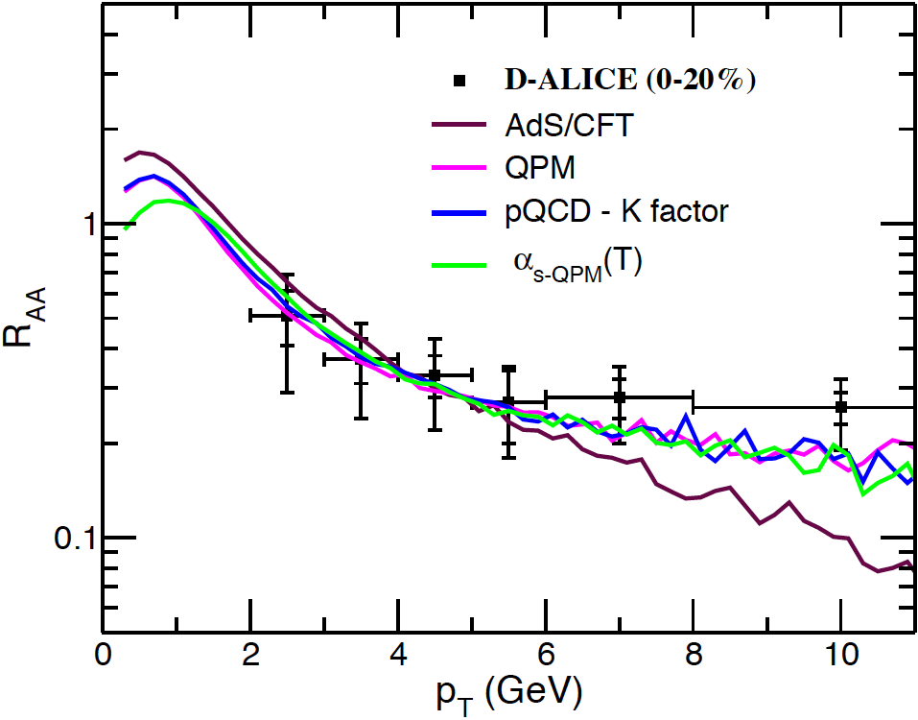
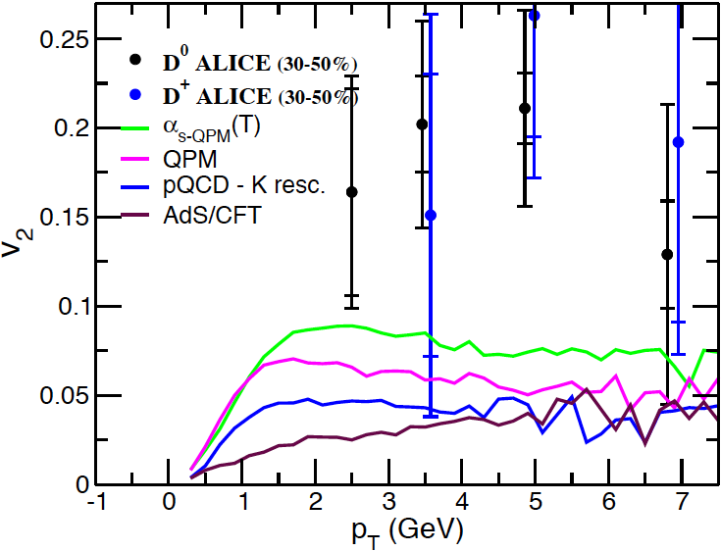
Impact of T-dependence of the Drag
LHC – Pb+Pb@2.76ATeV
Similar trends as for RHIC case

Slide 11
T-matrix approach: scattering under V(r,T)
Hadronic bound states can survive at temperature larger than T_{C}
_
_
q
q
“D”
The interaction potential V(r,T) can be evaluated employing T-matrix scattering theory
c
V(r,T)
c
Resonant Scattering
The resonant scattering tends to compensate the decrease by the density scatters because takes into account that V(r,T) becomes stronger close to Tc
T-matrix approach produces a quite large v₂ because of the T-dependence of interaction
[T-matrix,PRL 100 (2008) V. Greco et al. ]

Slide 12
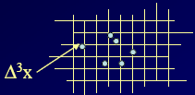
Transport theory
Mean Field
Classic Boltzmann equation
Free-streaming
Collisions
Describes the evolution of the one body distribution function f(x,p)
It is valid to study the evolution of both bulk and Heavy quarks
To solve numerically the B-E we divide the space into a 3-D lattice and we use the standard test particle method to sample f(x,p)

Slide 13
Transport theory
Collision integral (stochastic algorithm)
ω(p,k) is the transition rate for collisions of HQ with heath bath changing the HQ momentum from p to p-k
Collision integral (stochastic algorithm)
Notes:
Inserire quadratini nello spazio delle fasi

Slide 14
Fokker Planck equation
HQ interactions are conveniently encoded in transport coefficients that are related to elastic scattering matrix elements on light partons.
The Fokker Planck eq can be derived from the B-E
B-E
If |k|<< |P|

Slide 15
Fokker Planck equation
where we have defined the kernels
→ Drag Coefficient
→ Diffusion Coefficient
Where B_{ij} can be divided in a longitudinal and in a transverse component B₀ , B₁
[B. Svetitsky PRD 37(1987)2484]

Slide 16

Langevin Equation
The Fokker-Planck equation is equivalent to an ordinary stochastic differential equation
is the deterministic friction (drag) force
C_{ij} is a stochastic force in terms of independent
Gaussian-normal distributed random variable ρ=(ρ_{x},ρ_{y},ρ_{z})
ρ obey the relations:
the covariance matrix and Γ are related to the diffusion matrix and to the drag coefficient by

Slide 17
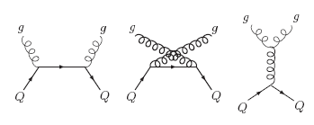
Evaluation of Drag and diffussion
Common approach between LV and BM
Boltzmann approach
Langevin approach
For Collision Process the A_{i} and B_{ij} can be calculated as following :
M -> A_{i}, B_{ij}
M -> σ

Slide 18
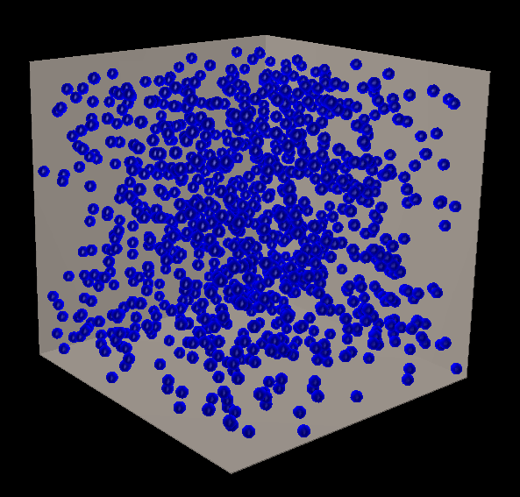
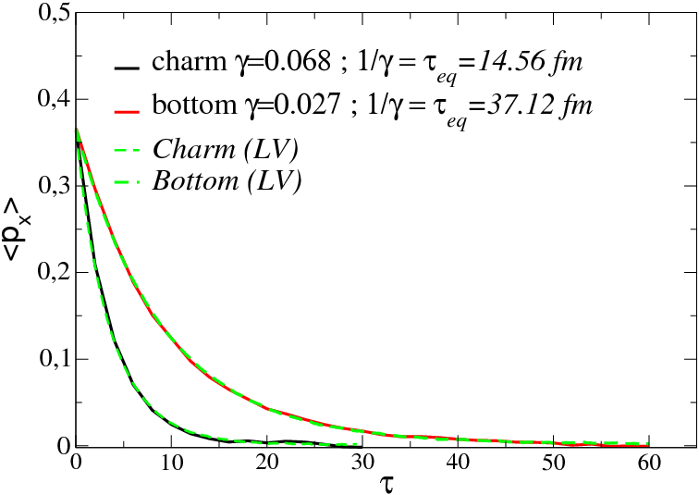
Mean momentum evolution in a static medium
We consider as initial distribution in p-space a
δ(p-1.1GeV) for both C and B with p_{x}=(1/3)p
Each component of average momentuma evolves according to
<p_{i}>=p⁰_{i}exp(-γt) where 1/ γ is the relaxation time to equilibrium (τ)
τ_{b}/τ_{c}=2.55≅m_{b}/m_{c}
For a very inclusive quantity BM and LV give same result

Slide 19
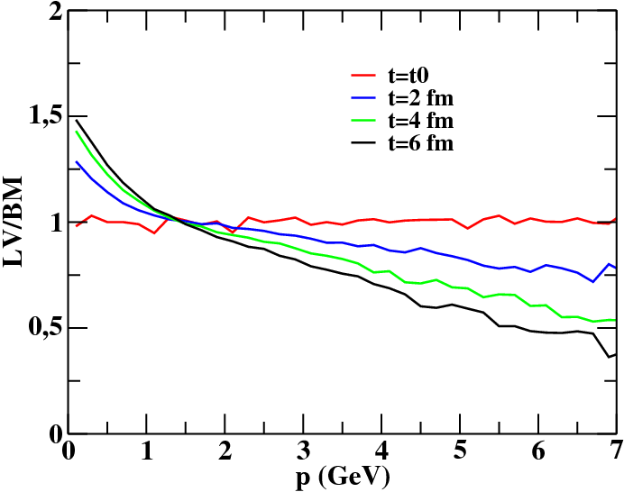
Boltzmann vs Langevin (Charm)
We have plotted the results as a ratio between LV and BM at different time to quantify how much the ratio differs from 1
[S. K. Das , F. Scardina, V. Greco PRC90 044901 (2014)]
Is the charm really Heavy and its scattering soft ?
We studied the effect of the mass and of the momentum transferred on the approximation involved in the F-P

Slide 20
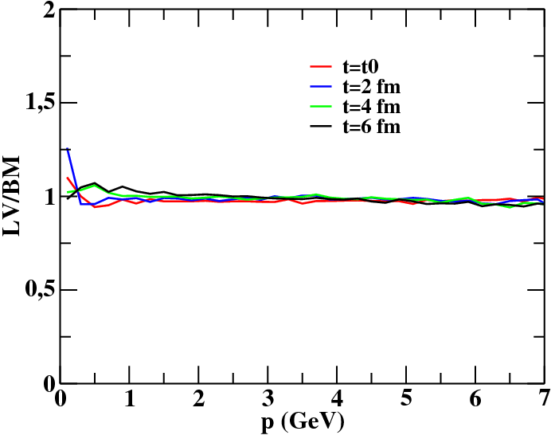
Boltzmann vs Langevin (Bottom)
In bottom case Langevin approximation gives results similar to Boltzmann
The Larger M the Better Langevin approximation works
[S. K. Das , F. Scardina, V. Greco PRC90 044901 (2014)]

Slide 21
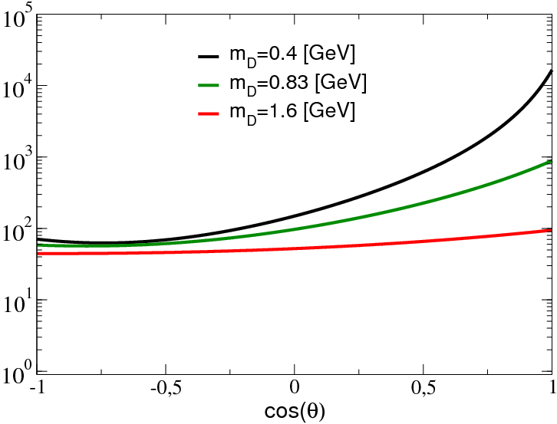
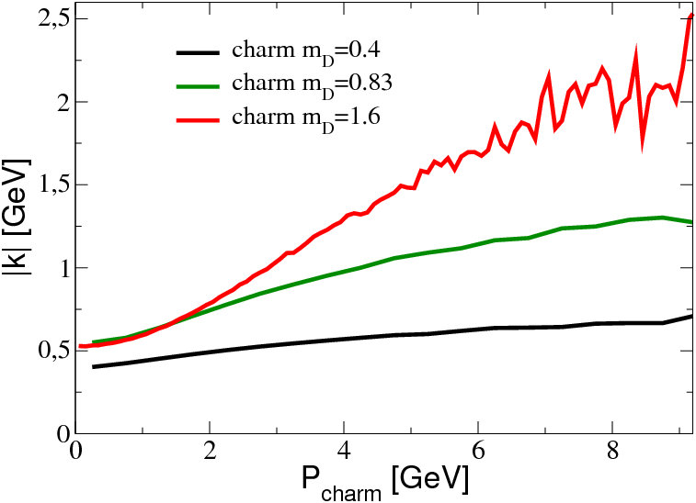
Boltzmann vs Langevin (Charm)
simulating different average momentum transfer
Angular dependence of σ
Mometum transfer vs P
Decreasing m_{D} makes the σ more anisotropic
Smaller average momentum transfer

Slide 22
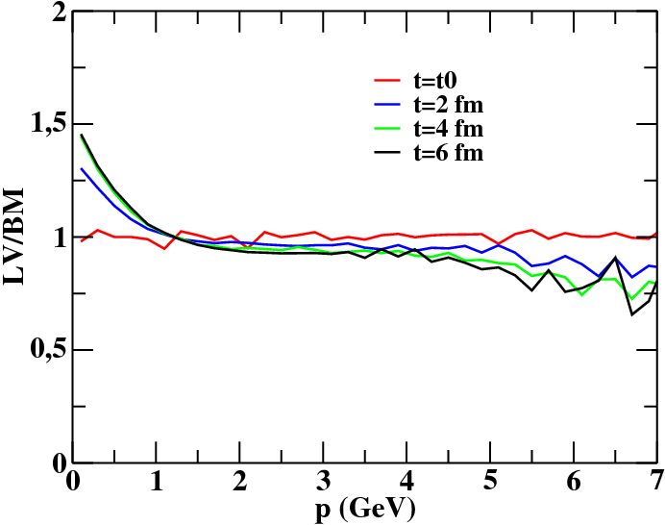
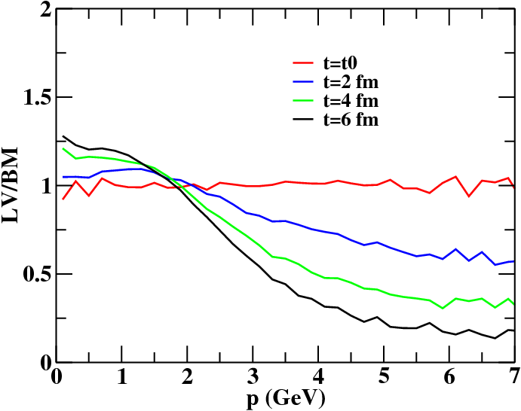
Boltzmann vs Langevin (Charm)
The smaller <k> the better Langevin approximation works

Slide 23
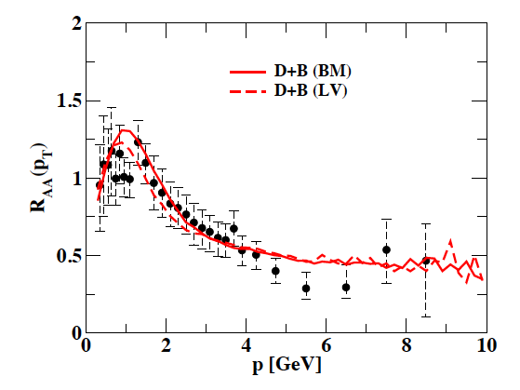
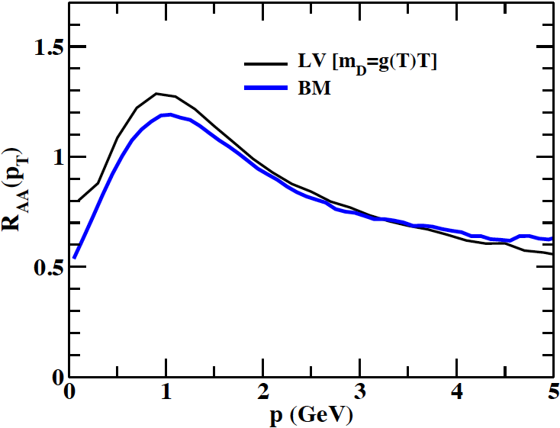
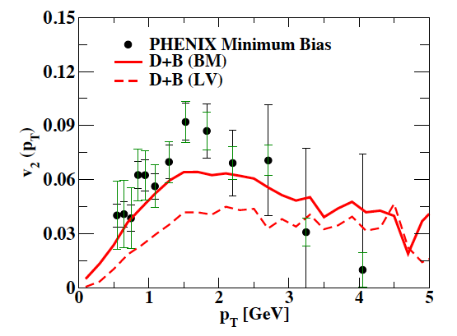
R_{AA} and v₂ Boltzmann vs Langevin
Au+Au@200AGeV, b=8 fm
40%
m_{D}=1.6 GeV
Fixed same R_{AA}(p_{T}) [reduce γ by 40%] → v₂(p_{T}) 35% higher (m_{D}=1.6 GeV)
- dependence on the specific scattering matrix (isotropic case -> larger effect)
Hadronization by coalescence not included
[S. K. Das , F. Scardina, V. Greco PRC90 044901 (2014)]

Slide 24
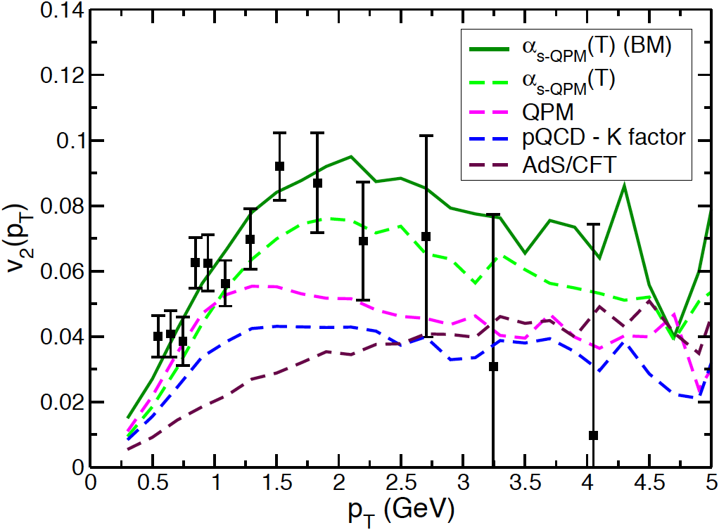
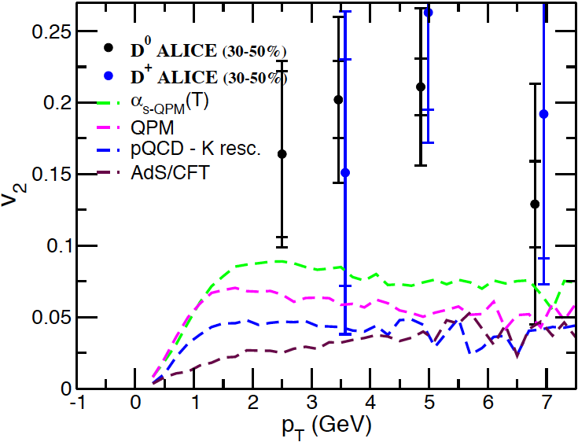
v₂ Boltzmann vs Langevin
Impact of the Boltzmann dynamics for α_{QPM}(T) case
Au+Au@200AGeV, b=8 fm
LHC – Pb+Pb@2.76ATeV
BM
LV
BM
LV
No coalescence included, only fragmentation

Slide 25
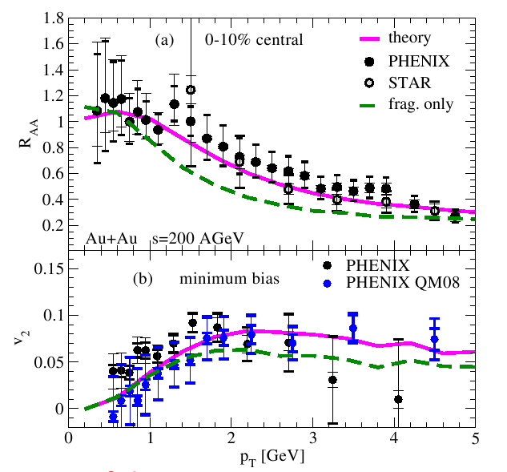

Impact of hadronization mechanism
Impact of hadronization
Coalescence increase
both R_{AA} and v₂
reverse the correlation
toward agreement with data
?
Hees-Mannarelli-Greco-Rapp, PRL100 (2008)
f_{q} from π, K
Greco,Ko,Levai - PRL90

Slide 26
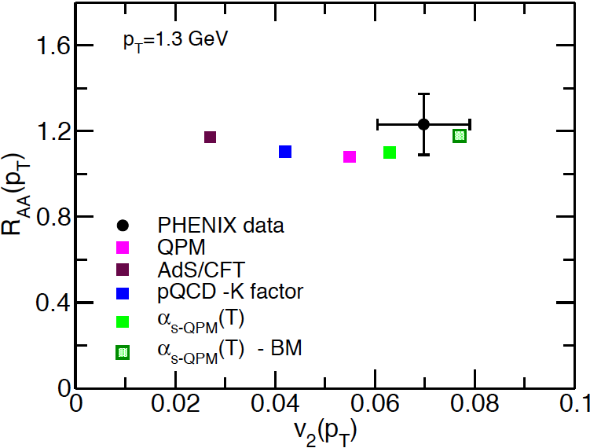
Summary on the build-up of v₂ at fixed R_{AA}
Varying γ (T)
Coal.
BM
R_{AA} and V₂ are correlated but still one can have
R_{AA} about the same while V₂ can change up to a factor 3:
γ(T) + Boltzmann dynamics+ hadronization

Slide 27
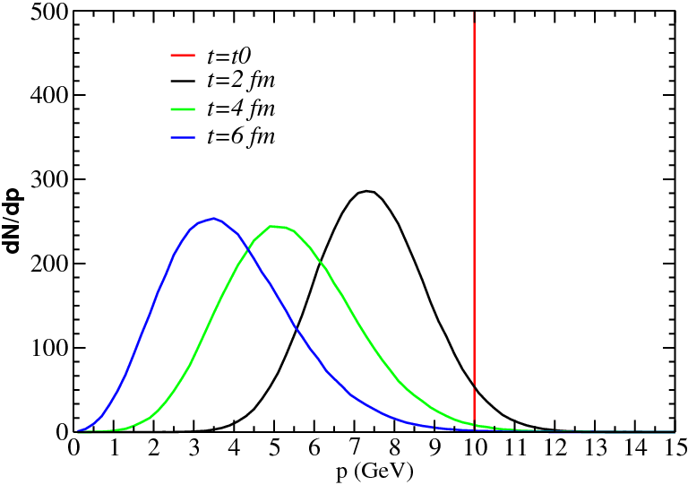
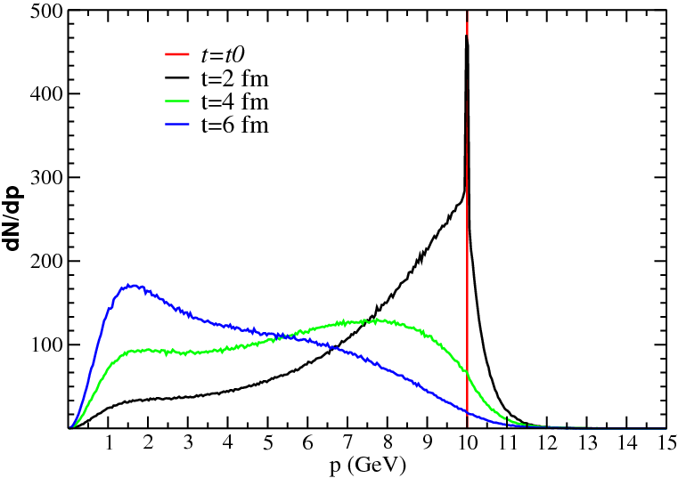
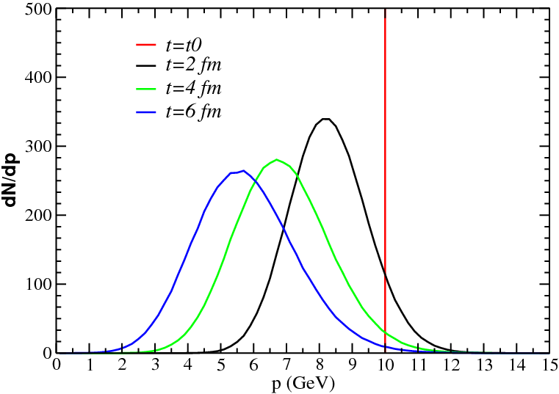
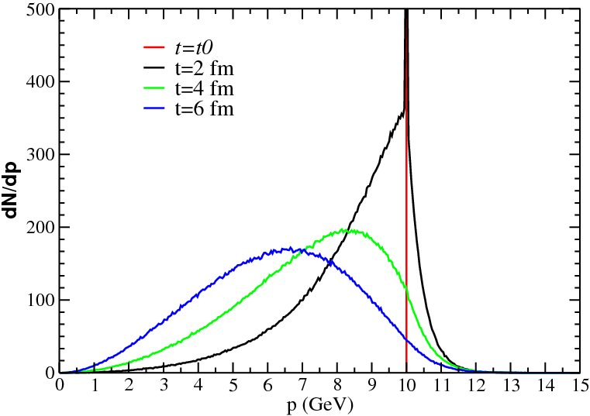
Energy loss of a single HQ
T=400 MeV
Langevin
Boltzmann
Charm
M_{c}/T≈3
Bottom
M_{b}/T≈10
T=400 MeV Mc/T≈3 Mb/T≈10
[F. ScardinaJ.Phys.Conf.Ser. 535 (2014) 012019]

Slide 28
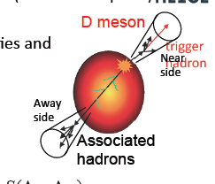
Back to Back correlation
Back to back correlation observable could be sensitive to such a detail
Langevin
Boltzmann
Initial δ(p=10) can be tought as a Near side charm with momentum equal 10
Final distribution can be tought as the momentum probabilty distribution
to find an Away side charm
Boltzmann implies a larger momentum spread

Slide 29
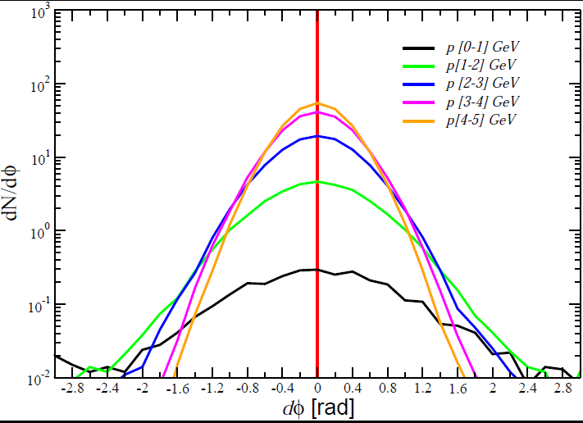
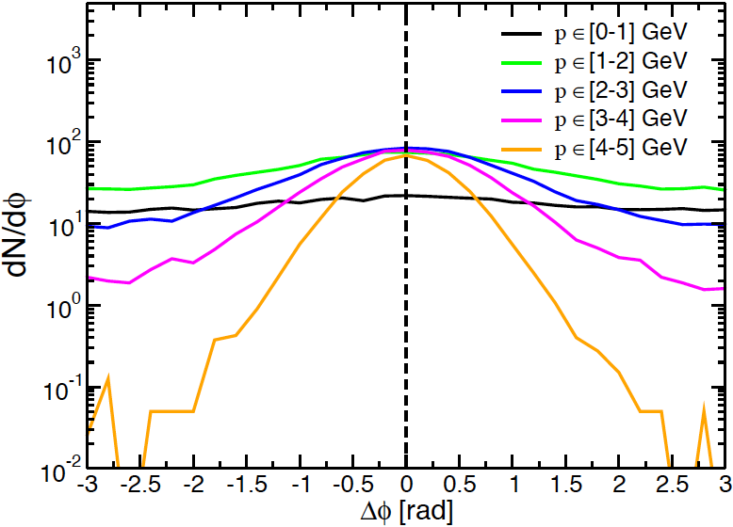
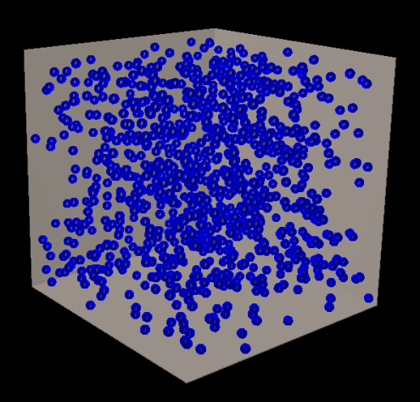
Langevin vs Boltzmann angular correlation
t= 5 fm/c
Boltzmann
The larger spread of momentum with the Boltzmann implicates a large spread in the angular distributions of the Away side charm
P₀=10 GeV
Striking difference also at Δφ =0:
- The evolution of the yield from 2 to 5 GeV
is about 50 times different

Slide 30
Summary
The exp. data for R_{AA} and v₂ seem to indicate an interaction about
constant in T
Boltzmann is more efficient in building up the v₂ related to HQ
The more one looks at differential observables R_{AA}->V₂-> dN_{cc}/dΔφ
the more the differences between the BM and F-P approach
increases
We can realize that charm in hot QGP is not that heavy and the
motion not really Brownian
Very similar dynamics for Bottom at least for R_{AA} and V₂

Slide 32
R_{AA} can be “generated” faster than v₂

Slide 33
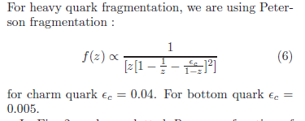

Slide 34
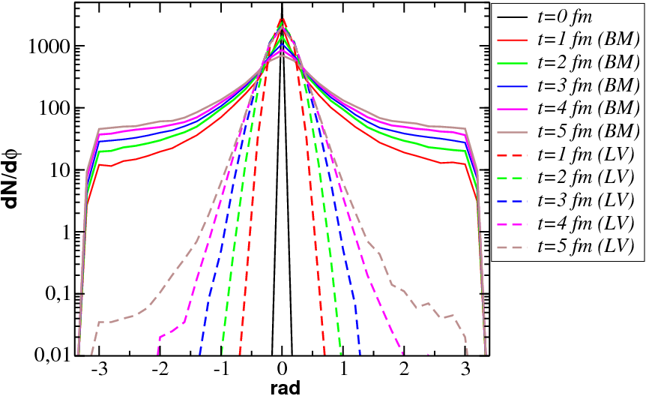
Back to Back correlation
Back to Back correlation
The larger spread of momentum with the Boltzmann implicates a large spread in the angular distributions of the Away side charm

Slide 35
Transport theory
Collision integral
ω(p,k) is the transition rate for collisions of HQ with heath bath changing the HQ momentum from p to p-k
HQ with momentum p+k
HQ with momentum p-k
Gain term
Loss term
HQ with momentum p
Element of momentum
space with momentum p
Notes:
Inserire quadratini nello spazio delle fasi

Slide 36
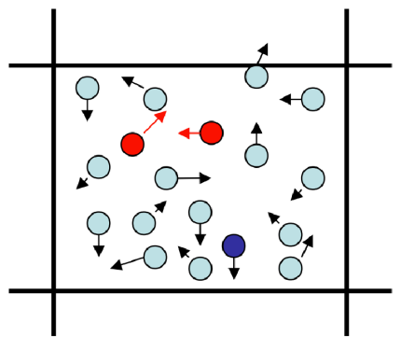
Transport theory
Collision integral (stochastic algorithm)
Assuming two particle
In a volume Δ³x in space
momenta in the range
(P,P+Δ³P) ; (q,q+Δ³q)
collision rate per unit phase space for this pair
Exact solution
Δ³x

Slide 37
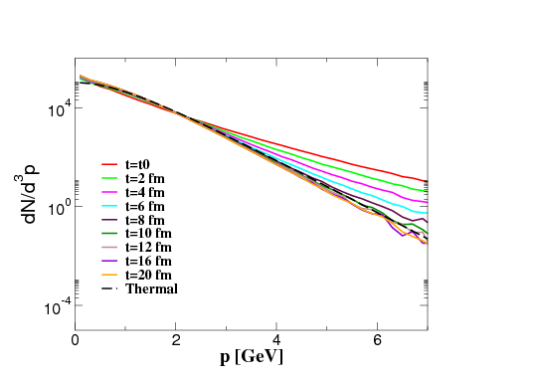
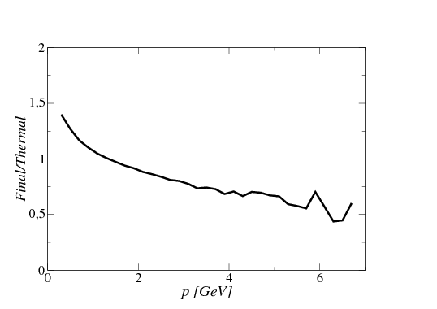
Charm propagation with the langevin eq
We solve Langevin Equation in a box in the identical environment of the B-E
Bulk composed only by gluon in Thermal equilibrium at T= 400 MeV.
The long-time solution of the Fokker Planck equation does not reproduces the equilibrium distribution (we are away from thermalization around 35-40 % at intermediate pt ).
This is however a well-know issue related to the Fokker Planck

Slide 38
Charm propagation with the langevin eq
The long time solution is recovered relating the Drag and Diffusion coefficent by mean of the fluctaution dissipation relation
Imposing the simple relativistic dissipation-fluctuation relations
D=Constant
A= D/ET from FDT

Slide 39
Charm propagation with the langevin eq
Imposing the full relativistic dissipation-fluctuation relations
D(E)

Slide 40
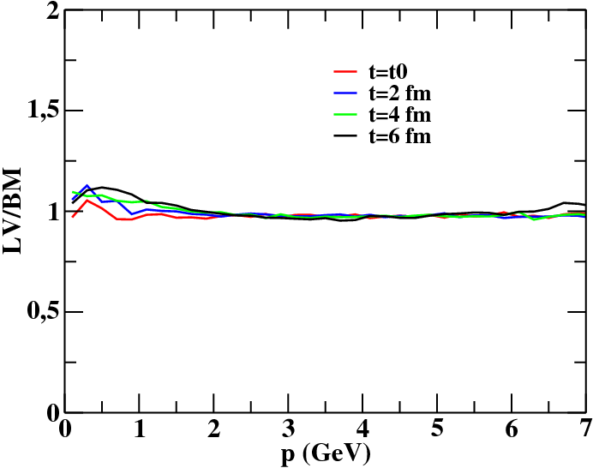
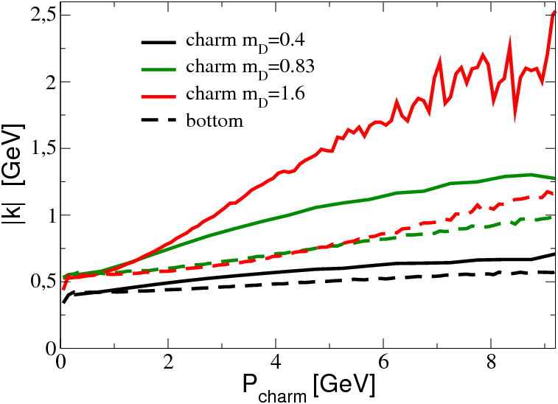
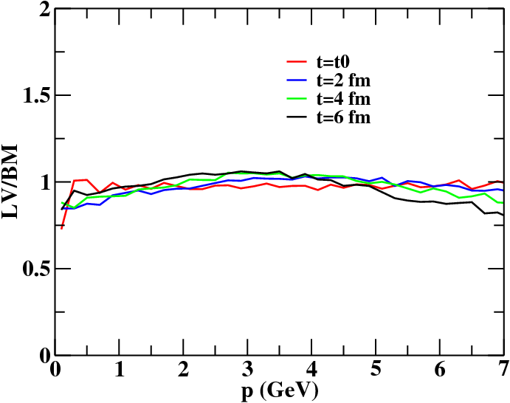
Boltzmann vs Langevin (Bottom)

