Slide 1
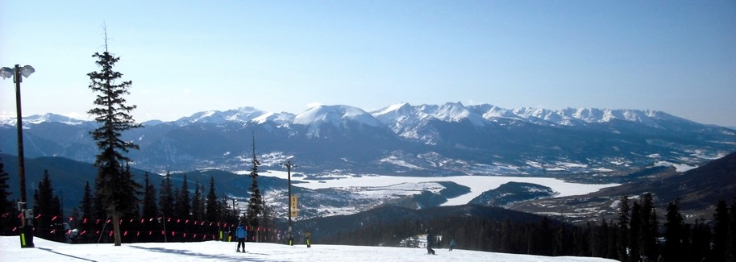
Quarkonia Production in p+p, d+Au and A+A from PHENIX
Melynda Brooks
Los Alamos National Laboratory
For the PHENIX Collaboration

Slide 2
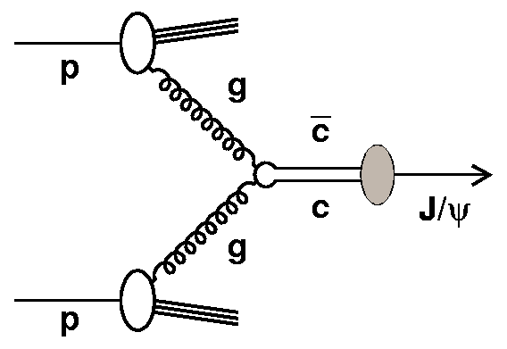
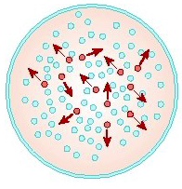
Heavy Flavor Production
Factorize calculations:
pQCD to calculate cc production
cċ propagation and hadronization
Note: much of J/Ψ production comes from feed-down from higher resonances, B
D mesons
, Ψ’, χ
Possible Modifications beyond p+p production extrapolation:
  Parton Distribution Functions modified in nucleus?
  Energy loss of partons traversing nucleus
  Cronin modification of p_{T} spectra
  Breakup of charmonium before exiting nucleus
  Energy loss of partons traversing QGP
  Debye screening of charmonia by QGP
  If enough cc, can have charmonium production through coalescence
ċ
c
Note heavy flavor kinematics differences

Slide 3
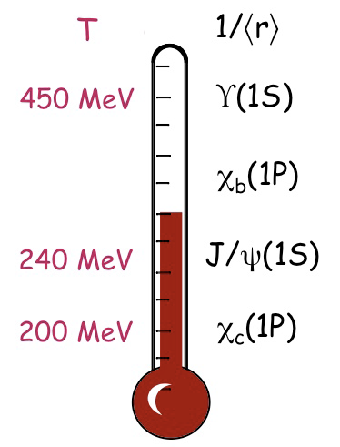
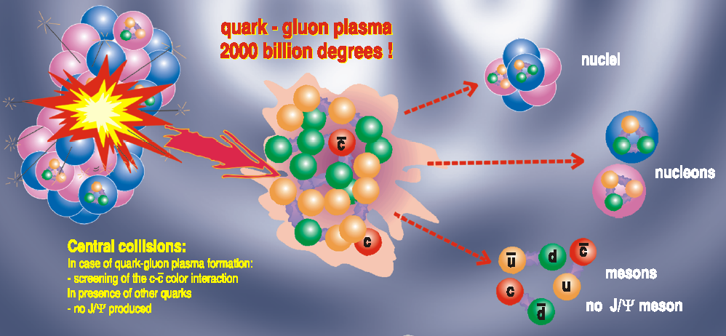
Upsilon
Charmonia plus upsilon states covers large range of binding energies which can give indication of whether screening is occurring or not

Slide 4
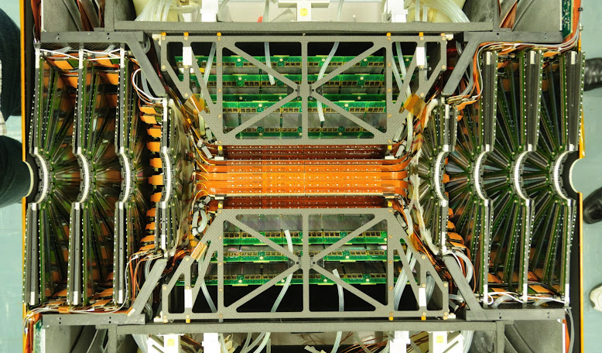
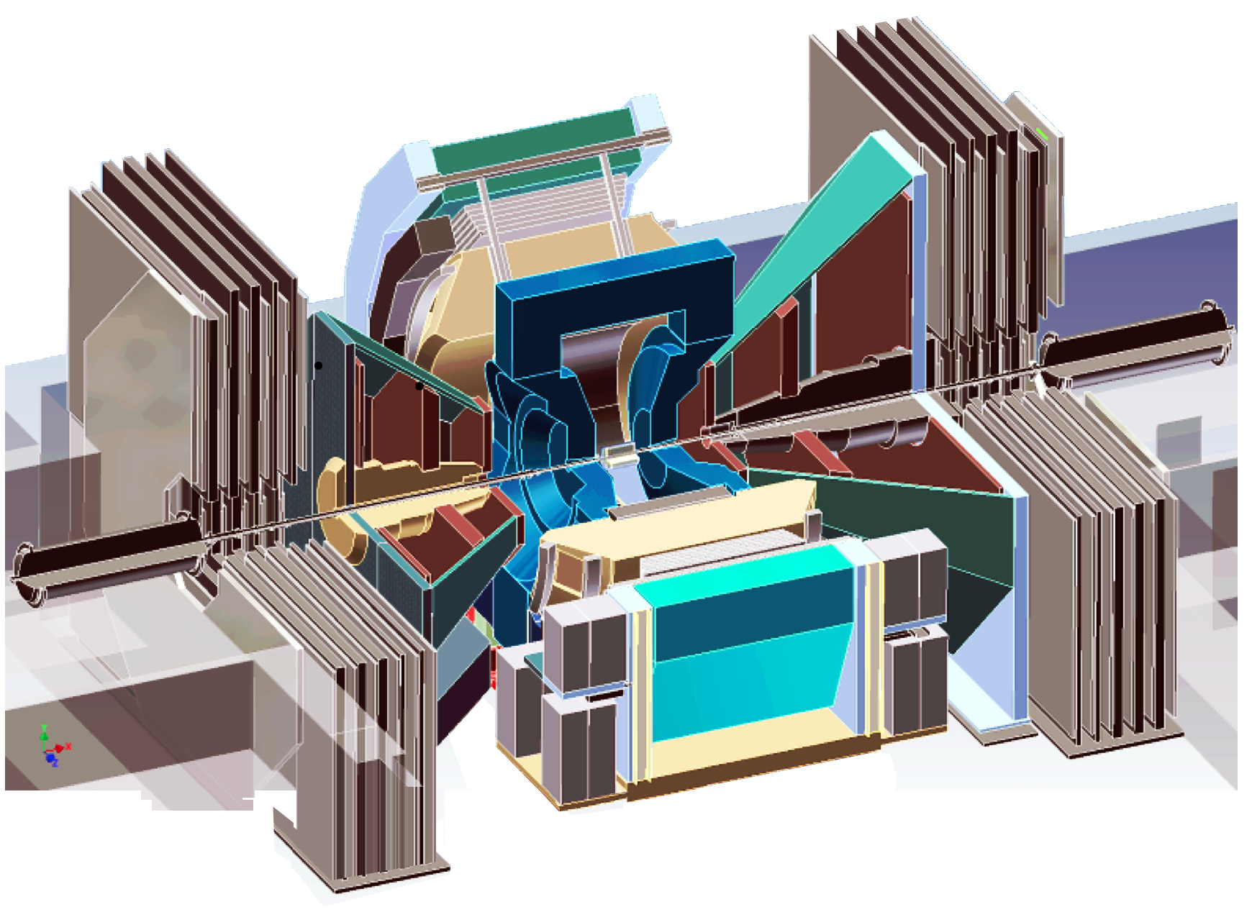
The PHENIX Detector
Central Arms:
Υ, J/ψ, ψ’→e⁺e⁻
D→X+e
e⁺
Adding FVTX:
ψ’ →μ⁺μ⁻
D, B
Muon Arms:
Υ, J/ψ→μ⁺μ⁻
D→X+μ
Au
μ⁺
x≈5x10⁻³
Shadowing region
d, Cu, Au
μ⁻
x≈8x10⁻²
Anti-shadowing region
e⁻

Slide 5
PHENIX Data Sets
p+p (200 and 510 GeV)
  J/ψ, ψ’, Υ at central and forward rapidities
d+Au (200 GeV)
  J/ψ, ψ’, χ_{c,} Υ at central rapidity
  J/ψ, Υ at forward/backward rapidities
Cu+Cu, Cu+Au, (200 GeV), Au+Au (39, 62, 200 GeV)
  CuCu J/ψ R_{AA} at forward/backward rapidities
  CuAu J/ψ R_{AA} at forward/backward rapidities
  AuAu J/ψ R_{AA} at central and forward rapidities
  AuAu J/ψ R_{cp} at 39, 62, 200 GeV, forward rapidities
  CuAu, AuAu ψ’ at forward rapidities analysis underway
  AuAu Υ at central rapidity

Slide 6
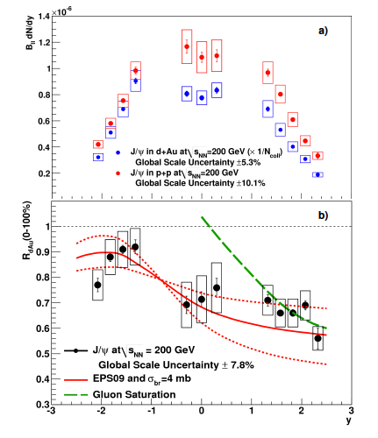
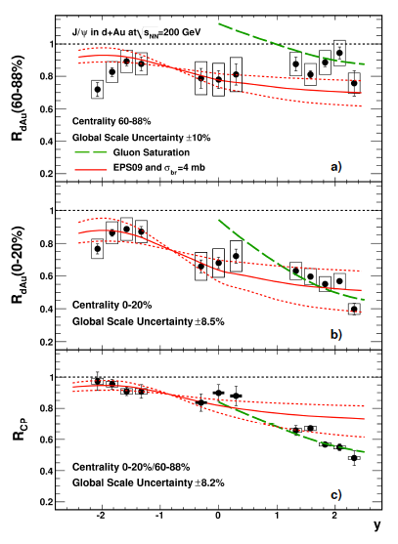
J/ψ in d+Au Collisions: Cold Nuclear Matter Effects
R_{dA} = dN/dy_{dAu}
dN/dy_{pp}*N_{coll}
In d+Au collisions, rapidity-dependent R_{dA}
Forward rapidity shows more suppression than central/backward rapidities. Centrality-dependent.
Possible explanations: gluon shadowing, nuclear breakup, energy loss

Slide 7
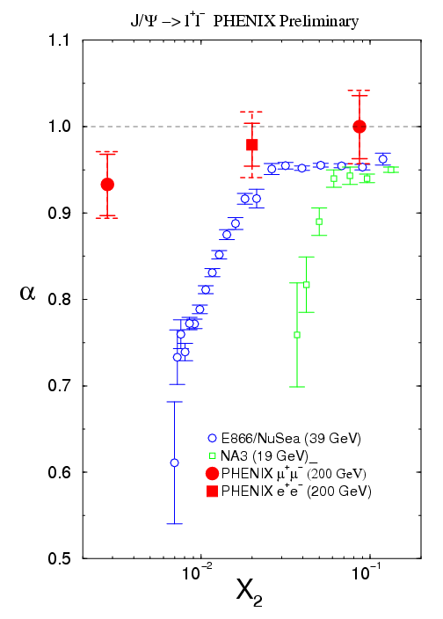
However,
We do not see x₂ scaling, which would be indicative of gluon shadowing
Initial-state energy loss and final-state effects?

Slide 8
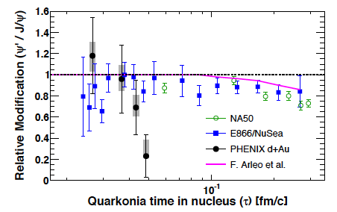
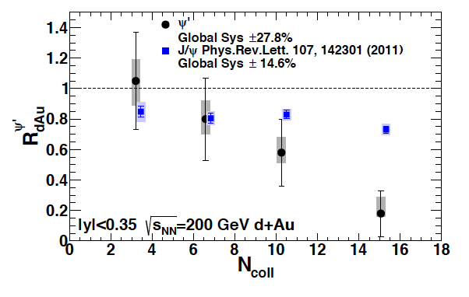
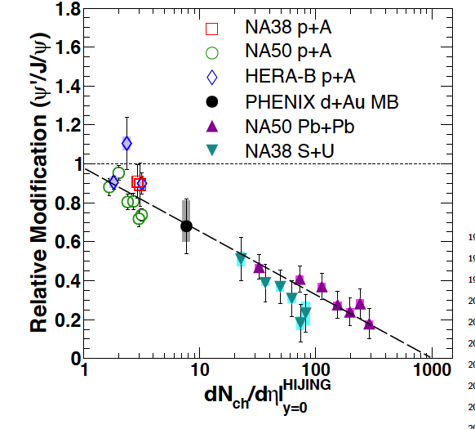
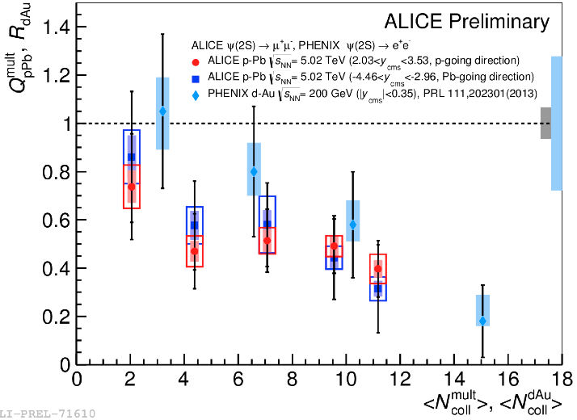
Comparing CNM for J/ψ, ψ’
PHENIX: ψ’ suppressed more than J/ψ at central rapidity, in d+Au. Time spent in nucleus (breakup) does not hold as explanation for PHENIX data.
Universal trend with dN_{ch}/dη for several systems, up to 200 GeV
Alice p-Pb data also seems consistent with this trend
Breakup by nucleus

Slide 9
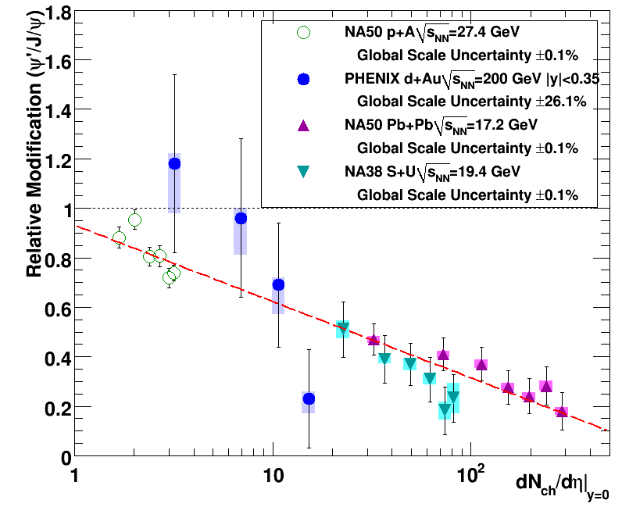
Comparing CNM for J/ψ, ψ’
Would like to more fully explore the trend with dN_{ch}/dη, but current data are limited (see below)
New p+A and heavy ion data from forward rapidity will expand our coverage at RHIC
Vertex Detectors allow us to explore trend versus event multiplicity

Slide 10
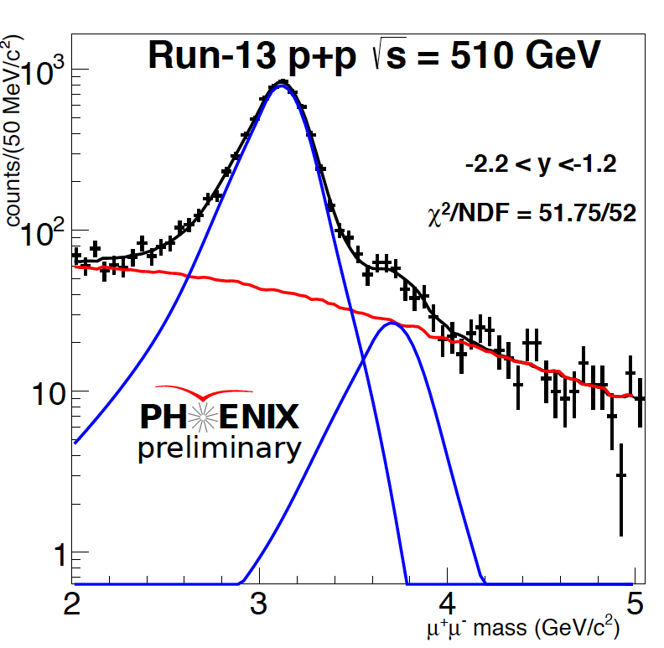
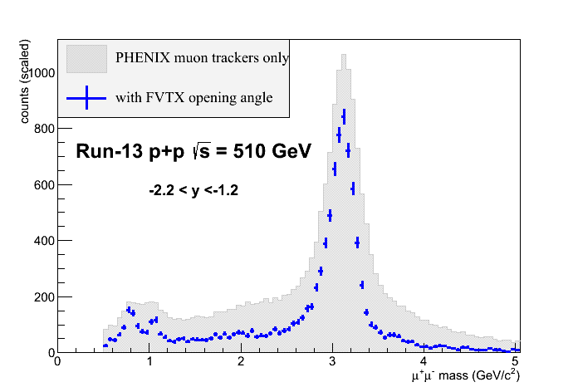
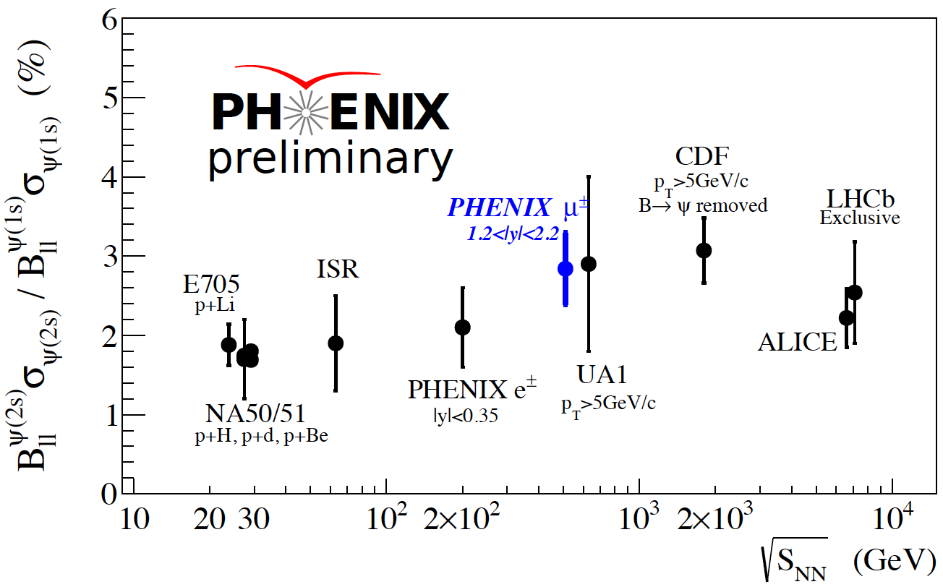
J/ψ:ψ’ at Forward Rapidity
PHENIX has a first J/ψ:ψ’ result at forward rapidity from p+p 510 GeV
FVTX detector allows separation of J/ψ and ψ’
Heavy Ion analysis underway. p+A data set coming.

Slide 11
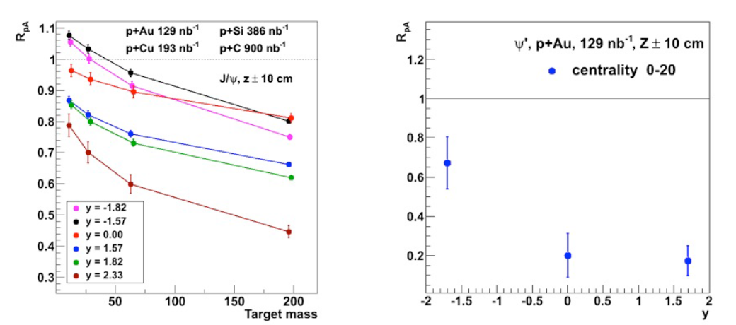
pA Projections for Quarkonia
Expect J/ψ measurements of significance for several nuclei
p+Au will provide a good statistical measurement of ψ’
p+A projections for Run 15

Slide 12

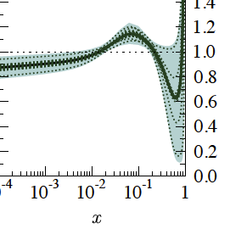
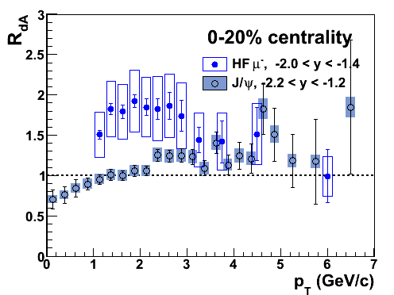
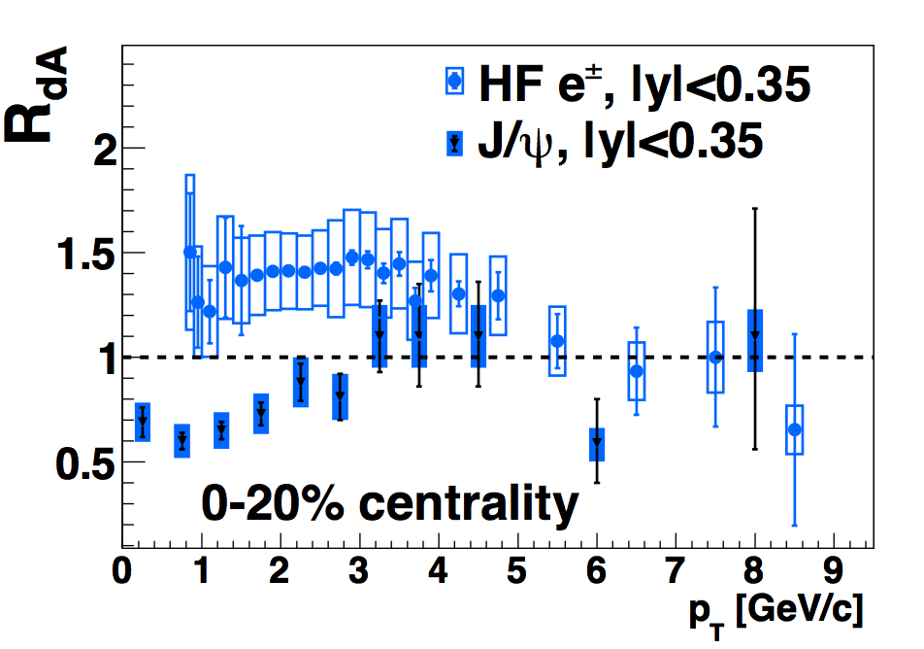
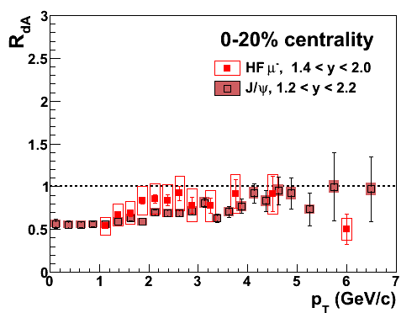

CNM for Open and Closed Heavy Flavor
Open heavy flavor shows a different rapidity dependence from J/ψ
Combination of initial-state and final-state effects or primarily final-state?
The FVTX will allow more precise measurement to better quantify differences from Run 15 p+A
EPS09
arXiv:1310.1005
PRL 109, 242301
PRC 87, 034904
PRC 87, 034904
arXiv:1310.1005
PRC 87, 034904
d
Au

Slide 13
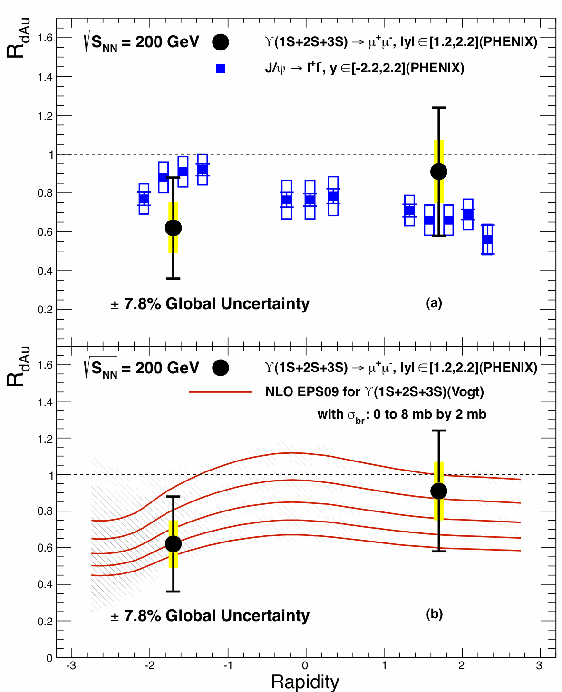
What About Upsilons?
Possible suppression at backward rapidity (but error bars large)
Forward rapidity may or may not be suppressed
Challenging to make significantly better measurements with PHENIX. sPHENIX proposes to continue upsilon program.

Slide 14
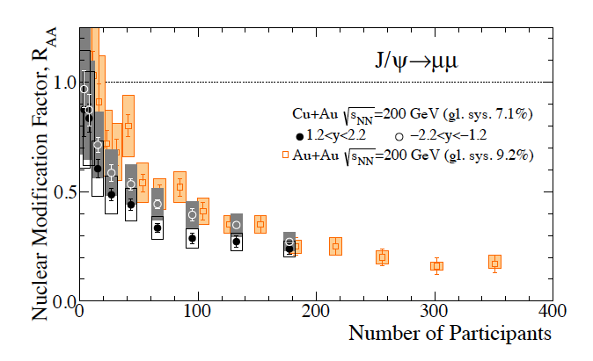
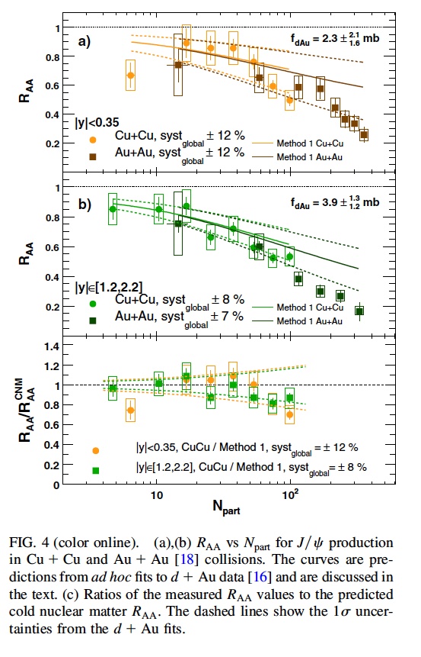
System Size and CNM
Suppression similar for smaller systems (CuCu) and larger (AuAu). Close to value extrapolated from dAu (modified PDF and breakup)
Small rapidity dependence in CuAu, more consistent with CNM effects than QGP

Slide 15
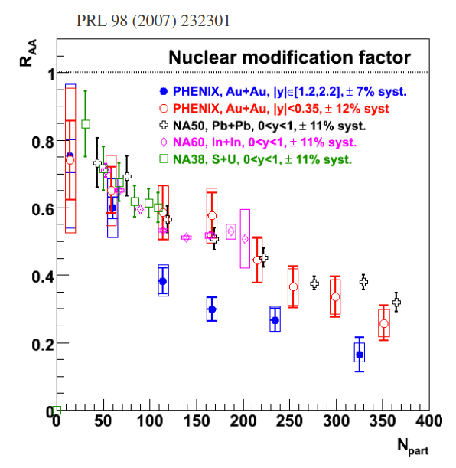
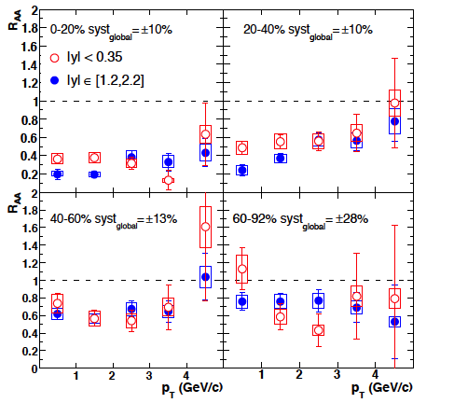
J/ψ Heavy Ion Measurements
J/ψ suppression strikingly similar at SPS and RHIC despite different energies
Rapidity dependence not initially expected: CNM effects bring forward down? Coalescence brings central up?
p_{T} dependence does not show a strong effect
PRL 98 (2007) 232301

Slide 16
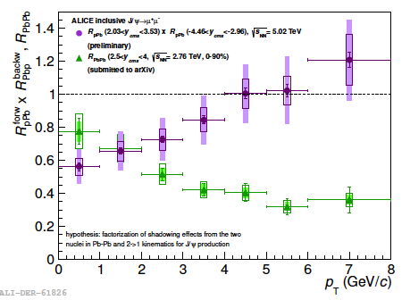
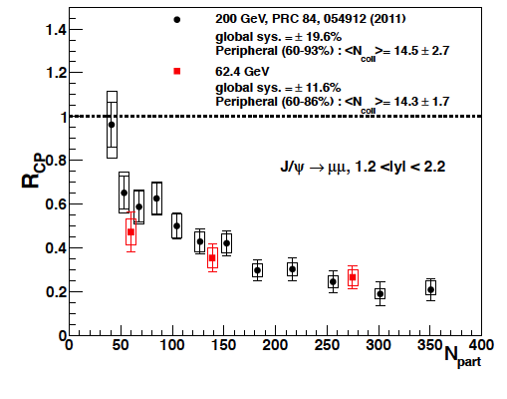
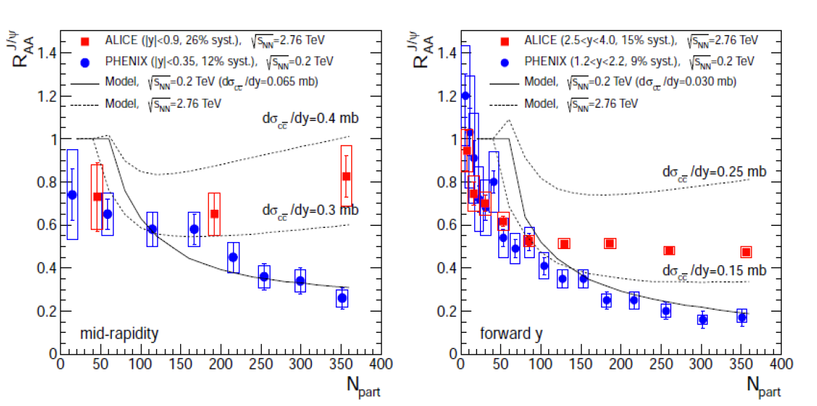
Energy Dependence Cont’d
Explore energy dependence more at RHIC
Don’t see large change in suppression until LHC
p_{T} dependence now looks consistent with coalescence picture

Slide 17
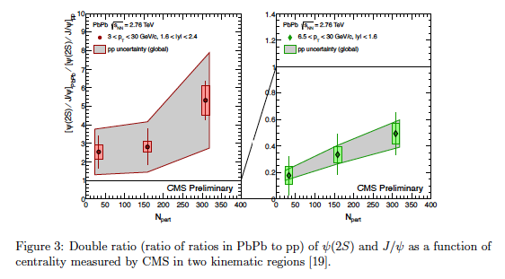

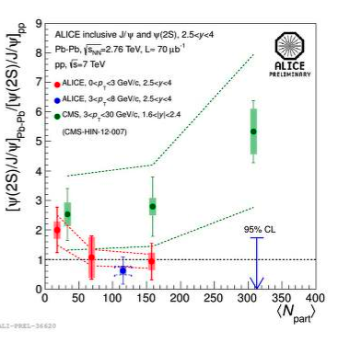
Heavy Ion ψ’:J/ψ
At LHC energies, the J/ψ:ψ’ ratio also seems to now deviate from linear trend.
Another indication of coalescence atLHC? What will we see in RHIC heavy ion?

Slide 18
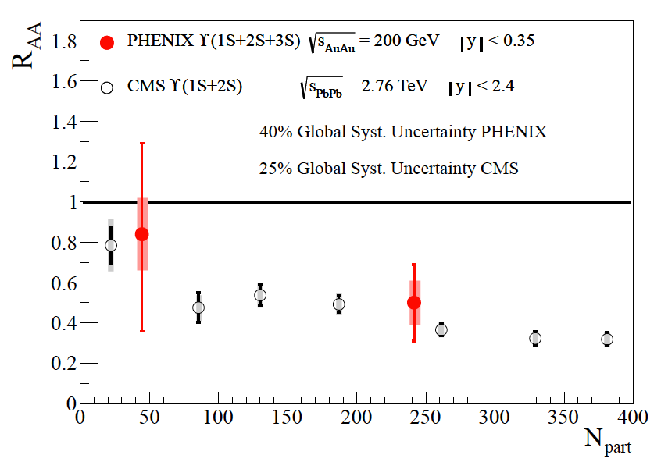
Upsilon Au-Au
R_{AA} ~0.65 if no 2S, 3S
R_{AA} ~0.37 if no 2S, 3S, χ_{B}
PHENIX consistent with 2S, 3S states both melt, if no other suppression effects
arXiv:1404.2246

Slide 19
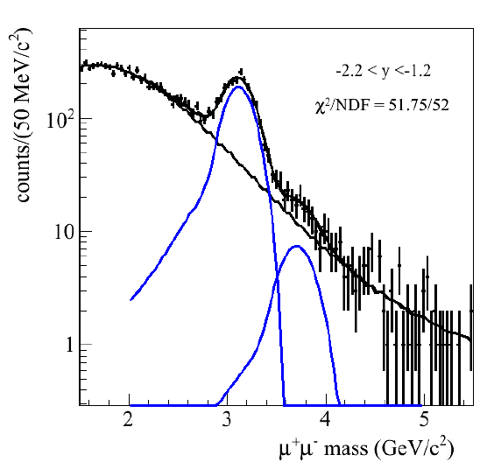
What’s Next at PHENIX?
J/ψ:ψ’ ratio in CuAu and AuAu at forward rapidity – will we see any ψ’?
J/ψ:ψ’ ratio in p+A at forward and backward rapidity – will it follow same dN_{ch}/dη trend?
J/ψ:ψ’ ratio versus multiplicity
Higher precision open heavy
flavor, B/D separation
CuAu J/ψ, ψ’

Slide 20
Summary
Significant suppression of J/ψ in d-Au; x₂ dependence → suppression not from gluon shadowing
Extrapolation to heavy ion similar to what is measured except perhaps central AuAu → what might QGP suppression be? Can we reduce extrapolation errors?
ψ’ suppressed beyond J/ψ in d+Au, proportional to dN_{ch}/dη independent of energy→co-mover type effect, not nuclear medium?
J/ψ suppression in heavy ion: similar N_{part} trend across energies, system-size until LHC where suppression is reduced →recombination?
How much of J/ψ suppression might be due to QGP effects? Does ψ’ survive in heavy ion collisions at RHIC?

