Slide 1
Status of KISTI Tier1
Sang-Un Ahn (sahn@kisti.re.kr)
On behalf of the GSDC Tier1 Team
WLCG Management Board
18 November 2014
Notes:
Good Day Everyone.
I am Sang-Un Ahn,
and on behalf of the GSDC Tier1 Team,
I am going to talk about the status of KISTI Tier1
precisely the progress and the performance of our site
as a candidate of WLCG Tier1.

Slide 2
OUTLINE
Operations
Network Upgrade Plan
Conclusion
Notes:
This is the outline of today’s talk.
Short introduction to the KISTI and GSDC,
Summary report on the operations of Tier1 and KIAF,
Current network configuration and future plan including OPN joining,
Milestones, and conclusion.

Slide 3
operations
Notes:
Operations.

Slide 4
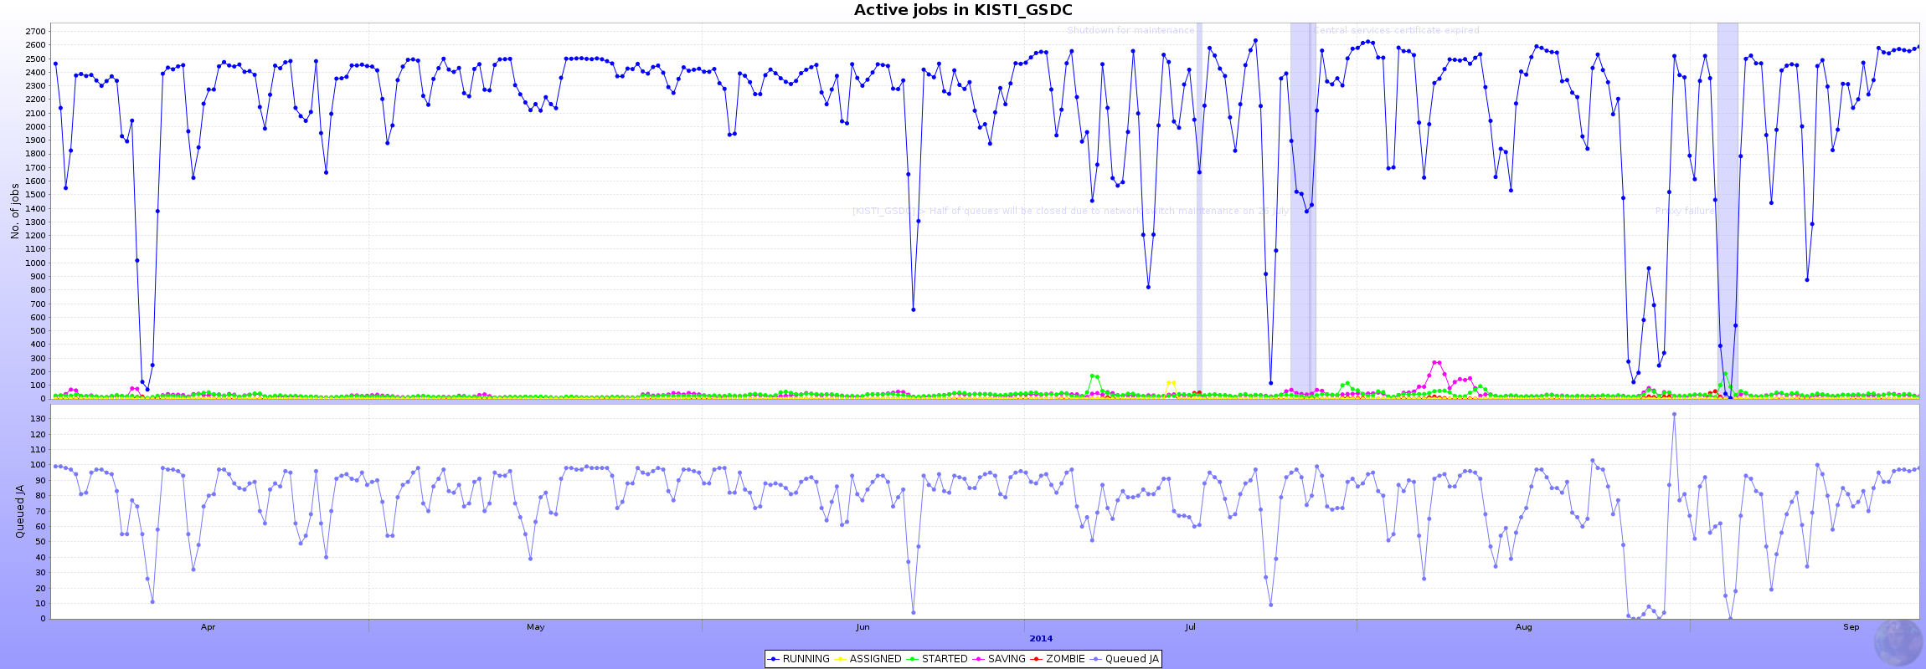
Jobs
Total wall clock hours for ALICE jobs in 2014
KISTI, 6.11 %
(Including Tier-2)
2,688 concurrent jobs = 28 kHS06
  84 nodes, 32 (logical) cores per node, 10.5 HS06/core
Stable and smooth running
  Few short incidents mostly due to the maintenance of undersea optical fibre link
Completed 2M jobs in the last 6 months
  More than total processed jobs in the last year (1.8M)
~ 2500
~ 100 (Queued Agents)
Apr 201
Aug 2014
Notes:
Concerning jobs, we have eighteen hundred job slots for ALICE.
Current performance for high energy physics job processing is about sixteen k-HepSpec.
Including computing power of KISTI Tier2, our share for ALICE jobs is three point six percent.
The pledges for this year is twenty five k-HepSpec with two thousand cores.
And this will be fulfilled by the end of November.
There has been several issues on operations but overall site performance has been gradually getting better as you can see in the bottom plot.
I am not going into details on this plot.

Slide 5
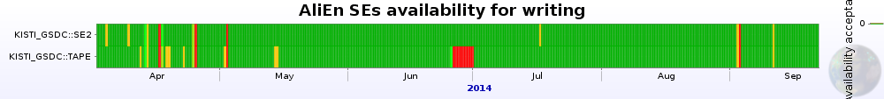
Storage
DISK
TAPE
Deployed 1000TB
  XRootD managed – 1 redirector, 9 storage nodes
  Pledges for 2014 fulfilled
Deployed 1040 TB
  8 Tape drives w/ total 2 GB/s throughput
  260 Tapes, 4 TB per tape
  Pledges for 2014: 1,500 TB - purchasing additional media now
Tape buffer pool – XRootD + TSM
  2 redirector, 20x20TB servers (400 TB pool)
  2 TSM server + 8 GPFS servers (200 TB pool)
  Total 600 TB
Data migration with FRM (File Redundancy Manager) from XRootD to GPFS
  Using ITLM(IBM) policy integrated in GPFS towards backend storage
< Storage Availability >
< Storage Usage >
< Tape Buffer Usage >
Notes:
Storage.
One petabyte of disk has been allocated for ALICE which fulfilled the pledges for two thousand thirteen,
And one petabyte of tape has been installed
together with a disk buffer of four hundred seventy five terabytes.
By the end of this year, disk pool for tape will be expanded up to six hundred
to have higher availability as well as better performance on throughput.
One of the milestones for Tier1, to be explained in the later, is to achieve more than 90% (ninety percent) of availability of storage for at least two months.
On the left plot, for more than six months, KISTI storage has shown higher availability than the requirement.

Slide 6
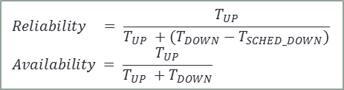
Site Availability/Reliability
$$Reliability = \frac{T_{UP}}{T_{UP} +(T_{DOWN}−T_{SCHED_DOWN})}$$
$$Availability = \frac{T_{UP}}{T_{UP} +T_{DOWN}}$$
100% Reliable for the last 6 month (from April to September)
  Monthly Target for Reliability of ALICE test: 97%
On track for a stable and reliable site
  Participating in weekly WLCG operations meetings (2 times (Mon/Thu) per week): reporting operation-related issues
< Summary >
 | Reliability |  | Availability
 | Overall in 2014 | Last 6 months | Overall in 2014 | Last 6 months
ALICE | 99 % | 100 % | 98 % | 99 %
< Monthly Availability/Reliability (%) >
 | Apr | May | Jun | Jul | Aug | Sep
Reliability | 100 | 100 | 100 | 100 | 100 | 100
Availability | 100 | 99 | 99 | 99 | 100 | 100
※ Few announced downtime for maintenance in May, June and July.
Downtime announcement keeps sites reliable but cannot prevent them from being unavailable
Notes:
In this slide I summarized our site availability based on WLCG monthly report.
Monthly target for reliability is ninety seven percent.
The red line on the bottom plot represents the monthly target,
and you can see the history of KISTI Tier1 site availability and reliability,
of OPS and ALICE VO on every months since March two thousand twelve.
As you can see, it has shown gradual increase of overall availability.
In particular, for the last year, mostly we achieved the monthly target in spite of a few unscheduled downtime.

Slide 7
Joining OPN
LHCOPN Joining done in Jan 2014
perfSONAR instances are installed and fully functional
  Scheduled tests among WLCG Tier-1 sites
※ For the moment, perfSONAR instances are down due to shellshock; to be re-installed with new release by December
Notes:
We have a good news regarding OPN.
After discussion on joining OPN and network performance issue with CERN OPN experts in October,
This week, finally we started OPN joining.
We informed KISTI Tier1 network prefix and KISTI KREONET service team is taking care of the technical part.
We will follow closely the bandwidth upgrade plan.
Concerning perfSONAR test mentioned in the previous slides, it will be carried out with the help of CERN external network people.

Slide 8
network PLAN
Notes:
Network.

Slide 9
Network Upgrade Schedule
10Gbps upgrade will be completed by March, 2015 at least before RUN2 starts
Tender
Notification
Complete
Contract
RUN2
2 mon
Upgrade
(3 mon)
Buffer
(2 mon)
Oct.
Dec.
Mar. 2015
May
Funding has been secured with a lot of supports from Korean government.
Only administrative procedures are left.
From Seo-Young Noh @ CKC in Oct. 2014

Slide 10
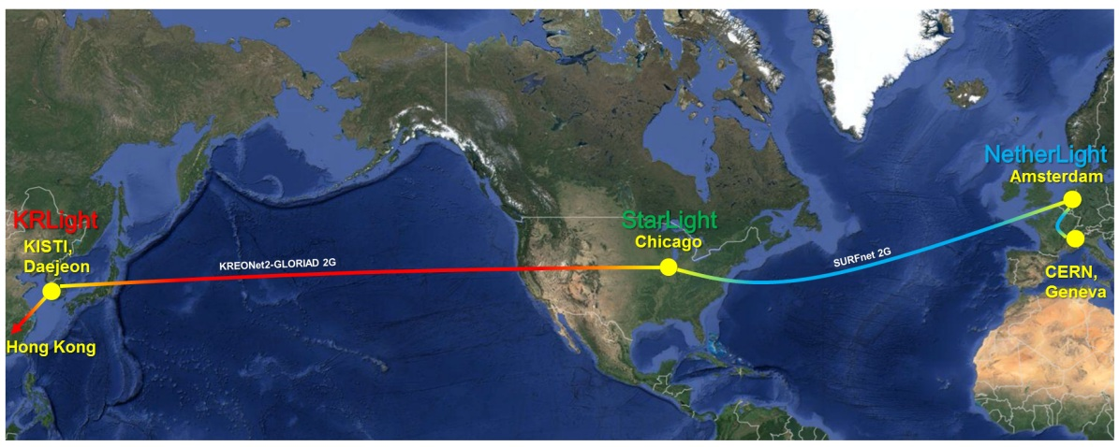
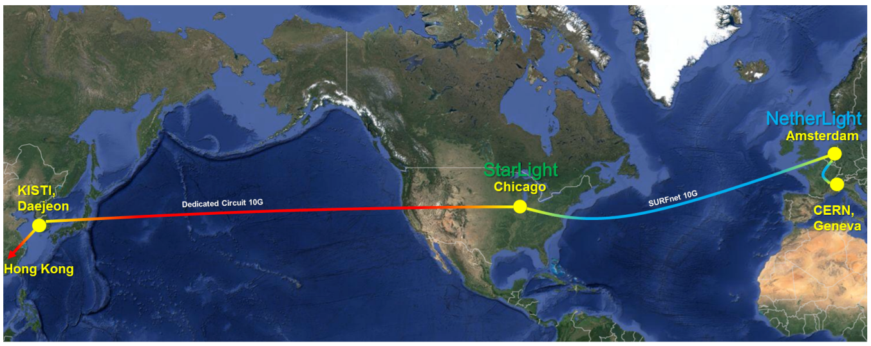
Planed 10Gbps Network
As-Is:
2G KREONET2 + 2G SURNet
10Gbps Upgrade
To-Be:
Dedicated Circuit 10G + 10G SURFnet
Contracted provider will allocate the dedicated circuit 10G.
From Seo-Young Noh @ CKC in Oct. 2014

Slide 11
Conclusion
WLCG Tier-1 at KISTI has been running stable
  Most reliable site in WLCG
Fulfilled the requirements for Tier-1 and fully functional
  Computing and Storage resources
  Network: 10G will be at service by (at least) Mar 2015 regarding procurement process
Notes:
Conclusion.
KISTI has deployed and run Tier1 services since the approval as a candidate in two thousand twelve ,
and majority of the milestones have been achieved.
By the end of this year, all resources pledges for ALICE will be fulfilled.
This table shows the summary of KISTI computing resources for ALICE including Tier2.
So, share of KISTI pledges in ALICE computing is 8 (eight) percent,
while the ALICE expectation to KISTI is 2.7 (two point seven) percent.
Budget for upgrading the connectivity up to ten giga-bps from KISTI to CERN is secured and will be performed in the coming fiscal year.
And now programme for joining OPN is under way.
Target for 10 giga-bps network is six months before the RUN two
Finally we strongly hope to get promoted as a full Tier1. Thank you.

Slide 12
THANK YOU
감사합니다

