Slide 1
Exploring dense gluon states with the Color Glass Condensate
Raju Venugopalan
Brookhaven National Laboratory
IS 2014, Napa, December 4-7, 2014

Slide 2
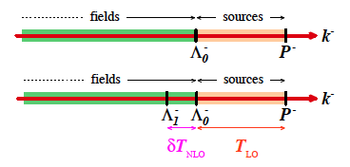
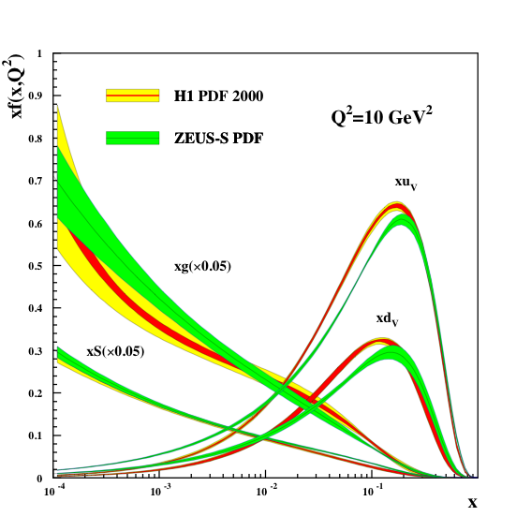
Color Glass Condensate EFT
Gelis,Iancu,Jalilian-Marian,RV: Ann. Rev. Nucl. Part. Sci. (2010)
QCD light front EFT framework of static light front (large x) color sources ρª coupled to dynamical (small x) gauge fields Aª_{μ}
Wilsonian procedure in x (or rapidity) whereby fields are successively
absorbed into sources- at each step, one has a classical EFT
- whereby A’s are functionals of ρ
where
Hamiltonian-describes functional “Fokker-Planck” –like evolution
(in rapidity) of hierarchy of Balitsky-JIMWLK multi-parton (Wilson line) correlators

Slide 3
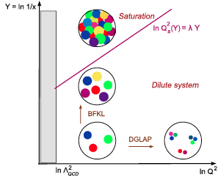
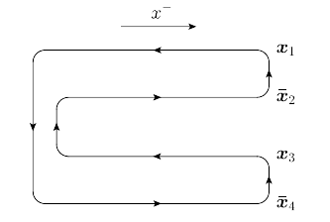

Color Glass Condensate EFT
Dynamically generated semi-hard
scale Q_{S} controls multi-parton
dynamics in the saturation regime
k_{T} >> Q_{S} , recover perturbative dynamics
k_{T} ≤ Q_{S} , classical high occupancy regime
In nuclei, the saturation scale
is enhanced: Q_{S}² ~ A^{1/3} Λ²_{QCD} e^{λY}
Multi-parton dynamics encoded in
energy evolution of light-like Wilson line correlators
These objects appear in
a number of final states in
DIS and hadron collisions
Dipoles
Quadrupole

Slide 4
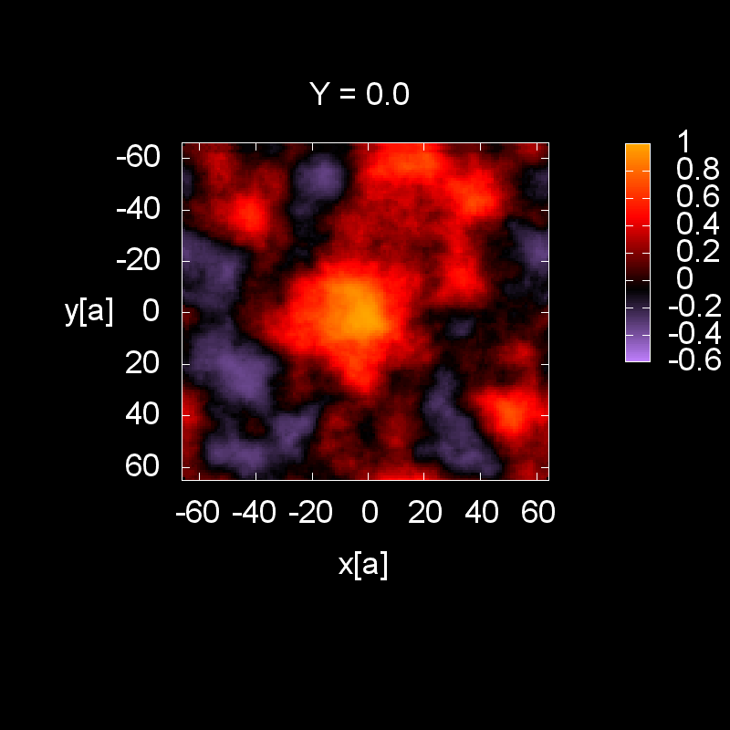
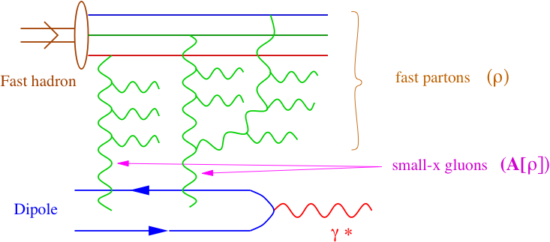
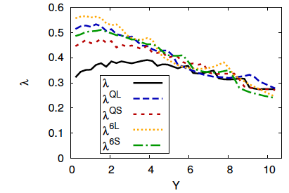
B-JIMWLK: the BBGKY hierarchy of gluodynamics
Balitsky (1996); Kovchegov (1999)
Jalilian-Marian,Kovner,McLerran,Weigert (1997)
Iancu, Leonidov, McLerran (2001)
Dumitru,Jalilian-Marian,Lappi,
Schenke,Venugopalan (2011)
Rate of energy evolution of dipole and quadrupole saturation scales
Results are to “leading log x accuracy”
+ running coupling
-- next-leading-log x results now
available
Balitsky, Chirilli, arXiv: 1309.7644
Kovner, Lublinsky, Mulan, arXiv:1405.0418

Slide 5
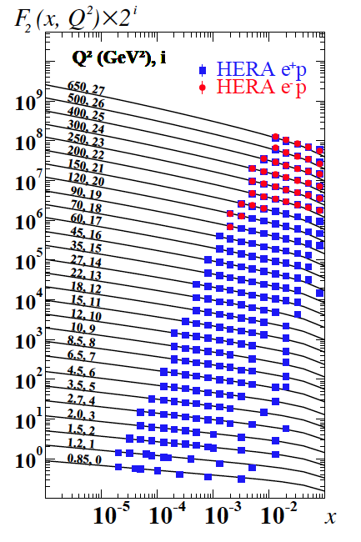
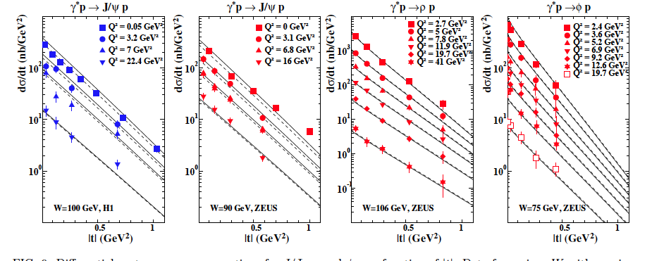
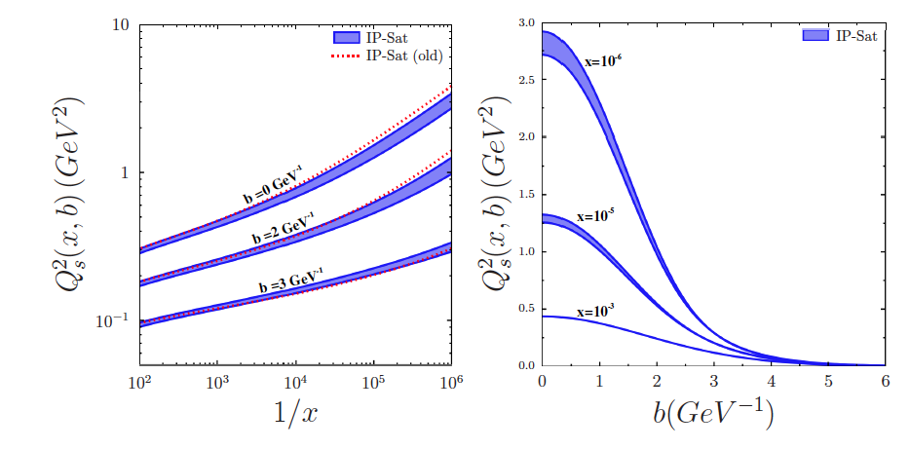
Gluon impact parameter profile: IPsat model
Rezaiean,Siddikov,Van der Klundert,RV:1212.2974
Inclusive DIS off proton
Exclusive DIS off proton
Average gluon radius of proton
from HERA diffractive data
Q_{S}² in rare p+p events ~ a factor of 5 >
than typical HERA events

Slide 6
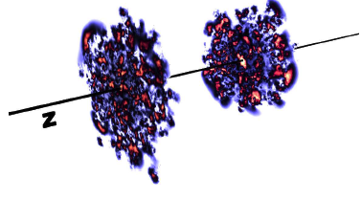
High multiplicity “dense-dense” collisions
CGC power counting terminology:
“dense-dense” -- Q_{S1}²(x,b)/k_{T1}² ≥ 1 ; Q_{S2}²(x,b)/k_{T2}² ≥ 1
Valid for A+A collisions, very central “rare” p+p and p+A collisions
“dilute-dense” -- Q_{S1}²(x,b)/k_{T1}² ≤ 1; Q_{S2}²(x,b)/k_{T2}² ≥ 1
Valid for dilute projectile, dense target (forward p+p, p+A)
“dilute-dilute” -- Q_{S1}²(x,b)/k_{T1}² ≤ 1; Q_{S2}²(x,b)/k_{T2}² ≤ 1
Valid for large k_{T}, peripheral collisions – regime to match smoothly to coll. pQCD

Slide 7
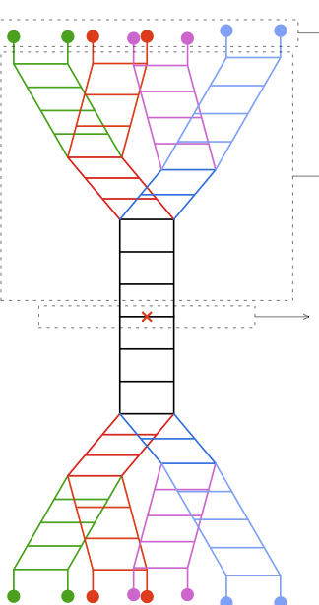
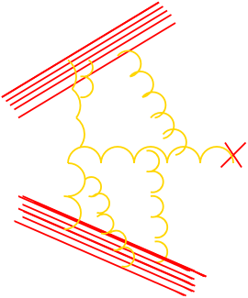
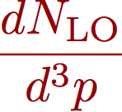
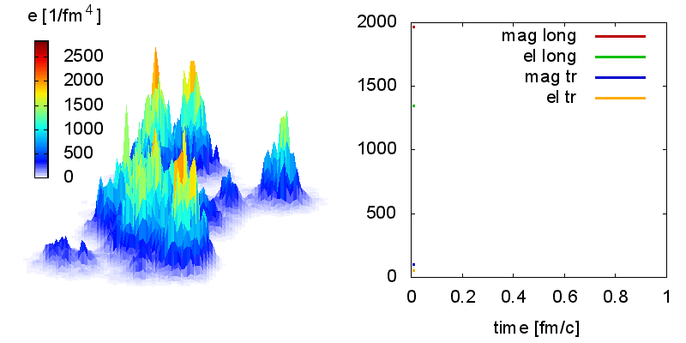
dense-dense factorization: gluon production
Schwinger-Keldysh formulation
Gelis,Lappi,RV; 0804.2630; 0807.1306
Jeon, 1308.0263
Epelbaum,Gelis; 1307.1765
Initial configuration of
sources for nucleus 1
BK/JIMWLK evolution for nucleus 1
Computed from Yang-Mills Glasma gluon fields -- includes coherent “final state” scattering
Krasnitz, Nara, RV; Lappi
Identical evol. for nucleus 2
Full JIMWLK+YM evolution feasible Lappi, PLB 703 (2011)209; see talk by Mantysaari
In practice, for A+A: IP-Glasma framework of using HERA proton DIS to obtain
energy evolution + construct “lumpy nuclei” at each rapidity+solve YM equations
Schenke,Tribedy,RV:1202.6646
Schenke, Tribedy, RV: 1206.6805

Slide 8
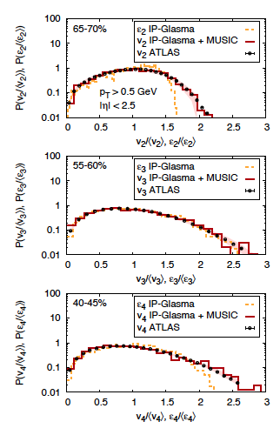
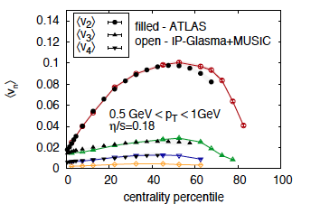
Heavy ion phenomenology with Glasma IC
Gale,Jeon,Schenke,Tribedy,Venugopalan, PRL (2013) 012302
Schenke, Venugopalan, PRL 113 (2014) 102301
IP-Glasma + viscous hydro (MUSIC)
-- excellent description of V_{n} centrality
dependence, p_{T} distributions, and
event-by event fluctuations in A+A

Slide 9
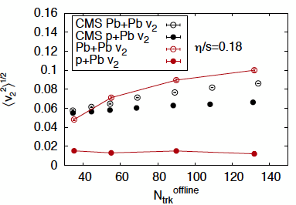
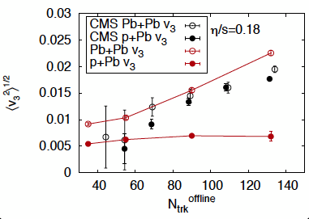
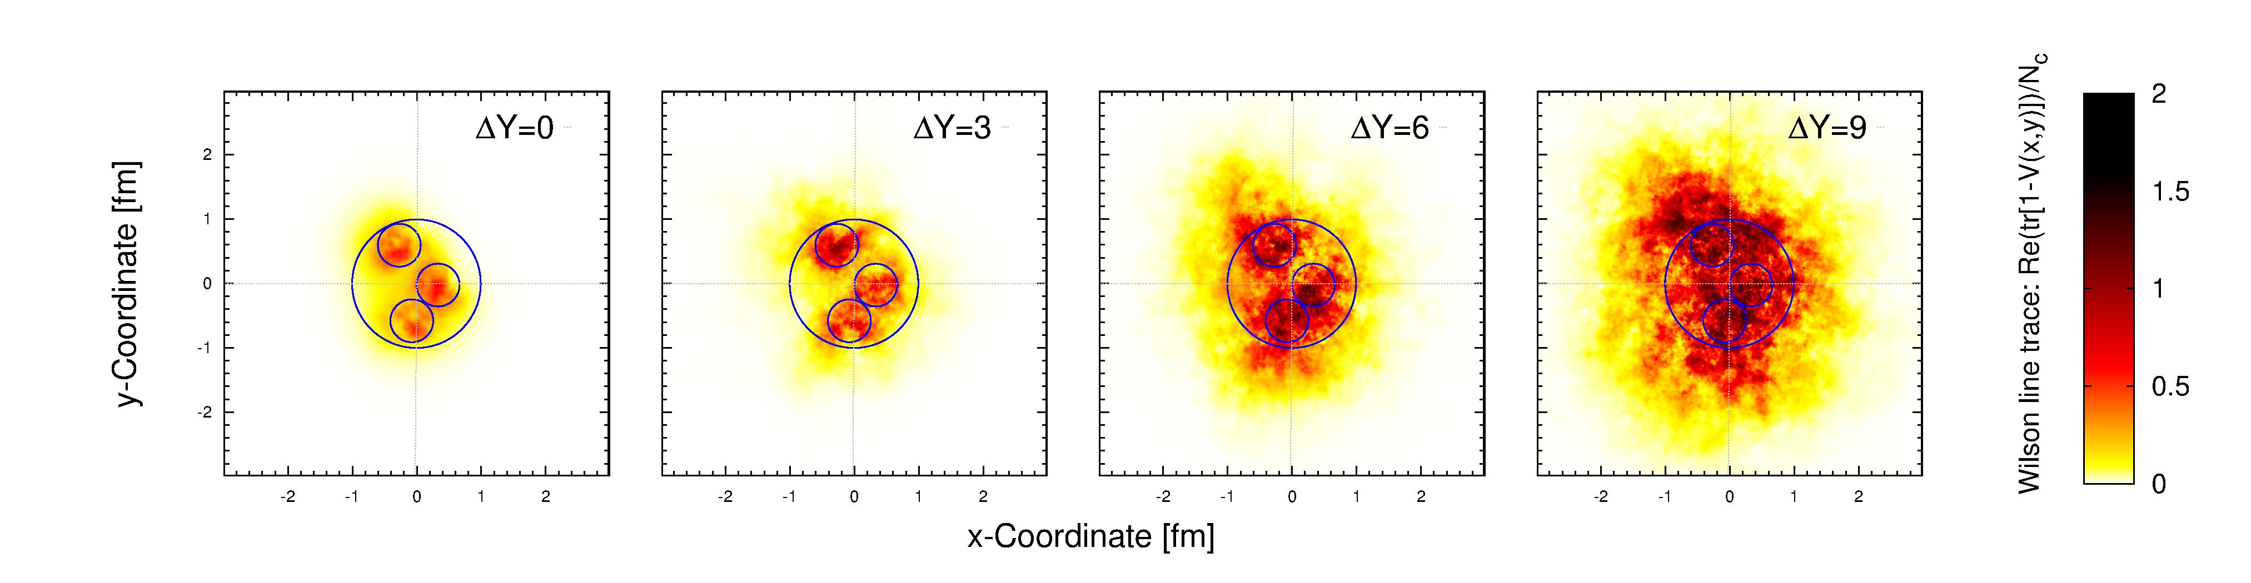
IP-Glasma and p+A collisions
Schenke, Venugopalan, PRL113 (2014 102301)
In contrast, IP-Glasma + MUSIC results, disagree with data…
Note: some Glauber models describe p+A data-- no model
simultaneously describes peripheral A_A and central p+A , eg., Kozlov et al., 1405.3976
Are p+A V_{n} sensitive to event-by-event
gluon spatial distribution in the proton ?
Promising results in purely
“initial state” (non-hydro) models
– see talks by Dumitru, Skokov and Schlichting
Schlichting, Schenke, 1407.7557
How do these “initial state” contributions compete with those from hydro –
Can we isolate their relative contribution ?

Slide 10
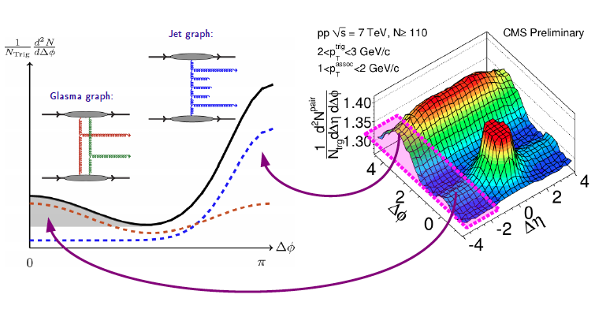
Intrinsic long range correlations in the Glasma
Dumitru,Dusling,Gelis,Jalilian-Marian,Lappi,RV, arXiv:1009.5295
Dusling, RV, 1302.7018
Glasma + BFKL graphs:
Prior treatments (assume
k_{T}≥Q_{S}) did not include
coherent multiple scattering or
proton shape fluctuation…:
Reproduce only even moments
-- not v₂{4, 6, 8}
“Net” initial state contribution is from
a) Event-by-event shape fluctuations: these are leading in N_{C} but suppressed by
the number of domains
b) Intrinsic 2-particle correlations – these are sub-leading in N_{C}
See also Kovchegov and Wertepny, 1310.6701

Slide 11
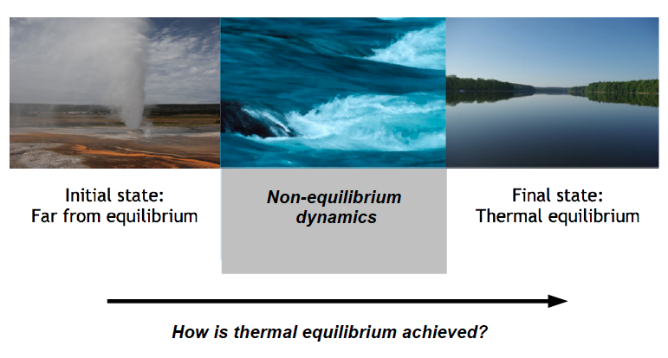
Equilibration of the Glasma

Slide 12
3+1-D Yang-Mills simulations
At early times τ ~ Ln²(1/α_{S})/Q_{S}, system is described by high
occupancy gluon fields – how does it evolve ?
For occupancies f >> 1, employ classical statistical
simulations
Is there a smooth matching to kinetic theory and hydrodynamics
for lower occupancies ?
Berges,Boguslavski,Schlichting,Venugopalan, 1303.5650, 1311.3005
Epelbaum, Gelis, 1307.1765, 1307.2214
Baier,Mueller,Schiff,Son
Kurkela, Moore,
Blaizot,Gelis,Liao,McLerran,Venugopalan
Blaizot, Liao, McLerran; Xu-gang Huang, Liao
Kurkela, Lu
Xu,Zhou,Zhuang,Greiner
Talks by Berges, Epelbaum, Kurkela

Slide 13
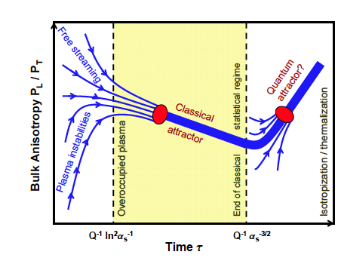
Quo vadis, QGP ?
Blaizot,Dominguez,
Iancu,Mehtar-Tani
Striking universality between expanding scalars and expanding gauge
theory in weak coupling
Berges,Boguslavski,Schlichting, RV, 1408.1670
Are there direct observable consequences of early-time dynamics ?
E&M probes are most promising
Talk by McLerran

Slide 14
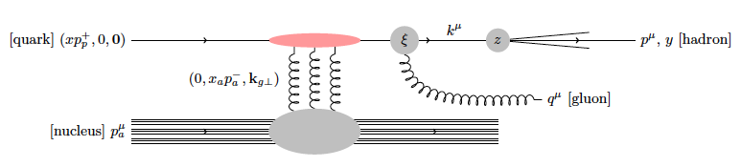
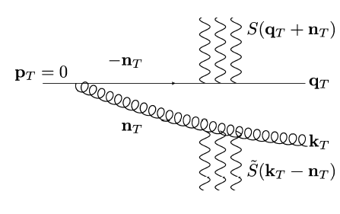
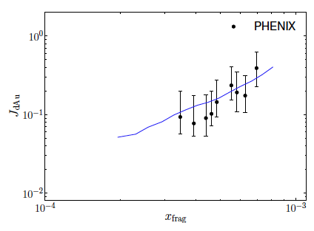
Probing the CGC in dilute-dense kinematics
Stasto,Xiao,Yuan,Zaslavsky, 1405.6311
Altinoluk et al., 1411. 2869
Forward single inclusive hadron production results are now available at
NLO –matching of collinear and small x formalisms
See also talk by Paatelainen
Double inclusive hadron production
Is sensitive to dipole and quadrupole gluon
correlators
Lappi, Mantysaari, 1209.2853
Dominguez,Marquet,Xiao,Yuan,1101.0715
Lappi, Mantysaari, 1209.2853

Slide 15
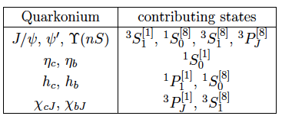




Quarkonia: CGC meets NRQCD
Kang,Ma,RV, JHEP1401 (2014) 056
Ma, RV, PRL113 (2014) 192301
κ = ^{2S+1}L_{J}^{[c]} quantum
numbers of the intermediate
heavy quark pair
Short distance dynamics
computed in the CGC
Long distance NRQCD matrix elements (LDME)
K.-T. Chao et al., PRL108 (2012) 2420
Onium overview
talk by Jianwei Qiu
CGC amplitude projected on state with quantum #’s κ
Dilute-dense CGC computation of
quark pair production
Blaizot,Gelis,RV, hep-ph/0402257

Slide 16
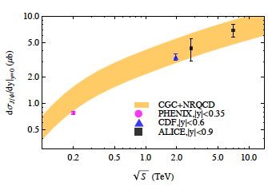
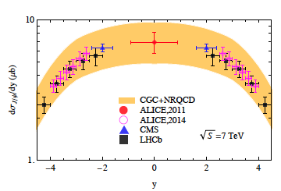
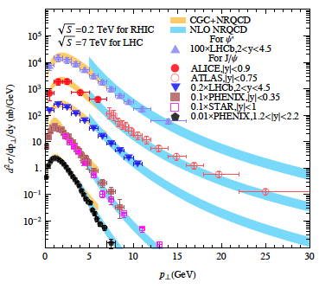
Results for p+p collisions
Total cross-sections
Ma, RV, PRL113 (2014) 192301
Rapidity distributions
p_{T} distributions match CGC+NRQCD at low p_{T} to NLO pQCD+NRQCD at large p_{T}
Color singlet contribution at most 10%
Estimate this to be 15-20% for p+A
Qualitative & quantitative differences
with other approaches
Brodsky,Lansberg, PRD81 (2010)051502
Fujii,Watanabe, NPA915 (2013) 1
Nelson,Vogt,Frawley, PRC87 (2013)014908

Slide 17
Quarkonia in p+A collisions
LHCb data. JHEP 02 (2014) 072
Yan-qing Ma, Hong-fei Zhang, RV, in preparation
THEORY
PRELIMINARY
THEORY
PRELIMINARY
Two “free” parameters-the transverse overlap area and saturation scale
at initial rapidities -- both are reasonable
The matching to NLO pQCD ensures (modulo small shadowing corrections)
that RpPb will go to unity – as seen in the data.
This will ensure better agreement with data relative to previous CGC calculations

Slide 18
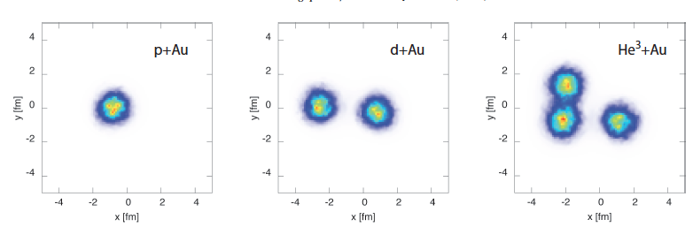
IP-Glasma+MUSIC and ³He+Au
Schenke,Venugopalan, arXIv:1407.7557
IP-Glasma+MUSIC prediction slightly overshoots v₂ but in good agreement for v₃
Theory curves
IP-Glasma+MUSIC
Glauber predictions w/o preflow:
Nagle et al, PRL 113 (1312.4565)

Slide 19
Some loose ends…
Role of gluon fragmentation for p_{T} ~ Q_{S} needs to be better understood
- fragmentation functions are problematic D’Enterrria, Eskola, Helenius, Paukkunen, 1408.4659
Color reconnection models can generate “flow-like” mass
splitting even in low multiplicity events. Ortiz Velasquez et al., 1303.6326
Much focus on p+A and A+A – p+p high multiplicity results too should be
incorporated in any complete picture – qualitative differences at same N_{ch}
Data on UPCs can now discriminate between models of gluon shadowing.
Lappi talk on CGC/shadowing model comparisons
Near future: RHIC ³He+Au & p+A data – essential insight into initial dynamics.
In the (not so) long term future, EIC will map out in detail the spatial
distribution of gluons for typical and rare events
Talks by Aschenauer and Lamont

