Slide 1
Crab Cavity Results
Ben Woolley
&
The Xbox team

Slide 2
Outline
Crab cavity RF Design
Fabrication
Tuning
High power testing: Xbox-2
Conditioning and Performance
Breakdown locations
Future testing

Slide 3
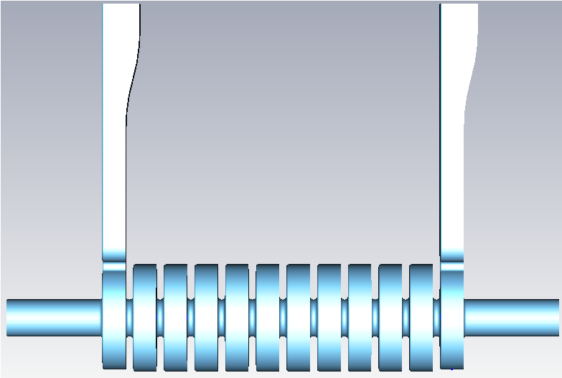
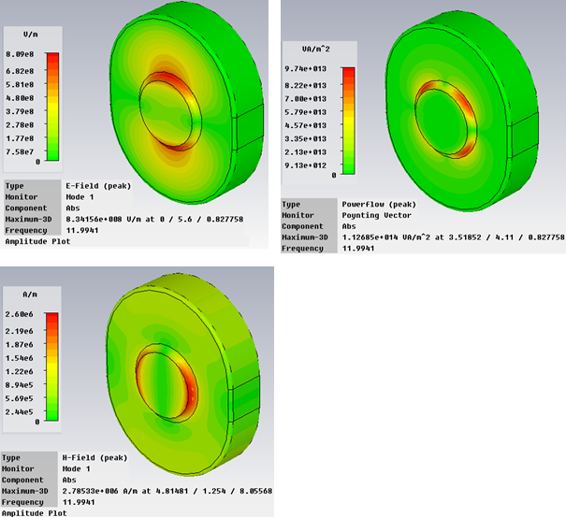
RF Design
E_{surf}
Peak electric and magnetic fields of the dipole mode are located 90 degrees from each other on the iris
Surface Poynting flux S_{surf} is however at 45 deg to both E and H
Location of the breakdown on the iris provides critical information about the role of magnetic field in breakdown.
The cavity has a large Sc but relatively low E and H fields at the surface so this also provides an independent verification of new theories.
H_{surf}
Property | Crab cavity | CLIC_G
Mode | 120° , 11.9942 GHz | 120° , 11.9942 GHz
Q | 6247 | 6100-6265
V_{group} | -2.9 %c | 1.66-0.83 %c
Kick | 2.55 MV | NA MV
Gradient | 26 MV/m | 100 MV/m
Power | 13.35 MW | 42 MW
E_{surf} | 103 MV/m | 190 MV/m
H_{surf} | 348 kA/m | 410 kA/m
ΔT (200ns) | 26 K | 21 K
Sc | 3.32 W/mm² | 3.8 W/mm²
S_{surf}=(ExH)_{surf}

Slide 4
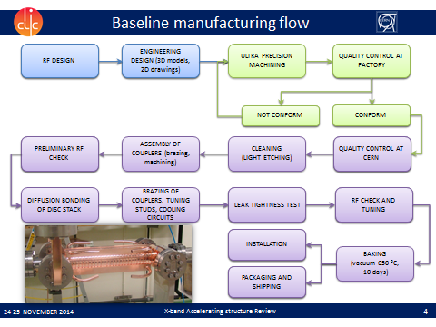
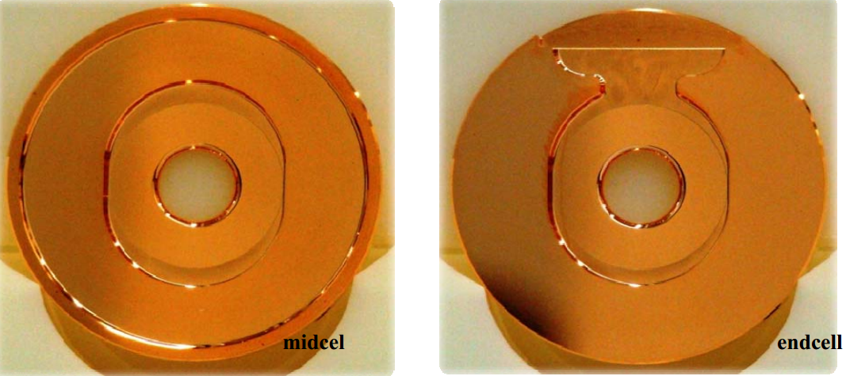
Fabrication
Manufactured with normal CERN techniques:
Discs ultra-precision machined at VDL
Stacking and alignment performed at CERN or Bodycote.
Coupler brazing and bake out at Bodycote.

Slide 5
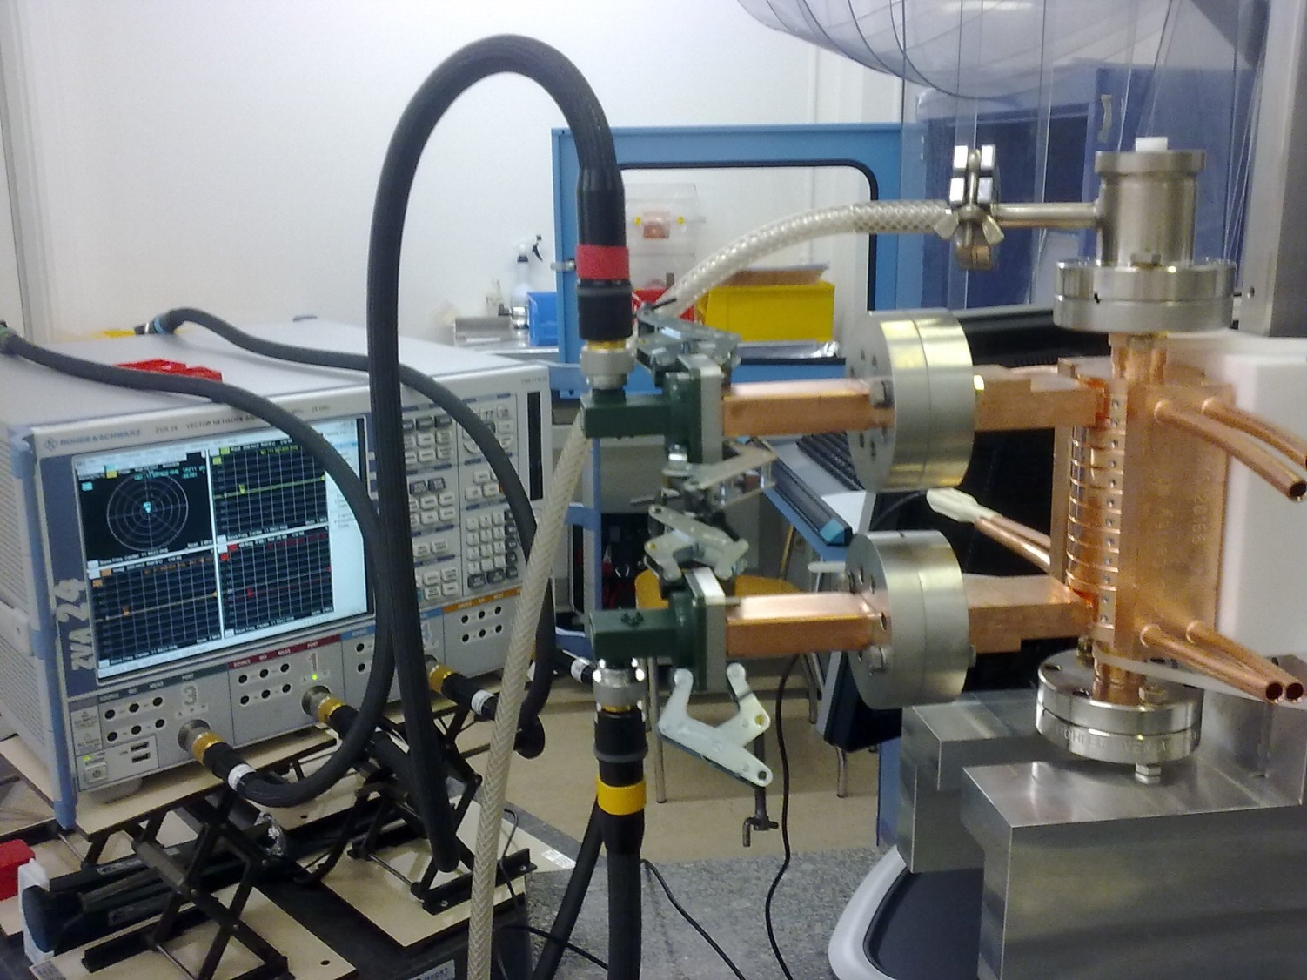
Tuning
centring V guiding the wire for bead-pull measurements
nitrogen supply
input (chosen and marked)
tuning pins (4 per cell)
temperature sensor
cooling block
output (marked)

Slide 6
Before Tuning
input reflection
bead-pull @ 11.9922 GHz

Slide 7
Tuning - E. Daskalaki, A. Degiovanni, C. Marrelli, M. Navarro Tapia, R. Wegner, B. Woolley
cell |  | tuning record of |ds11|*sign(df) (mU)
 |  | 1 | 2 | 3 | 4 | 5 | 6 | 7 | 8 | 9 | 10 | 11 | 12 | 13 | 14
1 | in
2
3
4
5
6
7 |  |  |  |  |  |  |  |  |  |  |  |  |  |  | +4.8
8 |  |  |  |  |  |  |  |  |  |  |  |  | +9.6 | +14.0
9 |  |  |  |  |  |  |  |  |  |  |  | -8.9 |  |  | -3.4
10 |  |  |  |  |  |  |  |  |  | +7.0 | +4.0
11 |  |  |  |  |  | +7.4 | +12.0
12 | out | +8.1 | +10.2 | +12.3 | +8.7 |  |  | -7.5 | -3.2
cell |  | tuning record of |ds11|*sign(df) (mU)
 |  | 15 | 16 | 17 | 18 | 19 | 20 | 21 | 22 | 23 | 24 | 25 | 26 | sum
1 | in |  |  |  |  |  |  |  |  |  |  | +9.8 |  | +9.8
2 |  |  |  |  |  |  |  |  |  |  | +10.5 |  | +9.9 | +20.4
3 |  |  |  |  |  |  |  |  | +6.2 | +21.7 |  |  |  | +27.9
4 |  |  |  |  |  | +5.3 |  | +3.8 |  |  |  |  |  | +9.1
5 |  |  |  |  | +6.4 |  | +3.1 |  |  |  |  |  |  | +9.5
6 |  | +5.0 |  | +5.7 |  |  |  |  |  |  |  |  |  | +10.7
7 |  | +7.0 | -3.4 |  |  |  |  |  |  |  |  |  |  | +8.4
8 |  |  |  |  |  |  |  |  |  |  |  |  |  | +23.6
9 |  |  |  |  |  |  |  |  |  |  |  |  |  | -12.3
10 |  |  |  |  |  |  |  |  |  |  |  |  |  | +11.0
11 |  |  |  |  |  |  |  |  |  |  |  |  |  | +19.4
12 | out |  |  |  |  |  |  |  |  |  |  |  |  | +28.6

Slide 8
Tuning Results
input reflection
bead-pull @ 11.9922 GHz

Slide 9
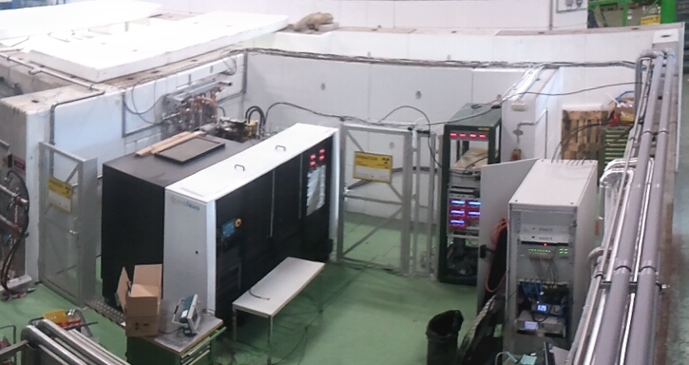
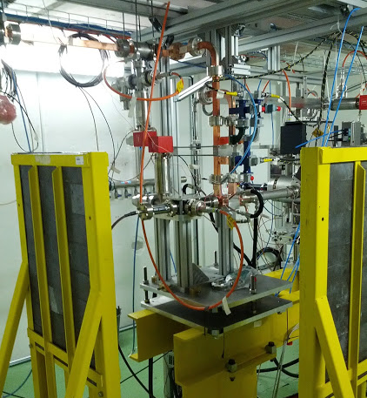
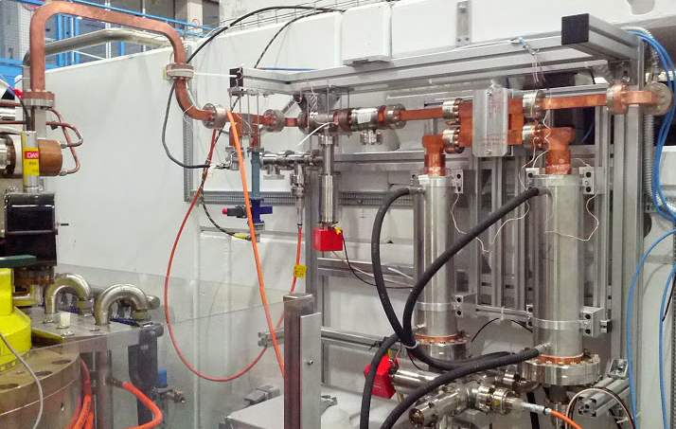
Xbox-2
Scandinova Modulator
Klystron (50MW, 1.5us pulse) For Crab cavity test: SLAC XL5 klystron
Pulse compressor (250ns, ratio ~3)
Stainless steel load

Slide 10
Crab Cavity Diagnostics
Reflected Power
Incident Power
Uppsala Dark Current Spectrometer
60 dB directional coupler
RF Load
RF In From Pulse Compressor
Transmitted Power
WR90 Waveguide
Ion gauge readout
Ion gauge readout
Input coupler
Output coupler
Screen
Dipole
Crab Cavity
Beam-pipe
Beam-pipe
Magnet
Upstream Faraday cup signal
Radiation Monitor
Downstream Faraday cup signal
Collimator Readout
Single feed structure requires a different feed to the accelerating structures.
We can take advantage of extra diagnostics with the Uppsala dark current spectrometer.

Slide 11
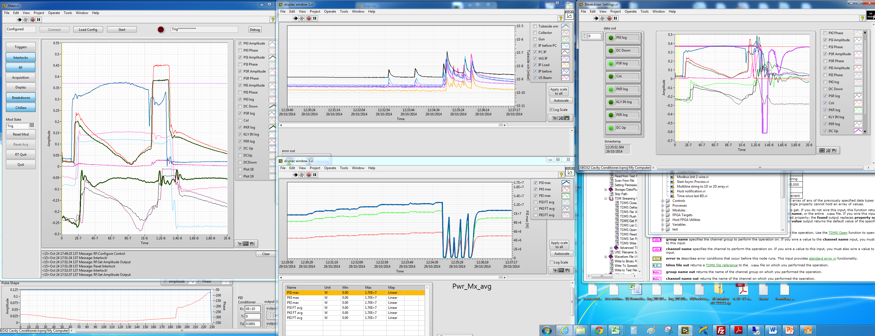
Xbox2 Operator Display
Vacuum Plot
RF Signals
Previous BD
RF Peak power
LLRF Phase program

Slide 12
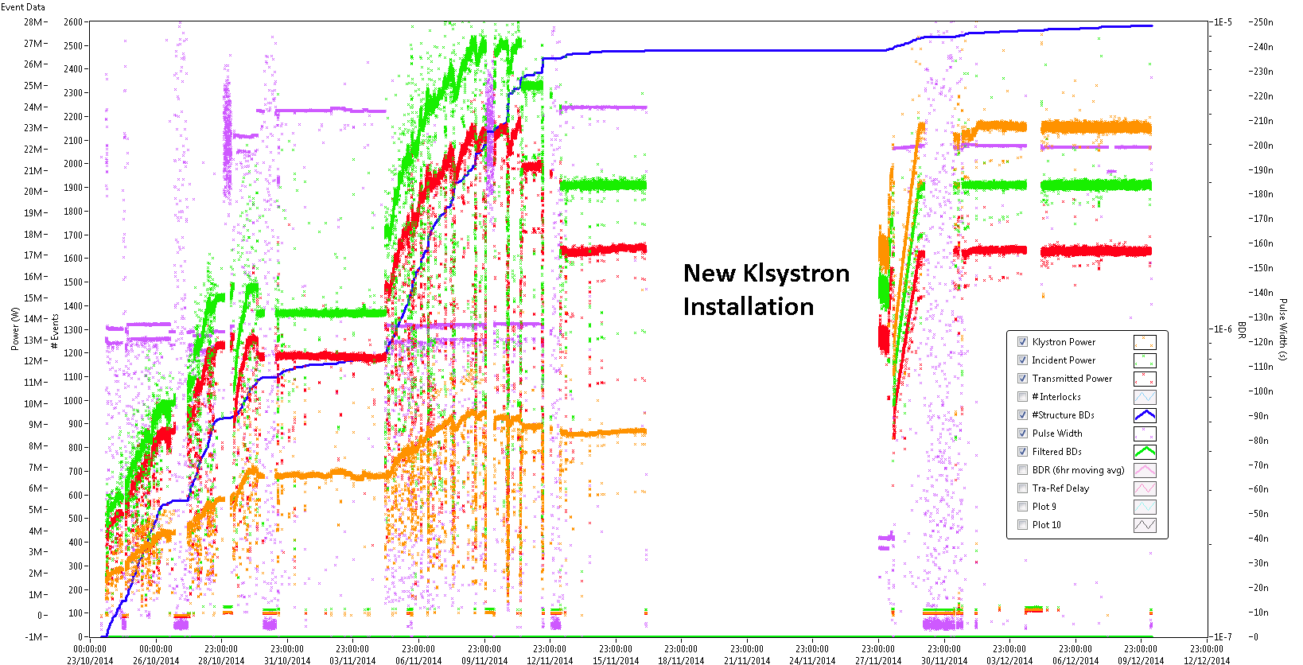
Results
23rd October – 10th December
Almost 2600 recorded breakdowns
New klystron allowed the pulse compressor to be turned off

Slide 13
Results
23rd October – 10th December
Almost 2600 recorded breakdowns
New klystron allowed the pulse compressor to be turned off

Slide 14
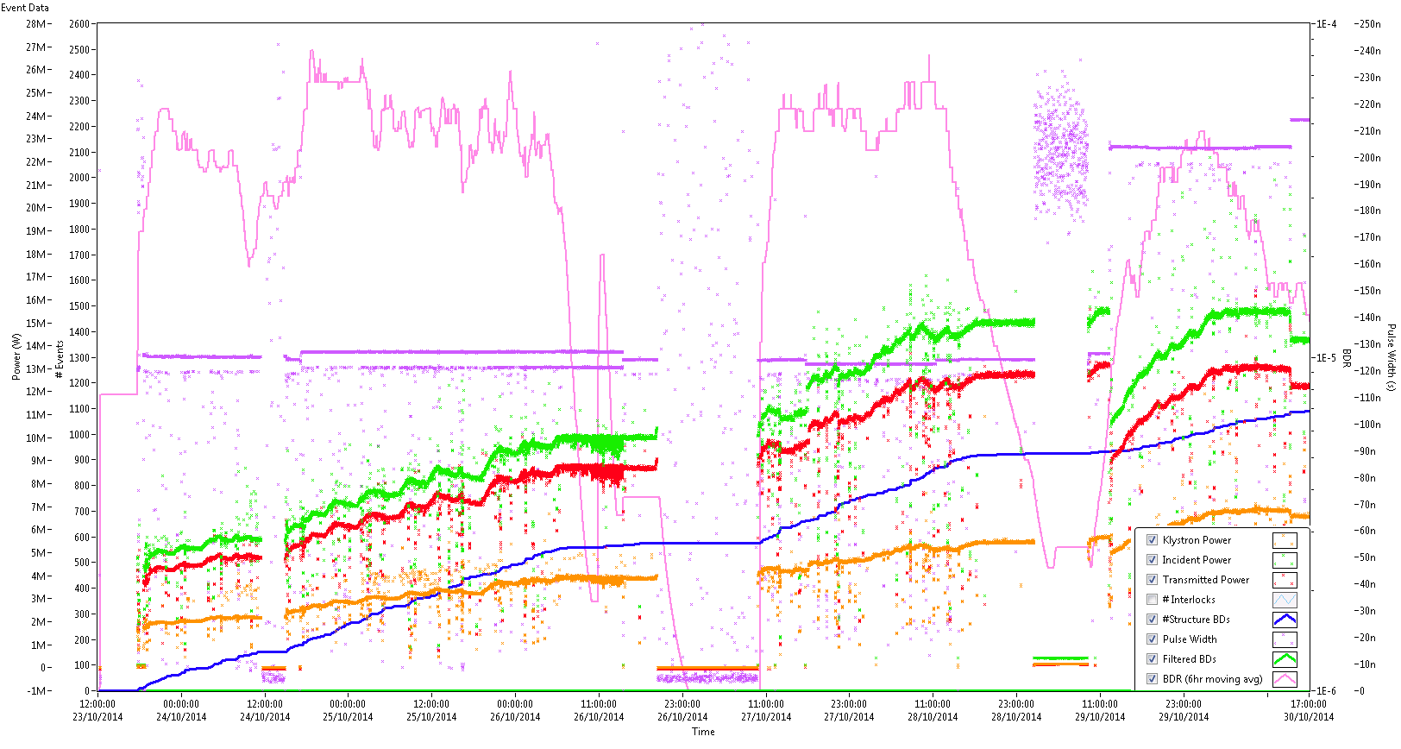
Initial Conditioning
23rd October – 30th October
Almost 1100 recorded breakdowns
Constant BDR ~5e-5

Slide 15
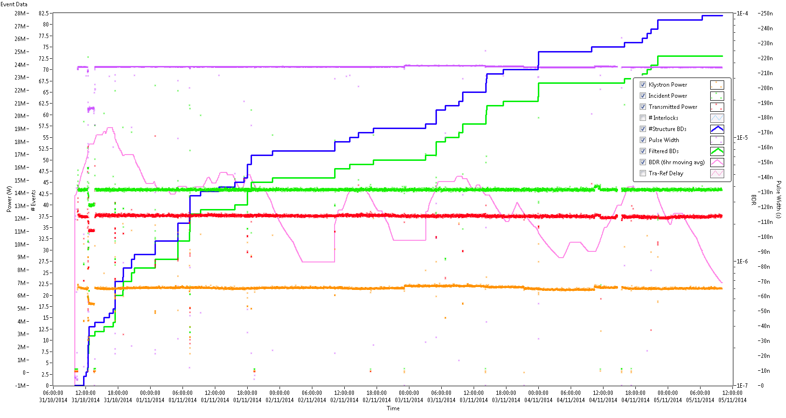
Nominal performance
31st October – 5th November
82 (73 when filtered by eye) recorded breakdowns
Overall BDR 3.4e-6 but if we discount first 36 hours BDR 1.3e-6

Slide 16
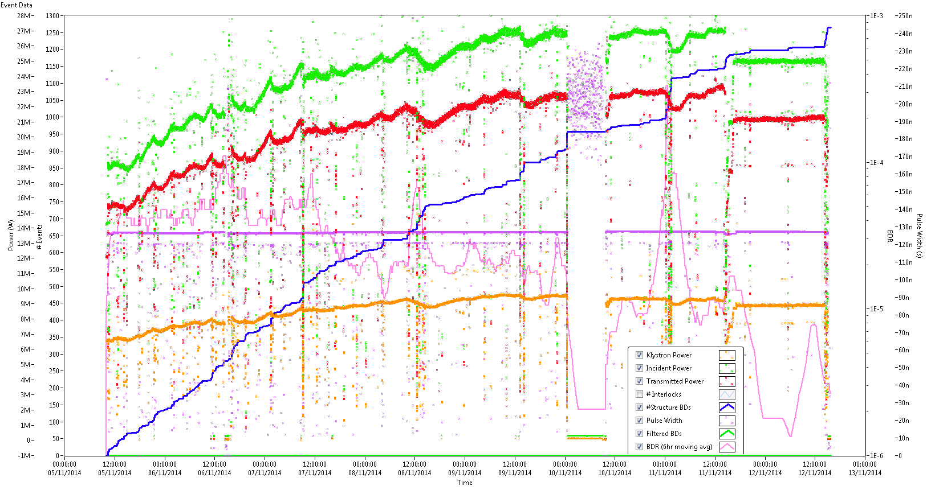
How high?
Pulse width 125ns
5th November – 12th November
About 1250 recorded breakdowns
BDR stable/decreasing ~3e-5 until 27 MW reached… Then oscillates by 1.5 orders of magnitude

Slide 17
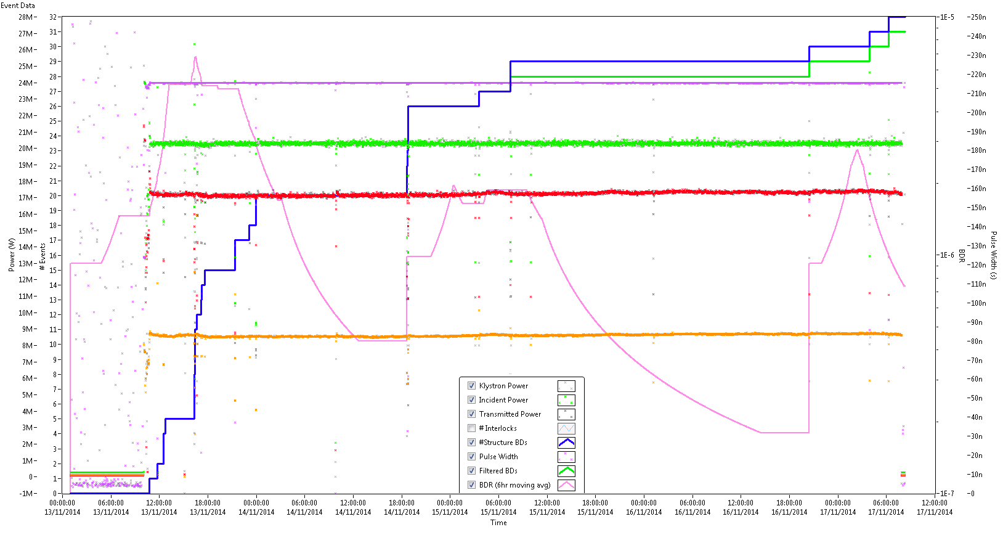
20MW Performance
Pulse width 215ns
13th November – 17th November
About 31 recorded breakdowns
Overall BDR 1.8e-6 but if we discount first 36 hours BDR ~7e-7

Slide 18
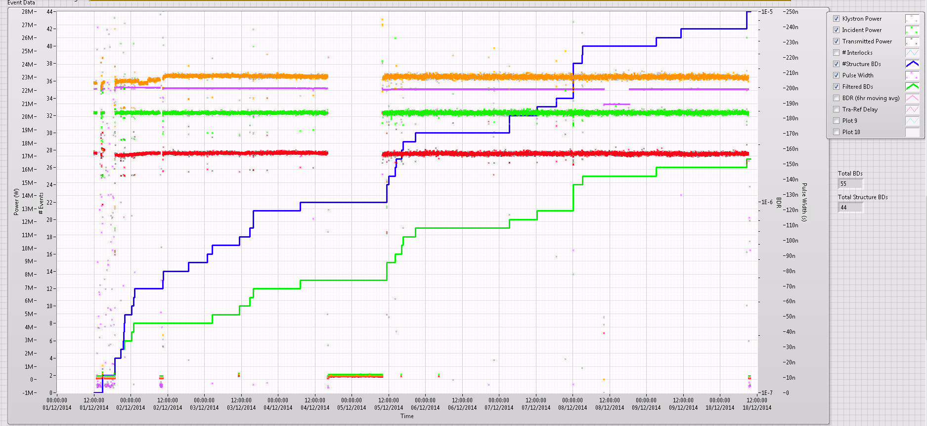
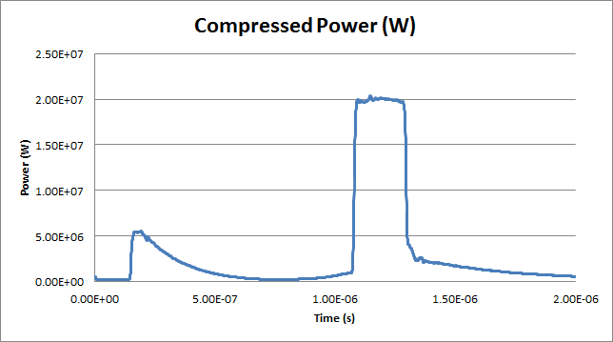
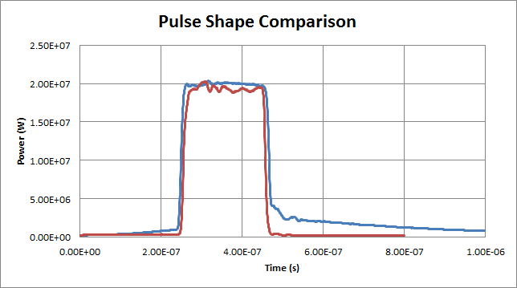
20 MW no compression
Events in RF network were excluded
27 breakdowns in ~9 day (BDR ~6x10⁻⁷/pulse/structure)
Similar to the compressed case (possibly lower need more data)
With PC
PC detuned

Slide 19
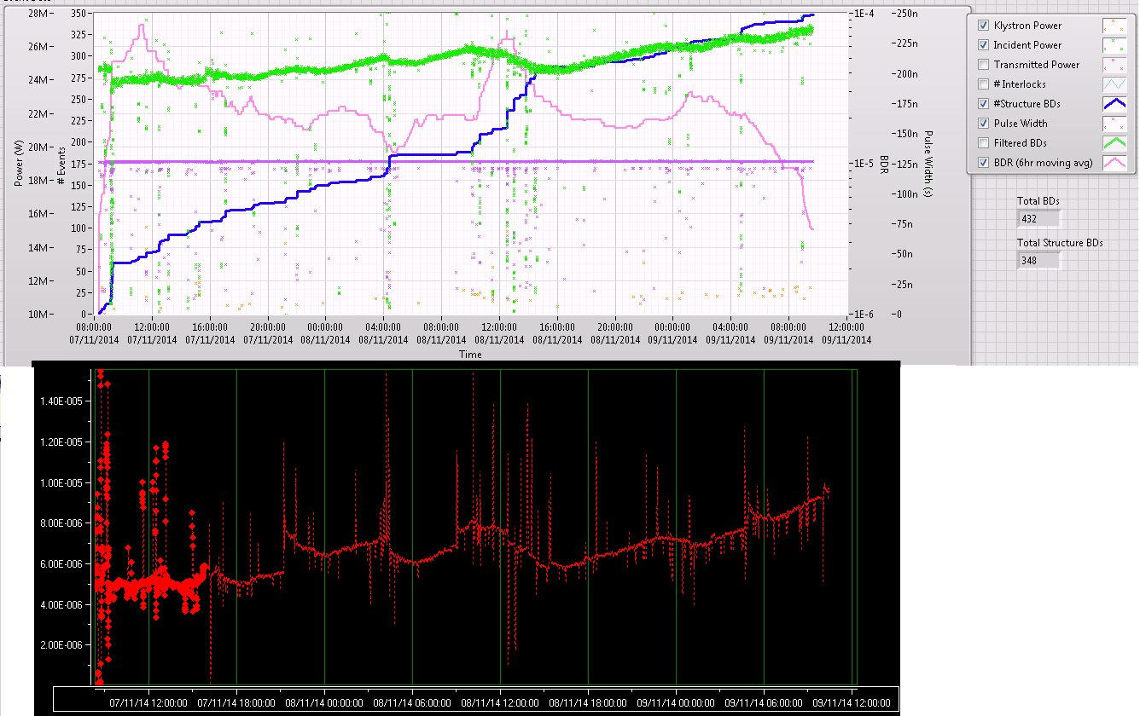
Radiation Monitor

Slide 20
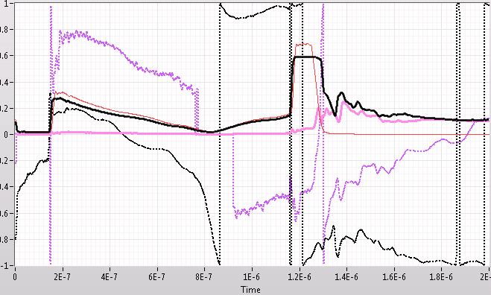
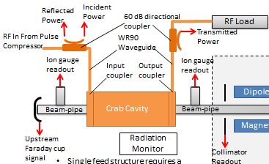
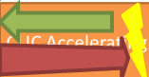
BD detection + cell location
Transmitted pulse drops as the arc is established.
Reflected power increases to the same order as the incident pulse.
We can use the difference in time between the transmitted power falling and the reflected power increasing to find the BD cell location.
The phase of the reflected signal is used to pinpoint cell location.
Incident
Reflected
Transmitted

Slide 21
Preliminary BD cell results
Relatively flat distribution (possibly a standing wave pattern at every 3rd cell?)
However large number of events ‘outside’ the structure needs further analysis.
Fast group velocity; 2.9%c for the crab vs 1.8-0.6%c for accelerating structures increases the errors.

Slide 22
Preliminary BD cell results
Shortly after BD there is only a single angle detected..
At +500ns after the BD there is a large spread supporting the travelling arc hypothesis.

Slide 23
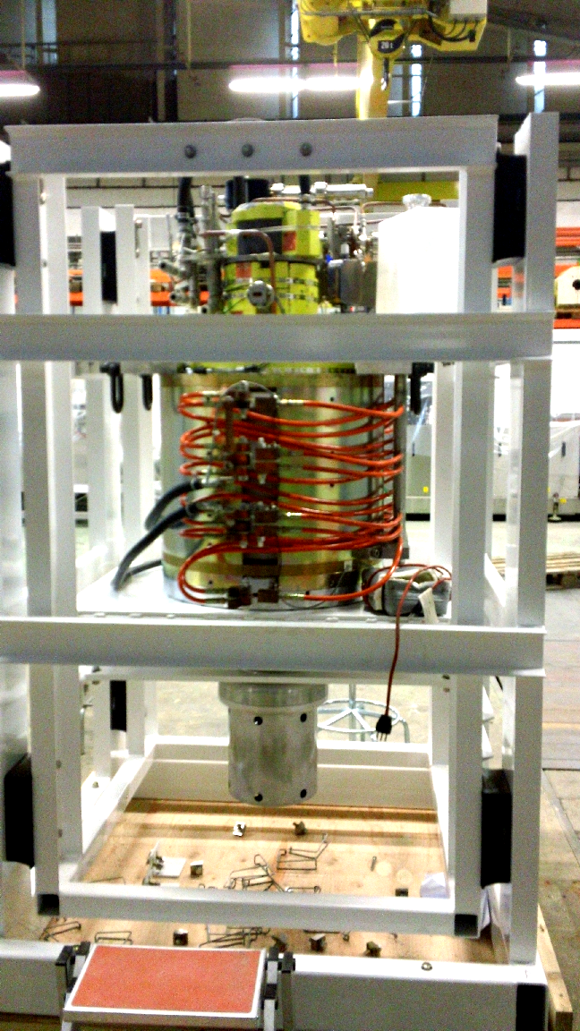
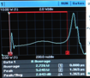
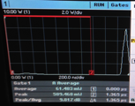
New Klystron: CPI#2
On 17.11.2014 XL5 was replaced by CPI#2
Diode tests (no RF) of CPI#2 tube showed that 0.7 GHz gun oscillations starts at about 240 kV and even generate RF power from the input cavity:
XL5 tube out of XBOX#2
12 GHz pulse from the input cavity
Fortunately, going higher in voltage, the instability zone moves towards the rise/fall time, so the plat top can be used now.
Example of the pulse with ~ 5 MW RF peak power expected:

Slide 24
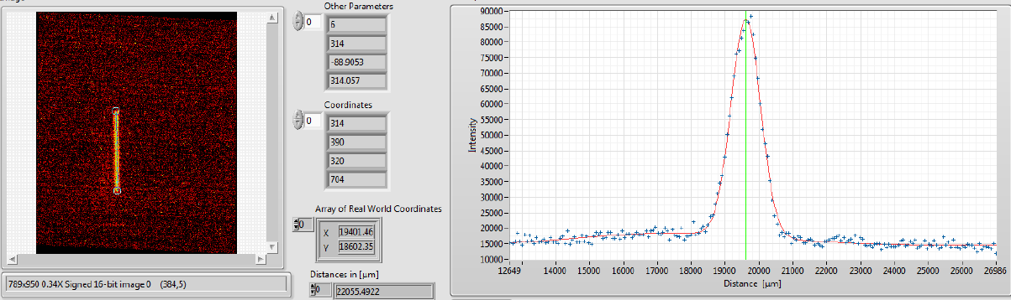
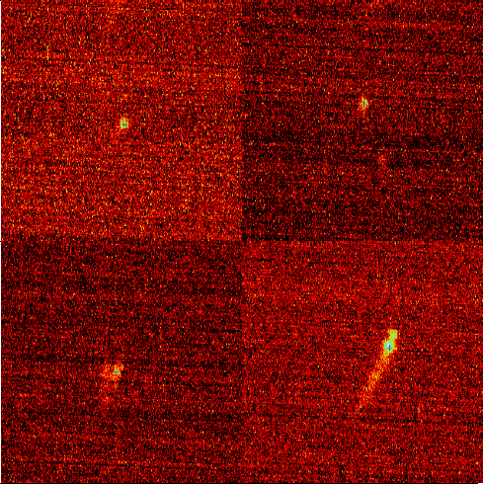
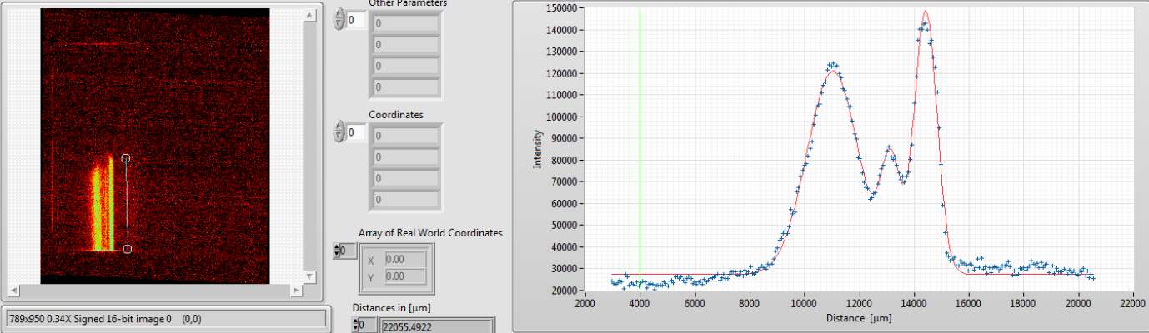
Sneak peek: DC spectrometer
Initial results show a mix of single projections and also many multiple hits on the screen. This suggests some of the electrons are kicked by the deflecting field.
This effect is seen with both the slit collimator and pin hole collimator.
Marek Jacewicz <marek.jacewicz@physics.uu.se>

Slide 25
Future tests
Change power and pulse width to get BDR vs power and pulse width plots.
More detailed analysis of BD distributions in time and cell position.
Push up power level or pulse width ‘to destruction’….
Post-mortem to assess the position on the iris where most damage occurs. (E,H,or Sc?)

Slide 26
Summary
Crab cavity RF design was presented and fabrication described.
Tuning results were discussed
Xbox-2 test stand used for the high power test
Conditioning and Performance of structure evaluated.
Breakdown analysis showed almost even distribution of breakdowns along the structure.
Dark current spectrometer results previewed.
Next steps discussed.

Slide 27
Thank you

